Slide 1
SUNSCREENS
By- Dr Neha Purohit
Assistant Professor
SBKS MI & RC

Slide 2
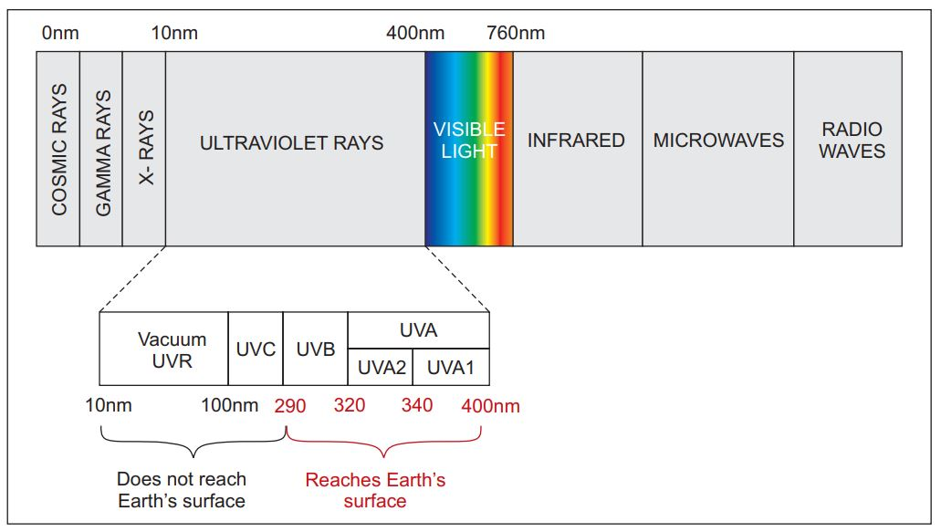
Sun is the chief component of the solar system, which produces a continuous spectrum of electromagnetic radiation ranging from the most energetic very short cosmic rays, gamma rays, and X-rays through UVR, VL, and infrared radiation (IR) to the long radio and television waves.

Slide 3
UV Spectrum (100-400nm)
UVC (Ultraviolet C) =100 -290 nm ; filtered out by ozone layer
UVB = 290 – 320 nm ; reach earth’s surface & responsible for photobiological events
UVA = 320 – 400 nm
UVA1 = 340- 400 nm
UVA2 = 320 – 340 nm
UVB forms 1% of the UVR reaching the Earth and is highly energetic, while UVA forms 99% of UVR reaching the Earth and is lower in energy.

Slide 4
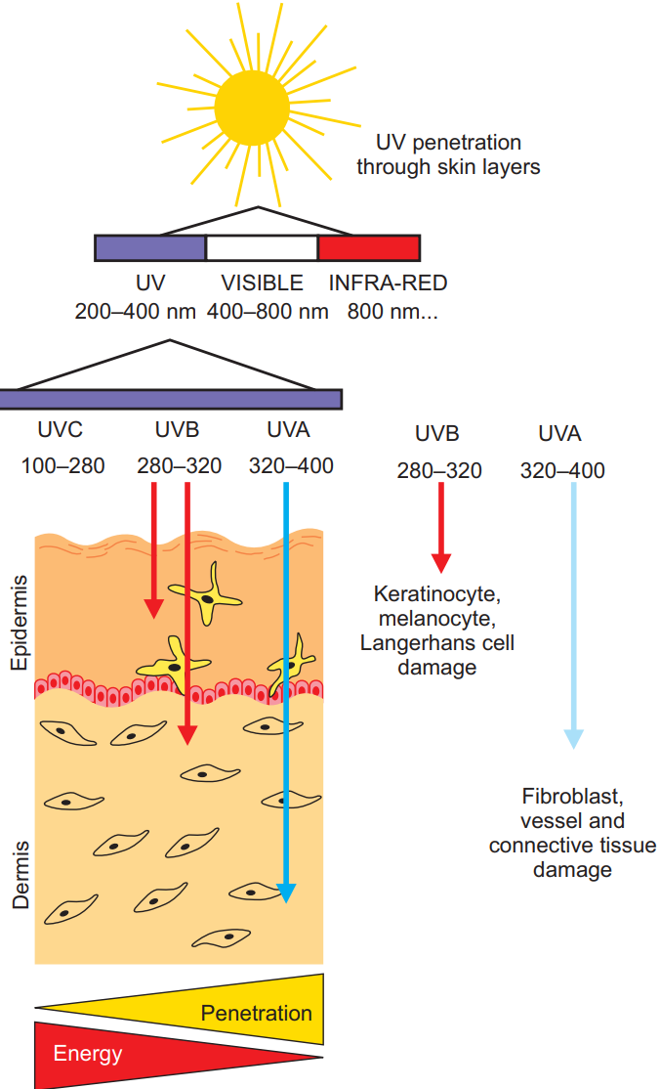
The depth to which light penetrates the skin depends on its wavelength (i.e., longer the wavelength, deeper the penetration.)
But the biological effects of UVR are more pronounced with the light of shorter wavelength as it contains a high quantum of energy.

Slide 5
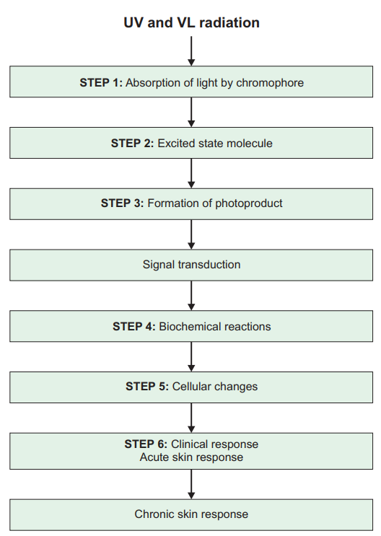
The biological effects of shorter wavelengths are much more pronounced than those of longer wavelengths because the light of shorter wavelength contains higher quantum of energy. This is exemplified by the fact that to produce the same degree of erythema, the dose of UVA required is 1000 times higher than that of UVB .

Slide 6
Minimal Erythema Dose
The minimal erythema dose (MED) is defined as either the lowest dose of UVR required to produce just perceptible erythema at 24 hours (MEDJP) or the lowest dose of UVR required to produce an erythema with a sharp margin at 24 hours (MEDSM).

Slide 7
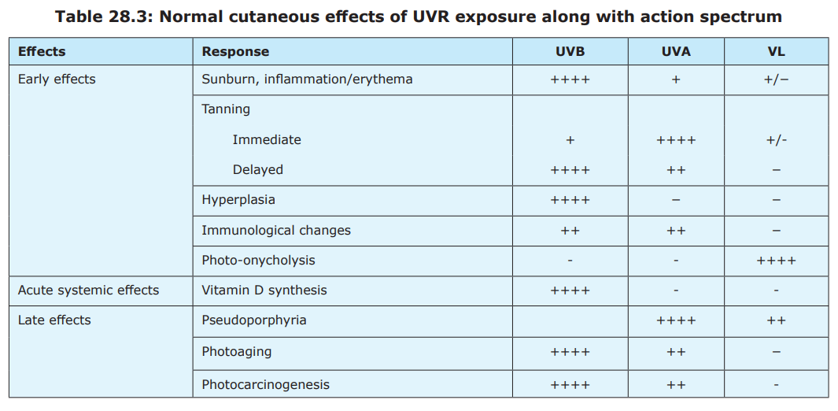

Slide 8
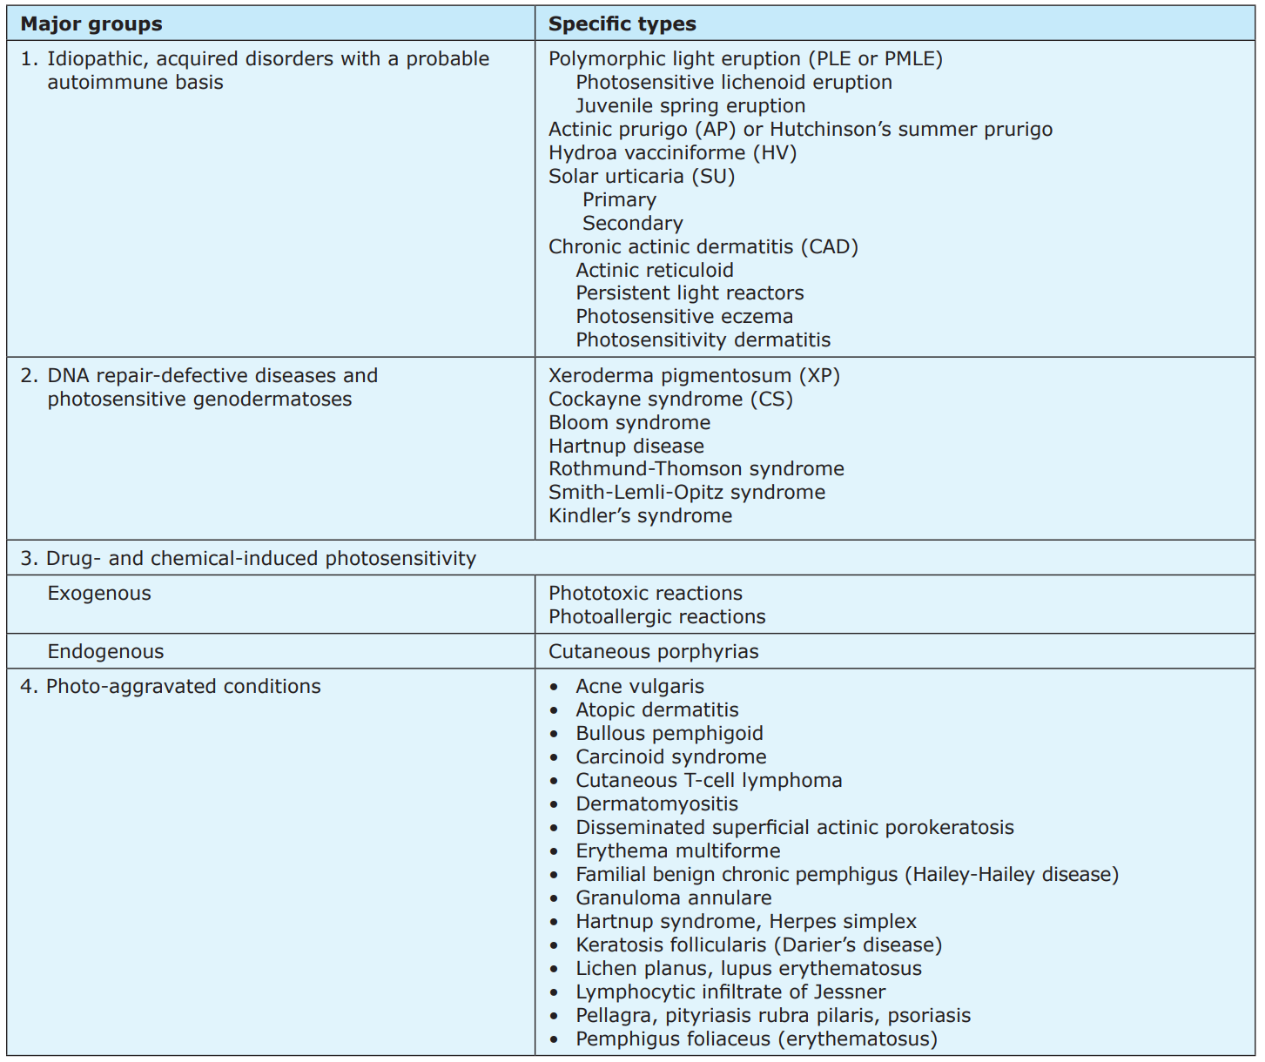
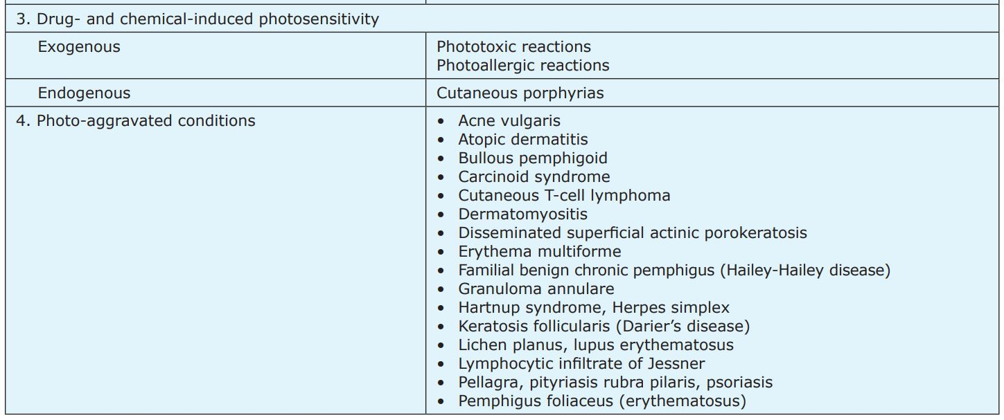
ABNORMAL RESPONSE OF SKIN TO SUNLIGHT

Slide 9
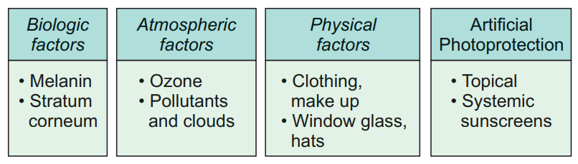
Photoprotection

Slide 10
Sunscreen products are regulated by the US Food and Drug Administration (FDA) as over-the-counter (OTC) drugs.
Ideal Sunscreen
Broad Spectrum
Photostable
Combination of Physical and Chemical Blocker
Non – irritant
Non – comedogenic
High substantivity
Hypoallergenic
Cosmetically elegant
Economical

Slide 11
Sunscreen Efficacy
The UVB protection offered by sunscreens is measured by the SPF and substantivity.
The sun protection factor (SPF) is defined as the dose of UVR required to produce 1 minimal erythema dose (MED) on protected skin after the application of 2 mg/cm2 of product divided by the UVR to produce 1 MED on unprotected skin.

Slide 12
SPF 50 – 98%
SPF 30 – 96.7%
SPF 15 – 93.3%
SPF 2 – 50%
Theoretically, a sunscreen with SPF-4 would permit the patient to increase his sun exposure time fourfold before developing sunburn.

Slide 13
A second determinant of sunscreen effectiveness is the adherent property or substantivity of the sunscreen.
It is defined as the ability of a sunscreen to maintain efficacy and withstand adverse conditions such as exposure to water and sweat
Water-resistant sunscreens: Water-resistance is defined as the ability of a sunscreen to retain its photoprotective properties following two 20 minutes intervals (40 minutes total) of moderate activity in water immersion.
Water proof sunscreens or very water-resistant: Very water-resistant is defined by doubling aquatic activity time to four 20 minutes activity intervals (80 min total).

Slide 14
UVA Protection Indices
Includes IPD, PPD, and the protection factor in the UVA (PFA) -
IPD describes the immediate gray-brown pigmentation of the skin as caused by the oxidation of preformed melanosomes in the skin
PPD is measured as UVA dose that induces pigment darkening 2–24 hours after exposure in sunscreen-protected skin / UVA dose that induces persistent pigment darkening 2–24 hours after exposure in unprotected skin
PFA measures erythema or pigmentation (tanning) after 24 hours of light exposure.

Slide 15
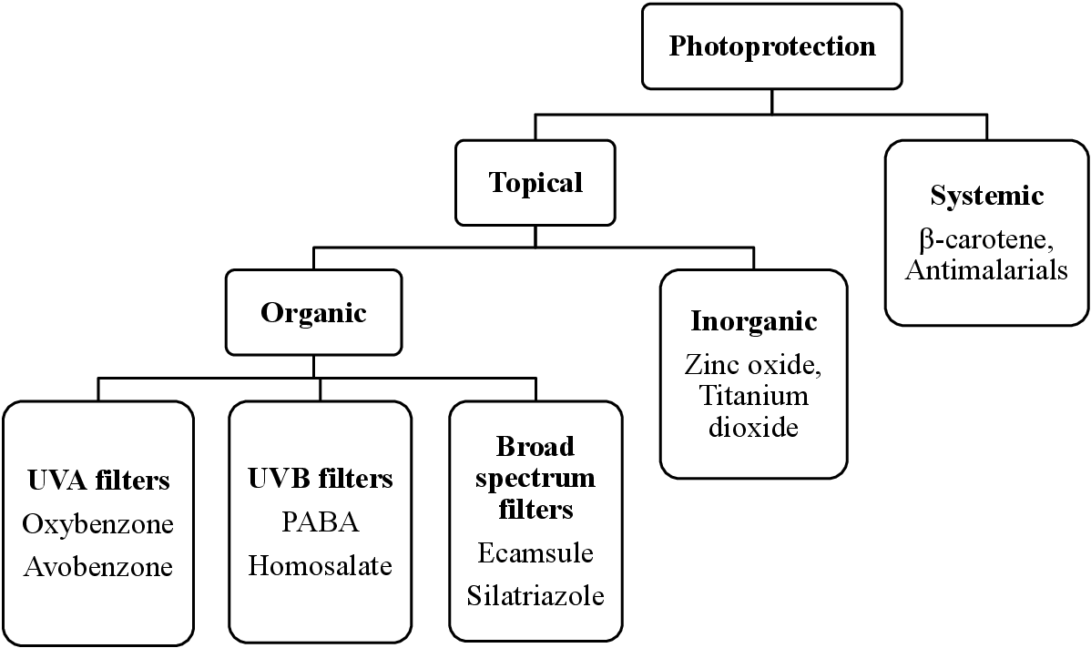

Slide 16
UVA BLOCKERS
Benzophenones – Oxybenzone
It absorbs the UVB and UVA2 spectrum effectively but is photolabile and occasionally produces photoallergy and contact allergy.
Dibenzoyl methanes – Avobenzone
Avobenzone is the most frequently used dibenzoylmethane with potent UVA1 absorption. However, it is photolabile and hence needs to be frequently combined with salicylates, zinc oxide, titanium oxide for photostability.
Anthranilates - Meradimate (Menthyl Anthranilate)

Slide 17
UVB blockers
PABA derivatives – PABA, Padimate - O
PABA is a very effective UVB filter but its use is limited because its use is associated with several adverse effects, such as photoallergy and carcinogenesis. It also stains clothes.
Padimate-O, a commonly used derivative of PABA, has a good safety profile

Slide 18
Cinnamate - Octinoxate (octyl methoxycinnamate) though a less potent UVB absorber, is the most frequently used UVB filter.
Salicylates - Octisalate and Homosalate
They are weak UVB filters, and so, they need to be used in higher concentrations. More frequently, they are used to augment the photoprotective effect of other sunscreens and delay their photodegradation

Slide 19
Broad spectrum sunscreens
Mexoryl XL (wavelengths, 290–320 nm; peak 345 nm)
Tinosorb M (λ wavelengths, 303 and 344 nm),
Tinosorb S (λ wavelengths, 310–343 nm) are new broad-spectrum sunscreens.
Tinosorbs are photostable and also improve the photostability of other sunscreens such as octinoxate and avobenzone.

Slide 20
Physical/Inorganic blockers reflect or scatter UVR. Microsized forms of physical blockers, also designated as inorganic particulates, also function in part by absorption.
They include Titanuim dioxide and Zinc Oxide.
The ideal sunscreening agent would be chemically inert, safe, and absorb or reflect through the full UV spectrum. TiO2 meets these criteria, limited only by aesthetics.
Protection against UVA-1 is superior for zinc oxide (340–380 nm) than for TiO2 , thereby providing more full-spectrum protection

Slide 21
Indications
Protection from ultraviolet radiation to prevent the following:
Sunburn—US Food and Drug Administration (FDA)-approved
Skin or lip damage, freckling, skin discoloration—FDA-approved
Skin aging—FDA-approved
Skin cancer—FDA-approved
Phototoxic or photoallergic drug reactions
Photosensitivity diseases
Photoaggravated dermatoses

Slide 22
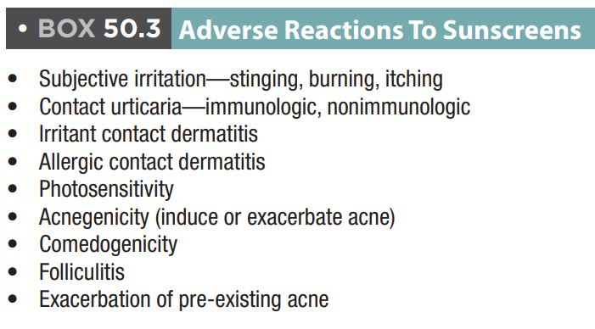

Slide 23
General Photoprotection Instructions for Patients
Sunscreens are most important from 10:00 AM to 4:00 PM when the sun’s rays are strongest. If possible, try to avoid significant sun exposure during these peak hours, by staying in the shade or indoors.

Slide 24
Up to 1 oz (about 30 g) of sunscreen may be needed to cover the entire body. Roughly 3 to 5 g are needed to cover the head and neck.
‘Teaspoon rule’ - To achieve application of 2mg/cm2, the following should be applied:
1 teaspoon of sunscreen to the face/head/neck,
1 teaspoon to each upper extremity,
2 teaspoons total for the front and back torso,
and 2 teaspoons to each lower extremity

Slide 25
For intermittent, casual daily use, a sun protection factor (SPF) 15 sunscreen is sufficient. For prolonged recreational exposures, an SPF 30 is more desirable, particularly for fair-skinned individuals.
Sunscreen should be applied 15 to 30 minutes before sun exposure to allow sufficient time for the protection to develop, and subsequently reapplied every 2 hours.

Slide 26
Systemic Sunscreens
β-Carotene, antimalarials, oral psoralens, ascorbic acid, α-tocopherols (i.e., vitamins A, C, and E), retinol, selenium, green tea polyphenols, PABA, antihistamines, aspirin, indomethacin, and corticosteroids are effective.

Slide 27
Beta - Carotene
β-Carotene is the natural precursor of vitamin A.
It is probably preferentially photo-oxidized by UVR and this spares the cell components (membrane lipids, cell nuclei, and guanine bases of DNA) from being photodamaged. It also functions as a free radical scavenger and singlet oxygen quencher
It is recommended that serum levels of b-carotene be maintained at 600–800 mg/100 mL, and this is achieved by administering 30–120 mg/day in children and 120–300 mg/day in adults (given in two to three divided doses)

Slide 28
Antimalarial drugs
Their photoprotective role stems from their ability to bind to DNA and RNA and their interference with UV-induced thymine dimer formation.
Antimalarials seem to intercalate between base pairs and act as a kind of photon sink.
The recommended dosage of chloroquine and HCQ is 250–500 mg/day and 200–400 mg/day, respectively

Slide 29
Theoretical Inhibition of Vitamin D Synthesis
Vitamin D is critical for skeletal and muscular health. Studies have linked low vitamin D levels to colon and breast cancers, cardiac, neurologic and autoimmune disorders, and overall mortality.
Sunlight, specifically UVB at 310 nm, is a major source of the biosynthesis of active vitamin D3 in people.

Slide 30
Sunscreen effectively blocks UVB absorption and thereby reduces or shuts down vitamin D synthesis in the skin. Sunscreen application can inhibit vitamin D synthesis.
For individuals practicing rigorous photoprotection, daily intake of vitamin D through diet or supplements of 600 IU would seem prudent. For those 71 years of age and older, 800 IU is recommended.

Slide 31
