Slide 1
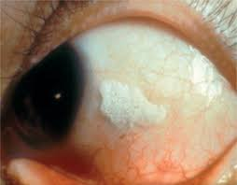
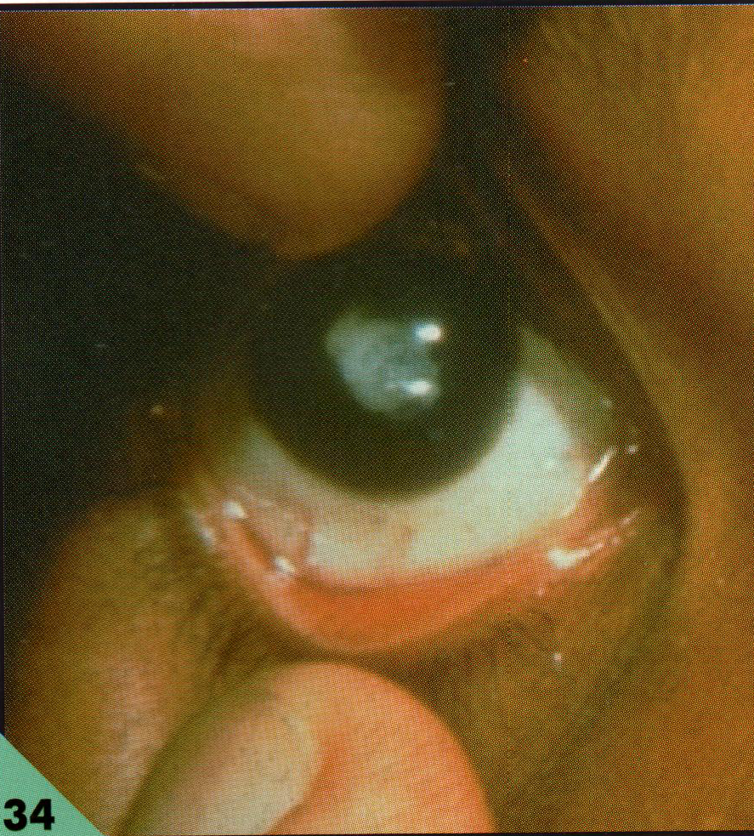
CM 5.3 VITAMIN A DEFICIENCY
Dr. Ankita Parmar
Associate Professor
Dept. of Community Medicine
Smt. B.K. Shah Medical college and research centre, Piparia

Slide 2
Student Learning Objectives (SLOs)
Vitamin A Deficiency Problem statement
Physiology, sources and functions of Vitamin A
Recommended daily allowance (RDA)
Vitamin A deficiency aetiology and risk factors
Clinical manifestations
Prevention and treatment
Vitamin A prophylaxis programme

Slide 3

NUTRITIONAL PROBLEMS IN INDIA
PROTEIN ENERGY MALNUTRITION
LOW BIRTH WEIGHT
XEROPHTHALMIA
NUTRITIONAL ANEMIA
IODINE DEFICIENCY DISORDERS
FLUROSIS
LATHYRISM
OBESITY
CARDIO VASCULAR DISEASES
DIABETES
CANCER

Slide 4
75 percent of preschool children suffer from iron deficiency anemia (IDA)
57 percent of preschool children have sub-clinical Vitamin A deficiency (VAD)
The prevalence of vitamin A deficiency was 18% among pre-school children, 22% among school-age children and 16% among adolescents
Iodine deficiency is endemic in 85 percent of districts
11% of Indian population in India are over-nourished
over 30 million people with diabetics in 1985 and by next year (2010) India is projected to have 50.8 million diabetics
India is hence considered as the country with the largest population of diabetics

Slide 6

Vitamin A
It is recorded in the history that Hippocrates(about 500 B.C.) cured night blindness.
He prescribed to the patients ox liver (in honey),which is now known to contain high quantity of vitamin A.

Slide 7
VITAMIN A :- Is widely distributed in animal and plant foods
animals –pre-formed – Retinol.
plants – pro-formed - carotene

Slide 8
Retinal (vitamin A aldehyde) :
This is an aldehyde form obtained by the oxidation of retinol.
Retinal and retinol are interconvertible.

Slide 9
Retinoic acid (vitamin A acid) :
Produced by the oxidation of retinal.
However, retinoic acid cannot give rise to the formation of retinal or retinol.

Slide 10
Beta-Carotene (provitamin A) :
Found in plant foods.
lt is cleaved in the intestine to produce two moles of retinal.
ln humans, this conversion is inefficient, hence beta-carotene possesses about one-sixth vitamin A activity compared to that of retinol.

Slide 11
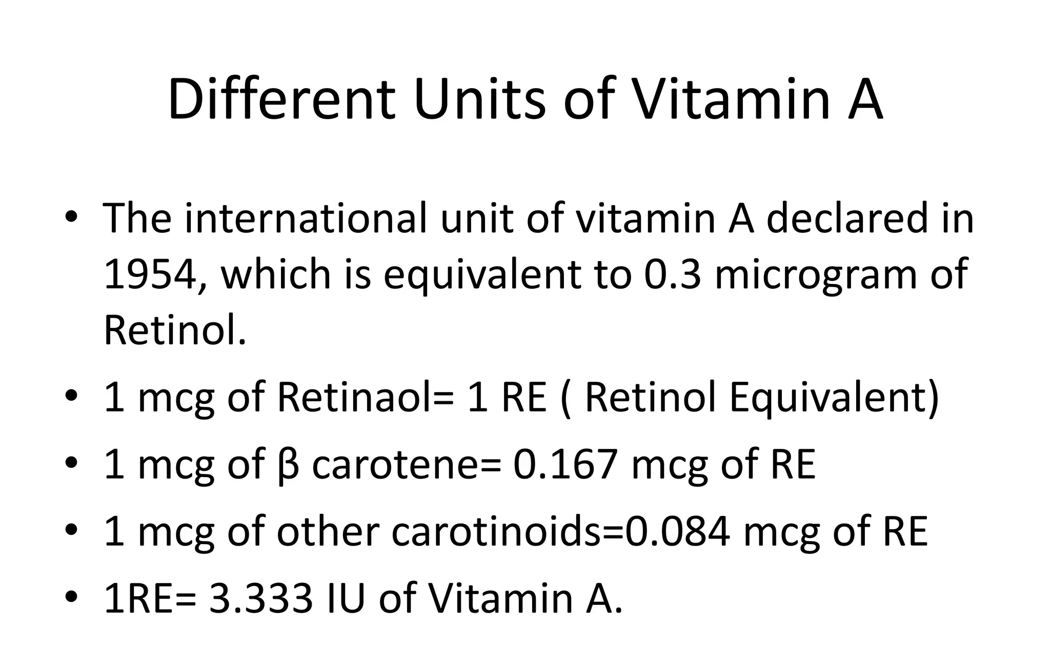

Slide 12
Dietary Sources of Vitamin A
Plant sources
Animal sources
Sweet potatoes Carrots Pumpkin Winter squash Cantaloupe Pink Grapefruit Mangoes Apricots Oranges Spinach Kale Beet greens Broccoli Dark green leafy vegetables
Chicken liver Cod liver oil Fish oil Canned beef stew Eggs Fish Shellfish Butter Fortified margarine Cheese Whole milk Fortified skim milk Fortified low fat dairy products

Slide 13
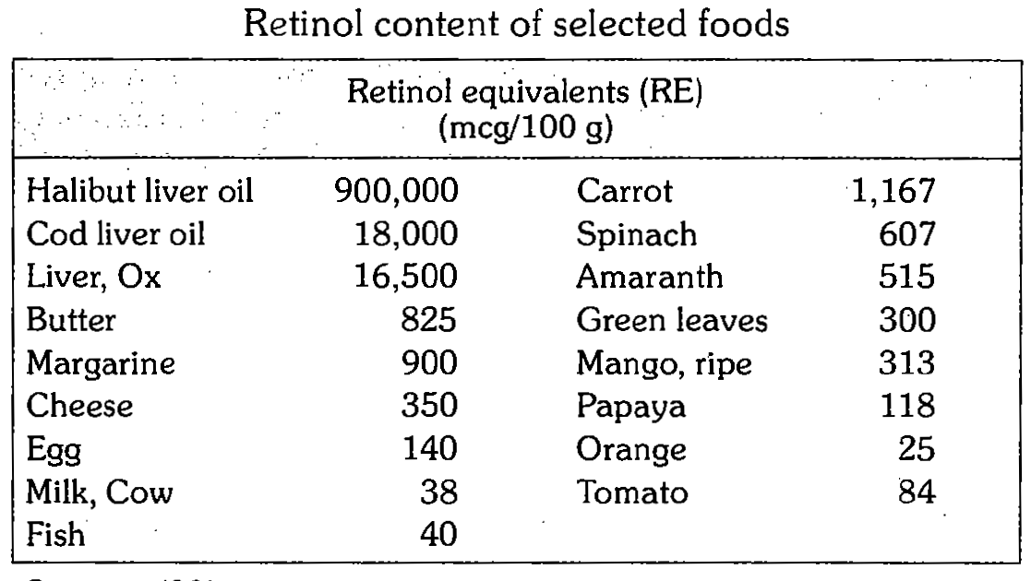
Notes:
Halibut and cod are names of fishes , amaranth is rajagra

Slide 14
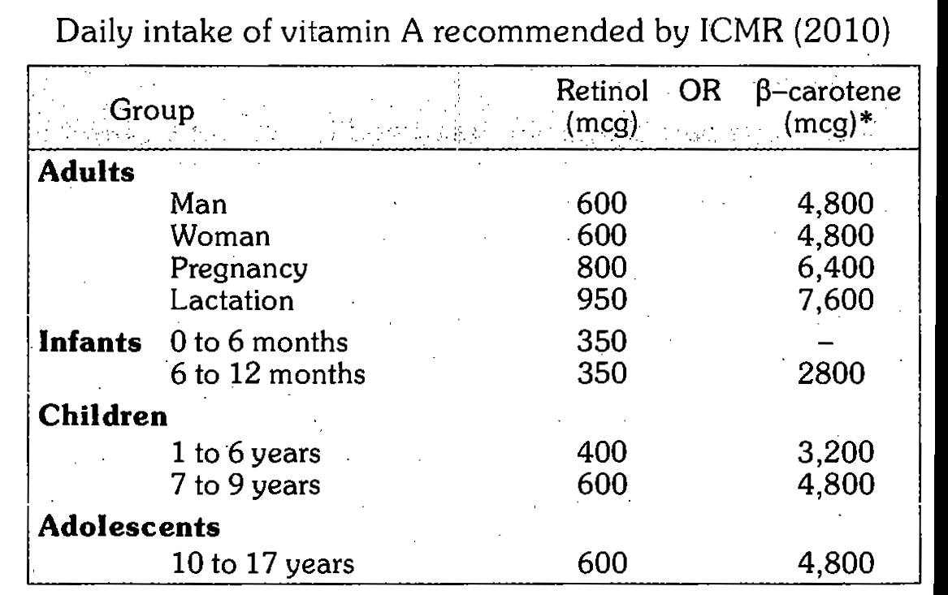
Daily requirement of vitamin A

Slide 15

ABSORPTION & STORAGE
The liver has enormous capacity to store – in the form of retinol palmitate.
Free retinol is highly active but toxic & therefore transported in blood stream in combination with retinol binding protein (liver)

Slide 16
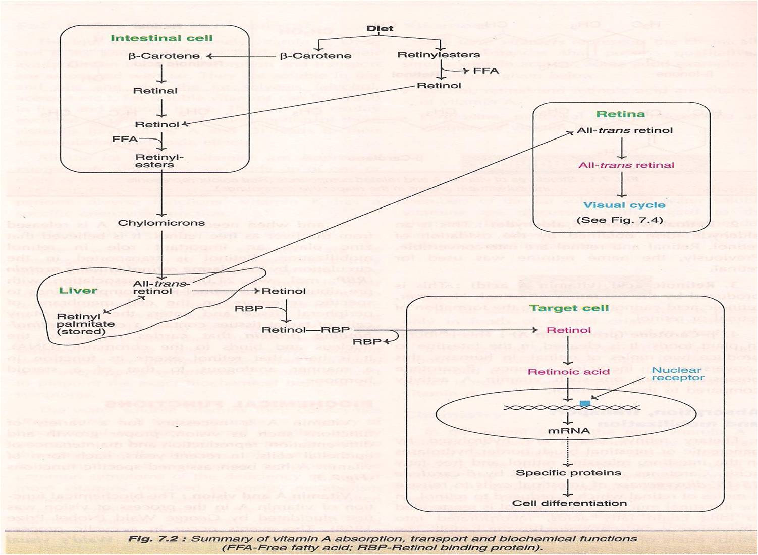

Slide 17
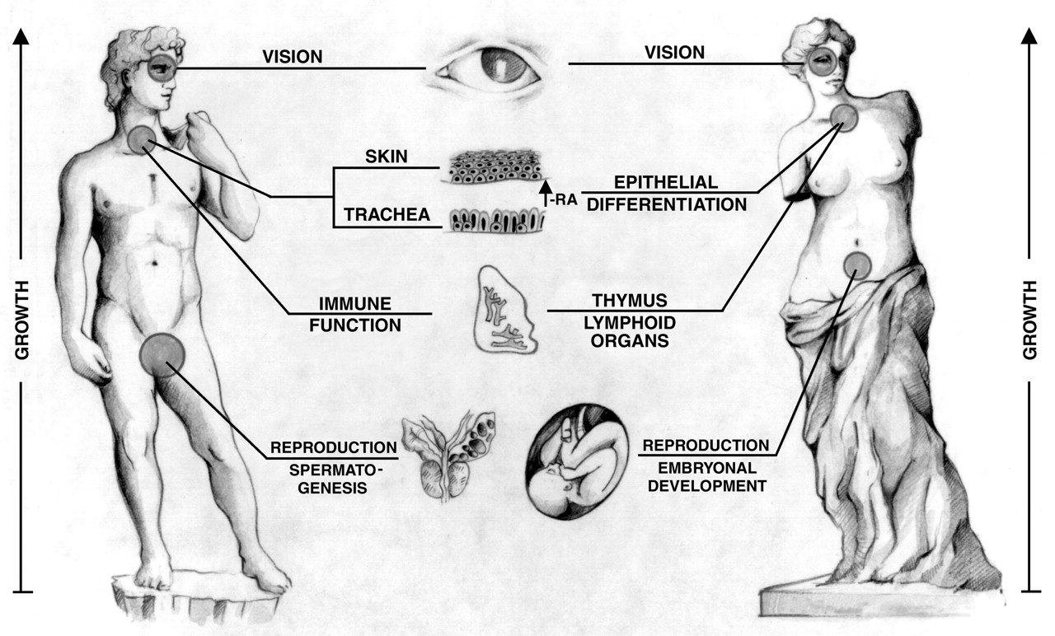
Physiological Functions of Vitamin A
Vision
Epithelial cell "integrity’
Reproduction
Resistance to infectious disease
Bone remodeling
Growth

Slide 18
Functions of Vitamin A
It is indispensable for normal vision.
It contributes to the production of retinal pigments which are needed for vision lights.
It is necessary for maintaining the integrity and the normal functioning of glandular and epithelial tissue which lines intestinal , respiratory and urinary tracts as well as the skin and eyes.
It supports growth, especially skeletal growth
It is anti-infective
It may protect against some epithelial cancers such as bronchial cancers.

Slide 19
Epithelial cell "integrity
Many epithelial cells appear to require vitamin A for proper differentiation and maintenance.
Lack of vitamin A leads to dysfunction of many epithelia
The skin becomes keratinized and scaly, and mucus secretion is suppressed

Slide 20
Reproduction:
Normal levels of vitamin A is required for sperm production,
Normal reproductive cycles in females require adequate availability of vitamin A.
Bone remodeling:
Normal functioning of osteoblasts and osteoclasts is dependent upon vitamin A.

Slide 21
Resistance to infectious disease
Vitamin A deficiency has been shown to increase the frequency and severity of disease.
Several large trials with malnourished children have demonstrated dramatic reductions in mortality from diseases such as measles by the simple and inexpensive procedure of providing vitamin A supplementation.

Slide 22
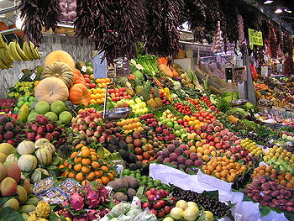
VITAMIN A DEFICIENCY

Slide 23
Vitamin A Deficiency and Child health
Improving vitamin A status of children
(6 months-5 yrs.)
Results in to
23% reduction in child mortality rate
50% reduction in child mortality rate due to acute measles
35-50% reduction in child mortality rate due to diarrhoea

Slide 24
Vitamin A deficiency
Vitamin A deficiency also diminishes the ability to fight infections.
In countries where children are not immunized, infectious disease like measles have higher fatality rates.
Even mild, subclinical deficiency can also be a problem, as it may
  Increase children's risk of developing respiratory and diarrheal infections
  Decrease growth rate
  Slow bone development
  Decrease probability of survival from serious illness.

Slide 25
Risk factors
Ignorance
Faulty feeding practices
Infections
Diarrhea
Use of skimmed milk(totally devoid of vitamin A)
Notes:
Skimmed milk- fat is removed from milk

Slide 26
Causes of vitamin A deficiency
The major cause is diets which include few animal sources of pre-formed vitamin A.
Breast milk of a lactating mother with vitamin A deficiency contains little vitamin A, which provides a breast-fed child with too little vitamin A.

Slide 27
Causes of vitamin A deficiency
In addition to dietary problems, there are other causes of vitamin A deficiency
  Iron deficiency can affect vitamin A uptake.
  Excess alcohol consumption can deplete vitamin A
  A stressed liver may be more susceptible to vitamin A toxicity.

Slide 28
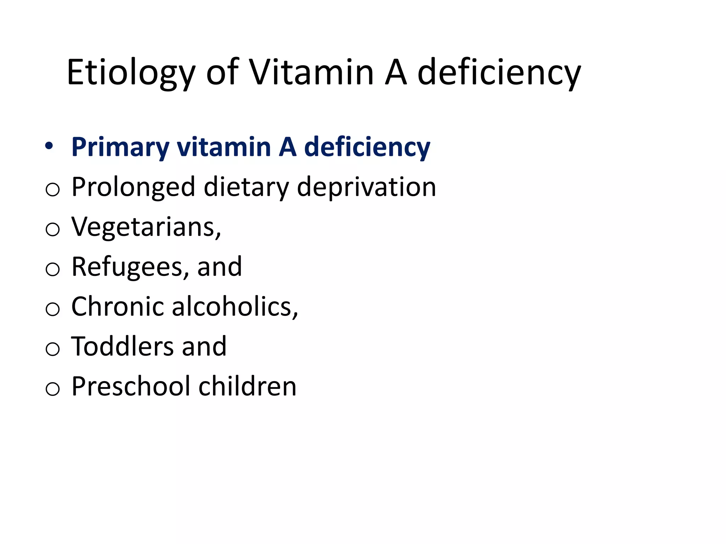

Slide 29
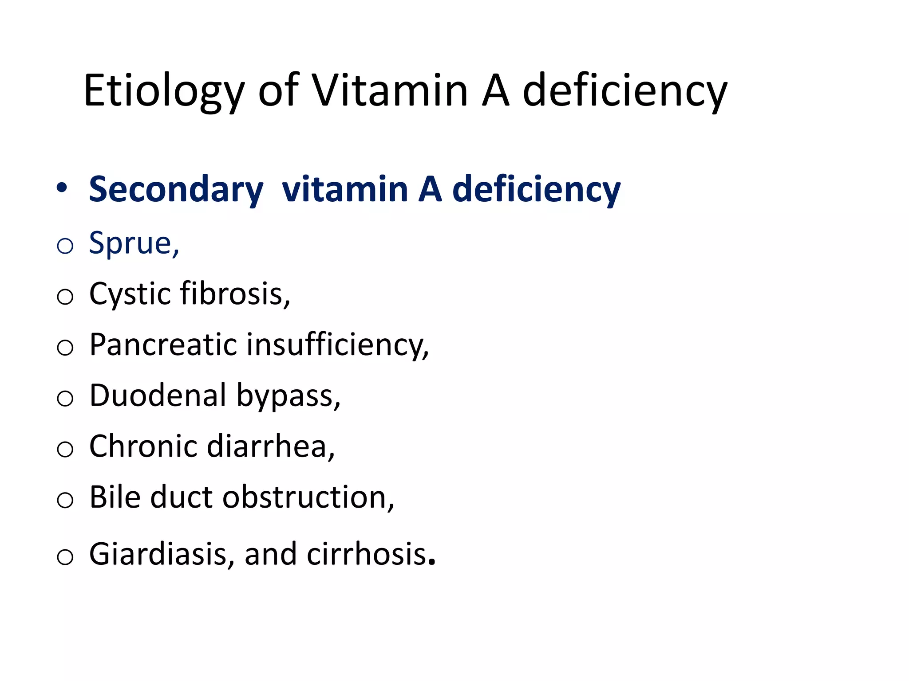

Slide 30
Symptoms of Vitamin A deficiency
The signs and symptoms of Vitamin A deficiency are grouped in to Ocular and Extra-ocular manifestations

Slide 31
Ocular Manifestations
All the ocular manifestations are due to decreased synthesis of rhodopsin in the retina and due to dryness of conjunctiva and its consequences.
All the ophthalmic manifestations due to vitamin A deficiency are included under the term ‘Xerophthalmia’ (Xerosis = dryness; dry eye).

Slide 32
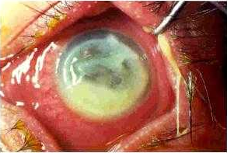
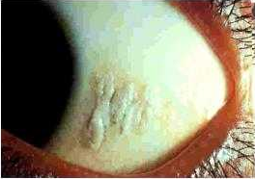
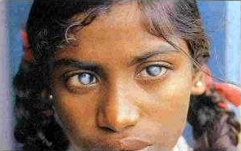
KERATOMALACIA
V
A
D
BITOT SPOT
BILATERAL BLINDNESS

Slide 33
Progress of Ocular complication (Xerophthelmia)
Night Blindness
Conjunctival Xerosis
Bitot’s spot
Corneal Ulcer
Keratomalasia

Slide 34
Vitamin A deficiency
Vitamin A deficiency is a lack of vitamin A in humans. It is common in developing countries but rarely seen in developed countries
Night blindness is one of the first symtom of vitamin A deficiency.
Night blindness is the difficulty for the eyes to adjust to dim light.
Affected individuals are unable to distinguish images in low levels of illumination.
People with night blindness have poor vision in the darkness, but see normally when adequate light is present.

Slide 35
Stages of ocular manifestations
Night blindness (Nyctalopia): That means inability to seen the dim light by an young child as the evening sets in.
This is because of failure in the dark adaptation because of decreased synthesis of rhodopsin in the retina.
The classical complaint by the mother is that her child cannot find her or dashes against the wall as the dark sets in.
Nyctalopia is the earliest clinical feature. If not managed at this stage, it passes on to the next stage.

Slide 36
Night Blindness
1st symptom of Vitamin A deficiency
Presented with symptoms only (not a sign)
Complaint of inability to see in dim light
Mother /care taker is reliable person to identify this problem (Not a child)
Reversible condition
Simple Vit. A administration can cure the patient

Slide 37

XEROPHTHALMIA (DRY EYE)
Disease due to deficiency of Vitamin A
Also Called Xeroma
Absence of tears
Xerophthalmia is most common in children aged 1-3 years
Cornea and conjunctiva become horny and necrosed

Slide 38
Bitot’s Spots
Collection of dried epithelium, micro organisms etc. forming shiny grayish white spot on the cornea
A sign of Vitamin A deficiency

Slide 39
KERATOMALACIA
Ulceration and softening of Cornea due to deficiency of vitamin A

Slide 40
Bilateral Blindness

Slide 41
Extra-ocular manifestations
Retardation of growth
Follicular hyperkeratosis (Phrynoderma)
Anorexia
Increased incidence of respiratory and alimentary infections
Development of urinary calculi.

Slide 42
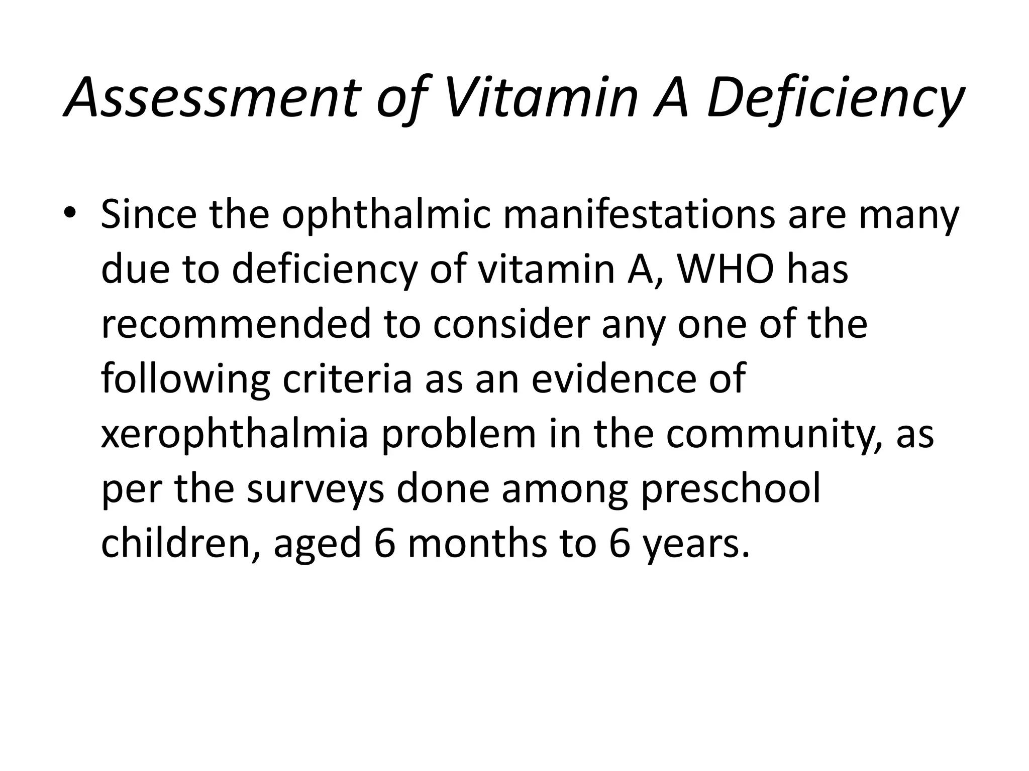

Slide 43
WHO Criteria for Public Health Significance
- VAD
Minimum Prevalence (%) in children <6 yrs
BITOT SPOTS 0.5
NIGHT BLINDNESS 1.0
CORNEAL LESIONS 0.01
CORNEAL SCARS 0.05
Serum Retinol <10 μg/l 5.0
Notes:
Normal serum retinol is 2o to 60 mcg/lt

Slide 44
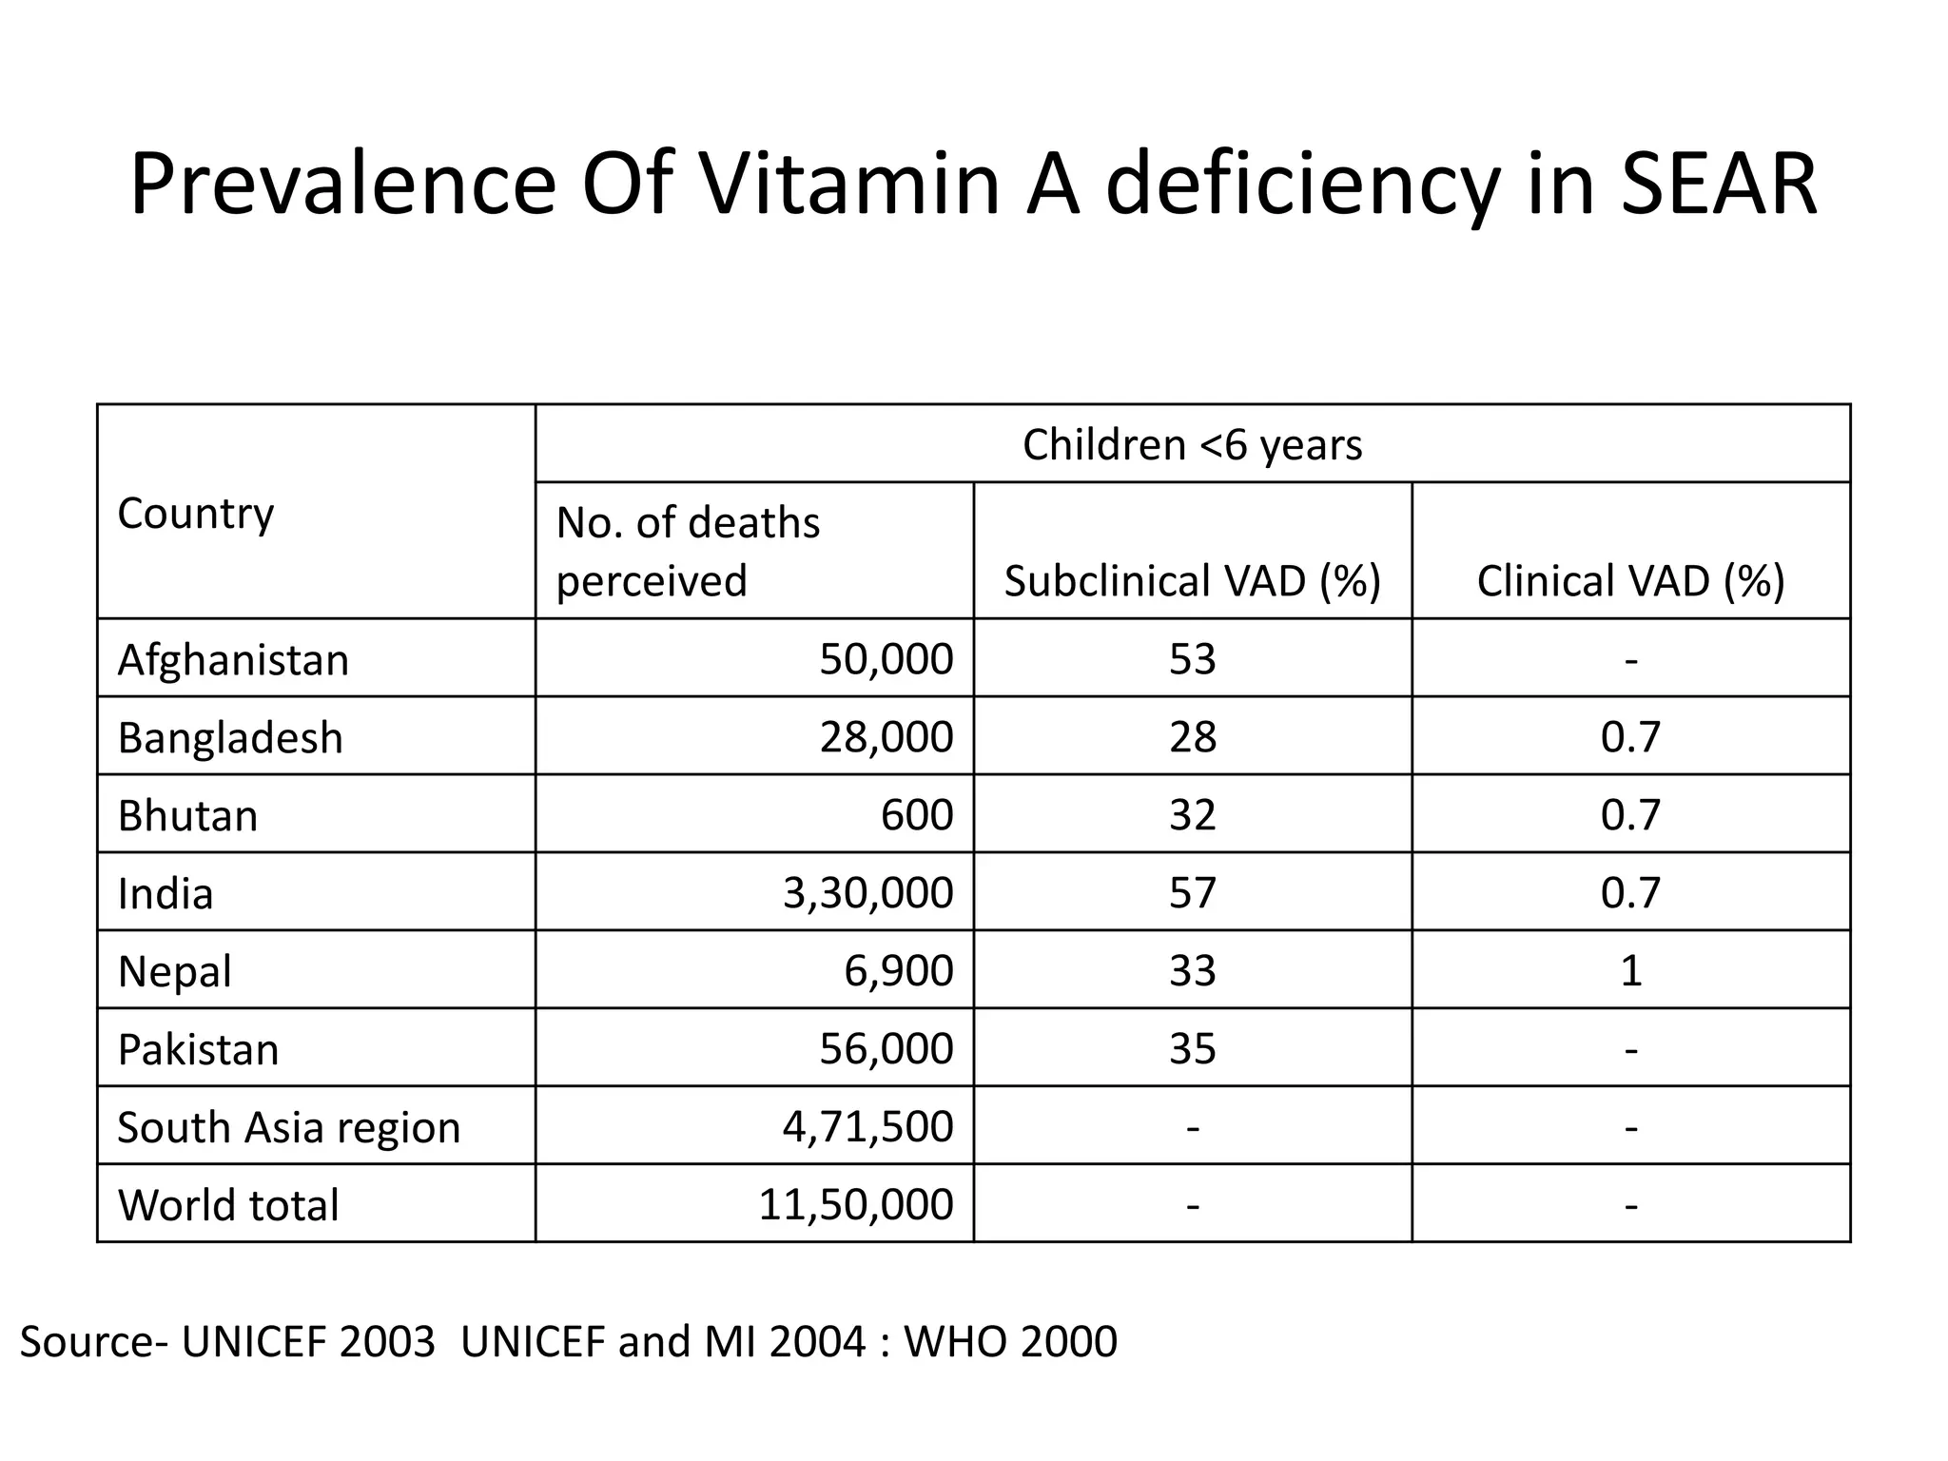

Slide 45
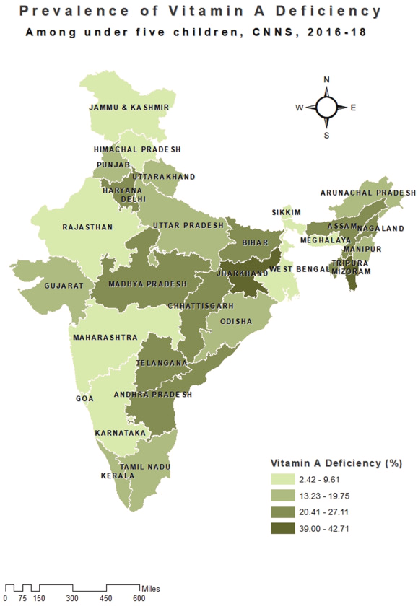
Comprehensive National Nutrition Survey (CNNS; 2016–18)
Notes:
Comprehensive National Nutrition Survey
(CNNS) to collect a comprehensive set of data on nutritional status of Indian children from
0–19 years of age.

Slide 46


Slide 47
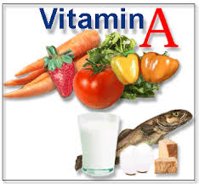
PREVENTION OF VITAMIN
“A” DEFICIENCY

Slide 48
Children should be encouraged to Consume vitamin “A” rich food.
Promote exclusive breast feeding of colostrum.
Promote intake of easily available vitamin “A” rich food such green leafy vegetables [spinach,methi, &capsicum] yellow vegetables & fruits [carrots, pumpkin, papaya, mango & yam ] &fish should be promoted.

Slide 49

Mother should be advised about the advantage of giving colostrum & breast feeding during antenatal visit & mother meeting.

Slide 50
Prevention
Short term action – oral Administration of large dose of Vitamin A (retinol Palmitate)
Medium term action – Food fortification with Vitamin A. Eg.: Dalda, Sugar, Salt, Tea etc
Long term action – Promote BF, consumption of Green Leafy Vegetables, Immunization to infections

Slide 51
Vitamin A Prophylaxis Programme
The programme was launched in 1970 with the objective of reducing the disease and preventing blindness due to Vitamin A deficiency.
It was initially started in 7 states with severe problems. Later it was extended to the entire country.

Slide 52
Under the programme, children aged 6 months to 6 years were to be administered a mega dose of vitamin A at 6 monthly intervals.
To prioritize Vitamin A administration, the programme was revised to give 5 mega doses at 6 months intervals to children 9 months to 3 years of age.
In view of adequate supplies of Vitamin A, the target group has been revised to cover children 9 months- 5 years, since 2007.

Slide 53
Objectives: to decrease the prevalence of Vitamin A deficiency from current 0.6% to less than 0.5%.

Slide 54
Strategy:
Health and nutrition education to encourage colostrum feeding, exclusive breast feeding for the first six months, introduction of complementary feeding thereafter and adequate intake of Vitamin A rich foods.
Early detection and proper treatment of infections

Slide 55
Prophylactic Vitamin A as per the following dosage schedule:
100000 IU at 9 months with measles immunization
200000 IU at 16-18 months, with DPT booster
200000 IU every 6 moths, up to the age of 5 years.
Thus a total of 9 mega doses are to be given from 9 months of age up to 5 years.

Slide 56
Age of the child | Quantity of vit A administered
At 9th month | 100.000 1 IU
At 15th to 16th month | Mega dose 200.000 1 IU
At 18 to 24 month | 200.000 1 IU
At 24 to 30 month | 200.000 1 IU
At 30 to 36 month | 200.000 1 IU

Slide 57
Sick Children:
All children with xerophthalmia are to be treated at health facilities.
All children having measles, to be given 1 dose of Vitamin A if they have not received it in the previous month.
All cases of severe malnutrition to be given one additional dose of Vitamin A.

Slide 58
Monitoring
The mother child immunization card is used to record and monitor the administration of vitamin A children under two years.
Similarly growth monitoring cards or register, used for monitoring growth of children under the ICDS Programme are used for recording and monitoring administration of vitamin A solution till the age of five years.

Slide 59
Distribution of vitamin A is carried out by the Auxiliary Nurse Midwife (ANM) - a functionary belonging to Health Department in Ministry of Health and Family Welfare.
There is an ANM for a population of 3000-5000 people in a state. Her main task is family welfare. She also educates people about healthy living and helps in distributing the benefits of nutrition programmes.

Slide 60
Actual feeding (administration) of the dose is conducted at the 'door-step' of the beneficiary, once in six months.
It is recommended that the health worker, as soon as she receives the stock of vitamin A, should cover all the eligible children of her area within as short a period as possible (on cash basis) by home (domiciliary) visits (administration at the clinics or at one place is not recommended).
Wherever Integrated Child development Services (ICDS) is functioning, anganwadi workers should be involved in the distribution and administration of vitamin.

Slide 61
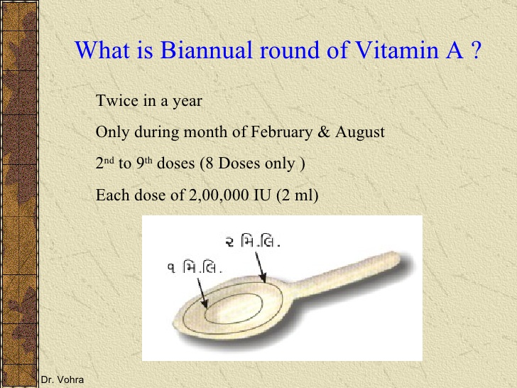

Slide 62
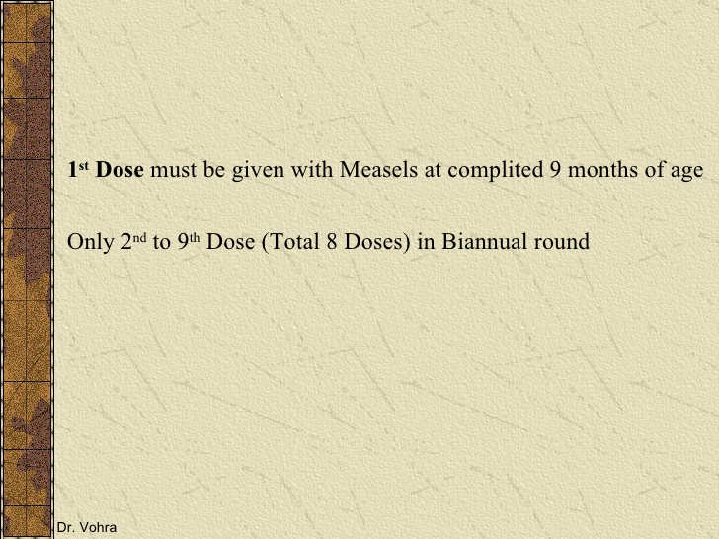
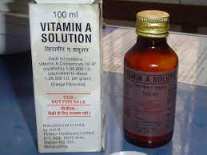
Notes:
The 2nd to 9th doses of Vitamin A can be administered to children 1-5 years old during biannual rounds, in collaboration with ICDS.

Slide 63
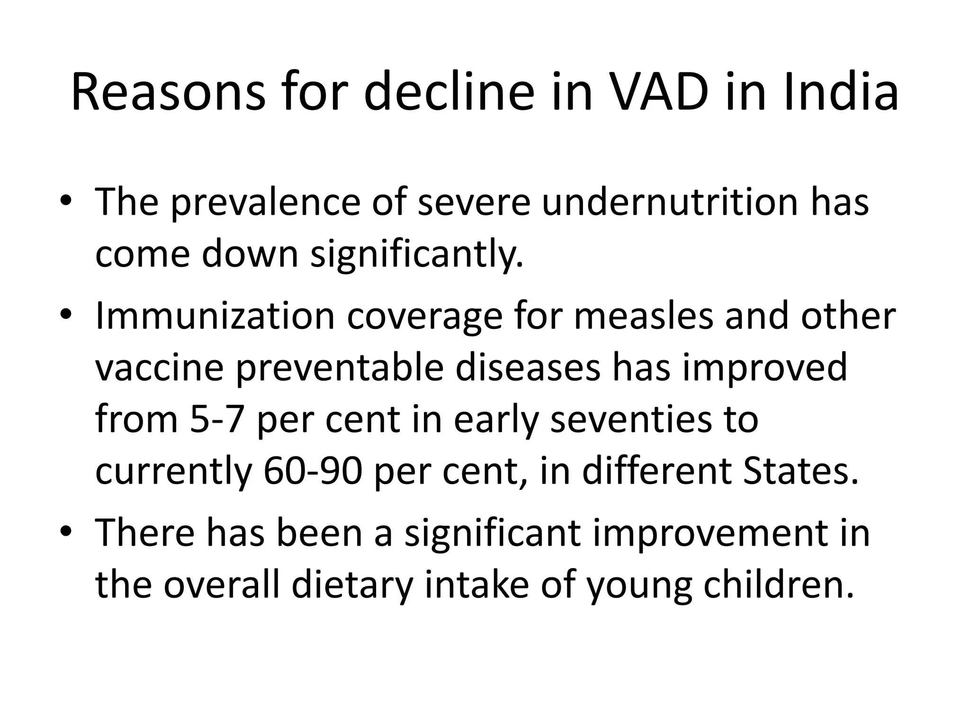

Slide 64
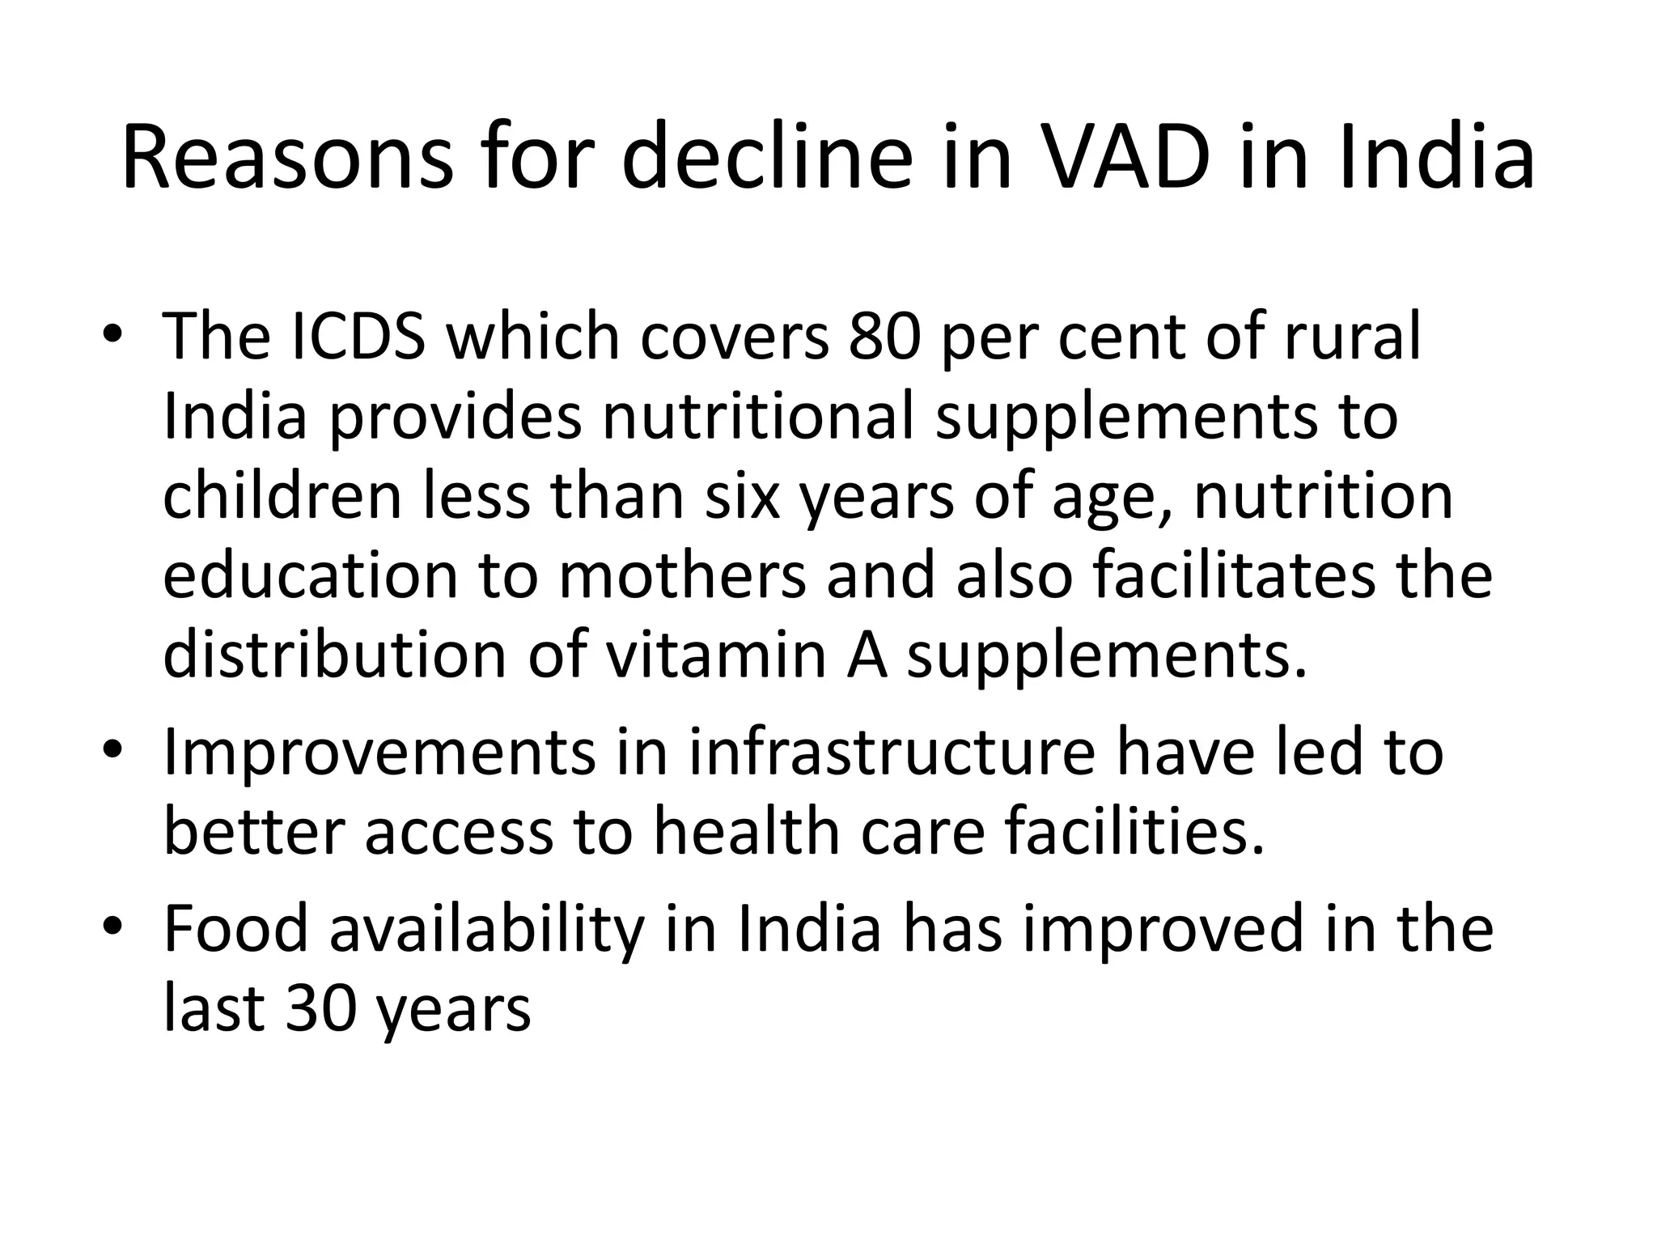

Slide 65
MCQ’S
Total 5 mcqs
Write on a paper with name and roll number
Batch name
Submit to the resident doctor

Slide 66
MCQ’S
1.
Vitamin A deficiency is considered a public health
problem if prevalence rate of night blindness in
children between 6 months to 6 years is more than:
0.01%
0.05%
0.1%
1.0%

Slide 67
2.
First clinical sign of Vitamin-A deficiency is:
Night blindness
Conjunctival xerosis
(c) Bitot’s spots
(d) Keratomalacia

Slide 68
3.
Under National Immunisation Schedule, total doses of Vitamin-A given to a child is:
(a) 15 lac IU
(b) 16 lac IU
(c) 17 lac IU
(d) 18 lac IU

Slide 69
4.
Daily requirement of Vitamin-A by an adult man is:
(a) 350 mcg
(b) 100 mcg
(c) 600 mcg
(d) 2000 mcg

Slide 70
5.
In measles which vitamin deficiency occurs:
(a) Vitamin A
(b) Vitamin B
(c) Vitamin C
(d) Vitamin D

Slide 71
END

Slide 72
Muliyil DE, Rose A, Senthamizh SV, Chatterjee T, Helan J, Kang G, Muliyil J. Prevalence and Risk Factors of Vitamin A Deficiency in Children and Women of Childbearing Age in a Southern Indian Tribal Population: A Cross-Sectional Study. Indian J Community Med. 2019 Apr-Jun;44(2) | Cross sectional study (Low level of evidence) | A cross-sectional study was done among children aged 1–8 years and women aged 15–45 years residing in Jawadhi hills. Participants were randomly selected by cluster sampling. Their sociodemographic characteristics and frequency of consumption of Vitamin A rich food were collected through a structured questionnaire. Anthropometric measures and serum retinol levels, using high-performance liquid chromatography, were estimated for all participants. | The prevalence of VAD among the children (1–8 years) was 10.2% (95% confidence interval [CI] 5.5%–14.9%) and among women of the reproductive age group was 3.8% (95% CI: 1.2%–6.4%). Dietary intake was not associated with serum retinol levels. Low educational status of the head of the household (adjusted odds ratio [aOR] = 8.9) and pregnancy (aOR = 11.6) was significantly associated with an increased risk of VAD among children and women, respectively. | The prevalence of VAD among children is a moderate public health problem. Strategies must focus on pregnant women and children from families with more than four children.

Slide 73


