Slide 1
CM 9.1
Demography: Introduction and Cycle & Fertility Indicators

Slide 2
Demographic Cycle
Dr. Pravin Parmar
Assistant Professor
Department of Community Medicine
SBKS MI RC Piparia

Slide 3
Structured Learning Objectives
Introduction to Demography
Demographic Cycle
World Population Trends
Demographic Trends in India

Slide 4
Introduction to Demography
Demography is the scientific study of human population.
It focuses its attention on three readily observable human phenomena
Changes in population size (growth or decline)
The composition of the population
The distribution of population in space.

Slide 5
Demography deals five “demographic processes”
Fertility
Mortality
Marriage
Migration
Social Mobility

Slide 6
Demographic Cycle
Passes through 5 stages
FIRST STAGE (High Stationary)
High birth rate and a high death rate which cancel each other and the population remains stationary.
India was in this stage till 1920.

Slide 7
2. SECOND STAGE (Early Expanding)
The death rate begins to decline, while the birth rate remains unchanged.
South Asia and Africa.
3. THIRD STAGE (Late Expanding)
The death rate declines still further and the birth tends to fall.
The population continues to grow because births exceed deaths.
India has entered this phase.

Slide 8
4. FOURTH STAGE (Low Stationary)
This stage is characterized by a low birth and low death rate with the result that the population becomes stationary.
Austria 1980-85.
5. FIFTH STAGE (Declining)
The population begins to decline because birth rate is lower than the death rate.
Some East European countries, notably Germany and Hungary are experiencing this stage.

Slide 9
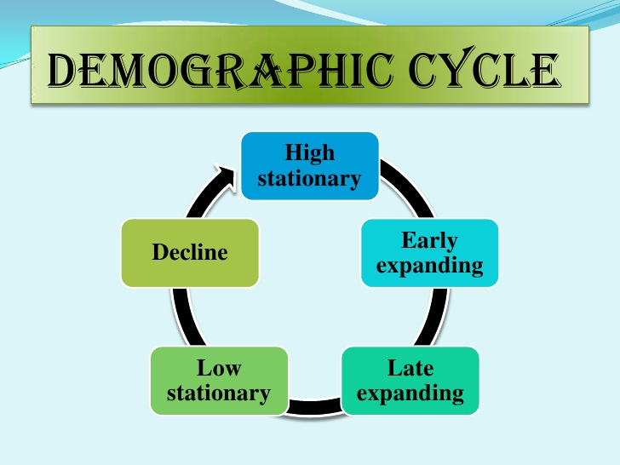

Slide 10
World Population Trends
World population reached 1 billion in 1800
2 billion in 1930
3 billion in 1960
4 billion in 1974
5 billion in 1987
6 billion in 1999
8 billion to be completed by 2022
https://www.worldometers.info/world-population/

Slide 12
Birth Rates
The world’s birth rate fell below 30 for the first time around 1975 and had declined to about 23.7 during 2010.
In 2021 the crude birth rate for the world is 17.76 births per thousand.
In most of the world the decline reflected falling birth rates and a global trend towards smaller families.
In 2021 the crude birth rate for India is 17.23 per 1000 people

Slide 13
Death Rates
The global death rate declined from 11(between 1975-1980) to 8.4 per 1000 population during 2010, a reduction of 23%.
Death rate for world is 7.64 per 1000 population in 2021
The decline in crude death rate of the South East Asian Region has been more marked, from 14.1 to 8.2 per 1000 population during the same period.
Death rate for INDIA is 7.34 per 1000 population in 2021

Slide 14
Growth Rates
When the crude death rate is subtracted from the crude birth rate, the net residual is the current growth rate exclusive of migration.
The world population growth rate was at, or near its peak, around 1970, when the human population grew by an estimated 1.92%.
In 2010 the population growth rate was 1.23% which showed a decline as compared to 1970.
The current population of World in 2022 is 7,975,105,156, a 0.83% increase from 2021.

Slide 15
Demographic Trends in India
In 2011 the population of India was 121 crores.
Second most populous country in the world next to China.
With only 2.4% of world’s land area, India is supporting about 17.5% of the world’s population.
India’s population has been steadily increasing since 1921.
The year 1921 is called the “big divide” because the absolute number people added to the population during each decade has been on increase since 1921.

Slide 16
India’s population is currently increasing at the rate of 1.6 crore each year.
These following ten states account for about 71% of total population of India.
Rank | State | Percentage to total population of India as on 31-3-2011
1. | Uttar Pradesh | 16.49
2. | Maharashtra | 9.29
3. | Bihar | 8.58
4. | West Bengal | 7.55
5. | Andhra Pradesh | 7.00
6. | Madhya Pradesh | 6.00
7. | Tamil Nadu | 5.96
8. | Rajasthan | 5.67
9. | Karnataka | 5.05
10. | Gujarat | 4.99

Slide 17
FERTILITY
Fertility is the actual bearing of children.
A woman’s reproductive age is considered to be from 15 to 45 years.
Fertility trends india:
Rural > Urban
Illiterate > Literate
Variations acc. to region, tribe, etc.
Standard of living index: med>low>high

Slide 18
Factors influencing fertility:
Age at marriage: Child Marriage Restraint Act 1978.
- Duration of married life: contraception.
- Spacing of children
- Education: illiterate 1.5 > literate
- Economic status
- Nutrition
- Family planning

Slide 19
Fertility related statistics:
Birth rate: per 1000.
General fertility rate(GFR)
General marital fertility rate(GMFR)
Age-specific fertility rate: No. of live births in a year to 1000 women in any specified age group.
Age-specific marital fertility rate

Slide 20
Total fertility rate: Avg. No. of children a woman would have if she were to pass through her rep. years bearing children as the women now in each age group.
Total marital fertility rate:
Gross Reproductive Rate-GRR
Net Reproductive Rate-NRR: NRR is a demographic indicator. Current value for NRR in India is 1.5. If NRR < 1, the reproductive performance of the pop. is below replacement level.

Slide 21
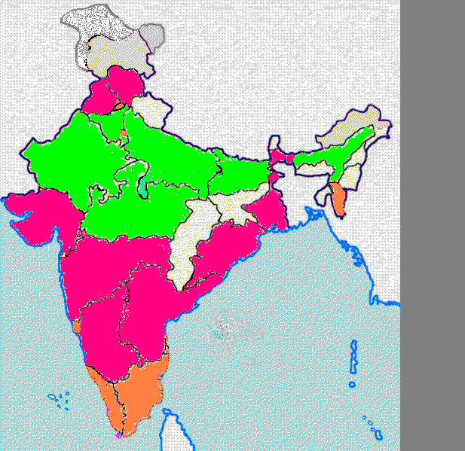
Total fertility rates in India
< 2.1
2.1-3.0
> 3.0

Slide 22
Key objectives of the National Population Policy - NPP - 2000
To achieve replacement level of fertility by 2010
To stabilise population by 2045
To provide universal access to quality contraceptive services in order to lower TFR to 2.1
To attain two-child norm
To reduce IMR to <30 /1000 live births
To reduce MMR to <100 /100000 live births

Slide 23
Aiyer. S., Mody .A., The Demographic Dividend: Evidence from the Indian States. International Monetary Fund 2011 | Cohort Study(Medium Level of Evidence) | This study makes progress by focusing on India, which will be the largest individual contributor to the global demographic transition ahead. It exploits the variation in the age structure of the population across Indian states to identify the demographic dividend. | The main finding is that there is a large and significant growth impact of both the level and growth rate of the working age ratio. This result is robust to a variety of empirical strategies, including a correction for inter-state migration. | A substantial fraction of the growth acceleration that India has experienced since the 1980s—sometimes ascribed exclusively to economic reforms—is attributable to changes in the country’s age structure.

Slide 24
Demography deals with how many demographic processes?
4
5
7
6

Slide 25
2. Early Expanding comes in which stage of
demographic cycle?
First
Third
Second
Fourth

Slide 26
3. The second most populous country in the
world is
India
China
USA
Brazil

Slide 27
4. The year ____ is called the “big divide” in
Indian population trend
1921
1931
1911
1941

Slide 28
5. In 2011 the population of India was
120 crores
122 crores
124 crores
121 crores

Slide 29
Answers
b
c
a
a
d

