Slide 1
CONCEPT OF CONTROL AND ICEBERG PHENOMENON OF DISEASE
Dr Jimmy Kagathara
Assistant Professor
Dept of Community Medicine

Slide 2
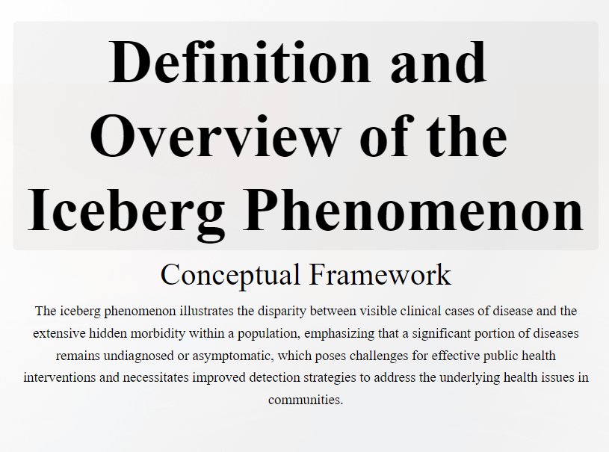
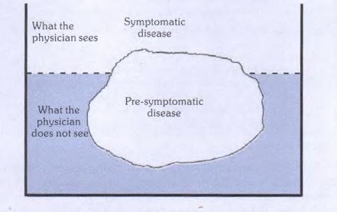

Slide 3
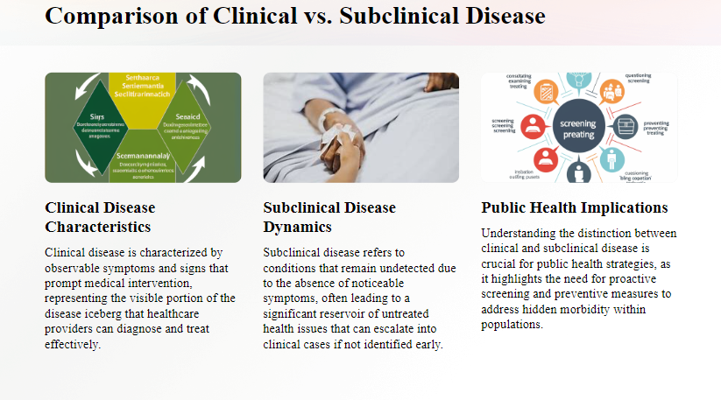

Slide 4
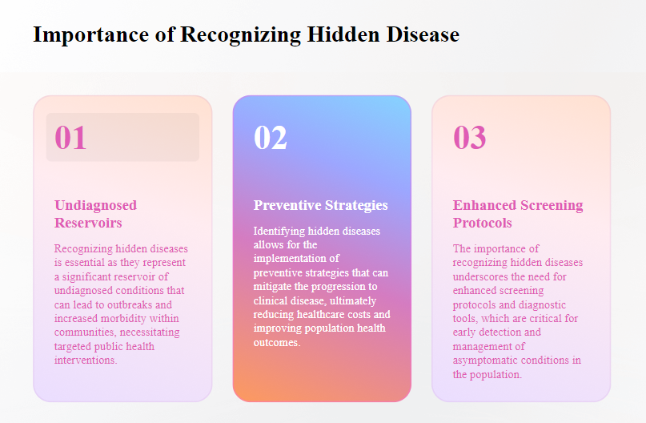

Slide 5
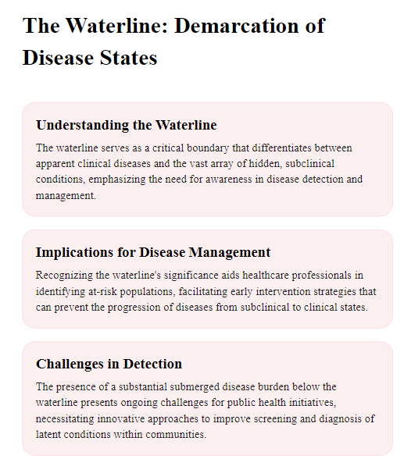

Slide 6
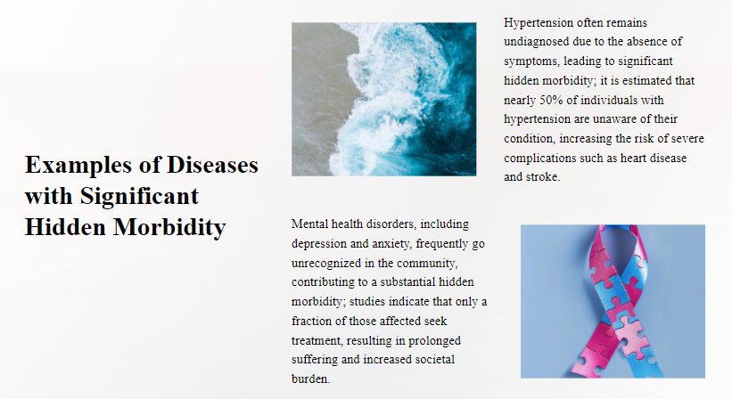

Slide 7
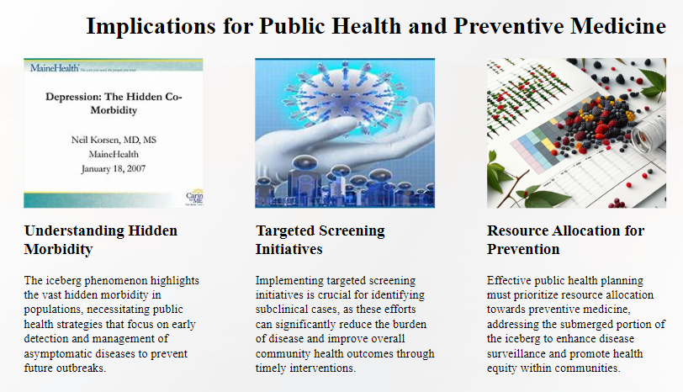

Slide 8
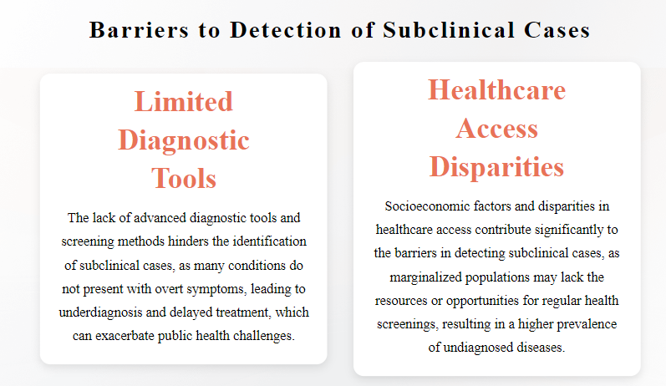

Slide 9
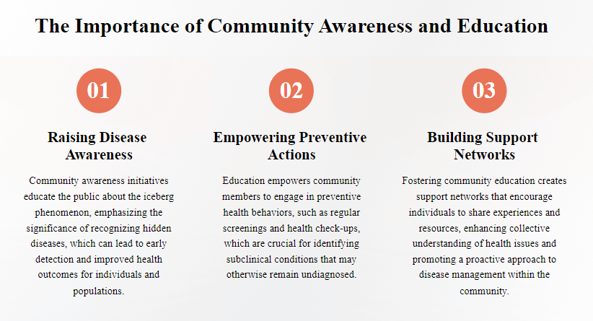

Slide 10
CONCEPT OF CONTROL, ELIMINATION & ERADICATION

Slide 11
Disease control
The term "disease control" describes (ongoing) operations aimed at reducing:
the incidence of disease
the duration of disease, and consequently the risk of transmission
the effects of infection, including both the physical and psychosocial complications
the financial burden to the community.

Slide 12
Control activities may focus on primary prevention or secondary prevention, most control programmes combine the two.
The concept of tertiary prevention is comparatively less relevant to control efforts. In disease control, the disease "agent" is permitted to persist in the community at a level where it ceases to be a public health problem according to the tolerance of the local population.
A state of equilibrium becomes established between the disease agent, host and environment components of the disease process. An excellent embodiment of this concept is malaria control, which is distinct from malaria eradication.

Slide 13
Disease elimination
Between control and eradication, an intermediate goal has been described, called "regional elimination".
The term "elimination" is used to describe interruption of transmission of disease, as for example, elimination of measles, polio and diphtheria from large geographic regions or areas.
Regional elimination is now seen as an important precursor of eradication

Slide 14
Disease eradication
Eradication literally means to "tear out by roots".
Eradication of disease implies termination of all transmission of infection by extermination of the infectious agent. As the name implies, eradication is an absolute process, and not a relative goal.
It is "all or none phenomenon".
The word eradication is reserved to cessation of infection and disease from the whole world.
Today, smallpox is the only disease that has been eradicated globally.

Slide 15
During recent years, three diseases have been seriously advanced as candidates for global eradication within the foreseeable future: polio, measles and dracunculiasis.
The feasibility of eradicating polio appears to be greater than that of others and the goal is in sight as Afghanistan and Pakistan are the only two countries endemic for poliomyelitis at present.

Slide 16
MCQ

Slide 17
Q 1. Which diseases recently has been declared as cessation of public health problem in India by WHO?
Measles
Yaws
Trachoma
Cholera

Slide 18
Q 2. If a disease has been not found in a country/region for how many years than it can defined as eliminated from that particular region?
1 year
2 years
3 years
4 years

Slide 19
Q 3. Which of the following diseases doesn’t show iceberg phenomenon ?
Hypertension
Anemia
Diabetes
Influenza

Slide 20
Q 4. Which of the following diseases is on verge of eradication from world?
Polio
Malaria
Meningococcal Meningitis
Brucellosis

Slide 21
Q 5. In iceberg phenomenon, in tip of the iceberg normally how many cases of total disease burden are present?
4/8th
3/8th
2/8th
1/8th

Slide 22
THANK YOU

Slide 23
ANSWER MCQ
1. C
2. C
3. D
4. A
5. D

