Slide 1
Protein synthesis inhibitors
Aminoglycosides
Dr. Samprada Tank
Assistant professor
Pharmacology department
17-09-24

Slide 2
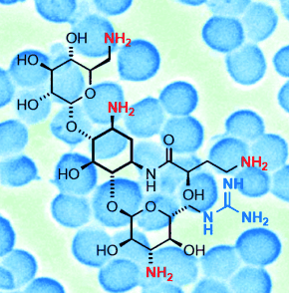
Intoduction
These drugs are used primarily to treat infections caused by aerobic gram-negative bacteria
Aminoglycosides are bactericidal inhibitors of protein synthesis

Slide 3
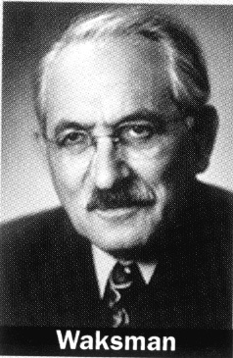
History and Source
Natural products or semisynthetic derivatives of compounds produced by a variety of soil actinomycetes
1944 : Streptomycin was first member discovered by Waksman and his colleagues from a strain of streptomyces griseus.

Slide 4
Year discovered | Drug | Genero
1944 | Streptomycin | Streptomyces griseus
1949 | Neomycin | S.fradiae
1957 | Kanamycin | S.kanamyceticus
1959 | Paromomycin | S.fradiae
1964 | Gentamicin | Micromonospora purpurea
1970 | Tobramycin | S.tenebrarius
1980 | Sisomicin | Micromonospora inyoensis

Slide 5
Suffix: “micin” - Micromonospora
“mycin”- Streptomyces
Other antibiotics have been developed (e.g., arbekacin, isepamicin, and sisomicin), but they have not been introduced into clinical practice:
because numerous potent, less toxic alternatives are available.

Slide 6
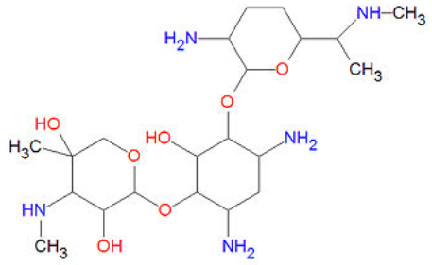
Chemistry
The term aminoglycoside stems from their structure:
Two aminosugars joined to aminocyclitol by glycosidic bond:
-O- -O-
aminosugar
2-deoxystreptamine
aminosugar

Slide 7
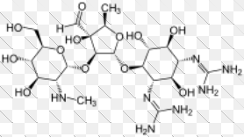
Contd…
In streptomycin aminocyclitol is streptidine:
-O- -O-
Streptidine
Streptose or aminosugar
N-methyl-L-Glucosamine aminosugar
Streptobiosamine

Slide 8
Classification
Systemic
Streptomycin
Topical
Neomycin
Framycetin
Gentamicin
Kanamycin
Tobramycin
Amikacin
Sisomicin
Netimicin
Paromomycin

Slide 9
Properties
All are used as sulfate salts,highly water soluble;solutions are stable for months.
They ionize in solution; not absorbed orall;distribute only extracellularly; don’t penetrate in brain or CSF.
Excreted unchanged in urine by glomerular filtration.
Bactericidal and more active at alkaline pH.
Act by interfering with bacterial protein synthesis.
Active against aerobic gram negative bacilli and don’t inhibit anaerobes.
Relatively narrow margin of safety.
All exhibit ototoxicity and nephrotoxicity.

Slide 10
Mechanism of action
Transport of aminoglycoside through bacterial cell wall and cytoplasmic membrane
Binding to ribosomes resulting in inhibition of protein synthesis

Slide 11
Inhibition of protein synthesis
Bind to 30s, 50s ribosome as well as 30s-50s interface
Freeze initiation, prevent polysome formation and misreading of mRNA code
Inhibit protein synthesis

Slide 12
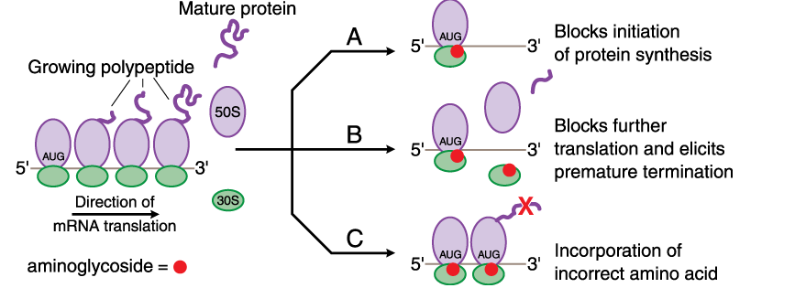
Bind to 30s ribosome and fix 30s-50s ribosomal complex at start codon(AUG)of mRNA,
Production of abnormal or nonfunctional protein

Slide 13
Cidal action due to secondary change in cell membrane.
Sensitive bacteria become more permeable
Ions,protein
Aminoacid
Leak out
Cell death
After exposure

Slide 14
Mechanism Of
Bacterial Resistance
1
Mutation decrease affinity of ribosomal proteins that are normally bound to aminoglycoside
2
Decrease efficiency of aminoglycoside transport mechanism
3
Most common
Cell membrane bound inactivating enzymes that phosphorylate, adenylate, acetylate drug

Slide 15
Resistance to gentamicin indicates cross resistance to tobramycin,amikacin,kanamycin and netilmicin because inactivating enzyme is bifunctional and can modify all these aminoglycosides.

Slide 16
Pharmacokinetics
Absorption:
Highly polar cations
Very poorly absorbed from the GI tract.(<0.1%)
Absorption of gentamicin from the GI tract-increased by GI disease(e.g.ulcers or inflammatory bowel disease.
Absorbed rapidly from intramuscular sites of injection
Absorption from intramuscular site is reduced In critically ill patients especially in shock because of poor perfusion.
Peak plasma concentration after 30-90 mins
Intoxication may occur when aminoglycosides are applied topically for long periods if there is renal insufficiency

Slide 17
Contd…
Increasing use of aminoglycosides administered via inhalation.
Primarily for the management of patients with cystic fibrosis who have chronic Pseudomonas aeruginosa pulmonary infections.
Amikacin and tobramycin solutions for injection have been used

Slide 18
Distribution:
Because of their polar nature, the aminoglycosides do not penetrate into most cells, the CNS, or the eye
Concentrations of aminoglycosides in secretions and tissues are low
Plasma protein binding: neglible(except streptomycin)
Volume of distribution:25% of lean body weight –equal to ECF

Slide 19
Contd…
High concentration- only in the renal cortex and endolymph and perilymph of the inner ear Contribute to nephrotoxicity and ototoxicity.
Penetration in to respiratory secretion-poor.
Diffusion in to pleural and synovial fluid – slow
But concentration that approximate those in plasma achieved after repeated administration.
Concentrations achieved in CSF with parenteral administration-subtherapeutic .
Do not cross BBB
Penetration in ocular fluid –so poor.
Required intraocular injections of drugs.

Slide 20
Contd…
Administration of aminoglycosides to women late in pregnancy may result in accumulation of drug in fetal plasma and amniotic fluid.
Streptomycin and tobramycin can cause hearing loss in children born to women who receive the drug during pregnancy

Slide 21
Elimination :
Excreted almost entirely in urine through glomerular filtration.
Aminoglycosides can be removed from the body either by hemodialysis or peritoneal dialysis.

Slide 22
 | Plasma half-life
Normal Patient | 2-4 hours
New born-weight<2kg in first week of life | 8-11hours
New born-weight>2kg | 5 hours
Clearances are increased and half-lives are reduced in patients with cystic fibrosis
Large dose is required in burn patients because of more rapid clearance

Slide 23
Contd.
Gentamicin/tobramycin
/sisomycin/netilmycin
Streptomycin/ kanamycin/
amikacin
3-5mg/kg/day
7.5-15mg/kg/day
Notes:
With normal RFT

Slide 24
Contd.
Single total daily dose regimen for patients with normal renal function because of:
Aminoglycosides have concentration dependent killing and a long post antibiotic effect
Plasma concentration remain sub-thresold for ototoxicity and nephrotoxicity

Slide 25
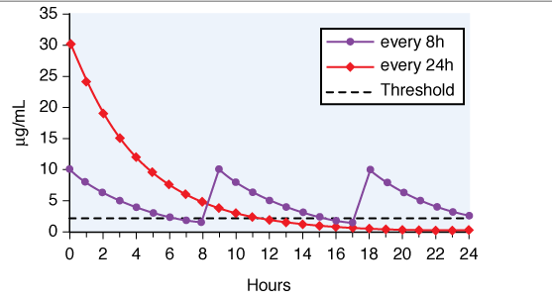
Single daily dose regimen is not used in
1)Abnormal renal function and children

Slide 26
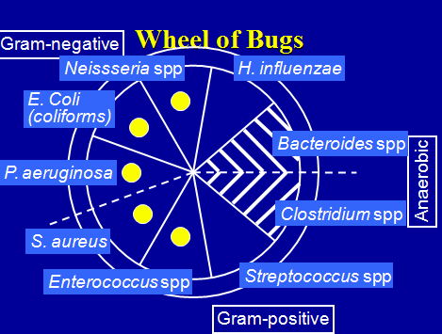
Antibacterial
Spectrum
Active mainly against Gram-negative aerobic bacilli(E.coli,Klebseilla,Shigella,Proteus including Enterobacter and Pseudomanas except salmonella)
Many enterobacteriaceae are sensitive
Only few Gram-positive cocci(Staph.aureus, Strept.viridans and faecalis) are sensitive.
Not effective against Gram-positive bacilli,Gram negative cocci and anaerobes.

Slide 27
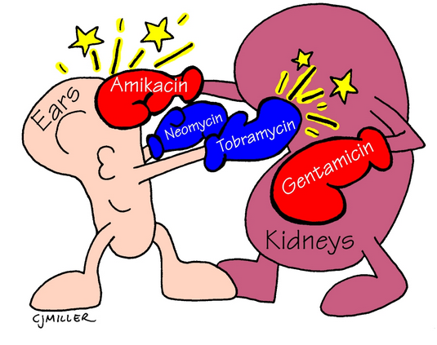
Untoward effects
Nephrotoxicity
Ototoxicity
Neuromuscular damage

Slide 28
Otoxicity
Impairement of VII th cranial nerve function
Irreversible, bilateral high-frequency hearing loss and temporary vestibular hypofunction
Degeneration of hair cells and neurons in the cochlea correlates with the loss of hearing
Ototoxicity higher when plasma concentration of drug is persistently high
For gentamicin: 2μg/ml
Recommended that dosing of gentamicin should be such that measured trough plasma concentration is <1 μg/ml to avoid toxicity

Slide 29

Cochlear toxicity
Vestibular toxicity
Start from base to apex
Symptoms:
Tinnitus –high pitched
Progressive hearing loss
Duration: On stopping of drug, tinnitus disappears in 4-10 days,but frequency loss persist
  Neomycin >amikacin & kanamycin
Headache
Nausea, vomiting
Dizziness
Nystagmus
Vertigo
Ataxia
When drug is stopped it passes into chronic stage(6-10 weeks,recovery(1-2 years)
  Streptomycin> gentamicin
Tobramycin has both types of toxicity
Netilmycin claimed to have low ototoxicity

Slide 30
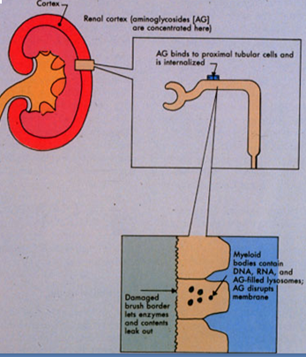
Nephrotoxicity
Incidence: 8-26%
Reversible if drug is discontinued
Results from accumulation and retention of drug in proximal tubular cells
Tubular damage causes:
Low glomerular filtration rate
Nitrogen retention
Albuminuria
Casts

Slide 31
Contd…
Reduced clearance of antibiotic leads to ototoxicity
Factors affecting nephrotoxicity
Total amount of drug administered
Duration of drug received
Advanced age, liver disease, diabetes mellitus, and septic shock↑ toxicity
Neomycin > Gentamicin,Tobramycin,Amikacin > Netilmicin >Streptomycin

Slide 32
Neuromuscular Blockage
Generally occurred after intra-pleural or intra-peritoneal instillation of large dose.
Mechanism:
Inhibit pre-junctional release of acetylcholine.
↓sensitivity of muscle end plates to acetylcholine.
Patient of myasthenia gravis are most susceptible.
Neomycin=Streptomycin > Kanamycin,Gentamicin,
Amikacin > Tobramycin

Slide 33
Precautions and interactions
A) Avoid during pregnancy: risk of foetal ototoxicity
B) Avoid concuurent use of nephrotoxic drug:
  NSAIDS
  Vancomycin
  Cisplatin
  Amphotericin B
  Cyclosporine

Slide 34
C) Cautious use of other ototoxic drug:
Vancomycin
Minocycline
Furosemide
D) Cautious use in renal damage and old age
E) Cautious use of muscle relaxant
F) Don’t mix aminoglycoside with any drug in same syringe

Slide 35
Gentamicin
Cheapest and first line antibiotic
More potent than streptomycin,kanamycin and amikacin, but equally as tobramycin,sisomicin and netilmicin.
Bacteria that acquire resistance against gentamicin generally exhibit cross resistance to tobramycin and sisomicin
It synergies with β-lactam antibiotics, against Enterococcus(endocarditis) and Peudomonas(meningitis)

Slide 36
Spectrum:
Gram-ve bacilli like: E.coli, Klebsillea, Enterobacter, H.Influenzae, proteus, serrratia, and pseudomonas
Many strain of brucella, campylobacter citrobacter, Fransisella and yersinia are sensitive

Slide 37
Uses
Preventing and treating respiratory infection in:
Critically ill patient
Impaired host defence: AIDS, neutropenia, Corticosteroids
Post operative pneumonia
With implants
ICU patients
Combined with penicillin/cephalosporin
Not used in community acquired pneumonia as it is caused by gram positive cocci and anaerobes
Added to peritoneal dialysate to prevent or treat peritonitis

Slide 38
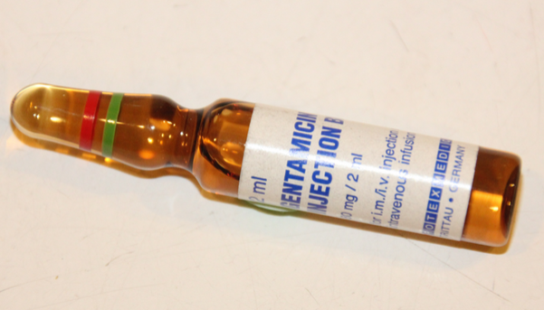
Contd…
Psuedomonas, Proteus, or Klebsiella
Burns
UTI
Osteomyelitis
Middle ear infection
Septicemia

Slide 39
Contd…
Meningitis caused by gram negative bacilli
Third genration cephalosporins with aminoglycoside is used
Subacute bacterial endocarditis(SABE)
Gentamicin 1 mg/kg 8 hrly intramuscularly with penicillin/ampicilllin/vancomycin
Dose : 3-5 mg/kg/day (single or 3 divided dose) intramuscular or intravenous line over 30-60mins.

Slide 40
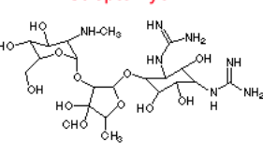
Streptomycin
Oldest aminoglycoside
Less potent than other aminoglycoside
Spectrum: narrow
H.Ducreyi, Brucella, Yersinia, Nocardia, Campylobacter granulomatis, Francisella tularensis, M. Tuberculosis
Only few strains of E.coli,H.influenzae,V.cholerae, Shigella,Klebseilla.enterococci and some gram positive cocci are now inhibited

Slide 41
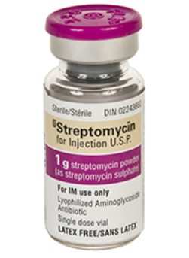
Uses
Tuberculosis
  Tuberculocidal
  Acts only on extracellular bacilli
Subacute bacterial endocarditis : Streptomycin and penicillin combination therapy for 2 weeks
Plague: rapid cure within 7-12 days but tetracycline is drug of choice.
Tularemia: Streptomycin is drug of choice for this rare disease.
Dose for Acute infection: 1g intramuscular once daily for 7-10days

Slide 42
Kanamycin
Similar to streptomycin in all aspects including efficacy against M.tuberculosis and lack of activity against Peudomonas.
More toxic to cochlea and to kidney.
Because of toxicity and narrow spectrum it has been largely replaced by other aminoglycosides for gram negative bacillary infections.
Occasionally used as 2nd line drug in resistant tuberculosis.
Dose: 0.5 g intramuscularly twice day(15mg/kg/day)

Slide 43
Tobramycin
Similar to gentamicin
But 2-4 times more active against Peudomonas and Proteus.
Used in Serious pseudomonas and proteus infection resistant to gentamicin
Ototoxicity and nephrotoxicity
is less than gentamicin
Used as nebulizer for treatment of cystic fibrosis due to pseudomonas
Dose : 3-5mg/kg/day in 1-3 doses

Slide 44
Amikacin
Semisynthetic derivative of kanamycin
Outstanding feature: its resistance to bacterial aminoglycoside inactivating enzymes.
Widest spectrum of activity
More hearing loss than vestibular disturbance occurs in toxicity
Dose :15mg/kg/day in 1-3 doses
Urinary tract iinfection - 7.5mg/kg/day

Slide 45
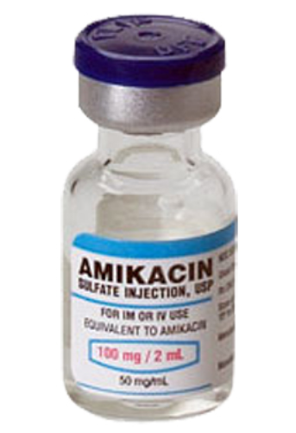
Contd..
USE:
Empirical treatment of hospital acquired gram negative bacillary infection where gentamicin resistant is very high
Multidrug resistant T.B.

Slide 46
Netilmicin
Semisynthetic derivative of gentamicin.
Broader spectrum.
Relatively resistant to aminoglycoside inactivating enzymes.
Effective against some gentamicin resistant strains.More active against klebseilla, Enterobacter and styphylococcus.
Less active against pseudomonas.
Less ototoxic than tobramycin and gentamicin
Dose : 4-6mg/kg/day in 1-3 doses

Slide 47
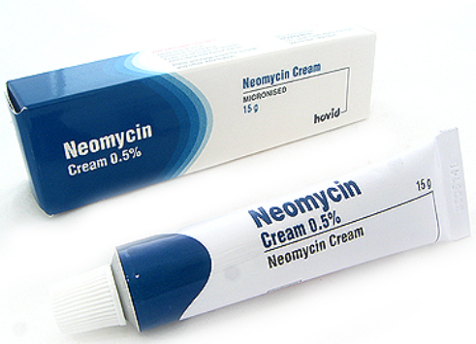
Neomycin
Wide spectrum
Use
Topically : combine with polymixin and bacitacin)
  Infected wound
  Ulcers
  Burns
  External ear infections
  Conjuctivitis

Slide 48
Orally
Preparation for bowel surgery: 3 doses of 1g along with metronidazole 0.5 g on day before surgery reduce postoperative infection
Hepatic coma :
By suppressing intestinal flora it decrease NH3 production
Because of toxicity lactulose is used
Dose :0.25 -1 g four times in day oral, 0.3-0.5% topical

Slide 49
Side effects
Malabsorption syndrome with diarrhoea and stetorrhoea
Hypersensitivity reactions, primarily skin rashes, occur in 6-8% of patients –with topical therapy
Superinfection with candida

Slide 50
Framycetin
Obtained from S. lavendulae
Similar to neomycin.
Used mainly topically.
Highly nephrotoxic on systemic administration.

Slide 51
Paromomycin
Chemically related to neomycin
Additional activity against:
E.histolytica
Giardia lamblia
Trichomonas vaginalis
Cryptosporidium
Leishmania

Slide 52
Contd…
Uses
Hepatic coma
Intestinal amoebiasis
Giardiasis
Kala azar
Crytosporidiosis
Trichomonas infection
Dose : Oral 500mg thrice daily
(25-30mg/kg/day )

Slide 53
Sisomicin
It is similar to gentamicin chemically and also susceptible to inactivating enzymes.
Similar to gentamicin but more potent to pseudomonas and beta hemolytic streptococci
Use: Along with penicillin for SABE.

Slide 54
Spectinomycin
Obtained from streptomyces
Not true aminoglycoside chemically
Single dose 40 mg/kg i.m. used for gonorrhoea alternative to penicillin
Adverse effects
Pain at the site of injection, occasional fever and nausea. Nephrotoxicity and ototoxicity very rare.

Slide 55
MCQs
1- which of the following is not a true aminoglycoside chemically?
A – Gentamicin
B – amikacin
C – spectinomycin
D – kanamycin

Slide 56
2- All are systemic aminoglycosides except
A- Tobramycin
B- paromomycin
C –sisomicin
D – neomycin

Slide 57
3-All are adverse drug effects of aminoglycosides except
A – neuromuscular damage
B – liver damage
C – nephrotoxicity
D – ototoxicity

Slide 58
4- MOA of aminoglycosides is
A- Protein synthesis inhibitors
B – DNA gyrase inhibitors
C- Cell wall synthesis inhibitors
D – misreading of mRNA

Slide 59
5- All are uses of neomycine and framycine except
A- Ulcers
B – Burns
C- Conjunctivitis
D – Tuberculosis

Slide 60
THANK YOU

