Slide 1
Larynx anatomy and physiology of phonation

Slide 2
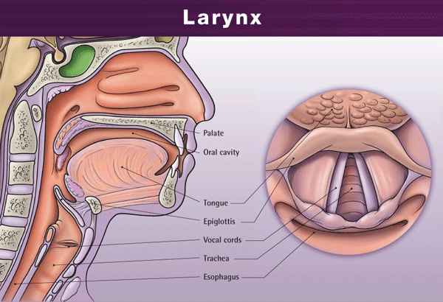
Location: C4-C6

Slide 3
ANATOMY OF THE LARYNX
Introduction:
Situated above the trachea.
Extends from the laryngeal inlet to the inferior border of the cricoid cartilage .
Opposite the third to sixth cervical vertebrae, being a little higher in women than in men.
The infantile larynx:
Smaller than the adult compared to body size
More funnel shaped.
Its narrowest part is at the junction of the subglottic larynx with the trachea and even slight swelling in this area may result in marked airway obstruction .
Cartilages are much softer and collapse more easily on forced inspiration.
The larynx starts high up under the tongue in early life and with age assumes an increasingly lower position in the neck .

Slide 4
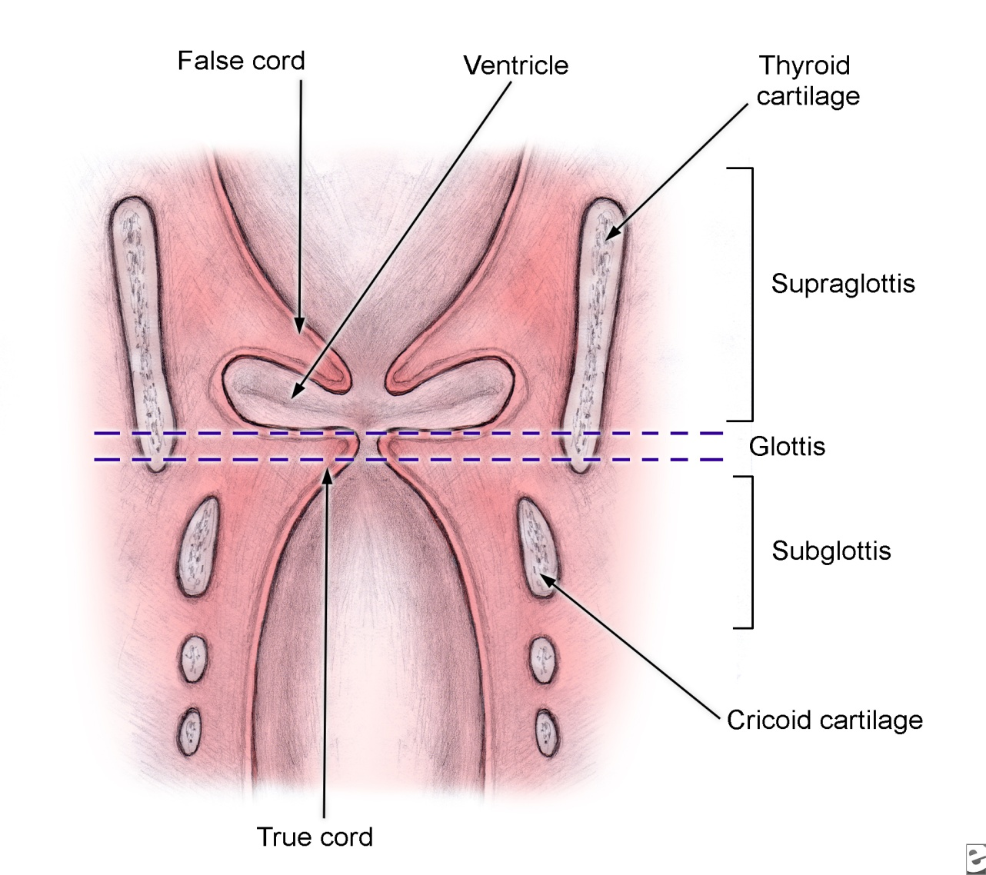
The larynx is divided anatomically into :
supra glottis
glottis And
sub glottis
By the false and
true vocal cords.

Slide 5
Laryngeal Cartilages
Paired
  Arytenoid cartilage
  Corniculate cartilage
  Cuneiform cartilage
Unpaired:
  Thyroid cartilage
  Cricoid cartilage
  Epiglottis

Slide 6
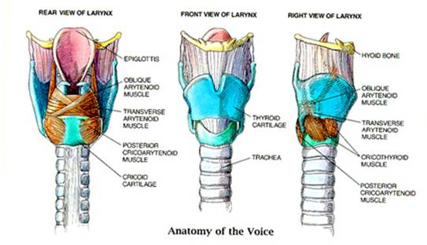

Slide 7
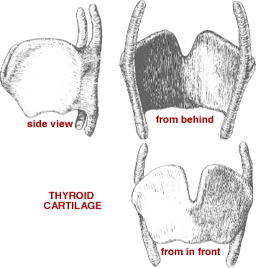
Thyroid Cartilage
Hyaline cartilage
Largest
Encloses the larynx anteriorly and laterally
Two alae
Ossification: 20-30 years
Notes:
This cartilage has two alae/wing which meet anteriorly, they form a depression called the THYROID NOTCH before meeting at the protruberance of the Adam’s apple or laryngeal prominence.
Posteriorly, each wing has a superior cornu (extending upward about 2 cm) and inferior cornu (articulates w/cricoid cartilage below; ONLY DIRECT ARTICULATION, all others being maintained by muscles or ligaments)
Ossifies at 20-30 years of age, begins in the inferior margin and progress cranially

Slide 8
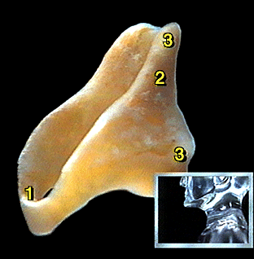
Cricoid Cartilage
Hyaline cartilage
Directly below the thyroid cartilage
It is the only cartilage forming a complete ring.
Its posterior part is expanded to form a lamina while anteriorly it is narrow forming an arch.
Ossifies after the thyroid cartilage, first part to be calcified being the superior portion (which can be mistaken for a foreign body)
Notes:
Ossifies after the thyroid cartilage, first part to be calcified being the superior portion (w/c can be mistaken for a foreign body) Calcification progresses caudally.
Lamina – flat portion of the ring llocated posteriorly and extends upward to form the POSTERIOR border of the larynx
Only complete annular support of the laryngeal skeleton; preservation essential to maintain the enclosed airways.
Level: Adult: C6-C7 Children: C3-C4
Posterolaterally, cricoid articulates w/ Inferior cornu of the thyroid cartilage, which forms true synovial joints (permit a ROCKING action of the cricoid cartilage on the thyroid cartilage and a slight anteroposterior SLIDING motion (cricoid cart. Supports the 2 arytenoid cartilages on posterosuperior aspect)

Slide 9
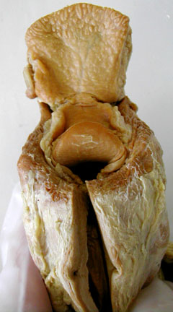
Epiglottis
Fibroelastic cartilage
Leaf-shaped structure
It never ossifies
Notes:
Attached to the INSIDE of the thyroid cart. Anteriorly and projects upward and backward above the laryngeal opening.
Petiole – small narrow portion of the glottis that is attached to the thyroid cart.
The epiglottis is attached to the hyoid bone by the hyoepiglottic ligament.
To the posterior part of the tongue by the median glossoepiglottic fold.
To the sides of the pharynx by the lateral glossoepiglottic folds.
To the thyroid cartilage by the thyroepiglottic ligament.
The mucous membrane covering the epiglottis is reflected to the posterior part of the tongue as one medial and two lateral glossoepiglottic folds. Between these folds are depressions called epiglottic valleculae.

Slide 10
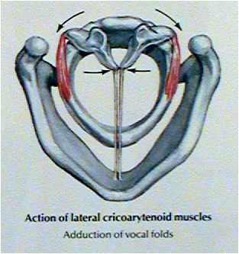
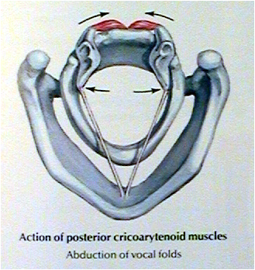
Arytenoid Cartilage
Paired.
Smaller in size
Responsible for opening and closing of the larynx
Notes:
Calcify at the 3rd decade (Hyoid – ossifies fr. 6 centers shortly after brith, complete by 2 years of age)
Arytenoids rest on the upper edge of the cricoid lamina at the posterior border of the larynx

Slide 11
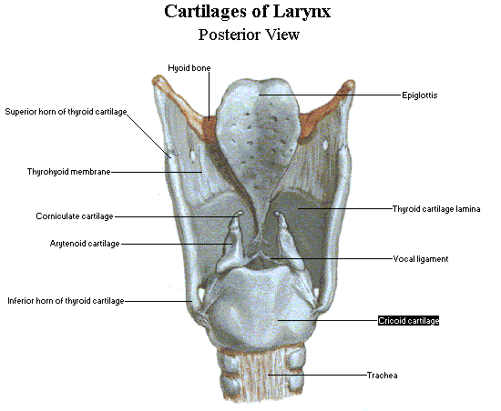
Arytenoid Cartilage
Shape: pyramidal
Base---articulate with cricoids cartilage.
Muscular process---laterally giving attachment to intrinsic muscle.
Vocal process--- anteriorly, giving attachment to vocal cord.
Apex---support the corniculate cartilage.
Notes:
Mobile end of VC – posterior
Lateral promincence of each arytenoid cart. Is known as Muscular process, becoz of insertion site of numerous muscles
Articulation of arytenoids with cricoid cart. Is at the CRICOARYTENOID JOINT, w/c permits a WIDE range of motion in 3 directions

Slide 12
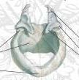
Corniculate Cartilages
Fibroelastic
Small cartilages that lie over the arytenoids.

Slide 13
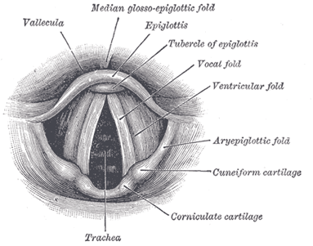
Cuneiform Cartilages
Fibroelastic cartilages
Elongated pieces of small yellow elastic cartilage in the aryepiglottic folds
Cuneiform Cartilage

Slide 14
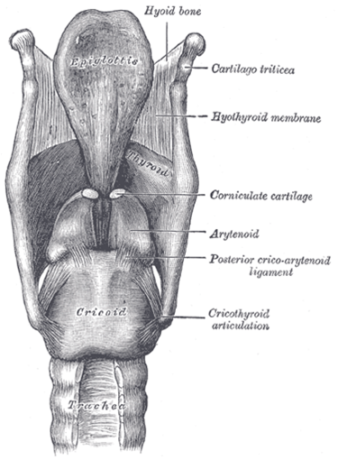
Laryngeal Joints
Cricothyroid Joint
Cricoarytenoid Joint
  Both are synovial joints.
  Both have two movements:
  Rotation
  Gliding
Notes:
Cricothyroid Joint - Synovial joint with a capsular ligament bet. Inferior cornu of the thyroid cartilage and the facet on the cricoid cartilage at the junction of the arch and lamina.
Rotation – thru a transverse axis Gliding – slightly
Cricoarytenoid Joint - Synovial joint with a capsular ligament bet. Base of the arytenoid cartilage and the facet on d upper border of the lamina of the cricoid cartilage
Rotation – arytenoid rotates on a vertical axis, vocal process moves medially or laterally
Gliding – arytenoids move toward or away from each other. (strong posterior cricoarytenoid ligament prevents excessive movements of the arytenoids on the cricoid)

Slide 15
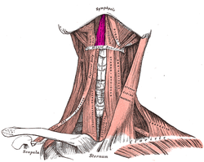
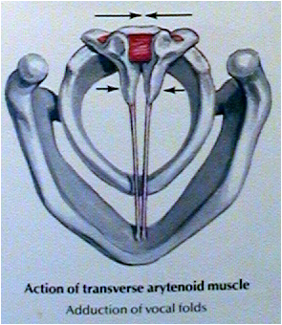
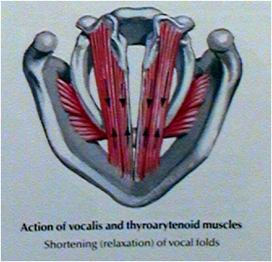
Laryngeal Muscles
1- Extrinsic Muscles
  Depressor group
  Elevator group
2- Intrinsic muscles:
All are paired except Interarytenoid muscle.
They open and close the glottis; and they are of three groups:
Abductors: posterior cricoarytenoid muscle. It opens the glottis and it is the most important muscle of the body.
Adductors: Lateral cricoarytenoid, interarytenoid, thyroarytenoid (external part)
Tensors: cricothyroid and vocalis (internal part of thyroarytenoid )
Notes:
Intrinsic muscles, all are paired except Interarytenoid m.
Larynx moves up during swallowing, down after.
The extrinsic muscles move the larynx as a whole. The infrahyoid muscles or straps (omohyoid, sternohyoid, and sternothyroid) are depressors of the hyoid bone and the larynx, whereas the suprahyoid muscles (stylohyoid, digastric, mylohyoid and geniohyoid) and the stylopharyngeus are elevator of the hyoid bone and larynx.

Slide 16
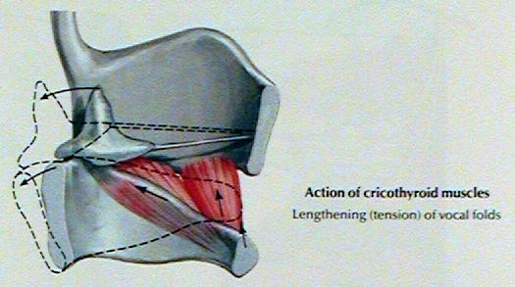

Slide 17
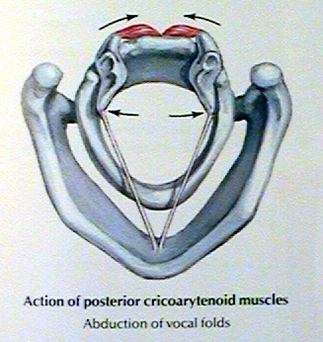
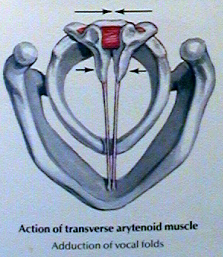

Slide 18
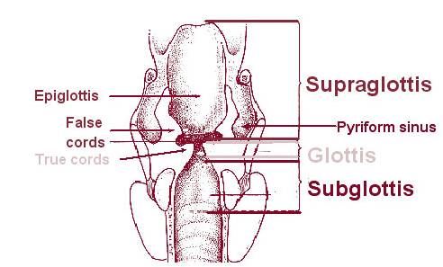
Laryngeal compartments
The glottis: composed of the vocal cords
The subglottis: from the lower border of the glottis to the inferior border of the cricoid.
The supraglottis: extend from the upper border of the glottis inferiorly to the hyoid bone superiorly.

Slide 19
Histology
Lining epithelium: squamous over the vocal cords
Mucous glands and lymphatics: rich in supraglottis, nil in glottis and very few in subglottis.
The mucosa of the glottis and supraglottis is firmly bound down to the underlying tissue, but not so in the subglottic region. Here, the laxity of tissue allows a dangerous degree of oedema, especially in children, where the diameter of the area is relatively smaller than in adult.

Slide 20
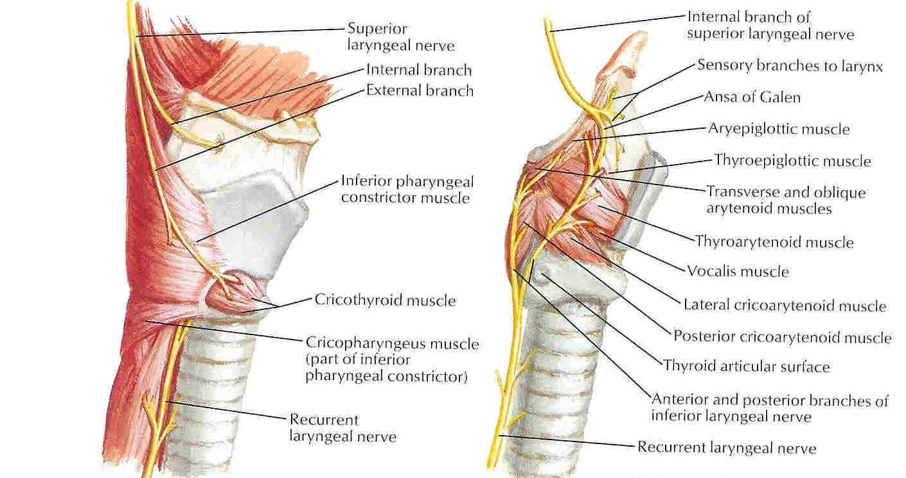
NERVE SUPPLY OF LARYNX

Slide 21
NERVE SUPPLY OF LARYNX
MOTOR SENSORY
All the muscles which move the vocal cords (abductors, adductors or tensors) are supplied by the Recurrent Laryngeal Nerve except the cricothyroid muscle, which is supplied by Superior Laryngeal Nerve.
Above the vocal cords, larynx is supplied by Internal Laryngeal Nerve – a branch of Superior Laryngeal Nerve & below the vocal cords by Recurrent Laryngeal Nerve.
Both of these are branches of the Vagus Nerve.

Slide 22
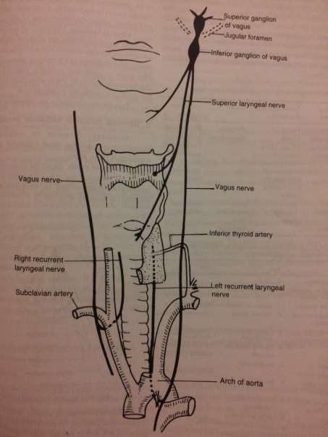
RECURRENT LARYNGEAL NERVE
Rt. Recurrent laryngeal nerve arises from the Vagus nerve at the level of Subclavian artery, hooks round it & then ascends between the trachea & oesophagus.
The Lt. Recurrent laryngeal nerve arises from the Vagus in the Mediastinum at the level of Arch of aorta, loops round it & then ascends into the neck in the tracheo-oesophageal groove.
Thus, Lt. Recurrent Laryngeal Nerve has a much longer course which makes it more prone to paralysis as compared to the right one.

Slide 23
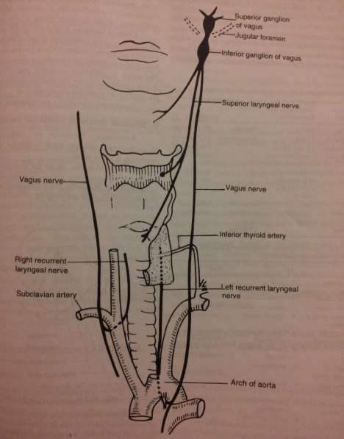
SUPERIOR LARYNGEAL NERVE
It arises from Inferior Ganglion of the Vagus nerve, descends behind Internal Carotid artery & at the level of Greater cornu of Hyoid bone, divides into External & Internal branches.
The external branch supplies cricothyroid muscle while the internal branch pierces the thyrohyoid membrane & supplies sensory innervation to the larynx & hypopharynx.

Slide 24
FUNCTIONS OF VOCAL CORDS
Vocal cord mainly has the following movements :
Adduction : approximation of vocal cord with each other.
Abduction : movement of vocal cord away from each other.

Slide 25
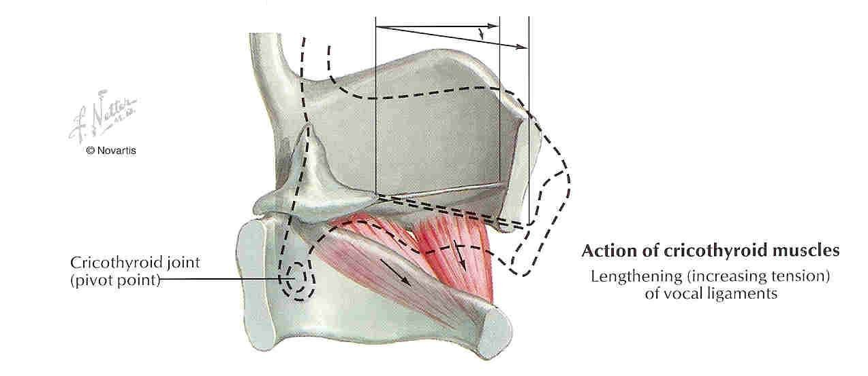
ADDUCTION OF VOCAL CORDS

Slide 26
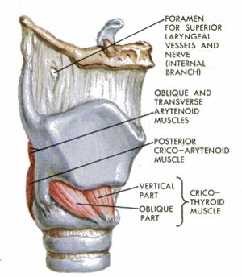
All muscles of the larynx are innervated by the recurrent laryngeal nerve, except cricothyroid muscle which is innervated by the external branch of the superior laryngeal nerve.

Slide 27
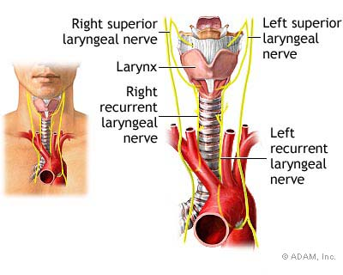

Slide 28
  Blood Supply
  External carotid artery
  Subclavian artery
  Venous Drainage
  Internal jugular vein
  Innominate vein
  Lymphatic drainage
  Main: Deep Cervical group L.N.
  The glottic area has NO lymphatic network.

Slide 29
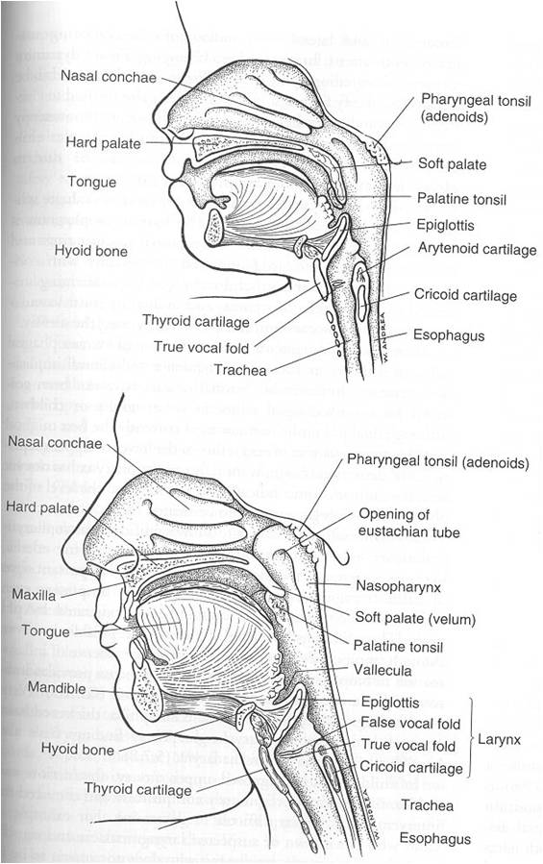
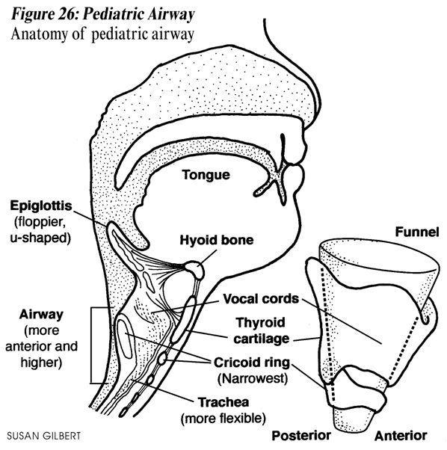
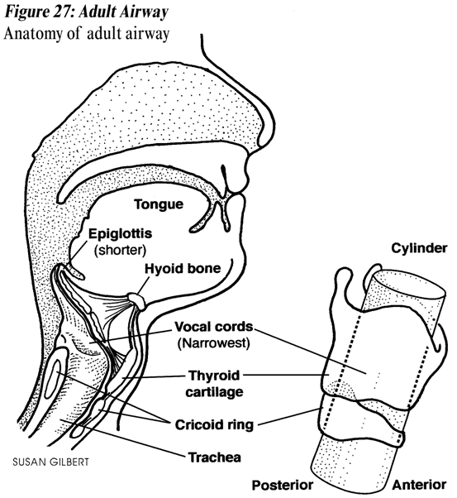
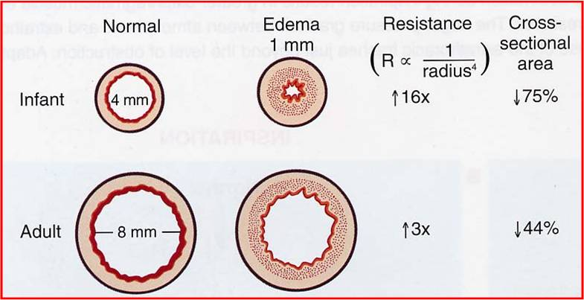
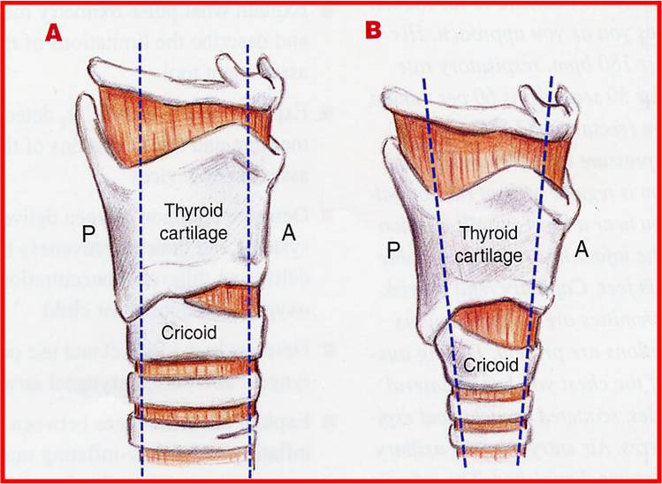
Paediatric larynx
It is positioned high in the neck opposite C3 or C4 (level of vocal cord) at rest and reaches C1 or C2 during swallowing.
The laryngeal cartilage are soft and collapse easily.
The thyroid cartilage in an infant is flat and the cricothyroid and thyrohyoid spaces are narrow.
It is small and conical in shape ( while it is cylindrical in adult).
Submucosal tissues of infant's larynx are loose and easily undergo oedematous changes with trauma or inflammation leading to obstruction.

Slide 30
Physiology

Slide 31
Three important functions
The larynx serves three important functions in humans. In order of functional priority, they are protective, respiratory, and phonatory.
In humans the protective and respiratory functions are compromised in favor of its phonatory function.
The protective function is entirely reflexive and involuntary, whereas the respiratory and phonatory functions are initiated voluntarily but regulated involuntarily.

Slide 32
Phonation
It is generally agreed that speech results from the production of a fundamental tone produced at the larynx and is modified by resonating chambers of the upper aerodigestive tract.
Intelligible speech, therefore, represents the combined effect of the larynx, tongue, palate, and related structures of the oral vestibule
The consonants of speech can be associated with particular anatomical sites responsible for their generation i.e. 'p' and 'b' are labials, 't' and 'd' are dentals and 'm' and 'n' are nasals.

Slide 33
The production of the fundamental tone is due to the vibration of the vocal folds against each other, generated by the passage of air between them. Vocal cord vibrations may be a passive phenomenon representing the basis of the aerodynamic theory of sound generation.
Such a theory finds support in the observation that the completely paralyzed larynx is capable of producing sound, as is the cadaver larynx when subglottic pressure is forcefully increased..

Slide 34
The aerodynamic theory of sound production therefore replaces the neurochronaxic theory which incorrectly advanced the notion that the central generation of recurrent laryngeal nerve impulses produced cord vibrations by active contraction of the thyroarytenoid muscles. Each vibration, therefore, represented the result of beat-by-beat impulses through the recurrent laryngeal nerve.

Slide 35

The cricothyroid muscle increases fundamental frequency by tensing the vocal fold. The vocal fold is stretched, elongated, thinned, and slightly adducted to the paramedian position as the vocal fold is lowered within the larynx. These changes reduce the cross-sectional area of the vocal fold, reducing vibratory mass and increasing fundamental frequency.

Slide 36
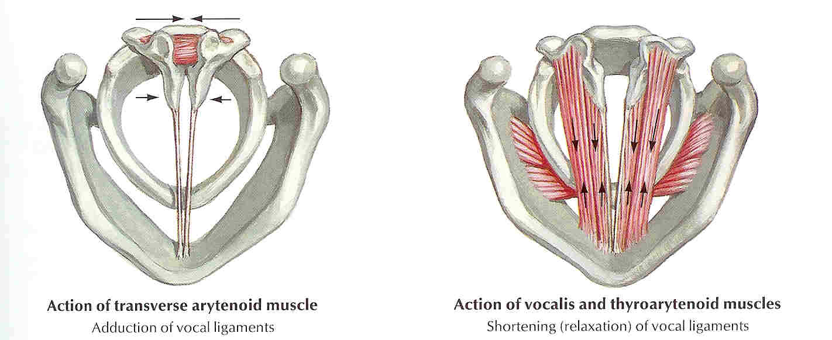
Vocalis muscle (Voc), on the other hand, generates the opposite effect as it loosens and thickens the vocal fold. In addition, as it increases glottal resistance, it contributes to vocal intensity as subglottal pressure is increased.
Vocal control, therefore, is achieved by the coordinated efforts of respiratory, laryngeal, and articulatory muscles capable of producing great variations of tonal qualities characterizing the human voice.

Slide 37
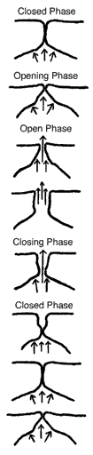
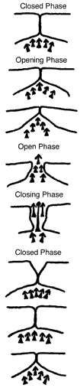
The Glottic Cycle
The vocal folds alternately trap and release air; each trap/release is one cycle of vibration. This cycle is often referred to as the glottic cycle, and it is divided into phases: opening phase, open phase, closing phase, closed phase
During the closed phase, the air pressure builds up below the vocal folds. When the glottis opens, the air explodes through the vocal folds, and that's the beginning of the sound wave. The strength of that explosion determines the loudness of the sound coming directly from the larynx.

Slide 38
First, the laryngeal muscles position the vocal cords in various degrees of adduction and place them under the appropriate longitudinal tension.
Next, muscular and passive forces of exhalation cause the subglottic air pressure to increase.
When this subglottic pressure reaches a point where it exceeds muscular opposition, the glottic chink is forced to open.
When the vocal cords start opening from complete closure, they open in a posterior to anterior direction with the posterior portion of the glottis opening first, reaching maximum excursion first, and recontacting each other at the end of the vibratory cycle prior to the anterior portion of the cords.

Slide 39
After release of the puff of air there is a reduction of subglottic pressure, and the vocal cords approximate each other again (myoelastic forces of the vocal cords have exceeded the aerodynamic forces).
The myoelastic forces are enhanced because air current flowing through a narrow channel exerts a negative pressure on the channel walls; This is the basis of Bernouilli's Principle.
The vocal cords are thus sucked back together in an adducted state until the subglottic air pressure can overcome the myoelastic forces of the reapproximated cords, and the cycle is then repeated.

Slide 40
Pitch
The faster the vocal folds vibrate, the higher the pitch.
In general, men's vocal folds can vibrate from 90 - 500 Hz, and they average about 115 Hz in conversation.
Women's vocal folds can vibrate from 150 -1000 Hz, and they average about 200 Hz in conversation.
Vocal folds vibrate faster as they're pulled longer, thinner, and more taut and vibrate more slowly when they're shorter, thicker, and floppier.
The cricothyroid muscle and thyroarytenoid muscle coordinate with each other to create different pitches

Slide 41
Vocal cord palsy

Slide 42
CLASSIFICATION OF LARYNGEAL PARALYSIS
Laryngeal paralysis can be :
Unilateral or Bilateral & may involve –
Recurrent laryngeal nerve
Superior laryngeal nerve
Both (Combined / Complete)

Slide 43
CAUSES OF LARYNGEAL PARALYSIS
In topographical manner they are :
Supranuclear : Rare
Nuclear : Vascular disease, Neoplastic disease, Motor neuron disease, Polio & Syringobulbia
High vagal lesions : Post. fossa tumors, Tubercular meningitis, Fracture of skull base, Nasopharyngeal cancer, Glomus tumor, Penetrating injury of neck, Parapharyngeal tumors, Metastatic neck nodes, Lymphoma
Low vagal or recurrent laryngeal nerve
Systemic causes : Diabetes, Syphilis, Diptheria, Typhoid, Viral infections, Lead poisoning
Idiopathic

Slide 44
INTRODUCTION
Vocal cord Paralysis : defined as total interruption of nerve impulse resulting in no movement of laryngeal muscles.
Vocal cord Paresis : defined as partial interruption of nerve impulse resulting in weak or abnormal movement of laryngeal muscles.

Slide 45
Vocal cord paresis/paralysis can occur at any age
or sex.
Effect of VC paralysis may vary & depends on the
patient’s use of his or her voice.
A mild vocal cord paresis can be the end to a singer's career but it have only marginal effect on any other professional career life.
Vocal cord Paralysis is a sign of a disease & not a diagnosis by itself.

Slide 46
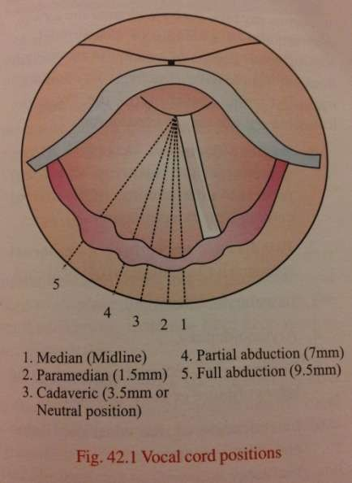
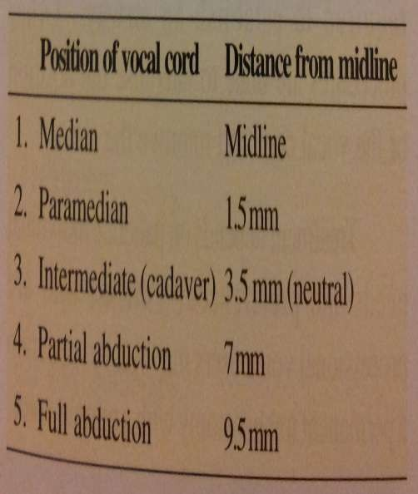
VOCAL CORD POSITIONS

Slide 47
THEORIES ON POSITION OF VOCAL CORD IN VOCAL CORD PARALYSIS
SEMON’S LAW : states that, in all progressive organic lesions, abductor fibres of the nerve which are phylogenitically newer are more susceptible & thus the first to be paralysed as compared to adductor fibres
WAGNER & GROSSMAN HYPOTHESIS : is the most widely accepted theory. It states that complete paralysis of the recurrent laryngeal nerve results in the vocal cord being in paramedian because of an intact cricothyroid muscle, which adducts the vocal cord. When the Superior laryngeal nerve is also paralysed, the vocal cord will be in intermediate or cadaveric position because of loss of this adductive force.

Slide 48
RECURRENT LARYNGEAL NERVE PARALYSIS
(A) UNILATERAL • Clinical features :
Asymptomatic
Change in voice
Unilateral injury to recurrent laryngeal nerve results in ipsilateral paralysis of all the intrinsic muscles of larynx ecxept the cricothyroid.
The voice in unilateral paralysis gradually improves due to compensation by healthy cord which crosses midline to meet paralysed one.
Treatment : Generally no
treatment is required.
The vocal cords thus assumes a median or paramedian position & doesn’t move laterally on deep inspiration.

Slide 49
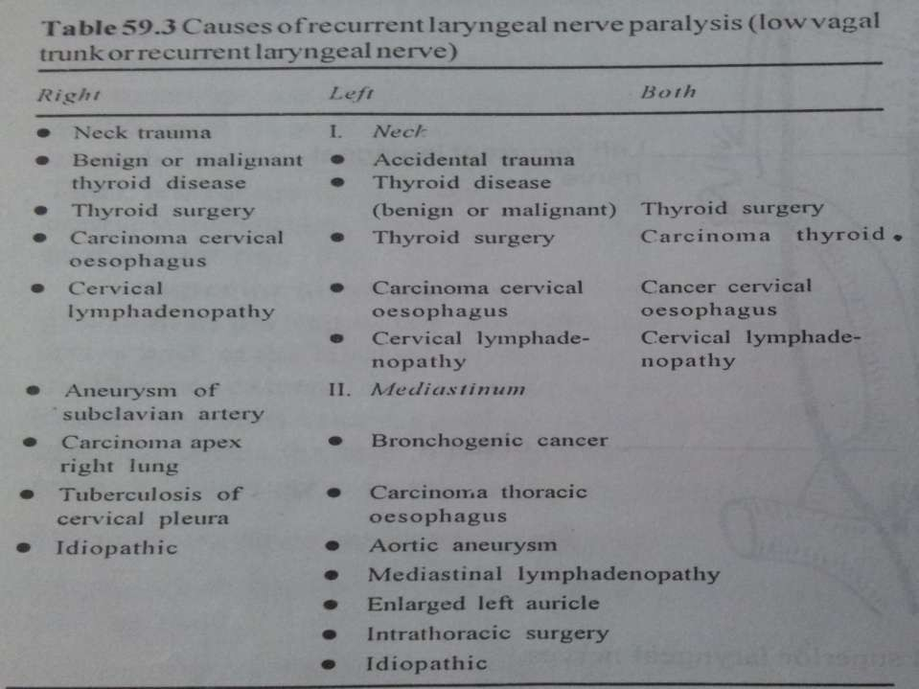

Slide 50
(B) BILATERAL (B/L Abductor paralysis) :
Position of vocal cords : All the intrinsic muscles of larynx are paralysed, vocal cords lie in median or paramedian position due to unopposed action of cricothyroid muscles.
Clinical features :
  Dyspnoea
  Stridor

Slide 51
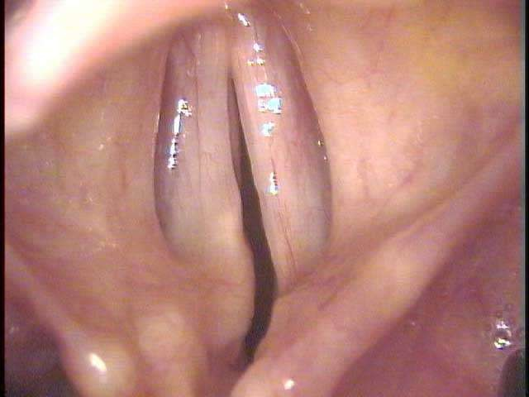
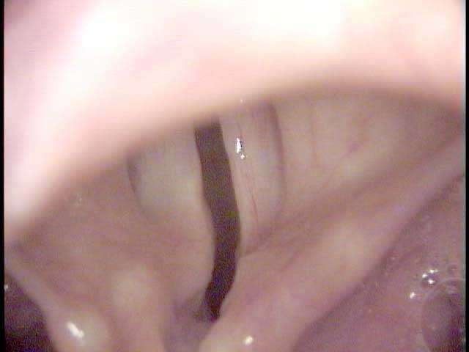
Movement of Vocal cord during
inspiration & expiration

Slide 52
Treatment :
Usually 6 months is an adequate time to wait for any spontaneous recovery.
In acute stridor, Tracheostomy may be required.
- If patient doesn’t want tracheostomy following option can be considered :
Lateralisation of the vocal cord: Aim is to move & fix the cord in a lateral
position to improve the airway. The various procedures are:
Arytenoidectomy
Vocal cord lateralisation through endoscope.
Thyroplasty type II
Cordectomy
Nerve muscle implant

Slide 53
PARALYSIS OF SUPERIOR LARYNGEAL NERVE
(A) UNILATERAL
Paralysis of cricothyroid muscle & ipsilateral anaesthesia of the larynx above the vocal cord.
(B) BILATERAL
An uncommon condition. Both the cricothyriod muscles are paralysed along with anaesthesia of upper larynx.
Causes:
Surgical or accidental trauma
Diptheria
Cervical lymphadenopathy
Neoplastic disease
Clinical features:
Both V.C. paralysis
Anaesthesia of larynx
Cough
Chocking fits
Weak & husky voice
Treatment:
Tracheostomy with a cuffed tube & an
oesophageal feeeding tube.
Epiglottopexy is an operation to close the laryngeal inlet to protect the lungs from repeated aspiration. It is a reversible precedure.
•
•
Causes :
Thyroid surgery
Thyroid Tumors
Diptheria.
Clinical features :
Weak voice with decreased pitch
Anaesthesia of the larynx on one side
Occassional aspiration.
Laryngeal findings include :
Askew position of glottis - Ant. Comissure is rotated to healthy side.
Shortening of V.C. with loss of tension & V.C.
appears wavy
Flapping of the paralysed vocal cord – V.C. sags down during inspiration & bulges up during expiration.

Slide 54
COMBINED/COMPLETE VOCAL CORD PARALYSIS
(Recurrent & Superior Laryngeal Nerve Paralysis)
(A) UNILATERAL :
Paralysis of all the muscles of the larynx on one side except
interarytenoid which also receives innervation from opposite side.
Aetiology :
Thyroid surgery
Lesions of nucleus ambigus which may lie medulla, post. cranial fossa, jugular foramen or parapharyngeal space.
Clinical features :
All the muscles of larynx on one side are paralysed
V.C. lie in cadeveric position ie. 3.5mm from the midline
Glottic incompetence results in hoarseness of voice & aspiration of
liquids

Slide 55
Treatment:
Speech therapy
Procedures to medialise the cord- Aim is to bring the paralysed vocal cord towards the midline so that healthy cord can meet it. This is achieved by :
Injection of teflon paste
Muscle or cartilage implant
Arthrodesis of cricoarytenoid joint
Thyroplasty type I

Slide 56
(B) Bilateral:
Both recurrent & superior laryngeal nerves on both sides are paralysed.
Rare condition.
Both cords lie in cadaveric position.
Total anaesthesia of the larynx.
Clinical features :
-Aphonia: As V.C. cords doesn’t meet at all.
-Aspiration: due to incompetent glottis & laryngeal anaesthesia.
-Inability to cough: due to inability of V.C. to meet which results in retention of secretions in the chest.
-Bronchopneumonia- due to repeated aspirations & retention of secretions.

Slide 57
Treatment
Tracheostomy
Epiglottopexy
Vocal cord plication
Total laryngectomy

Slide 58
CONGENITAL VOCAL CORD PARALYSIS
UNILATERAL
More common
Causes :
Birth trauma
Congenital anomaly of great vessels or heart
BILATERAL
Causes :
Hydrocephalus
Arnold-Chiari malformation
Intracerebral haemorrhage
Meningocele
Cerebral agenesis
Clinical features :
Dyspnoea
Stridor

Slide 59
EVALUATION OF VOCAL CORD PARALYSIS PATIENT
History
Local Examination :
Symptoms: |  | (a) | Examination of larynx & laryngopharynx – IDL, FOL
(a) | Change in voice
(b) | Hoarseness | (b) | Neck examination
(c) | Aphonia
(d) | Vocal fatigue | (c) | Cranial nerve examination
(e) | Neck pain
(f) | Aspiration | • | Investigations :
(g) | Cough
• | Past Medical & Surgical History : | - | Nasopharyngolaryngoscopy
• | Social History : | - | Videostroboscopy
• | General Examination : | - | Chest X-ray PA view
 |  | - | C.T. with contrast- may evaluate the entire course of recurrent laryngeal nerve
 |  | - | MRI

