Slide 1
NASAL POLYPOSIS
DR GAURAV

Slide 2
Nasal polyps are polypoidal masses arising mainly from the oedematous mucous membranes of the nose and paranasal sinuses.
freely movable and nontender.
frequently accompany allergic rhinitis.

Slide 3
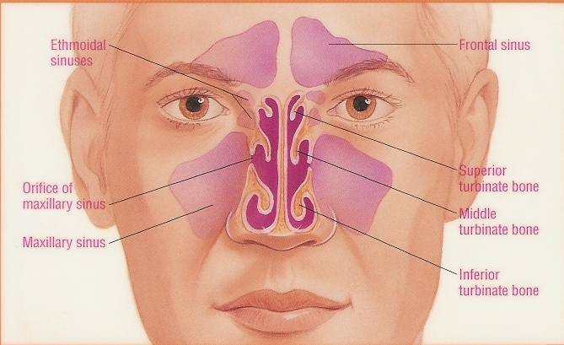

Slide 4
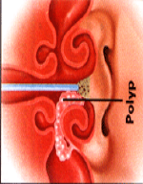
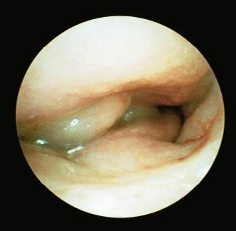

Slide 5
Types
Antrochoanal
Single, Unilateral
maxillary sinus.
Children
Trifiliate
Inflamation
Grows posteriorly
Ethmoidal
Bilateral
Mulptiple
adults
Grapes like
Allergic
Grows anteriorly
Recurrence high

Slide 6
Pathophysiology
Unknown
Chronic inflammation
Autonomic nervous system dysfunction
Genetic predisposition
Allergic verses non-allergic

Slide 7
Associated with allergic conditions
20-50% have asthma
Allergic rhinitis
8-26% have aspirin intolerance
50% have alcohol intolerance
Non allergic conditions
Cystic Fibrosis 6-48% have polyps
Young syndrome
Churg-Strauss syndrome

Slide 8
Various theories
Burnulli theory
Vasomotor theory
Epithelia rupture theory

Slide 9
Causes
Chronic rhinosinusitis
Hay fever (allergic rhinitis)
Asthma
Aspirin intolerance
Cystic fibrosis
Kartagener's syndrome
Young's syndrome
Churg-strauss syndrome
Exposure to some forms of chromium
salicylate sensitivity

Slide 10
SYMPTOMS
  Asymptomatic
  Airway obstruction
  Postnasal drip
  Dull headaches
  Runny nose
  Headaches or pain (sinus infection)
  Snoring
  Rhinorhoea
  Hyposmia / Anosmia
  Epistaxis (often other lesion)
  Obstructive sleep apnoea
  Craniofacial abnormalities
  Optic nerve compression

Slide 11
Signs
Examining the nose shows a smooth, lobulated, whitish gray coloured single or grape-like mass in the nasal cavity.

Slide 12
Differential
  Encephalocoeles
  Gliomas
  Dermoid tumours
  Haemangiomas
  Papillomas / transitional cell papillomas
  Nasopharyngeal angiofibromas
  Rhabdomyosarcomas
  Lymphomas
  Neuroblastomas
  Sarcomas
  Chordomas
  Nasopharyngeal carcinomas

Slide 13
Investigations
Nasendoscopy
RAST / skin testing
Nasal smear
  Microbiology
  Eosinophils (allergic component)
  Neutrophils (chronic sinusitis)
Coronal CT scan
MRI scan

Slide 14
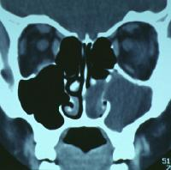
CT scan
Coronal CT scan through anterior sinuses. Opacification of left maxillary sinus, opacification of inferior half of nasal cavity. Due to antro coanal polyp.

Slide 15
complications of nasal polyps
Chronic or frequent sinus infections
Obstructive sleep apnea
The structure of the face may be altered, leading to double vision. Sometimes the eyes may be set wider apart than normal (more common in patients with cystic fibrosis).

Slide 16
Treatment
Medical Mx
Surgical Mx

Slide 17
Medical Mx
Nasal steroid sprays - safe for adults and children.
Corticosteroid pills along with nasal spray improve symptoms.
Antihistamines,
Antibiotics - if bacterial sinus infection.
Antileukotriene Medications -high levels of leukotrienes, so it help to reduce symptoms of chronic sinus disease and polyp formation.
Nasal Saline Irrigation

Slide 18
Surgical Mx
Traditional polypectomy
Endoscopic sinus surgery
Cad-well luc sx
Microdebrider

Slide 19
Recurrence
  Multiple small polyps common
  Large and antro-coanal less

Slide 20
Thank you

