Slide 1
RHINOSINUSITIS
BY DR GAURAV

Slide 2

RHINOSINUSITIS
Rhinosinusitis is a group of disorders characterized by inflammation of the mucosa of the nose and paranasal sinuses. [****/**/*]

Slide 3
Classification of rhinosinusitis.
Acute (ARS)
Sub acute
Recurrent acute
Chronic (CRS)
Acute exacerbation of chronic
7 days to less than 4 weeks
4-12 weeks
4 episodes of ARS per year
>12 weeks
Sudden worsening of CRS with return to baseline after
Notes:
Acc to time frame.by rhinosinusitis task force of the american acedemy of otorhinolaryngology

Slide 4
Rhinosinusitis symptoms/signs (requires two major factors, or one major and two minor).
Major symptoms
Minor symptoms
Facial pain/pressure
Facial congestion/fullness
Nasal obstruction/blockage
Nasaldischarge/purulence/discoloured posterior drainage
Hyposmia/anosmia
Purulence on nasal examination
Fever (acute RS only)
Headache
Fever (nonacute)
Halitosis
Fatigue
Dental pain
Cough
Ear pain/pressure/ fullness

Slide 5
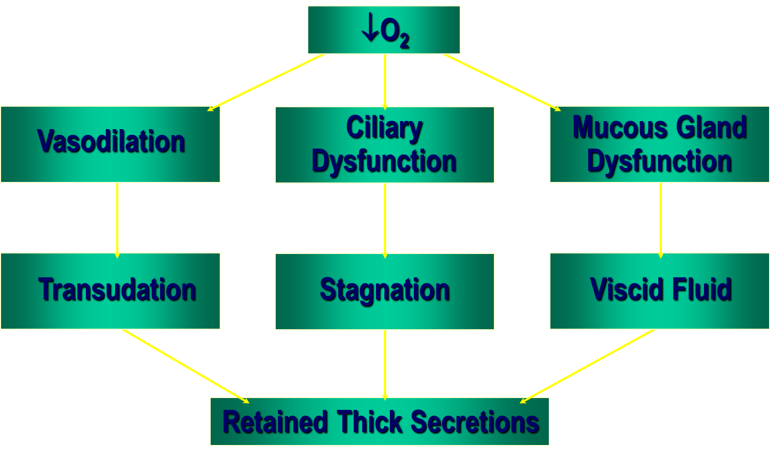
Pathophysiology
An inflammatory response is an expected sequela of an infectious process.
Inflammation in the nose and sinuses from a variety of causes can result in sinus ostia obstruction and predispose to the development of an infection

Slide 6
Factors
Genetic factors - immotile cilia syndrome or cystic fibrosis.
Anatomic abnormalities such as a concha bullosa, septal spur or paradoxical turbinate.
Allergic or immune disorders.
Environ­mental factors: bacterial, viral, or fungal infections.
Primary or secondary tobacco smoke exposure
Chronic or acute irritants or noxious chemicals;
Iatrogenic factors including surgery, med­ications, nasal packing or nasogastric tube placement.

Slide 7
Histology
Acute rhinosinusitis—Predominance of neutrophils, Visible areas of necrosis, haemorrhage , ulcerations, necrosis.
Chronic rhinosinusitis—Proliferative process ,lymphocytes , plasma cells , eosinophils.

Slide 8
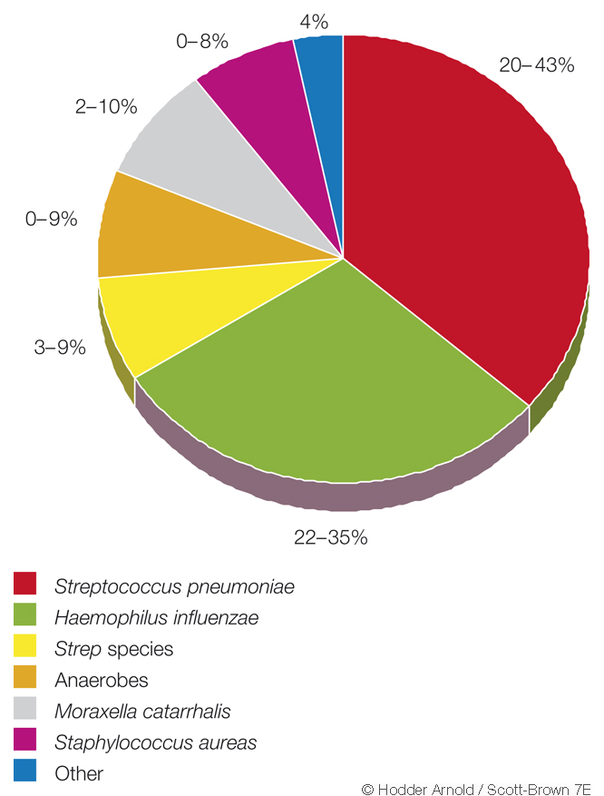
Microbiology of acute bacterial rhinosinusitis in adults.

Slide 9
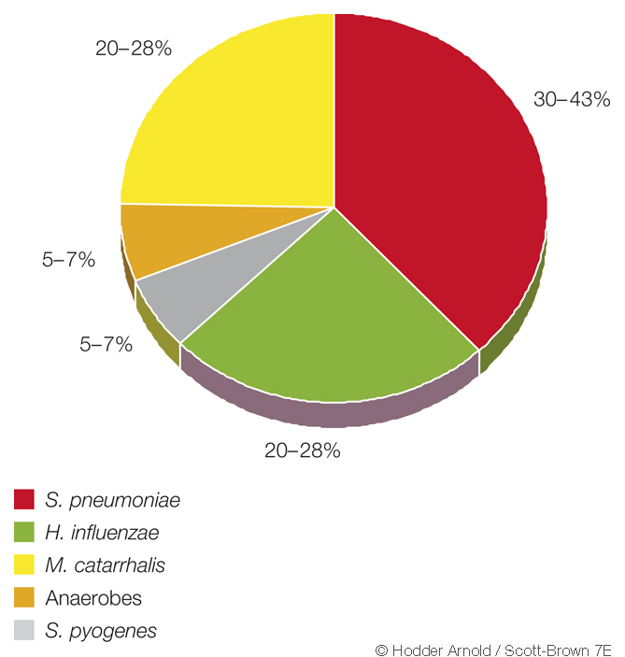
Microbiology of acute bacterial rhinosinusitis in children

Slide 10
Resistance
Mechanism—
Antibiotic deactivating enzymes
Alteration in target site of enzymes
Changes in influx/efflux processes
Formation of Biofilms (Bacterial colonies)

Slide 11
Diagnosis
There are many possible methods to make a diagnosis of rhinosinusitis, but there is much debate related to the best method. [****/***]
History
General ENT examination
Endoscopy
Allergy tests
Nasal swabs
Radiology
Nasal biopsy for histology Mucociliary function
Notes:
1*10⁴ colony forming units/ml in sinus aspirate

Slide 12
NATURAL HISTORY
ABRS – self limiting disease.
Antibiotics play an important role in treatment.
They reduce symptoms & speed the recovery
The natural history of CRS is much more variable and is dependent on a number of factors including those of both the host and external factors. [**** /** /*]

Slide 13
Glicklich et al shown that rhino sinusitis has a significant impact that are comparable to chronic debiliating diseases & congestive cardiac failure.
RSDI-Validated Instrument in measurement of physical ,functional & emotional impact of rhinosinusitis on quality of life.

