Slide 1

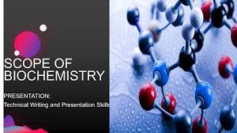
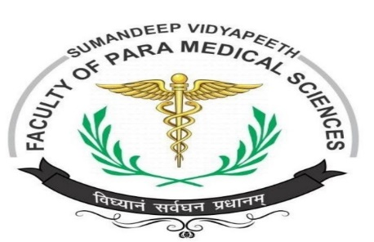

Scope and Importance of Biochemistry
Dr. Navneet Kumar Singh
Associate professor
Department of Paramedical, Sumandeep Vidyapeeth

Slide 2
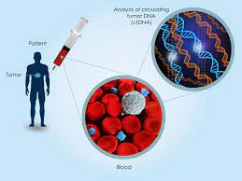
Biochemistry
Biochemistry has become the foundation for understanding all biological
processes.
It has provided explanations for the causes of many diseases in humans,
animals and plants
2

Slide 3
What is Biochemistry ?
Biochemistry is the application of chemistry to the study of biological processes at the cellular and molecular level.
It emerged as a distinct discipline around the beginning of the 20th century when scientists combined chemistry, physiology and biology to investigate the chemistry of living systems by:
  Studying the structure and behavior of the complex molecules found in biological material and
  the ways these molecules interact to form cells, tissues and whole organism
3
Notes:
3
Biochemistry has become the foundation for understanding all biological processes. It has provided explanations for the causes of many diseases in humans, animals and plants."

Slide 4
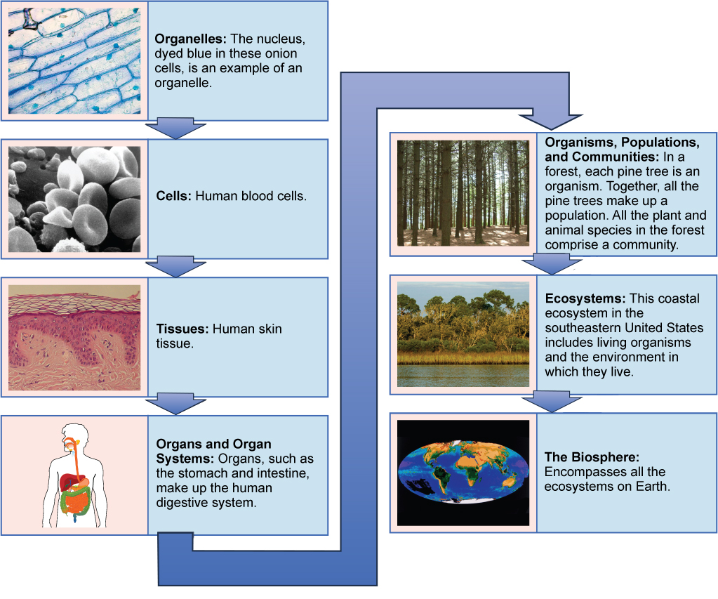

Slide 5
Biochemistry
Aim: to describe and explain, in molecular terms, all chemical processes of living cells
  Structure-function
  Metabolism and Regulation
  How life began

Slide 6
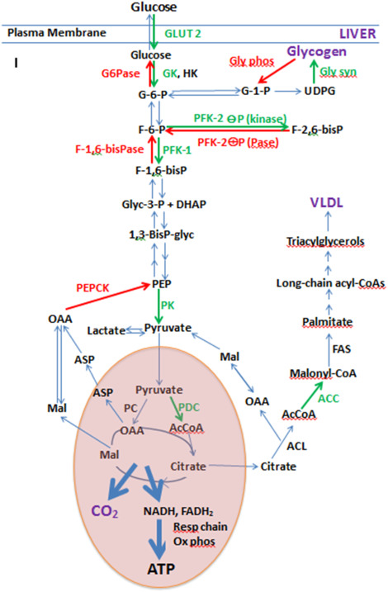


Slide 7
Biochemistry
Significance: be essential to all life sciences as the common knowledge
  Genetics; Cell biology; Molecular biology
  Physiology and Immunology
  Pharmacology and Pharmacy
  Toxicology; Pathology; Microbiology

Slide 8
Biochemistry
  Medical/Healthcare students who acquire a sound knowledge of biochemistry will be in a strong position to deal with two central concerns of the health sciences:
  (1) the understanding and maintenance of health
  (2) the understanding and effective treatment of disease
    Causes of cancers, etc
    Molecular lesions causing various genetic diseases
    Rational design of new drugs

Slide 9
Principles of Biochemistry
Cells (basic structural units of living organisms) are highly organized and constant source of energy is required to maintain the ordered state.
Living processes contain thousands of chemical pathways. Precise regulation and integration of these pathways are required to maintain life
Certain important pathways e.g. Glycolysis is found in almost all organisms.
All organisms use the same type of molecules: carbohydrates, proteins, lipids & nucleic acids.
Instructions for growth, reproduction and developments for each organism is encoded in their DNA
9

Slide 10
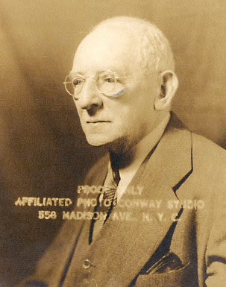
History and development of Biochemistry
1903, Neuberg (German): “Biochemistry”
“Chemistry of Life”

Slide 11
Two notable breakthroughs
(1) Discovery of the role of enzymes as catalysts
(2) Identification of nucleic acids as information molecules
Flow of information: from nucleic acids to proteins
DNA RNA Protein

Slide 12
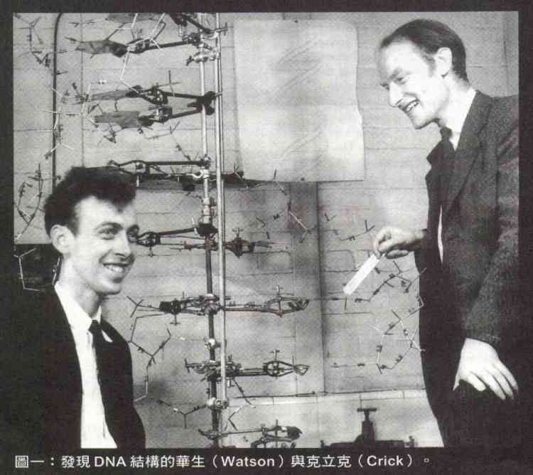
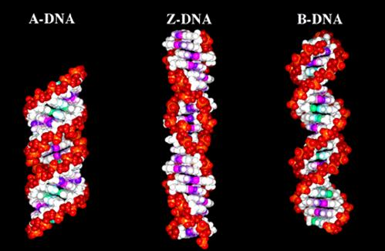
Some historic events
In 1937， Krebs for the discovery of the Citric Acid Cycle-won the Nobel Prize in Physiology or Medicine in 1953
In 1953，Watson & Crick for the discovery of the “DNA Double Helix” -won the Nobel Prize in Physiology or Medicine in 1962

Slide 13
In 1955，Sanger for the determination of insulin sequence- won the Nobel Prize in Physiology or Medicine in 1956
In 1980， Sanger & Gilbert for Sequencing of DNA-won the Nobel Prize in Chemistry in 1980
In 1993, Kary B. Mullis for invention of PCR method -won the Nobel Prize in Chemistry in 1993

Slide 14
Organization of Life
elements
simple organic compounds (monomers)
macromolecules (polymers)
supramolecular structures
organelles
cells
tissues
organisms
Notes:
14

Slide 15
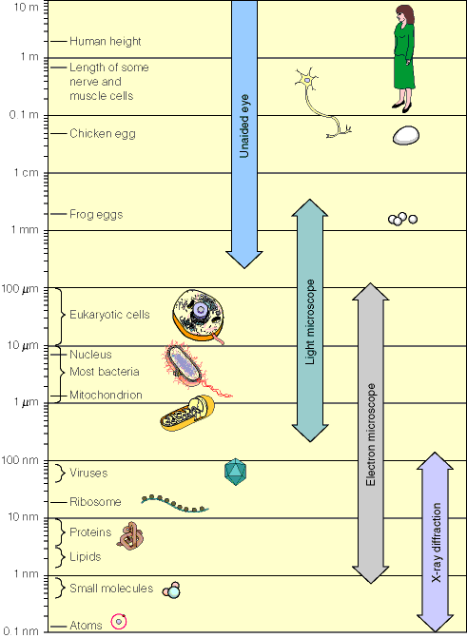
Range of the sizes of objects studies by Biochemist and Biologist
1 angstrom = 0.1 nm
Notes:
15

Slide 16
What dose the Biochemistry discuss?
DNA RNA Protein
structure and function of cellular components
  proteins, carbohydrates, lipids, nucleic acids and other biomolecules
Metabolism and Regulation
Gene expression and modulation

Slide 17
Monomers /Polymers/Macromolecule
Each of these types of molecules are polymers that are assembled from single units called monomers.
Each type of macromolecule is an assemblage of a different type of monomer.

Slide 18
Many Important Biomolecules are Polymers
lipids
proteins
carbo
nucleic acids
monomer
polymer
supramolecular
structure
Notes:
18

Slide 19
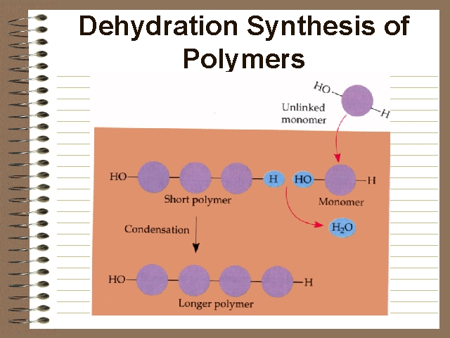
How do monomers form polymers?
In condensation reactions (also called dehydration synthesis), a molecule of water is removed from two monomers as they are connected together.

Slide 20
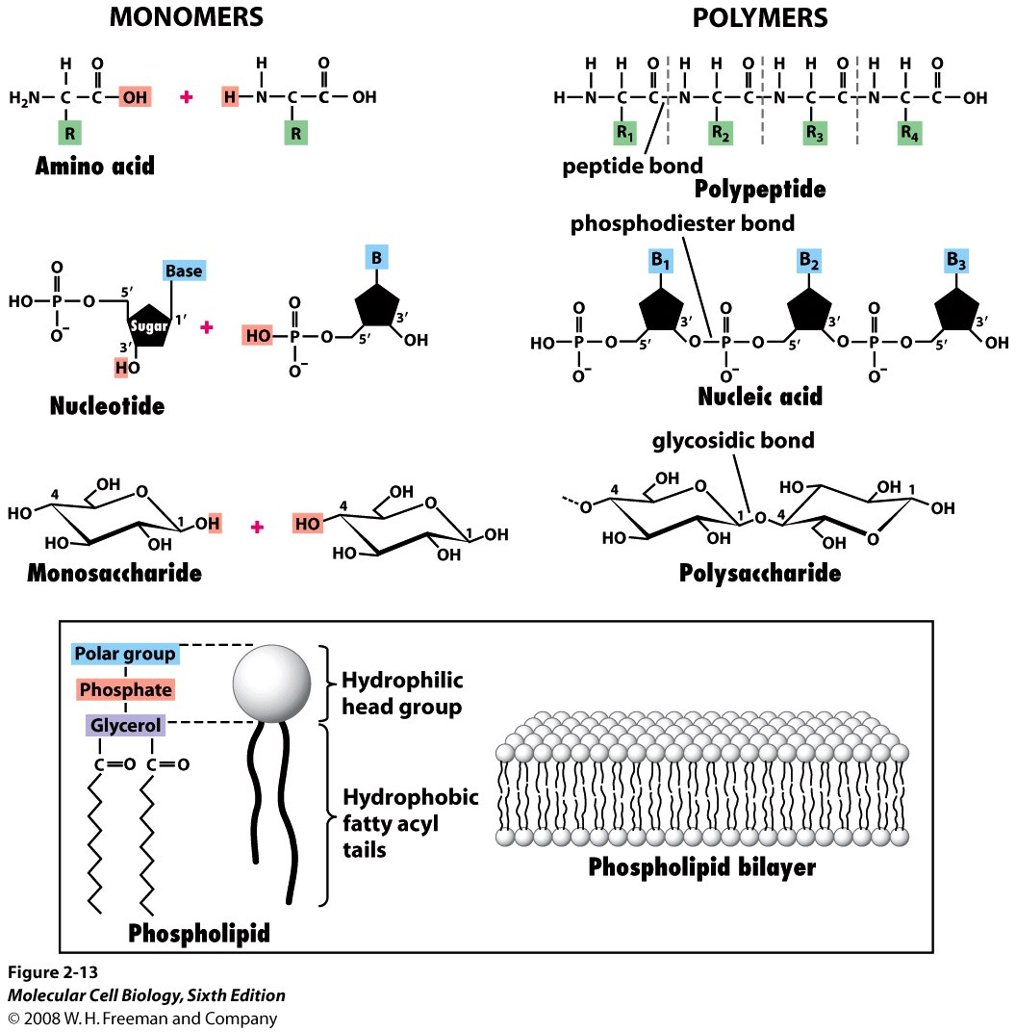
Notes:
20
20

Slide 21
Anabolic
Building block
  Simple sugar
  Amino acid
  Nucleotide
  Fatty acid
Macromolecule
  Polysaccharide
  Protein (peptide)
  RNA or DNA
  Lipid
Catabolic

