Slide 1


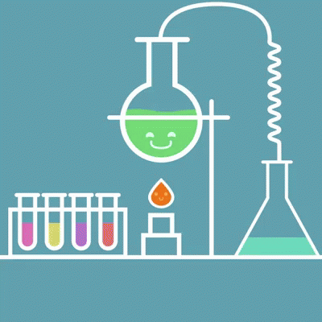
Laboratories
Dr. Navneet Kumar Singh
Associate professor
Department of Paramedical, Sumadeep Vidyapeeth

Slide 2
Outline of Presentation
Historical perspective
Definition
Components
Types of laboratories
Laboratory safety
Laboratory accreditation

Slide 3
Historical perspectives
Origin: Early 17th century: from medieval Latin laboratorium, from Latin laborare ‘to labour’.
Webster: Workroom of a chemist
Greek philosopher and scientist Pythagoras: The earliest laboratory according to the present evidence is a home laboratory of Pythagoras of Samos, the well-known.
This laboratory was created when conducted an experiment about tones of sound and vibration of string.
Refernce: Schummer, Joachim; Spector, Tami I (July 2007). "The Visual Image of Chemistry:
Perspectives from the History of Art and Science“. HYLE International Journal for Philosophy of
Chemistry (1): 3–41.

Slide 4
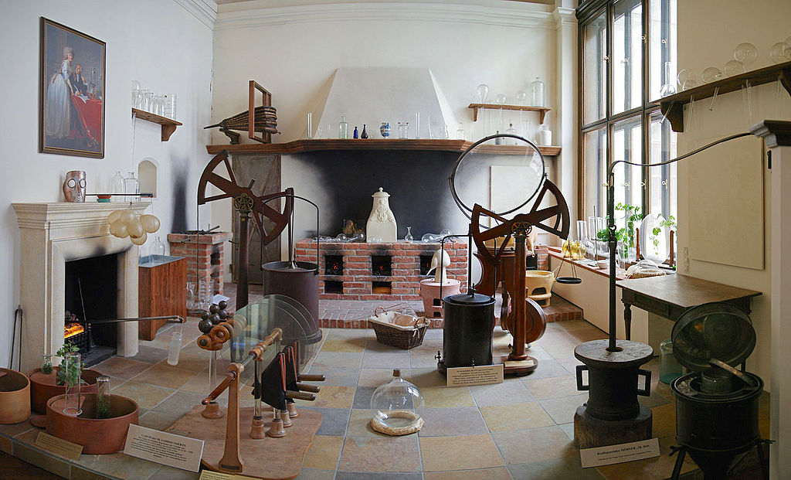
Laboratory of the 18th century, of the sort used by Antoine Lavoisier and his contemporaries
Reference: Chemielabor_des_18._Jahrhunderts,_Naturhistorisches_Museum_Wien.jpg

Slide 5
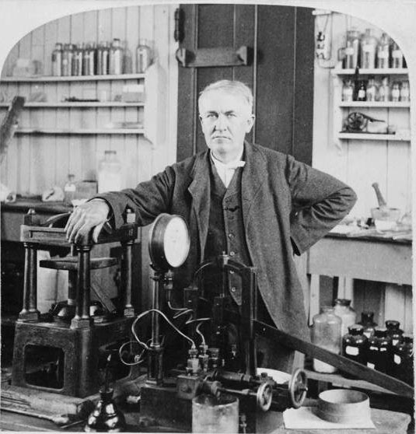
Definition of Laboratory
A laboratory is a facility that provides controlled
conditions in which scientific or technological
research, experiments, and measurement may be
performed.
A room or building equipped for scientific experiments, research, or teaching, or for the manufacture of drugs or chemicals.
By Oxford dictionaries

Slide 6
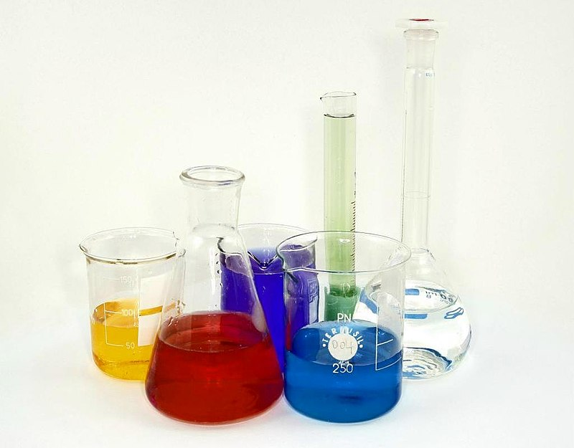
Laboratory components
Laboratory techniques are the set of procedures used on natural sciences such as chemistry, biology, physics to conduct an experiment, all of them follow the scientific method; while some of them involve the use of complex laboratory equipment from laboratory glassware to electrical devices, and others require more specific or expensive supplies.

Slide 7
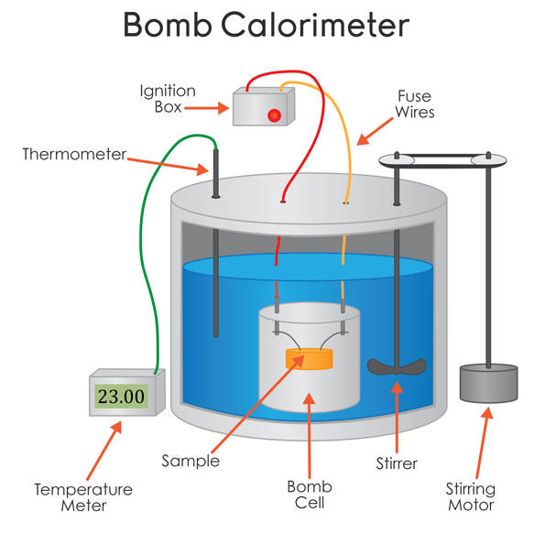
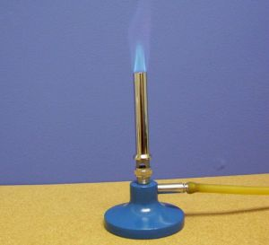
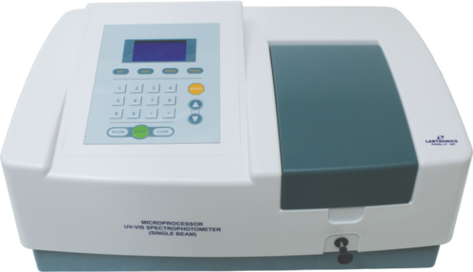
Laboratory: Equipment and supplies
The classical equipment includes tools such as Bunsen burners and microscopes as well as specialty equipment such as operant conditioning chambers, Spectrophotometer, calorimeter and many others…….

Slide 8
Equipments & Supplies
Laboratory glassware such as the beaker or reagent bottle
Analytical devices as HPLC or spectrophotometer
Molecular biology laboratories + Life science laboratories
Autoclave
Microscope
Centrifuge
Shaker & mixers
Pipette
Thermal cyclers
Photometer
Refrigerators and Freezers
Universal testing machine
ULT Freezer
Incubators
Bioreactor
Biological safety cabinet
Sequencing instruments
Fume hoods
Environmental chamber
Humidifier
Weighing scale
Reagents (supply)
Pipettes tips (supply)
Polymer (supply) consumables for small volumes (µL and mL scale), mainly sterile

Slide 9
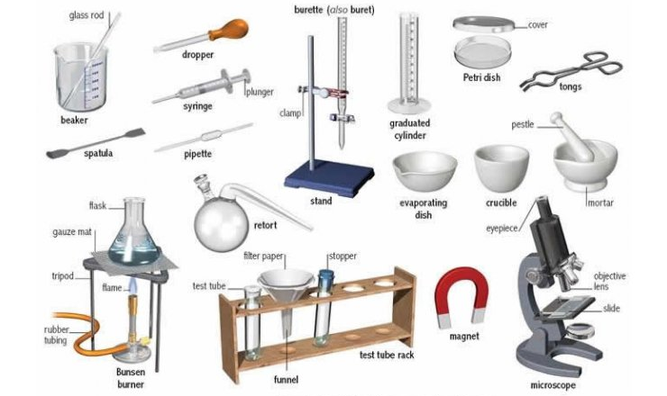
Laboratory Equipments

Slide 10
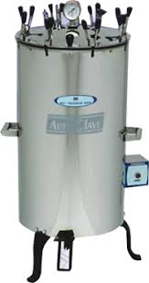
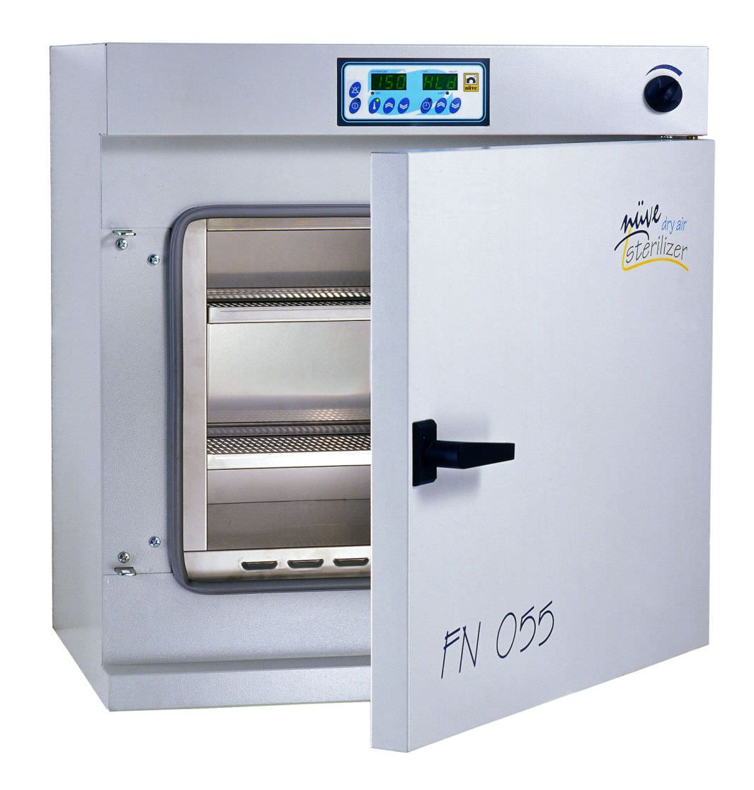

Slide 11
Different types of Laboratories
BIOCONTAINMENT LABORATORIES
ANIMAL LABORATORIES
WET LABORATORIES
Dry LABORATORIES

Slide 12
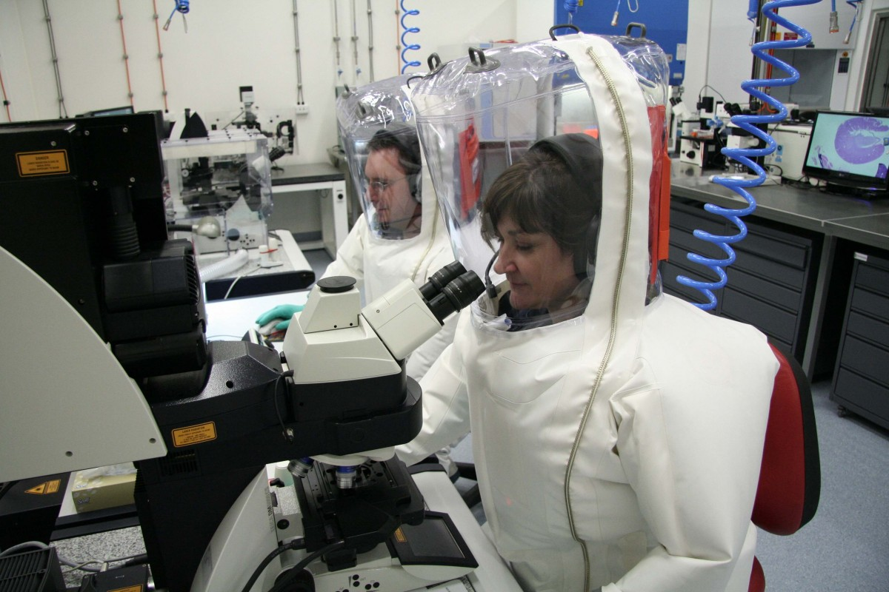
BIOCONTAINMENT LABORATORIES
The concept of biocontainment is related to laboratory biosafety and pertains to microbiology laboratories in which the physical containment of highly pathogenic organisms or agents is required, usually ...Pressurization Control
BSL-1 through 3
ABSL-1 through 3
Solvent Storage and Distribution
AIDS, HIV, TB, Anthrax, etc.
Biological Safety Cabinets
Fume Hoods (Chemical, Radioisotope)
Distillation

Slide 13
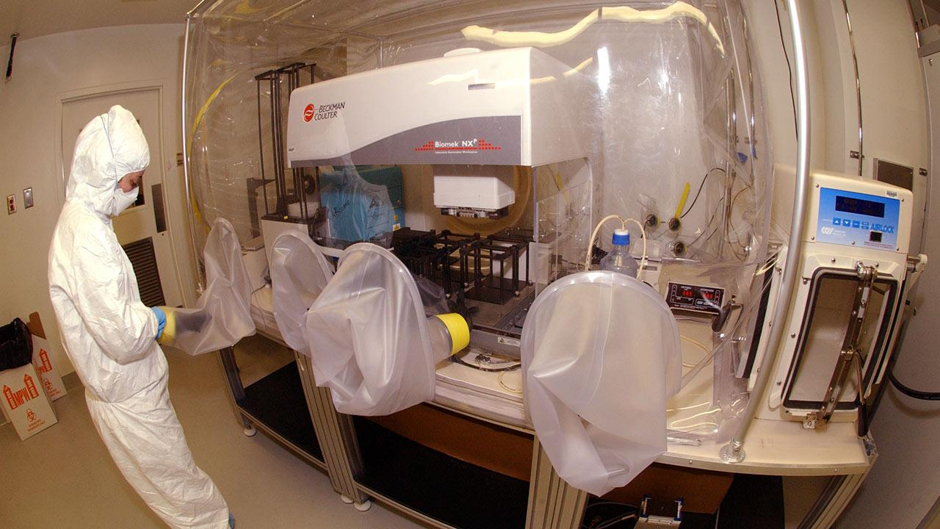
Highly sophisticated bio containment Laboratory

Slide 14
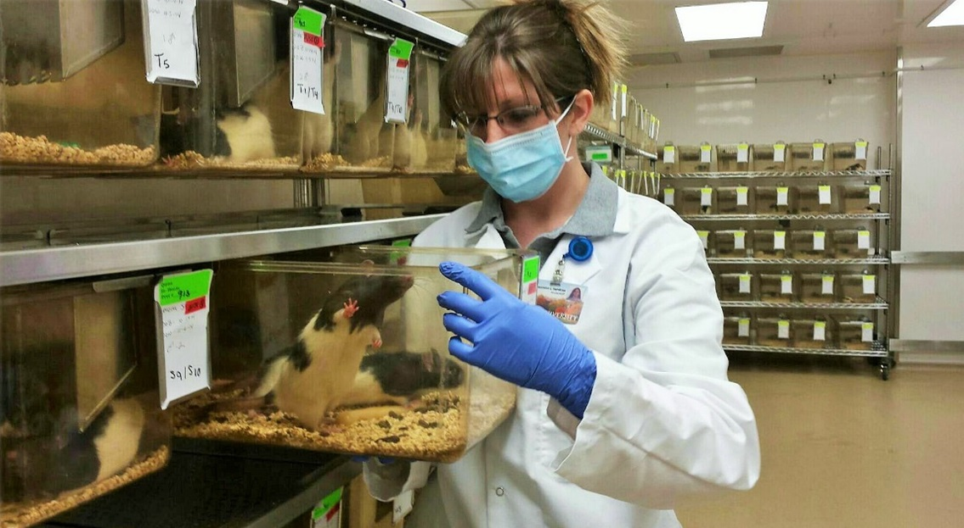
Animal LABORATORIES
Animal testing, also known as animal experimentation, animal research and in vivo testing, is the use of non-human animals in experiments that seek to control the variables that affect the behaviour or biological system under study.
ABSL-1 through 3
Non-Human Primates
Large Animal,Swine, Aquatic, Amphibian
Avian, Canine & Rodents
Biowaste Decontamination and Biokill
Pathological Incinerators and Tissue Digesters

Slide 15
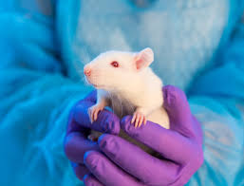
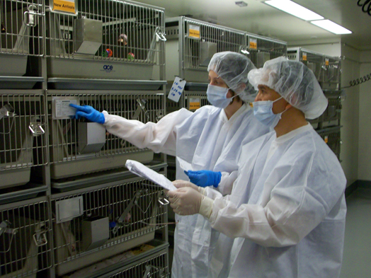
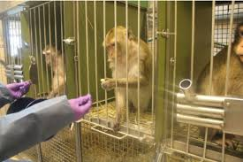
Animal laboratories

Slide 16
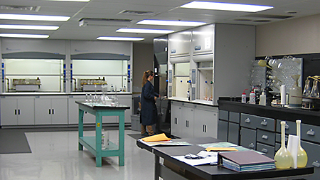
WET LABORATORIES
Wet Laboratory space types are defined as laboratories where chemicals, drugs, or other material or biological matter are tested and analyzed requiring water, direct ventilation, and specialized piped utilities.
Biochemistry/Pathology
Combinatorial Chemistry
Physical Chemistry
Organic Chemistry
Pharmacokinetics
Cell Biology
Molecular Biology

Slide 17
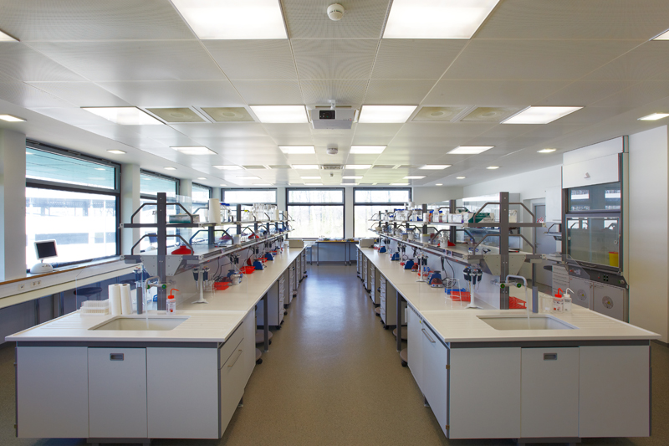
Ideal wet Laboratory of Chemistry

Slide 18
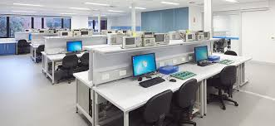
DRY LABORATORIES
A dry lab is a laboratory where computational or applied mathematical analyses are done on a computer-generated model to simulate a phenomenon in the physical realm.
Bioinformatics/Robotics
Electrophysiology/Biophysics
Electron Microscopy
Laser
Magnetic Resonance Imaging (MRI)
Nuclear Magnetic Resonance (NMR)
X-Ray Crystallography
Mass Spectrometer
HPLCs

Slide 19
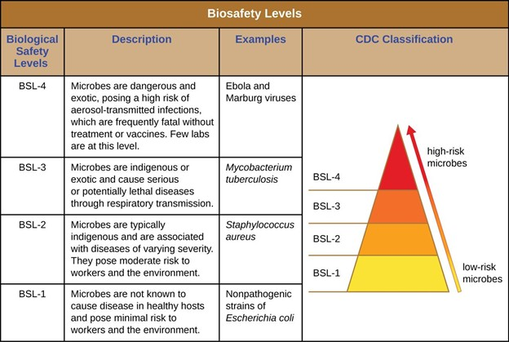
Laboratory and Bio
Safety

Slide 20
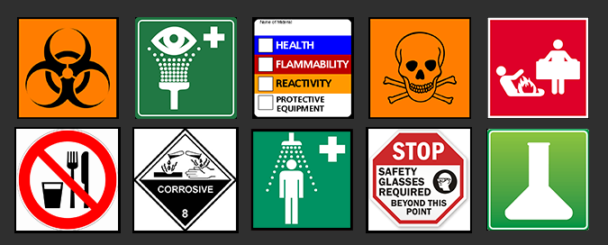
Laboratory safety signs

Slide 21
Laboratory accreditation
Laboratory accreditation is a means of determining the technical competence of laboratories to perform specific types of testing, measurement and calibration.
To maintain this recognition, laboratories are re-evaluated periodically by the accreditation body to ensure their continued compliance with requirements, and to check that their standard of operation is being maintained.

Slide 22
Laboratory accreditation
In short accreditation has worldwide acceptance. NABL is an autonomous body under the aegis of Department of Science & Technology, Government of India, and is registered under the Societies Act.
It is only one of its kinds that assess laboratories in India for quality and consistency in the results.

Slide 23
College of American Pathologist
The CAP Laboratory Accreditation Program is an internationally recognised program based on rigorous accreditation standards, covering a complete array of disciplines and testing procedures, whereby helps in achieving a consistently high level of service throughout the institution and the healthcare system.

Slide 24
Example of CAP accrediated laboratory
Kokilaben hospital, mumbai
Strand Life Sciences for Genomics and Personalized Medicine — the company's next-generation laboratory based in Bangalore, India — has received accreditation certificates from both the College of American Pathologists (CAP), and the National Accreditation Board for Testing & Calibration Laboratories (NABL).
Metropolis Pathology Laboratory

Slide 25

Thanks for your kind attention

