Slide 1


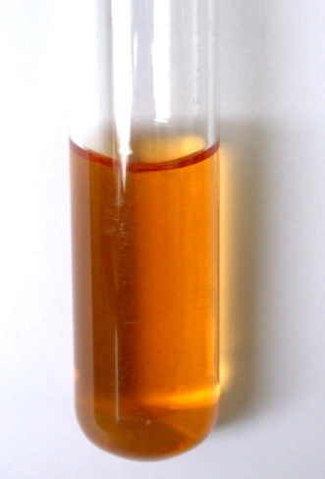
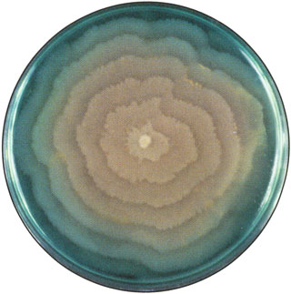
CULTURE MEDIA & CULTURE METHODS
Dr. Navneet Kumar Singh
Associate professor
Department of Paramedical ,
Sumadeep Vidyapeeth

Slide 2
Bacteria have to be grown (cultured) for them to be identified.
By appropriate procedures they have to be grown separately (isolated) on culture media and obtained as pure for study.
History
The original media used by Louis Pasteur – urine or meat broth
Liquid medium – diffuse growth
Solid medium – discrete colonies.

Slide 3
Colony – macroscopically visible collection of millions of bacteria originating from a single bacterial cell.
Cooked cut potato by Robert Koch – earliest solid medium
Gelatin – not satisfactory
- liquefy at 24ºC

Slide 4
Agar
Frau Hesse
Used for preparing solid medium
Obtained from seaweeds.
No nutritive value
Not affected by the growth of the bacteria.
Melts at 98ºC & sets at 42ºC
2% agar is employed in solid medium

Slide 5
Types of culture media
Based on their consistency
a) solid medium
b) liquid medium
c) semi solid medium
Based on the constituents/ ingredients
a) simple medium
b) complex medium
c) synthetic or defined medium
d) Special media

Slide 6
Special media
  Enriched media
  Enrichment media
  Selective media
  Indicator media
  Differential media
  Sugar media
  Transport media
  Media for biochemical reactions
Based on Oxygen requirement
- Aerobic media
- Anaerobic media

Slide 7
Solid media – contains 2% agar
Colony morphology, pigmentation, hemolysis can be appreciated.
Eg: Nutrient agar, Blood agar
Liquid media – no agar.
For inoculum preparation, Blood culture, for the isolation of pathogens from a mixture.
Eg: Nutrient broth
Semi solid medium – 0.5% agar.
Eg: Motility medium

Slide 8
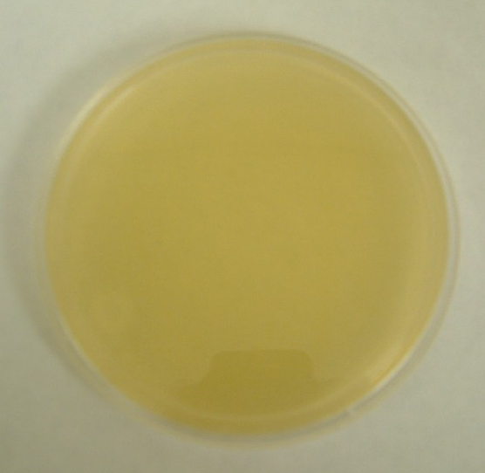
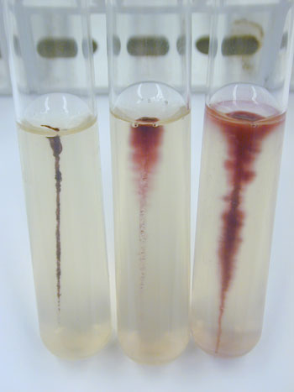


Slide 9
Simple media / basal media
  - Eg: NB, NA
  - NB consists of peptone, meat extract, NaCl,
  - NB + 2% agar = Nutrient agar

Slide 10
Complex media
Media other than basal media.
They have added ingredients.
Provide special nutrients
Synthetic or defined media
Media prepared from pure chemical substances and its exact composition is known
Eg: peptone water – 1% peptone + 0.5% NaCl in water

Slide 11
Enriched media
Substances like blood, serum, egg are added to the basal medium.
Used to grow bacteria that are exacting in their nutritional needs.
Eg: Blood agar, Chocolate agar

Slide 12
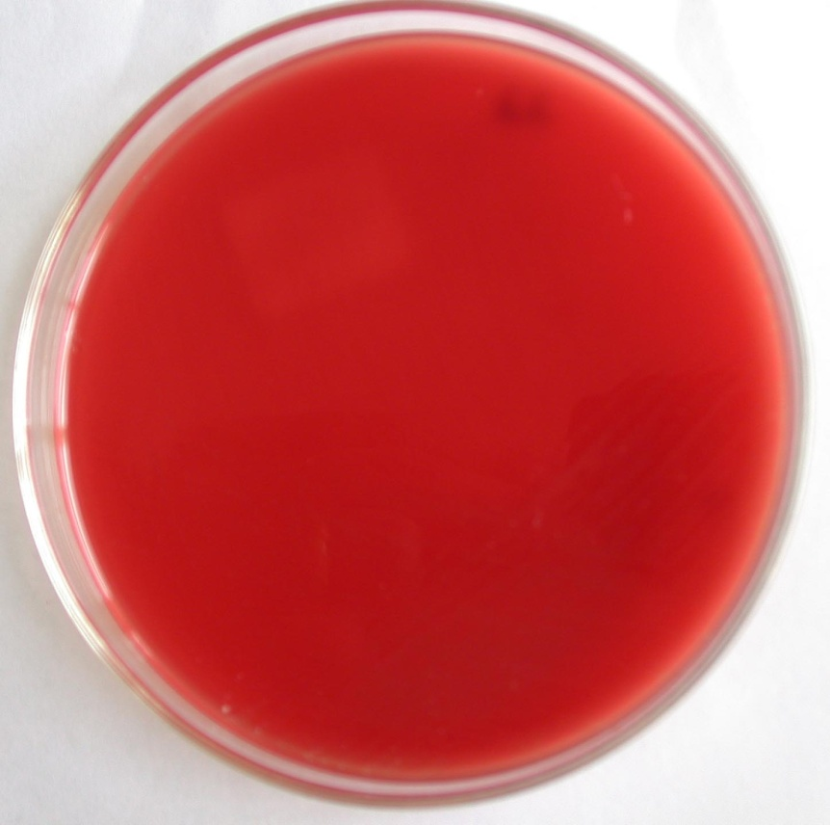
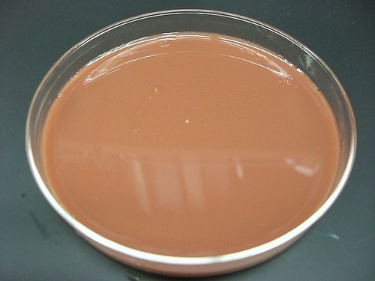
Blood agar
Chocolate agar
Notes:
Chocolate agar

Slide 13

Enrichment media
Liquid media used to isolate pathogens from a mixed culture.
Media is incorporated with inhibitory substances to suppress the unwanted organism.
Eg:
  Selenite F Broth – for the isolation of Salmonella, Shigella
  Alkaline Peptone Water – for Vibrio cholerae

Slide 14
Selective media
The inhibitory substance is added to a solid media.
Eg:
Mac Conkey’s medium for gram negative bacteria
TCBS – for V.cholerae
LJ medium – M.tuberculosis
Wilson and Blair medium – S.typhi
Potassium tellurite medium – Diphtheria bacilli

Slide 15
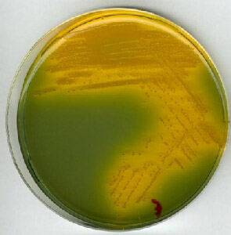
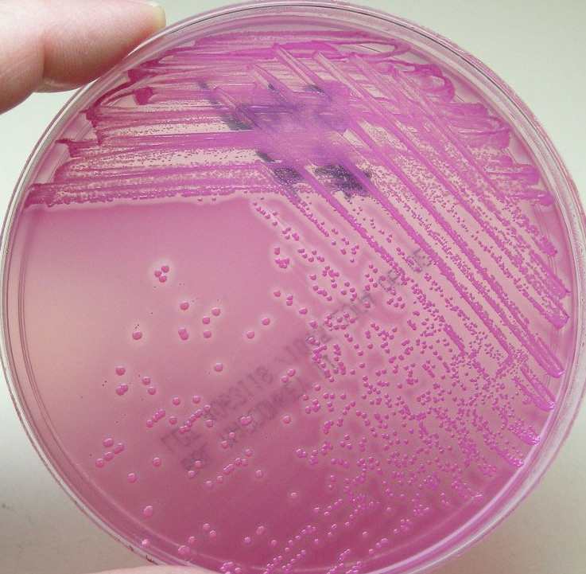
Mac Conkey’s medium
TCBS
Notes:
TCBS

Slide 16
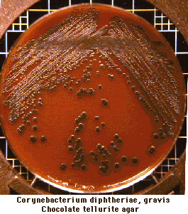
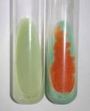
Potassium Tellurite media
LJ media

Slide 17
Indicator media
These media contain an indicator which changes its colour when a bacterium grows in them.
Eg:
  Blood agar
  Mac Conkey’s medium
  Christensen’s urease medium

Slide 18
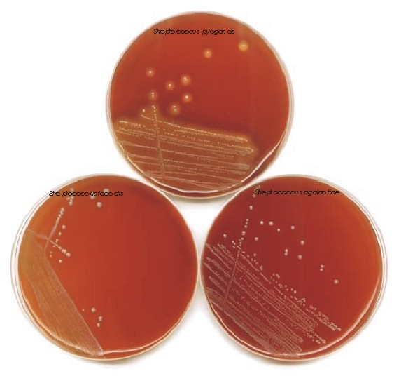
Notes:
C.Diphtheriae on Potassium tellurite media

Slide 19
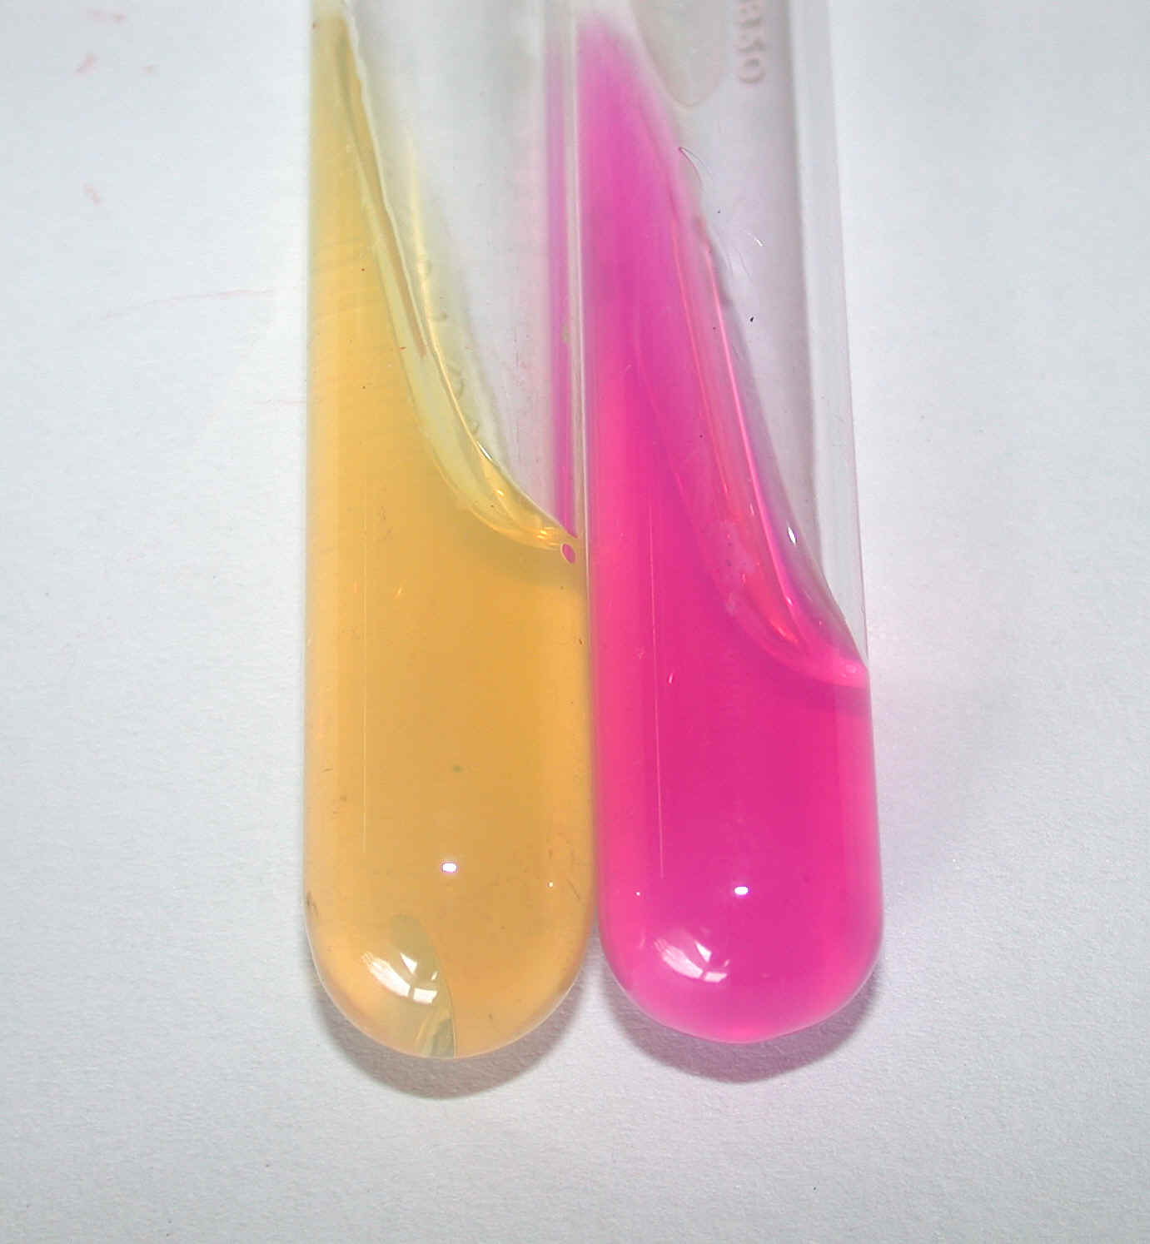
Urease medium
Notes:
Mac Conkey’s medium

Slide 20
Differential media
A media which has substances incorporated in it enabling it to distinguish between bacteria.
Eg: Mac Conkey’s medium
  Peptone
  Lactose
  Agar
  Neutral red
  Taurocholate
Distinguish between lactose fermenters & non lactose fermenters.

Slide 21
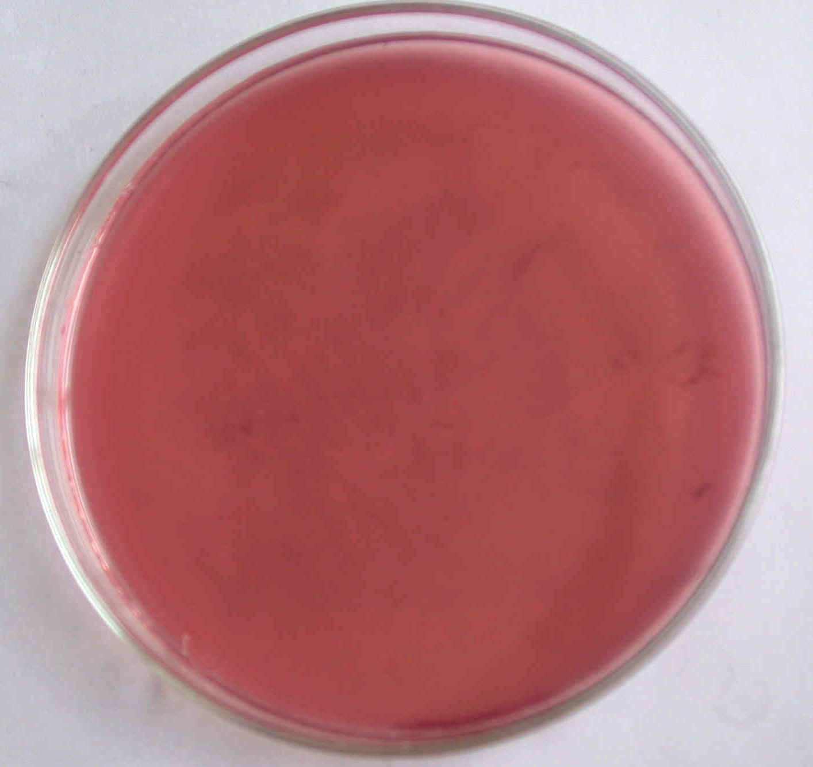
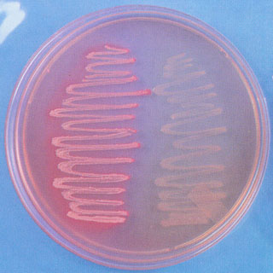
Lactose fermenters – Pink colonies
Non lactose fermenters – colourless colonies

Slide 22
Sugar media
Media containing any fermentable substance.
Eg: glucose, arabinose, lactose, starch etc.
Media consists of 1% of the sugar in peptone water.
Contain a small tube (Durham’s tube) for the detection of gas by the bacteria.

Slide 23
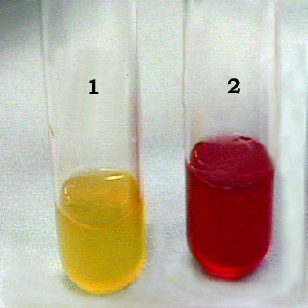


Slide 24
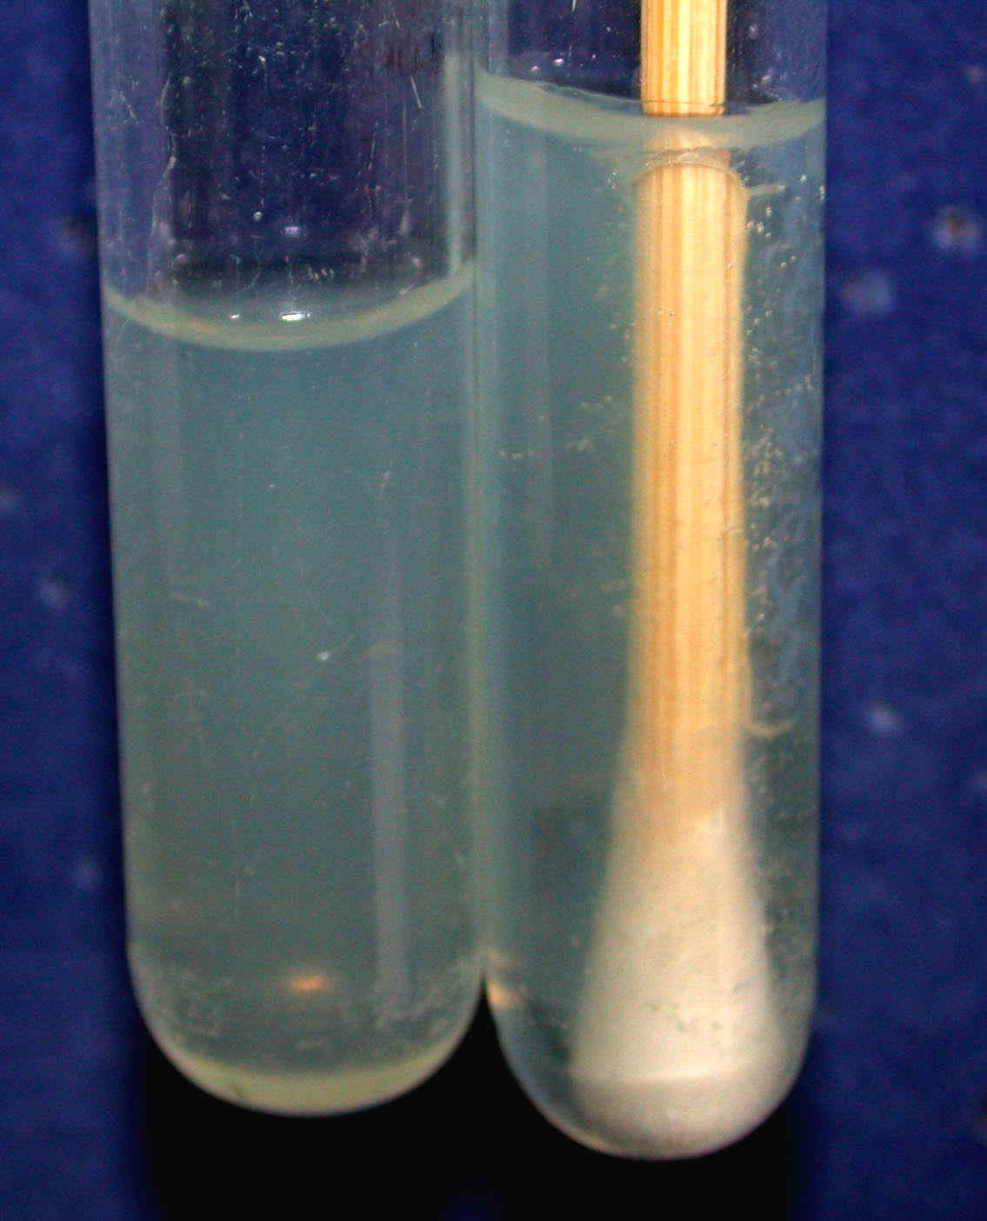
Transport media
Media used for transporting the samples.
Delicate organisms may not survive the time taken for transporting the specimen without a transport media.
Eg:
  Stuart’s medium – non nutrient soft agar gel containing a reducing agent
  Buffered glycerol saline – enteric bacilli

Slide 25
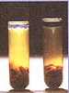
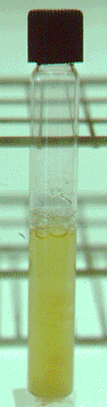
Anaerobic media
These media are used to grow anaerobic organisms.
Eg: Robertson’s cooked meat medium, Thioglycolate medium.

Slide 26
BIOCHEMICAL TEST & REACTIONS
They provide additional information for the identification of the bacterium.
The tests include:
  Oxidase test
  Triple sugar iron agar (TSI)
  Indole test
  MR Test
  VP test
  Citrate utilization
  Urease test

Slide 27
OXIDASE TEST
Detects the presence of an enzyme “oxidase” produced by certain bacteria which will reduce the dye – tetramethyl-p-phenylene diamine dihydrochloride.
Positive test is indicated by the development of a purple colour.
Oxidase positive – Pseudomonas, Vibrio, Neisseriae
Oxidase negative – Salmonella, Shigella

Slide 28
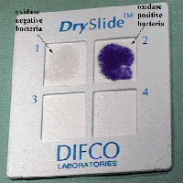

Slide 29
TRIPLE SUGAR IRON AGAR (TSI)
It is a composite media used to study different properties of a bacterium – sugar fermentation, gas production and H₂S production.
In addition to peptone, yeast extract & agar, it contains 3 sugars – Glucose, Lactose, Sucrose.
The Iron salt – Ferric citrate indicates H₂S production.
Phenol red is the indicator.
It is an orange red medium with a slant and a butt.
pH of the medium – 7.4

Slide 30
TSI REACTIONS:
Yellow – Acid
Pink - Alkaline
Yellow slant / Yellow butt (A/A) – Lactose fermenters.
Pink slant / Yellow butt (K/A) – Non lactose fermenters.
Pink slant / no colour change (K/K) – Non fermenters
Black colour – H₂S production.
Gas bubbles or crack in the medium – gas production.
LF – E.coli, Klebsiella
NLF – Salmonella, Shigella
H₂S - Proteus

Slide 31
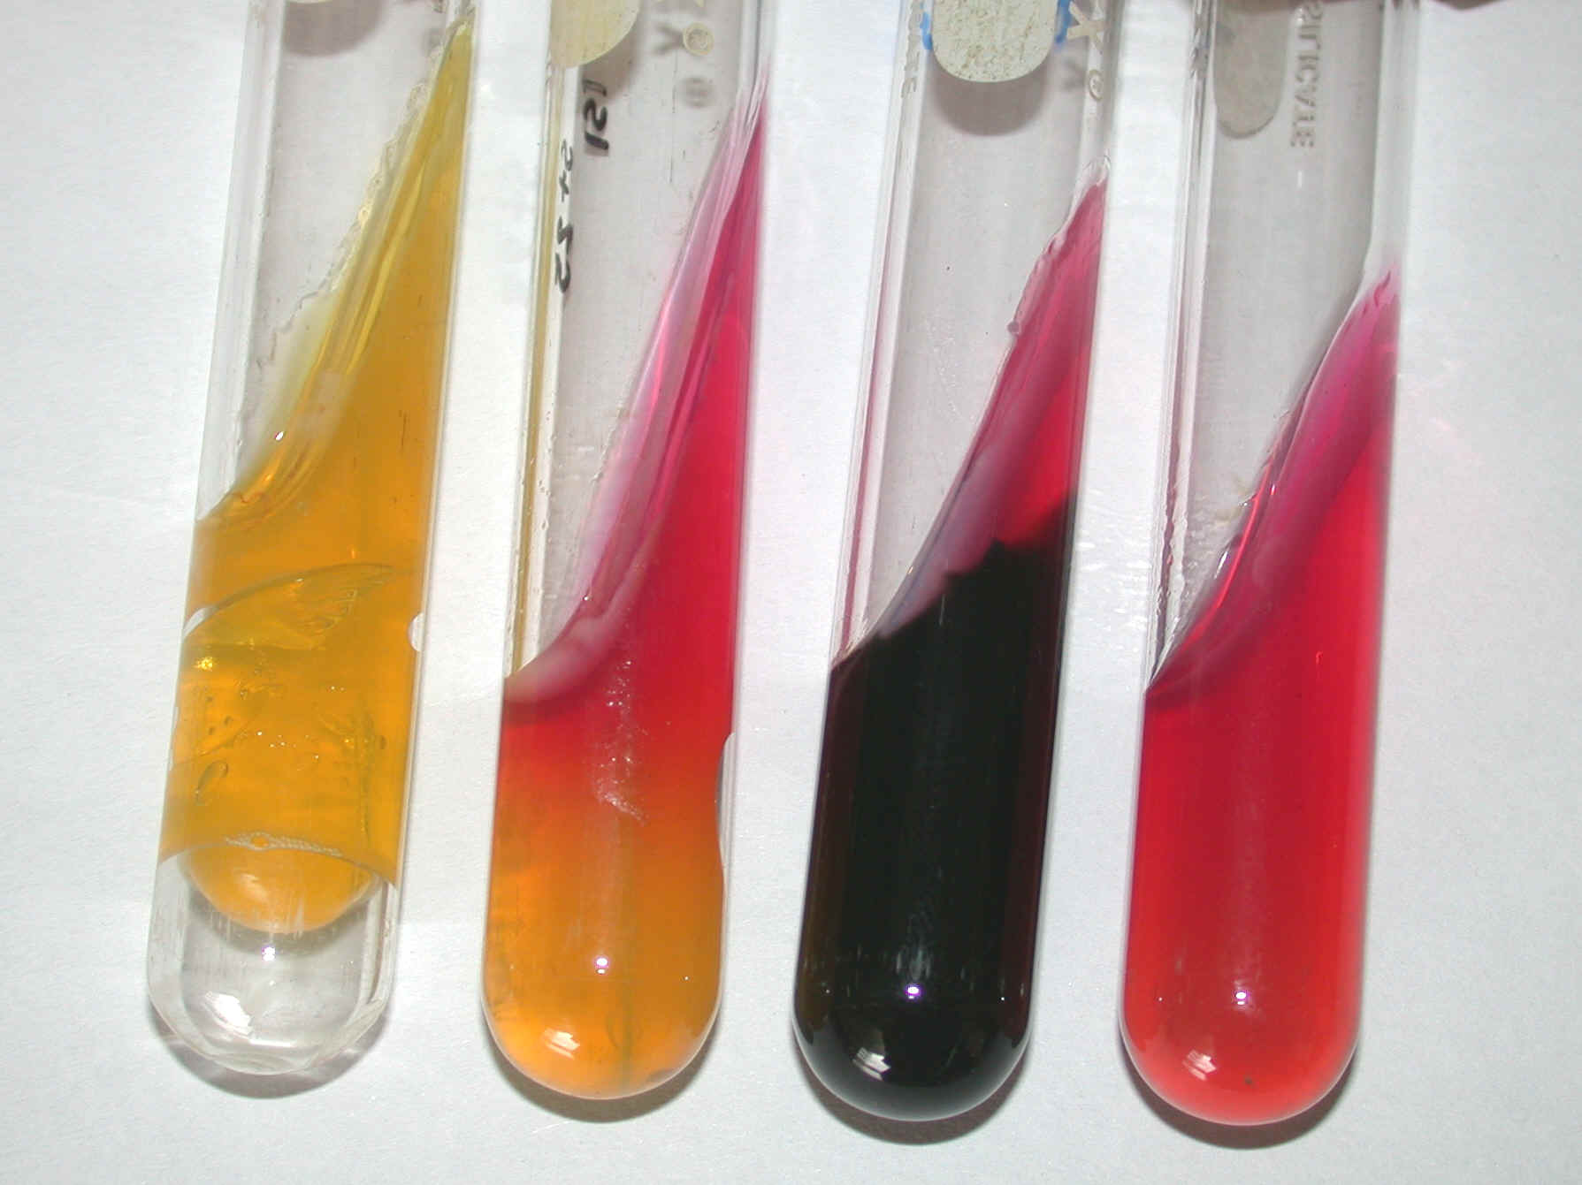

Slide 32
INDOLE TEST
Used to detect indole production by the organism.
They produce indole from tryptophan present in peptone water.
After overnight incubation, a few drops of indole reagent (Kovac’s reagent) is added.
Positive test is indicated by a pink ring.
  Positive indole test – pink ring
  Negative indole test - yellow ring
Indole positive – E.coli
Indole negative – Klebsiella, Salmonella.

Slide 33
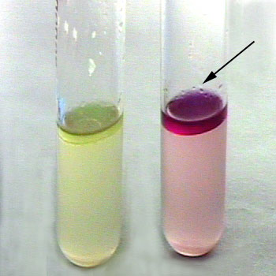

Slide 34
Methyl Red (MR)Test
Methyl red test and Voges-Proskauer test both are done in methyl red–Voges-Proskauer (MR-VP) broth, but the reagents that are added varies according to the test

Slide 35
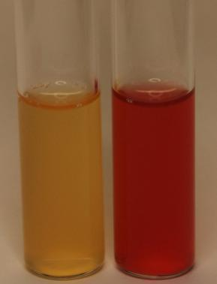
Positive methyl red test are indicated by the development of red color after the addition of methyl red reagent.
A negative methyl red test is indicated by no color change after the addition of methyl red reagent

Slide 36
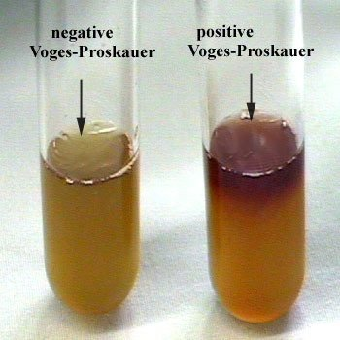
Voges proskauer(V.P) Test
Negative test is indicated by lack of color change after the addition of Barritt’s A and Barritt’s B reagents.
A positive Voges-Proskauer test is indicated by the development of red-brown color after the addition of Barritt’s A and Barritt’s B reagents.
Barritt’s A Reagent
Ingredients a-Naphthol (1-Naphthol) 5.000 gm Absolute ethanol 100.000 ml
Barritt’s B Reagent
Ingredients Potassium hydroxide 40.000 gm Distilled water 100.000 ml

Slide 37
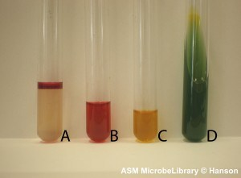
IMViC Reaction of E. coli

Slide 38
CITRATE UTILIZATION
Done in Simmon’s Citrate medium.
To detect the ability of certain bacteria to utilize citrate as the sole source of carbon.
Contains Sodium citrate and bromothymol blue as the indicator.
If citrate is utilized, alkali is produced which turns the medium to blue.
  Citrate positive – blue colour
  Citrate negative – green colour
Positive – Klebsiella
Negative – E.coli

Slide 39
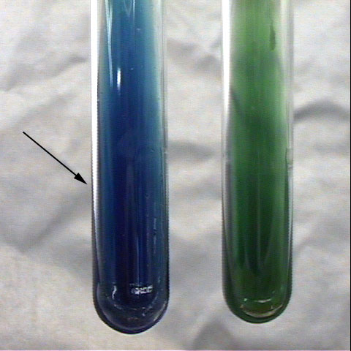

Slide 40
UREASE TEST
Done in Christensen’s urease medium.
This test is used to detect organisms that produce urease.
Urease produced by the organisms split urea into ammonia and CO_{2.}
  Urease positive – pink colour
  Urease negative – yellow colour
Positive – Proteus, Klebsiella
Negative – E.coli, Salmonella

Slide 42
CULTURE METHODS
Culture methods employed depend on the purpose for which they are intended.
The indications for culture are:
  To isolate bacteria in pure cultures.
  To demonstrate their properties.
  To obtain sufficient growth for the preparation of antigens and for other tests.
  For bacteriophage & bacteriocin susceptibility.
  To determine sensitivity to antibiotics.
  To estimate viable counts.
  Maintain stock cultures.

Slide 43
Culture methods include:
Streak culture
Lawn culture
Stroke culture
Stab culture
Pour plate method
Liquid culture
Anaerobic culture methods

Slide 44
STREAK CULTURE
Used for the isolation of bacteria in pure culture from clinical specimens.
Platinum wire or Nichrome wire is used.
One loopful of the specimen is transferred onto the surface of a well dried plate.
Spread over a small area at the periphery.
The inoculum is then distributed thinly over the plate by streaking it with a loop in a series of parallel lines in different segments of the plate.
On incubation, separated colonies are obtained over the last series of streaks.

Slide 45
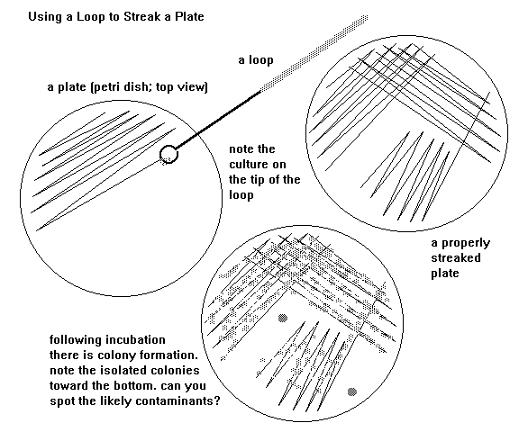

Slide 47
LAWN CULTURE
Provides a uniform surface growth of the bacterium.
Uses
  For bacteriophage typing.
  Antibiotic sensitivity testing.
  In the preparation of bacterial antigens and vaccines.
Lawn cultures are prepared by flooding the surface of the plate with a liquid suspension of the bacterium.

Slide 48
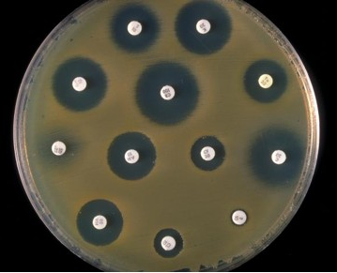
Antibiotic sensitivity testing
Notes:
Antibiotic sensitivity testing

Slide 49
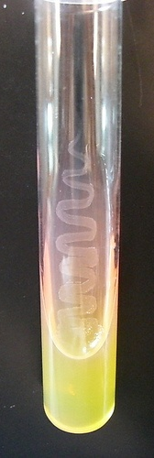
STROKE CULTURE
Stroke culture is made in tubes containing agar slope / slant.
Uses
  Provide a pure growth of bacterium for slide agglutination and other diagnostic tests.

Slide 50
STAB CULTURE
Prepared by puncturing a suitable medium – gelatin or glucose agar with a long, straight, charged wire.
Uses
  Demonstration of gelatin liquefaction.
  Oxygen requirements of the bacterium under study.
  Maintenance of stoke cultures.

Slide 51
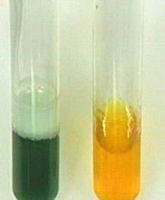
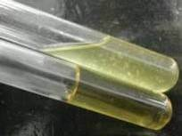
Gelatin liquefaction
Oxidation – Fermentation medium
Notes:
Motility medium

Slide 52
POUR PLATE CULTURE
Agar medium is melted (15 ml) and cooled to 45ºC.
1 ml of the inoculum is added to the molten agar.
Mix well and pour to a sterile petri dish.
Allow it to set.
Incubate at 37ºC, colonies will be distributed throughout the depth of the medium.
Uses
  Gives an estimate of the viable bacterial count in a suspension.
  For the quantitative urine cultures.

Slide 53
LIQUID CULTURES
Liquid cultures are inoculated by touching with a charged loop or by adding the inoculum with pipettes or syringes.
Uses
  Blood culture
  Sterility tests
  Continuous culture methods
Disadvantage
  It does not provide a pure culture from mixed inocula.

Slide 54
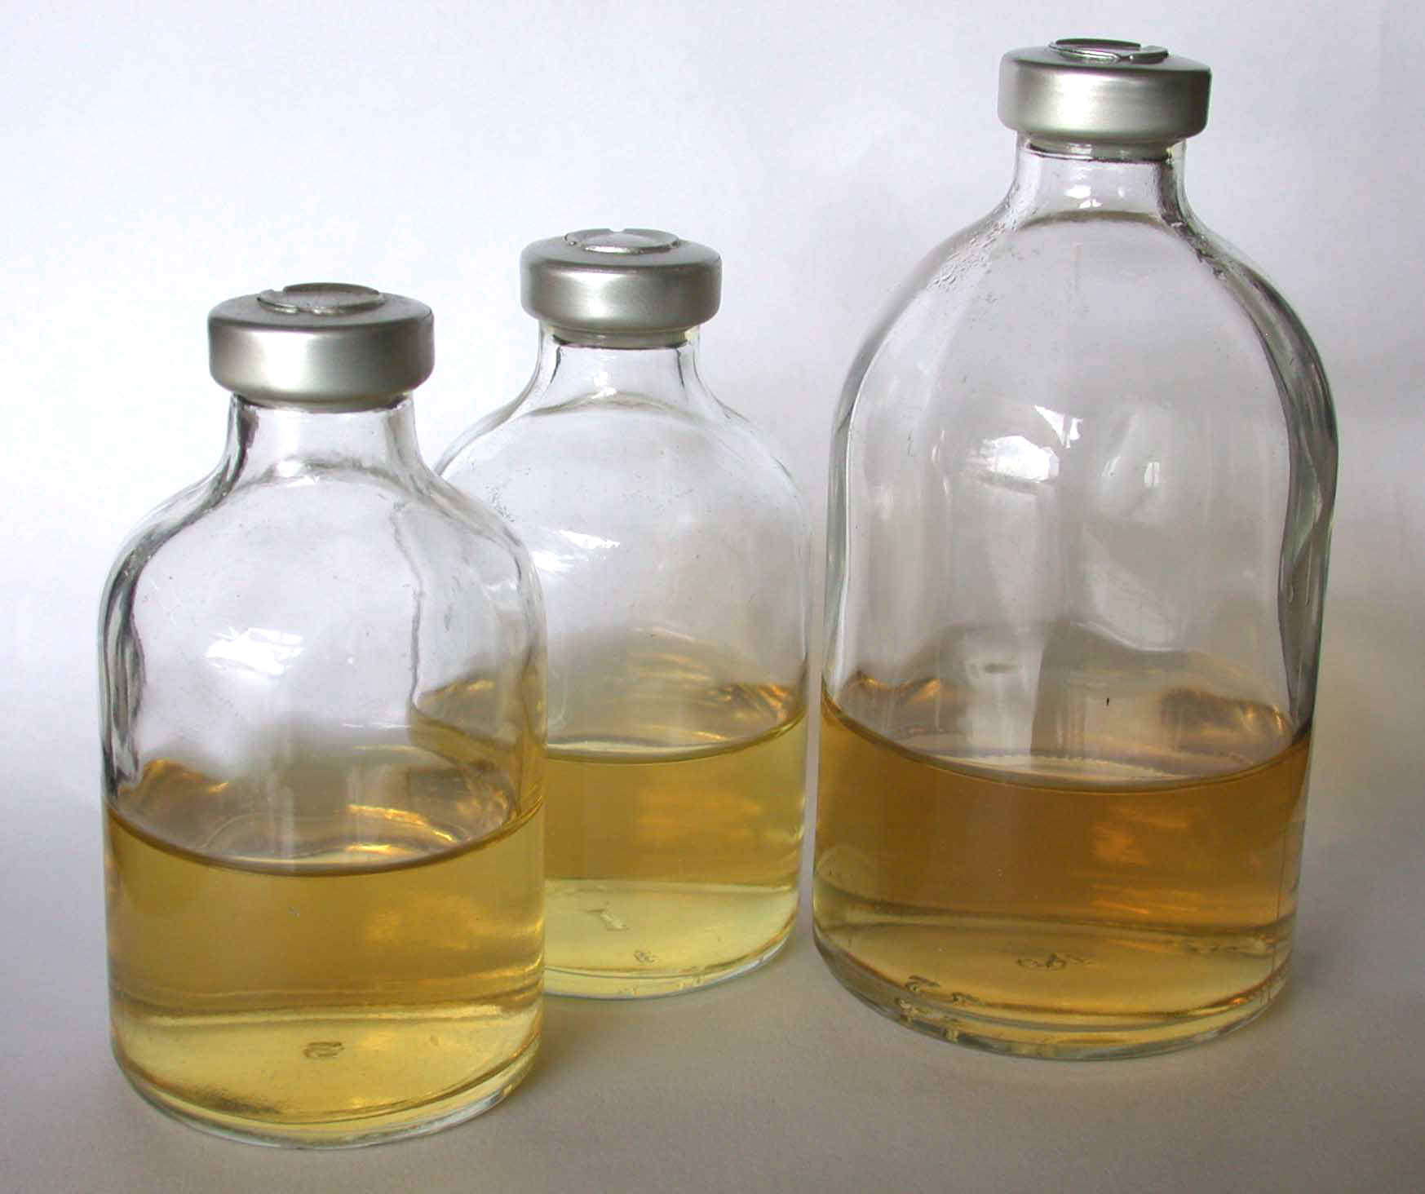
Blood culture bottles

Slide 55
ANAEROBIC CULTURE METHODS
Anaerobic bacteria differ in their requirement and sensitivity to oxygen.
Cl.tetani is a strict anaerobe – grows at an oxygen tension < 2 mm Hg.
Methods:
  Production of vacuum
  Displacement of oxygen with other gases
  Chemical method
  Biological method
  Reduction of medium

Slide 56
Production of vacuum:
Incubate the cultures in a vacuum desiccator.
Displacement of oxygen with other gases
Displacement of oxygen with hydrogen, nitrogen, helium or CO₂.
Eg: Candle jar

Slide 57
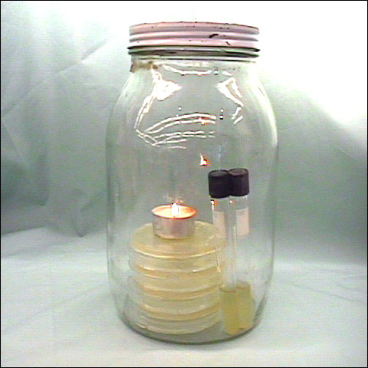

Slide 58
Chemical method
Alkaline pyrogallol absorbs oxygen.
McIntosh – Fildes’ anaerobic jar
Consists of a metal jar or glass jar with a metal lid which can be clamped air tight.
The lid has 2 tubes – gas inlet and gas outlet
The lid has two terminals – connected to electrical supply.
Under the lid – small grooved porcelain spool, wrapped with a layer of palladinised asbestos.

Slide 59
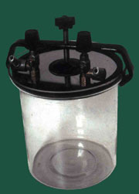

Slide 60
Working:
Inoculated plates are placed inside the jar and the lid clamped air tight.
The outlet tube is connected to a vacuum pump and the air inside is evacuated.
The outlet tap is then closed and the inlet tube is connected to a hydrogen supply.
After the jar is filled with hydrogen, the electric terminals are connected to a current supply, so that the palladinised asbestos is heated.
Act as a catalyst for the combination of hydrogen with residual oxygen.

Slide 61
Gaspak
Commercially available disposable envelope.
Contains chemicals which generate H₂ and CO₂ on addition of water.
Cold catalyst – in the envelope
Indicator is used – reduced methylene blue.
  Colourless – anaerobically
  Blue colour – on exposure to oxygen

Slide 62
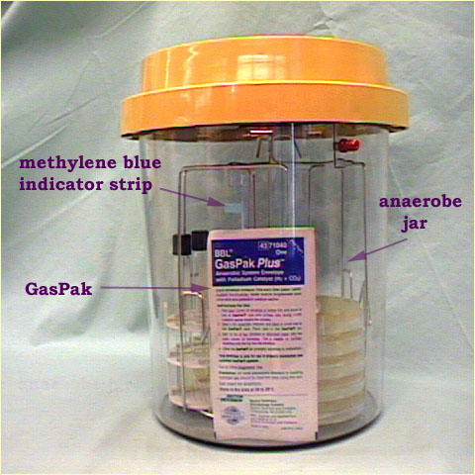

Slide 63
Biological method
Absorption of oxygen by incubation with aerobic bacteria, germinating seeds or chopped vegetables.
Reduction of oxygen
By using reducing agents – 1% glucose, 0.1% Thioglycolate

Slide 64
THANK YOU

