Slide 1


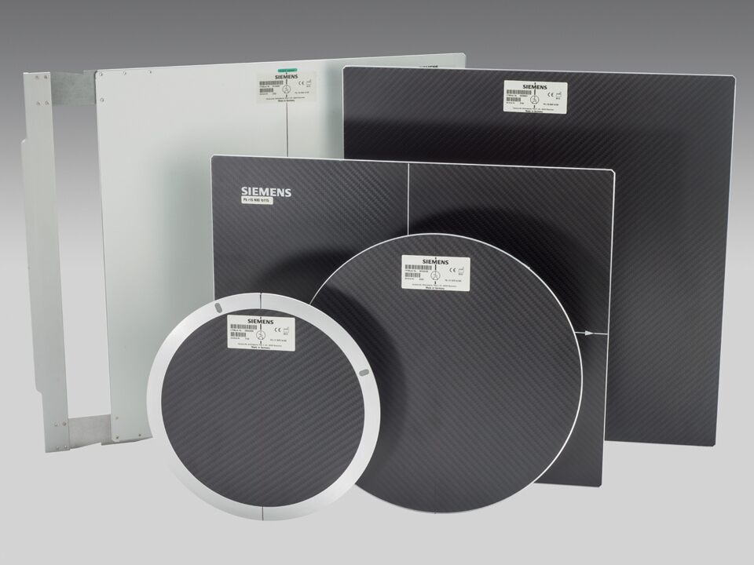
DR. JAYAPANDIYAN
Department of Paramedical Sciences,
SVDU

Slide 2
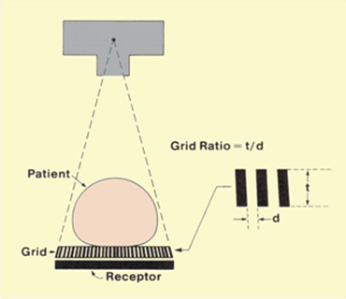
Radiographic Grid
A device placed between the patient
and film for the purpose of absorbing
scattered radiation before it can
interact with the imaging receptor.
An X-ray grid is the part of an
X-ray machine that filters out
randomly deflected radiation that
can obscure or blur an image produced by the machine.

Slide 3
Grids are devices that are used to improve contrast on a radiographic image.
This improvement of contrast is achieved by absorption of scatter radiation
produced by the patient as the primary beam interacts with the patient’s tissues.
When an X-ray machine sends radiation through an object, specifically a body, the
object absorbs or deflects most of the rays.
Only about 1 percent of the X-rays pass through the body on a straight line and
burn an image onto the film. The deflected X-rays can hit the film at random
angles, obscuring the image. The grid filters out these random X-rays.
A high quality grid can attenuate 80 –90 % of scatter radiation

Slide 4
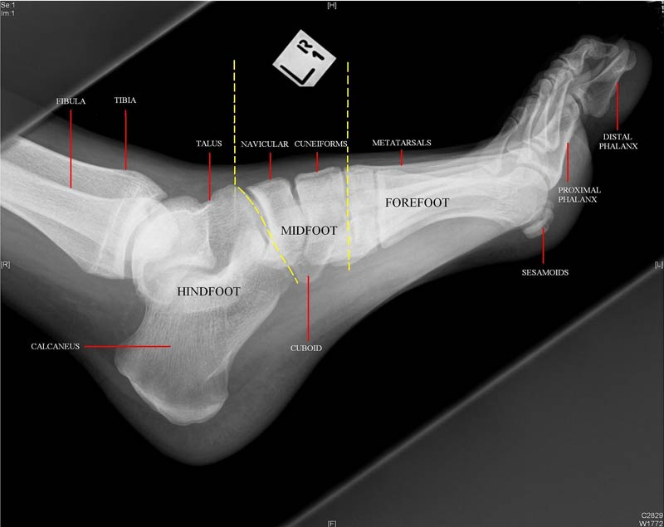
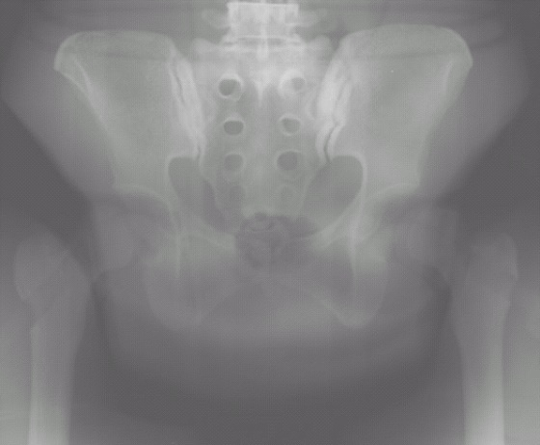
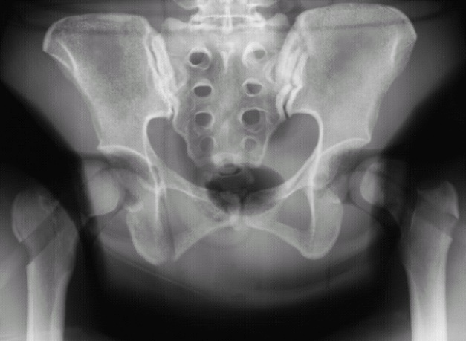

Slide 5
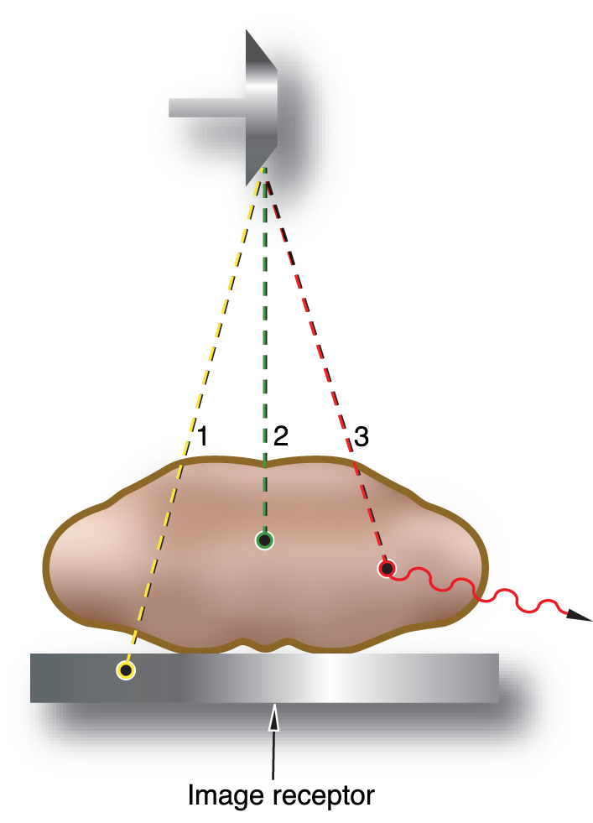
Creating the Image- Factors
Transmission
  Responsible for dark areas
Absorption
  Responsible for light areas
Scatter
  Creates fog
  Lowers contrast
3 factors contribute to an increase in scatter
  kV increases
  Field size increases
  Thickness of part increases

Slide 6
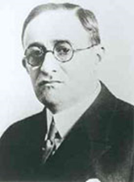
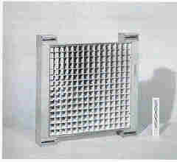
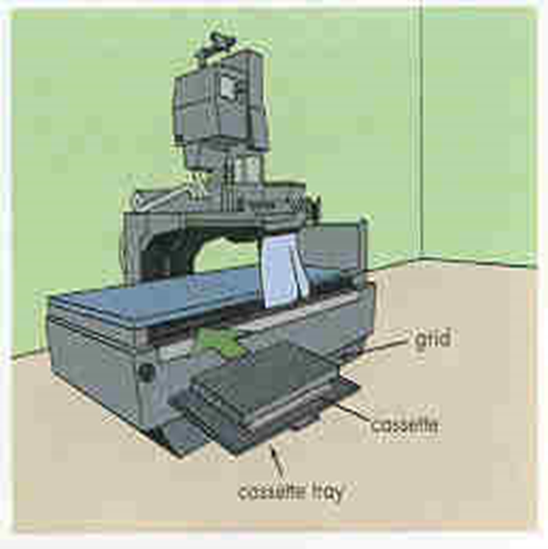
History
First grid was made by Dr. Gustav Bucky in 1913.
Consisted of wide strips of lead approx. 2cm apart in a
crisscross pattern.
1920 – Dr. Hollis Potter improved the grid device.
Realigned the lead strips to run in one direction.
Made the lead strips thinner.

Slide 7

Grid Construction
Grid Materials
A series of radiopaque lead strips which
alternate with radiolucent materials.
a. Strips are held firmly together then sliced into flat sheets.
b. Lead is the radiopaque material of choice.
Interspace materials are radiolucent, made of
a. Aluminum
b. Plastic fibers

Slide 8
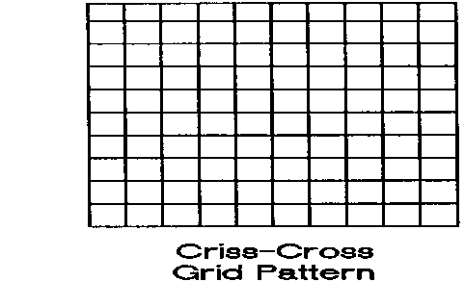
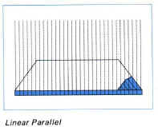
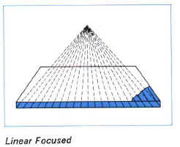
Aluminium is more common than plastic fiber because of ease to manufacture, durability and provides additional absorption of low energy photons.
Disadvantage when using low kVp techniques.
Fiber Interspace grids are preferred when using low kVp techniques (pediatric radiography).
Grid Patterns
Criss-cross or cross-hatched
Linear
  Parallel
  Focused

Slide 9
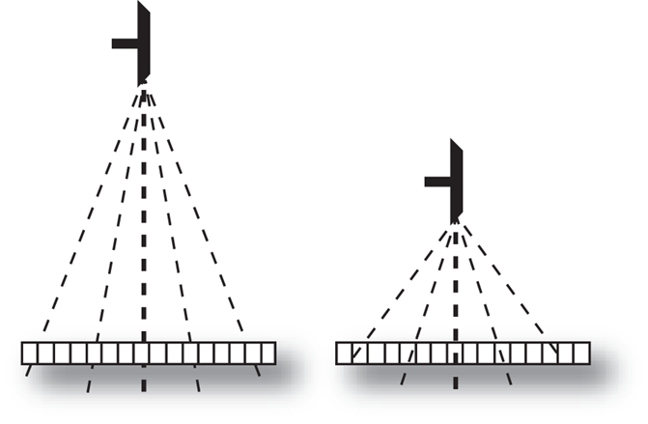
Parallel grids
All lead strips are parallel to one another and straight up and down
Less commonly employed than focused grids.
Best used with longer SIDs because the beam is straighter and more perpendicular at longer SIDs.
Lead strips run the length of the cassette.

Slide 10
Focused grids
Lead strips are tilted toward the center to correspond with the divergence of the X-ray beam.

Slide 11
Crisscross
Contains two sets of lead strips at 90 degrees from one
another.
Cross-hatched
Equivalent of two linear grids not quite at 90 degrees.

Slide 12
Grid Selection
Patient Dose
Examination
Details required
Part/organ thickness or properties
Desired technique (kVp)
Equipment availability
Indications for Grid Use
Part thickness > 10 cm
kVp > 60

Slide 13
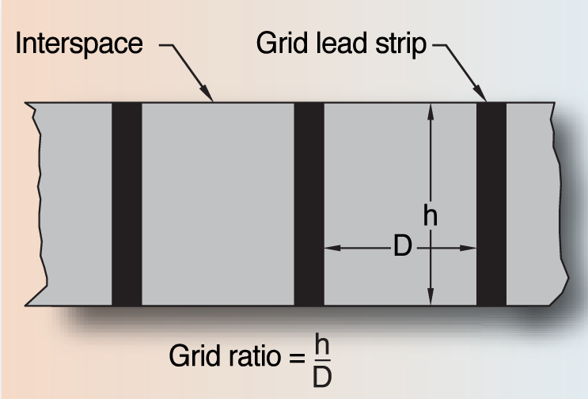
Grid Dimensions
Grid ratio = h/D
h = the height of the radiopaque strips
D = the distance between the strips
  the thickness of the interspace material
The distance between lead strips may remain constant so the hight of the grid must increase as grid ratios increase.
High ratio grids usually "clean-up the beam," removing scatter radiation more effectively than low ratio grids.

Slide 14
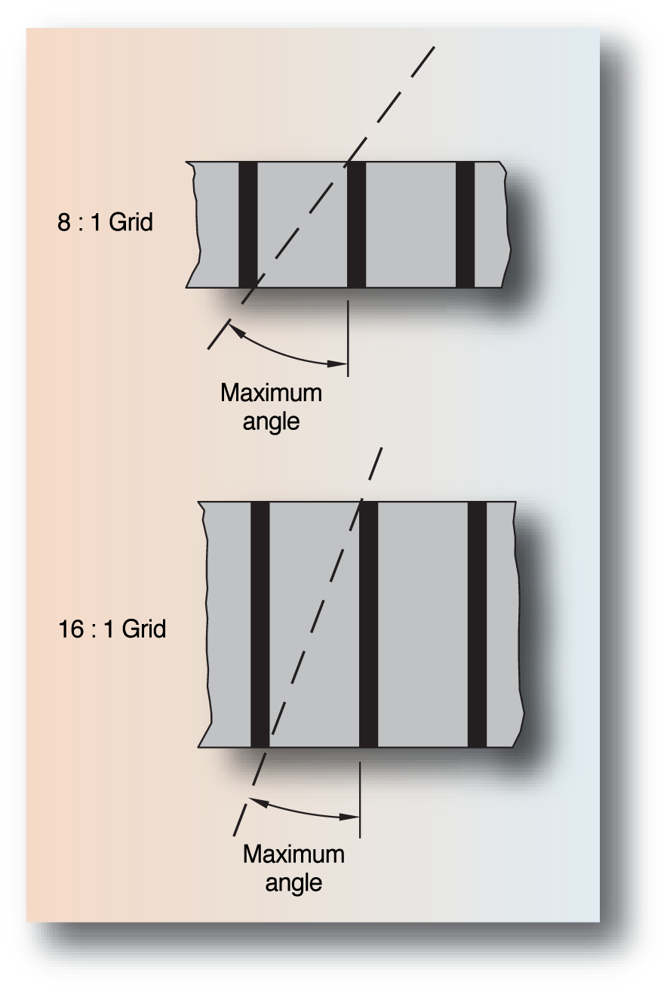
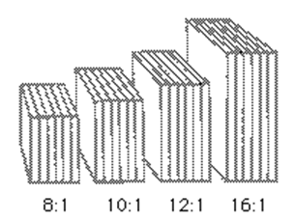
Grid Ratio
Higher grid ratio
  More efficient in removing scatter
Typical grid ratio range is 5:1 to 16:1
Grid ratios vary from 5:1 to 16:1, with 5:1 being the most common for mammography. 8:1 is used for 70-90 kVp technique and 12:1 is used for >90 kVp technique.

Slide 15
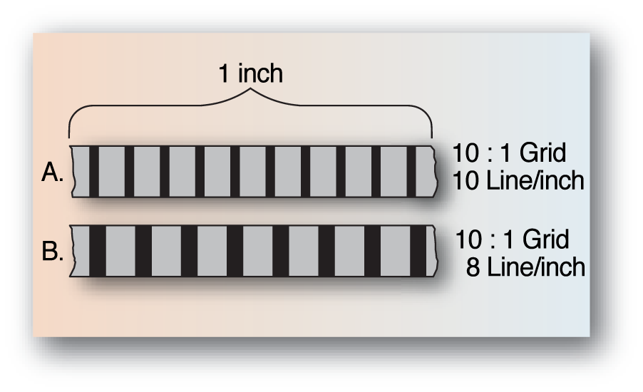
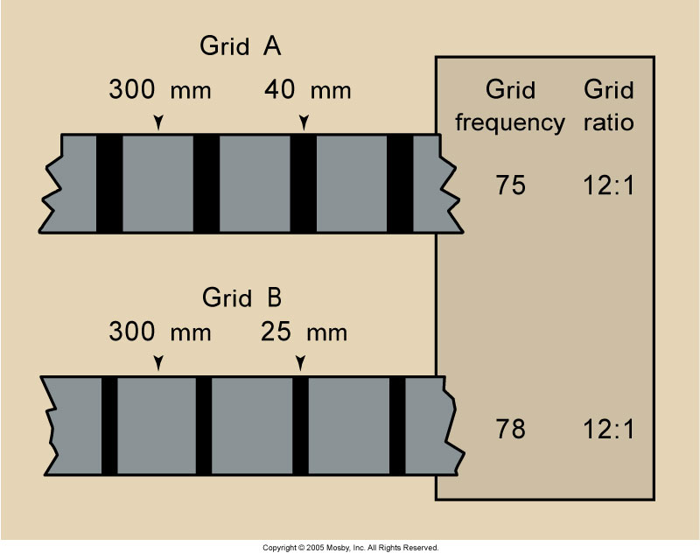
Grid Frequency
The number of lead strips per inch or cm
Frequency range
  60-200 lines/in
  25-80 lines/cm
Typically higher frequency grids have thinner lead strips

Slide 16
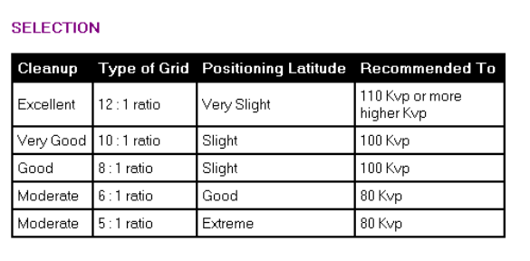
Grid ratios range from 5:1 to 16:1
Most common 8:1 to 10:1
A 5:1 grid will clean up 85% (Mammography uses 5: 1)
16:1 clean up 97%

Slide 17
LIMITATIONS OF GRIDS
The grid can be used for higher exposure data (higher mAs values and higher kilovolts) is a disadvantage.
For mammography the grids cannot be used since they use low energy x ray for the imaging process.
Grid Cut - off
It is an undesirable absorption of primary x-ray beams by grid strips, which prevents the useful x-rays from reaching the image receptor.
It is caused by improper grid positioning and most often occurs with parallel grids.

Slide 18
TYPES
Grid cut off - Decrease in density on the film because the grid is absorbing the primary beam.
Peripheral cut off - Absorption of the primary beam due to the divergence of the beam at the periphery of a parallel grid.
Off focus grid - Peripheral grid cut off that occurs because the SID is not within the recommended focal range. Higher grid ratios have narrower focal ranges.
Off level grid - A decrease in density across the film that occurs when the grid or tube is angled.
Off center grid - Decreased density across the film caused by incorrect centering. The center of the grid must be positioned directly under the x-ray tube target. Correct centering is more important with higher grid ratios.
Upside down grid - Severe cut off on either side of the central ray and increased density in the middle of the film caused by placing a focused grid in upside down.

Slide 19
Air Gap Technique
The air gap technique is an old method for the rejection of scattered radiation. It is still used in lung examinations.
The air gap technique is a radiographic technique that improves image contrast resolution by reducing the amount of scattered radiation that reaches the image receptor.
In the air gap technique, the object-to-image distance (OID) is increased, resulting in a magnified image. To reduce magnification, source-to-image distance (SID) can be increased.
The disadvantage of the grid-air gap technique is an increased patient skin dose because of the short focal spot-object distance.

Slide 20
THANK YOU

