Slide 1

X-RAY FILTERS
By
Dr. Jayapandiyan
Department of Paramedical Sciences
SVDU

Slide 2
INTRODUCTION
Diagnostic x-ray beams are polychromatic ( A spectrum of many different energies).
High energy photons are transmitted to form the radiographic image.
Low energy photons get absorbed/ scattered.
Contributes to the increase in patient radiation dose.
Or if scattered then degrade the image quality.

Slide 3
Thin sheets of metals(Al, Cu) are placed in the path of an x-ray beam.
To attenuate the low energy (soft) x-ray photons from the spectrum before reaching to the patient body is filtered. The process is known as filtration/beam hardening.
Unit is mm Al equivalent.

Slide 4
FILTRATION
TYPES OF FILTRATION
INHERENT FILTRATION
ADDED/EXTERNAL FILTRATION

Slide 5
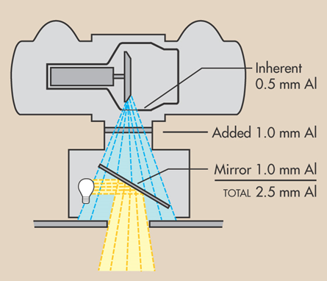
INHERENT FILTRATION
Absorption of x-rays as they pass through
Glass/metal envelope
The insulating oil
The window
Thickness 0.5-1mm Al equivalent

Slide 6
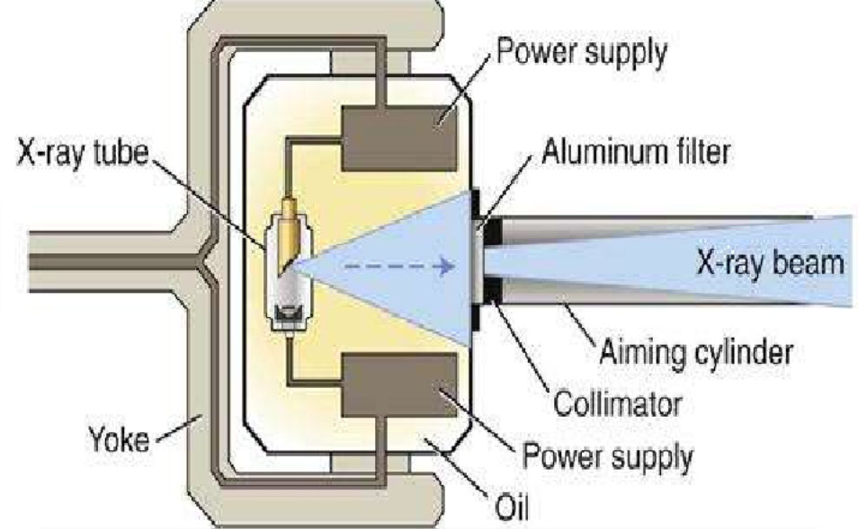
ADDED FILTRATION
Outside the x-ray tube and housing
Silver on collimator mirror,
Al/Cu between the collimator
and protective housing.
Thickness 1-1.5mm Al equivalent.
Can be customized(filter thickness, type of metal)

Slide 7
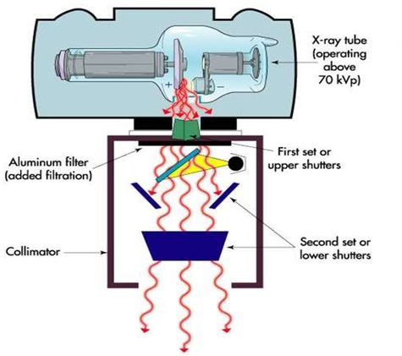
TOTAL FILTRATION
Total filtration = inherent filtration + added filtration
Recommended by NCRP
Operating kVp | Total filtration
Below 50kvp | 0.5 mm aluminum
50-70 kVp | 1.5 mm aluminum
Above 70kVp | Minimum of 2.5 mm aluminum

Slide 9
MATERIALS USED
Copper(Z=29)
- for high energy radiation
Aluminum(Z=13)
- for low energy radiation - most commonly preferred in diagnostic
radiology.
REASONS FOR USING
low atomic number therefore excellent material for absorbing low energy x-ray photons.
low in weight makes the x-ray tube lighter in weight and easy to handle.

Slide 10
OTHER TYPES
Compensation filters
Boomerang filters
Trough filters
Wedge filters
Ferlic filters
Flattening filters
Compound filters
Thoreau's filters
K-edge filers(heavy metal filters)

Slide 11

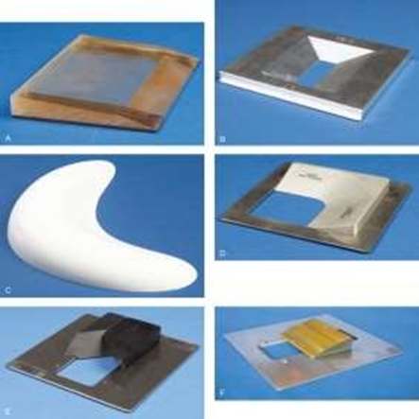
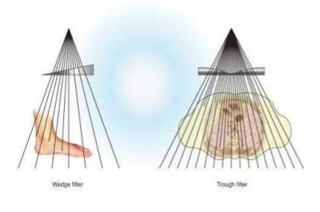
Compensation filters
Exposure of tissue with various densities results in underexposed and overexposed areas in the radiographic image.
Compensate for these variations and produce uniform densities in the radiographic image
A, Supertech wedge, collimator- mounted Clear Pb filter used for AP projection of hips, knees, and ankles on long (51-inch) film. B, Trough, collimator-mounted aluminum filter with double wedge used for AP projections of thoracic spine. C, Boomerang contact filter used for AP projections of shoulder and facial bones. D, Ferlic collimator-mounted filter used for AP and PA oblique (scapular Y) projections of shoulder. E, Ferlic collimator-mounted filter used for lateral
projections of cervicothoracic region (swimmer’s technique) and axiolateral projections (Danelius-Miller method) of hip. F, Ferlic collimator-mounted filter for AP axial projections of foot.

Slide 12
Compound filters
Consists of two or more layers of different materials.
THORAEUS FILTERS
Contains 3 layers(tin, copper, aluminum)
Each layer absorbs characteristics photons created in the previous layer.
Harden and smooth the spectrum of higher energy kilovoltage.
Tin(K-edge = 29.2keV) absorbs characteristic radiation produced by tungsten. Unfortunately tin produces its own characteristic x-rays.
Copper(K-edge=9keV) compensates the characteristic x-ray (9-30keV) produced by tin.
Aluminum(K-edge=1.6keV) filter beyond copper absorbs the very low energy characteristics x-ray produced by the copper.

Slide 13
K-edge/heavy metal filters
A K-edge filter is used as an X-ray filter to separate X-rays’ energy spectrum into high and low-energy regions.
Make use of the principle of the K-edge of elements.
Elements with atomic no. >60 (except Mo)
e.g.:-Gadolinium - Chemical element with atom 64

Slide 14
k-edge filters V/S Aluminum filters
Transmits a significantly narrower spectrum of energies (hard x-rays) than aluminum, with decreased no. of both low and high energies of photons.
A decrease in low-energy photons decreases the patient’s absorbed dose.
A decrease in high-energy photons improves image contrast.

Slide 15
Applications of filters
Diagnostic x-ray energy range | Primary aluminum filter (mm Al)
Orthovoltage range | Compound filter (1-4mm Cu)
Cesium & cobalt teletherapy machines | No filter (monoenergetic)
Megavoltage x-ray beam | Inherent filtration of transmission target Flattening filter
Pediatric applications | K-edge filters as they use low kVp techniques
Mammography machines | Molybdenum filters (k-edge filter) reduce the amount of high energies x- rays and improve the contrast in breast soft tissues.
Instrument
Filter

Slide 16
Effect of Filtration on Patient
Increased filtration = decreased patient exposure dose
At 60 kVp beam
Aluminum filtration(mm) | Exposure dose to skin(mR) | Decrease in exposure dose(%)
None | 2380 | 0
0.5 | 1850 | 22
3 | 465 | 80

Slide 17
Effect of Filtration on Exposure Factor
Effect on exposure factors:
The major disadvantage of filtration is the reduction in the intensity of the X-ray beam.
We must compensate it by increasing mAs.
Filter absorbs many photons, hence the total number reaching the patient actually decreases.
Increased filtration is responsible for increased exposure factors(mAs).

Slide 18
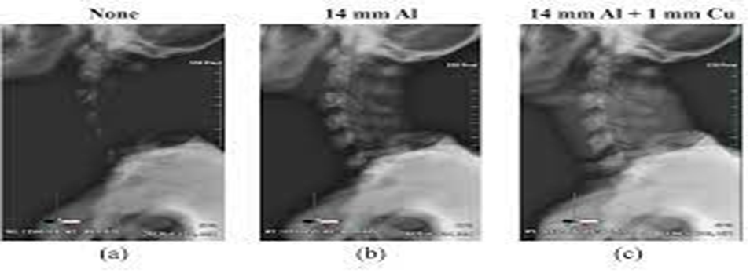
On radiographic image
The introduction of filters into the beam of x-rays in the diagnostic range improves both the sharpness and the number of identifiable values.
Appropriate filtration = Good image contrast
Disadvantages
Reduction in the intensity of x-ray photons
Lengthen the time required to make an exposure
May absorb primary x-ray beam during excessive filtration
Increase tube loading (due to more mAs).

Slide 19
Half Value Layer
The concept of the half-value layer or HVL is used to quantify the ability of an x-ray beam to penetrate the material being examined.
The HVL of an x-ray beam is the amount or thickness of absorbing material or filtration that must be placed in the beam to reduce the transmission of the beam by one-half.
The material predominantly used to determine the HVL of diagnostic X-ray equipment is aluminum, and hence HVL is expressed in terms of mm of aluminum.
Medical diagnostic x-ray machines typically have HVLs ranging from 2.3 to 5 mm Al.

Slide 20
THANK YOU

