Slide 1
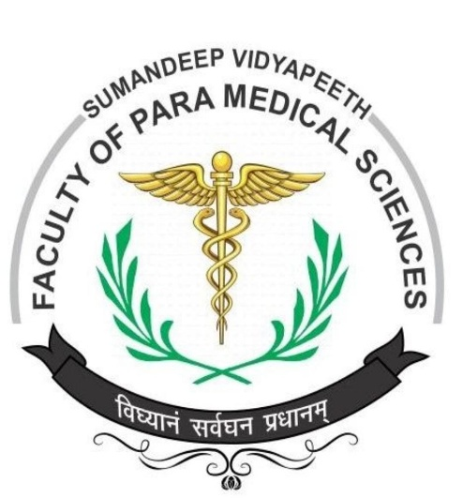
Methods of Sterilization and Disinfection
PRESENTATION BY:
Ms. Pooja Shashikant Chavan
F Y Microbiology for B. Sc Cardiac/Perfusion Radio Imaging/Medical Laboratory Technology

Slide 2
Terms:
Sterilization: Article, surface, or medium is freed of all living microorganisms either in the vegetative or in the spore state
Used only in absolute sense
Disinfection: Destruction of microorganisms, especially potential pathogens, on the surfaces of inanimate objects or in the environment
Reduce the microbial population, not bacterial endospores on
inanimate surfaces or in organic materials
Antisepsis: Destruction or inhibition of microorganisms on living
tissues by chemicals (non-toxic and non-irritating)
Chemical agents- Antiseptics

Slide 3
Germicide/microbicide: chemical agent that kills pathogenic microorganisms
Sepsis: growth of microorganisms in the body or the presence of microbial toxins in blood and other tissues
Asepsis: Practice to prevent entry of infectious agents into sterile tissues and thus prevents infection
Sanitization: Cleansing technique that mechanically removes microorganisms to reduce the level of contaminants
Sanitizer- compound (e.g., soap or detergent)
..

Slide 4
Uses of Sterilization
1. Sterilization for Surgical Procedures and
medicines: instruments, supplies etc.
Gloves, aprons, syringes, drugs and
surgical other
2. Sterilization in Microbiological works: Preparation of culture media, reagents and equipments

Slide 5
METHODS
Sterilization and disinfection are done by :
Physical methods
Chemical methods
  Heat:
    Dry heat
    Moist heat
Radiation:
  Non-ionising radiation (Ultraviolet radiation)
  Ionising radiation (X-ray, gamma ray)
(c) Filtration
(Berkfeld, Chamber land, Seitz, sintered glass, cellulose membrane filters etc)

Slide 6
Heat
Mostly used method
Highly effective and most reliable process
Two major methods:
Dry heat and moist heat
Dry heat induces:
Denaturation of protein, oxidative damage and toxic effect
due to the high level of electrolytes
Also damage the DNA of the microorganism
As a result, the microorganism got killed

Slide 7
..
Moist Heat:
kills the microorganisms by denaturation and coagulation of proteins
Temperature required to kill microbe by dry heat more than moist heat
Thermal death time-
Minimum time required to kill a suspension of organisms at a predetermined temperature in a specified environment

Slide 8
Factors affecting sterilization by heat
Nature of heat: Moist heat is more effective
Temperature and time: inversely proportional
Number of microorganisms: More number- higher temperature or
longer duration
Nature of microorganism: Species and strain, Spores highly resistant
Type of material: heavily contaminated, higher
temperature/prolonged exposure
Certain heat sensitive articles sterilized at lower temperature
Presence of organic material: Organic materials (protein, sugars, oils and fats) increase the time required

Slide 9
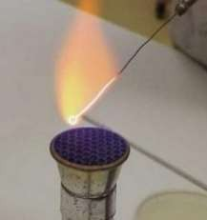
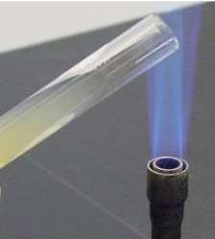
DRY HEAT:
• ..
Red heat:
sterilized by holding them in Bunsen flame
till they become red hot
bacteriological loops, straight wires, tips of
forceps and searing spatulas
limited to those articles that can be heated
to redness in flame
Flaming:
method of passing the article over a
Bunsen flame, but not heating it to redness
e.g. scalpels, mouth of test tubes, flasks, glass slides and cover
(Image source-Google)

Slide 10
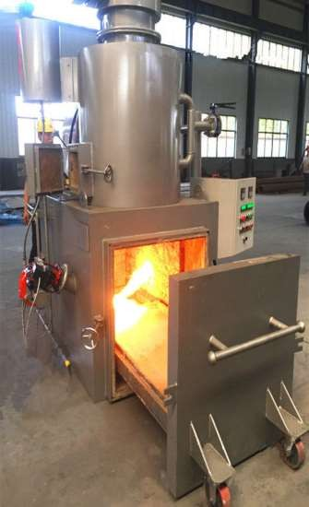
Incineration:
Method of contaminated material
destroying
by
burning them in incinerator
safely materials ashes
destroying infective
by burning them to
e.g. soiled dressings; animal carcasses, pathological material, bedding
Suitable only for those articles to be disposed
(Image source-Google)

Slide 11
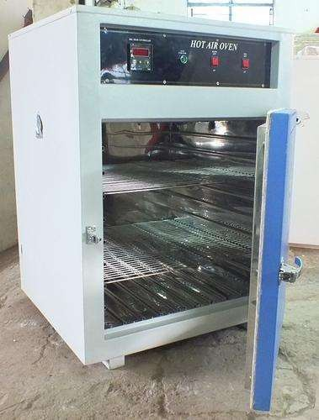
Hot air oven:
Introduced by Louis Pasteur
Metallic instruments forceps, scalpels, scissors)
(like
Glasswares (such as petri- dishes, pipettes, flasks, all-glass syringes)
Swabs, oils, grease, petroleum jelly and some pharmaceutical products
Unsuitable for rubber and plastics

Slide 12
..
Exposed to high temperature in an electrically heated oven
Air poor conductor of heat, even distribution of heat throughout
the chamber by a fan
fitted with a thermostat control, temperature indicator, meshed shelves or trays
Oven not overloaded
Materials perfectly dry and arranged to allows free circulation of air
inside the chamber
Mouths of flasks, test tubes and both ends of pipettes must be
plugged with cotton
Petri dishes and pipettes wrapped in a paper

Slide 13
..
160⁰C for two hours, 170⁰C for 1 hour and 180⁰C for 30 minutes
Increasing temperature by 10 degrees shortens the sterilizing time by 50 percent
The hot air oven must not be opened until the temperature
inside has fallen below 60º C to prevent breakage of glassware
To determine the efficacy of sterilization
- Thermocouples, chemical indicators, and bacteriological spores of Bacillus subtilis as sterilization controls

Slide 14
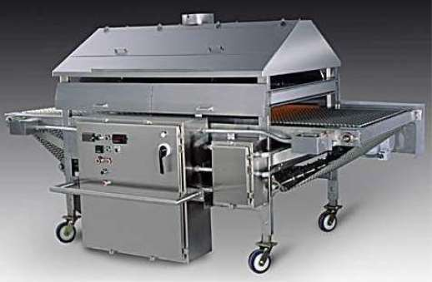
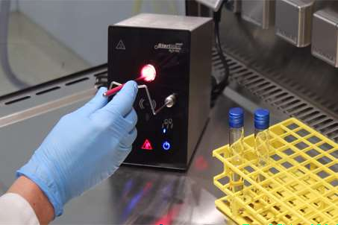
Infra red rays:
Sterilization by generation of heat
Articles placed in a moving conveyer belt and passed through a tunnel that is heated by infrared radiators to a temperature of 180º C
The articles are exposed temperature for a period minutes
to that
of 7.5
Articles sterilized:
instruments and glassware
Requires special equipment
metallic
Efficiency can be checked using
Browne’s tube No.4 (blue spot)

Slide 15
Sterilization by moist heat
In the form of
hot water
boiling water
steam (vaporized water)
In practice, the temperature of moist heat usually ranges from 60 to 135°C
Adjustment of pressure in a closed container- regulate the temperature of
steam
kills microorganisms by denaturation and coagulation of proteins
Sterilization by moist heat:
temperature <100°C
temperature of 100°C
temperature >100°C

Slide 16
At temperature below 100º C
Pasteurization:
originally employed by Louis Pasteur
employed in food and dairy industry
Two methods of pasteurization
holder method (heated at 63º C for 30 minutes)
flash method (heated at 72º C for 15 seconds)
followed by quickly cooling to 13º C
Suitable to destroy most milk borne pathogens (Mycobacteria, Streptococci, Staphylococci, Brucella etc.)
Inactivates most viruses and destroys the vegetative stages of 97–99% of bacteria,
fungi, does not kill endospores or thermoduric species
Efficacy tested by phosphatase test and methylene blue test
Newer techniques: Ultra-High Temperature (UHT), 134°C for 1–2 second

Slide 17
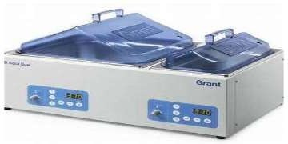
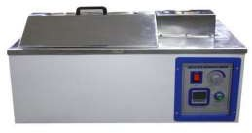
Vaccine bath:
The contaminating bacteria in a vaccine preparation can be inactivated by heating in a water bath at 60º C for one hr
Only vegetative bacteria are killed and spores
survive
Serum bath:
The contaminating bacteria in a serum preparation can be inactivated by heating in a water bath at 56º C for one hour on several successive days
Proteins in the serum will coagulate at higher
temperature
Only vegetative bacteria are killed and spores
survive

Slide 18
Inspissation:
Egg and serum containing media(Lowenstein- Jensen’s; Loeffler’s
serum)
Inspissation means stiffening of protein without coagulation
Placed in an inspissator and heated at 80-85º C for 30 minutes on
three successive days
On the first day, the vegetative bacteria would die and those spores
that germinate by next day are then killed the following day
The process depends on germination of spores in between
inspissation

Slide 19
At temperature 100º C
Boiling:
Boiling water (100º C) for 10–30 minutes kills most vegetative bacteria and
viruses
Certain bacterial toxins such as Staphylococcal enterotoxin heat resistant
Some bacterial spores are resistant to boiling and survive
Not a substitute for sterilization
The killing activity can be enhanced by addition of 2% sodium bicarbonate
Certain metal articles and glasswares disinfected by placing them in
boiling water for 10-20 minutes
The lid of the boiler must not be opened during the period
Syringes, forceps, scissors etc.

Slide 20
Steam at 100º C
Subjected to free steam at 100º C
Traditionally Arnold’s and Koch’s steamers were used
A steamer is a metal cabinet with perforated trays to hold the articles and a conical lid
The bottom of steamer is filled with water and heated
The steam generated sterilizes the articles when exposed for a period of 90 minutes
Media such as TCBS, DCA and Selenite broth are sterilized by steaming

Slide 21
Tyndallisation:
Heat labile media like those containing sugar, milk, gelatin
Tyndallisation (after John Tyndall)/ fractional sterilization/
intermittent sterilization
Steaming at 100°C is done in steam sterilizer for 20 minutes followed by incubation at 37°C overnight
Repeated for another 2 successive days
The vegetative bacteria are killed in the first exposure and the spores that germinate by next day are killed in subsequent days
The success of process depends on the germination of spores

Slide 22
At temperature above 100º C:
Sterilization by steam under pressure
When a gas is compressed, its temperature rises in direct relation to the amount of pressure
5 psi above normal atmospheric pressure- 109°C
10 psi above normal- 115°C
15 psi - 121°C
Pressure–temperature combinations achieved special device “Autoclave”
with
At 15 lb per sq. inch pressure, 121°C temperatures is obtained, kept for 15 minutes for sterilization

Slide 23
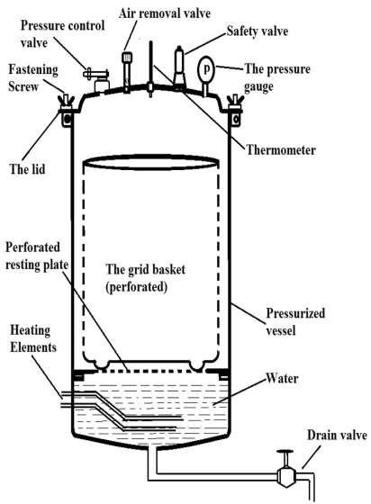
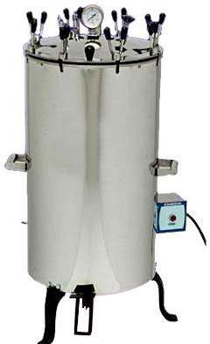
Autoclave
(Image source-Google)

Slide 24
Autoclave
Vertical or horizontal cylindrical body
Articles sterilized: Culture media, dressings, certain equipment, linen, rubber (gloves), heat-resistant plastics, liquids etc.
Ineffective for sterilizing substances that repel moisture (oils, waxes, or powders)
Kills all the vegetative as well as spore forms of bacteria
Sterilization controls:
Thermocouples
Chemical indicators- Brown’s tube No.1 (black spot)
Bacteriological spores- Bacillus stearothermophilus

Slide 25
RADIATION:
Ionizing and non-ionizing
Non-ionizing rays
low energy rays, poor penetrative power
Rays of wavelength longer than visible light
Microbicidal
wavelength of UV rays: 200-280 nm, 260 nm most effective
UV rays induce formation of thymine-thymine dimers, ultimately inhibits
DNA replication
UV readily induces mutations in cells
Don’t kill spores

Slide 26
Uses of UV radiation:
Disinfection of closed areas in microbiology laboratory, inoculation hoods, laminar flow, and operating theaters
Harmful to skin and eyes
Doesn't penetrate glass, paper or plastic
Of use in surface disinfection
Generated using a high-pressure mercury vapor lamp

Slide 27
Ionizing rays
High-energy rays, good penetrative power
Radiation does not generate heat- "cold sterilization“
e.g. (a) X-rays, (b) gamma rays, and (c) cosmic rays
Gamma radiation from cobalt-60 source-
sterilization of antibiotics, hormones, vitamins, sutures, catheters, animal feeds, metal foils, and plastic disposables, such as syringes, petri dishes
A dosage of 2.5 megarads kills all bacteria, fungi, viruses and spores
Also used for meat and other food items
Damage the nucleic acid of the microorganism

Slide 28
FILTRATION:
Does not kill microbes, it separates them out
Membrane filters with pore sizes between 0.2-0.45 μm
used to remove microbes from heat labile liquids such as serum,
antibiotic solutions, sugar solutions, urea solution
For removing bacteria from ingredients of culture media, preparing suspensions of viruses and phages
Aided by using either positive or negative pressure using vacuum
pumps
Older filters made of earthenware or asbestos- depth filters

Slide 29
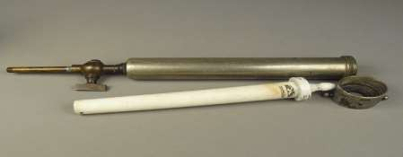
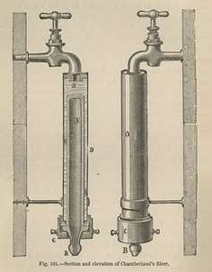
Types of filters
Earthenware filters:
  Made up of diatomaceous earth or
porcelain
  usually baked into the shape of candle
Pasteur-Chamberland filter:
  Candle filters from France, of porcelain
  Various porosities, graded as L1, L1a,
L2, L3, L5, L7, L9 and L11
• ..
Similar filter from Britain is Doulton;
P2, P5 and P11
(Image source: https://www.nlm.nih.gov)

Slide 30
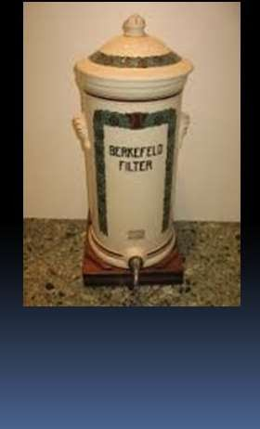
b. Berkefeld filter:
..
made of Kieselguhr, a fossilized diatomaceous earth found in Germany
Three grades depending on their porosity (pore size)
V (veil), N (normal) and W (wenig)
Mandler filter:
  from America
  made of kieselguhr, asbestos and plaster of Paris

Slide 31
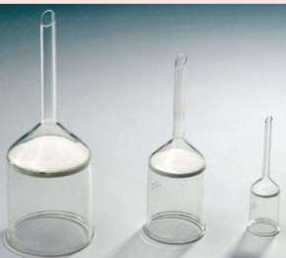
Asbestos filters:
Made up of asbestos such as magnesium silicate
Examples- Seitz and Sterimat filters
Disposable, single-use discs in different grades
Tend to alkalinize the filtered fluid
Use limited, carcinogenic potential of asbestos Sintered glass filters:
Made up of finely powdered glass particles,
which are fused together
Available in different pore sizes

Slide 32
Membrane filters:
made up of
(a) Cellulose acetate
(b) Cellulose nitrate,
(c) Polycarbonate
(d)Polyvinylidene fluoride,
(e) Other synthetic materials
Widely used, circular porous membranes, usually 0.1 mm thick
Variety of pore sizes (0.015–12 μm)
Membranes with pores about 0.2 μm are used, smaller than the size of bacteria

Slide 33
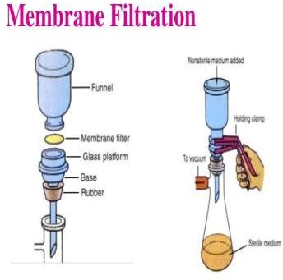
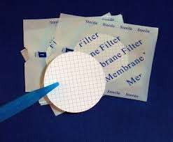
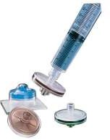
Uses of membrane filters
Sterilize pharmaceutical substances, ophthalmic solutions, liquid culture media, oils, antibiotics, and other heat-sensitive solutions
To obtain filtrates specimens isolation
bacterial free
of
clinical
for virus
To separate toxins and bacteriophages from bacteria

Slide 34
Chemical Methods of Sterilization
Several chemical agents- antiseptics/ disinfectants
Properties of Ideal Disinfectant
Wide spectrum of antimicrobial activity
Should act in the presence of organic matter
Non-toxic, non-corrosive
Stable upon storage, no chemical change
Odorless or with a pleasant odor
Soluble in water, lipids for penetration into microorganisms
Effective in acidic as well as in alkaline media
Speedy action, relatively inexpensive

Slide 35
Action of Disinfectants
Damage to the cell wall and alter permeability of the cell membrane, resulting in
exposure, damage, or loss of the cellular contents
Alter proteins and form protein salts or cause coagulation of proteins
Inhibit enzyme action, nucleic acid synthesis or alter nucleic acid molecules
Cause oxidation or hydrolysis
Factors Influencing Activity of Disinfectants
Temperature: Increase in temp. increases the efficiency of disinfectants
Type of microorganism: Vegetative cells more susceptible than spores. Spores may
be resistant
Physiological state of cell: Young and metabolically active cells more sensitive
Environment: Physical or chemical properties of medium or substance
e.g., pH of the medium and presence of extraneous materials

Slide 36
Types of Disinfectants
(a) phenolic compounds
(b) halogens
(c) alcohols
(d) aldehydes
(e) gases
(f) surface active agents
(g) oxidizing agents
(h) dyes
(i) heavy metals
(j) acids and alkalis

Slide 37
ALCOHOLS:
Mode of action:
Alcohols dehydrate cells, disrupt membranes and cause coagulation of
protein
Examples:
Ethyl alcohol, isopropyl alcohol and methyl alcohol
Application:
70% ethyl alcohol (spirit) is used as antiseptic on skin
Isopropyl alcohol is preferred to ethanol
Also used to disinfect surfaces
Used to disinfect clinical thermometers
Methyl alcohol kills fungal spores, hence is useful
inoculation hoods
in disinfecting
Disadvantages:
Skin irritant, volatile (evaporates rapidly), inflammable

Slide 38
ALDEHYDES:
Mode of action:
Acts through alkylation of amino-, carboxyl- or hydroxyl group, damages nucleic acids.
It kills all microorganisms, including spores
Examples:
Formaldehyde, Glutaraldehyde
Application:
Bactericidal, sporicidal, and also effective against viruses
Can also be used as chemical sterilants
40% Formaldehyde (formalin): for surface disinfection and fumigation
10% formalin with 0.5% tetraborate sterilizes clean metal instruments
2% glutaraldehyde
To disinfect hospital and laboratory equipments
An exposure of at least 3 hours at alkaline pH is required for action by
glutaraldehyde
Especially effective against tubercle bacilli, fungi, and viruses

Slide 39
PHENOL:
Mode of action:
Act by disruption of membranes, precipitation of proteins and inactivation
of enzymes
Examples:
5% phenol, chloroxylenol
1-5% Cresol, 5% Lysol, hexachlorophene, chlorhexidine,
Applications:
As disinfectants at high concentration and as antiseptics at low
concentrations
Bactericidal, fungicidal, but are inactive against spores and most viruses
Effective in the presence of organic material and remain active on surfaces long after application

Slide 40
HALOGENS:
Mode of action:
Oxidizing agents and cause damage essential sulfydryl groups of enzymes
by oxidation of
Chlorine reacts with water to form hypochlorous acid, microbicidal
Examples:
Chlorine compounds (chlorine, bleach, hypochlorite) and iodine compounds (tincture iodine, iodophores)
Application:
Effective disinfectants and antiseptics
Microbicidal
Also sporicidal with longer exposure

Slide 41
HEAVY METALS:
Mode of action:
Act by precipitation of proteins and oxidation of sulfydryl groups
They are bacteriostatic
Examples:
Mercuric chloride, silver nitrate, copper sulfate, organic mercury
salts (e.g., mercurochrome, merthiolate)
Applications:
Silver compounds as antiseptics
Silver sulfadiazine for burns
Silver nitrate in eye infection
Merthiolate in 1:10000 -preservation of serum
Copper salts as a fungicide

Slide 42
SURFACE ACTIVE AGENTS:
Mode of actions:
Disrupt membrane resulting in leakage of cell constituents
Examples:
Soaps or detergents, anionic or cationic
Anionic detergents- soaps and bile salts
Cationic detergents are known as quaternary ammonium compounds (or quat)
Cetrimide and benzalkonium chloride act as cationic detergents
Application:
active against vegetative cells, Mycobacteria and enveloped viruses
As disinfectants at dilution of 1-2% for domestic use and in hospitals

Slide 43
DYES:
Acridine dyes, Aniline dyes
Act by interfering with the synthesis of nucleic acids and proteins in
bacterial cells
Acridine dyes such as acriflavin and aminacrine
More effective against gram positive bacteria than gram negative bacteria and are more bacteriostatic in action
Aniline dyes (such as gentian violent, crystal violet, and malachite green)
Also more active against Gram-positive bacteria than against Gram- negative organisms
Applications:
Topically as antiseptics, on skin treat bacterial skin infections
The dyes are used as selective agents in certain selective media

Slide 44
HYDROGEN PEROXIDE:
Mode of action:
Release of nascent oxygen, that damages proteins and DNA of microorganisms
Application:
6% concentration to decontaminate the instruments, equipments such as
ventilators
3% for skin disinfection and deodorising wounds and ulcers
Strong solutions are sporicidal
BETA-PROPIOLACTONE (BPL):
Mode of action:
Acts through alkylation of carboxyl- and hydroxyl- groups
Application:
Effective sporicidal agent, broad-spectrum activity, 0.2%
biological products
Carcinogen
to sterilize

Slide 45
ETHYLENE OXIDE (EO):
Mode of action:
by alkylating sulfydryl-, amino-, carboxyl- and hydroxyl- groups
Application:
Effective chemisterilant, capable of killing spores rapidly
Highly flammable,
used as 10% CO₂+ 90% EO) or
dichlorodifluoromethane
Used to sterilize heat labile articles such as bedding, textiles, rubber, plastics, syringes, disposable petri dishes, respiratory and dental equipments
Highly toxic, irritating to eyes, skin, highly flammable, mutagenic
and carcinogenic

