Slide 1

Radiographic positioning of Upper Extremities
Yuvraj Maharshi
Lecturer
Department Of Paramedical Science,svdu

Slide 2
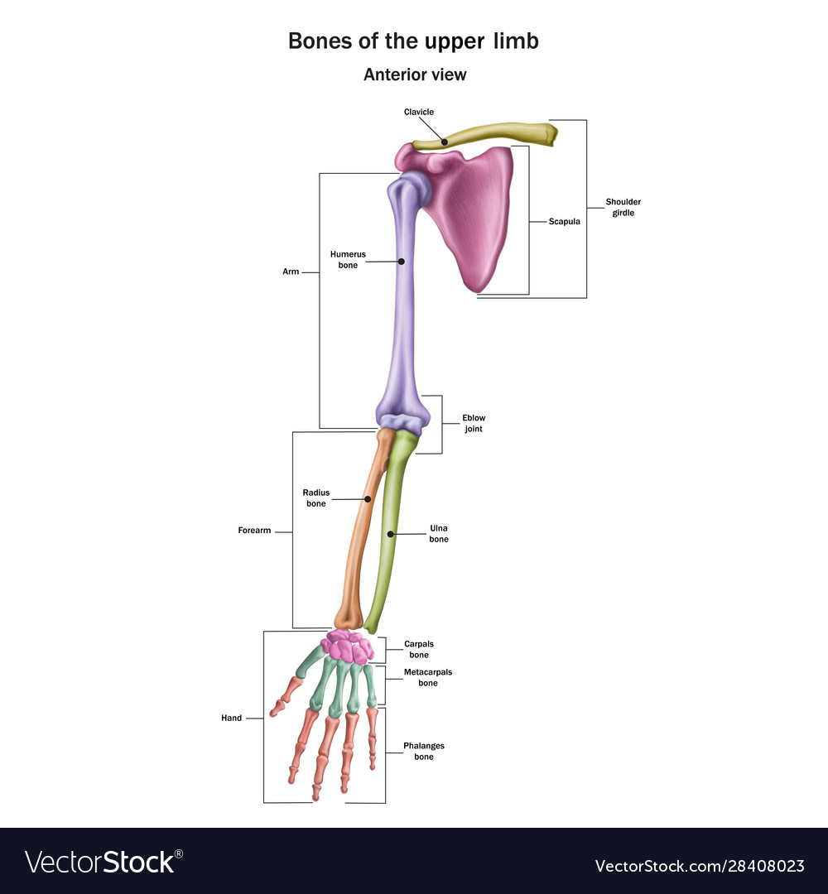
Content
The upper Extremities consists of 60 bones:
Humerus - 2
Ulna - 2
Radius - 2
Carpals - 16
Metacarpals - 10
Phalanges - 28

Slide 3
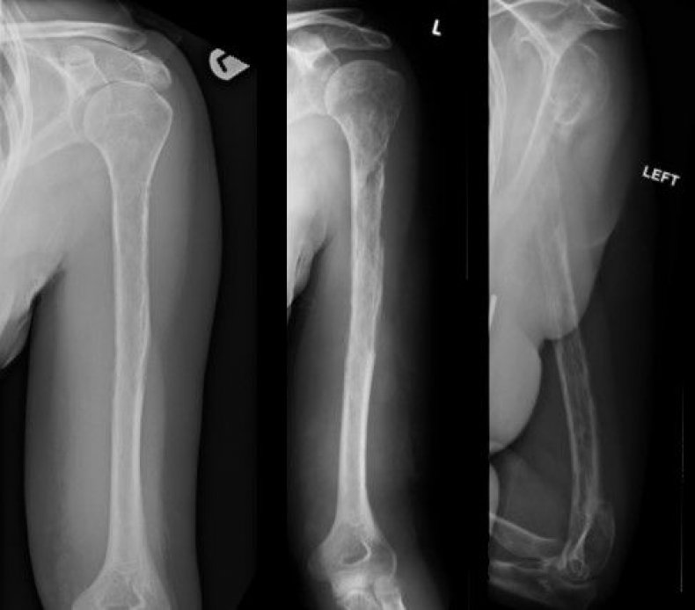
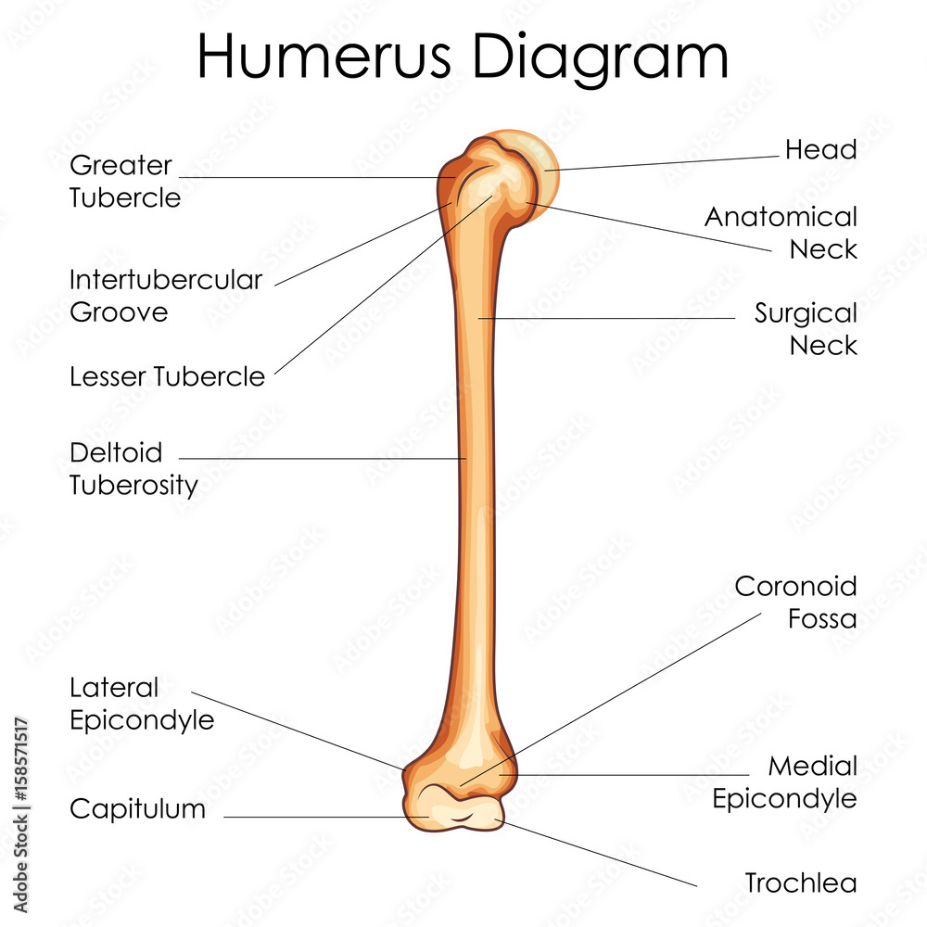
Humerus Anatomy
Longest and strongest bone of the upper limb.
The humerus articulates proximally at the shoulder joint .
The humerus articulates distally at the elbow joint.

Slide 4
Indication of AP humerus
Exclude large humeral shaft fractures
Suspected symptomatic metastatic lesions
Trauma
Bony tenderness at the glenohumeral joint/region
Restriction of abduction
Suspected dislocation
Suspected bone tumors .

Slide 5
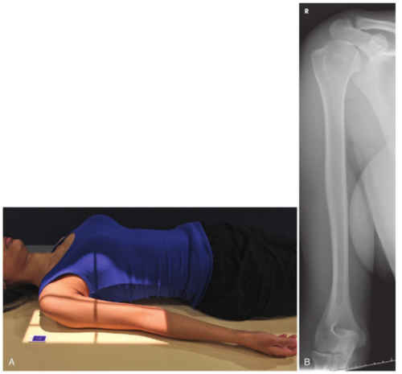
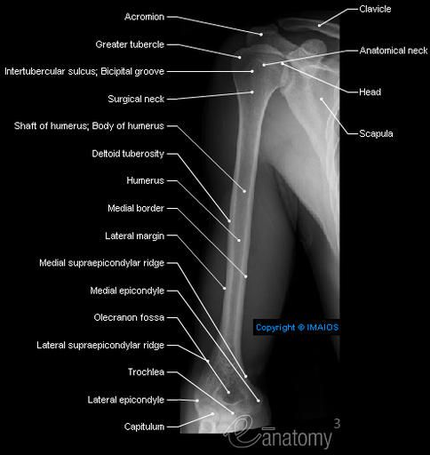
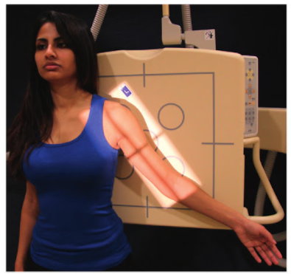
AP Humerus
35 × 43 cm L.W. (14 × 17″)
Position:-Erect or supine with humerus aligned to long axis of IR Place shield over gonads.
Abduct arm slightly, supinate hand for true AP (epicondyles parallel to IR)
Central Ray: to mid humerus
Collimation:-

Slide 6
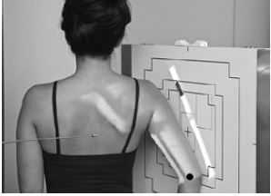
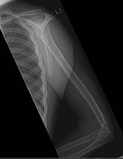
Rotational Lateral Humerus
Erect (PA): Elbow flexed 90°, patient rotated 15°-20° from PA
Central Ray: mid humerus

Slide 7
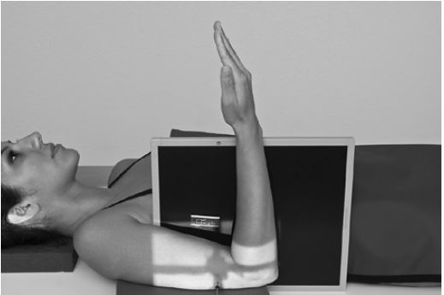
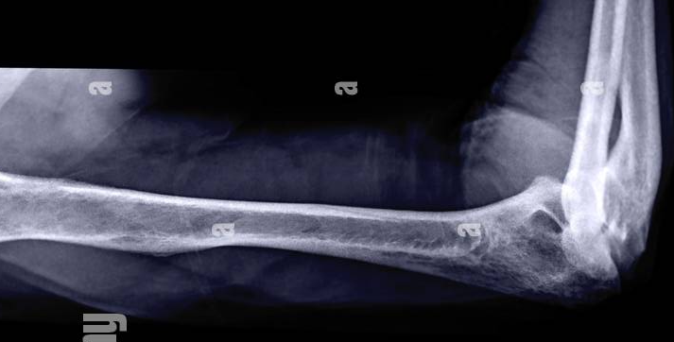
Trauma Lateral Humerus
(Midhumerus and Distal Humerus)
30 × 35 cm L.W. (11 × 14″) or 24 × 30 cm L.W. (10 × 12″
No grid
Position:- Gently lift arm and place support block under arm, rotate hand into lateral position if possible for true lateral elbow projection.
Place IR vertically between arm and thorax with top of IR at axilla

Slide 8
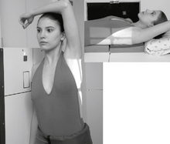
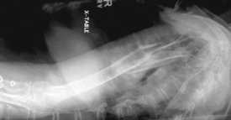
Trauma Transthoracic Lateral Humerus
35 × 43 cm L.W. (14 × 17″)
Grid
Position :- Patient lying down or erect
Affected limb closest to IR
Raise opposite arm over head
Central Ray : mid-shaft of affected humerus
Respiration:

Slide 9
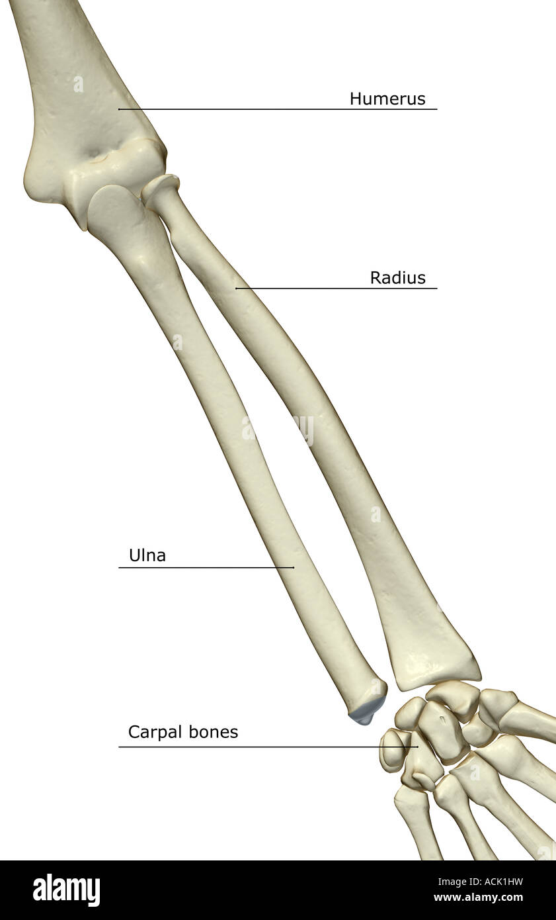
Forearm Anatomy
It consists of 2 bones :
Ulna
Radius
Proximal ends articulate with the humerus
Distal ends articulates with carpals

Slide 10
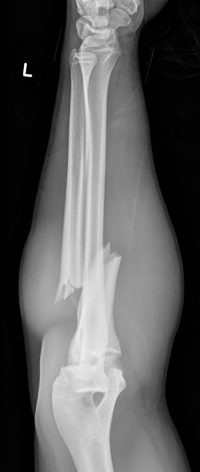
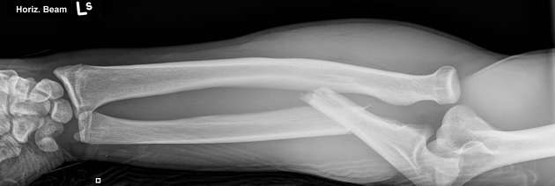
Indication of forearm
Trauma
Bony tenderness
Suspected fracture
Obvious deformity
Non-traumatic pain
Suspected foreign body

Slide 11
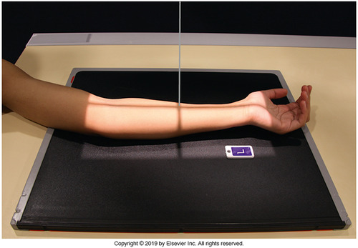
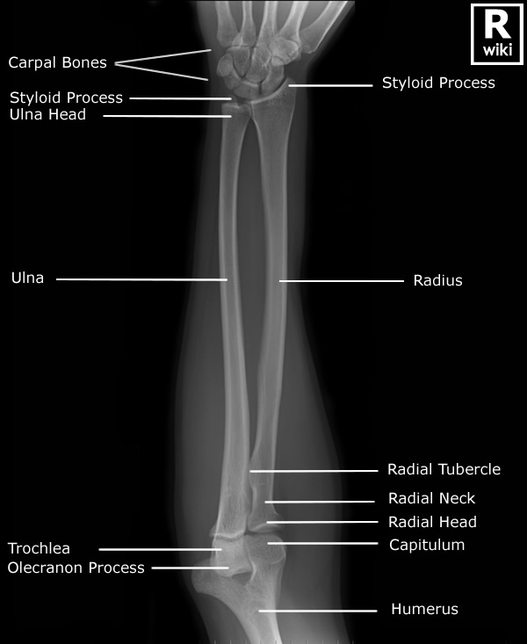
AP Forearm
35 × 43 cm L.W. (14 × 17″) or 30 × 35 cm (11 × 14″) for smaller patients
No grid
Position:-Patient seated at end of table with arm extended and hand supinated
Ensure that both wrist and elbow joints are included
Central Ray: midpoint of forearm

Slide 12
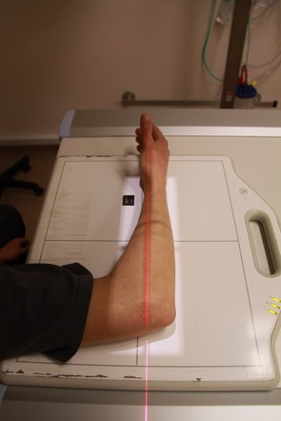
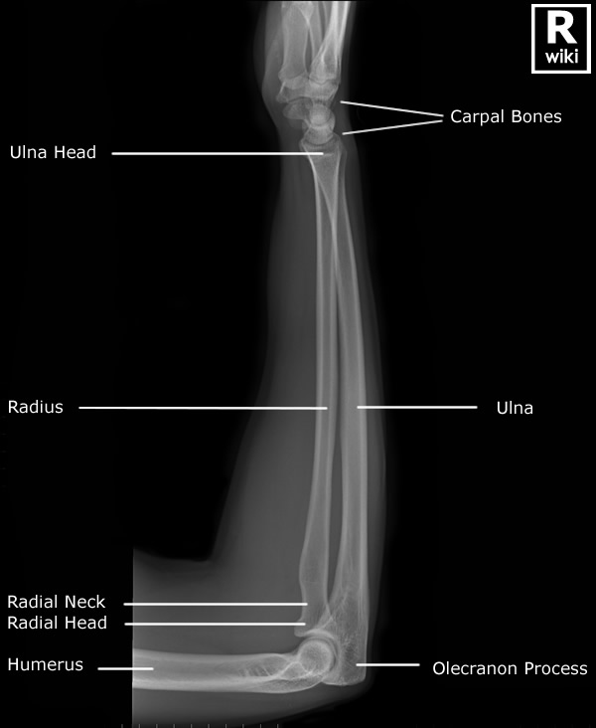
Lateral Forearm
No grid
Position :- Elbow should be flexed 90°
Central Ray:- midpoint of forearm

Slide 13
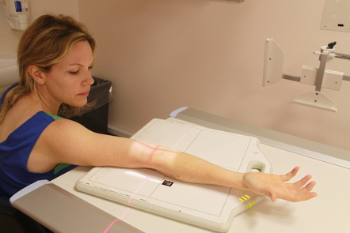
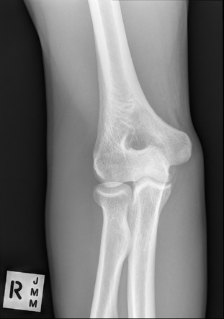
AP Elbow
24 × 30 cm L.W. (10 × 12″)
No grid
Position :- Elbow extended and hand supinated
Central Ray: mid elbow joint

Slide 14
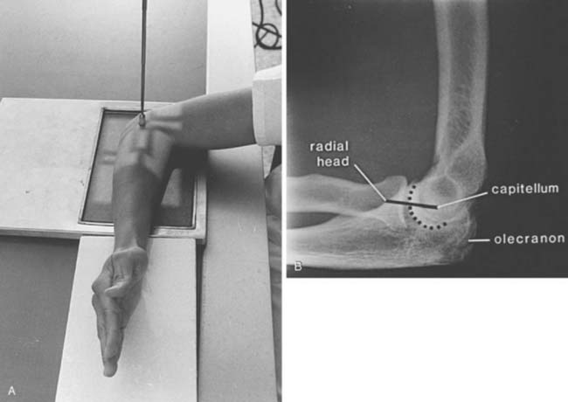
Lateral Elbow
24 × 30 cm L.W. (10 × 12″)
No grid
Position : elbow flexed at 90° ,shoulder dropped as needed to rest forearm and humerus flat on table and IR
Central Ray: mid elbow joint

Slide 15
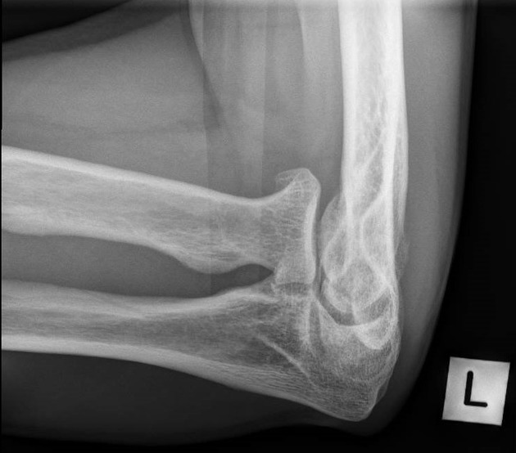
Trauma Axial Lateral Elbow
(Coyle Method)
The Coyle's view is performed for any patient with a suspected radial head fracture 1-3 or dislocation.
Position and Central Ray : Elbow flexed 90° if possible,
Angle CR 45° toward thorax, centered to radial
head and neck (CR to enter at mid-elbow joint)

Slide 16
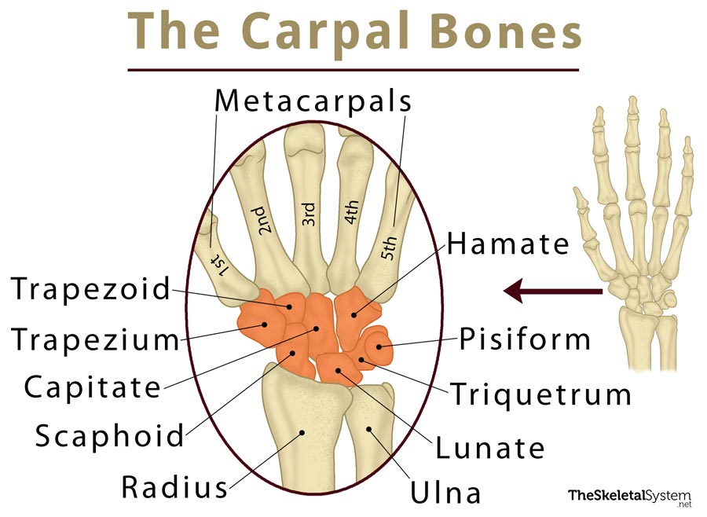
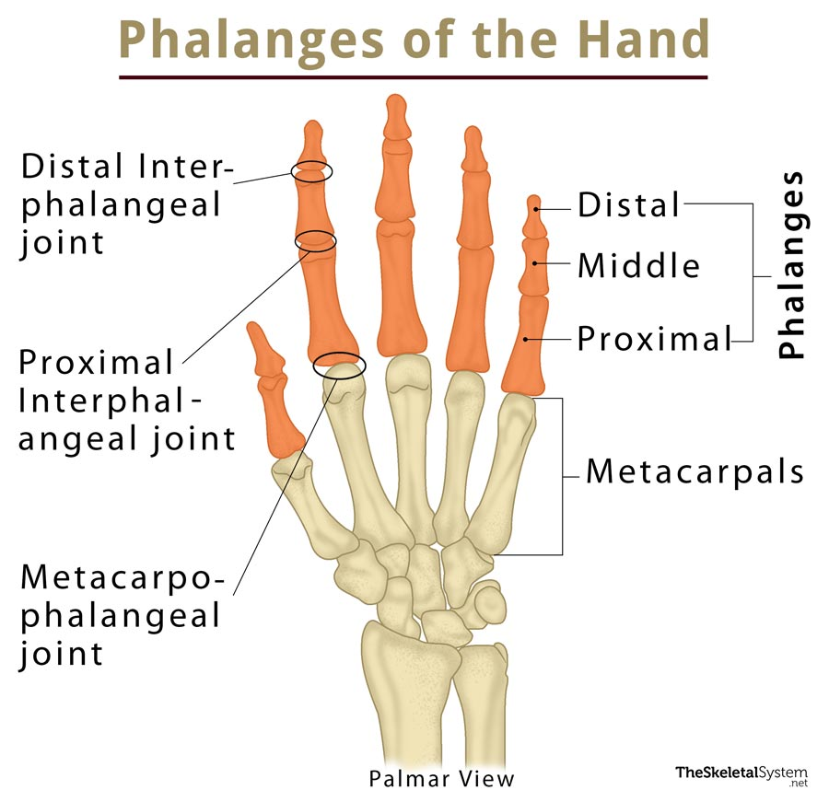
Hand Anatomy
Carpals – 8
Wrist
Metacarpals -5
Palm
Phalanges - 14 Fingers
She Looks Too Pretty Try To Catch
Her
S - scaphoid
L - lunate
T - triquetrum
P - pisiform
T - trapezium
T - trapezoid
C - capitate
H - hamate
Head
Body
Base
Finger:- 4x3=12
Thumb:- 2
Proximal
Middle
Distal

Slide 17
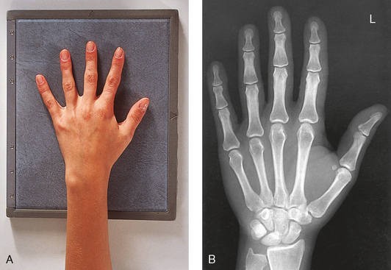
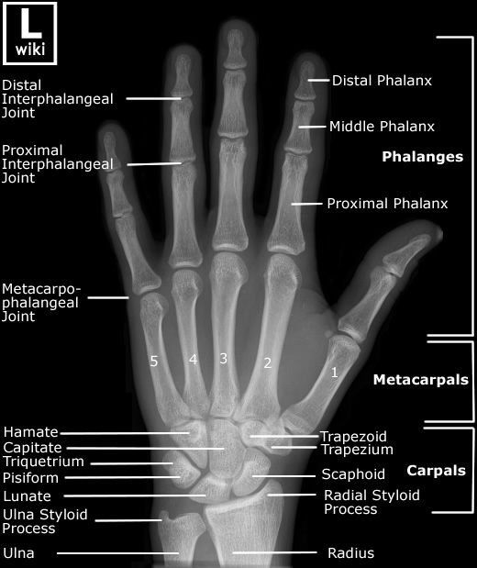
PA Hand
(10 × 12″)
18 × 24 cm L.W. (8 × 10″) smaller hand
No grid
Position :- Patient seated, hand on table, elbow flexed
Central Ray: Centered to 3rd MCP joint

Slide 18
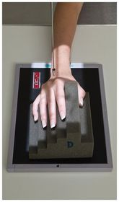
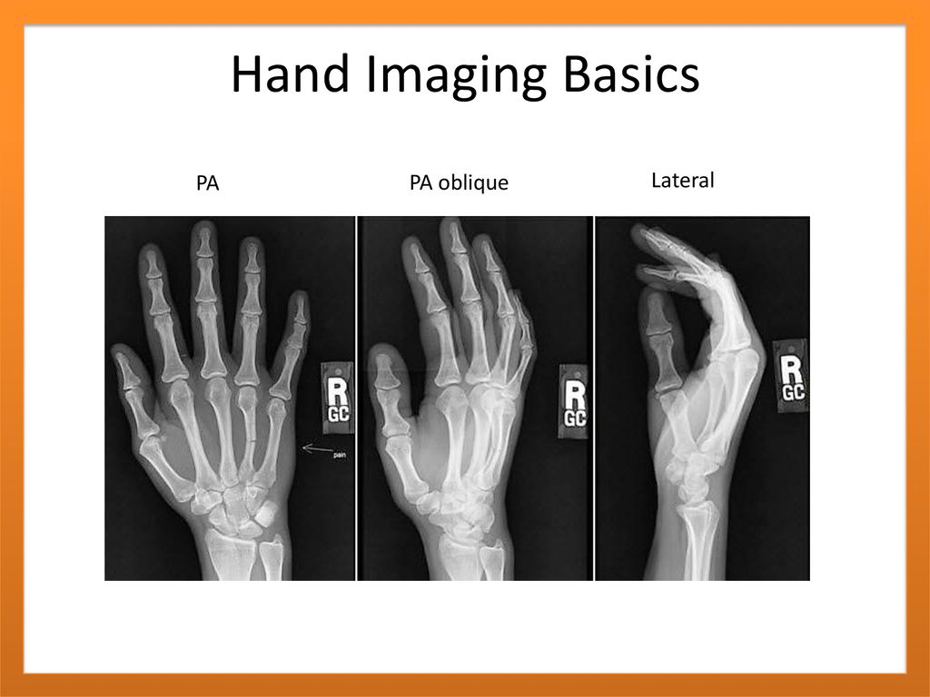
PA Oblique Hand
L.W.10 × 12 or 8 × 10
No grid
Position : Patient seated, hand on table, elbow flexed. Rotate entire hand and wrist laterally 45°, support with wedge or step block. Align hand and wrist to IR.
Central Ray: Centered to 3rd MCP joint

Slide 19
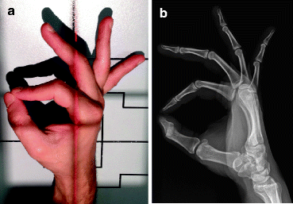
“Fan” Lateral Hand
Anatomy : hand/wrist and 1″ (2.5 cm) distal forearm
interphalangeal and MCP joints open position
position : phalanges and metacarpal surfaces symmetric
distal radius, ulna, and metacarpals superimposed

Slide 20
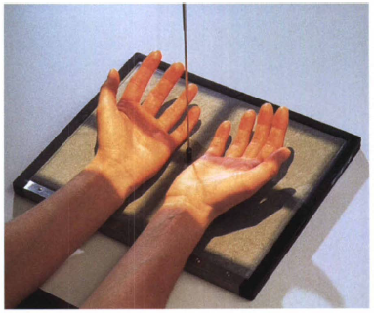
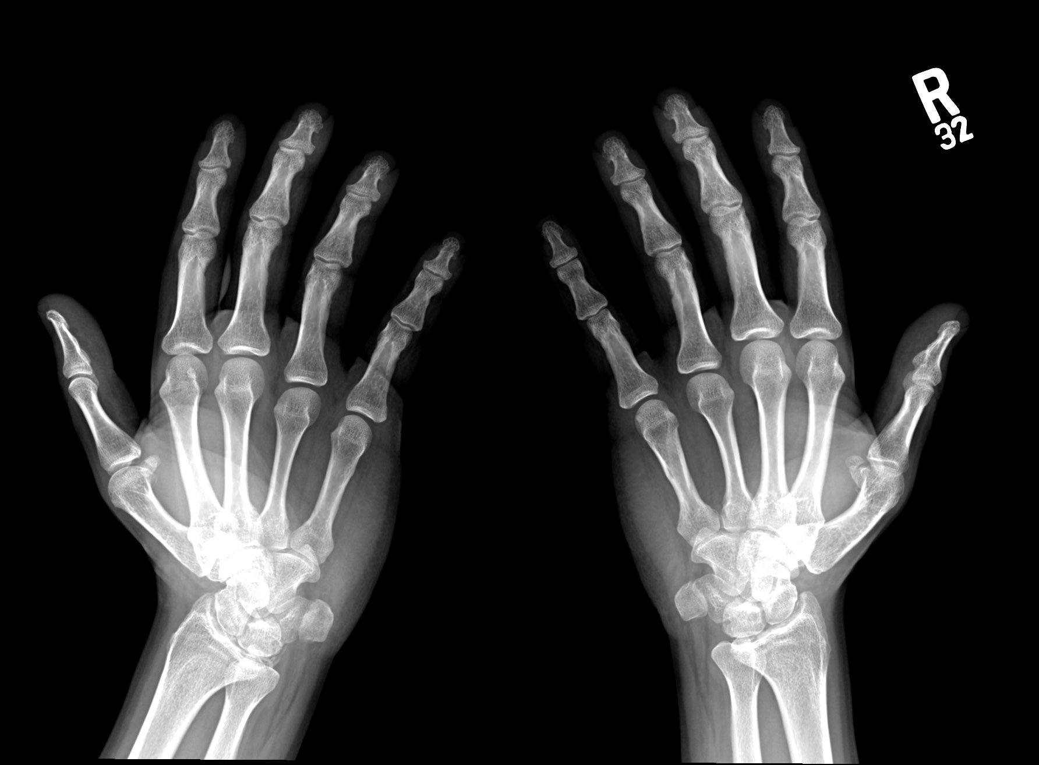
AP Oblique Bilateral Hand
(Norgaard Method and Ball-Catcher’s)
10×12 crosswise or 14×17 crosswise
No grid
Position : Patient seated at end of table, both arms and hands extended with palms up and hands obliqued 45°, medial aspects touching.
Fingers fully extended supported by 45° support blocks.
Central Ray: CR ⊥, centered to midway between 5th MP joints

Slide 21
Paediatric AP Upper Limb
IR size determined by
patient age and size
Position : Supine position, arm abducted away from body, lead shield over pelvic area
Include entire limb unless a specific joint or bone is indicated
Immobilize with clear flexible-type retention band and sandbags, or with tape
Use parental assistance only if necessary, provide lead gloves and apron
Central Ray: centered to mid limb

Slide 22


