Slide 1

Myelogram
Yuvraj Maharshi
Lecturer
Department Of Paramedical Sciences,SVDU

Slide 2
Definition
A myelogram is a diagnostic imaging procedure in which contrast dye is injected into the spinal canal to visualize the spinal cord, nerve roots, and surrounding structures using fluoroscopy or CT. It helps detect abnormalities that may not be visible on MRI or plain X-rays

Slide 3
Indications
Spinal abnormalities
Herniated discs.
Spinal stenosis.
Spinal cord tumors or cysts.
Nerve compression
Radiculopathy.
Sciatica.
Spinal trauma
Fractures.
Suspected spinal cord injury.

Slide 4
Post-surgical evaluation
To assess scarring or surgical complications.
Contraindications to MRI
Patients with implanted devices incompatible with MRI.

Slide 5
Contraindications
Absolute
Allergy to iodine-based contrast agents.
Active infection near the puncture site.
Increased intracranial pressure.
Coagulopathy or bleeding disorders.
Relative
Severe degenerative spine disease.
Pregnancy (relative contraindication due to radiation exposure).

Slide 6
Equipment
Sterile equipment
  Needles (spinal or lumbar puncture needle).
  Syringes and sterile drapes.
Contrast medium
  Non-ionic, water-soluble iodine-based contrast agents.

Slide 7
Imaging systems
  Fluoroscopy machine.
  CT scanner (optional for post-procedure imaging).
Miscellaneous
  Antiseptic solution, local anesthetic (lidocaine), sterile gloves, and gowns.

Slide 8
Patient Preparation
Pre-procedure instructions
  Discontinue anticoagulants (if necessary, after consultation).
  Fasting for 4–6 hours before the procedure.
  Ensure hydration to help eliminate contrast medium post-procedure.
Pre-procedure assessment
  Allergy history (contrast agents).
  Recent imaging studies.
  Neurological examination.
Consent
  Explain the procedure, risks, and aftercare to obtain informed consent.

Slide 9
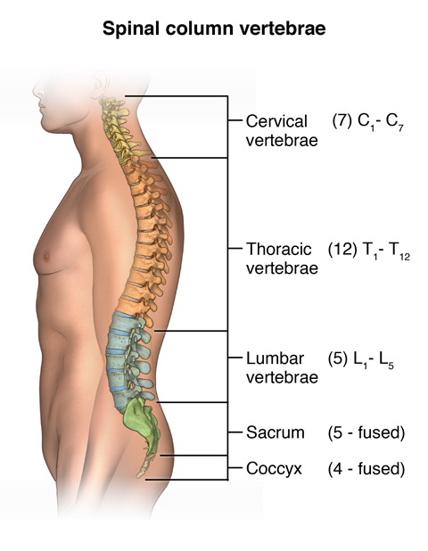

Slide 10
Procedure
Positioning
Patient lies prone or lateral with knees and neck flexed to expose the lumbar spine.
Sterile preparation
The area is cleaned and draped.
Lumbar puncture
Needle is inserted at L3-L4 or L4-L5 interspace under fluoroscopic guidance.

Slide 11
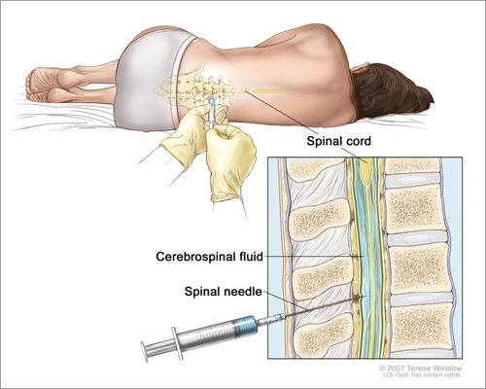

Slide 12
Contrast injection
A small amount of CSF may be withdrawn first.
Contrast medium is injected slowly.
Imaging
The table is tilted, or the patient is repositioned to allow the contrast to flow.
Real-time fluoroscopic images are taken.
CT images may follow for detailed visualization.

Slide 13
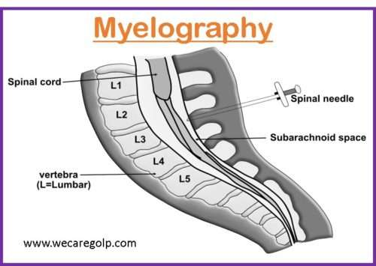

Slide 14
Imaging
Fluoroscopy
Used during the procedure to ensure proper contrast distribution.
CT myelography
Performed post-contrast injection for detailed imaging of nerve roots and spinal structures.

Slide 15
Aftercare
Post-procedure monitoring
Vital signs and neurological status are monitored for a few hours.
Hydration
Encourage increased fluid intake to flush out the contrast.

Slide 16
Positioning
Patients are often advised to lie flat for 24 hours to minimize headache risk.
Activity restriction
Avoid strenuous activity for 1–2 days

Slide 17
Complications
Common
  Post-dural puncture headache.
  Nausea or vomiting.
Rare
  Allergic reaction to contrast.
  Infection (meningitis).
  Nerve root irritation.
  Bleeding or hematoma formation.

Slide 18
Severe (extremely rare)
  Seizures due to contrast in subarachnoid space

Slide 19
Thank You

