Slide 1

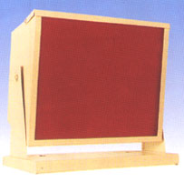
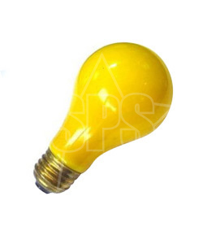
Darkroom Illumination
Yuvraj Maharshi
Lecturer
Department Of Paramedical Science,svdu

Slide 2
Place where necessary handling and processing of light sensitive film can be carried out safely and efficiently
Area from where a latent image is converted to a visible image
DAR
K
ROOM

Slide 3
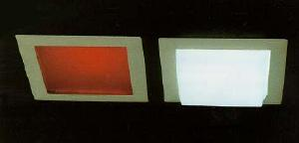
Darkroom illuminations
Ordinary white lighting
Safe lighting

Slide 4
White lighting
Inspection and maintenance of cassettes and screens.
Cleaning of work surface and floors
Servicing of equipment.

Slide 5
White lighting should be:
Close to ceiling.
Moderate in intensity(60W tungsten or 30W fluorescent)
Centrally placed

Slide 6
Safe lighting
Dim, colored lighting which provides the sufficient illumination for handling, manipulating & processing the film.
A source of light - with no film fogging
- adequate illumination under
processing condition
Safe light is not totally safe

Slide 7
Construction
Sheet of gelatin dyed filter sandwiched between two sheet of glass.
Fitted in metal lantern box.
Plain or clear glass
Colored gelatin layer
Diffusing glass
Color of the filter depends upon the sensitivity of
the x-ray film

Slide 8
How dose safelight filters works???
The pigment in the filter selectively attenuates those parts of the spectrum to which the film is most sensitive.
Infra-red
Ultravoilet
Blue
Green
Red
Yellow Filter
Yellow light

Slide 9
The pigment in the filter selectively attenuates those parts of the spectrum to which the film is most sensitive.
Ultravoilet
Infra-red
Green
Blue
Red
Red Filter
Red light

Slide 10
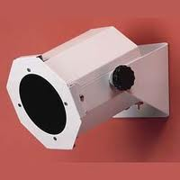
Types
Direct safelighting :
- light from the safelamp
directly falls onto the
worksurface.
- e.g. beehive safelamp
- sited at distance of 1.2 m (4 ft)
- film loading and unloading areas

Slide 11
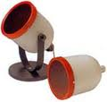
Indirect safelighting :
- intended to provide
general illumination of dark
room.
- directs lamp towards the
ceilieng
- suspended 2.1 m above floor
level.

Slide 12
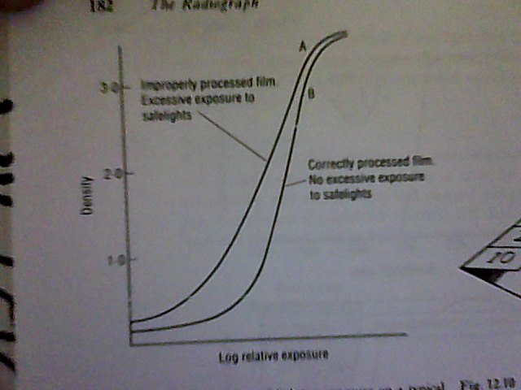
Sensitivity of exposed and unexposed film
1- an increase in
gross fog
2- an overall loss
of contrast

Slide 13
Safe film handling time
Tests to determine safe film handling time
Materials required:-
-Sheet of 30×35 cm card folded
and marked Sheet of 24х30 cm
card
- 24×30 cm screen -Type xray
film
- 24×30 cm xray cassette
- Densitometer

Slide 14
60
50
40
30
20
10
A folded card film holder for carrying out a safe film-handling time test

Slide 15
PROCEDURE
Load the cassette – no safelight is used
In the x ray room mask one half of the cassette lengthwise with a peace of lead
Make an exposure

Slide 16
while exposing
A
B
C
D
LEAD
3 MIN 30 SEC
2 MIN 30 SEC
1 MIN 40 SEC
1 MIN
30 SEC
10 SEC
XRAY
+SAFELIGHT
Only SAFELIGHT
No safelight no xray
X RAY

Slide 17
In the darkroom unload the film and place in the cardboard holder
Place the second sheet of card on top
Switch on the safelight to be tested

Slide 18
EXPOSURE TO SAFE LIGHT
AFTER XRAY EXPOSURE
A
B
C
D
CARDBOARD
60
60
60s
3 MIN 30 SEC
50s
50s
2 MIN 30 SEC
40s
40s
1 MIN 40 SEC
30s
30s
1 MIN
20s
20s
30 SEC
10 s
10 s
10 SEC
XRAY
+SAFELIGHT
No safelight no xray
X RAY
Only SAFELIGHT

Slide 19
Move the covering card down to the first marked line and expose the uncovered portion of the film for 1 min
The card is then moved to the next uncovered portion and expose for 50 sec
Proceed in the same way until the entire film has been exposed
Turn off the safelight and process the film

Slide 20
exposure to safe light
A
B
C
D
60
60
CARDBOARD
3 MIN 30 SEC
60s
50s
50s
2 MIN 30 SEC
40s
40s
1 MIN 40 SEC
30s
30s
1 MIN
20s
20s
30 SEC
10 s
10 s
10 SEC
X RAY
XRAY
+SAFELIGHT
Only SAFELIGHT
No safelight no xray

Slide 21
After processing-calculating value with densitometer
A
B
C
D
D’ | D’+0.05 Safe time to handle exposed film | D+0.05 Safe time to handle unexposed film
D
3 MIN 30 SEC
2 MIN 30 SEC
Safe light handling time ranges b/w 20 – 45 sec
1 MIN 40 SEC
1 MIN
30 SEC
10 SEC
X RAY
XRAY
+SAFELIGHT
Only SAFELIGHT
No safelight no xray

Slide 22
when should the test be carried out?
New darkroom
Where safelights have been changed or additional safelights added
If faster film material is introduced into a department
Whenever it is suspected that safelight fogging is occurring
Quality assurance programme

Slide 23


