Slide 1

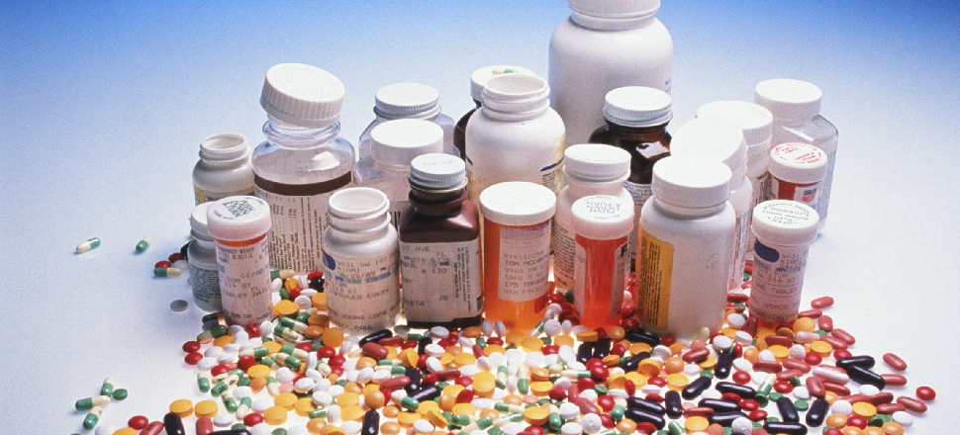
EMERGENCY MEDICINE
Mr. Yash Rakholiya
Tutor
Department of Paramedical sciences
SVDU,SBKS MI & RC

Slide 2
HEPARIN SODIUM INJECTION:
Heparin injections an anticoagulant.it is used to decrease the clotting ability of the blood and help prevent harmful clots from forming in blood vessels.
Heparin (25000 IU) 5 ML VIAL
1 ML =5000 IU
5ML=25000 IU
(5 ML Syringe-1ml heparin+4 ml ns dilute=5000 IU)
SIDE EFFECTS:
Irritation,redness,allergic reaction

Slide 3
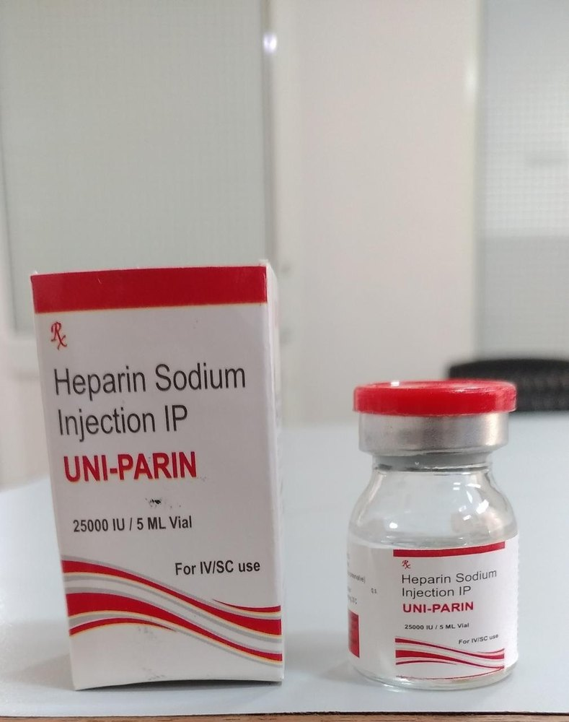
HEPARIN INJECTION:

Slide 4
Atropine Sulphate Injection:
Atropine Sulphate Injection is used to treat bradycardia (slow heart rate). It helps to restore normal heartbeat in cardiac arrest cases.(anticholinergic drug)
1ml Ampule
1ml=0.6 mg
(10 ml syringe-1 ml atropine injection+9 ml ns dilute)
SIDE EFFECTS:
Tachycardia
Decreased vision
Decreased in urine volume
Dryness of mouth,difficult swallowing,allergic reaction

Slide 5
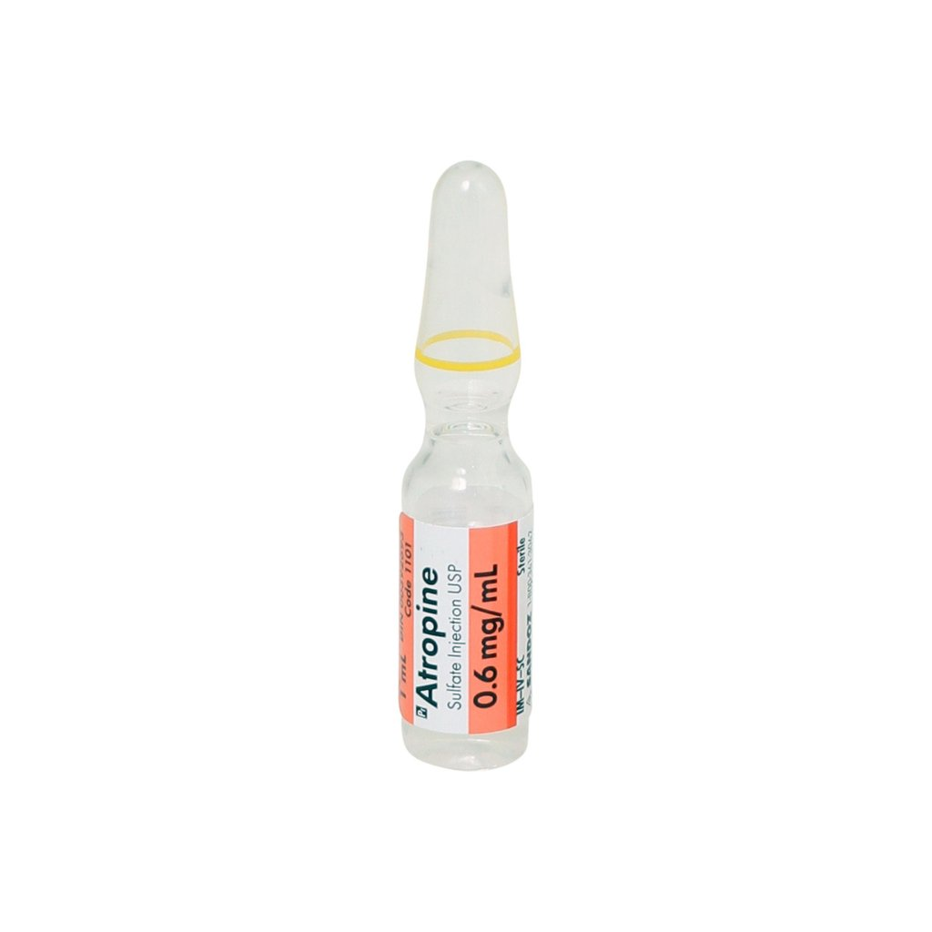
ATROPINE INJECTION:

Slide 6
Adrenaline Bitartrate Injection:
Adrenaline Tartrate Injection is used in the treatment of life-threatening emergencies like severe allergic reaction and cardiac arrest. It rapidly relieves breathlessness and wheezing by relaxing the airways. It also stimulates the heart and increases the blood pressure.
sympathomimetic agents
1 ml ampule
1 ml =1 mg
(10 ml syringe-1 ml adrenaline injection+9 ml ns dilute)
SIDE EFFECTS: Headache
Palpitations
Restlessness
Tremor

Slide 7
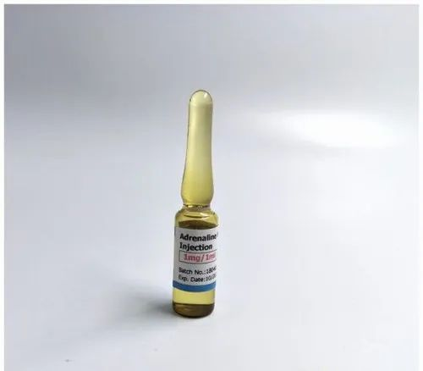
Adrenaline Bitartrate Injection:

Slide 8
Noradrenaline Biatrtrate Injection:
Norad Injection is used to treat hypotension (low blood pressure) that may occur due to causes such as sepsis (infection). It helps to increase blood pressure by narrowing the blood vessels of the heart. It may be used to revive a patient with cardiac arrest.
sympathomimetic amines.
2 ml ampule
1 ml=2mg/ 2ml=4mg
(50 ml syringe-2 ampule norad injection+46 ml ns dilute)
SIDE EFFECTS:
Systemic hypertension (high blood pressure)
Headache
Restlessness
Insomnia (difficulty in sleeping)
Palpitations
Tremors

Slide 9
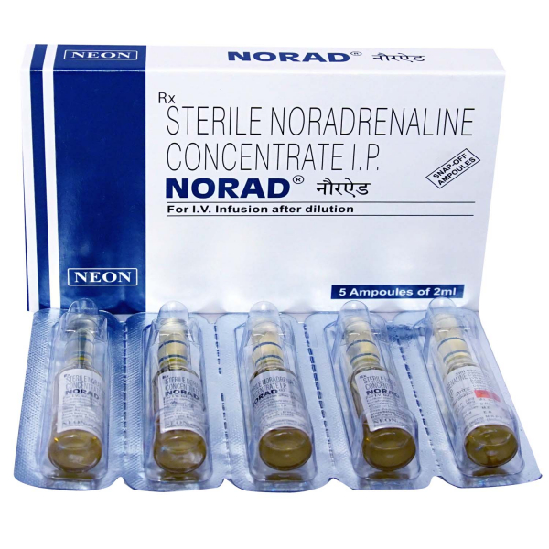
Noradrenaline Biatrtrate Injection:

Slide 10
Mephentermine Sulphate Injection:
Mephentermine Sulphate Injection is used to raise blood pressure in hypotensive (low blood pressure) states, such as following It increases the blood pressure rapidly by increasing the pumping capacity of the heart and narrowing blood vessels of the heart.
Antihypotensives
10 ml vial
1 ml=30mg
(10 ml syringe-1 ml mephentermine injection+9 ml ns dilute)
SIDE EFFECTS:
Systemic hypertension (high blood pressure)
Anxiety
Insomnia (difficulty in sleeping)
CNS stimulation

Slide 11
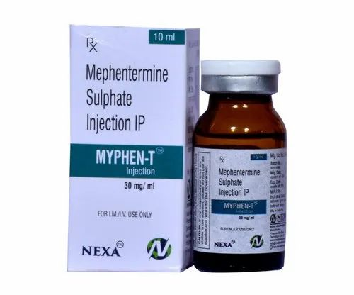
Mephentermine Sulphate Injection:

Slide 12
Avil Injection(pheniramine maleate inj):
Avil Injection is an antihistamine used to treat allergic conditions (such as hay fever, drug rashes, allergic conjunctivitis, food allergy, etc.), respiratory tract conditions, and other skin conditions. It effectively reduces the severity, duration, and occurrence of symptoms and provides quick relief.
2 ml ampule
2ml=22.75mg
(10 ml syringe-one ampule avil injection+8ml ns dilute)
SIDE EFFECTS:Sleepiness.
Dryness in mouth
Fast/irregular heart beat
Blurred vision

Slide 13
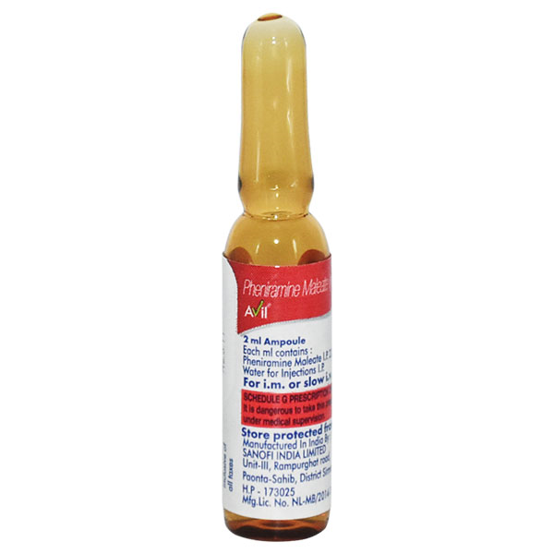
Avil Injection(pheniramine maleate inj):

Slide 14
Hydrocort Injection:
Hydrocort Injection belongs to a group of medicines called corticosteroids. It is used to treat a variety of diseases and conditions such as severe allergic reactions, allergic conditions, cancer, and skin and eye disorders. It is used for the treatment of conditions that need a quick response.
Corticosteroids
100 mg vial
(10 ml syringe-100mg hydrocort inj+9ml ns dilute)
SIDE EFFECTS:
back pain
lightheadedness, dizziness, or fainting
Cough
eye pain and blurred vision

Slide 15
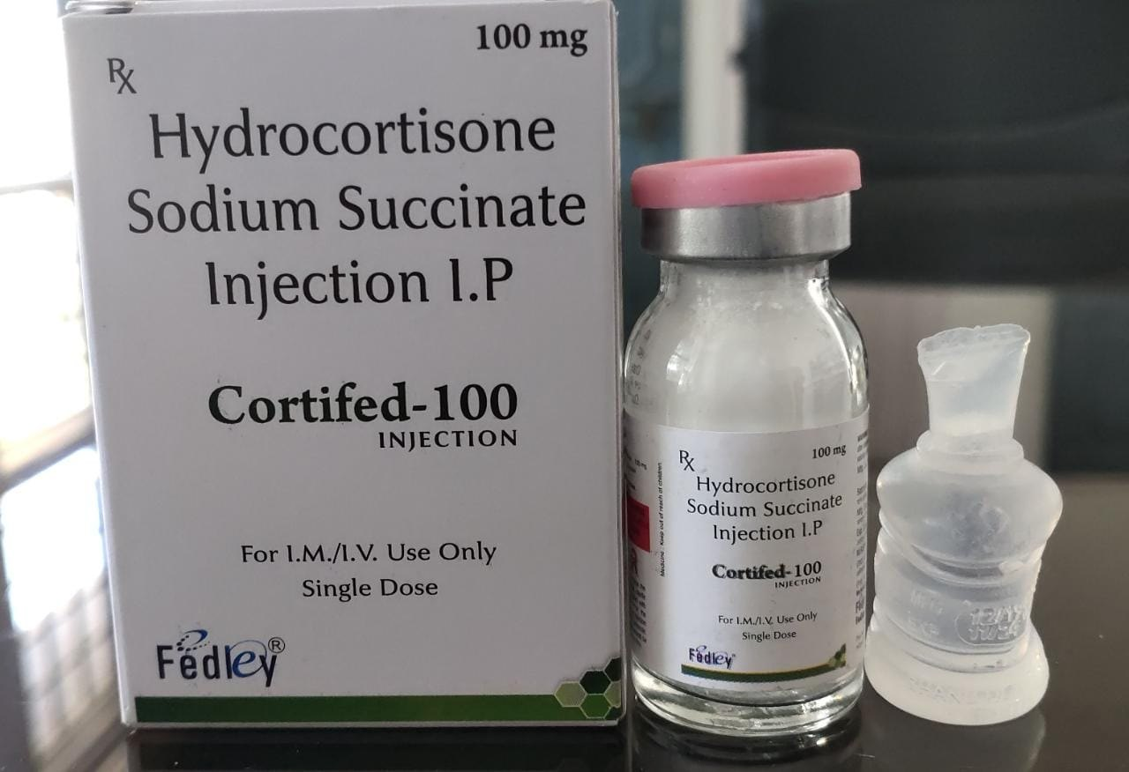
Hydrocort Injection:

Slide 16
Ntg Injection:
Ntg Injection is used to treat and prevent heart-related chest pain (angina) and hypertension (high blood pressure) during surgery. This medicine works by relaxing and widening blood vessels so blood can flow more easily to the heart. It has a very short-lived effect.
5 ml ampule
1 ml =50 mg
(5ml syringe-5ml ntg+500 ml ns pine dilute)
Nitrates
SIDE EFFECTS:
Blurred vision
Decreased blood pressure
Dizziness
Headache
Increased heart rate
Lightheadedness

Slide 17
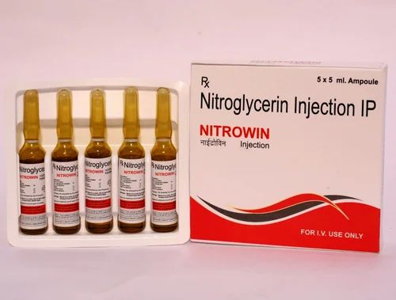
Ntg Injection:

Slide 18
Dilzem Injection:
Dilzem IV Injection is used to treat angina (heart-related chest pain), high blood pressure and some types of irregular heartbeats (arrhythmia). It works by relaxing blood vessels to lower blood pressure. This helps to reduce the workload of the heart.
Calcium-channel blocker
5 ml vial/25mg per ml
1ml=5mg
SIDE EFFECTS:
Headache
Dizziness
Nausea
Edema (swelling)
Hypotension (low blood pressure)
Injection site reactions (pain, swelling, redness)

Slide 19
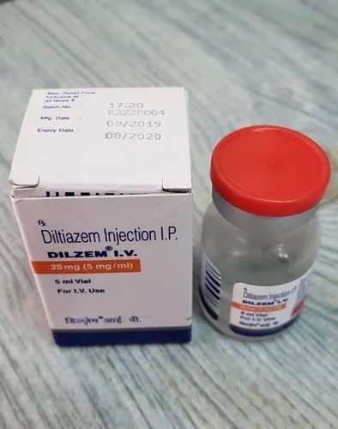
Dilzem Injection:

Slide 20
Metoprolol tartrate injection:
Metolar Injection belongs to a group of medicines called beta-blockers. It is used to treat emergency high blood pressure (hypertensive emergency), angina (heart-related chest pain), irregular heart rhythms (arrhythmia).
5 ML Ampule
1ml=1mg
SIDE EFFECTS:
Orthostatic hypotension (sudden lowering of blood pressure on standing)
Slow heart rate
Headache
Dizziness
Tiredness
Nausea
Stomach pain
Breathlessness
Itching

Slide 21
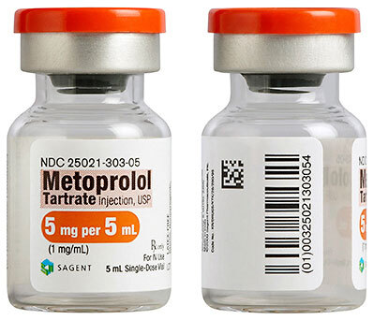
Metoprolol tartrate injection:

Slide 22
Tramdol Injection:
Tramdol Injection is a pain-relieving medicine. It is used to manage persistent, moderate to severe chronic pain that requires continuous, around-the-clock treatment.
2ml ampule
1 ml =50mg
SIDE EFFECTS:
Nausea
Constipation
Sleepiness
Dizziness
Vomiting

Slide 23
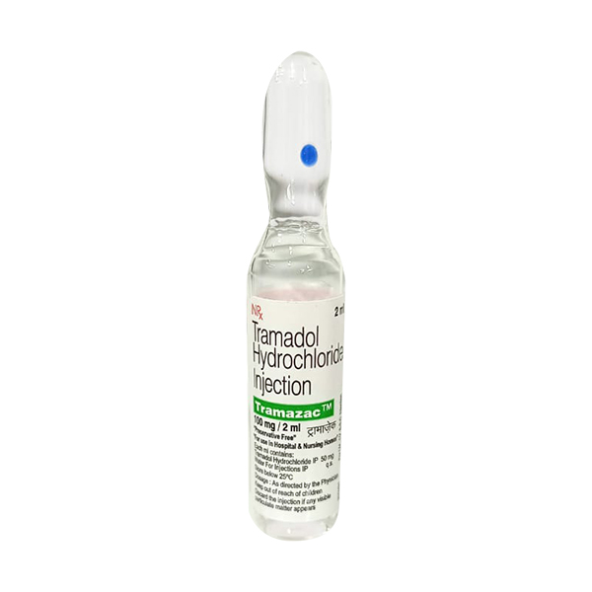
Tramdol Injection:

Slide 24
Protamine sulfate:
Protamine sulfate is used in the treatment of heparin overdose
5ML Vial/50mg per ml
1 ml=10mg
SIDE EFFECTS:
Decreased blood pressure
Slow heart rate
Injection site reactions (pain, swelling, redness)

Slide 25
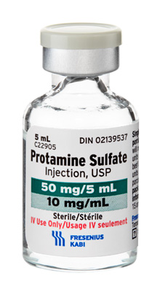
Protamine sulfate:

Slide 26
Taxim Injection:
Taxim 1gm Injection is an antibiotic medicine used to treat bacterial infections in your body. It is effective in infections of the brain, lungs, ear, urinary tract, skin and soft tissues, bones and joints, blood, and heart. It is also used to prevent infections during surgery.
antibiotic
1G VIAL
1G=1000 mg
SIDE EFFECTS:
Injection site reactions (pain, swelling, redness)
Hypersensitivity
Gastrointestinal disorder

Slide 27
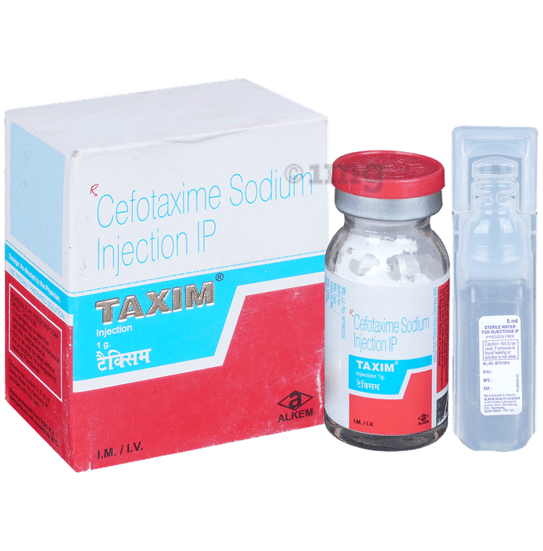
Taxim Injection:

Slide 28
Lasix Injection:
Lasix Injection belongs to a group of medicines called diuretics. It is used for the emergency treatment of very high blood pressure (hypertensive emergency), as it reduces the blood pressure immediately. It also rapidly reduces the swelling (edema) caused by too much water in the body.
Diuretics
4ml ampule
1 ml=10mg
SIDE EFFECTS:
Dizziness
Weakness
Dehydration
Decreased potassium level in blood
Increased blood uric acid
Decreased magnesium level in blood

Slide 29
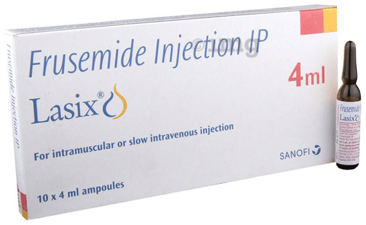
Lasix Injection:

Slide 30
Aggramed 5mg Infusion:
aggramed 5mg Infusion is a blood thinner which prevents formation of harmful blood clots. It helps to prevent a heart attack in patients presenting with severe chest pain due to a sudden decrease in blood flow to the heart.
5mg/100 ml
SIDE EFFECTS:
Headache
Nausea
Hematoma
Ecchymosis (discoloration of the skin resulting from bleeding underneath)
Postoperative bleeding
Blood in stool
Blood in urine

Slide 31
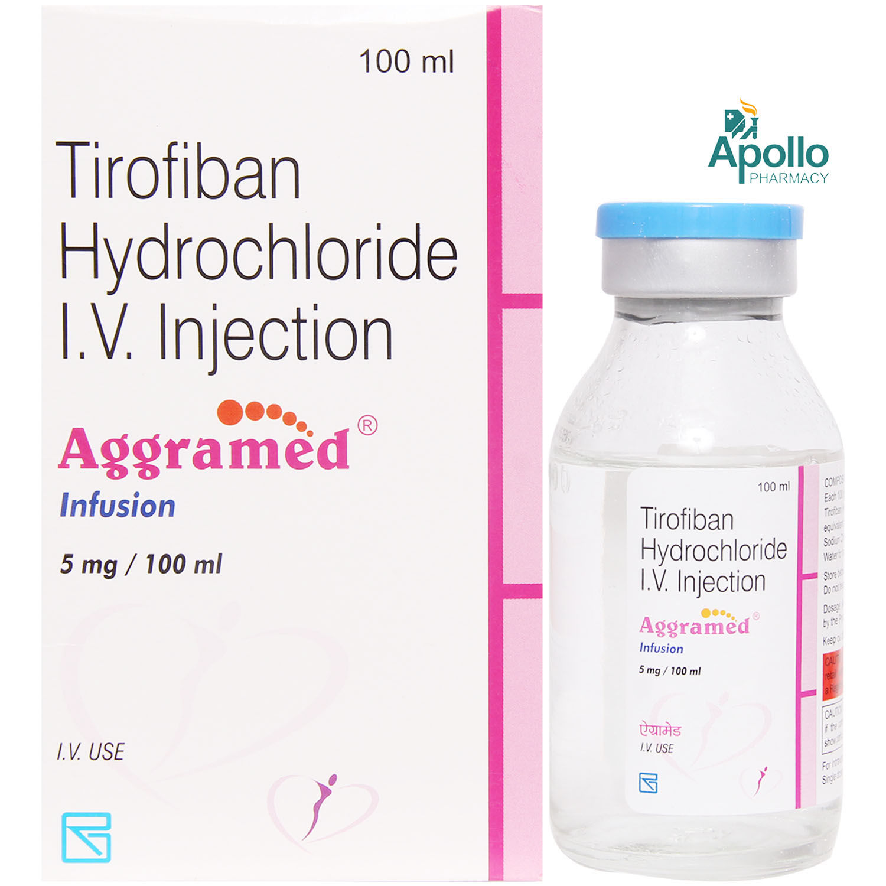
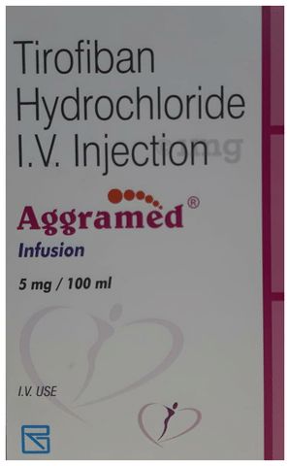
Aggramed 5mg Infusion

Slide 32
Nicorandil injection:
Nikoran IV 48 Injection is a medicine used to prevent and treat heart-related chest pain (angina). It is usually prescribed when other heart medicines are not suitable or have not worked. It reduces the risk of an angina attack by widening blood vessels and improving blood flow to the heart.
48 mg vial
SIDE EFFECTS:
Headache
Ulcer
Dizziness
Weakness
Nausea
Vomiting
Palpitations

Slide 33
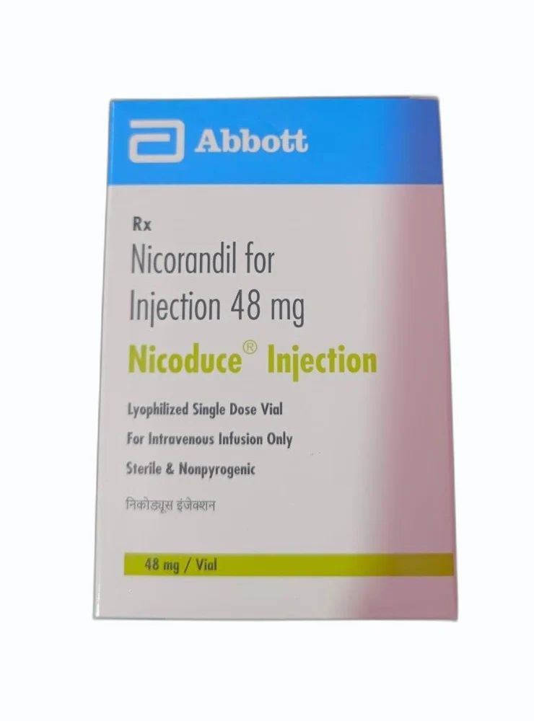
Nicorandil injection:

