Slide 1


Catheterization
Mr. Yash Rakholiya
Tutor
Department of Paramedical sciences
SVDU,SBKS MI & RC

Slide 2

CHAPTER-3
Peripheral Angiography

Slide 3
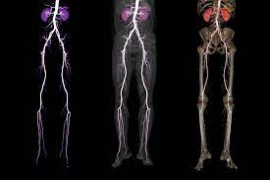
Contents
  Overview
  Introduction
  General anatomy
  Indication
  Contra-indication
  Equipments and accessories
  Procedure
  Post procedure care following
  Complications
  References

Slide 4
Introduction of Angiography
Angiography is the one of the radiological imaging procedure available for detailed investigation of heart and blood vessels after injecting the contrast media.
Angiography can be more specifically described as follows:
Arteriography: imaging of the arteries
Venography: imaging of the veins/phlebogram
Angiocardiography: imaging of the heart and associated structures
Lymphography: imaging of the lymphatic vessels/nodes
Importances
Shows blockage, deformities in the vessels Could be both therapeutic and diagnostic
Angiography followed by angioplasty and stenting could be life saving in case of arterial blockage or narrowing of vessels
Angioplasty is beneficial for reducing angina.
Could be beneficial to reduce ischemia due to blockage in any peripheral or coronary arteries

Slide 5
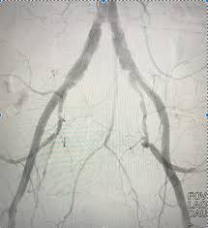
What is Peripheral Angiography?
Peripheral Angiography is a diagnostic and radiologic examination of the peripheral vasculature (artery) after the injection of contrast media.
Could be upper limb angiography or lower limb angiography, such as the legs, arms, and neck.
This procedure is crucial in evaluating the blood flow and detecting any potential blockages, narrowing, or abnormalities within the peripheral vascular system.
It plays a vital role in diagnosing various conditions, including peripheral arterial disease (PAD), deep vein thrombosis (DVT), aneurysms, and other vascular disorders.

Slide 6
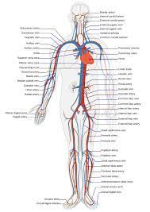
General Anatomy
Their main function is to facilitate the exchange of materials between blood and body tissues (e.g., muscles, kidneys, liver). They deliver blood and its components (nutrients and oxygen) to tissues throughout the body and transport waste products.
Aside from capillaries, blood vessels are all made of three layers: The adventitia or outer layer which provides structural support and shape to the vessel. The tunica media or a middle layer composed of elastic and muscular tissue which regulates the internal diameter of the vessel
Note - By adulthood, we each have 60,000 miles of blood vessels inside our bodies

Slide 7
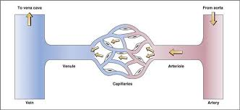
General Peripheral circulation
Systemic circulation carries oxygenated blood from the left ventricle, through the arteries, to the capillaries in the tissues of the body. From the tissue capillaries, the deoxygenated blood returns through a system of veins to the right atrium of the heart.

Slide 8
Peripheral arterial disease (PAD
Peripheral arterial disease (PAD) is a common circulatory problem that occurs when there is a narrowing or blockage of the blood vessels outside the heart and brain, particularly in the arteries that supply blood to the limbs, most commonly the legs.
This narrowing is often caused by atherosclerosis, a condition where plaque builds up inside the arteries, leading to reduced blood flow to the muscles and other tissues.
The most common symptom of PAD is intermittent claudication, which manifests as pain, cramping, or fatigue in the legs during physical activity
Other symptoms may include numbness, weakness, or a feeling of coldness in the lower extremities. In severe cases, PAD can lead to non-healing wounds or ulcers in the feet or toes, and in extreme cases, it can even result in tissue death, known as gangrene.
Risk factors for developing PAD include advanced age, smoking, diabetes, high blood pressure, high cholesterol, obesity, and a sedentary lifestyle.
Diagnosis – Physical examination, ankle-brachial index (ABI) measurement, CTA, MRA, Ultrasound.

Slide 9
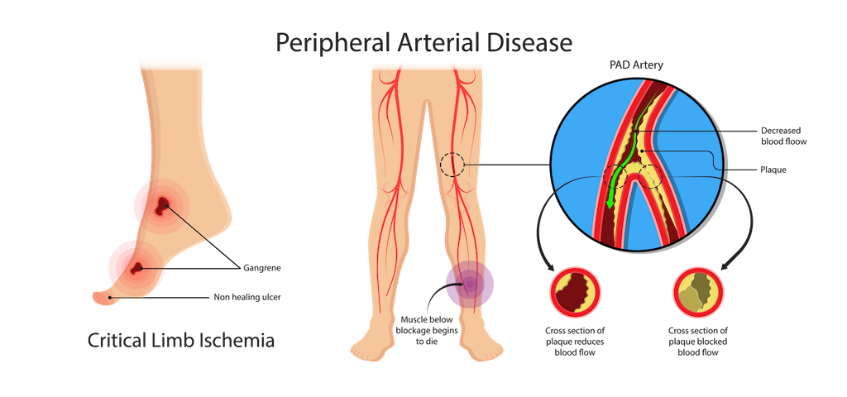
Peripheral arterial disease (PAD
https://ctvstexas.com/wp-content/uploads/2020/12/PAD-page.png

Slide 10
Indications of PA
Peripheral angiography is indicated for a variety of clinical situations where there is a need to evaluate the blood flow in the peripheral arteries, particularly in the lower extremities, arms, and neck.
Atherosclerotic disease
Embolus and thrombus
Arterial ischemia, stenosis or occlusion.
Trauma to a limb with arterial involvement
Congenital abnormalities
Burgers disease or other forms of arteritis
Prior to and following vascular surgery
Neoplasm
Angioma
Popliteal artery entrapment syndrome
Claudication
Evaluation of aneurysms

Slide 11
Contra-Indications of PA
There are specific contraindications and precautions that need to be considered before performing the procedure.
Hypersensitivity to iodinated contrast media.
Blood-clotting disorders or bleeding disorder
Anti coagulant medication
Impaired renal function
Local infection of the puncture site.
Unable to do vascular surgery.
High grade fever
Low Hb
Relative contraindications
Blood dyscrasias
Aneurysms or pseudoaneurysms
Local soft tissue infections
Severe hypertension
Ehlers-Danlos syndrome

Slide 12
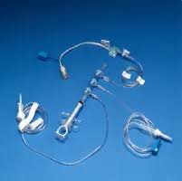
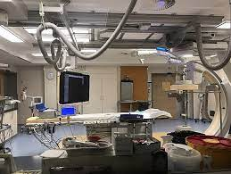
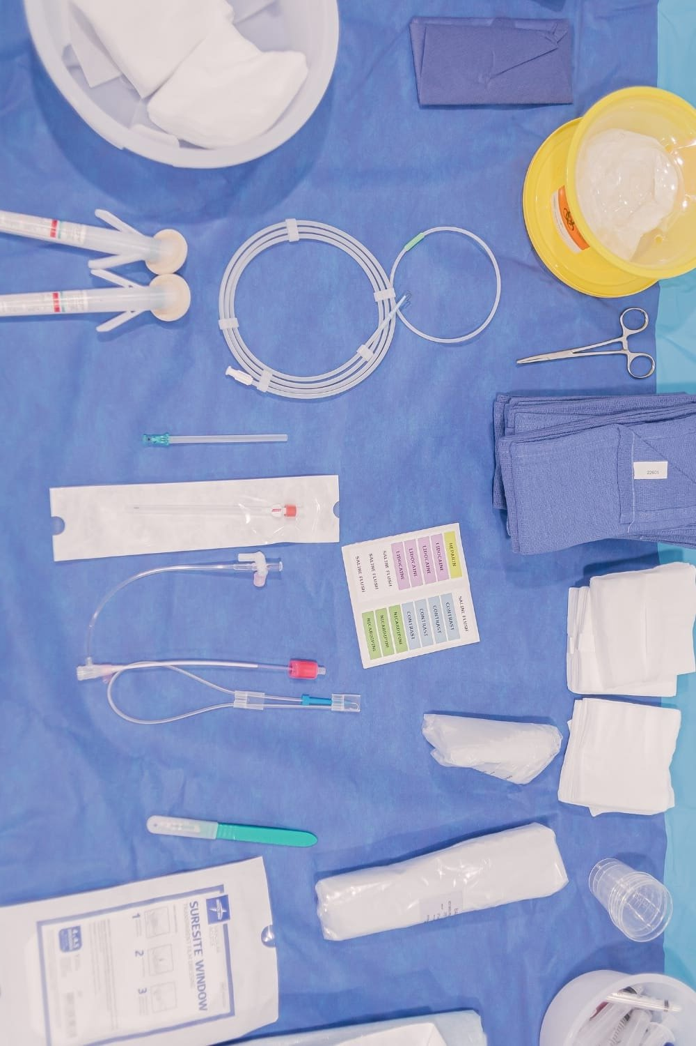
What are the equipment's using ?

Slide 13
Equipment's and accessories
The equipment required for a peripheral angiography procedure typically includes a variety of specialized tools and devices designed to facilitate the insertion of a catheter into the peripheral blood vessels,.
Catheters
Guidewires
Pulse oximeter
Fluroscopy machine
Contrast media and injector
Syringes and needles
Sterile and needles
Sterile drapes and gowns
Monitoring and recording equipment
This comprehensive set of equipment allows healthcare providers to perform peripheral angiography safely and accurately, enabling them to diagnose and manage various cardiac conditions effectively.

Slide 14
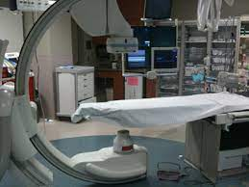
Equipment's and accessories
Generator- required 3 phase 12-pulse unit with a power rating of 85-100kw at 100k (to withstand heat)
Fast screen film combination.
grid also necessary to reduce scatter radiation.
Automatic injector is required for bolus injection at predetermined amount and preset rate.
physiologic monitoring equipment is required for constant cardiac and intravascular pressure recording.

Slide 15
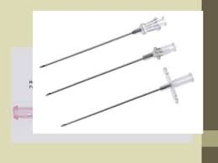
Introducer needle
Consists of:
1. Outer thin walled blunt cannula
2. Inner needle
3. Stilette
• Size based on external diameter of needle. (18G)
• Internal diameters should be known to allow for appropriate Guide-wires matching
•Proper needle gauge and guide wire diameter are chosen because:
- large diameter could result in backflow of blood through cannula of needle, blood loss
- small needle gauge cause difficult or impossible for wire to pass through the cannula of the needle
https://encrypted-tbn0.gstatic.com/images?q=tbn:ANd9GcR7YSmcfSI_aiB9CoY0hdgMmoAHP7AB6Gcp3mSs7m-rLJH-39EzqOnwy29PLcI9YpMmEgU&usqp=CAU

Slide 16
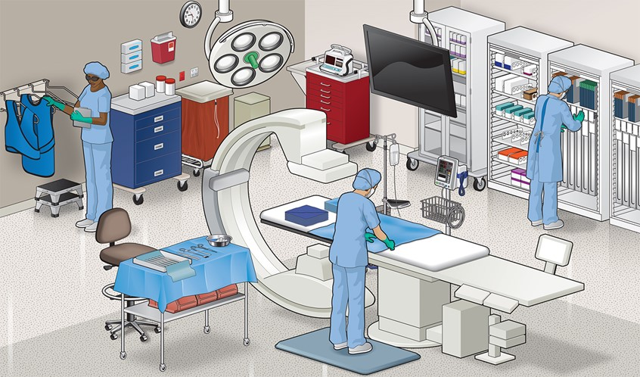
Preparation
https://www.medillsb.com/images/artistimages/images/15354_335261.jpg

Slide 17
Preparation
• Oral anticoagulants are stopped at least 24 hours before the procedure (depending on the creatinine clearance). Before the procedure, a thorough history should be taken with special emphasis on contrast allergy.
• A detailed examination is done to assess the access site, and peripheral pulses are documented. Laboratory investigations, including hemoglobin, platelets, creatinine, and coagulation profile, should be checked.
• The operating provider should obtain informed consent, and the procedure should be explained in detail, including risks and complications associated with the procedure.
• Intravenous normal saline should be administered to prevent contrast-induced renal dysfunction, especially in those with underlying renal dysfunction.
• After shifting to the catheterization laboratory, the patient is placed in a supine position on the table, access sites are sterilized, and the patient is draped. All cannulas, needles, and catheters are flushed with heparinized saline. Cardiologists and assisting technologists wear a sterile gown, gloves, head cap, and facial protecting shields.

Slide 18
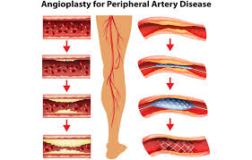

Procedure
https://encrypted-tbn0.gstatic.com/images?q=tbn:ANd9GcQjjBWkeFVlatHF0Yzlb4EoikczoUB_pVL-mA&usqp=CAU

Slide 19
Procedure
This procedure is crucial for evaluating the blood flow in these peripheral areas and diagnosing various vascular conditions such as peripheral arterial disease (PAD), aneurysms, deep vein thrombosis (DVT), and other vascular abnormalities.
The following steps provide a detailed overview of the peripheral angiography procedure:
Patient preparation
Informed consent is obtained from the patient, ensuring they understand the nature of the procedure, the risks involved, and any alternative options available.
A peripheral intravenous (IV) line may be inserted to administer medications or fluids as needed during the procedure.
Depending on the specific case and patient comfort, local anesthesia may be administered at the site where the catheter will be inserted. General anesthesia or conscious sedation may be used if necessary.
Catheter Insertion: A small incision is made at the chosen entry site, commonly in the groin, wrist, or arm, and a thin, flexible catheter is carefully inserted into the artery or vein. The catheter is then guided through the vessels to the target area under the guidance of fluoroscopy, which provides real-time X-ray images.

Slide 20
Continued…
Contrast Injection: Once the catheter is correctly positioned, a contrast medium, often iodine-based, is injected through the catheter. The contrast medium helps visualize the blood vessels during the X-ray imaging, highlighting any abnormalities, blockages, or narrowing within the vessels.
Imaging and Visualization: X-ray images are captured as the contrast medium flows through the blood vessels. The imaging process may involve taking images from different angles to obtain a comprehensive view of the blood vessels and identify any areas of concern.
Assessment and Diagnosis: The images obtained during the procedure are carefully analyzed by a radiologist or vascular specialist to assess the condition of the blood vessels, identify any obstructions or abnormalities, and make an accurate diagnosis.
Catheter Removal and Hemostasis: After the procedure is complete, the catheter is removed, and pressure is applied to the insertion site to promote clotting and prevent bleeding.

Slide 21
Post-procedure care following
A Peripheral angiography is essential to ensure the patient's safety, comfort, and recovery. Here is a detailed guide on the post-care measures typically recommended after a peripheral catheterization:
Monitoring vital signs
Bed rest
Monitoring the insertion site
Hydration
Medical management
Patient education
Activity restrictions
Follow-up appoinements
Wound care
It is important for patients to adhere to the post-procedure care instructions provided by their healthcare providers to promote optimal recovery and minimize the risk of complications following a peripheral catheterization. Any concerns or unexpected symptoms should be promptly reported to the healthcare team for further evaluation and management.

Slide 22
Complications
Risks of a peripheral angiogram include:
Allergic reaction to contrast dye
Bleeding and hematoma
Swelling
Bruising
Infection where the catheter is inserted
Kidney problems from the dye
Embolization
Arrhythmias
Radiation exposure
It is important for healthcare providers to discuss these potential complications with patients before the procedure and to take appropriate measures to minimize risks. Close monitoring of patients during and after the procedure, along with prompt intervention if complications arise, can help ensure the safety and well-being of patients undergoing peripheral angiography.

Slide 23
References
1. Dawson, D. L., & Pena, C. S. (Eds.). (2015). The Vascular System (Diagnostic Medical Sonography Series). Lippincott Williams & Wilkins.
2. Creager, M. A., Loscalzo, J., & Dzau, V. J. (Eds.). (2016). Vascular Medicine: A Companion to Braunwald's Heart Disease. Elsevier Health Sciences.
3. White, C. J., Ramee, S. R., & Collins, T. J. (Eds.). (2012). The Endovascular Intervention: A Case-Based Approach. CRC Press.
4. Ouriel, K. (Ed.). (2014). Peripheral Vascular Interventions: An Illustrated Manual. Lippincott Williams & Wilkins.

Slide 24
THANK YOU

