Slide 1

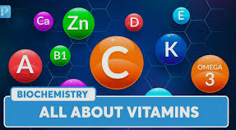

By -
Ms. Darshi Jain,
Assistant Professor,
Department of Paramedical Sciences, SVDU

Slide 2
OBJECTIVES
Introduction
General characteristics
General Functions
Classification

Slide 3

INTRODUCTION
The word "vitamin" comes from the Latin word “vita”, means "life".
Vitamins are organic components in food that are needed in very small amounts for growth and for maintaining good health.
Everybody must eat a certain amount of vitamins to stay healthy.
Vitamins are chemicals found in very small amounts in many different foods.

Slide 4
CHARACTERISTICS
Vitamins are required in small quantities in the diet because they cannot be synthesized by the body.
Water soluble vitamins cannot be stored in human tissues. Their excess is excreted with urine.
Significant amounts of fat soluble vitamins can be stored in adipose tissue and the liver.
Synthetic vitamins are identical to natural vitamins.
Once growth and development are completed, vitamins remain essential nutrients for the healthy maintenance of the cells, tissues, and organs.

Slide 5
FUNCTIONS
Vitamin are helpful for the health and life of the body in the following respects:
(a) They build up the resistance of the body against diseases.
(b) Prevent and cure various diseases caused by deficiency.
(c) Help the digestion and utilization of mineral salts and Carbohydrates in the body.
(d) Stimulate and give strength to digestive and nervous system.
(e) Help health protection.
(f) Help maintenance of proper health and normal growth.

Slide 6
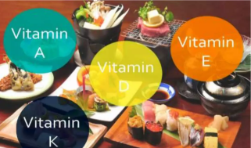
Classification
On the basis of their solubility vitamins are mainly 2 types-
Fat soluble vitamins: Vitamins that dissolve in fat. Because fat is easily stored on our body, fat-soluble vitamins can be stored within our fat. This means they can accumulate and be saved for later use. The fat-soluble vitamins are A, D, E and K.

Slide 7
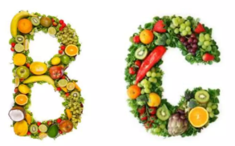
Water soluble vitamins: Vitamins that dissolve in water. Because our body is a watery environment, these vitamins can move through our body pretty easily, and they can also be flushed out by the kidneys. Water-soluble vitamins include the B-complex vitamins and vitamin C. There are eight B vitamins, including vitamin B1, B2, B3, B5, B6, B7, B9 and B12.

Slide 8
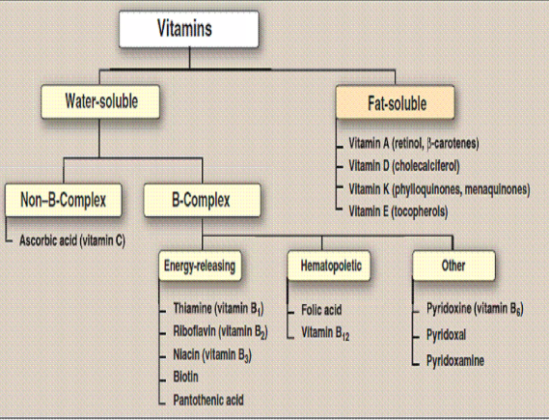

Slide 9
Water Soluble vs Fat Soluble Vitamins
Criteria | Water Soluble | Fat soluble
Absorption | Directly to blood | Lymph via CM
Transport | Free | Require carrier
Storage | Circulate freely | In cells with fat
Excretion | In Urine | Stored with fat
Toxicity | Possible with supplements | Likely with supplements
Requirements | Every 2-3 days | Every week

Slide 10


