Slide 1

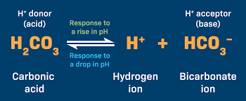
BIOLOGICAL BUFFER SYSTEM
Dr. Navneet Kumar Singh
Associate Professor & I/C Principal
Dept. of Paramedical Sciences
Sumandeep Vidyapeeth Deemed to be University
(Accredited by NAAC with A++ Grade and
Conferred with UGC Category I Status)
Vadodara, Gujarat, INDIA.

Slide 2
Learning objectives
Understanding pH,
Differentiate between strong and weak acids and bases,
The role of buffers in maintaining pH, and the various buffer systems in the body, including their mechanisms and importance.
How buffers work to maintain pH homeostasis.

Slide 3
What is pH?
Normal pH Regulation in the Body
The body uses three main systems to regulate pH:
Buffer systems – like the bicarbonate buffer system in blood
Respiratory system – controls CO₂ levels (CO₂ is acidic when dissolved in blood)
Renal system – kidneys excrete hydrogen ions (H⁺) and reabsorb bicarbonate (HCO₃⁻)
pH measures how acidic or basic (alkaline) a solution is.
  pH < 7: Acidic
  pH = 7: Neutral
  pH > 7: Basic (alkaline)

Slide 4
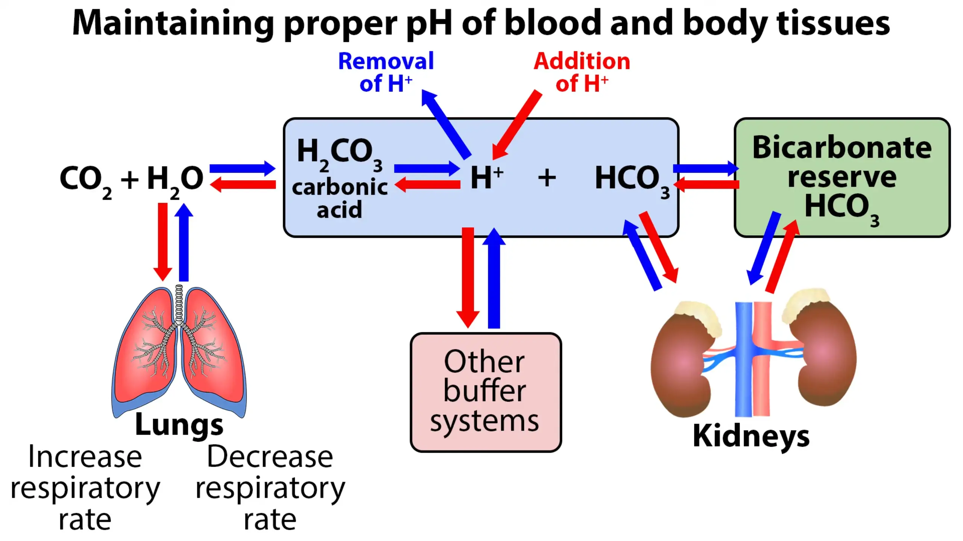
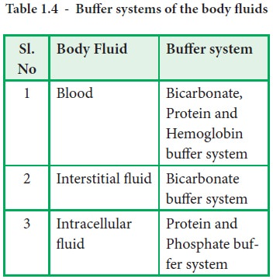
1

Slide 5
Effects of pH Imbalance
1. Acidosis (pH < 7.35)
Causes:
Respiratory: COPD, hypoventilation (↑ CO₂)
Metabolic: Kidney failure, diabetic ketoacidosis, lactic acidosis
Symptoms:
Fatigue, confusion, headache
Shortness of breath
Increased heart rate
In severe cases: shock or coma
Body Effects:
Decreases cardiac contractility
Increases risk of arrhythmias
Impairs enzyme function
2. Alkalosis (pH > 7.45)
Causes:
Respiratory: Hyperventilation (↓ CO₂)
Metabolic: Vomiting (loss of stomach acid), diuretic use
Symptoms:
Muscle twitching, cramps
Dizziness, confusion
Numbness or tingling
Seizures in severe cases
Body Effects:
Reduces calcium ion availability, leading to neuromuscular irritability
Can impair oxygen delivery due to changes in haemoglobin binding

Slide 6
Almost every biological process is pH-dependent; a small change in pH produces a
large change in the rate of the process.
True both for reactions occurring with or without H⁺ ions.
The enzymes and many of their substrates, contain ionizable groups with characteristic pKa values.
The protonated amino and carboxyl groups of amino acids and the phosphate groups of nucleotides, for example, function as weak acids; their ionic state is determined by the pH of the surrounding medium.
Cells/ organisms maintain a specific and constant cytosolic pH, usually near pH 7, keeping biomolecules in their optimal ionic state.
In multicellular organisms, the pH of extracellular fluids is also tightly regulated.
2

Slide 7



Ionization/Dissociation of Water, Weak Acids, and Weak Bases
Pure water ionizes slightly, forming equal numbers of hydrogen ions (H₃O⁺) and OH⁻ ion.
The extent of ionization is described by an equilibrium constant,
The ion product of water (Kw) is derived from K_{eq}.
Weak acids partially ionize to release a H⁺, and lowers the pH of the aqueous solution. Weak bases accept a H⁺ and increases the pH.
The extent of these processes is characteristic of each particular weak acid or base and is expressed as an acid dissociation constant:
The pKa expresses, on a logarithmic scale, the relative strength of a weak acid or base:
The stronger the acid, the smaller its pKa; the stronger the base, the larger its pKa. The pKa can be determined experimentally; it is the pH at the midpoint of the titration curve for the acid or base.
3

Slide 8
The Henderson-Hasselbalch Equation
Relates to the dissociation of weak acids in equilibrium. HA ↔ [H⁺] + [A⁻]
Dissociation constant (K_{a}) = [H⁺] + [A⁻]
[HA]
[H⁺] =
K_{a} x [HA]
[A⁻]
Taking log on both the sides, log [H⁺] = log K_{a} + log [HA]/[A⁻] Changing signs on both the sides, -log [H⁺] = -log K_{a} - log [HA]/[A⁻]
pH = pk_{a} + log [A⁻]/[HA] or, pH = pk_{a} + log [Proton acceptor] (HH Equation)
[Proton donor]
4

Slide 9
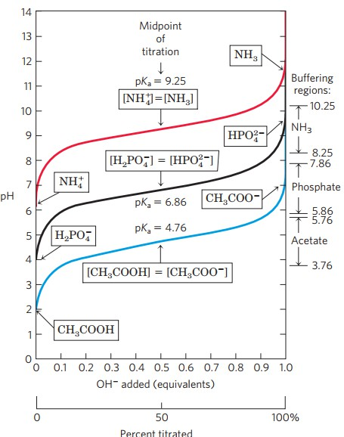
Titration curves reveal the Pka of weak acids
Titration determines the amount of an acid in a given solution. A measured volume of the acid is titrated with a solution of a strong base, usually NaOH, of known concentration.
A titration curve is the plot of the pH of the analyte solution vs. the volume of the titrant added as the titration progresses.
A titration curve can be used to determine:
  The equivalence point of an acid-base reaction (the point at which the amounts of acid and of base are just sufficient to cause complete neutralization).
  The pH of the solution at equivalence point is dependent on the strength of the acid and strength of the base used in the titration.
-- For strong acid-strong base titration, pH = 7 at equivalence point
-- For weak acid-strong base titration, pH > 7 at equivalence point
-- For strong acid-weak base titration, pH < 7 at equivalence point
Comparison of the titration curves of three weak acids: Acetic acid, dihydrogen phosphate and ammonium ion.
5

Slide 10
Buffer
Mixtures of weak acids and their salts of strong bases OR Mixtures of strong acids and their salts of weak bases.
Example: mixture of acetic acid and sodium acetate. CH₃COOH + CH₃COONa Na⁺ + H⁺ + 2CH₃COO⁻
Resists change in pH on the addition of acid (H⁺) or base (OH⁻). Weak acid: H⁺ donor, Weak base: H⁺ acceptor.
Addition of alkali (NaOH) or acid (HCl): Salt is formed, but no free H+ or OH- will be available.
CH₃COOH + CH₃COONa + NaOH 2CH₃COONa+ H₂O
CH₃COOH + CH₃COONa + HCl NaCl + 2CH₃COOH
Two factors determine effectiveness/capacity of buffers:
  Molar conc. of buffer components: Directly proportional.
  Relative conc. of the conjugate base and the weak acid.
Ideal buffer: Equal concentrations of acidic and basic components.

Slide 11
Biological Buffer systems
Buffer systems in the human body are extremely efficient.
Different systems work at different rates.
Takes only seconds for the chemical buffers in the blood to make adjustments to pH. The respiratory tract can adjust the blood pH upward in minutes by exhaling CO₂ from the body. The renal system can also adjust blood pH through the excretion of H⁺ and the conservation of bicarbonate, but this process takes hours to days to have an effect.
Principal buffers of ECF:
ICF: RBC:
Bicarbonate buffer, Protein buffer Phosphate buffer, Protein buffer Hemoglobin buffer
Gunanidhi Sahoo, Department of Zoology, Utkal University

Slide 12
1. The Bicarbonate buffer system
Principal buffer in blood plasma.
Consists of H₂CO₃ (proton donor) and HCO₃ (proton acceptor).
-
Neutralizes stronger dietary acids and metabolic acids (HA) by converting them to weak bases (A⁻) and increase in H₂CO₃.
Strong base (B) Weak acids (BH+) with rise in HCO₃ .
-
_{A}-
Formation of H₂CO₃ depends on dissolved CO₂ conc.
which in turn depends on gaseous CO₂.
HA + HCO₃ ↔ + H₂CO₃
-
B + H₂CO₃ ↔ BH+ + HCO₃ .
-
[HCO₃ ]/[H₂CO₃] of 20:1 is required to maintain pH of plasma at 7.4.
-
Neutralization of any acid or base and subsequent change in buffer ratio or blood pH is
neutralized by respiratory elimination of H₂CO₃ as CO₂ or urinary elimination of HCO₃ .
As cells contain much lower amounts of HCO₃⁻, imp of this buffer in cells is negligible.
-

Slide 13
Acidosis
Accumulation of acids or loss of alkali
Fall of [HCO₃ ]/[H₂CO₃] below 20.
Ratio in favor of H₂CO₃.
-
Two types:
1. Metabolic acidosis: Conc. of plasma HCO₃ . decreased due to excessive loss of bases in renal failure,
diabetic ketosis and severe diarrhea.
-
Respiratory acidosis: Retention of CO₂ due to hypoventilation Rise in H₂CO₃ lowers the ratio. Occurs due to chronic respiratory obstructive airway disease (asthma), prolonged anesthesia, unconsciousness, etc.
Alkalosis
Accumulation of alkali or loss of acids Increase in ratio Rise in pH.
  Metabolic alakalois: High intake of alkaline substances, severe vomiting, indiscriminate use of
antacids, etc.
2. Respiratory alakalosis: Excess removal of CO₂ from blood due to hyperventilation DecreaGsunea in H2CO3
9

Slide 14
2. The Phosphate buffer system
Consists of H₂PO₄⁻ (H⁺ donor) and HPO₄⁻² (H ⁺ acceptor).
H₂PO₄ (Dihydrogen phosphate) ↔
_{H}+
-2
+ HPO₄
-
Acts in cytoplasm of all cells. More effective in pH range of 5.8 to 7.8.
pH of ICF = 6.0 – 6.9, close to its pKa (6.86).
Plasma HPO ⁻² : H PO ⁻ is 4.0. Hence, pH = Pka + log [HPO ⁻²], pH = 6.86 + log4 = 7.4
4 2 4 4
[H₂PO₄ ]
-
If HPO ⁻² : H PO ⁻ tends to be changed by more H PO ⁻, renal elimination of H PO ⁻
4 2 4 2 4 2 4
occurs and pH remains unchanged.
Works exactly like acetate buffer system except pH range.
Conc. of phosphate buffer very low in plasma, hence less effective.

Slide 15
The Protein buffer system
  Very imp in plasma and ICF, but conc. low in CSF, lymph and intestinal fluids.
  Proteins exist as anions serving as conjugate bases (Pr⁻) at blood pH 7.4 and form conjugate acids (HPr) accepting H⁺.
  Have the capacity to buffer some H₂CO₃ in blood.
H₂CO₃ + Pr⁻- HCO₃⁻ + HPR

Slide 16
The Hemoglobin buffer system
  Buffers CO₂ inside RBC, capacity depends on oxygenation/deoxygenation of Hb.
Inside RBC, CO₂ + H₂O Carbonic anhydrase H₂CO₃.
At blood pH (7.4), H₂CO₃ H⁺ + HCO₃ , needs instant buffering.
-
Oxyhemoglobin (HbO₂⁻) loses O₂ to form deoxyhb (Hb⁻) which remains undissociated (HHb) by accepting H⁺ from the ionization of H₂CO₃. Thus, Hb⁻ buffers H₂CO₃ in RBC.
HbO₂⁻ (Oxyhb) Hb⁻ + H₂CO₃
Hb⁻ + O₂ HHb + HCO₃⁻

Slide 17
Some HCO ⁻ diffuse out into plasma and maintain the balance between ICF and
3
plasma HCO ^{-.} This causes influx of some Cl⁻ into RBC (Chloride shift).
3
HHbO₂, produced in lungs by oxygenation of HHB, instantly ionizes to H⁺ and HbO₂ .
-
❖
_{H}+
buffered by HCO₃ in RBC forming H₂CO₃ which is dissociated into H₂O and CO₂.
-
CO₂ diffuses out of RBC and escapes into alveolar air.
Some HCO ⁻ return from plasma to RBC in exchange of Cl⁻ and changed to CO .
3 2
HHb + O₂ HHbO₂
HCO ⁻ + H⁺ H CO
3 2 3
- +
HbO₂ + H
H₂O + CO₂

Slide 18
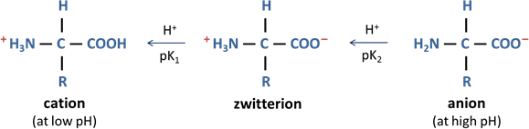
5. The Amino acid buffer system
Contains both acidic (COOH) and basic (-NH₂) groups, H⁺ can pass between this two groups.
Zwitterion form: Addition or removal of H⁺ to or from zwitterion produces either cation or anion.
Addition of: OH⁻ to a solution of aas, they take up H⁺ to form H₂O + anion.
H⁺, they are taken up by zwitterions to produce cationic form.
NaOH
HCl
H₃N – CH₂ – COONa (salt)
ClH - H₃N – CH₂ – COOH (amino acid hydrochloride)
Thus, an aa solution is not neutral, but acidic or basic depending on the form in which it presents in greater concn.
14

