Slide 1

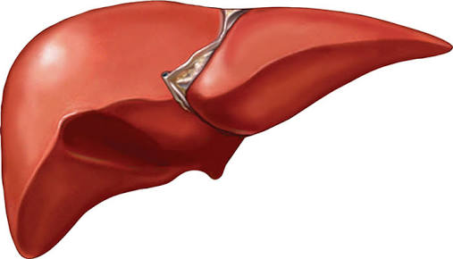
Liver function test
Dr. Navneet Kumar Singh
Associate Professor & I/C Principal
Dept. of Paramedical Sciences
Sumandeep Vidyapeeth Deemed to be University
(Accredited by NAAC with A++ Grade and
Conferred with UGC Category I Status)
Vadodara, Gujarat, INDIA.

Slide 2
Learning objectives
Function of Liver
Understanding the purpose of LFTs,
Recognizing the significance of different liver enzymes and markers,
Interpreting abnormal LFT results, and knowing the appropriate follow-up and treatment based on those results.
Hepatic neoplasm markers

Slide 3
Function of Liver
1. Metabolic Functions:
Urea cycle
Glycogen synthesis
Vitamin Metabolism
Minral Metabolism
Lipid Metabolism
Glycolysis
2. Excretory Functions:
Cholesterol
Bile Pigments
Bile salts
3. Protective Functions & Detoxification:
Ammonia
Clearance of insulin, PTH, estrogens, cortisol.

Slide 4
4.Hematological function:
Formation of Blood
Destruction of erythrocytes
5. Synthetic functions:
Protein, Albumin, Prothrombin, Hormones
6.Storage Functions:
Glycogen, Vitamin A, D and B12

Slide 5
USES
Screening of liver dysfunction
To recognize Pattern of liver disease
To Assess Prognosis of patient
Follow up of disease
To evaluate the response to therapy

Slide 6
Liver function tests include:
SGPT (ALT-Alkaline Transaminase)
SGOT (AST-Aspartate Transaminase)
GGT (Gama glutamic traspeptidase)
ALP (Alkaline Phosphatase)
Bilirubin
Total Protein
Serum Albumin
Serum Globulin
PT/BT /CT (Prothombin, Bledding, Clotting Time)
5’ nucleotide

Slide 7
Other test include:
Blood ammonia
LDH (Lactate Dehydrate)
AFP (Alfa feto protein)
Ceruloplasmin
Leucine aminopeptidase
Alpha - 1 antitrypsin
Procollagen III peptide
Cholesterol
Glycoprotein

Slide 8
SGPT(ALT)
Method: L- Alanine LDH UV Kinetic (IFCC kinetic)
Measuring the rate of decrease in absorbance of NADH at 340 nm due to the oxidation of NADH to NAD.

Slide 9
L-Alanine + α-ketoglutarate ^{ALT} Pyruvate+ L-glutamate
Pyruvate+NADH+H+ Ldh Lactate +NAD+

Slide 10
Significance
Serum Glutamic Pyruvate Transaminase (SGPT)
Alanine aminotransferase (ALT)
Enzyme present in hepatocytes .
Significantly elevated levels of ALT (SGPT) often suggest the existence of other medical problems such as viral hepatitis, diabetes, congestive heart failure, liver damage, bile duct problems, infectious mononucleosis, or myopathy.
So ALT is commonly used as a way of screening for liver problems.

Slide 11
INERFERANCE:
Alanine transaminase (ALT) – 10-40 u/L
When a cell is damaged, it leaks this enzyme into the blood, where it is measured.
ALT rises in
  Viral hepatitis
  Alcoholic Liver disease
  Hepatic congestion
  Hepatocellular carcinoma
  Cholecystitis
  Paracetamol (acetaminophen) overdose.

Slide 12
SGOT (AST) Principal
Method: L- Alanine LDH UV Kinetic
SGOT (AST) catalyzes the transfer of amino group between L-Aspartate and α Ketoglutarate to form Oxaloacetate and Glutamate.
The Oxaloacetate formed reacts with NADH in the presence of Malate Dehydrogenase to form NAD.
The rate of oxidation of NADH to NAD is measured as a decrease in absorbance which is proportional to the SGOT (AST) activity in the sample.

Slide 13
Oxaloacetate + NADH + H+ mdh Malate + NAD+
L-Aspartate + α Ketoglutarate SGOT Oxaloacetate + L-Glutamate

Slide 14
Significance
Serum Glutamic Oxaloacetic Transaminase (SGOT)
The AST is a cellular enzyme is found in highes concentration in heart muscle, The cells of the liver the cells of the skeletal muscle & in smaller amounts in other weaves.
The blood SGOT levels are thus elevated with liver damage or insult to the heart.
Some medication can also raise SGOT level.

Slide 15
Interference
Normal Range:- 10-40 U/L
It is raised in acute liver damage,
But,also present
  Red blood cells
  Cardiac and Skeletal muscle
  And therefore it is not specific to the liver.

Slide 16
GGT PRINCIPAL
Method: Carboxy Substrate Method
GGT catalyzes the transfer of amino group between L- γ-Glutamyl-3-carboxy-4 nitroanilide and Glycylglycine to form L- γ-Glutamylglycylglycine and 5-amino-2- nitrobenzoate.
The rate of formation of 5-amino-2-nitrobenzoate is measured as an increase in absorbance which is proportional to the GGT acitivity in the sample.

Slide 17
L- γ-Glutamyl 3-carboxy 4-nitroanilide + Glycylglycine GGT L- γ-Glutamyl glycylglycine+ 5-Amino-2-nitrobenzoate.

Slide 18
Significance
The gamma-glutamyl transferase (GGT) test may be used to determine the cause of elevated alkaline phosphatase (ALP).
Both ALP and GGT are elevated in disease of the bile ducts and in some liver diseases.

Slide 19
Interference
Normal Range: 10-30 u/L.
Although reasonably specific to the liver and a more sensitive marker for cholestatic damage than ALP.
Gamma glutamyl transpeptidase (GGT) may be elevated with even minor, sub-clinical levels of liver dysfunction.
GGT is raised in alcohol toxicity (acute and chronic).

Slide 20
ALP PRINCIPLE
Method: para-nitrophenylphosphate with AMP buffer
Alkaline phosphatase in the sample catalyzes the hydrolysis of colourless p-nitrophenyl phosphate (p-NPP) to give p-nitrophenol and inorganic phosphate.
At the pH of the of the assay (alkaline), the p-nitrophenol is in the yellow phenoxide form.
The rate of absorbance increase at 404 nm is directly proportional to the alkaline phosphatase activity in the sample.
Optimized concentrations of zinc and magnesium ions are present to activate the ALP in the sample.

Slide 21
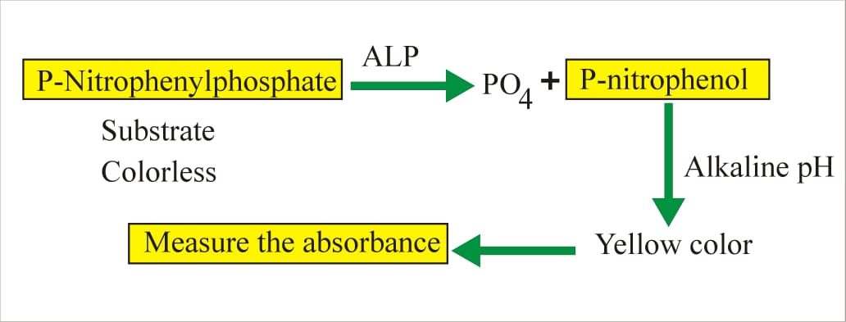
Reaction:

Slide 22
CLINICAL SIGNIFICANCE
Increased levels of serum ALP;
In growing children
Bone disease like;
Metastasis, rickets, healing fractures, Osteomalacia.
Sex | Age | Reference Interval
Male-femals | 4-15 yr | 54-36 U/L
Male | 20-50 yr | 53-128 U/L
Male | >60 yr | 56-119 U/L
femals | 20-50 yr | 42-98 U/L
femals | >60 yr | 53-141 U/L

Slide 23
Interference
Mild elevations (<500 IU/L)
  Viral hepatitis
  Alcoholic cirrhosis
  Infiltrative liver disease like lymphoma, sarcoidosis
Moderate elevation (500 – 1000 IU/L)
  Cholecystitic
  Gall bladder stone
Severely elevation (>1500 IU/L)
  Osteomalacia
  Osteoporosis
  Ricket
  Osteosarcoma
  Bone tumour
  Paget's disease

Slide 24
Bilirubin PRINCIPAL
Method: Diazo Reaction
Bilirubin glucuronide +diazonium salt azodye (tan or pink to viotel)

Slide 25
Different between Unconjugated & Conjugated Bilirubin
 | UNCONJUGATED | CONJUGATED
In water | Insoluble | Soluble
In alcohol | Soluble | Soluble
Normal | <1.3 | <0.4
In bile | Absent | Present
In Urine | Always absent | Normally absent
Absorption gut | Absorbed | Not absorbed
Diffusion into tissues | Diffuses-yellow colour | Doesn’t diffuse
Van den bergh | Indirect + | Direct +

Slide 26
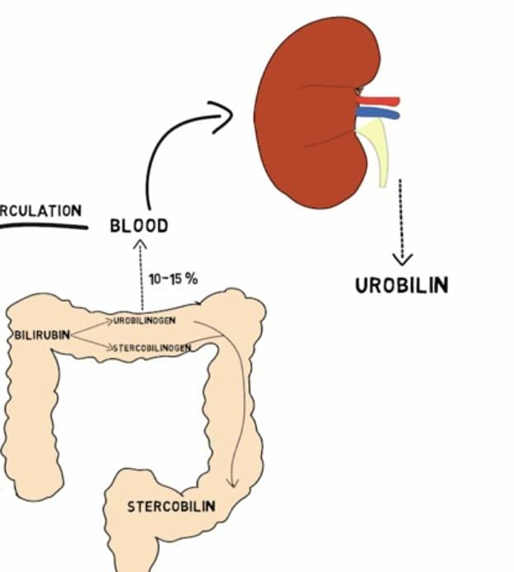
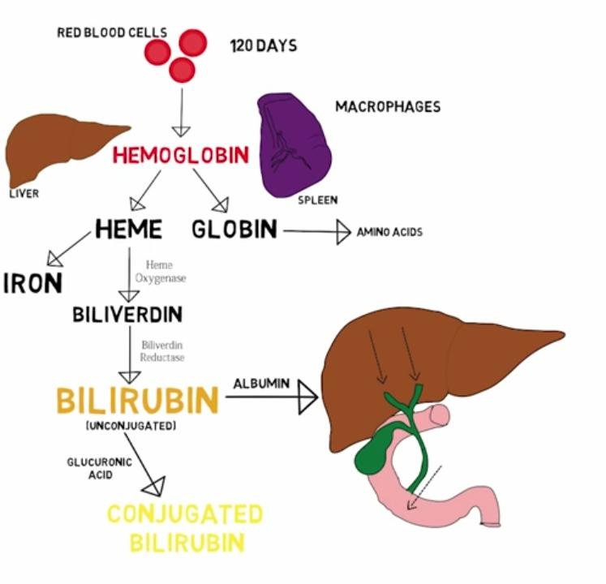
Bilirubin Pathway

Slide 27
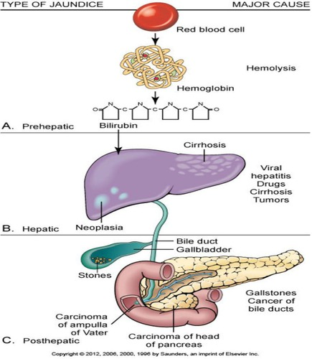

Slide 28
Type & Cause of Jaundice
Pre-hepatic Jaundice
  Neonatal (Physiological) Jaundice
  Malaria
  G 6 PD deficiency
  Thalassaemia
  Sickle cell disease
  Mis-match Blood Transfusion
  Auto-immune
Intra-Hepatic Jaundice
  Acute Viral hepatitis
  Alcohol Cirrhosis
  Cirrhosis of Liver
  Primray Biliary Cirrhosis,
  Haemochromatosis
  Wilson Disease
  Alpha-1 antitrypsin deficiency
  Drug induce – Quinine Group, NSAID, Chemotherapeutic drugs
Post Hepatic Jaundice
  Gall Bladder - Common Bile Duct - Pancreatic duct Stone
  Gall Bladder - Hepatic – Pancreatic – Duodenal Carcinoma

Slide 29
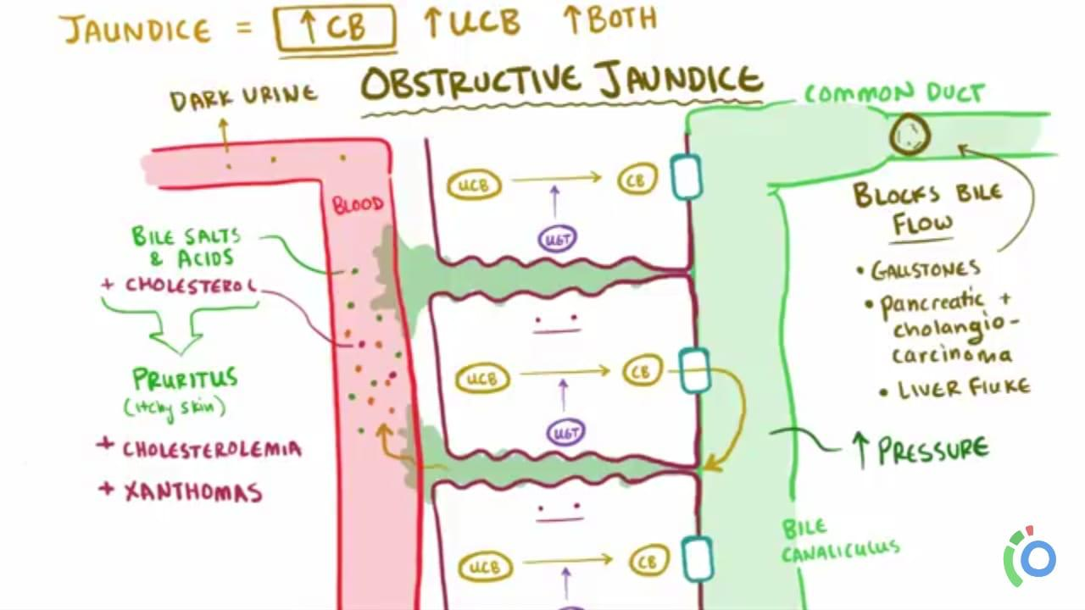
OBSTRUCTIVE JAUNDICE

Slide 30
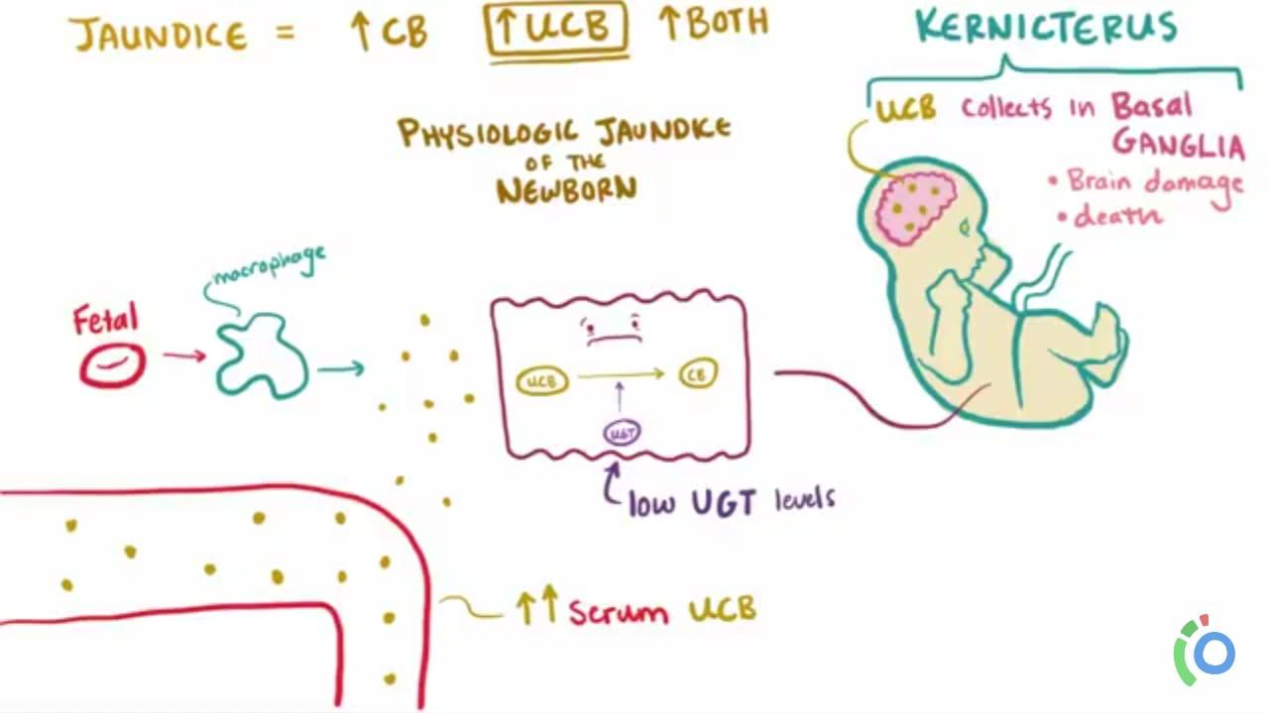
PHYSIOLOGIC JAUNDICE OF THE NEWBORN

Slide 31
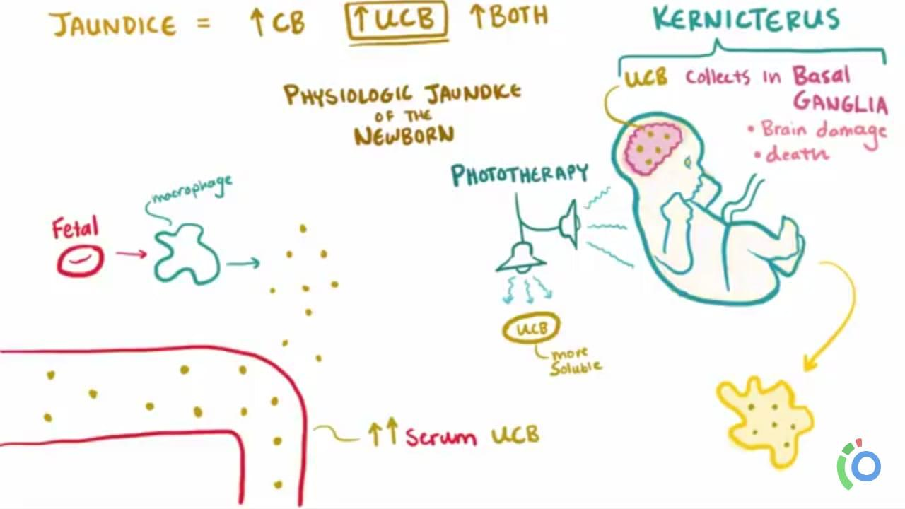
PHOTOTHERAPY

Slide 32
Features | Pre-hepatic Heamolytic | Hepatic Hepatocellular | Post-hepatic Obstructive
Blood Examination
Total Billirubin | ↑↑ | ↑↑ | ↑↑
Direct Billirubin | Normal | ↑ | ↑↑
Indirect Billirubin | ↑↑ | ↑ | Normal
ALT | Normal | ↑ ↑ | Normal
Alkaline phosphatase | Normal | Normal / ↑ | ↑ ↑
Urine Examination
Bile Pigment | Normal | Normal / ↑ | ↑ ↑
Urobillinogen | ↑ ↑ | Normal / Absent | Absent
Bile Salt | Normal | Normal / ↑ | ↑ ↑
Stool Examination | Normal | Normal | Clay Colour
Specific Investigation | Haemoglobin, LDH | Liver Function Test | USG Abdomen

Slide 33
Van den bergh Test :Direct & Indirect Bilirubin
Method: Diazo Reaction
This is specific reaction to identify the increase in serum bilirubin level.
Normal serum gives a negative Van den Bergh reaction.
sulfanilic acid + sodium nitrate Diazotized
Diazotized sulfanilic acid + bilirubin Azobilirubin (purple color).

Slide 34
Major causes for increase in blood Bilirubin level
Major causes for increase bilirubin levels in blood:
Hemolysis:-
Damage to RBC may cause increased breakdown of Hb producing Unconjugated Bilirubin, which may overload liver conjugating system, causing Hyperbilirubinemia;
Failure of Conjugating system in the liver,
Obstruction in the Biliary system,

Slide 35
Total Protein PRINCIPAL
Method: Biuret
Proteins react with cupric ions in alkaline medium to form a violet colored complex. The intensity of the color produced is directly proportional to proteins present in the specimen and can be measured on a photometer at 530 nm (or by using a green filter).
Normal Range
Serum Protein: 6-8 g/dl

Slide 36
Albumin Principal
Method: Bromocresol Green (BCG)
Albumin present in serum binds specifically with bromocresol green at pH 4.1 to form green colored complex, intensity of which can be measured colorimetrically by using 640 nm (or a red filter)
Normal Range
3.3-4.8 g/dl

Slide 37
Total Protein & Albumin
Both decrease in Hepato-cellular disease.
Because it is synthesized & store into liver.
It may found decrease in following disease:
  Malnutrition
  Chronic disease
  Nephrotic syndrome
  Inflammatory bowel disease
  Chronic infection
  Tuberculosis

Slide 38
Prothombin time Principal
Method: Capillary tube method
When preformed tissue thromboplastin and calcium chloride are added to citrated plasma, the plasma clots.
The time taken for the clot to appear is called Prothrombin time (PT).

Slide 39
Significance
Prothrombin time (PT) is a blood test that measures how long it takes blood to clot.
A prothrombin time test can be used to check for bleeding problems.
PT is also used to check whether medicine to prevent blood clots is working. A PT test may also be called an INR test.
Normal Range
11 to 16 second

Slide 40
Interferance
Another measure of hepatic synthetic function is the prothrombin time.
Prothrombin time is affected by proteins synthesized by the liver.
Thus, in patients who have prolonged prothrombin times, liver disease may be present.
Since a prolonged PT is not a specific test for liver disease, confirmation of other abnormal liver tests is essential.

Slide 41
Diseases such as malnutrition, in which decreased vitamin K ingestion is present, may result in a prolonged PT time.
An indirect test of hepatic synthetic function includes administration of vitamin K (10mg) subcutaneously over three days.
Several days later, the prothrombin time may be measured. If the prothrombin time becomes normal, then hepatic synthetic function is intact.
This test does not indicate that there is no liver disease, but is suggestive that malnutrition may coexist with (or without) liver disease.

Slide 42
Bledding Time
Determination of bleeding time helps to detect vascular defect & platelet disorder.
Prolonged bleeding time is generally absociated thrombocytopenia.
Principle:- A 1mm deep prick made on ear lobe or finger of the patient the length of time required for bleeding to cease is record.
Normal Range:- 1-5 minutes

Slide 43
Procedure
Sterilize the finger lip or ear lobe with spirit and given a deep prick to get free flow of blood, immediately, with a clean, white filter paper and note the time. Continue to apply the filter paper to pricked site at the interval 30 seconds, till no blood stain is seen on the filter paper. The duration of time from the firs sport till no blood stain on filter paper is known as BLEEDING TIME.

Slide 44
Clotting Time
Principle:- Blood is collected in capillary tube after a finger prick & the stop watch is started. The formation of fibrin string is noted by breaking the capillary tube at regular interval, The time is noted at the first appearance of the fibrin string.
This method is generally useful in severe clotting disorders.
Normal Range:- 4-9 min.

Slide 45
Procedure
Sterilize the finger top with spirit and given a deep prick to get free flow of blood. Start the stop watch as soon as blood starts coming out. Fill a thin capillary tube (it will be filled by capillary action by just applying the tip on the blood drop) with blood. After every 30 seconds, break a small portion of the capillary tube till a thin line of unbroken coagulam is seen between the broken ends. Stop the stop watch and note the time. This is CLOTTING TIME.

Slide 46
Blood Ammonia
Ammonia is a by product of amino acid catabolism.
Ammonia is used as a potential marker of hepatic encephaophathy, but it is not a good test for liver function.
High annonia levels have been found with near normal liver function and vice versa.

Slide 47
Role of liver
Liver converts blood ammonia into urea and muscles use it in transmination reaction to produce glutamate or alanine etc..
Pateints with advanced liver diseases usually also have muscle wasting which then also contributes, to hyperammonemia.
Liver biopsy is oftern the last test used to arrive at a final diagnosis of liver disease.
It is indicated in chronic cases of liver diseases characterized by unexplained clinical findings pointing to liver disease.

Slide 48
Coagulation tests
The liver is responsible for the production of coagulation factors.
If it is increased, it means it is taking longer than usual for blood to clot.
It will only be increased if the liver is so damaged that synthesis of vitamin K-dependent coagulation factors has been impaired.
It is not a sensitive measure of liver function.

Slide 49
Hepatic neoplasm markers
Alpha fetoprotein (AFP): primary hepatocellular carcinoma
Carcinoembryonic antigen (CEA): increased CEA: liver metastatic carcinoma or other carcinomas of the gastrointestinal system
Abnormal prothrombin (APT): increased APT primary hepatocellular carcinoma

