Slide 1

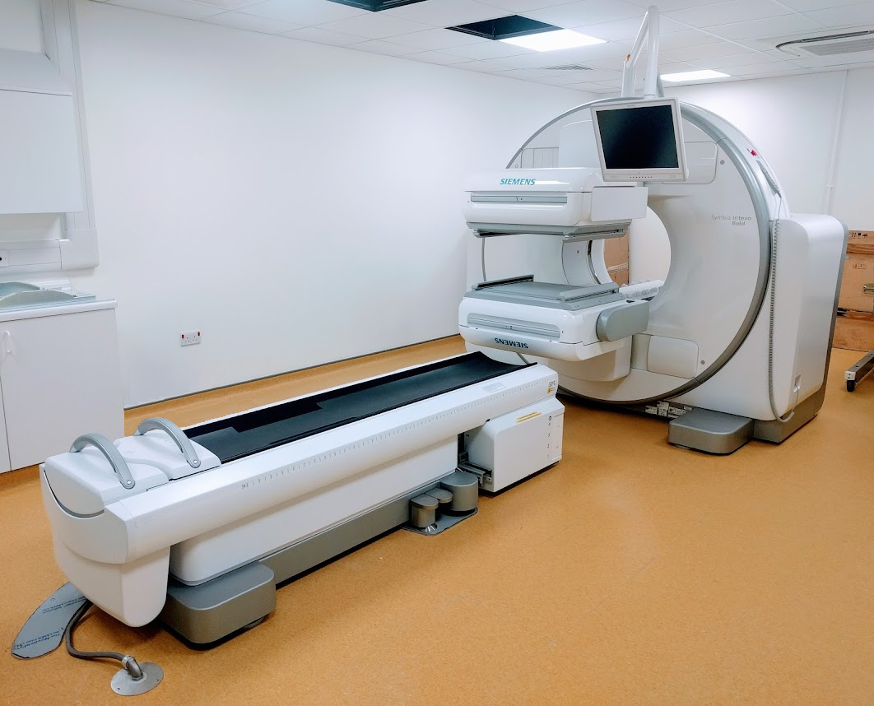
Gamma Camera
By Nagaraju B
By
Dr.Jayapandiyan
Assistant Professor,
Department of Paramedical Sciences
SVDU

Slide 2
GAMMA CAMERA
Learning Objectives
At the end of the lecture, the students will be able to
Understand the Basic Components
Explain the Working Principle
Differentiate Types of Collimators
Analyze Image Formation and Quality Factors
Apply Safety and Quality Control Measures

Slide 3
GAMMA CAMERA
Developed by Hal Anger at Berkeley in 1957 and therefore also called Anger camera
An electronic device that detects gamma rays emitted by radio pharmaceutical that have been introduced into the body as tracers.
The position of the source of the radioactivity can be plotted and displayed on a TV monitor or photographic film.

Slide 4
COMPONENTS OF GAMMA CAMERA
A radioactive material that can be used as a label and which has the
appropriated energy range of photons and with a short live time
The scattered radiation is not contributing for the image, it should be avoided
and discriminated (Collimator and MCA)
A large detector (Scintillator)
A system for measuring the light produced by the radiation (PMT tubes)
A system for determining the position of the interaction of the radiation with
the detector (Weighting and calculation systems)
A system for computing and processing the data (Image processor)
A mechanical system for positioning the detector and the patient.

Slide 5
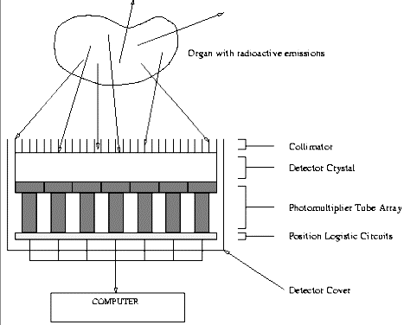
Gamma Camera - Outline

Slide 6
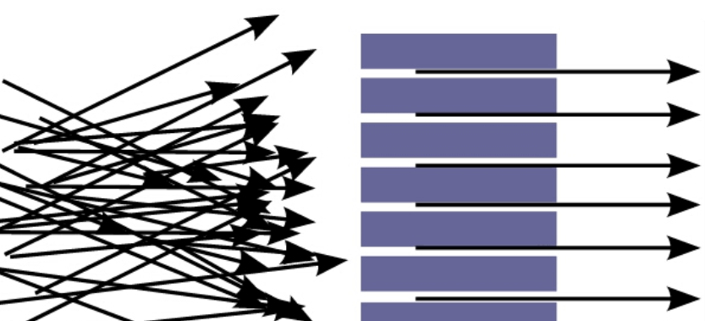
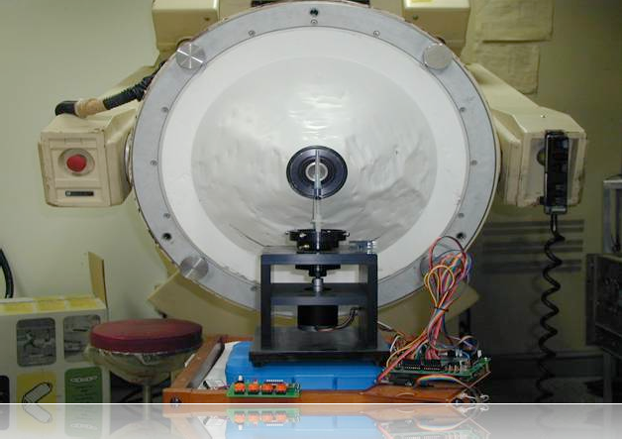
Collimators
A collimator is a device that narrows a beam of particles or waves. It can also produce a beam of parallel rays. It eliminates the scattered radiation
Gamma rays can’t be focused
Pinhole Collimator
A pinhole collimator only lets in photons that pass through the small hole. The rest are blocked.

Slide 7
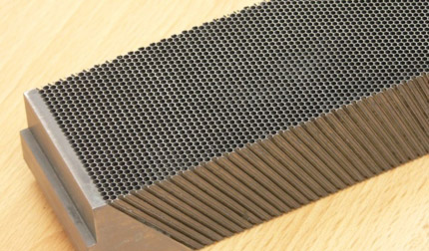
PARALLEL COLLIMATOR
Collimator is made from lead.
Maintains the quality of image
Spaces between holes known as septa
Collimator consisting of a series of
holes in a lead plate can be used to select the direction of
the rays falling on the crystal.
There are 4 types of collimator.
  Parallel-hole collimator
  Pin-hole collimator
  Diverging
  Converging
Most collimators in use are parallel hole collimators.

Slide 8
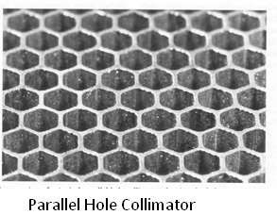
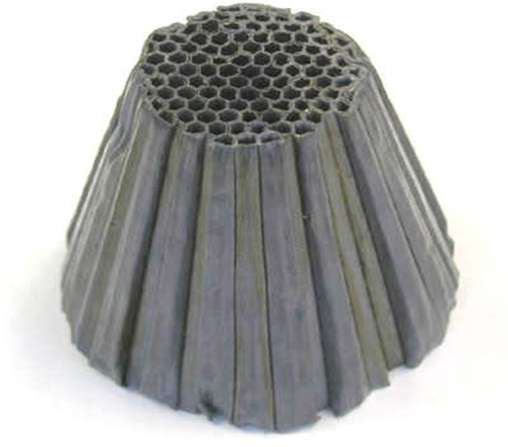
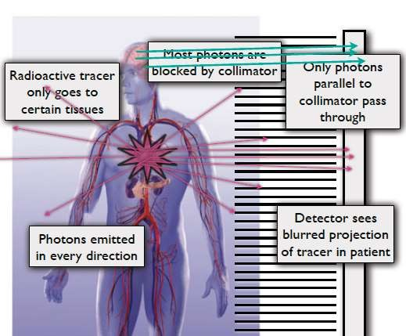
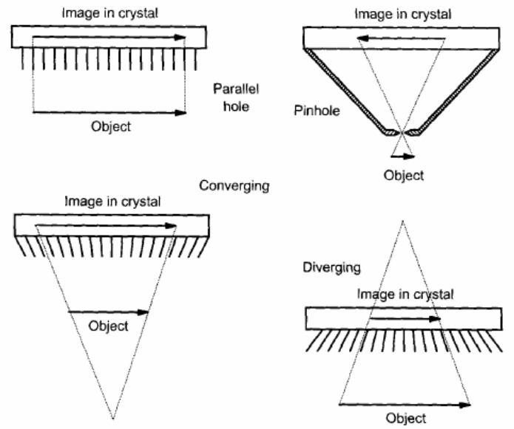

Slide 9
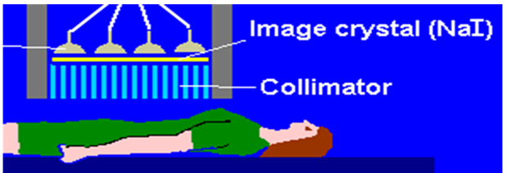
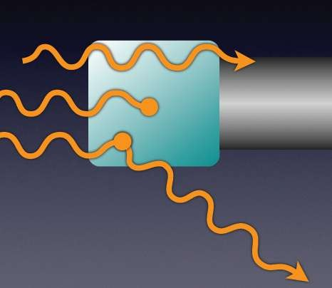

Scintillator (Crystal)
Sodium Iodide with Thallium – NaI(Tl)
The main function of the crystal is to convert gamma ray into photons of visible light and the process is called scintillation
The amount of light is proportional to the amount of gamma photons incident on it.

Slide 10
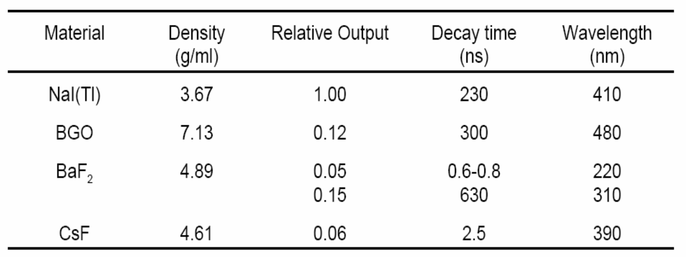
Crystal Materials

Slide 11
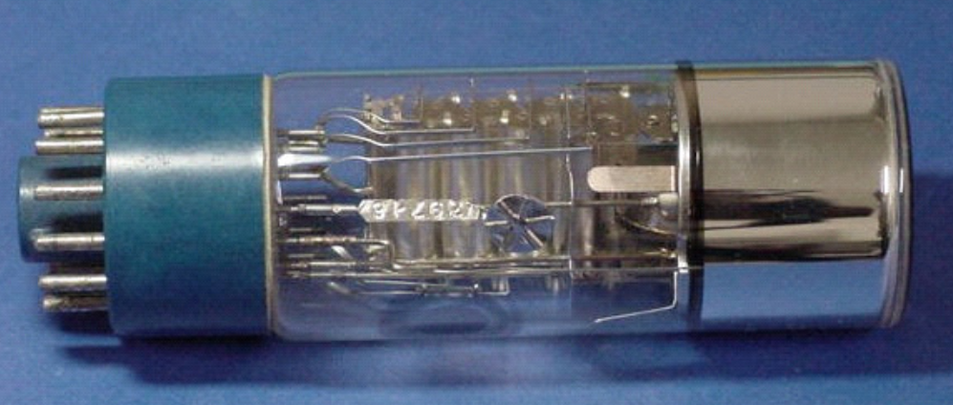
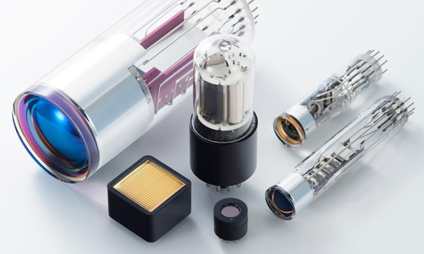
Photo Multiplier Tube (PMT)
Photo Multiplier tube (PMT) is an instrument that converts light to electrical signals.
Gamma Camera contains 37 - 91 PMT
It detects and amplifies the electrons that are produced by the photocathode.
The photocathode , when stimulated by ligh photons, ejects electrons. The PMT is attached to the back of the crystal.

Slide 12
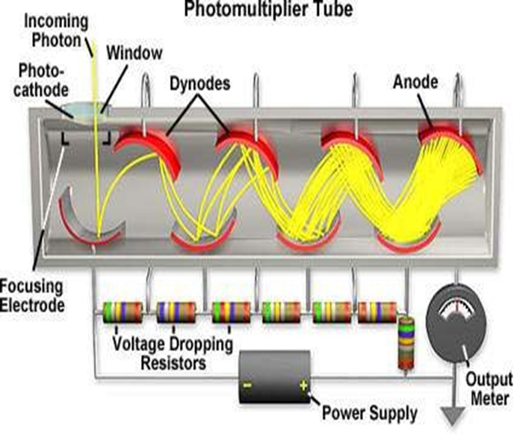
Photo Multiplier Tube (PMT)
Only a very small amount of light is given off from the scintillation detector.
Only one electron is generated for every 7 to 10 photons incident on the photocathode.
This Electron is focused on a dynode that absorbs it and reemits many more electrons (usually 6 to10).
These new electrons are focused on the next dynode and the process is repeated over and over in an array of dynodes.
At the base of the PMT is an anode that attracts the final large cluster of electrons and converts them into an electrical pulse
.

Slide 13
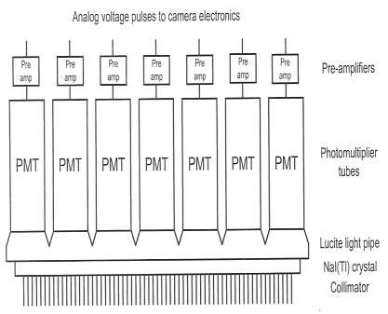
Pre Amplifier and Amplifier
Preamps attach above the PMT.
The amount of charge given by PMT is very small. Even though we have used a sophisticated photodetector like a PMT we still end up with quite a small electrical signal.
A very sensitive amplifier is therefore needed to amplify this signal. This type of amplifier is generally called a pre-amplifier.
After that use amplifier to amplify the signal as need.

Slide 14
Position Circuitry and Pulse Height Analyzer
Position circuitry receives the electrical impulses from pre-amplifiers.
This allows the position circuits to determine where each scintillation event occurred in the detector crystal.
A pulse height analyzer determines the energy of the incident ray that interact within the NaI(Tl) crystal.
A peak height analyzer and a computer convert the light into a useful anatomical image
Data Analysis Computer
Finally, a processing computer is used to deal with the incoming projection data and processes it into a readable image of the 3D spatial distribution of activity within the patient.
The computer may use various methods to reconstruct an image, such as filtered back projection or iterative reconstruction.

Slide 15
APPLICATIONS OF GAMMA CAMERA
Gamma Camera is used to locate cancerous tumours, minor bone fractures, abnormal functioning of organs, and other medical problems
Gamma cameras give structural and functional images of body organs.
Bone scan.
Myocardial Perfusion (a procedure that illustrates the function of the heart muscle)
Lungs scan.
To detect the thyroid (a gland that absorbs Iodine) problems.

Slide 16
THANK YOU

