Slide 1

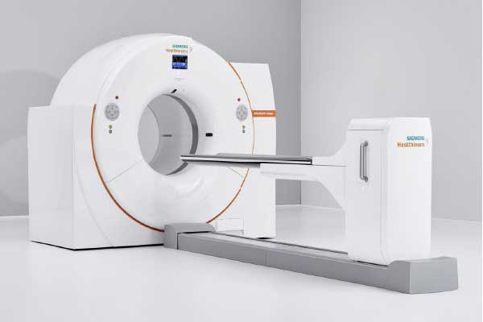
Positron Emission Tomography
P.E.T
By
Dr.Jayapandiyan
Assistant Professor,
Department of Paramedical Sciences
SVDU

Slide 2
Positron Emission Tomography
Learning Objectives
At the end of the lecture, the students will be able to
Understand the Fundamental Principles of PET Imaging
Describe PET Scanner Components and Functionality
Interpret PET Image Reconstruction and Quantification
Differentiate PET Tracers and Their Clinical Applications
Apply Safety, Quality Control, and Regulatory Guidelines

Slide 3
Content
What is PET?
History of positron
What is a Positron?
What happens after the positron is obtained?
Uses
How does it work?
How is it performed?
What are the benefits vs. risks?
Things to consider
Limitations

Slide 4
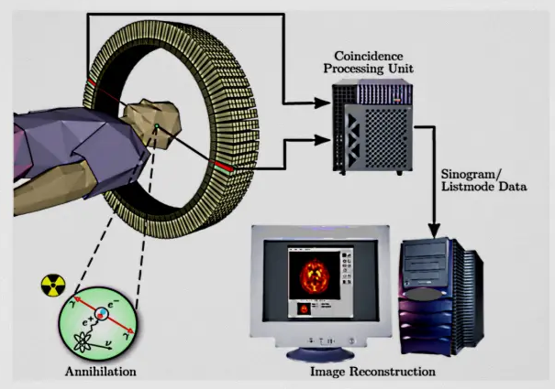
What is PET?
PET is a noninvasive, diagnostic imaging technique for measuring the metabolic activity of cells in the human body.
It was developed in the mid 1970s and it was the first scanning method to give functional information about the brain.
PET Instrument

Slide 5
History - POSITRON
Existence first postulated in 1928 by Paul Dirac
First observed in 1932 by Carl D. Anderson, who gave the positron its name. He also suggested to rename the electron to “negatron” but he was unsuccessful.
POSITRON
A Positron is an anti-matter electron. It is identical in mass but has an apposite charge of +1.
Positrons can come from different sources, but in PET they are produced by nuclear decay.

Slide 6
Nuclear decay is basically when unstable nuclei are produced in a cyclotron by bombarding the target material with protons, and as a result, a neutron is released.
O₁₈ + proton => F₁₈ + neutron (F₁₈ has half-life of 109.771 min)
In PET the target material is chosen so that the product of the bombardment decays to a more stable state isotope by emitting a positron, for instance, F₁₈ has too many protons, so one of these protons decays into a neutron, a positron, and a neutrino. (F₁₈ has a half-life of 109.771 min)
proton (+1 charge) => neutron (0 charge) + positron (+1 charge) + neutrino (0 charge)

Slide 7
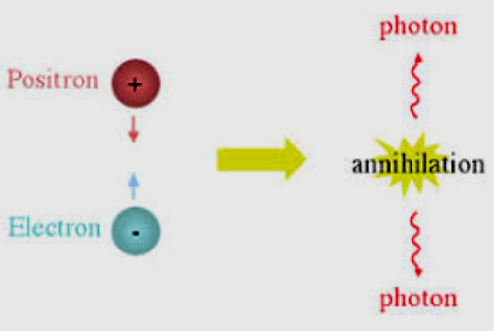
What happens after the positron is obtained?
Leftover energy from the nuclear decay process is shared between the positron and the departing neutrino.
(The positron or antielectron is the antiparticle or the antimatter counterpart of the electron. The positron has an electric charge of +1 e, a spin of ½, and has the same mass as an electron.)
When a positron collides with an electron, annihilation occurs)
Positron begins its activity in colliding
with other particles and gradually loses its
kinetic energy and thus slowing down.

Slide 8
Uses
Detect cancer.
Determine whether cancer has spread in the body.
Assess the effectiveness of a treatment plan, such as cancer therapy.
Determine if cancer has returned after treatment.
Determine blood flow to the heart muscle.
Determine the effects of a heart attack.
Identify areas of the heart muscle that would benefit from a procedure such as angioplasty or coronary artery bypass surgery.
Evaluate brain abnormalities, such as tumors, memory disorders, and seizures, and other central nervous system disorders.
To map normal human brain and heart function.

Slide 9
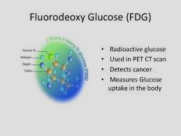
PET -Working
Before the examination begins, a radioactive substance is produced in a cyclotron and attached, or tagged, to a natural body compound, most commonly glucose, but sometimes water.
Once this substance is administered to the patient, the radioactivity localizes in the appropriate body areas and is detected by the PET scanner.
Different colors or degrees of brightness on a PET image represent different tissue or organ function levels.
Healthy tissue uses glucose for energy, it accumulates some of the tagged glucose, which will show up on the PET images.
Cancerous tissue, which uses more glucose than normal tissue, will accumulate more of the substance and appear brighter than normal tissue on the PET images.

Slide 10
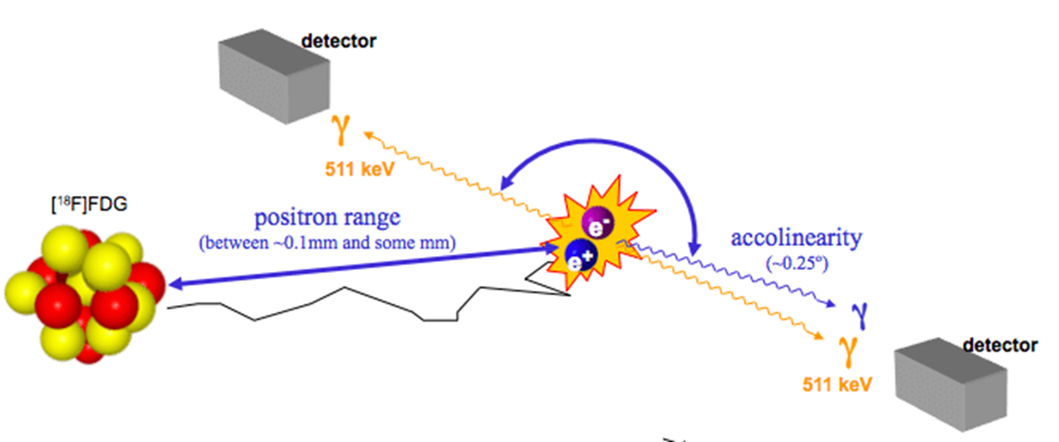
Annihilation

Slide 11
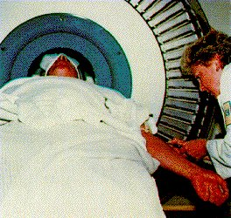
How is it performed?
The radioactive substance is administered as an intravenous injection (although in some cases, it will be given through an existing intravenous line or inhaled as a gas).
It will then take approximately 30 to 90 minutes for the substance to travel through your body and accumulate in the tissue under study.
During this time, you will be asked to rest quietly and avoid significant movement or talking, which may alter the localization of the administered substance. After that time, scanning begins. This may take 30 to 45 minutes.
Some patients, specifically those with heart disease, may undergo a stress test in which PET scans are obtained while they are at rest and again after undergoing the administration of a pharmaceutical to alter the blood flow to the heart.
Usually, there are no restrictions on daily routine after the test, although you should drink plenty of fluids to flush the radioactive substance from your body.

Slide 12
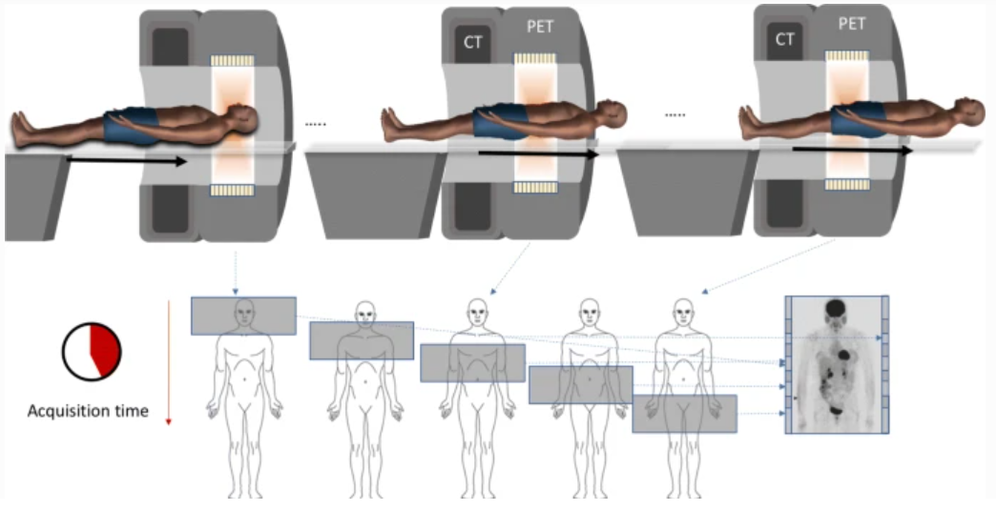

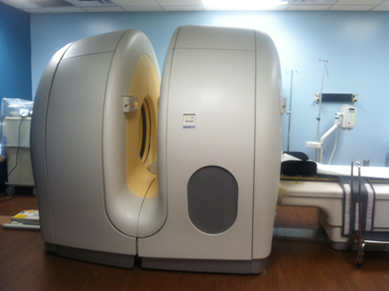
PET - Detector
Ring (multiple rings) with lots of little detectors (up to 23,040)
Rings have axial coverage of up to 26cm.
Detectors must have good stopping power
Lutetium Yttrium Oxyortho Silicate LSO (LYSO) is commonly used (is one of the most widely used scintillation crystal in the high-performance Positron Emission Tomography (PET) systems)

Slide 13
Benefits vs Risks
Because PET allows the study of body function, it can help physicians detect alterations in biochemical processes that suggest disease before changes in anatomy are apparent with other imaging tests, such as CT or MRI.
PET imaging has been shown to improve the detection of a variety of cancers.
RISKS
The radioactive substance may expose radiation to the fetus in patients who are pregnant or the infants of women who are breastfeeding.
The risk to the fetus or infant should be considered in relation to the potential information gained from the result of the PET examination.
The pregnant patient should inform the PET imaging staff before the examination is performed.

Slide 14
Things to consider
You will remain still for a long time.
Claustrophobic persons may feel some anxiety.
Claustrophobic - a person having an extreme or irrational fear of confined places
Limitations
Time-consuming.
PET can give false results if a patient's chemical balances are not normal. Specifically, test results of diabetic patients or patients who have eaten within a few hours prior to the examination can be adversely affected because of blood sugar or blood insulin levels.

Slide 15
Limitations
Also, because the radioactive substance decays quickly and is effective for a short period of time, it must be produced in a laboratory near the PET scanner.
It is important to be on time for the appointment and to receive the radioactive substance at the scheduled time. PET must be done by a radiologist who has specialized in nuclear medicine and has substantial experience with PET.
Finally, the value of a PET scan is enhanced when it is part of a larger diagnostic work-up. This often entails comparison of the PET scan with other imaging studies, such as CT or MRI.
A person who is very obese may not fit into the opening of a conventional PET/CT unit.

Slide 16
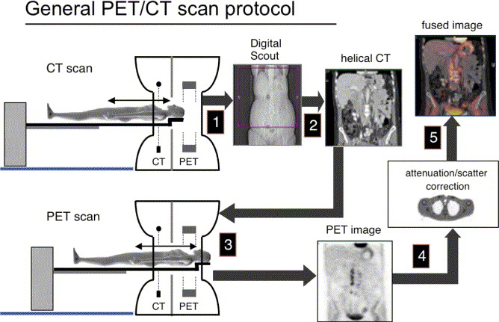
Instrumentation – PET/CT

Slide 17
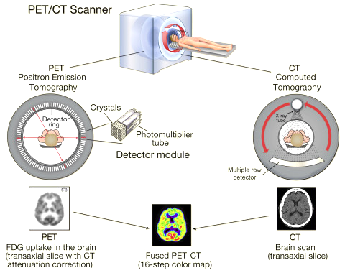
Instrumentation- PET/CT

Slide 18
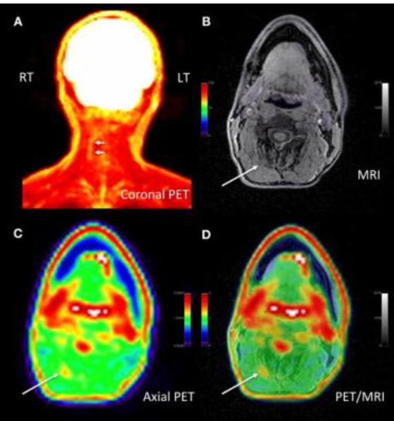
PET/MRI
PET/MRI – Pinpoints the location of pain

Slide 19
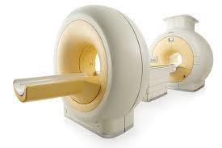
THANK YOU

