Slide 1

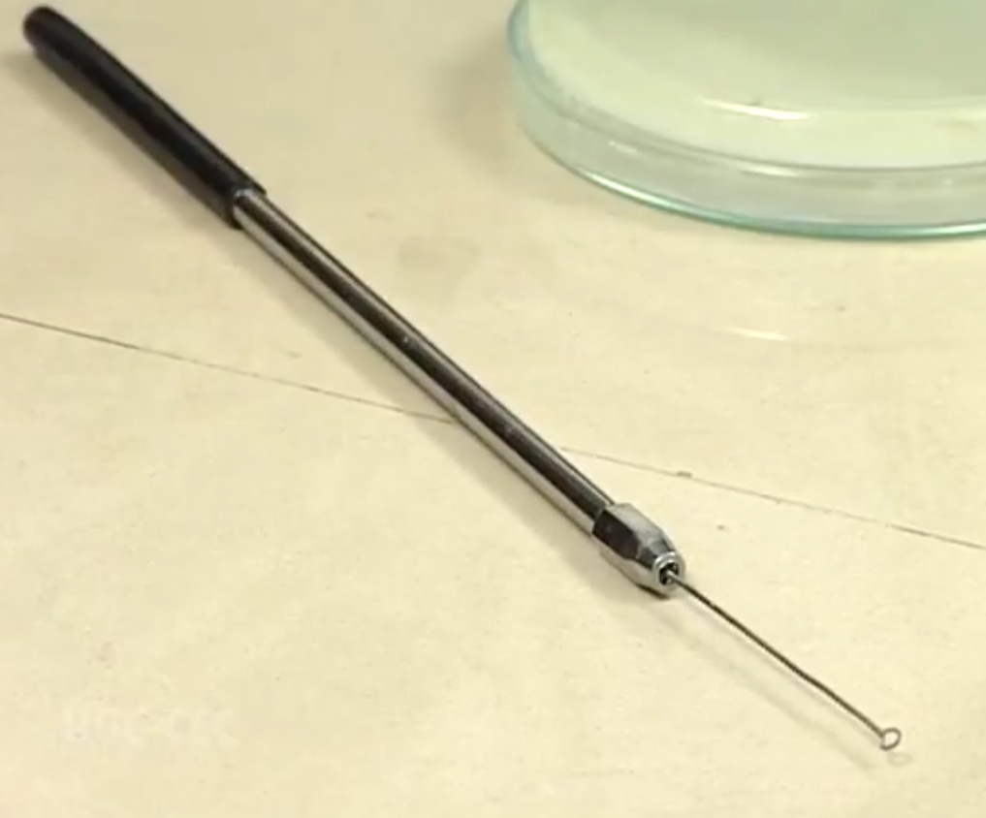
Isolation Techniques & Preservation and Maintenance of Culture
PRESENTATION BY:
Ms. Pooja Shashikant Chavan
Tutor,Department of Paramedical Sciences,SVDU

Slide 2
Learning Objectives
1.Understand the principles and importance of microbial isolation techniques.
2.Identify different methods of isolation (e.g., streak plate, pour plate, spread plate).
3. List and describe different preservation methods (e.g., refrigeration, deep freezing, lyophilization.
4.Differentiate between pure culture and mixed culture.
5. Understand the advantages and limitations of each preservation technique.
6.Maintain the viability and purity of microbial cultures over time

Slide 3
Isolation of Microbial Pure Culture
Microorganisms are generally found in nature (air, soil and water) as mixed population.
Even the diseased parts of plants and animals contain a great number of microorganisms, which differ markedly from the microorganisms of another environment.
To study the specific role played by a specific microorganism in its
environment, one must isolate the same in pure culture

Slide 4
Isolation of Microorganisms
The process of screening a pure culture by separating one type of microbes from a mixture is called Isolation. Various techniques are developed for the isolation of pure culture from mixed culture.
A. Isolation of Microorganism from water
B. Isolation of Microorganism from air
C. Isolation of Microorganism from Decomposing Matte

Slide 5
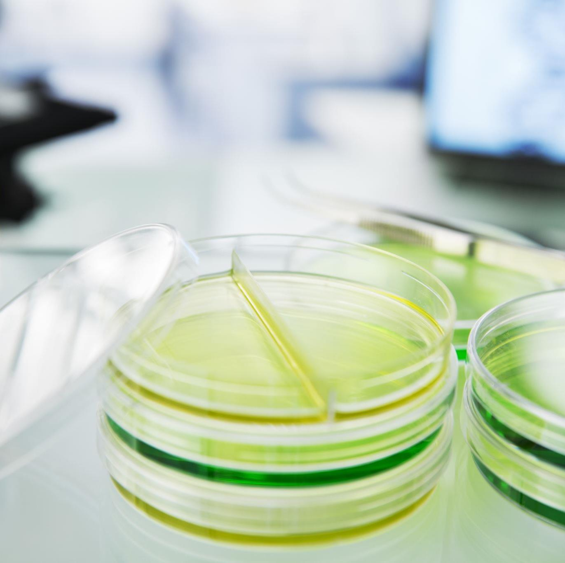
Common Methods of Isolation of Pure Culture
The process of screening a pure
culture by separating one type of
microbes from a mixture is called
Isolation.
Some common isolation methods are
1. Isolation by Streak Plate method
2. Micromanipulator Methods
3. Enrichment culture method
4. Serial Dilution method

Slide 6
1. Isolation by Streaking or Streak plate
This method is used most commonly to isolate pure cultures of bacteria.
• In this method the tip of a fine structure wire loop called Inoculation needle consist of a wooden or glass handle with a nichrome wire the end
of which is bent to form a loop is used to transfer microbes from culture.
• The straight wires are like wire loop except they do not have loop. These
are used to transfer culture in colony formed on solid culture medium.
• In such cases the colony from solid medium is streaked on surface of
nutrient agar medium in a sterile Petri dish.

Slide 7
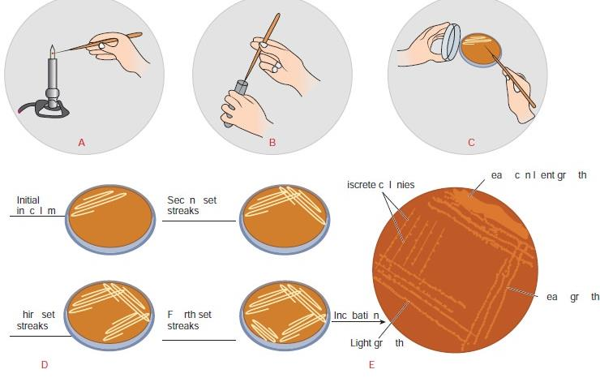
Steps of Streak Plate Isolation method

Slide 8
Streak Plate method
This technique consists of the following steps
1. Hold the broth culture containing tube in left hand and shake it
2. Sterilize the wire loop of the inoculation needle on burner flame
3. Remove the cotton plug of the broth culture tube by little finger of right hand
4. Flame the mouth of the test tube immediately
5. Insert the wire loop to form a thin film and replace the cotton plug
6. The thin film in the loop is streaked in either a zig-zag manner by removing the loop backwards and forwards firmly. Care should be taken that the loop should not be firmly pressed against the agar surface.
7. Incubate the Petri dish in incubator at a required temperature
8. Growth of the bacteria will be visible (after an overnight incubation) on the streaked mark

Slide 9
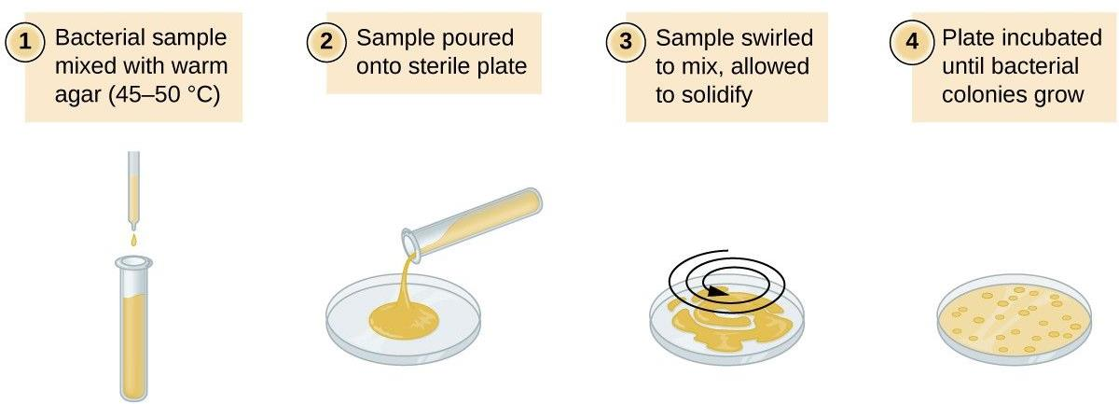
Pour Plate Method

Slide 10
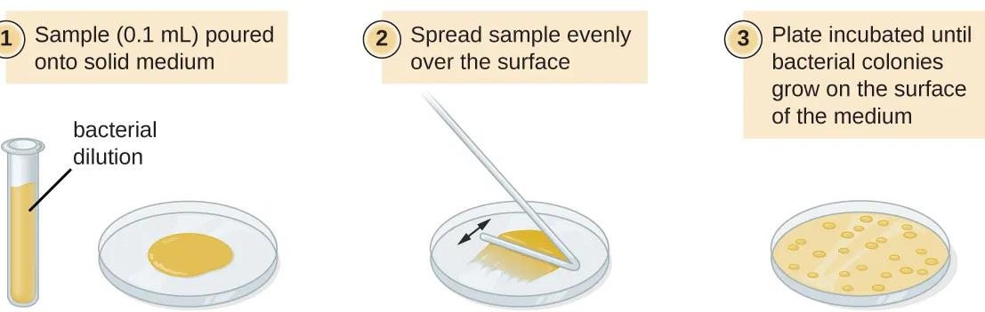
Spread Plate Method

Slide 11
2. Micromanipulator Method
Micromanipulators have been built which permit one to pick out a single cell from a mixed culture. This instrument is used in conjugation with a microscope to pick a single cell (particularly bacterial cell) from a hanging drop preparation.
Advantages of micromanipulator method
The advantage of this method is that one can be reasonably sure that the cultures come from a single cell and one can obtain strains within the species
Disadvantages
The disadvantages are that the equipment is expensive its manipulation is very tedious, and it requires a skilled operator.

Slide 12
Isolation by Using Selective of Enrichment media/Enrichment method
Generally, it is used to isolate those microorganisms, which are present in relatively small numbers or that have slow growth rates compared to the other species present in the mixed culture.
The enrichment culture strategy provides a specially designed culture environment by incorporating a specially designed cultural environment by incorporating a specific nutrient in the medium and by modifying the physical condition of the incubation.
The medium of known composition and specific condition of incubation favors the growth of desired microorganisms but is unsuitable for the growth of other types of microorganisms.
Chemical dyes such as malachite green and crystal violet are used to inhibit the growth of bacteria and yeast. Sodium azide is a metal-binding agent that inhibits the growth of anaerobic bacteria, bit does not affect the anaerobic lactic acid bacteria

Slide 13
Preservation and Maintainance of Pure Cultures
Once a microorganism has been isolated and grown in pure culture it become necessary to maintain the viability and purity of microorganism by keeping the pure cultures free from contamination.
Normally in laboratories, the pure cultures are transferred periodically onto or into a fresh medium (subculturing) to allow continuous growth and viability of microorganisms.
The transfer is always subject to aseptic conditions to avoid contamination.
These methods include refrigeration, paraffin method, cryopreservation and lyophilization (freeze drying).

Slide 14
A. Refrigeration
Pure cultures can be successfully stored at 0-4ْC either in refrigerators or in cold rooms.
This method is applied for short duration (2-3 weeks for bacteria and 3-4 months for fungi) because the metabolic activities of the microorganisms are greatly slowed down but not stopped.
Thus, their growth continues slowly, nutrients are utilized, and waste products released in medium. This results in finally the death of the microbes after some time

Slide 15
B.Cryopreservation
Cryopreservation (i.e., freezing in liquid nitrogen at -196ْC ) helps survival of pure cultures for long storage times.
In this method, the microorganisms of culture are rapidly frozen in liquid nitrogen at -196ْC in the presence of stabilizing agents such as glycerol that prevent the formation of ice crystals and promote cell survival.

Slide 16
C.Lyophilization (Freeze Drying)
In this method the culture is rapidly frozen at a very low temperature (-70ْ) and then dehydrated by vacuum.
Under these conditions, the microbial cells are dehydrated, and their
metabolic activities are stopped; as a result, the microbes go into
dormant state and retain viability for years.
Lyophilized or freeze-dried pure cultures and then sealed and stored
in dark at 4ْC in refrigerators.
Freeze drying method is the most frequently used technique by
culture collection centres.

Slide 17
Culture Characterization
Bacteria grow tremendously fast when supplied with an abundance of nutrients.
• Different types of bacteria will produce different looking colonies,
some colonies may be colored, some colonies are circular in shape
and others are irregular.
• The characteristics of a colony ( shape, size, pigmentation etc.) are
termed the colony morphology

Slide 18
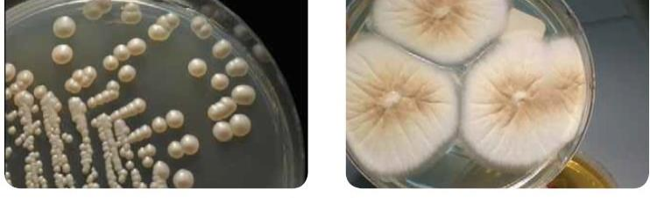
1.Colony appearance
Many fungi produce colonies with a fluppy appearance similar to cotton wool the molds produce colonies which on aging develop a dry chalky appearance.
Example: Yeast, a type of fungi, is found in many places from nature to research labs and even everyday kitchens for baking. Yeast colonies generally look similar to bacterial colonies.Some species, such as candida, can grow as white patches with a glossy surface

Slide 19
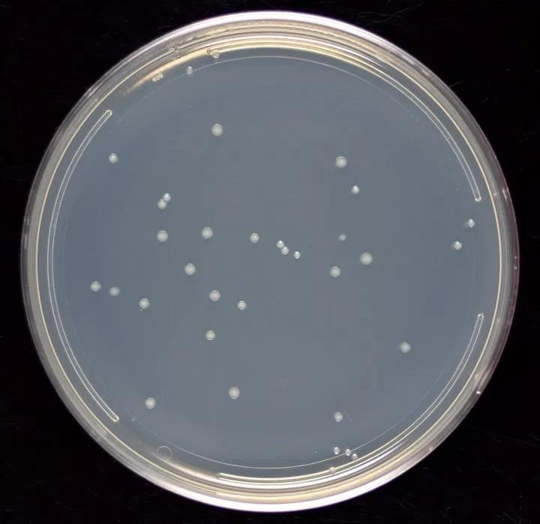
Bacterial colony:
Each distinct circular colony should represent an individual bacterial cell or group that has divided repeatedly.
Being kept in one place, the resulting cells have accumulated to form a visible
patch.
Most bacterial colonies appear white, cream, or yellow in colour and fairly circular in shapeColony Forms:
The colony shape may be circular, filamentous, rhizoidal, punctiform (dot like), irregular or spindle shape.

Slide 20
3. Colony Elevation:
This form is used to describe the depth of the colony developed by microbes.
4. A colony margins:
The margins may be entire undulate(wavy), crenate, dentate, lobate, rhizoidal or
filamentous
5. Optical Density:
The colony may be transparent or translucent (foggy in appearance) or opaque (not permitting light to pass through it) or irrediscent (rainbow colour)
6.Colour:
Many microbes develop colonies which are pigmented . Such coloured substances are either water soluble or insoluble. The soluble pigments diffuse out in the medium
7. Colony Odour:
Some microbe produces a characteristic smell which sometimes helps in identifying the microbe

Slide 21
References:
1.Sharma, P.D. Microbiology and Plant Pathology.
2.Sharma, O.P. Diversity of Microbes and Cryptogams, Mc Graw Hill Publication.
3.Joanne Willey and Linda Sherwood and Christopher J. Woolverton “Prescott's Microbiology” Mc Graw Hill 2017, 10th edition

