Slide 1
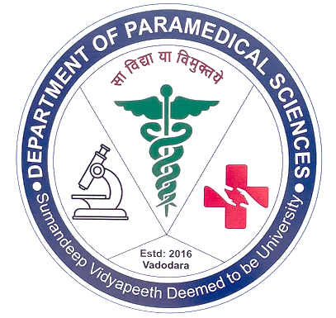
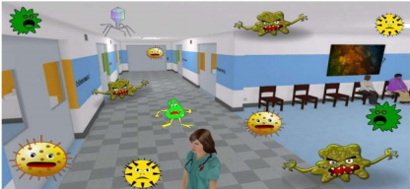
NOSOCOMIAL INFECTIONS
RESENTATION BY:
Ms. Pooja Shashikant Chavan
Tutor,Department of Paramedical Sciences,SVDU

Slide 2
Learning Objectives:
1. Define hospital-acquired infections and differentiate them from community-acquired infections.
2.Identify common types of HAIs (e.g., catheter-associated urinary tract infections, ventilator-associated pneumonia, surgical site infections, bloodstream infections).
3.Recognize the most common pathogens responsible for HAIs (e.g., Staphylococcus aureus, Escherichia coli, Pseudomonas aeruginosa, etc.).
4.Understand the modes of transmission of HAIs within healthcare settings.
5.Demonstrate knowledge of standard precautions and isolation techniques to prevent infection spread.

Slide 3
Nosocomial infection
An infection acquired in hospital by a patient who was admitted for a reason other than that infection.
An infection occurring in a patient in a hospital or other health care facility in whom the infection was not present or incubating at the time of admission.

Slide 4
Impact of hospital-acquired infections
Serious illness or death
Prolonged hospital stay, which costs money
Increasing the time of absence from work
Need for additional antimicrobial therapy, which is costly and expose the patient to additional risks of toxicity
The infected patient becoming a source from which others
may become infected.

Slide 5
Sources of infection
The sources of hospital-acquired infection may be:
1- An endogenous source (patients own flora)
Patients own flora may cause infections in different tissues of the patient duringcertain surgical operations, manipulationby instruments, or nursing procedures.

Slide 6
2- An exogenous source: Is most important and occurs mostly from:
Another patient
A member of the medical and paramedical staff harboring the pathogens
From the environment. includes inanimate objects (e.g., catheters),
bed pans, and surfaces contaminated by the patient’s secretions. It
also includes hospital food, water, and environmental air

Slide 7
Microorganisms causing infections
Gram-positive organisms like Streptococcus pyogenes and methicillin-resistant Staphylococcus aureus (MRSA).
Gram-negative enteric pathogens including Escherichia coli, Klebsiella,
Enterobacter species.
Pseudomonas and Acinetobacter species developing resistance to most of the commonly used antibiotics.Many different viruses, fungi and parasites

Slide 8
Transmission of infections
Infections can be transmitted by following ways:
Air-borne transmission: Hospital infections may be transmitted by
Air-borne droplets, dust particles, and aerosols.
Aerosols produced by humidifiers, and air conditioning apparatus
https://line.17qq.com/articles/qmhfsfskwy.html
Transmission by direct contact: is the principal route of transmission
Direct contact with hands and clothing's of medical personnel harboring
microorganisms
Contact with certain hospital instruments (e.g., endoscopes

Slide 9
Transmission by oral route
Transmission by hospital foods served to
hospitalized patients.
Transmission by parenteral route
Blood-borne pathogens, such as hepatitis B and
C and HIV, may be transmitted by transfusion of
blood or blood products.

Slide 10
1.Urinary tract infections
- Account for as many as 40–45% of nosocomial infections.
- Associated with indwelling bladder catheters, which create a 3–
10% risk of infection each day.
2- Nosocomial pneumonia
- Accounts for 15–20% of nosocomial infections.
- Caused by aspiration of endogenous or hospital-acquired
oropharyngeal flora.
- Associated with more deaths than are infections at any other
body site

Slide 11
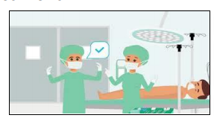
3.Surgical wound infections
Account for nearly 30% of all hospital infections.
These occur in up to 10% of patients undergoing clean surgery.
Result from contamination of the surgical wound with the Patient’s own flora or that of operating-room personnel or environment at the time of the surgery

Slide 12
Diagnosis of infections
Diagnosis of hospital-acquired infections is made by:
Routine bacteriological methods, such as
Direct demonstration of microorganisms in specimens by microscop.
Isolation by culture.
Testing bacterial isolates for their antibiotics sensitivity pattern.
The specimens are usually sampled from possible sources of infections, such as environment, inanimate objects, water, air, food, hospital personnel, etc

Slide 13
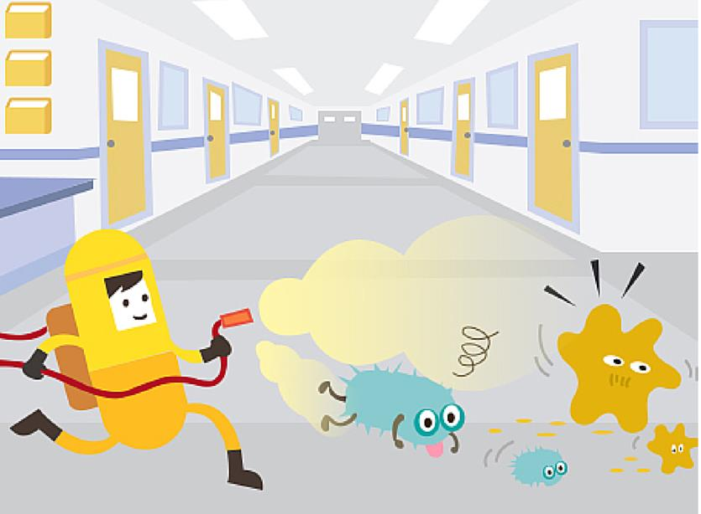
Prevention of hospital-acquired infections
Compliance with hand washing protocols.
Use of aseptic technique for insertion of intravenous and urinary catheters.
Compliance with guidelines on antimicrobial use.
Proper patient care.
Short hospital stays.
Early removal of invasive devices.
Isolation of infectious patients.
Staff vaccination
Adequate sterilization and disinfection of surgical instruments
Active surveillance for hospital-acquired infection

Slide 14
References:
1.Patrick R. Murray, Ken S. Rosenthal and Michael A. Pfaller. 2021.
Medical Microbiology. 9th edition. Elsevier.
2.Richard V. Goering, Hazel M. Dockrell, Mark Zuckerman, Peter L. Chiodini. 2019. Mims' Medical Microbiology and Immunology. Sixth edition. Elsevier.
3.Subhash Chandra Parija . 2016. Text book of Microbiology and Immunology. 3rd edition. ELSEVIER.

