Slide 1

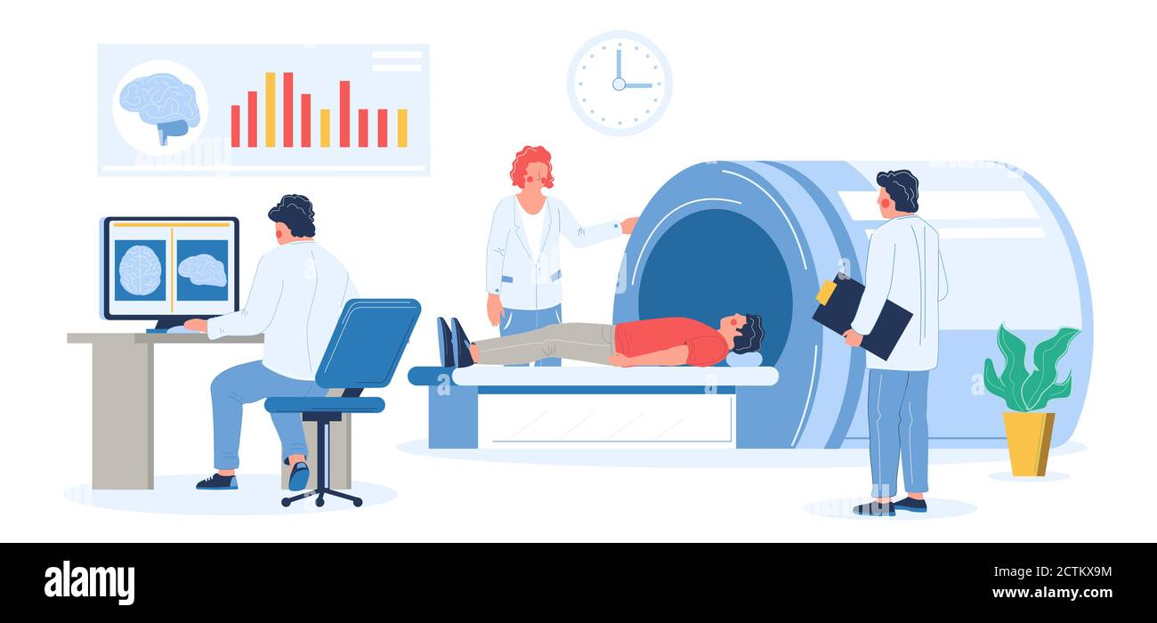
MRI BASIC PRINCIPLE
Yuvraj Maharshi
Lecturer
Department Of Paramedical Sciences,SVDU

Slide 2
MRI(Magnetic Resonance Imaging)
Learning Objective for MRI
Understand the Basic Principles of Magnetic Resonance Imaging (MRI)
Explain the Motion of Atomic Nuclei and Their Role in MRI Signal Generation
Identify MRI-Active Nuclei and Their Clinical Relevance
Describe the Historical Development of MRI Technology
Demonstrate an Understanding of Hydrogen Nucleus Behavior in Magnetic Fields
Apply the Knowledge of Basic MRI Concepts in Clinical Imaging Scenarios

Slide 3
What is MRI ?
Magnetic resonance imaging (MRI) is an imaging technique used primarily in medical settings to produce high quality images of the inside of the human body.
More specifically the images of protons in water. Hydrogen is used because it is plentiful in the human body and has the highest NMR signal of any atomic species.
Based on the principles of Nuclear Magnetic Resonance.

Slide 4
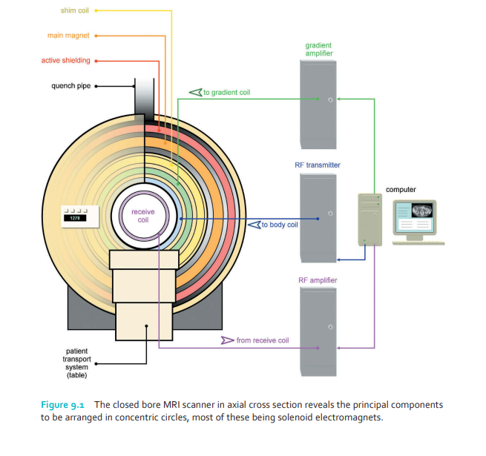
BASIC PRINCIPLE OF MRI
Magnetic fields are used to create images during magnetic resonance imaging (MRI), a non-ionizing radiation technique. It is a method of tomographic imaging that gathers information in a number of very thin slices or sections. These can be obtained in any direction, even on oblique planes. Four key parts make up an MRI machine.
The 1st is a magnet
The 2nd is a radiofrequency (RF) device.
The 3rd part is the collection of gradient systems.
The final component is made up of computers.

Slide 5
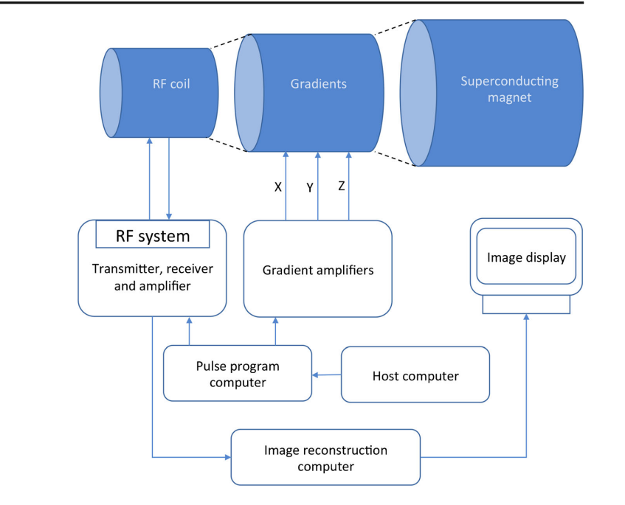

Slide 6
A Brief History of MRI
Felix Bloch and Edward Purcell were awarded the Nobel Prize in 1952, for discovering the magnetic resonance phenomenon independently in 1946.
1950-1970: NMR was developed and used for chemical and physical molecular analysis (uniform magnetic field).
In 1973 the x-ray-based computerized tomography (CT) was introduced by Hounsfield
Early 1970s Paul Lauterbur and Peter Mansfield utilization of gradients in magnetic field.
1975 Richard Ernst proposed magnetic resonance imaging using phase and frequency encoding, and the Fourier Transform
In 1993 functional MRI (fMRI) was developed. This technique allows the mapping of the function of the various regions of the human brain.

Slide 7
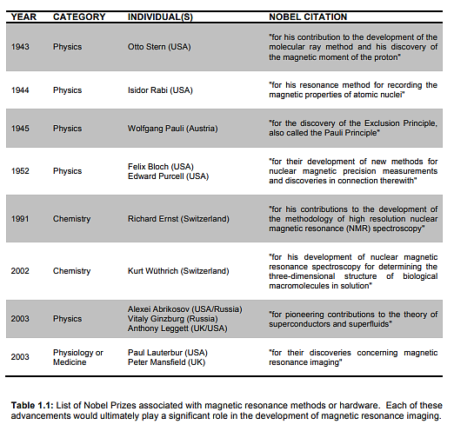

Slide 8
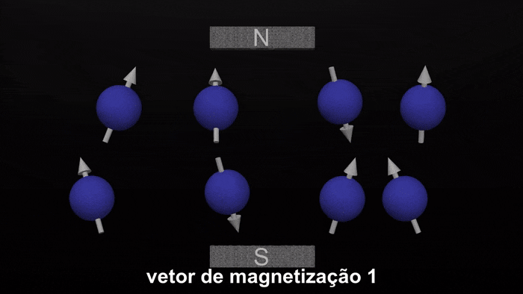
BASIC PRINCIPLE OF MRI
Protons, which are the hydrogen atoms nucleus, are largely used in clinical MRI. The magnetic moment interacts with the magnetic fields of the MRI systems & determines the direction & strength of the proton's magnetic field.
Due to the substantial natural abundance of water in human bio-logical systems, hydrogen nuclei are exploited in MRI for practical clinical imaging applications.
Both a magnetic dipole moment parallel to the spin vector and intrinsic spin angular momentum are present in hydrogen nuclei.
The hydrogen nuclei magnetic moment precesses with two distinct orientations in the presence of an external static magnetic field, B0, either parallel or anti-parallel to the static magnetic field, and a net alignment of nuclei exists parallel to the direction of the externally applied field (B0) .

Slide 9
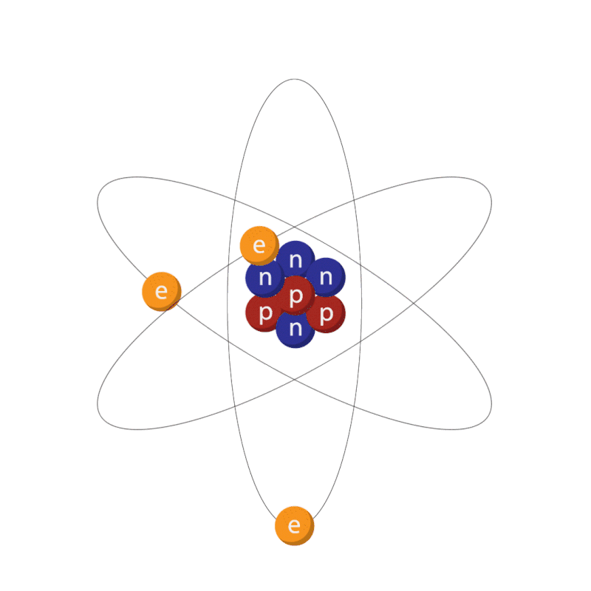
Motion in the atom
Three types of motion are present within the atom . These are:
electrons spinning on their own axis
electrons orbiting the nucleus
the nucleus itself spinning about its own axis.
The principles of MRI rely on the spinning motion of specific nuclei present in biological tissues. This spin derives from the individual spins of protons and neutrons within the nucleus. Pairs of subatomic particles automatically spin in opposite directions but at the same rate as their partners

Slide 10
MR active nuclei
MR active nuclei are characterized by their tendency to align their axis of rotation to an applied magnetic field. This occurs because they have angular momentum or spin and, as they contain positively charged protons, they possess electrical charge. MR active nuclei that have a net charge and are spinning (motion), automatically acquire a magnetic moment and can align with an external magnetic field.
Important examples of MR active nuclei, together with their mass numbers are listed below
hydrogen 1
carbon 13
nitrogen 15
oxygen 17
fluorine 19
sodium 23
Phosphorus 31

Slide 11
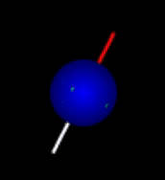
The hydrogen nucleus
The isotope of the hydrogen nucleus called protium is the MR active nucleus used in clinical MRI. This contains a single proton (atomic and mass number 1).
It is used because hydrogen is very abundant in the human body, and because its solitary proton gives it a relatively large magnetic moment. Both of these characteristics enable utilization of the maximum amount of available magnetization in the body.

Slide 12
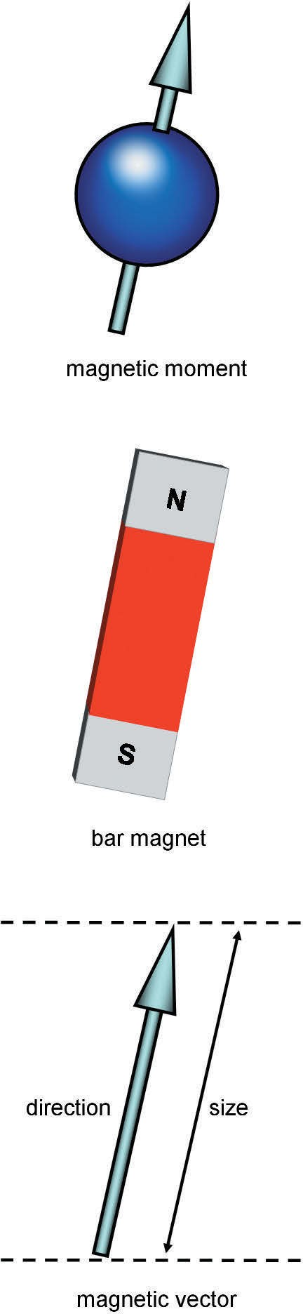
The Hydrogen Nucleus as a Magnet
The hydrogen nucleus contains one positively charged proton that spins, i.e. it moves. Therefore the hydrogen nucleus has a magnetic field induced around it and acts as a small magnet.
The magnet of each hydrogen nucleus has a north and a south pole of equal strength. The north/ south axis of each nucleus is represented by a magnetic moment and is used in the classical theory of the principles of MRI.
The magnetic moment of each nucleus has vector properties, i.e. it has size and direction and is denoted by an arrow.
The direction of the vector designates the direction of the magnetic moment, and the length of the vector designates the size of the magnetic moment as in fig
FThe magnetic moment of the hydrogen nucleus.

Slide 13
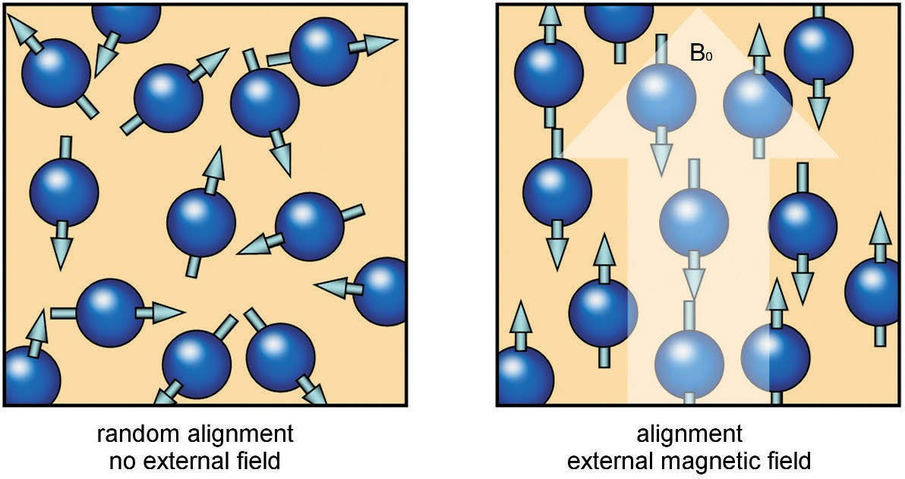
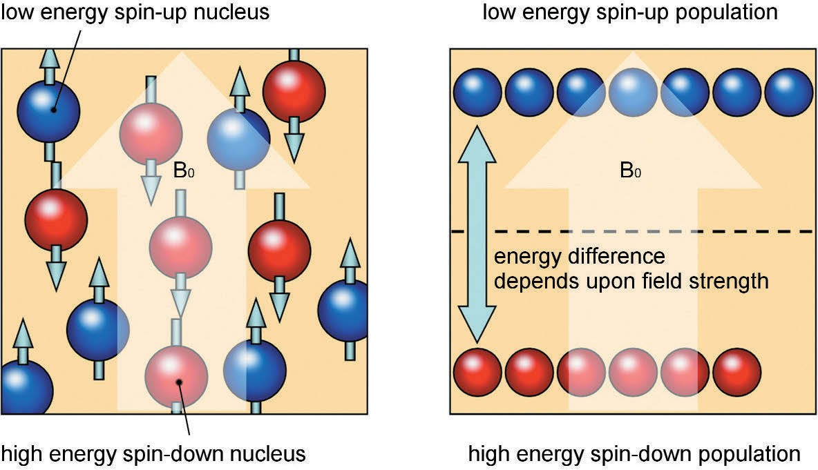
Alignment
In the absence of an applied magnetic field, the magnetic moments of the hydrogen nuclei are randomly orientated. when placed in a strong static external magnetic field, the magnetic moments of the hydrogen nuclei align with this magnetic field. Some of the hydrogen nuclei align parallel with the magnetic field (in the same direction), while a smaller number of the nuclei align anti-parallel to the magnetic field (in the opposite direction).
Applying quantum theory to MRI, hydrogen nuclei possess energy in two discrete quantities or populations termed low and high Low-energy nuclei align their magnetic moments parallel to the external field and are termed spin-up nuclei (shown in blue ). High-energy nuclei align their magnetic moments in the anti-parallel direction and are termed spin-down nuclei (shown in red )
Alignment – classical theory.
Alignment – quantum theory.

Slide 14
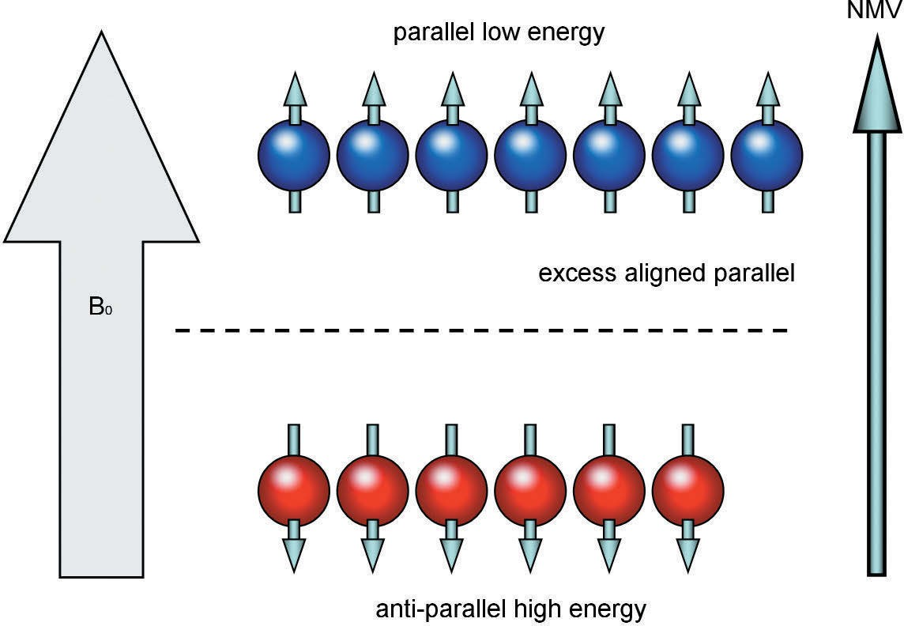
High thermal energy nuclei, however, do possess enough energy to oppose this field, and as the strength of the magnetic field increases, fewer nuclei have enough energy to do so. This is called thermal equilibrium. Under these circumstances it is the strength of the external field that determines the relative quantities of spin-up to spin-down nuclei.
The net magnetic moment of hydrogen, however, produces a significant magnetic vector that is used in clinical MRI. This is called the net magnetization vector (NMV) and reflects the relative balance between spin-up and spin-down nuclei.
The net magnetization vector.

Slide 15
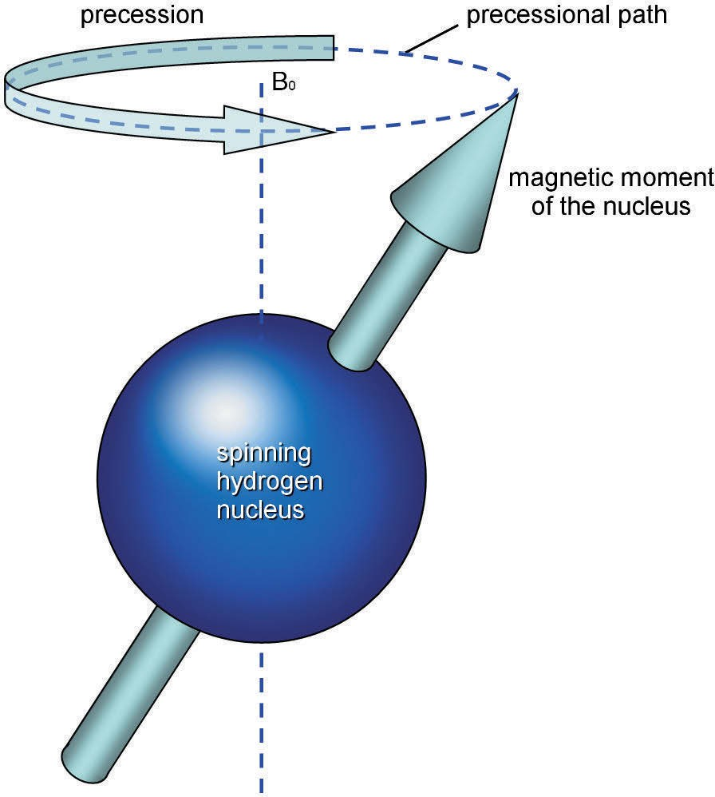
Precession
Each hydrogen nucleus is spinning on its axis . The influence of B₀ produces an additional spin or wobble of the magnetic moments of hydrogen around B₀. This secondary spin is called precession and causes the magnetic moments to follow a circular path around B₀.
This path is called the precessional path and the speed at which they wobble around B₀ is called the precessional frequency.
The unit of precessional frequency is megahertz (MHz) where 1 Hz is one cycle or rotation per second and 1 MHz is one million cycles or rotations per second.
Precession.

Slide 16
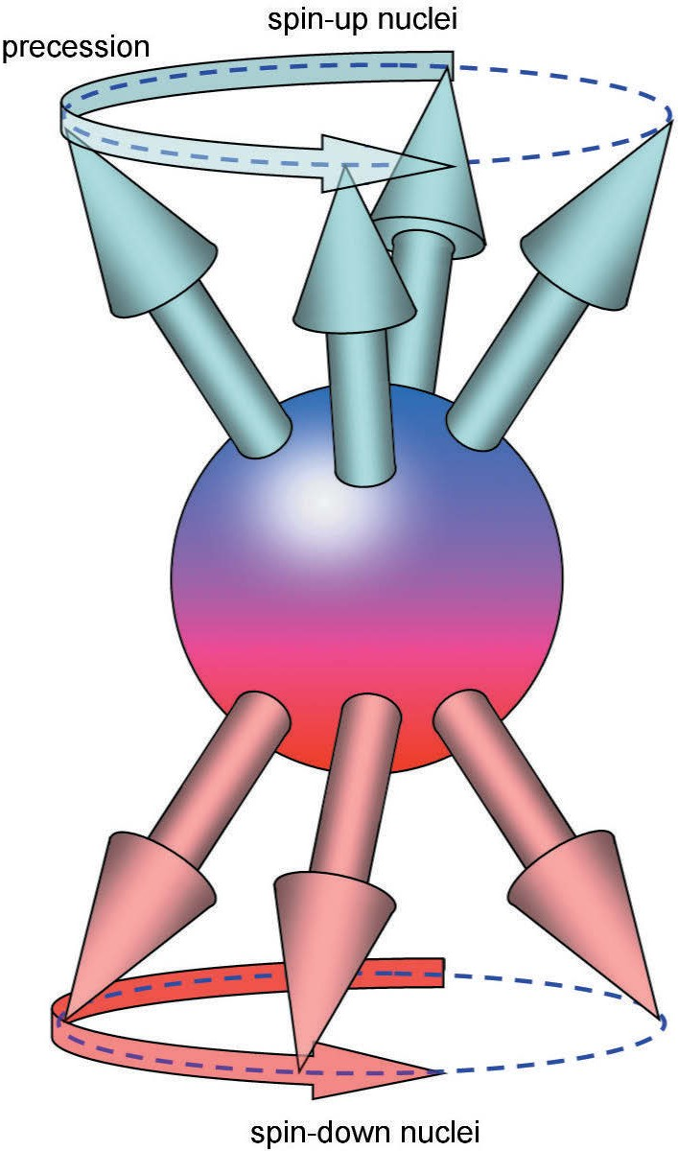
The Larmor equation
The value of the precessional frequency is governed by the Larmor equation. The Larmor equation states that:
ω₀ = B₀ × λ
where:
ω₀ is the precessional frequency
B₀ is the magnetic field strength of the magnet
λ is the gyromagnetic ratio.
The gyromagnetic ratio expresses the relationship between the angular momentum and the magnetic moment of each MR active nucleus. It is constant and is expressed as the precessional frequency of a specific MR active nucleus at 1 T.
The unit of the gyromagnetic ratio is therefore MHz/T. The gyromagnetic ratio of hydrogen is 42.57 MHz/T. The precessional frequency is often called the Larmor frequency, because it is determined by the Larmor equation.
Precession of the spin-up and spin-down populations.

Slide 17
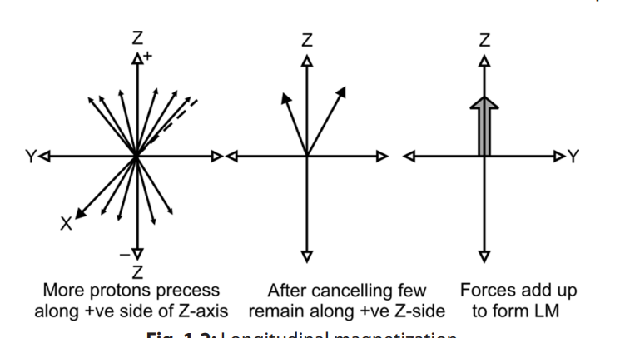
Longitudinal Magnetization
There are always more protons spinning on the positive side or parallel to Z-axis than negative side. So after canceling each others forces there are a few protons on positive side that retain their forces. Forces of these protons add up together to form a magnetic vector along the Z-axis. This is called as longitudinal magnetization. Longitudinal magnetization thus formed along the external magnetic field can not be measured directly. For the measurement it has to be transverse.

Slide 18
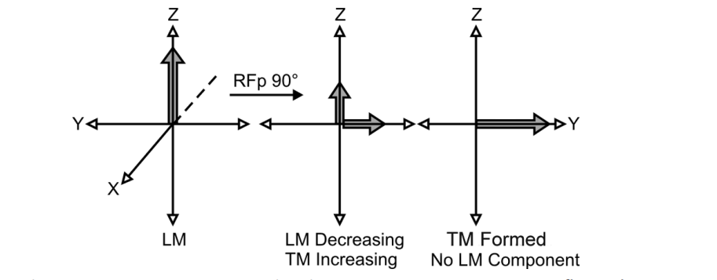
Transverse Magnetization
when patient is placed in the magnet, longitudinal magnetization is formed along the Z-axis. The next step is to send radiofrequency (RF) pulse. The precessing protons pick up some energy from the radiofrequency pulse. Some of these protons go to higher energy level and start precessing antiparallel (along negative side of the Z-axis).
The imbalance results in tilting of the magnetization into the transverse (X-Y) plane. This is called as transverse magnetization.

Slide 19
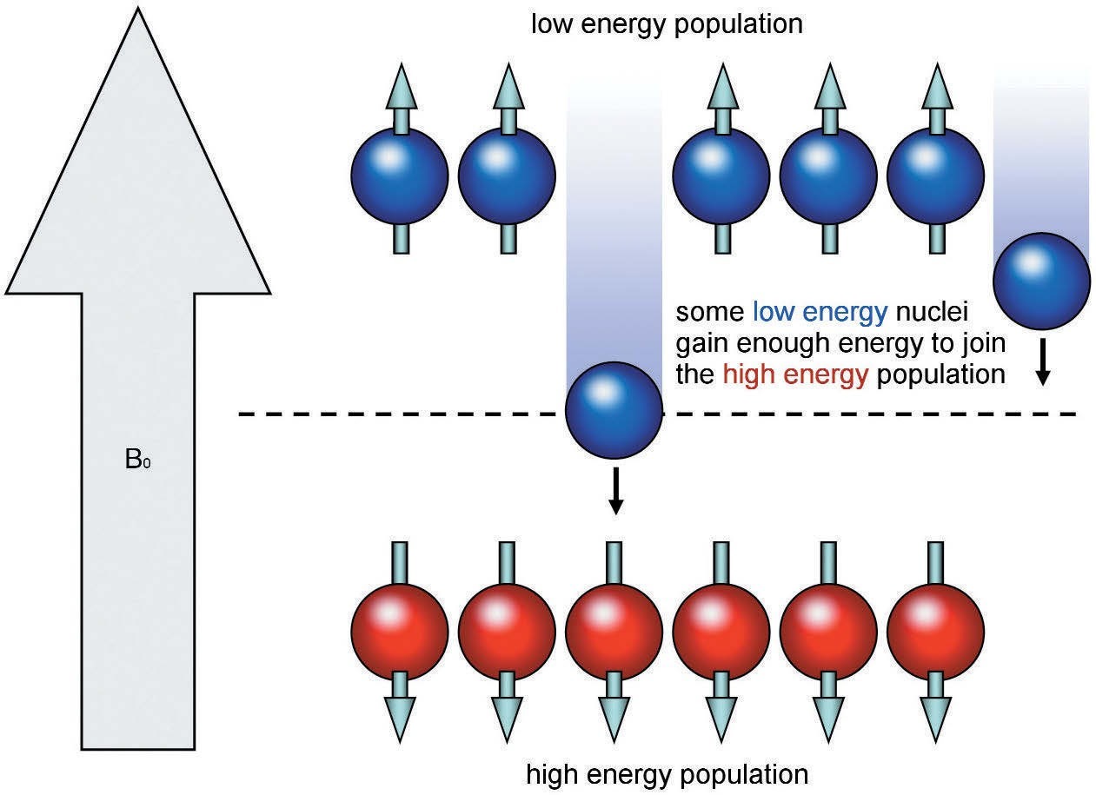
Resonance
Resonance is a phenomenon that occurs when an object is exposed to an oscillating perturbation that has a frequency close to its own natural frequency of oscillation.
Energy at the precessional frequency of hydrogen at all field strengths in clinical MRI corresponds to the radio frequency (RF) band of the electromagnetic spectrum .
The application of an RF pulse that causes resonance to occur is termed excitation. This absorption of energy causes an increase in the number of spin-down hydrogen nuclei populations as some of the spin-up nuclei gain energy via resonance and become high-energy.
Energy transfer during excitation.

Slide 20
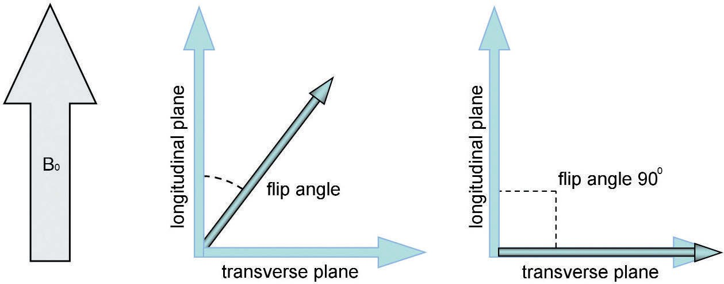
The Results of Resonance
One of the results of resonance is that the NMV moves out of alignment away from B₀.
The angle to which the NMV moves out of alignment is called the flip angle .The magnitude of the flip angle depends on the amplitude and duration of the RF pulse.
the NMV is a vector, even if flip angles other than 90° are used, there is always a component of magnetization in a plane perpendicular to B₀. B₀ is now termed the longitudinal plane. The plane at 90° to B₀ is termed the transverse plane.
The other result of resonance is that the magnetic moments of hydrogen nuclei move into phase with each other. Phase is the position of each magnetic moment on the precessional path around B₀.
Magnetic moments that are in phase (or coherent) are in the same place on the precessional path around B₀ at any given time.Magnetic moments that are out of phase (or incoherent) are not in the same place on the precessional path.
Energy transfer during excitation.
The flip angle.

Slide 21
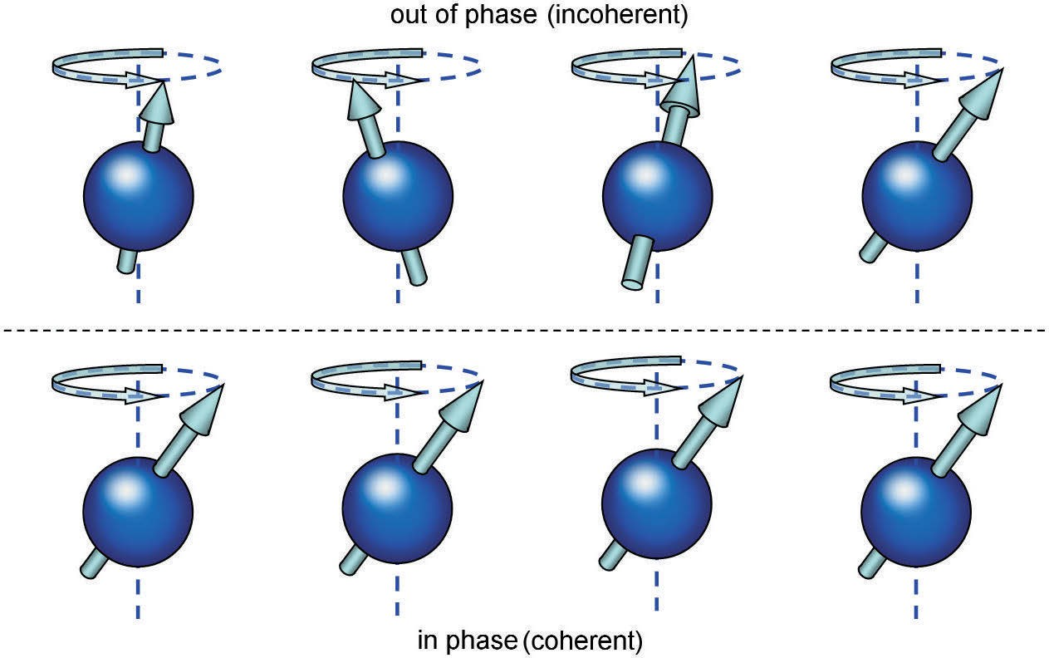
In phase (coherent) and out of phase (incoherent).

Slide 22
Thank You

