Slide 1

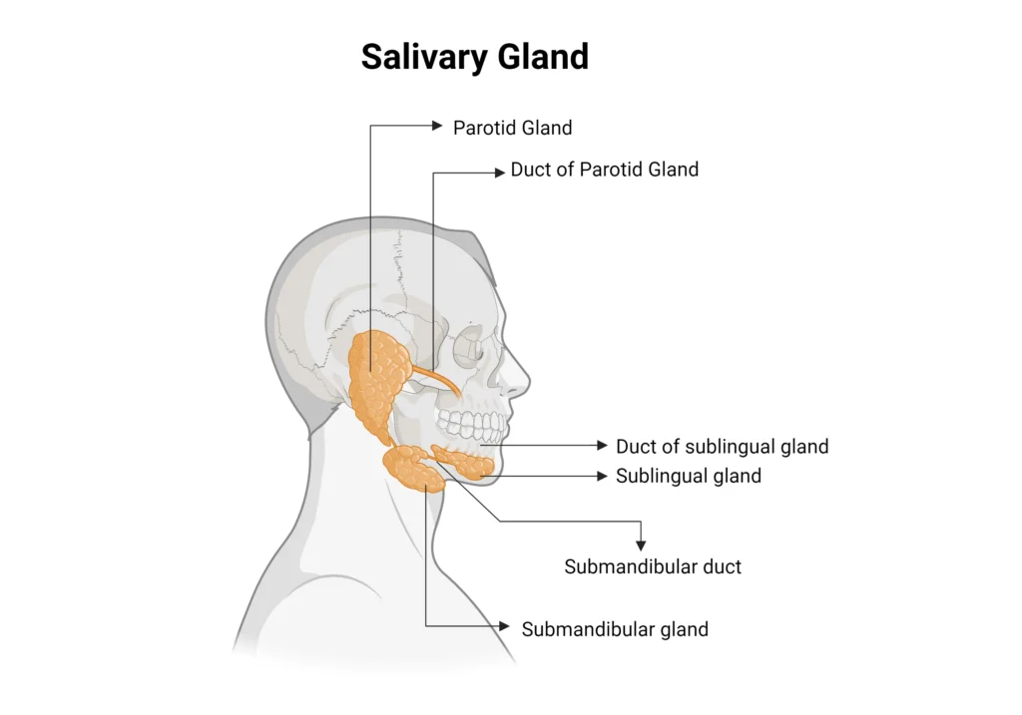
Sialography
Yuvraj Maharshi
Lecturer
Department Of Paramedical Sciences,
SVDU

Slide 2
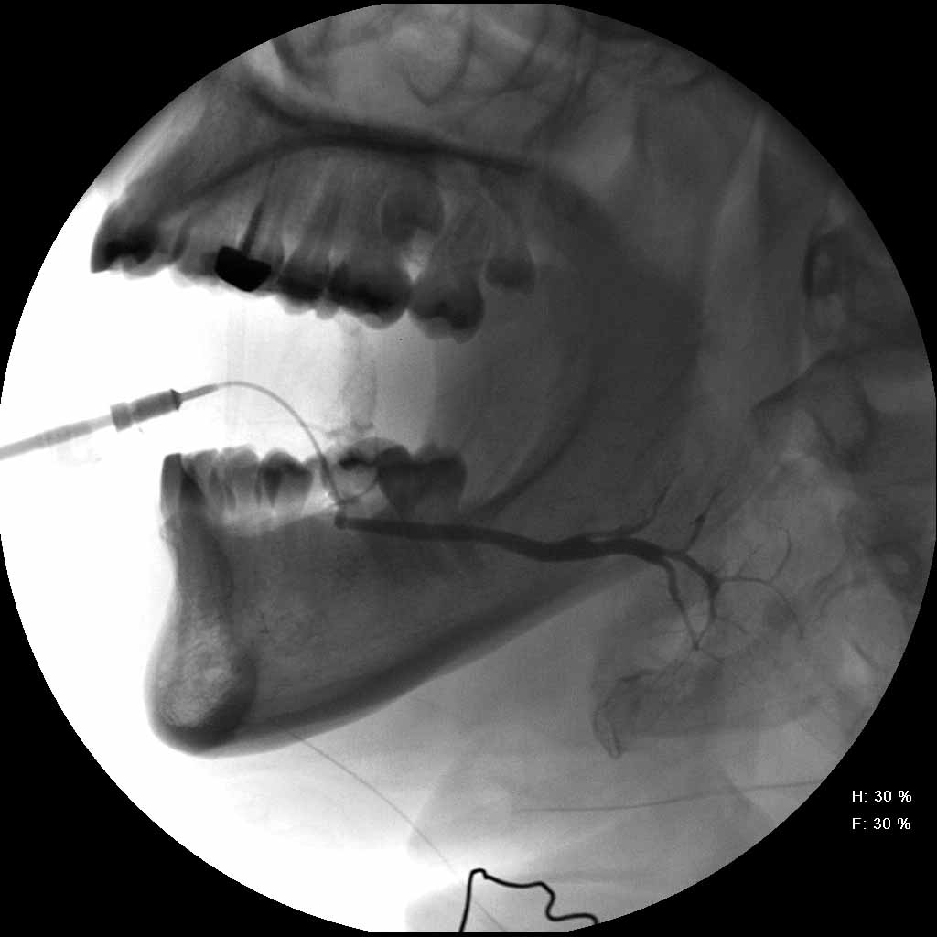
Learning Objective for Sialography
Understand the Introduction and Purpose of Sialography
Identify Clinical Indications for Performing Sialography
Recognize Contraindications to Sialography
Describe the Required Equipment for Sialography
Identify the Types and Properties of Contrast Media Used in Sialography
Explain Patient Preparation Steps Prior to Sialography
Apply Principles of Aftercare Following the Sialography Procedure

Slide 3
Introduction
Sialography is performed to assess the salivary glands, mainly the parotid and submandibular glands. The technique involves the injection of a contrast medium directly into the salivary ducts, followed by imaging with X-ray or fluoroscopy.

Slide 4
Indications
Evaluation of salivary gland disorders, such as:
Chronic sialadenitis (inflammation of the salivary glands).
Sialolithiasis (salivary duct stones).
Salivary duct strictures.
Assessment of tumors or cysts in the salivary glands.
Detection of ductal obstructions or fistulas.
Investigation of recurrent salivary gland infections.
Evaluation of autoimmune diseases like Sjögren's syndrome.

Slide 5
Contraindications
Acute infection or inflammation of the salivary glands.
Known allergy to iodinated contrast media.
Severe contrast hypersensitivity.
Pregnancy (relative contraindication, depending on necessity).
Complete obstruction of the salivary duct.

Slide 6
Equipment
Sterile sialography cannula (or fine catheter).
Syringe (5–10 mL) for injecting contrast.
Iodinated contrast medium (e.g., water-soluble contrast agents).
Sterile gloves, drapes, and antiseptic solution.
X-ray machine with fluoroscopy capabilities.
Suction device (if needed).
Luer-lock syringe and adapters for cannula attachment.

Slide 7
Contrast Media
Water-soluble iodinated contrast agents (e.g., Iohexol or Iodixanol) are preferred due to their safety and ease of removal.
Fat-soluble agents (historical use, less common now).

Slide 8
Patient Preparation
Obtain informed consent.
Assess for history of allergies to contrast media.
Ensure the patient has avoided eating or drinking for 2–4 hours before the procedure.
Explain the procedure, including potential sensations (e.g., mild discomfort during injection).
Administer prophylactic antihistamines or steroids if the patient has a mild contrast allergy history.

Slide 9
Procedure
Positioning:
The patient is seated or supine.
The mouth is kept open using a bite block if necessary.
Ductal Cannulation:
The orifice of the duct (e.g., Stensen’s duct for the parotid gland) is identified.
The area is sterilized, and a cannula is inserted gently into the duct opening.

Slide 10
Contrast Injection:
Slowly inject the contrast medium (1–3 mL) under fluoroscopic guidance to avoid overfilling.
Monitor the flow and ensure it spreads uniformly in the ductal system.
Imaging:
X-rays are taken in multiple views (e.g., lateral, oblique).
Post-contrast images are acquired to evaluate the glandular structures and ductal anatomy.
Post-Injection:
The cannula is removed, and the patient is asked to rinse the mouth.

Slide 12
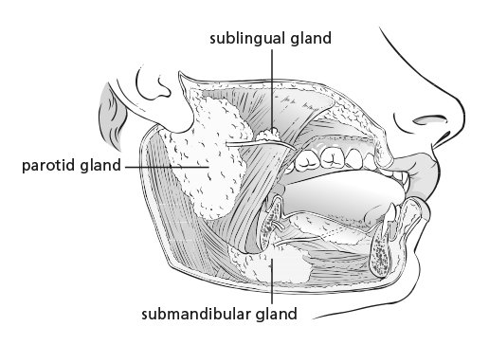

Slide 14
Aftercare
Encourage the patient to drink plenty of water to help flush out residual contrast.
Advise the patient to gently massage the salivary glands to aid in contrast removal.
Provide mild analgesics if the patient experiences discomfort.
Monitor for any signs of allergic reaction or swelling.

Slide 15
Complications
Pain or discomfort during contrast injection.
Allergic reaction to the contrast medium.
Ductal rupture due to excessive pressure during injection.
Infection or inflammation (sialadenitis) post-procedure.
Residual contrast retention.

Slide 16
Thank You

