Slide 1


Cardiac Catheterization
By
Mr. Yash Rakholiya
Tutor,
Department of Paramedical Sciences
SVDU
1

Slide 2

CHAPTER-3
Right Heart Catheterization
Mr. Yash Rakholiya
2

Slide 3
learning objectives for Right Heart Catheterization:
Understand the anatomy and physiology of the right side of the heart, including its role in pulmonary circulation.
Learn the indications, contraindications, and clinical applications of right heart catheterization, especially in the diagnosis of pulmonary hypertension and heart failure.
Gain knowledge of the catheterization procedure, including access sites, equipment used (e.g., Swan-Ganz catheter), and step-by-step technique.
Interpret hemodynamic parameters such as right atrial pressure, pulmonary artery pressure, pulmonary capillary wedge pressure, and cardiac output.
Identify and manage potential complications, such as arrhythmias, infection, or pulmonary artery rupture.
Develop skills in data interpretation and clinical decision-making based on the hemodynamic findings obtained during the procedure.
3

Slide 4
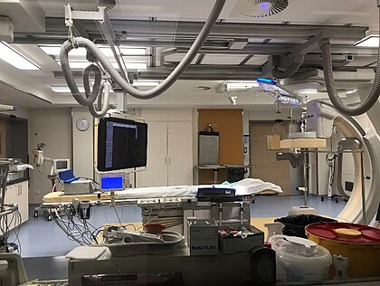
What is cardiac catheterization?
Cardiac catheterization (heart cath) is the insertion of a catheter into a chamber or vessel of the heart. This is done both for diagnostic and interventional purposes.
Catheterization is most often performed in special laboratories with fluoroscopy and highly maneuverable tables. These "cath labs" are often equipped with cabinets of catheters, stents, balloons, etc. of various sizes to increase efficiency. Monitors show the fluoroscopy imaging, Electrocardiogram (ECG), pressure waves, and more.
https://upload.wikimedia.org/wikipedia/commons/thumb/b/bb/Cathlab.jpg/420px-Cathlab.jpg
Mr. Yash Rakholiya
4

Slide 5
What is the uses?
Cardiac catheterization is a medical procedure used to diagnose and treat certain heart conditions.
Fluoroscopy is used to visualize the lumens of the arteries as a 2-D projection. Should these arteries show narrowing or blockage, then techniques exist to open these arteries.
Measuring pressures in the heart is also an important aspect of catheterization.
The catheters are fluid filled conduits that can transmit pressures to outside the body to pressure transducers. This allows measuring pressure in any part of the heart that a catheter can be maneuvered into.
Measuring blood flow is also possible through several methods. Most commonly, flows are estimated using the Fick principle and thermodilution.
Cardiac catheterization can be used as part of a therapeutic regimen to improve outcomes for survivors of out-of-hospital cardiac arrest.
Mr. Yash Rakholiya
5

Slide 6
Preparation of catheterization
Preparing for a cardiac catheterization involves several steps to ensure that the procedure is safe and successful. Here are some general guidelines on how to prepare for a cardiac catheterization:
Medical evaluation and history
Fasting instructions
Medical management
Allergy assessment
Transportation arrangements
Clothing and personal belongings
Information and consent
Following these specific preparation guidelines will help ensure that your cardiac catheterization procedure is as safe and successful as possible. Always adhere to the instructions provided by your healthcare team, and do not hesitate to ask questions or seek clarification on any concerns you may have before the procedure.
Mr. Yash Rakholiya
6

Slide 7
Types of Cardiac Catheterization
There are several types of cardiac catheterization procedures, each serving different diagnostic or therapeutic purposes:
Coronary Angiography
Right Heart Catheterization
Left heart catheterization
Coronary angioplasty and stenting
Electrophysiology study
Cardiac catheterization is generally considered a safe procedure, but like any invasive procedure, it may carry some risks, such as bleeding, infection, or damage to blood vessels or the heart. It is crucial to discuss the benefits and risks with a healthcare provider before undergoing any medical procedure.
Mr. Yash Rakholiya
7

Slide 8
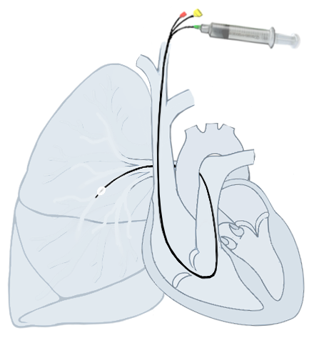
What is right heart catheterization
Right heart catheterization is an invasive test that can show how well your heart is pumping. It measures blood pressure and oxygen in your lungs and the right side of your heart. It’s also called pulmonary artery catheterization. You may hear it referred to as a Swan-Ganz catheter.
Mr. Yash Rakholiya
8

Slide 9
Right heart catheterization
To perform the test, your healthcare provider will use a thin, flexible tube called a catheter. They'll insert the catheter into a blood vessel in your neck, groin or arm. Then they'll thread it through the right side of your heart into your pulmonary artery, the main artery that carries blood to your lungs.
Uses –
This procedure involves the insertion of a catheter into the right side of the heart to measure pressures in the heart chambers and blood vessels.
It helps evaluate conditions such as heart failure, pulmonary hypertension, and congenital heart defects.
It can also be used to assess the heart's pumping function.
Mr. Yash Rakholiya
9

Slide 10
Indications
Right heart catheterization to diagnose and manage many conditions, including:
Cardiogenic shock.
Cardiomyopathy.
Congenital heart disease.
Heart failure.
Heart valve disease.
Pulmonary hypertension.
You may also need right heart catheterization before or after organ transplantation or placement of a left ventricular assist device.
10
Mr. Yash Rakholiya

Slide 11
Contra-Indications
Contraindications refer to specific conditions or situations in which the risks of the procedure outweigh the potential benefits. Some contraindications for right heart catheterization include:
Insertion of the catheter through a site where is an active infection
Presence of a Right sided ventricular assist device
Lack of consent
Severe bleeding or severe coagulopathy
Severe pulmonary hypertension
Right sided endocarditis or valvular infection
Severe arrhythmias
Severe infection or sepsis
unstable hemodynamics
Mr. Yash Rakholiya
11

Slide 12
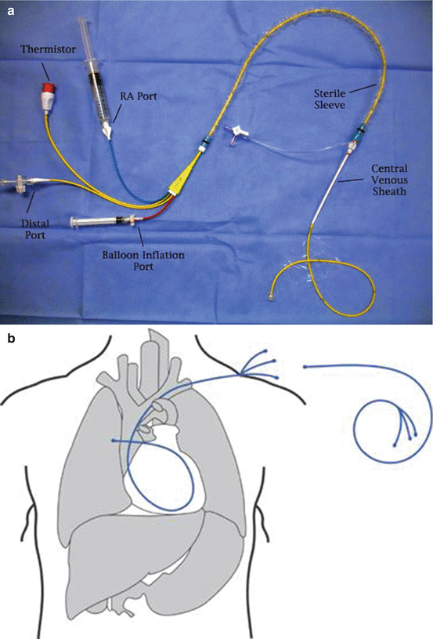
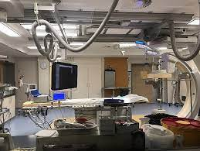
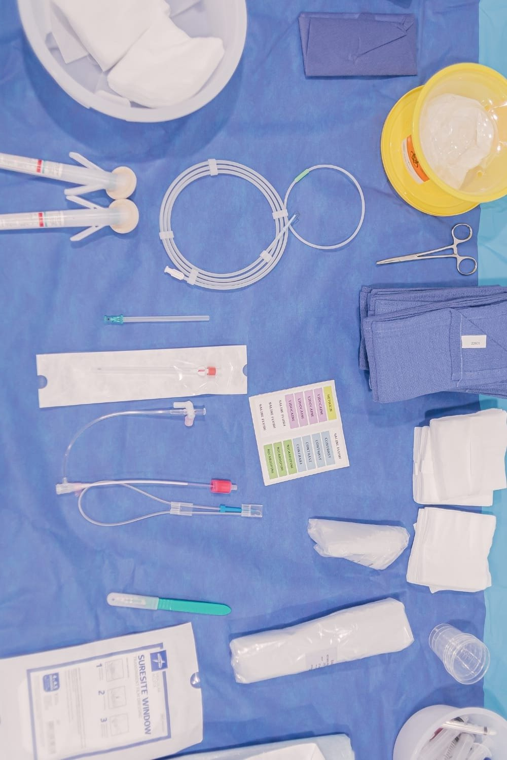
What are the equipment's using ?
Mr. Yash Rakholiya
12

Slide 13
Equipment's list
The equipment required for a right heart catheterization procedure typically includes a variety of specialized tools and devices designed to facilitate the insertion of a catheter into the right side of the heart.
Catheters
Guidewires
Pulse oximeter
Fluroscopy machine
Contrast media and injector
Syringes and needles
Sterile and needles
Sterile drapes and gowns
Monitoring and recording equipment
This comprehensive set of equipment allows healthcare providers to perform right heart catheterization safely and accurately, enabling them to diagnose and manage various cardiac conditions effectively.
Mr. Yash Rakholiya
13

Slide 14
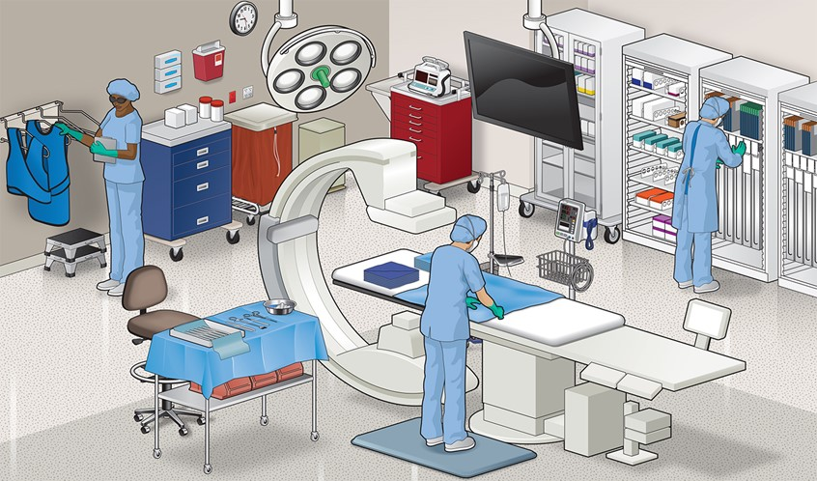
Preparation
Mr. Yash Rakholiya
https://www.medillsb.com/images/artistimages/images/15354_335261.jpg
14

Slide 15
Preparation
• Oral anticoagulants are stopped at least 24 hours before the procedure (depending on the creatinine clearance). Before the procedure, a thorough history should be taken with special emphasis on contrast allergy.
• A detailed examination is done to assess the access site, and peripheral pulses are documented. Laboratory investigations, including hemoglobin, platelets, creatinine, and coagulation profile, should be checked.
• The operating provider should obtain informed consent, and the procedure should be explained in detail, including risks and complications associated with the procedure.
• Intravenous normal saline should be administered to prevent contrast-induced renal dysfunction, especially in those with underlying renal dysfunction.
• After shifting to the catheterization laboratory, the patient is placed in a supine position on the table, access sites are sterilized, and the patient is draped. All cannulas, needles, and catheters are flushed with heparinized saline. Cardiologists and assisting technologists wear a sterile gown, gloves, head cap, and facial protecting shields.
Mr. Yash Rakholiya
15

Slide 16
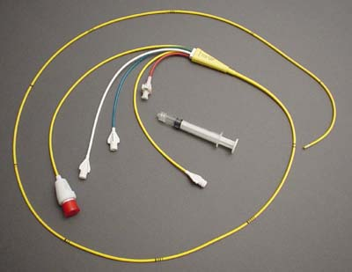
Technique
For right sided pressure monitoring a catheter is inserted into the pulmonary artery. The pulmonary artery catheter (PAC) is frequently referred to as a Swan-Ganz catheter, named after its inventors Jeremy Swan and Willam Ganz in 1970.
A PAC is a 5-7 french catheter which consists of 2-5 lumina with different purposes: a lumen for inflation of the balloon, a proximal and distal lumen for infusion of fluid or extraction of blood, a temperature thermistor and one for RV pacing.
Ports left to right: thermistor connector, medication portal, proximal injection hub, distal lumen hub, balloon inflation valve with syringe.
Mr. Yash Rakholiya
16

Slide 17
Technique
Preparing the catheter;
Under sterile conditions remove the Pulmonary artery catheter from packaging
Flush the proximal and distal ports with saline to ensure an air free system and place stopcocks on the ends
Fill the balloon inflation syringe with 1.5 cc of air and inflate the balloon under saline to ensure no air leaks in the balloon
Prepare the pressure monitoring system for use according to institutional practice, ensuring an air free system
Inserting catheter;
The pulmonary artery catheter can be inserted either under fluoroscopic guidance or under the guidance of the pressure wave forms
Fluoroscopic guidance is recommended in patients with markedly enlarged RA or RV, severe tricuspid regurgitation, or in those with left bundle branch block
A PA catheter with the balloon inflated is designed to be flow-directed and will follow the directions of blood flow (right atrium to pulmonary arteries)
Mr. Yash Rakholiya
17

Slide 18
Technique
Once a PCWP tracing is seen, deflate the balloon
The catheter should be withdrawn 1-2 cm to remove any redundant length o loop in the RA or RV. Keep the tip in a position where full or near full inflation volume is necessary to produce a wedge tracing
The balloon should be deflated and the pressure wave form seen should now be that of the PA. If still the PCWP, it is likely that the catheter is distal and should be retracted until a PA pressure tracing is seen
The ideal position of the catheter is the zone 3 region of the lung (lower zone
For subsequent wedge tracings, the balloon should be inflated with the minimum amount of air to produce a wedge tracing. Excess can cause "over wedging" where the PCWP will be higher due to transmittal of pressure from the balloon and with loss of characteristic waveforms
Removing the catheter;
The catheter should always be removed with the balloon deflated to avoid damaging the valves
18
Mr. Yash Rakholiya

Slide 19
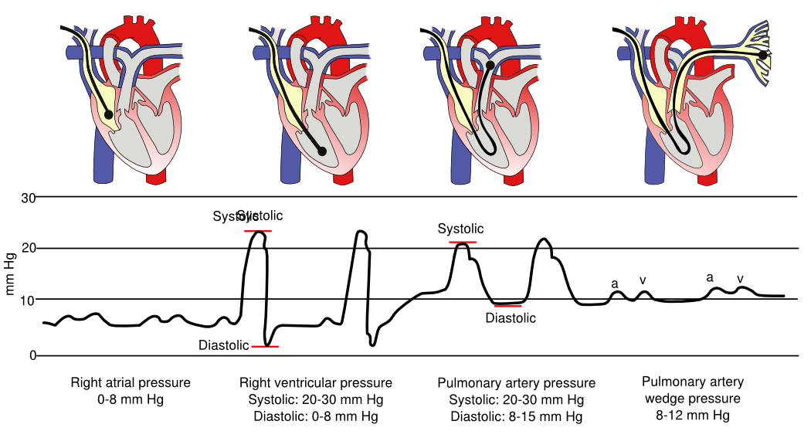
Normal waveforms by the catheter placement
The normal pressure waves in the cardiac chambers during right heart catheterization with normal values shown are shown in figure
Mr. Yash Rakholiya
19

Slide 20
Procedure of RHC
Puncture technique – Seldingers technique
Access - Jugular, subclavian, or femoral vein
Following local anesthesia, the femoral, jugular, brachial or subclavian vein is punctured, then a guidewire is introduced into the vein by Seldinger technique.
Next a sheath is introduced. Femoral access is associated with increased risk of local hemorrhage. When the catheter is left indwelling, the jugular or subclavian vein is preferable, because it allows the patient to sit.
The jugular approach is preferred to the subclavian to lessen the risk of pneumothorax and is easiest performed ultrasound guided.
The basilica or medial antibrachial vein can also be used, while contrast via an radial arterial sheath (for cardiac output measurement) will visualize the vein.
After placement of the sheath, the flushed catheter is introduced into the vein and advanced into the inferior vena cava, superior vena cava, right atrium, right ventricle and pulmonary artery
Mr. Yash Rakholiya
20

Slide 21
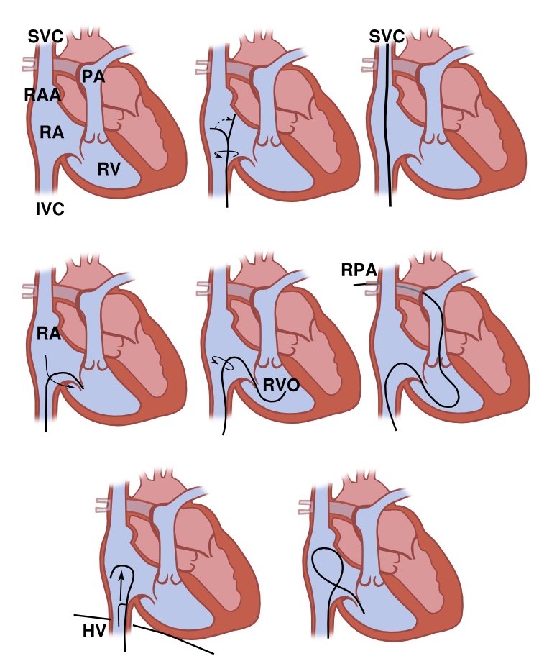
Continued…
Top row: the PAC is placed in the right atrium aimed at the lateral wall. Counterclockwise rotation aims the catheter posteriorly and allows advancement into the superior vena cava. Centre row: the catheter is then withdrawn into the right atrium and aimed laterally. Clockwise rotation causes the tip to cross the tricuspid valve. With the tip in a horizontal position, it is positioned below the right ventricular outflow tract. Additional clockwise rotation causes the catheter to point straight up, allowing it to advance into the pulmonary artery and from there into the right pulmonary artery.
21
Mr. Yash Rakholiya

Slide 22
Pressure recordings
Always record pressure at end expiration (except in patients on PEEP)
Under normal conditions, pressures will be lower in inspiration due to decrease in intrathoracic pressure
Before any pressure measurements are taken, it is imperative to perform zeroing and referencing of the system
Zeroing- accomplished by opening the system to air so as to equilibrate with atmospheric pressure
Referencing- accomplished by ensuring that the air-fluid interface of the transducer is at the level of the patient heart (phlebostatic axis) (4th intercostal space midway between anterior and posterior chest wall)
For every inch the heart is offset from the reference point of the transducer, a 2mm Hg of error will be introduced. If the heart is lower than the transducer, the pressure will be erroneously low and if the heart is higher, the pressure will be erroneously high.
Mr. Yash Rakholiya
22

Slide 23
Pressure recordings
Fast flush test/ Square wave testing;
The dynamic response of the pressure monitoring system is determined by measuring the resonant frequency and the damping coefficient of the system using the fast flush test
Performed by briefly opening and closing the valve in the continuous flush device
This produces a square ware pattern on the oscilloscope, an initial steep rise followed by a plateau, followed by steep fall below baseline which is then followed by oscillations. The pattern determines optimal versus suboptimal damping
Optimal damping- usually 1.5 to 2 oscillations before returning to baseline. This is ideal
Over damping. None to <1.5 oscillations before retuning to baseline. Common cause air bubbles. Underestimation of systolic pressure. Diastolic pressure may not be affected
Under damping->2 oscillations before returning to baseline. Common cause- excessive tube length, multiple stopcocks in the circuit, etc. Overestimated systolic pressure and underestimated diastolic pressure
Mr. Yash Rakholiya
23

Slide 24
Normal pressure value of RHC
Table 19-3: Normal Pressures and Vascular Resistances
Pressures | Average (mm Hg) | Range (mm Hg)
Right atrium
a wave | 6 | 7-Feb
v wave | 5 | 7-Feb
Mean | 3 | 5-Jan
Right ventricle
Peak systolic | 25 | 15-30
End-diastolic | 4 | 7-Jan
Pulmonary artery
Peak systolic | 25 | 15-30
End-diastolic | 9 | 12-Apr
Mean | 15 | 19-Sep
Pulmonary capillary
Wedge
Mean | 9 | 12-Apr
24
Mr. Yash Rakholiya

Slide 25
Continued…
Left atrium
a wave | 10 | 16-Apr
v wave | 12 | 21-Jun
Mean | 8 | 12-Feb
Left ventricle
Peak systolic | 130 | 90-140
End-diastolic | 8 | 12-May
Central aorta
Peak systolic | 130 | 90-140
End-diastolic | 70 | 60-90
Mean | 85 | 70-105
Vascular Resistance | Mean (dyne-sec · cm ⁻⁵) | Range (dyne-sec · cm ⁻⁵)
Right atrium
Systemic vascular resistance | 1100 | 700-1600
Total pulmonary resistance | 200 | 100-300
Pulmonary vascular resistance | 70 | 20-130
Mr. Yash Rakholiya
25

Slide 26
Cardiac Output
Three indirect methods for cardiac output determinations
Dye indicator dilution technique
Fick's technique
Cardiac Output = Oxygen consumption in ml/min / A-V Oxygen difference
Oxygen consumption measured using an oxygen hood
Normal oxygen consumption is 250 ml/min
A-V Oxygen difference = 13.4 x Hgb concentration x (SaO2-SvO₂)
Most accurate in low output states and is considered the gold standard
Thermodilution technique
Known amount of solution (usually saline) is injected into the proximal port (right atrium) and mixes and cools the blood which is recorded by a thermistor located at the distal end of the catheter
Mr. Yash Rakholiya
26

Slide 27
Complications
Right heart catheterization is generally safe. But it's an invasive procedure with certain risks, including:
• Allergic reactions to medications or materials.
• Arrhythmia.
• Artery damage.
• Bleeding or bruising at the insertion site.
• Blood clots.
• Cardiac tamponade, heart attack or stroke.
• Infection.
• Collapsed lung.
• Conduction disorders
• Damage to the pulmonic or tricuspid valve
• Thrombo-embolism of pulmonary infarction
27
Mr. Yash Rakholiya

Slide 28
References
1. Braunwald E et al. Braunwald's Heart Disease: A Textbook of Cardiovascular Medicine. 8th edition: page 445.
2. Redrawn from Gore, JM, Alper, JS, Benotti, JR, et al. Handbook of hemodynamic monitoring, 1st ed, Boston, Little Brown & Co, 1985.
3. Redrawn from Daily EK, Schroeder JS, Hemodynamic Waveforms: Exercises in Interpretation and Analysis, St. Louis, CV Mosby, 1983, p. 139.
4. Kern, M. J., & Sorajja, P. (Eds.). (2017). The Interventional Cardiac Catheterization Handbook (E-Book). Elsevier Health Sciences.
Mr. Yash Rakholiya
28

Slide 29
THANK YOU
Mr. Yash Rakholiya
29

