Slide 1


Cardiac Catheterization
By
Mr. Yash Rakholiya
Tutor,
Department of Paramedical Sciences
SVDU
1

Slide 2

CHAPTER-9
Materials used in Cath lab
2
Mr. Yash Rakholiya

Slide 3
Learning Objectives for Materials Used in the Cath Lab:
Understand the types and functions of commonly used materials in the cardiac catheterization laboratory, including catheters, guidewires, sheaths, balloons, and stents.
Identify the indications and proper selection criteria for each material based on the type of cardiac procedure (e.g., diagnostic angiography, angioplasty, stenting).
Demonstrate knowledge of the material composition, size, and compatibility with imaging and interventional equipment.
Recognize the importance of sterility, handling protocols, and storage requirements to maintain safety and effectiveness.
Analyze the risks, complications, and troubleshooting strategies associated with the improper use of cath lab materials.
Apply theoretical and practical knowledge to assist efficiently and safely in various interventional cardiology procedures.
3
Mr. Yash Rakholiya

Slide 4
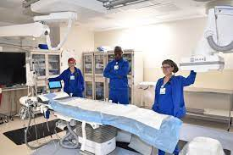
Introduction
  A catheterization laboratory or Cath lab is an examination room in a hospital or clinic with diagnostic imaging equipment used to visualize the arteries of the heart and the chambers of the heart and treat any stenosis or abnormality found.
  A catheterization laboratory, often referred to as a Cath lab, is a specialized facility equipped with advanced medical imaging equipment and tools used for diagnostic and interventional procedures.
4
Mr. Yash Rakholiya

Slide 5
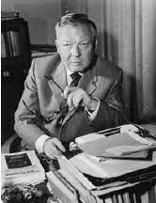
History
The development of the modern catheterization laboratory can be traced back to the mid-20th century when pioneering cardiologists and researchers, such as André Frédéric Cournand, Werner Forssmann, and Dickinson W. Richards, made significant contributions to the field of cardiac catheterization. Their groundbreaking work laid the foundation for the establishment of dedicated Cath labs, where diagnostic and therapeutic procedures for various cardiovascular conditions could be performed with improved precision and safety.
Over the years, advancements in technology and medical imaging have revolutionized the capabilities of Cath labs, enabling healthcare providers to perform intricate procedures, such as coronary angiography, angioplasty, stent placement, and structural heart interventions, with greater accuracy and efficacy. The continuous evolution of Cath lab technology has significantly improved patient outcomes and has become an integral component of modern cardiovascular care.
Mr. Yash Rakholiya
5

Slide 6
Uses of Cath lab?
Catheterization laboratories serve a crucial role in the diagnosis and management of a wide range of cardiovascular conditions. Some common uses of Cath labs include:
Coronary angiography
Percutaneous coronary intervention
Structural heart interventions
Electrophysiology studies
Peripheral vascular interventions
Diagnostic imaging
The multifaceted capabilities of catheterization laboratories have transformed the landscape of cardiovascular medicine, enabling the diagnosis and treatment of complex cardiac and vascular conditions in a minimally invasive and highly effective manner, ultimately improving patient outcomes and quality of life.
Mr. Yash Rakholiya
6

Slide 7
Importance of Cath lab
Its importance stems from its ability to provide essential diagnostic and interventional services for patients with a wide range of cardiovascular conditions.
Diagnosing and fixing problems
To evaluate or to confirm the presence of coronary artery disease.
To determine the need for further treatment
For integrated patient care
For multi-department approach
Minimally invasive interventions
Timely management of acute conditions
The importance of the Cath lab lies in its ability to provide timely and effective cardiovascular care, improve patient outcomes, and contribute to the ongoing advancements in the field of cardiovascular medicine and research.
Mr. Yash Rakholiya
7

Slide 8
What are the Essential Equipment's used in Cath lab?
Mr. Yash Rakholiya
8

Slide 9
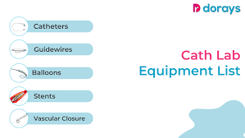
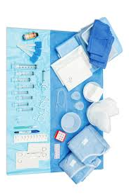
Essential materials
Mr. Yash Rakholiya
9

Slide 10
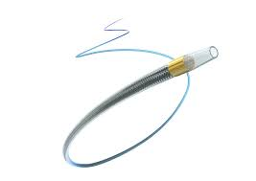
Catheters
Angiographic catheters:
•Used for diagnostic and therapeutic invasive intra‐vascular procedures.
•Are of various shapes and tip configurations
•Usually have one end‐hole for selective injections
•Usual size: 2Fr – 8Fr
Drainage catheters:
•Used for percutaneous drainage of fluid/collections
•Usual shape is straight tip or “pigtail” or a mushroom (Malecot).
•Usually have multiple holes in the “pig” for optimal drainage
•Usual size: 6Fr to 32Fr
https://encrypted-tbn0.gstatic.com/images?q=tbn:ANd9GcQQYSLvQoWhP9_DertOBkZRBIY4Dqe7QY6Agg&usqp=CAU
Mr. Yash Rakholiya
10

Slide 11
Angiographic catheters:
Usually made of plastic (polyurethane, polyethylene, Teflon, or nylon)
• exact catheter material, construction, coatings, inner diameter, outer diameter, length, tip shape, side ‐hole pattern, and end ‐hole dimensions are determined by the intended use
• Diameter is outer size described in French gauge (3F = 1 mm) and inner lumen is in hundredth of an inch
• Length described in centimeters (usually between 65 and 100 cm)
• usually have fine metal or plastic strands incorporated into the wall (“braid”) which enables the catheter tip to be responsive to gentle rotation of the shaft
11
Mr. Yash Rakholiya

Slide 12
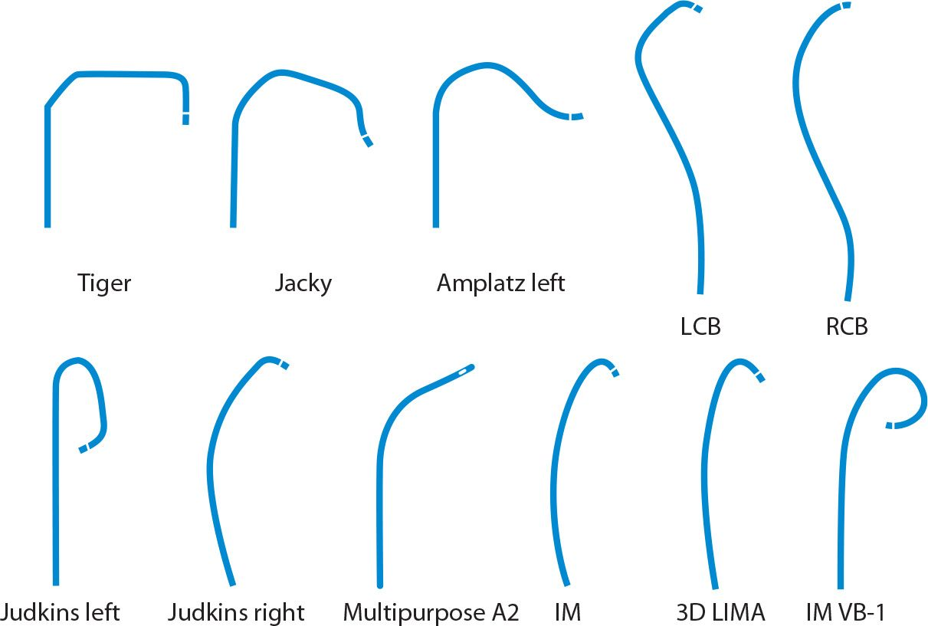
Angiographic catheters:
Mr. Yash Rakholiya
12
https://thoracickey.com/wp-content/uploads/2016/06/image00593-1.jpeg

Slide 13
Microcatheters:
• Small catheters (3F or smaller outer diameter) that are specially designed to fit coaxially within the lumen of a standard angiographic catheter
• Soft and flexible; typically 2F to 3F in diameter, with 0.010 ‐ to 0.027 ‐inch inner lumens
• Advanced over specially designed 0.010 ‐ to 0.025 ‐inch guidewires
• Designed to reach far beyond standard catheters in small or tortuous vessels (super ‐selective position & procedures)
• Technologically advanced with wide range of characteristics, such as stiffness, braiding, flow rates, and hydrophilic coatings
• The small inner lumen and long length result in a high resistance to flow not used for routine angiography.
• Contrast and flush solutions most easily injected through these catheters with 3 ‐ mL or smaller Lure‐Lock syringes.
Mr. Yash Rakholiya
13

Slide 14
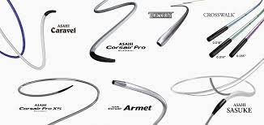
Microcatheters:
Mr. Yash Rakholiya
14

Slide 15
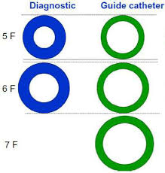
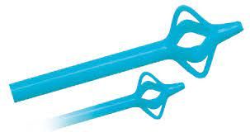
Guide catheters & Drainage catheter:
Guide catheters
• Class of catheters designed to make selective catheterization and interventions easier
• Used in some situations to help position and stabilize standard catheters
• They are non ‐tapered catheters with extra ‐large lumens and a simple shape that accepts standard ‐sized catheters and devices
Drainage catheter
Direct trocar puncture:
•Can be used in large superficial lesions
•Require blunt dissection and direct placement by “push”
•Trocar may advance farther than intended
•Difficult in deep seated collections
15
Mr. Yash Rakholiya

Slide 16
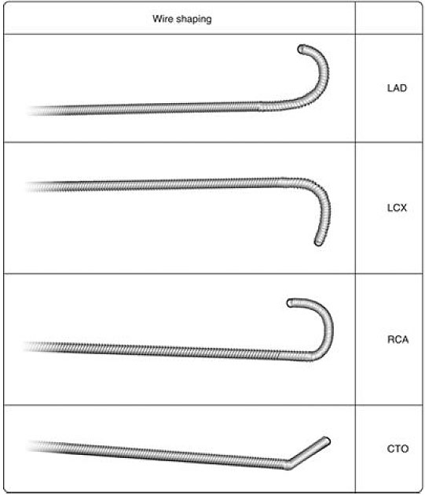
Guide wires
• Guidewires (solid wires navigated within the vascular system / extra‐ vascular tract) act as a lead point for catheters, allowing operators to traverse along a given vessel / track.
• General Types of Guidewires:
Starting guidewires ‐ used for catheter introduction and some procedures.
Selective guidewires ‐ used to cannulate side branches or cross critical lesions.
Exchange guidewires ‐ are stiffer and used to secure position as devices are passed over the wire.
https://cardiologyapps.com/wp-content/uploads/2021/06/image-29.jpg
Mr. Yash Rakholiya
16

Slide 17
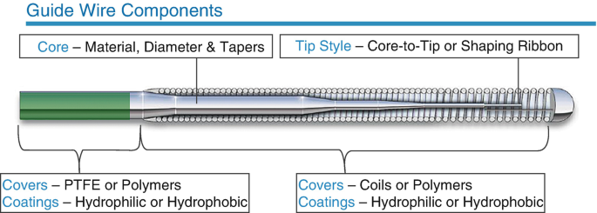
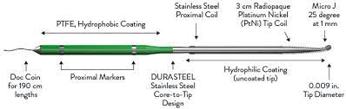
Characteristic of guidewire
Length
•Must be long enough to cover the distance both inside and outside the patient. •Must also account for access well beyond the lesion, so that access across the lesion will not be lost intraoperatively.
•Usually varies from 145 to 300 cm.
Diameter
•Vascular catheters are designed with a guidewire port of specific diameter.
•Most procedures are performed with O35 guidewires (0.035 in.).
•Small‐vessel angiography requires 0.018–0.014 in. guidewires.
Mr. Yash Rakholiya
17

Slide 18
Characteristic of guidewire
Stiffness and Coating
•Most guidewires have a tightly wound steel core that contributes to body stiffness.
•A surrounding layer of flexible material prevents fracture during use.
•Teflon or silicone coatings are often used to reduce friction coefficient & allow smooth advancement within a vessel.
Tip Shape
•The shape of the guidewire tip often reveals the function of the guidewire. •Floppy tip wires reduce the potential for vessel injury during access.
•Selective cannulation wires may be employed to traverse bends and curves and may be curved or angled to help the operator steer in a certain direction.
Mr. Yash Rakholiya
18

Slide 19
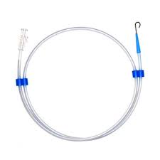
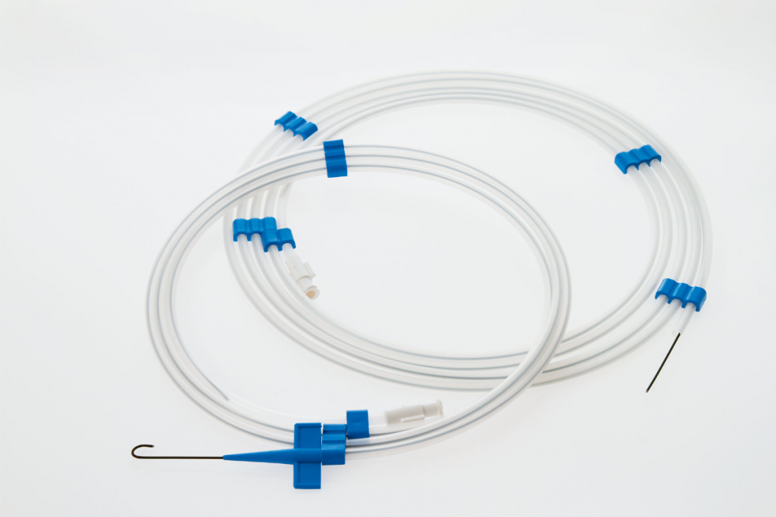
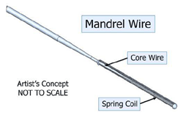
Basic construction of common guidewire
Curved and straight safety guidewires with outer coiled spring wrap, central stiffening mandril welded at back end only, and small safety wire (arrow) welded on inside at both ends.
Movable ‐core guidewire in which mandril can be slid back and forth and even removed completely to change wire stiffness, using handle incorporated into guidewire (arrow).
Mandril guidewire in which soft spring wrap is limited to one end of guidewire (arrow). Remainder of guidewire is a plain mandril.
Mandril guidewire coated with hydrophilic substance
• The hydrophilic‐coated guidewire is the most commonly used vascular specialty guidewire; its central core is coated with an outer layer of hydrophilic material
• The stiff, metallic guidewire is the most commonly used non‐ vascular guidewire for drainage catheter placements
Mr. Yash Rakholiya
19

Slide 20
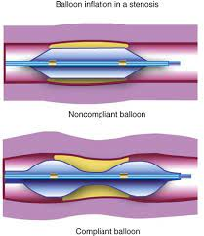
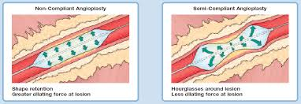
Coronary balloons:
The purpose of the balloon dilatation catheter is to improve myocardial perfusion by balloon dilatation of the stenotic portion of a coronary artery or bypass graft stenosis.
Types of coronary balloon
Compliant and non-compliant balloons are mainly used for lesion preparation and stent expansion optimization
Cutting and scoring balloons are used for lesion preparation in mild to moderate calcified artery before stent deployment. Sometimes, cutting balloons can also be used together with rotational atherectomy for calcific lesion modification.
Very high pression balloon (e.g. OPN): The balloon has unique double layer and can withstand high pressure inflation which is particularly useful in a tight stenosis, and under expanded stent
Mr. Yash Rakholiya
20

Slide 21
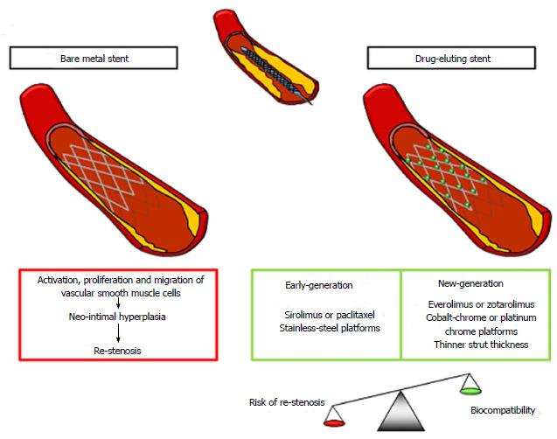
Coronary Stents
The purpose of the balloon dilatation catheter is to improve myocardial perfusion by balloon dilatation of the stenotic portion of a coronary artery or bypass graft stenosis.
coronary stents (CS) are expandable tubular metallic devices which are introduced into the coronary arteries that demonstrate stenosis due to an underlying atherosclerosis disease. This revascularization procedure is termed as a percutaneous coronary intervention (PCI) or coronary angioplasty with stent placement.
Types of Coronary Stents
Bare metal stents (BMS)
Drug-eluting stents (DES)
Bioresorbable scaffold system (BRS)
Drug-eluting balloons (DEB)
21
Mr. Yash Rakholiya

Slide 22
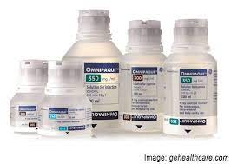
Contrast agent
Mr. Yash Rakholiya
22

Slide 23
Contrast agent
Its, also known as contrast media or contrast dye, are substances used to improve the visibility of blood vessels and other structures on X-ray images. In coronary interventional procedures, contrast agents are specifically used to visualize the coronary arteries, which supply blood to the heart muscle.
There are two main types of contrast agents used in coronary interventions:
a. iodine-Based Contrast Agents: These are the most commonly used contrast agents in cardiac procedures. They contain iodine compounds, which are highly radio-opaque, meaning they absorb X-rays and appear white on X-ray images. Examples include iohexol and iodixanol.
b. CO2 (Carbon Dioxide): In some cases, especially when there are concerns about allergies to iodine-based contrast media or kidney function, carbon dioxide can be used as a contrast agent. CO2 is a gas and is injected into the coronary arteries. It appears dark on X-ray images, creating a negative contrast.
Mr. Yash Rakholiya
23

Slide 24
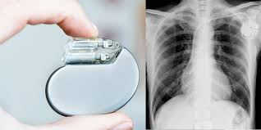
Pacemaker and Defibrillator
Mr. Yash Rakholiya
Pacemaker and Implantable Defibrillator.
24

Slide 25
Pacemaker and Defibrillator
Pacemaker
Pacemakers are primarily used to treat bradycardia, a condition in which the heart beats too slowly or has irregular rhythms. They help maintain a consistent and adequate heart rate.
There are different types of pacemakers, including single-chamber (one lead), dual-chamber (two leads), and biventricular (Cardiac Resynchronization Therapy or CRT) pacemakers with three leads.
Implantable Cardioverter-Defibrillator (ICD):
Defibrillators, or ICDs, are designed to treat life-threatening ventricular arrhythmias, such as ventricular tachycardia and ventricular fibrillation, which can lead to sudden cardiac arrest.
Both pacemakers and defibrillators have greatly improved the prognosis and quality of life for individuals with heart rhythm disorders, and they can be life-saving devices for those at risk of sudden cardiac death.
Mr. Yash Rakholiya
25

Slide 26
Sterilization of Cath lab equipment's
Cath lab ethylene oxide sterilizer is one of the key machines commonly used in pharmaceutical, textile, healthcare and food industries among others. Adinath International is a leading Cath lab hospital EO sterilizer manufacturer in India offering Cath lab sterilizer equipped with plethora of features.
Cath lab ETO sterilizer is also known as hospital ETO sterilizer and is uses to sterilize medical and pharmaceutical products which cannot be sterilized using conventional high temperature steam sterilization methods. Such products include devices which are made of electronic components or plastic packaging containers.
EO gas sterilizers of the following two types:
Fully Automatic EO sterilizer
Semi-Automatic EO sterilizer
Mr. Yash Rakholiya
26

Slide 27
Features of ETO Sterilizer
Safe to operate as there is virtually no leakage and the entire cycle operates in vacuum.
Flawless electronic design for maximum precision, dependability, and repeatability. Since the chamber is continuously purged and aerated until the door is opened, there is no possibility of ethylene oxide buildup.
Better than a typical sterilizer because, despite its small size, this device can hold a larger volume.
To ensure a smooth and effortless cycle completion, a valve is included. Because ethylene oxide gas cartridges have a precisely calculated 100% EO quantity, you can attain the highest level of sterility possible.
Cartridges for EO are moveable .Cylinder deposits are not required. Since the entire sterilizing procedure is done in a vacuum, or under negative pressure, it is safe.
In contrast to traditional cylinder models, the likelihood of gas leakage is almost nonexistent.
Mr. Yash Rakholiya
27

Slide 28
References
"Catheter-Based Cardiovascular Interventions: A Knowledge-Based Approach" by Ashfaq S. Memon and Michael Ragosta.
"Cardiac Catheterization Handbook" by Morton J. Kern and Paul Sorajja.
"Interventional Cardiology: Principles and Practice" by Eric J. Topol and Paul S. Teirstein.
"Sterilization of Medical Devices" by Jeremy Gilbert and Helmut Dunkelberg.
Mr. Yash Rakholiya
28

Slide 29
THANK YOU
Mr. Yash Rakholiya
29

