Slide 1


Biomedical Importance of Carbohydrate
PRESENTATION BY:
Ms. Darshi Jain
Assistant Professor,
Department of Paramedical Sciences,SVDU

Slide 2
Learning Objectives:
1.Define carbohydrates
2.Explain the roles of carbohydrates in the human body.
3.Describe the role of carbohydrates in Human metabolism.

Slide 3
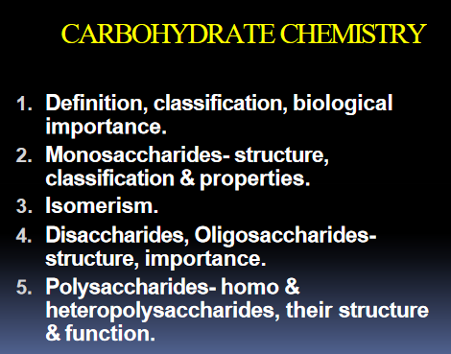

Slide 4
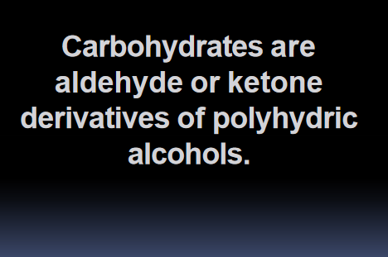

Slide 5
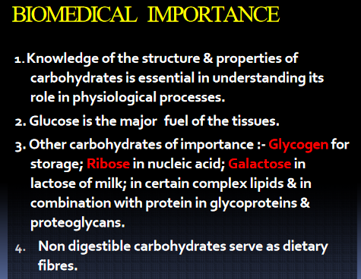

Slide 6
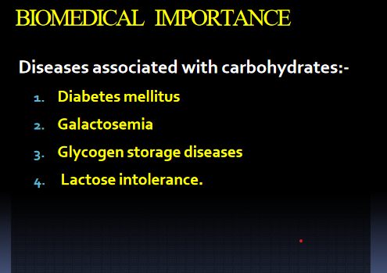

Slide 7


