Slide 1

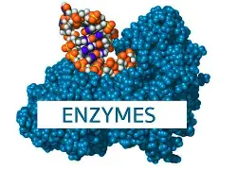
Biomedical Importance of Enzyme
PRESENTATION BY:
Ms. Darshi Jain
Assistant Professor,
Department of Paramedical Sciences,SVDU

Slide 2

Learning Objectives:
Define enzymes and explain their general properties and classification based on the type of reaction catalyzed.
Describe the mechanism of enzyme action.
Explain the role of enzymes in metabolism, emphasizing their specificity and regulatory function in biochemical pathways.
Identify the clinical significance of enzymes.
Discuss the use of enzymes in diagnostics.

Slide 3
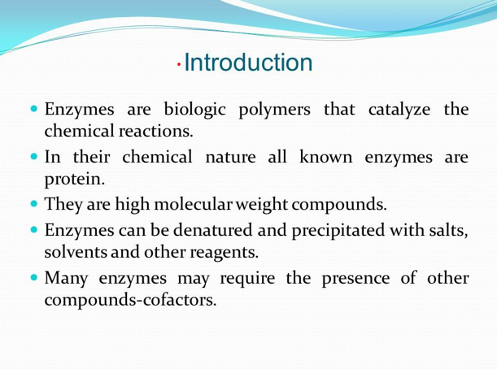

Slide 4
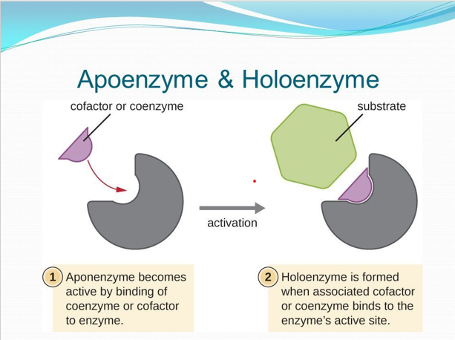

Slide 5
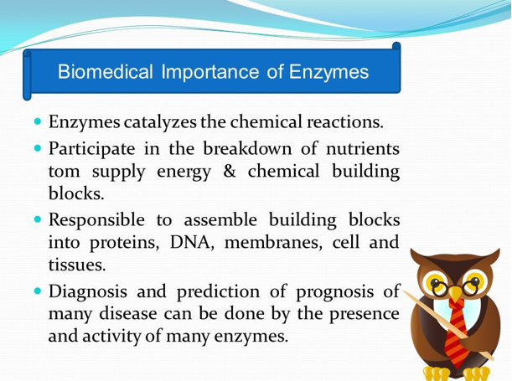

Slide 6
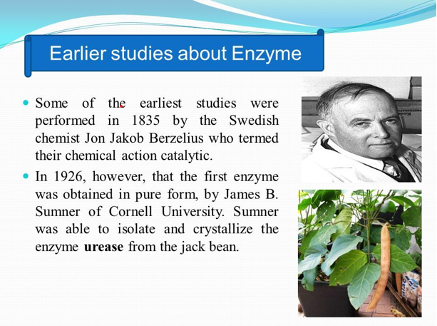

Slide 7
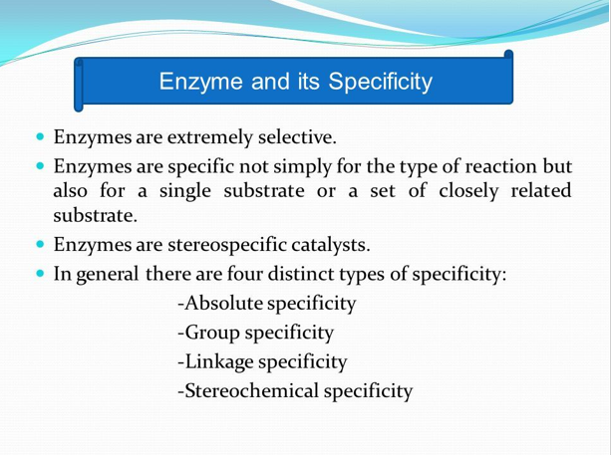

Slide 8
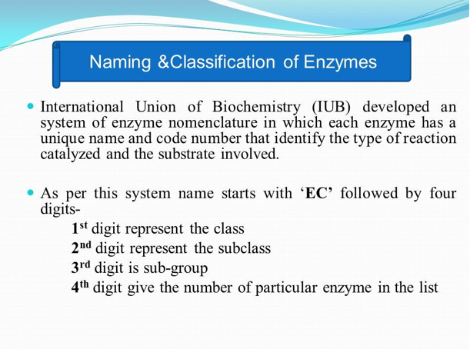

Slide 9
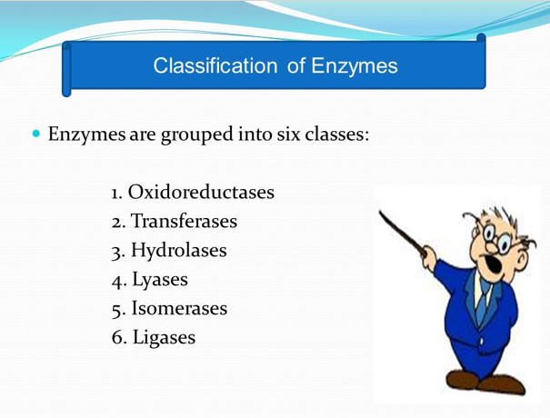

Slide 10
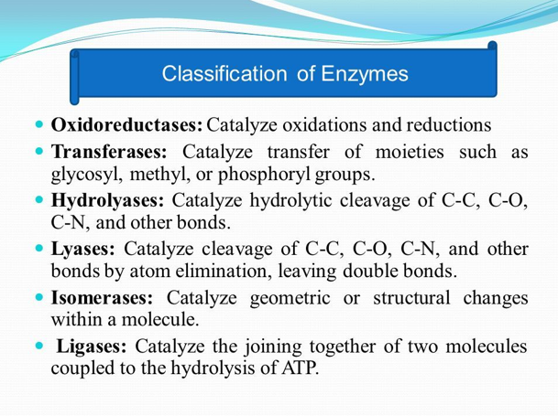

Slide 11
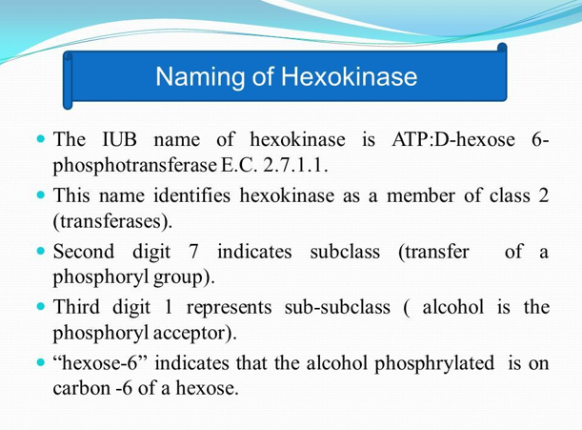

Slide 12


