Slide 1
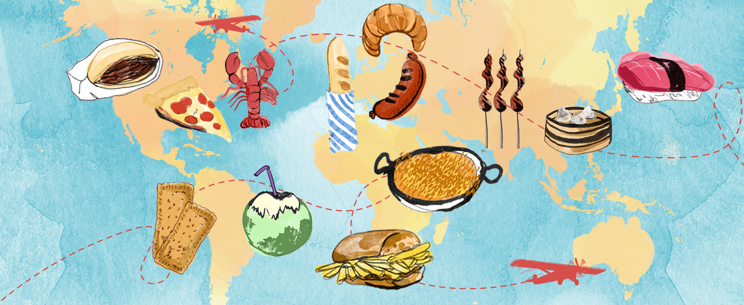

Unit 4: Cultural and Social aspects of Eating
Neha Soni (phd, foods and nutrition)
Tutor, paramedical sciences
Clinical dietician, Dhiraj hospital
svdu

Slide 2
Learning Objectives
Understand how culture influences food choices and dietary practices
Identify the impact of social settings and family dynamics on eating patterns
Analyze the role of festivals, rituals, and food symbolism in cultural identity
Evaluate the influence of globalization and acculturation on dietary habits
Apply cultural sensitivity in dietary counseling and nutrition interventions

Slide 3
TOPICS COVERED
1. Cultural Influences on Diet and Mood
How different cultures view food and mood
The impact of cultural dietary patterns on mental health
2. Social Eating and Emotional Bonds
The role of communal meals in emotional well-being
How social interactions during meals influence mood
3. Marketing and Its Influence on Eating Behaviour
The psychology behind food marketing
How advertising affects food choices and mood

Slide 4

Cultural Influences on Diet and Mood
Culture plays a significant role in shaping both diet and mood, influencing what we eat, how we feel about food, and even how we regulate emotions through eating.

Slide 5
1. Cultural Influences on Diet
Traditional Foods & Culinary Practices: Different cultures have staple diets based on local ingredients and historical practices (e.g., Mediterranean diet rich in olive oil and fish, Asian diets with rice and fermented foods, Latin American diets with maize and beans).
Religious & Ethical Beliefs: Many religions have dietary restrictions that shape eating habits (e.g., halal in Islam, vegetarianism in Hinduism and Buddhism).
Social Norms & Rituals: Eating patterns, portion sizes, and meal timing vary. Some cultures emphasize communal dining (e.g., family-style meals in India, Italy or China), while others prioritize individual eating.
Westernization & Globalization: Processed and fast food have altered traditional diets worldwide, sometimes leading to health shifts (e.g., increased obesity and diabetes in areas adopting Western diets).

Slide 6
2. Cultural Influences on Mood
Food & Emotional Connection: Many cultures link food with comfort, celebration, or healing (e.g., chicken soup as a remedy in Jewish culture, spicy foods as mood boosters in Latin American cuisine).
Nutritional Psychology & Mental Health: Traditional diets rich in whole foods (e.g., Mediterranean diet) have been associated with lower rates of depression and anxiety, while processed foods are linked to mood disorders.
Festivals & Emotional Eating: Food is central to celebrations and religious festivals (e.g., sweets during Diwali, Thanksgiving feasts), which can impact mood positively. Conversely, some cultures use food for emotional regulation, leading to binge eating or stress-related eating habits.
Caffeine & Alcohol Consumption: Some cultures consume more caffeine (e.g., coffee in Italy, tea in China) or alcohol (e.g., wine in France), which can affect mood and social bonding.

Slide 7
3. How Culture Shapes Food & Mood Together
Spicy & Fermented Foods and Mood: Cultures that favor spicy foods (e.g., India, Thailand) or fermented foods (e.g., Korea, Germany) may benefit from mood-boosting compounds like capsaicin or probiotics.
Cultural Attitudes Toward Body Image & Eating: Some cultures emphasize body positivity, while others encourage restrictive diets or fasting traditions (e.g., intermittent fasting in Islam and Christianity).
Collectivism vs. Individualism in Eating: Collectivist cultures (e.g., Japan, Mexico) often associate food with social bonding, while individualist cultures (e.g., U.S., U.K.) may focus on convenience and personal choice, impacting emotional well-being.

Slide 8
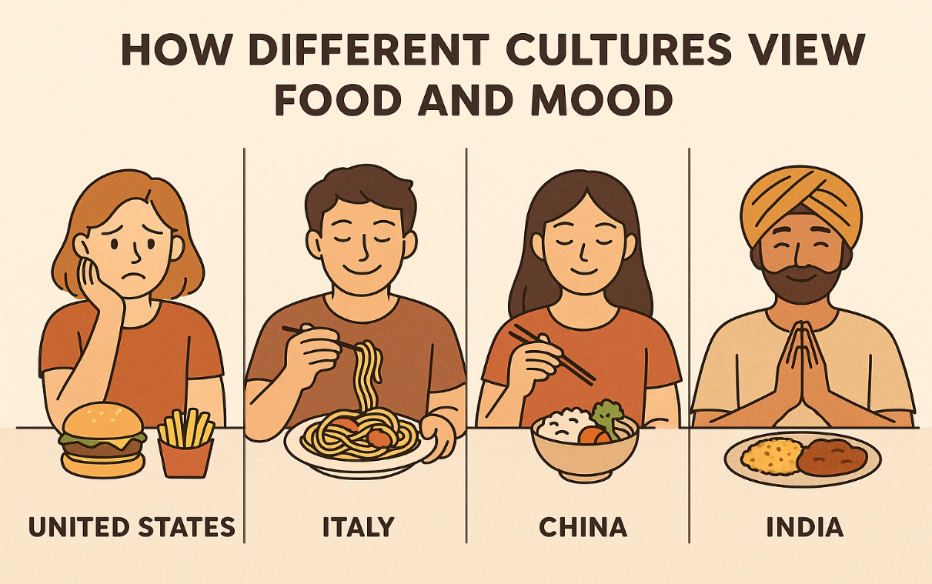
How different cultures view food and mood
Different cultures have unique perspectives on the relationship between food and mood, influenced by traditions, beliefs, and social norms.

Slide 9

1. Asian culture- Balance and Healing
China (Traditional Chinese Medicine - TCM)
Food is seen as medicine, and balance is key
Warm foods like ginger and garlic boost energy, while cooling foods like cucumber and watermelon calm the body.
Certain foods, like green tea, are believed to enhance mental clarity and reduce stress.

Slide 10
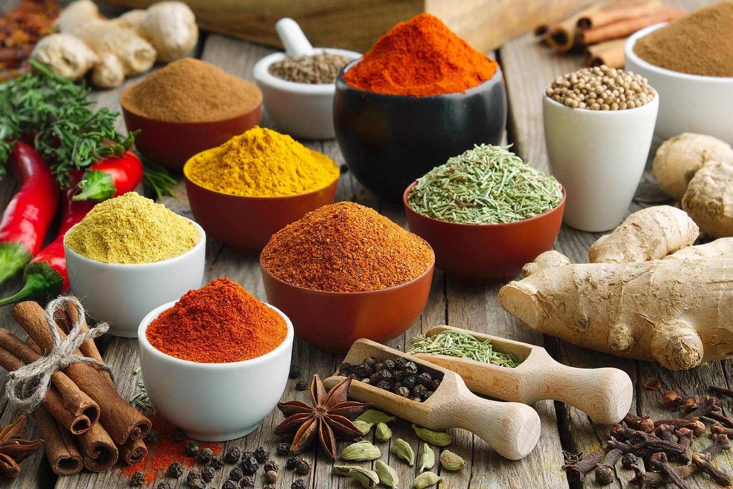
1. Asian culture- Balance and Healing
B. India (Ayurveda and Spices for Mood)
Ayurveda classifies food into three categories:
  Sattvic (calming, spiritual) – fresh fruits, nuts, dairy, and whole grains.
  Rajasic (stimulating, fiery) – spicy food, caffeine, onion, garlic.
  Tamasic (dulling, heavy) – processed foods, stale food, alcohol.
Spices like turmeric (curcumin) and saffron are linked to improved mood and reduced depression.

Slide 11
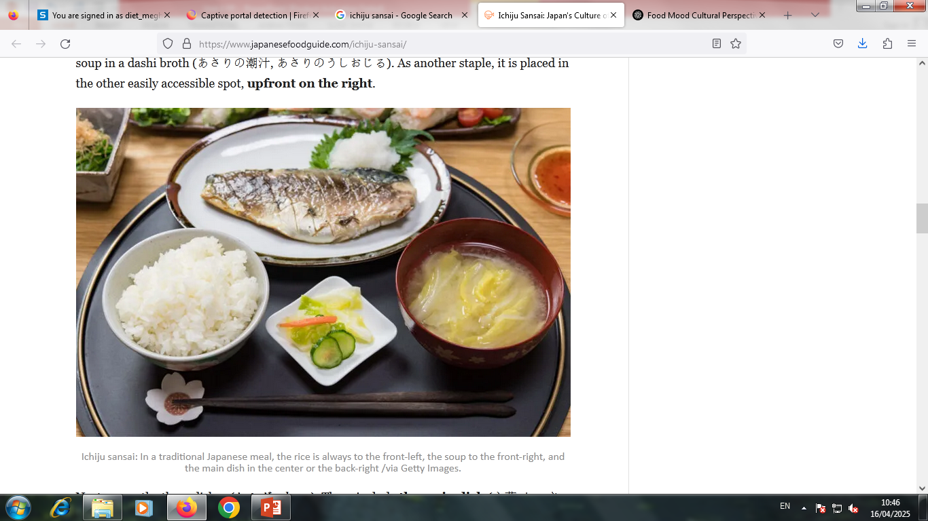
1. Asian culture- Balance and Healing
C. Japan (Mindful Eating & Mood Regulation)
The “ichiju sansai” principle (one soup, three side dishes) encourages balance.
1 hot soup, 1 main dish; usually a protein like fish, meat, or tofu and 2 side dishes; usually vegetables, pickles, or small salads. (and also rice, often served alongside but not counted in the one and three).
Fermented foods support gut health, which is linked to mood.
The concept of “hara hachi bu” (eating until 80% full) prevents overeating, promoting emotional stability.
It’s a principle of mindful eating, especially practiced in Okinawa, where people are known for their longevity. The idea is to stop eating before you're completely full, giving your body time to feel satisfied without overeating.

Slide 12
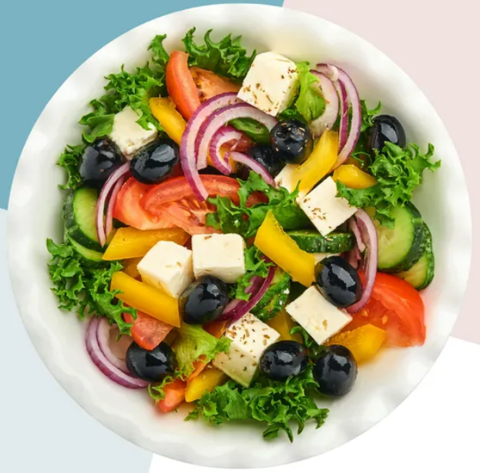
2. Mediterranean Cultures: Social & Nutritional Well-Being
A. Greece, Italy, Spain (Mediterranean Diet & Mood)
A diet rich in olive oil, fish, nuts, and vegetables is linked to lower depression rates.
Meals are social and leisurely, reinforcing positive emotions.
Wine is consumed in moderation, often as part of a meal, promoting relaxation.

Slide 13
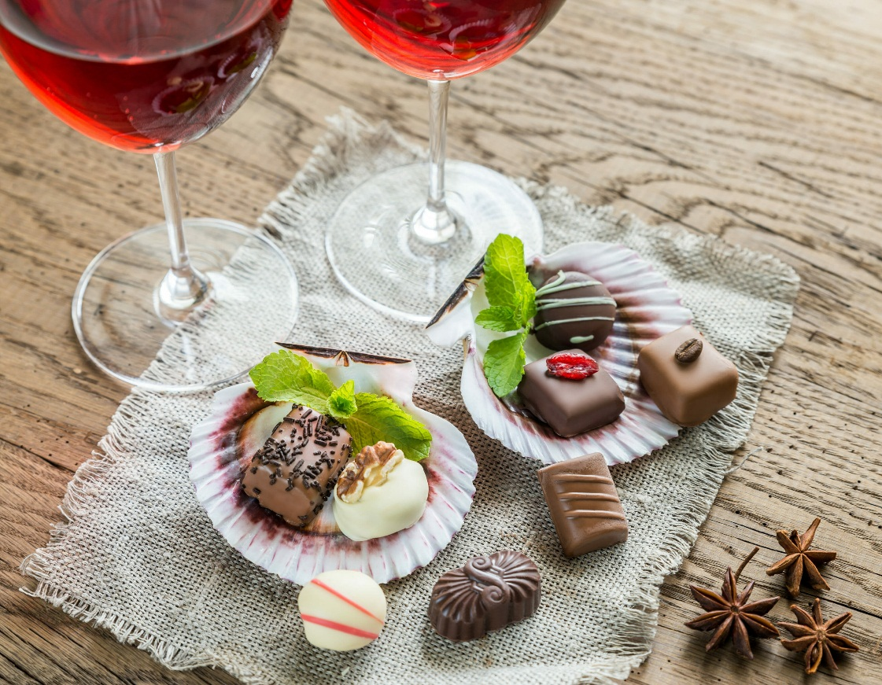
2. Mediterranean Cultures: Social & Nutritional Well-Being
B. France (Pleasure & Moderation)
  The French see food as pleasure, not guilt, reducing emotional eating.
  Small portions and slow eating improve satisfaction and mindfulness.
  Cheese, wine, and dark chocolate are enjoyed in moderation, contributing to mood regulation.

Slide 14
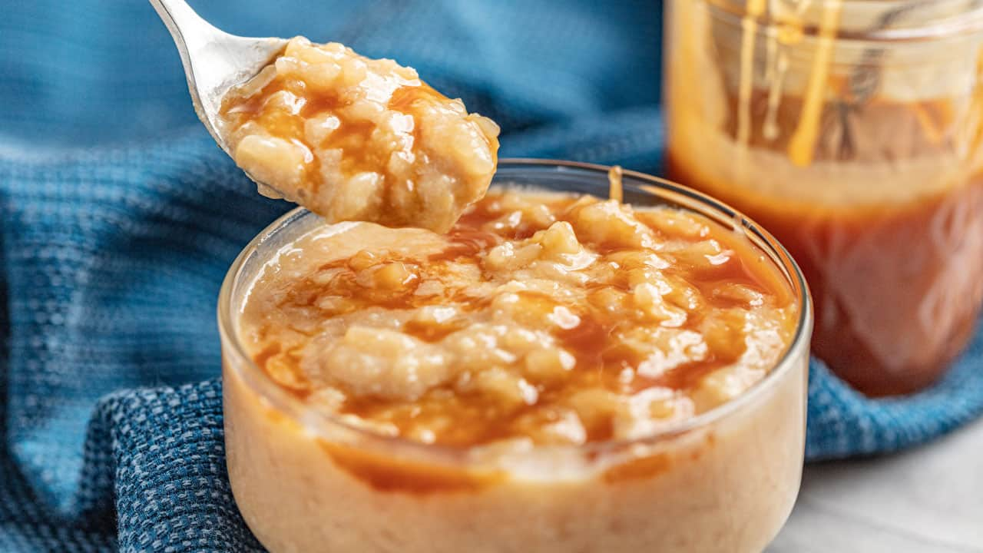
3. Latin American Cultures: Emotional & Festive Eating
A. Mexico, Brazil, Argentina (Food & Celebration)
Food is central to family gatherings and celebrations (e.g., tamales during Christmas, asado in Argentina).
Spicy foods (chili peppers) can trigger endorphins, boosting mood.
Comfort foods like rice pudding and caramel milk spread are associated with nostalgia and happiness.

Slide 15

3. Latin American Cultures: Emotional & Festive Eating
B. Caribbean Cultures (Tropical Mood-Boosting Foods)
Fresh fruits like mango, papaya, and coconut are rich in vitamins that enhance energy and mood.
Seafood provides omega-3 fatty acids, known to support brain health.
Communal dining strengthens social bonds, reinforcing positive emotions.

Slide 16
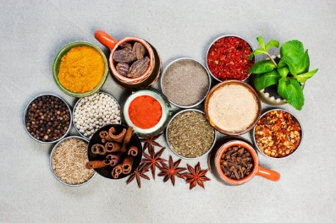
4. Middle Eastern & African Cultures: Food as Nourishment & Connection
A. Middle East (Spices & Fasting for Mental Clarity)
Spices like saffron and cinnamon are believed to enhance mood and cognitive function.
Dates and honey are traditionally used for energy and well-being.
Fasting (e.g., during Ramadan) is seen as spiritually and emotionally cleansing, improving mindfulness and self-discipline.

Slide 17
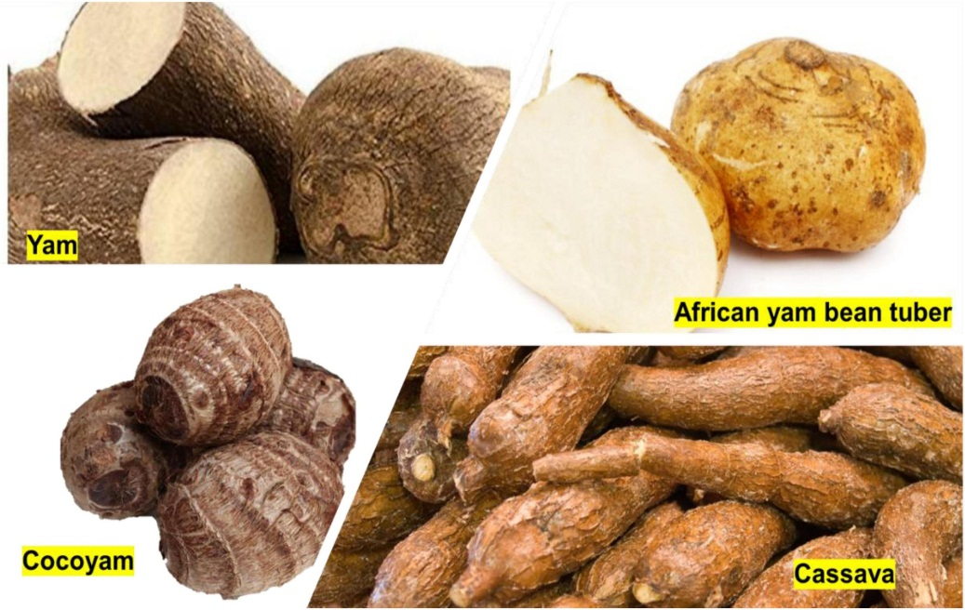
4. Middle Eastern & African Cultures: Food as Nourishment & Connection
B. West Africa (Root-Based, Nutrient-Dense Diets)
Foods like yams, plantains, and groundnuts provide sustained energy and regulate mood.
Fermented foods (e.g., a fermented cereal pudding) support gut health and emotional balance.
Meals are often shared, reinforcing a sense of community and belonging.

Slide 18
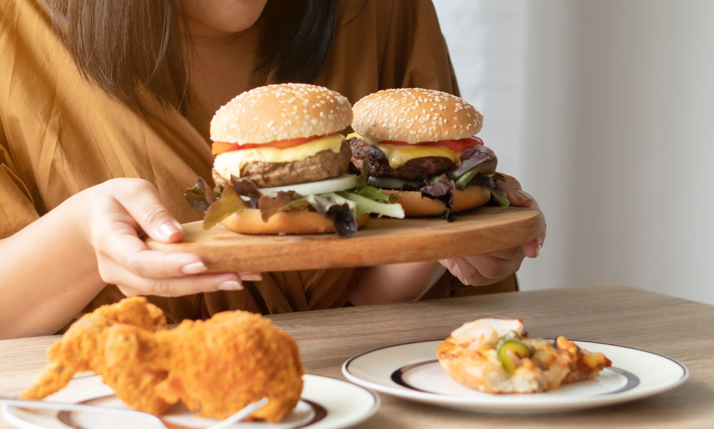
5. Western Cultures: Emotional & Convenience-Based Eating
A. United States (Fast Food, Stress Eating & Diet Trends)
Food is often associated with comfort and emotional regulation (e.g., ice cream after a breakup, pizza for celebrations).
Highly processed foods and sugar spikes can contribute to mood swings.
Diet culture (e.g., low-carb, keto, intermittent fasting) influences eating behaviors and emotions.

Slide 19
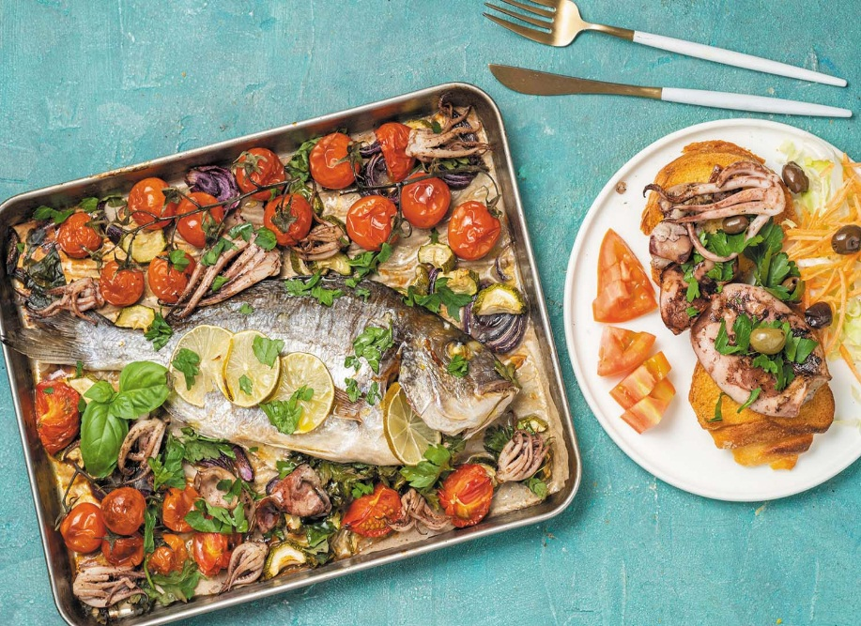
5. Western Cultures: Emotional & Convenience-Based Eating
B. Northern Europe (Simple, Seasonal, & Mood-Boosting Foods)
Scandinavian diets include fish, berries, and whole grains, supporting brain health.
Hygge (a Danish concept of coziness) promotes warm, comforting foods like stews and teas for emotional well-being.
Dark winter months lead to a focus on vitamin D-rich foods (e.g., salmon) to combat seasonal depression.

Slide 20
Conclusion
Some cultures view food as medicine (China, India), while others focus on social bonding (Mediterranean, Latin America).Spices, fermented foods, and whole foods are commonly linked to positive mental health. Fast-paced Western lifestyles often lead to emotional or convenience-driven eating.

Slide 21
Impact of cultural dietary patterns on mental health
Cultural dietary patterns significantly impact mental health by influencing brain function, gut health, and emotional well-being. Traditional diets often provide essential nutrients that support mood stability, while modern, highly processed diets can contribute to mental health disorders.

Slide 22
1. Nutritional Foundations of Mental Health
Certain nutrients are essential for brain health, mood regulation, and emotional resilience:
Omega-3 fatty acids (found in fish, nuts, seeds) reduce inflammation and support cognitive function.
B vitamins (in whole grains, leafy greens) help neurotransmitter production.
Probiotics and fiber (in fermented and plant-based foods) improve gut health, which influences mood.
Antioxidants (from fruits, vegetables, and spices) reduce oxidative stress linked to depression and anxiety.

Slide 23
2. How Cultural Diets Influence Mental Health
A. Traditional Diets: Nutrient-Rich and Mental Health-Friendly
These diets are often associated with lower rates of depression and anxiety due to their high nutritional value and social eating practices.
B. Mediterranean Diet (Greece, Italy, Spain)
  Rich in olive oil, fish, nuts, legumes, and whole grains.
  High in omega-3s, antioxidants, and polyphenols that protect against depression.
  Social dining culture enhances emotional well-being and reduces stress.
C. Japanese & Korean Diets
  Emphasize fish, seaweed, fermented foods (kimchi, miso), and green tea.
  Probiotics from fermented foods promote gut health and mood stability.
  High consumption of fish (rich in DHA and EPA) improves brain function.

Slide 24
2. How Cultural Diets Influence Mental Health
D. Indian Ayurvedic Diet
  Includes spices (turmeric, saffron), lentils, whole grains, and dairy.
  Turmeric (curcumin) has anti-inflammatory and antidepressant properties.
  Balanced food philosophy (sattvic foods for mental clarity) supports emotional health.
E. Nordic Diet (Scandinavia)
  Features fish, root vegetables, whole grains, and berries.
  Rich in omega-3s and fiber, reducing inflammation and stabilizing mood.
  Focus on seasonal, fresh foods helps regulate energy and mental focus.
F. West African Diet
  Staples like yams, plantains, beans, and leafy greens provide steady energy and essential nutrients.
  Fermented foods support gut health and emotional balance.
  Social eating culture reinforces mental well-being.

Slide 25
3. Gut Health & the Gut-Brain Connection
Cultural diets rich in fermented foods (e.g., kimchi, yogurt, miso) promote a healthy gut microbiome, which plays a key role in:
Serotonin production (90% is made in the gut), influencing mood and anxiety.
Reducing inflammation, which is linked to depression.
Balancing stress response through improved digestion and nutrient absorption.
Modern, processed diets reduce gut bacteria diversity, increasing the risk of mood disorders.

Slide 26
4. Social & Cultural Eating Habits
Beyond nutrition, cultural attitudes toward eating impact mental health.
Collectivist Cultures (Mediterranean, Asian, Latin American, African)
  Encourage shared meals and slow eating, reducing stress and promoting emotional connection.
  Food as tradition and identity enhances psychological stability.
  Less focus on restrictive dieting leads to healthier relationships with food.
Individualistic & Fast-Paced Cultures (Western Nations)
  Fast food and eating alone are more common, increasing stress and emotional eating.
  Diet culture can lead to eating disorders and anxiety about food.

Slide 27
5. Fasting and Mental Clarity in Different Cultures
Fasting is a common practice in many cultures and can have both positive and negative mental health effects.
Religious & Cultural Fasting (India, Islam, Christianity, Buddhism)
  Intermittent fasting (e.g., Shravan, Navratri, Ramadan, Lent, Buddhist fasting) can promote mental clarity and self-discipline.
  Spiritual connection and mindfulness can reduce stress and improve emotional resilience.
  However, extreme fasting can lead to fatigue, mood swings, and disordered eating.
Modern Fasting Trends (Intermittent Fasting, Keto)
  Some find cognitive benefits and mood stability.
  Others experience irritability, anxiety, and obsession with food timing.

Slide 28
6. The Impact of Westernization on Traditional Diets & Mental Health
As traditional diets shift toward more processed foods, there is a rising trend of mental health issues:
Increased depression and anxiety in countries adopting Western diets.
Higher rates of obesity and metabolic disorders, which affect mood regulation.
Loss of cultural food traditions reduces emotional connection and mindfulness around eating.

Slide 29
7. How to Improve Mental Health Through Diet (Across Cultures)
Regardless of cultural background, incorporating traditional, whole-food-based eating patterns can support mental well-being.
Key Strategies:
Prioritize whole, nutrient-dense foods (fruits, vegetables, lean proteins, whole grains).
Incorporate fermented foods (kimchi, yogurt, miso, sauerkraut) for gut health.
Reduce ultra-processed and high-sugar foods to avoid mood swings.
Practice mindful eating (slow, social, and gratitude-based meals).
Embrace cultural food traditions that promote balance and emotional well-being.

Slide 30
Conclusion: Culture, Diet & Mental Health Are Deeply Connected
Traditional diets (Mediterranean, Asian, Nordic, African) support mental health through nutrient-dense foods and strong social eating practices.
Westernized diets rich in processed foods and refined sugars are linked to higher depression, anxiety, and cognitive decline.
Cultural attitudes toward food (communal dining vs. fast-food culture) play a significant role in emotional well-being.
By integrating the best aspects of culturally rich, whole-food diets, we can create an eating pattern that supports both mental and physical health.

Slide 31
Social Eating and Emotional Bonds
Food is more than just sustenance—it is deeply connected to social bonding, emotional well-being, and cultural identity. Across the world, communal meals strengthen relationships, provide comfort, and influence emotional health.

Slide 32
1. Why Social Eating is Important for Emotional Well-Being
A. Strengthening Relationships & Social Bonds
Sharing meals fosters connection, trust, and belonging among family, friends, and communities.
Eating together is associated with lower loneliness, improved communication, and stronger emotional support.
Many cultures emphasize family dinners or communal feasts, reinforcing social ties.
B. Reducing Stress & Enhancing Mood
Eating in a relaxed, social setting lowers cortisol (stress hormone) and increases oxytocin (bonding hormone).
Laughter and conversation during meals improve emotional resilience and reduce anxiety.
C. Encouraging Mindful & Healthier Eating Habits
Social meals encourage slower eating, leading to better digestion and portion control.
Family or group settings promote healthier food choices compared to eating alone or in isolation.

Slide 33
2. Cultural Perspectives on Social Eating & Emotional Connection
A. Mediterranean Cultures: Food as a Celebration of Togetherness
Meals in Italy, Greece, and Spain are leisurely and family-centered.
Tapas culture (Spain) promotes sharing small plates, fostering connection.
Wine and food are enjoyed in moderation, reducing stress and enhancing relaxation.
B. Asian Cultures: Harmony & Collective Eating
China & Japan: Sharing meals symbolizes family unity and respect.
Hot pot (China) and Korean BBQ require group participation, reinforcing bonding.
Japan’s “Itadakimasu” (gratitude for the meal) enhances mindfulness and emotional connection.

Slide 34
2. Cultural Perspectives on Social Eating & Emotional Connection
C. Latin American Cultures: Feasting & Emotional Warmth
Food is central to celebrations, family gatherings, and community events.
Tacos, empanadas, asado (Argentinian BBQ) are often shared, creating a sense of belonging.
Meals are loud, expressive, and full of laughter, strengthening emotional bonds.

Slide 35
2. Cultural Perspectives on Social Eating & Emotional Connection
D. African Cultures: Communal Eating & Storytelling
Many African cultures emphasize group dining with shared platters (e.g., injera in Ethiopia, jollof rice in West Africa).
Storytelling and wisdom-sharing during meals strengthen intergenerational connections.
E. Middle Eastern Cultures: Hospitality & Generosity
Meze-style dining (Lebanon, Turkey) promotes slow, social eating.
Food is a symbol of hospitality, respect, and emotional connection.
Breaking fast during Ramadan brings families together and enhances gratitude.

Slide 36
3. The Psychological Impact of Eating Alone vs. Social Eating
A. Eating Alone: Risks to Emotional Health
Loneliness & Depression: Regularly eating alone can increase feelings of isolation.
Mindless Eating: People eating alone tend to eat faster, overeat, or consume unhealthy foods.
Higher Stress Levels: Lack of social interaction during meals increases cortisol (stress hormone).
B. Social Eating: Emotional & Mental Health Benefits
Boosts Happiness: Sharing meals releases endorphins, promoting a sense of joy.
Improves Self-Esteem: Feeling included in social meals enhances confidence & belonging.
Encourages Emotional Expression: Family or friend meals create space for sharing emotions and reducing anxiety.

Slide 37
4. Social Eating in Modern Life: Challenges & Solutions
A. Modern Challenges (Fast-Paced Lifestyles & Technology)
Busy schedules lead to fewer family meals and more on-the-go eating.
Technology (phones, TV) distracts from mindful social interactions.
Western fast-food culture prioritizes individual meals over shared dining experiences.
B. How to Reintroduce Social Eating in Daily Life
Prioritize family or friend meals at least a few times per week.
Create “tech-free” dining zones to encourage real conversation.
Host potlucks or group dinners to make social eating a regular event.
Join cultural or community food events to strengthen social bonds.
Practice mindful eating by focusing on flavors, company, and gratitude.

Slide 38
5. The Future of Social Eating: Adapting Traditions for Mental Well-Being
More people are recognizing the value of communal meals for mental health. Workplace lunch breaks, dinner clubs, and virtual meal-sharing events are gaining popularity. Mindful eating movements encourage social engagement, not just food consumption.

Slide 39
Conclusion: Social Eating is a Powerful Emotional Connector
Across cultures, shared meals symbolize love, belonging, and emotional well-being.
Eating together reduces stress, promotes happiness, and strengthens relationships.
Prioritizing communal dining—even in modern busy lives—can improve mental health & emotional resilience.

Slide 40
Marketing and Its Influence on Eating Behaviour
Marketing has a significant impact on eating behavior, shaping what, when, and how much people eat. It influences food choices through advertising, packaging, branding, and promotions.

Slide 41
1. Advertising and Brand Influence
Emotional Appeals: Food advertisements often evoke emotions like happiness, nostalgia, or excitement. For example, fast-food commercials frequently associate their products with family time or fun with friends.
Celebrity Endorsements: Well-known figures endorsing foods (e.g., athletes promoting sports drinks) can increase their desirability.
Targeted Ads: Social media and digital marketing use data to personalize ads, making certain foods more appealing to specific demographics.

Slide 42
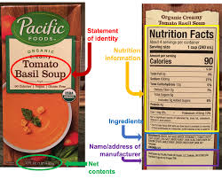
2. Packaging and Labeling
Colors and Design: Bright, eye-catching colors and fun designs attract children, while sleek, minimalist packaging may appeal to health-conscious consumers.
Health Claims: Labels such as "organic," "low-fat," or "high-protein" can influence perceptions, sometimes leading to the “health halo” effect where people assume a food is healthier than it actually is.
Portion Perception: Large packages can encourage overeating, as people tend to consume more when food is in bigger portions.

Slide 43

3. Pricing and Promotions
Discounts and Deals: "Buy one, get one free" (BOGO) or "value meals" encourage consumers to buy and eat more.
Placement Strategies: Supermarkets place high-margin, impulse-buy snacks at checkout counters and eye-level shelves, increasing consumption.
Subscription Models: Meal kits and delivery services use convenience and personalized marketing to drive consistent eating patterns.

Slide 44
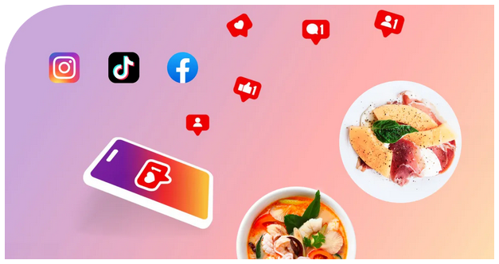
4. Social Media and Influencer Marketing
Food Challenges and Trends: Viral food trends (e.g., mukbang videos, TikTok recipes) can encourage excessive consumption or specific food preferences.
User-Generated Content: Seeing friends and influencers posting about specific foods can normalize or glamorize certain eating habits.
"Healthy Eating" Influences: While marketing also promotes healthy eating, some diet trends may lead to restrictive or disordered eating behaviors.

Slide 45
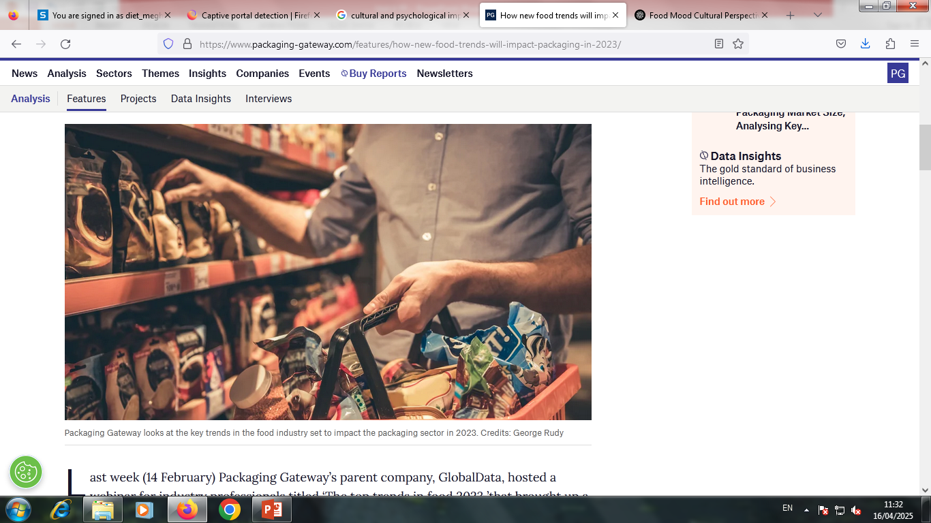
5. Cultural and Psychological Impact
Association with Lifestyle: Brands position certain foods as part of a lifestyle (e.g., energy drinks for athletes, organic foods for wellness-focused individuals).
Nostalgia and Tradition: Marketers use cultural and nostalgic elements (e.g., holiday food ads) to reinforce cravings and habitual eating.
Impulse Eating: Fast-food ads during peak hunger hours (e.g., evening TV commercials) can trigger cravings and impulse purchases.

Slide 46
The psychology behind food marketing
Food marketing leverages psychological principles to shape consumer decisions, influencing what, when, and how much people eat. By tapping into emotions, cognitive biases, and behavioral triggers, marketers create strategies that drive sales and reinforce eating habits.

Slide 47

1. Emotional and Psychological Triggers
A. Emotional Branding
Marketers use emotions like happiness, nostalgia, and comfort to make food more appealing.
Example: Ads featuring families sharing a meal create an emotional connection, making consumers associate the product with warmth and togetherness.
B. Craving and Sensory Appeal
Images and videos of sizzling burgers or melting cheese trigger cravings by stimulating the senses.
The Mere Exposure Effect (familiarity breeds preference) means repeated exposure to a product increases the likelihood of purchasing it.
C. Social Proof and FOMO (Fear of Missing Out)
Seeing influencers, celebrities, or peers enjoying a food product makes people more likely to try it.
Limited-time offers (e.g., "Only available for one month!") create urgency and drive impulse purchases.

Slide 48
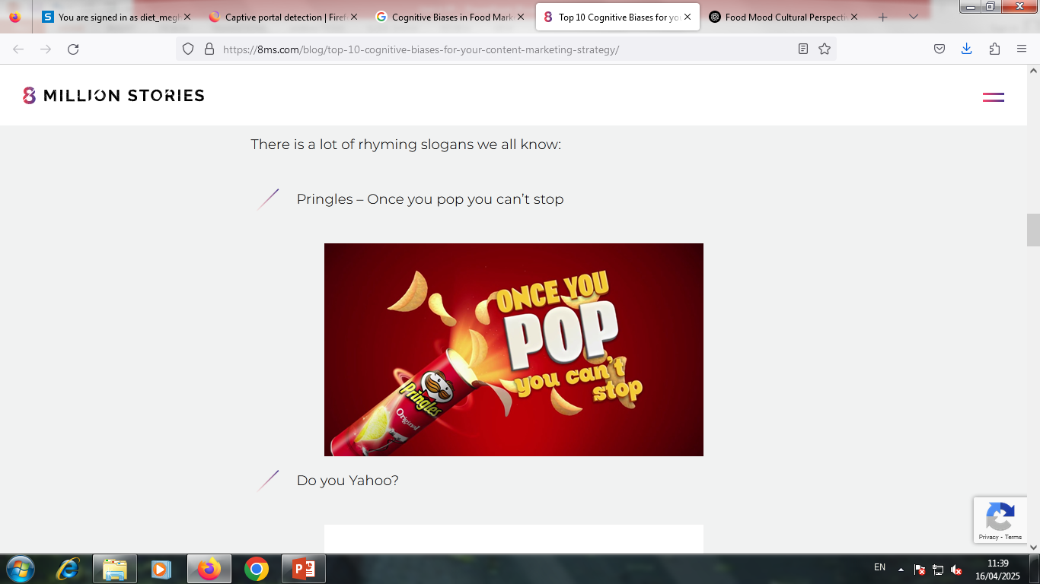
2. Cognitive Biases in Food Marketing
A. The Health Halo Effect
When a food is marketed as "organic," "gluten-free," or "low-fat," consumers assume it’s healthy—even if it’s high in sugar or calories.
Example: Yogurt labeled as "low-fat" may have more sugar, but consumers perceive it as a better choice.
B. Anchoring Bias
Consumers rely on the first piece of information they see.
Example: A menu showing an expensive dish first makes everything else seem more affordable, encouraging larger purchases.
C. Scarcity and Urgency Bias
The Scarcity Principle suggests that people value things more when they’re limited.
Example: McDonald's "McRib" being available only for a short period increases demand.

Slide 49
3. Behavioral Triggers and Decision-Making
A. Placement and Environmental Cues
Supermarkets place snacks and candy at checkout aisles to encourage impulse buying.
Bright colors and appealing packaging at eye level increase purchase likelihood, especially among children.
B. Portion Distortion
Larger portion sizes lead to greater consumption due to the unit bias (people eat in full units rather than stopping when full).
Example: "Super-sized" fast food meals make people feel they’re getting more value, leading to overeating.
C. Pricing and Discounts
"Buy One, Get One Free" or meal deals encourage overconsumption by making more food seem like a better deal.
The Decoy Effect: When presented with three pricing options, consumers often choose the middle-priced option, even if they wouldn’t have considered it otherwise.

Slide 50

4. Digital Influence and Social Media Psychology
A. Viral Trends and Influencer Marketing
TikTok and Instagram food trends create mass appeal, making certain foods seem more desirable.
Example: The Dalgona coffee trend or rainbow bagels went viral, driving demand through social proof.
B. Personalized Advertising
Algorithms track eating habits and preferences, displaying targeted ads that increase cravings and impulse purchases.
Example: Seeing ads for burgers at lunchtime increases the likelihood of ordering fast food.

Slide 51
How advertising affects food choices and mood
Food advertising is a powerful force that shapes our eating habits and emotional responses. Marketers use psychological techniques to influence what we eat, how much we consume, and how we feel about food. These strategies impact not only our food choices but also our overall mood and relationship with eating.

Slide 52
1. The Influence of Advertising on Food Choices
A. Creating Cravings and Preferences
Food advertisements use highly stimulating visuals, sounds, and descriptions to trigger cravings.
Example: A fast-food ad showing a juicy burger with sizzling sounds can make people suddenly crave one, even if they weren’t hungry.
B. Branding and Emotional Associations
Ads connect foods with emotions like happiness, nostalgia, or excitement.
Example: Coca-Cola ads often show people laughing and sharing moments, making consumers associate the drink with joy.
C. The "Health Halo" Effect
Ads emphasize certain aspects like "organic," "gluten-free," or "low-fat," making people perceive these foods as healthy—even if they are high in sugar or calories.
Example: A "low-fat" granola bar may still be high in sugar, but consumers may choose it over a truly healthy option.
D. Influence on Children
Kids are highly susceptible to food marketing, as they lack the ability to critically evaluate advertisements.
Bright colors, cartoon mascots, and free toys in kids' meals make fast food more appealing.

Slide 53
2. The Psychological Impact on Mood
A. Instant Gratification and Dopamine Release
Seeing food ads can trigger the brain’s reward system, releasing dopamine (the "feel-good" neurotransmitter).
This can lead to impulse eating or seeking out specific foods to recreate that pleasure.
B. Emotional Eating and Comfort Foods
Ads often position certain foods as solutions to stress or sadness.
Example: Ice cream brands promote their products as a way to "cheer up" after a bad day, reinforcing emotional eating habits.
C. Guilt and Anxiety from Health Messaging
Some ads use fear-based tactics, making consumers feel guilty for their current diet.
Example: Diet food ads may portray regular foods as "bad," leading to stress and unhealthy food relationships.
D. Social Comparison and Food Trends
Seeing influencers or celebrities enjoying certain foods can make people feel pressured to follow trends.
Example: "Superfoods" like acai bowls or matcha lattes become popular because they are marketed as both trendy and healthy.

Slide 54
3. Long-Term Effects on Eating Habits
Overconsumption of Processed Foods: Repeated exposure to ads normalizes frequent consumption of fast food and snacks.
Diet Culture and Restrictive Eating: Ads promoting "quick fixes" (like weight-loss shakes) can lead to unhealthy dieting cycles.
Mindless Eating: Marketing encourages snacking while watching TV or using social media, leading to overeating without realizing it.

Slide 55
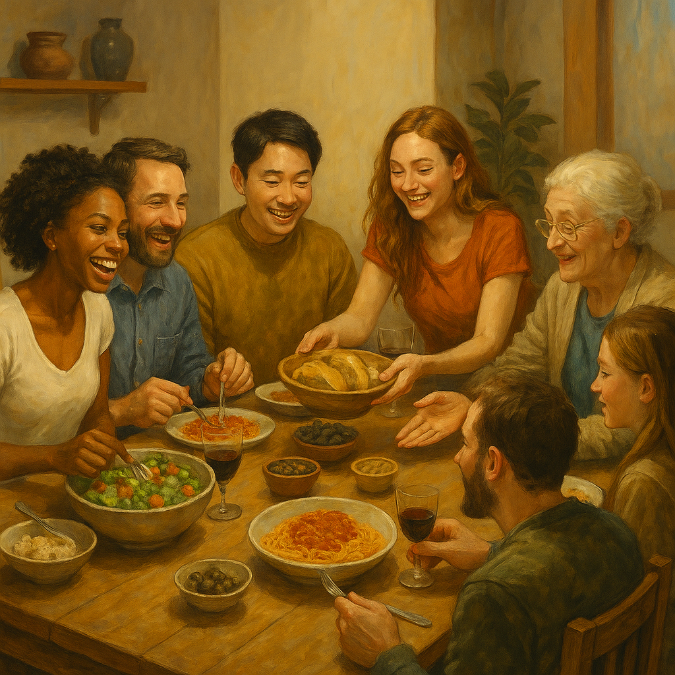
Thank You

