Slide 1

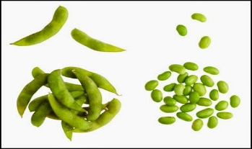
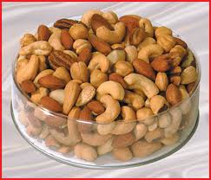
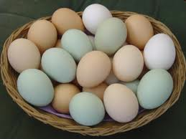
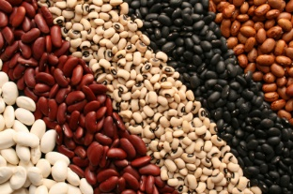
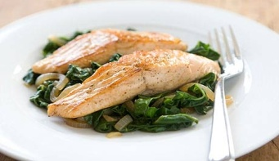
Power of Proteins
Neha Soni
Tutor, Dept of Clinical Nutrition
Paramedical Sciences
SVDU

Slide 2
Learning Objectives
Explain the structure, classification, and biological functions of proteins
Evaluate dietary sources and quality of proteins
Analyze
Discuss the role of protein in weight management, muscle health, and metabolism
Debunk myths and clarify misconceptions about high-protein diets

Slide 3

What is Protein ?
They are large, complex organic compounds composed of carbon, hydrogen, oxygen and nitrogen (sometimes Sulphur).
The presence of nitrogen (which is about 16%) differentiates proteins from carbohydrates and fats.
The body has at least 30,000 types of protein, each with a different job.
The building blocks of all protein molecules are amino acids.
Proteins form an important part of both animal and plant cells. It is found in hair, skin, nails and muscles.

Slide 4
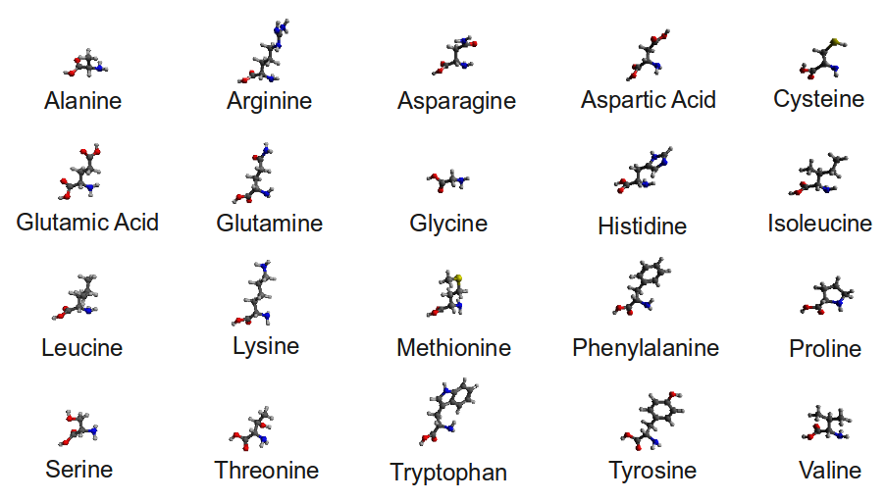
STRUCTURE
There are 20 different amino acids that create different combinations for specific functions in the body.
DNA provides the instructions for how the amino acids will be linked to form the proteins in your body.

Slide 5
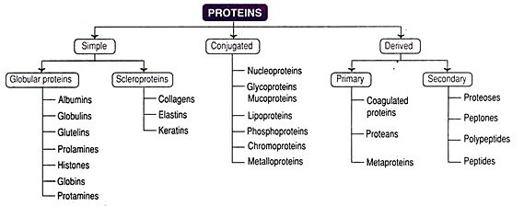
Classification

Slide 6
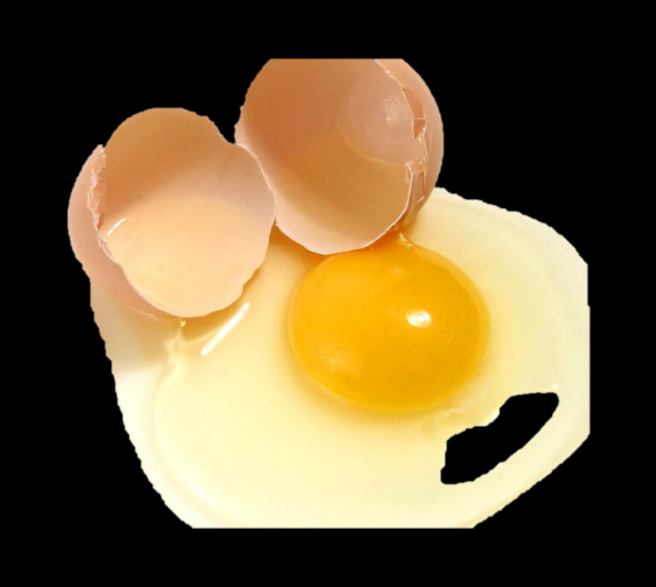
Classification
Simple proteins
(i) Albumins:
Soluble in water, coagulable by heat and 1 precipitated at high salt concentrations. Examples – Serum albumin, egg albumin, lactalbumin (Milk), leucosin (wheat), legumelin (soyabeans).

Slide 7
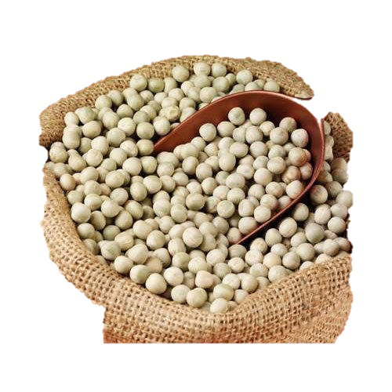
Classification
(ii) Globulins:
Insoluble in water, soluble in dilute salt 1 solutions and precipitated by half 1 saturated salt solutions.
Examples – Serum globulin, vitellin (egg yolk), tuberin (potato), myosinogen (muscle), legumin (peas).

Slide 8
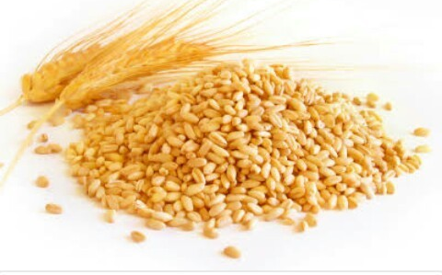
Classification
(iii) Glutelins:
Insoluble in water but soluble in dilute 1 acids and alkalis. Mostly found in plants.
Examples – Glutenin (wheat), oryzenin (rice).

Slide 9
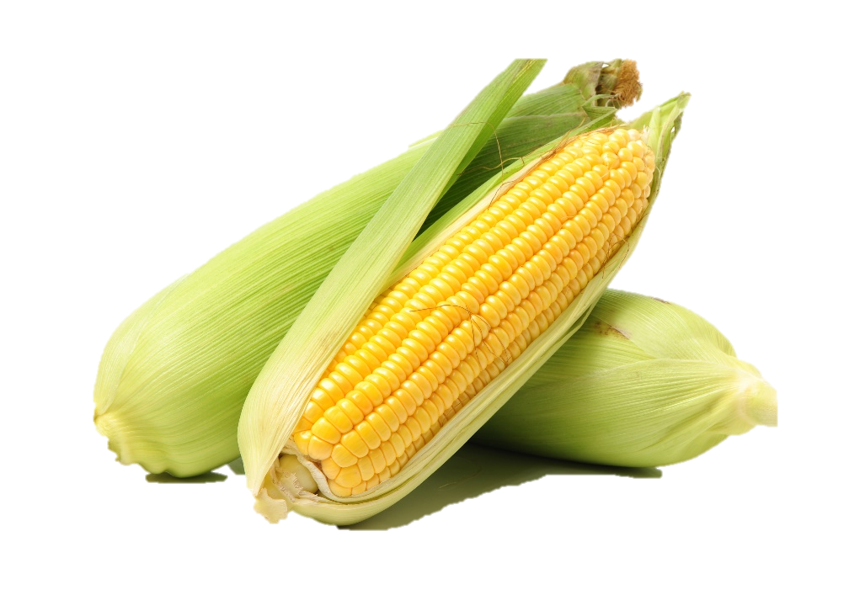
Classification
(iv) Prolamines: Insoluble in water and absolute alcohol 1 but soluble in 70 to 80 per cent alcohol.
Examples – Gliadin (wheat), zein (maize).

Slide 10
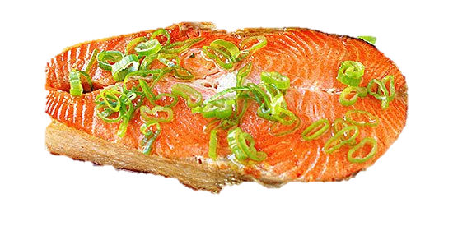
Classification
(v) Protamines:
Basic proteins of low molecular weight. 1 Soluble in water, dilute acids and alkalis, Not coagulable by heat.
Examples – Salmine (salmon sperm).

Slide 11
Classification
(vi) Histones:
Soluble in water and insoluble in very I dilute ammonium hydroxide.
Examples – Globin of hemoglobin and thymus histones.

Slide 12
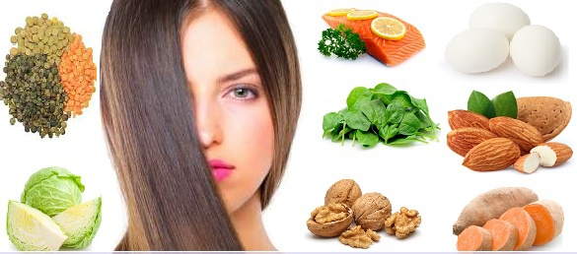
Classification
(vii) Scleroproteins:
Insoluble in water, dilute acids and alkalis.
Examples – Keratin (hair, horn, nail, hoof and feathers), collagen (bone, skin), elastin (ligament).

Slide 13
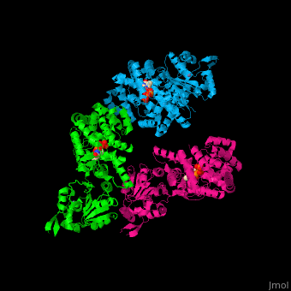
Classification
I. Conjugated Proteins
(i) Nucleoproteins:
Composed of simple basic proteins (pro­tamines or histones) with nucleic acids, found in nuclei. Soluble in water.
Examples – Nucleoprotamines and nucleohistones.

Slide 14
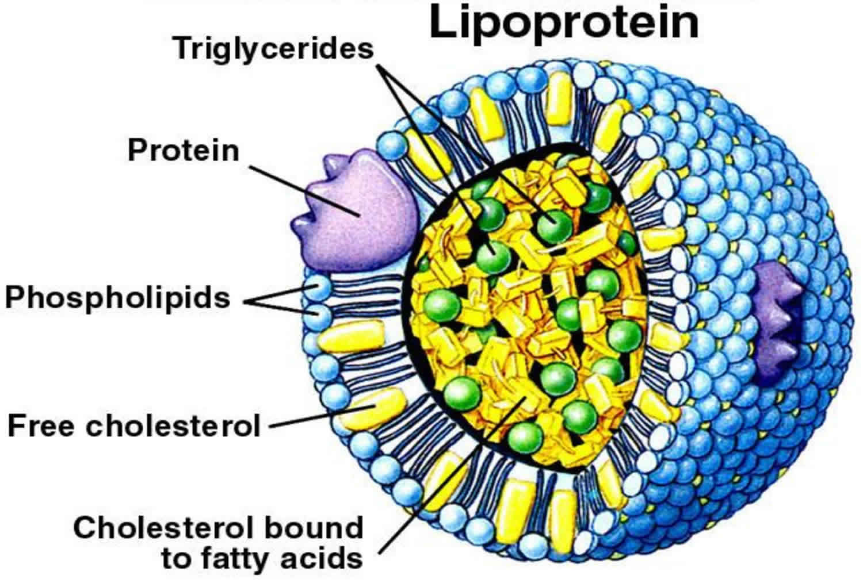
Classification
(ii) Lipoproteins:
Combination of proteins with lipids, such ‘ as fatty acids, cholesterol and 1 phospholipids etc.
Examples – Lipoproteins of egg-yolk, milk and cell membranes, lipoproteins of blood.

Slide 15
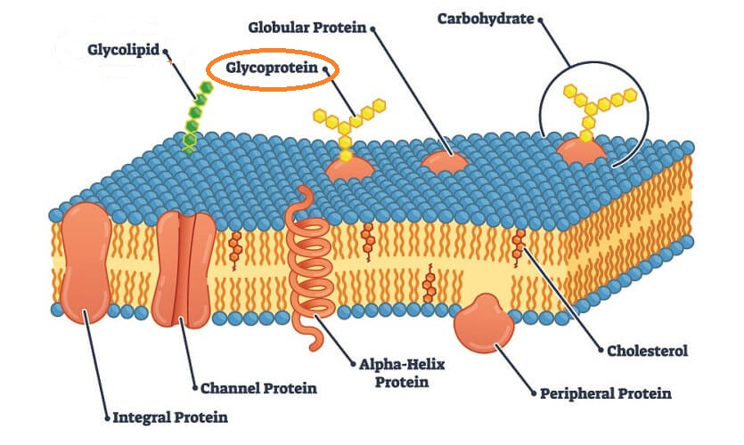
Classification
(iii) Glycoproteins:
Combination of proteins with carbohydrate (mucopolysaccharides).
Examples – Mucin (saliva), ovomucoid (egg white), osseomucoid (bone), tendomucoid (tendon).

Slide 16
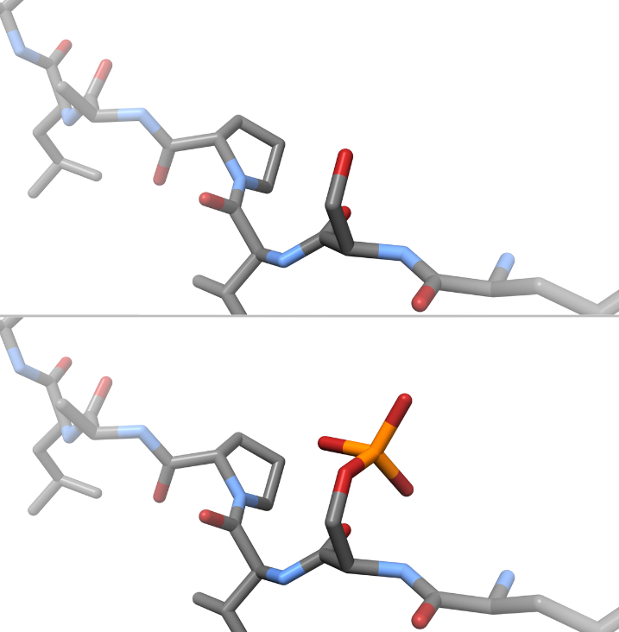
Classification
(iv) Phosphoproteins:
Contain phosphorus radical as a | prosthetic group.
Examples – Caseinogen (milk), ovovitellin (egg yolk).

Slide 17
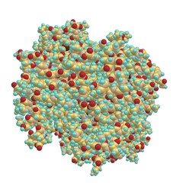
Classification
(v) Metalloproteins:
Contain metal ions as their prosthetic groups. The metal ions generally are Fe, Co. Mg, Mn, Zn, Cu etc.
Examples – Siderophilin (Fe), ceruloplasmin (Cu).

Slide 18
Classification
(vii) Flavoproteins:
Contain riboflavin as their prosthetic 1 groups.
Examples – Flavoproteins of liver and kidney.

Slide 19
Classification
(vi) Chromoproteins:
Contain porphyrin (with a metal ion) as | their prosthetic groups.
Examples – Haemoglobin , myoglobin, catalase, peroxidase, cytochromes.

Slide 20
Classification
III. Derived Protein - degradation products obtained by partial hydrolysis of simple and conjugated proteins by acid s alkalies of enzymes
A. Primary derivatives
(i) Proteans:
Derived in the early stage of protein hydrolysis by dilute acids, enzymes or alkalis.
Examples – Fibrin from fibrinogen.
(ii) Metaproteins:
Derived in the later stage of protein hydrolysis by slightly stronger acids and alkalis.
Examples – Acid and alkali metaproteins.
(iii) Coagulated:
They are denatured proteins formed by the action of heat. X-rays, ultraviolet rays etc.
Cooked proteins, coagulated albumins.

Slide 21
Classification
B. Secondary derivatives
(i) Proteoses:
Formed by the action of pepsin or trypsin. Precipitated by saturated solution of ammonium sulphate, incoagulable by heat.
Examples – Albumose from albumin, globulose from globulin.
(ii) Peptones: .
Further stage of cleavage than the proteoses. Soluble in water, incoagu­lable by heat and not precipitated by saturated ammonium sulphate solutions.
(iii) Peptides:
Compounds containing two or more amino acids. They may be di-, tri-, and porypeptides.
Examples – Glycyl-alanine, leucyl-glutamic acid.

Slide 22
Biological Importance of Proteins:
Proteins are the essence of life processes.
They are the fundamental constituents of all protoplasm and are involved in the structure of the living cell and in its function.
Enzymes are made up of proteins.
Many of the hormones are proteins.
The cement substances and the reticulum which bind or hold the cells as tissues or organs are made up partly of proteins.

Slide 23
Biological Importance of Proteins, Contd…
Trans­port of oxygen and carbon dioxide by hemoglobin and special enzymes in the red cells.
They function in the homostatic control of the volume of the circulating blood and that of the interstitial fluids through the plasma proteins.
They are involved in blood clotting through thrombin, fibrinogen and other protein factors.
They act as the defense against infections by means of protein antibodies.
They perform hereditary transmission by nucleoproteins of the cell nucleus.

Slide 24
Amino Acids
Types of Amino Acids
Non-essential amino acids : our body can produce these on its own.
  Our body can synthesize 11 of the amino acids from the other amino acids
Essential amino acids : The remaining 9 amino acids must come from your diet – also called Indispensable Amino Acids
  You need all the amino acids to make the proteins your body needs for good health

Slide 25
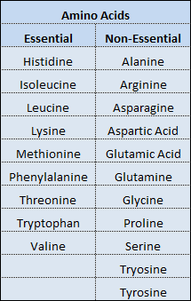
Essential vs. Non Essential Amino Acids

Slide 26
Protein
The quality of a protein is determined by its ability to provide the 9 essential amino acids.
Proteins from animal sources (eggs, dairy, meat, poultry, and fish) and one vegetable protein (soy) are all considered high-quality because they contain all of the essential amino acids in the necessary proportions.

Slide 27
The Function of Protein
Build and maintain tissues
  Protein makes up about 18-20% of your body
  Is a necessary part of every cell (needed to form the structure of muscles, organs, skin, blood, hair, nails and every other body part).
  Skeletal muscle accounts for more than half of body protein
Make important compounds
  Body uses proteins to make enzymes, some hormones, and antibodies (defence against infection and disease)
Regulate mineral and fluid balance
  Proteins help carry the minerals sodium and potassium from one side of cell walls to the other (keeps a balance of fluid inside and outside the cell)

Slide 28
The Function of Protein
Maintain acid-base balance
  Maintenance of the correct level of acidity of a body fluid
    Proteins in the blood act as chemical buffers (counteract an excess of acid or base in a fluid)
Carry vital substances
  Used to transport lipoproteins (protein linked with fat), iron, and other nutrients, as well as oxygen, chromosomes, and other bundles of protein to other parts of cells
Provide energy
  Provides the cells with the energy they need to exist
    If carbs and fats are lacking, the body uses protein as an energy source

Slide 29
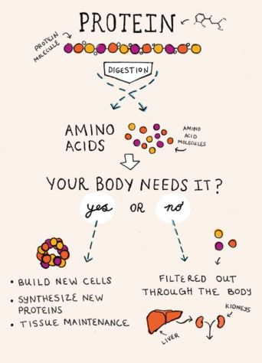
Protein in the Body
When you consume protein food,
acids in the stomach start to denature
the proteins
Once the proteins are broken down
into their simplest form the amino
acids are then carried in the blood
stream to the parts of the body they
are needed.

Slide 30
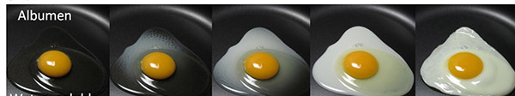
Denaturation of Protein.
The protein we consume can be altered and changed but can never return to its initial form. This is called denaturation. This can be seen when we add heat to an egg (it changes from a runny fluid to a solid mass). The shapes of the protein molecules in these foods have changed.
  Factors that cause denaturation:
  Heat
  Acids
  Bases
  Alcohol

Slide 31
How Much Protein Do You Need?
Protein is not stored in the body
Quantity depends on:
  Age
  Gender
  Body Size
  State of Health
RDA is 60 grams/day Adult males, 55 g/day for females
  1.0 grams of protein per kilogram of body weight

Slide 32
RDA for Protein in different Age Group
Group | Age | Body Weight (Kg) | Protein (g/d)
Men | Adult | 60 | 60
Women | Adult | 55 | 55
Infant | 0-6 months | 5.4 | 1.16g/Kg/Day
 | 6-12 months | 8.4 | 1.16g/Kg/Day
Children | 1-3 Years | 12.9 | 16.7
 | 4-6 Years | 18.0 | 20
 | 7-9 Years | 25.1 | 29.5

Slide 33
RDA for Protein in different Age Group
Group | Age | Body Weight (Kg) | Protein (g/d)
Boys | 10-12 Years | 34.3 | 39.9
Girls | 10-12 Years | 35.0 | 40.4
Boys | 13-15 Years | 47.6 | 54.3
Girls | 13-15 Years | 46.6 | 51.9
Boys | 16-17 Years | 55.4 | 61.5
Girls | 13-17 Years | 52.1 | 55.5

Slide 34
Who needs more protein?
  Growing youth and teens
  Pregnant & Breast Feeding Women
  Teen & Adult Males
  Individuals with Lean Muscle
    Large, tall person in comparison to a small, short person
  Ill and Injured People to build antibodies and rebuild damaged tissue

Slide 35
Protein Needs
Balanced Diet
  Focus on Carbohydrates: 60 – 65%
  Fats: 20 – 25%
  Remaining calories are adequate for Protein: 10 – 20%
Avoid dehydration
Consume low-fat sources of protein
Use low-fat cooking methods: grilling, baking, & poaching

Slide 36
Food Sources of Protein
Proteins in the diet can be provided from both animal and plant sources.
Factors that influence peoples protein choices:
  Availability
  Health Concerns
  Food Preferences
  Religious Beliefs
  Environmental Factors

Slide 37
Food Sources of Protein
Animal Sources of Protein
  The largest source of protein.
  Beef, Lamb, Poultry, & Fish.
  Other: Eggs, Milk, Yogurt, and Cheese
Meat is an excellent source of protein but can be high in fat, the same is true for dairy.
  57% of calories in ground beef come from fat
  Mostly saturated
  No fiber
Considerably more expensive

Slide 38
Food Sources of Protein
Plant Sources of Protein
  Can be found in grains, nuts, seeds, and legumes
    Legumes capture nitrogen making them more protein dense: peanuts, black-eyed peas, kidney beans, black beans, lentils, chickpeas, and lima beans
  Soybeans are a type of legume that can be converted to form different types of food products – meat alternative

Slide 39
Food Sources of Protein
Protein Quality: the amount and type of protein can vary greatly, some are better than others
Complete Proteins
  Meat, Poultry, & Fish (Animal Sources)
  Very high
  All Indispensable Amino Acids are present
Incomplete Proteins
  Plant Sources
  Lower Quality
  Missing or short in one or more of the indispensable Amino Acids.

Slide 40
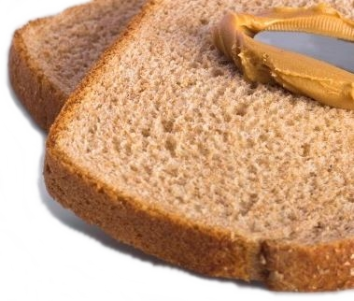
Food Sources of Protein
Complementary Proteins: Two or more incomplete proteins that can be combined to provide all the indispensable amino acids.
  Must consume more to get what is needed
  Only focusing on incomplete protein is harmful
The right combinations:
  Grains, nuts, or seeds with legumes.
  Peanuts (legumes) and wheat (grain)=complete protein
  Add complete protein sources (meat)

Slide 41
Protein Deficiency: IN ADULTS
PEM in adults leads to loss of body weight, some forms of anemia, lethargy, nutritional edema and delay in wound healing.

Slide 42
Protein Deficiency: IN CHILDREN
Protein- Energy Malnutrition (lack of calories and protein in the diet).
Kwashiorkor Marasmus
Intake of calories is adequate, protein is deficient
Deficiency of both calories and proteins present

Slide 43
Protein Deficiency: KWASHIORKOR
Causes
• The main causes of this grave nutritional problem in India are the socioeconomic factors like poverty, illiteracy, religious and cultural beliefs, customs, ignorance about weaning and supplementary feeding. • Kwashiorkor is seen mainly in the children of 1-5 years age group. They are weaned early from breast milk and their diet is replaced by predominantly starchy foods, which are deficient in proteins. In some areas, owing to the gender bias, many girl children get less quantity of food.

Slide 44
KWASHIORKOR
Symptoms of Kwashiorkor
• Retarded growth Stunting Muscle wasting
• Oedema or swelling
• Loss of colour in skin and hair
• Diarrhoea

Slide 45
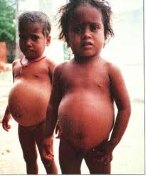
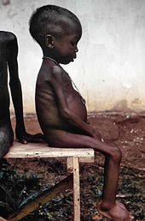
KWASHIORKOR
  In poor countries it can occur when the next sibling is born and the older sibling is no longer receiving protein-rich breast milk and starts a diet that is much lower in protein
Child suffering from Kwashiorkor:
  Does not reach full growth potential
  Bloated abdomen
  Skinny arms and legs
  Fluid imbalance resulting in death from simple illnesses.

Slide 46
Protein Deficiency
Marasmus: wasting disease cause by a lack of calories and protein
  Most often affects infants
  Muscles and tissues of these children begin to waste away
  More susceptible to infection and disease.
  Suffering from starvation

Slide 47
Over Consumption
High protein diets are more common in the west than in India, as it is predominantly a nation of cereal eaters. However, a high protein diet may lead to renal insufficiency.
It increases loss of calcium through urine leading to a risk of osteoporosis.
Animal proteins when taken in excess may cause high cholesterol as they are rich in saturated fats.

Slide 48
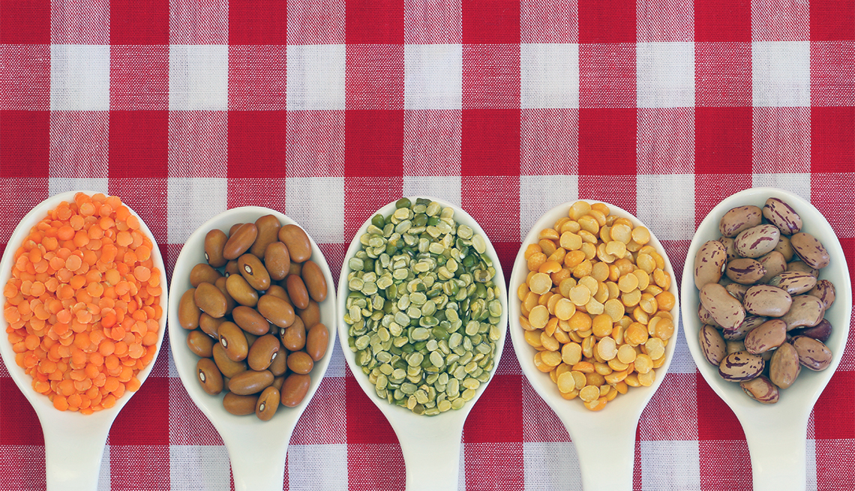
THANK YOU

