Slide 1

Fats : Fads and Facts
Dr. Meghana Patel
Assistant Professor
Dept. of Clinical Nutrition and Dietetics
SVDU

Slide 2
Learning Objectives
Differentiate between types of dietary fats
Critically analyze popular fat-related dietary trends and fads
Assess the impact of dietary fats on health outcomes
Interpret current dietary guidelines and recommendations for fat intake
Apply knowledge to counsel individuals or design diet plans

Slide 3
LIPIDS
MADE UP OF...
Lipids are chains (polymers) made of monomers. The most common monomer of lipids is…
TRIGLYCERIDES
Notes:
3

Slide 4
LIPIDS
AT THE ATOM LEVEL
Each carbohydrate is made up of…
Carbon, Hydrogen, and Oxygen
THINK: “CHO”
Notes:
4

Slide 5
NO CHO!
Lipids like Carbs?
We have noticed that both carbohydrates and lipids have the elements Carbon, Hydrogen, and Oxygen.
“CHO”
A carbohydrate, has twice as many hydrogen atoms as the number of oxygen atoms.
EX: C₆H₁₂O₆
(This is a carb= there are double the number of H compared to O)
On the other hand, lipids have a lot more than twice the amount hydrogen atoms as the number of oxygen atoms.
EX: C₂₇H₄₆O cholesterol

Slide 6
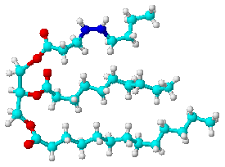
The Shape of a triglyceride is like the letter
E
This is a triglyceride molecule
Notes:
6

Slide 7
Fat Is…
The most concentrated source of food energy.
1gm of fat gives 9 kcals.
Fats that are liquid at room temperature are called oils.
(Examples: vegetable oil, canola oil, olive oil, etc.)
Fats that are firm at room temperature are called solids or saturated fats.
(Examples: lard, butter, shortening, etc.)

Slide 8
Fats that are solid at room temperature are made up mainly of saturated fatty acids.
Fats that are liquid at room temperature are made up mainly of unsaturated fatty acids.

Slide 9
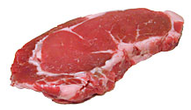
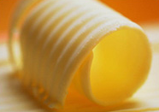
Visible Fat
Fat that is easily seen
Examples: Butter on a baked potato, layer of fat around a pork chop etc.

Slide 10
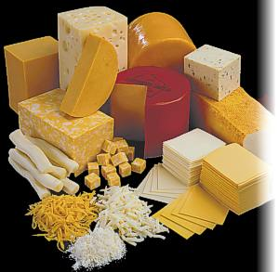
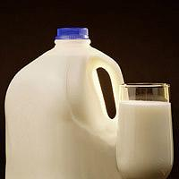
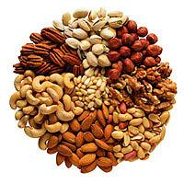
Invisible Fat
Fat that cannot be detected by the eye
Examples: whole milk, some cheese, egg yolks, nuts, avocados, etc.

Slide 11
Functions of Fat
Supplies Energy
Carries Vitamins A, D, E and K through the body
Provides a reserve store of energy
Promotes healthy skin
Promotes normal cell growth
Acts like a “cushion”and heat regulator to protect your heart, liver and other vital organs
It helps you feel full longer
Adds flavor to food

Slide 12
LIPIDS
WHAT DO THEY DO?
They are a great source of STORED ENERGY so we have it in the future.
They INSULATE the body to maintain normal body temperature and they CUSHION the internal organs for protection.
They produce hormones for the body called STERIODS
They waterproof surfaces of animals,plants, and fruits- these are waxes!
THINK: Waterproof, insulate, steriods, energy, cushion… “WISE C”
Notes:
12

Slide 13
LIPIDS
WHERE ARE THEY FOUND?
In plants- in the seeds
In animals- in adipose tissue, connective tissue, in animals
Notes:
13

Slide 14
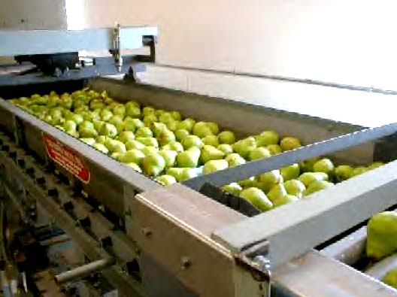

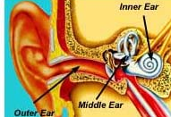
LIPIDS…Some interesting info
Waterproofing...
Fruits produce a waxy coating to keep from drying out.
Ear wax traps dust, sand, and other foreign particles from going deeper into the ear and causing damage.
Beeswax- a structural material to hold honey in the hive
Notes:
14

Slide 15
LIPIDS…Some info
Steriods...
There are many different types of steroids. They are all lipids. Their functions vary. Some common steroids are:
SEX STEROIDS ANABOLIC STERIODS
CHOLESTEROL
They increase muscle
Like testosterone and estrogen
Notes:
15

Slide 16
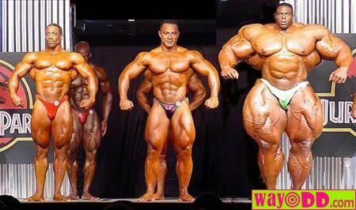

LIPIDS…Some info
Steriods...
Some anabolic steroids are illegal
And can be dangerous and
very unhealthy
NATURAL STERIODS IN OUR BODY INCREASE MUSCLE GROWTH AND BONE DEVELOPMENT AND ARE GOOD. THE ILLEGAL ONES THAT ARE SYNTHETIC ARE BAD.
Notes:
16

Slide 17

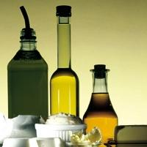
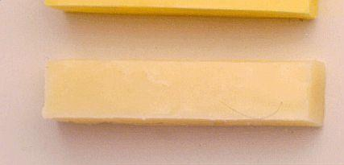
LIPIDS
OILS
BUTTER
MARGARINE
Notes:
17

Slide 18
Energy Gained from Lipids
Eating 1 gram of fat provides your body with 9 Calories.
Notice if you eat 1 gram of fat, you are gaining more than twice the amount of Calories than from a gram of carbohydrate or protein!
Notes:
18

Slide 19
ENERGY
So…
MACRONUTRIENTS | Number of Calories it provides
Carbohydrates | 4
Proteins | 4
Lipids | 9
TEST: If you eat a sandwich with 46 grams of carbs and 24 grams of protein and 10 grams of fat, how much energy will you gain?
Notes:
19

Slide 20
What is Cholesterol?
Cholesterol is NOT fat.
It is a “fat-like” substance present in all body cells that is needed for many essential body processes.
It contributes to the digestion of fat and the skin’s production of vitamin D.
Adults manufacture all the cholesterol they need, mostly in the liver.
All animals also have the ability to manufacture cholesterol.

Slide 21
Cholesterol In Foods
Because all animals make cholesterol, if you eat any animal product, including meat, poultry and fish, you will be consuming some “extra” cholesterol.
Other foods high in cholesterol are:
  Egg Yolk
  Liver / Organ Meats
  Some Shellfish

Slide 22
LDL’s and HDL’s
A certain amount of cholesterol circulates in the blood. It does not float through the bloodstream on its own, but in chemical “packages” called lipoproteins.
  LDL (Low-Density Lipoprotein)
  HDL (High-Density Lipoprotein)

Slide 23
Low-Density Lipoproteins
Takes cholesterol from the liver to wherever it is needed in the body.
If too much LDL cholesterol is circulating, the excess amounts of cholesterol can build up in artery walls.
This buildup increases the risk of heart disease or stroke.
Thus, LDL cholesterol has come to be known as “bad cholesterol.”

Slide 24
High-Density Lipoproteins
Picks up excess cholesterol and takes it back to the liver, keeping it from causing harm.
Thus, HDL cholesterol has come to be known as “good cholesterol.”

Slide 25
For most people, the amounts and types of fats eaten have a greater effect on blood cholesterol than does the cholesterol itself.
The fats found in food, such as butter, chicken fat, or corn oil, are made up of different combinations of fatty acids.

Slide 26
Types of Fat
Fatty Acids:
  Organic acid units that make up fat. There are three types…
    Saturated
    Polyunsaturated
    Monounsaturated

Slide 27
Saturated Fatty Acids
Appear to raise the level of LDL (“bad”) cholesterol in the bloodstream
  Food sources: meat, poultry skin, whole-milk dairy products, and the tropical oils-coconut oil, palm oil, and palm kernel oil.

Slide 28
Polyunsaturated Fatty Acids
Fats that seem to lower total cholesterol levels.
  Food sources: many vegetable oils, such as corn oil, soybean oil and safflower oil.

Slide 29
Monounsaturated Fatty Acids
Appear to lower LDL (“bad”) cholesterol and help raise levels of HDL (“good”) cholesterol.
  Food sources: olives, olive oil, peanuts, peanut oil and canola oil.

Slide 30
No more than 10% (22 grams) of the total fat should come from saturated fat
20% (44 grams) should be from monounsaturated and polyunsaturated fat sources
All fats include all 3 kinds of fatty acids, but in varying amounts.
Each type of fat has a different effect on cholesterol levels

Slide 31
Other “Essential” Fatty Acids
Linolenic Acid
Linoleic Acid
They are called “essential” because the body cannot manufacture them.
They must be supplied by food a person eats.
They are both polyunsaturated fatty acids.
They are found in the natural oils of plants and fish.
The body needs them for its basic functions, including production of various hormones.

Slide 32
When linoleic acid is obtained from diet it can be converted to both arachidonic acid and linolenic acid. Linoleic acid is commonly found in cold pressed oils, especially oils extracted from cold water fish and certain seeds.
Supplementation with EFAs appears to be useful as a treatment for certain neurological disorders. However, arachidonic acid may lower the seizure threshold. For that reason, it is important to consult a physician before starting a program of EFA supplementation.

Slide 33
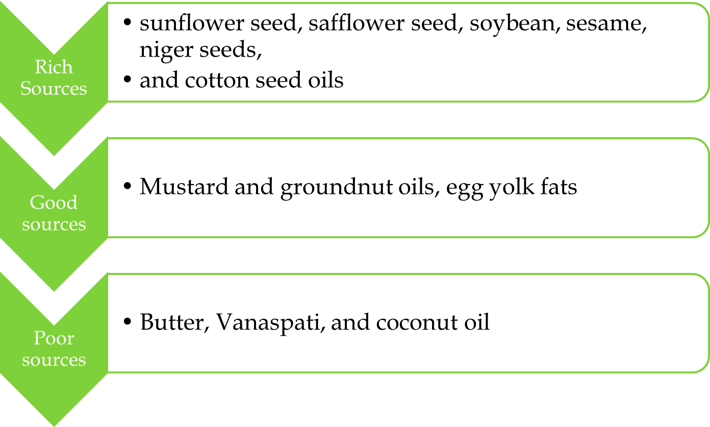
EFA content of oils:

Slide 34
Signs and symptoms of EFA deficiency
Dry skin
Scaly or flaky skin
Cracking/ peeling fingertips and skin
Lack luster skin
Small bumps on back of upper arms
Patchy dullness and/or color variation of skin
Mixed oily and dry skin
Irregular quilted appearance of skin
Thick or cracked calluses (hard skin)
Dandruff or cradle cap
Dry, lack luster brittle or unruly hair

Slide 35
Lipid in blood
Normal human plasma in the post absorptive state contains about 500 mg of total lipids of which about 120 mg are TG, 160 mg phospholipids, 180 mg cholesterol and about 10-15 mg free fatty acid.

Slide 36
High level of TG are associated with the occurrence of coronary artery disease in some people. However, when TG levels are exceeding high, the risk is not to the heart but to the pancreas gland which may become inflamed. This condition is called pancreatitis.

Slide 37
DEFICIENCY OF FATS
Deficiencies:
Deficiency of dietary lipids is very rare because they are widely distributed in foods. Deficiency of essential fatty acids and fat soluble vitamins.
Risk includes infants consuming low fat diet include anorexic nervosa, patients receiving lipid- free parenteral nutrition for long periods with malabsorption syndrome.
Infants:
Hansen and coworkers have reported that infants fed on a EFA deficient diet developed perianal irritation and skin changes such as dryness, etc within a few weeks. Supplementation of the diet with linoleic acid cured the condition.

Slide 38
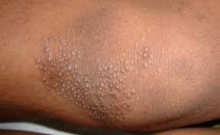
Adults and children:
Recent studies by Gopalan and associated in India have shown that phrynoderma in adults and children is cured rapidly by the administration of linseed or safflower seeds oil rich in essential fatty acids along with vitamin B2 complex and not by vitamin A.

Slide 39
Hypercholesterolemia and coronary heart disease
The following factors influence the serum cholesterol level
1) calorie intake
2) cholesterol intake
3) Fat intake
4) essential fatty acid content in the fat
Low calorie intake tend to reduce while calorie excess tends to increase serum cholesterol levels.
The dietary intake of cholesterol may vary from 500 mg to 1200 mg depending on the quantity of milk, butter, eggs, meat and fish in the diet.

Slide 40
An adult human body synthesizes daily about 2000 mg cholesterol.
Saturated fats viz, animal body fats, butter, coconut oil and hydrogenated fats tend to increase markedly the serum cholesterol levels while fats rich in essential fatty acids, viz sunflower seeds, safflower seeds, sesame seeds, soybean niger seeds and cotton seed oils and fish oils tend to reduce the serum cholesterol levels.
When the blood cholesterol level is over 250 mg /ml, the incidence of atherosclerosis and coronary heart disease is high.

Slide 41
Overconsumption
Over consumption of fats is associated with increased risk of certain chronic diseases, like, obesity, heart diseases, certain types of cancers etc.
i) Obesity: Obesity results from a chronic imbalance between energy intake and energy expenditure. reasons are;
Fat is more concentrated form of energy than carbohydrates and proteins.
Obesity can also lead to type II diabetes mellitus and heart diseases.
Body has the capacity to increase the utilization (oxidation) of carbohydrate and protein whenever their intake is high. But, body can not do so during high fat intake

Slide 42
ii)Coronary heart disease:
Development of atherosclerosis and coronary heart diseases
Dietary cholesterol increases total and LDL-cholesterol
Poly unsaturated fatty acids lower the levels of total and LDL-cholesterol and hence beneficial effect on CHD.
iii) Cancer
High fat diet increase the risk of colon cancer and breast cancer. They may promote, not cause cancers.

Slide 43
Treatment of high TG level
Lifestyle changes are the most important aspect of treating high TG levels and often the changes alone are sufficient to bring TG levels back to normal.
Reduce weight. Ideally keep the body mass index between 20-25. The body mass index is the ratio of your weight in Kg to your height in meters squared. Weight (in kg)/ht (in meters).
Do not take excess quantities of carbohydrates
Reduce saturated fat and cholesterol content in the diet.
Cut down alcohol intake considerably .
If you suffer from very high TG levels, it is best to avoid alcohol entirely.
Regular exercise helps clear TG levels.

Slide 44
Hydrogenation
The process in which missing hydrogen atoms are added to an unsaturated fat to make it firmer in texture.
This forms a new type of fatty acid called trans fatty acid.
Trans fatty acids have many of the same properties as saturated fats.

Slide 45
High fat diets are linked to…
Heart Disease
Obesity
Cardiovascular Problems

Slide 46
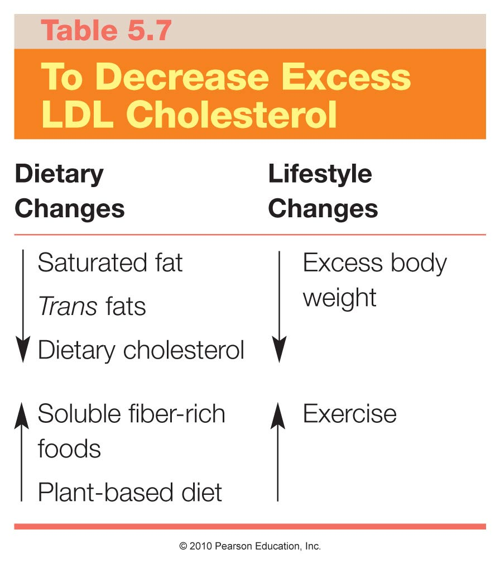

Slide 47
Lowering Fat and Cholesterol in the Diet
Consume less saturated and trans fats
Make smart, informed food choices
  Avoid or consume processed food in moderation
  Eat at least two servings of fish per week
  Consume more plant foods
  Consume antioxidants and phytochemicals
  Garlic may help lower cholesterol

Slide 48
Lowering Fat …
Exercise
Steam, boil or bake foods instead of cooking them in oil or fat
Increase intake of fibre rich foods -whole grains,pulses ,fruits /vegetables

Slide 49
Thank You

