Slide 1

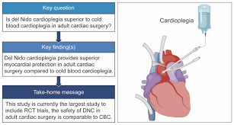
Myocardial protection
During CPB
Malavika M.
Clinical Perfusionist and Tutor
Dept. of Paramedical Sciences
Sumandeep Vidyapeeth Deemed to be University
(Accredited by NAAC with A++ Grade and
Conferred with UGC Category I Status)
Vadodara, Gujarat, INDIA.

Slide 2
Learning objectives
Understanding the goals, techniques, and strategies to minimize myocardial injury during Cardiac surgery.
Reducing myocardial oxygen demand, maintaining cellular integrity, preventing reperfusion injury, and ensuring adequate substrate delivery.
Understanding the mechanisms of ischemic and reperfusion injury, the role of cardioplegia

Slide 3
Introduction
Myocardial protection is the " strategies" and methodologies used to reduce or prevent post ischemic myocardial dysfunction during and after CPB.
Or
The need to protect the myocardium from intraoperative damage predates the availability of CPB.

Slide 4
Goals
There are three main goals for myocardial protection
Protect the myocardium against ischaemic injury
Provide motionlees , blood less ﬁeld, surgeon can easily repair the defect
Allow effective post ischaemic myocardial resuscitation

Slide 5
History
1950- Bigelow et al. Ann surg.on hypothermia.
" A form of anesthetic" that might permit surgeons to operate on the bloodless heart without recourse to extracorporeal pumps.
1955- Melrose et al. reported method of stoping heart.
Injected potassium citrate into the root of aorta.

Slide 6
Clinical use potassium citrate to chemically arrest the heart became widespread and term " cardioplegia".
1957- This term was ﬁrst used by Lam et al.
1976- Hearse et al. Studied various components of cardioplegia solution developed St. Thomas solution.
Composition based on Ringer's lactate + potassium chloride and magnedium chloride.

Slide 7
Cardioplegia
Cardioplegia means " paralysis of the heart". Actions of ingredients of cardioplegia solutions Ingredients. Actions
Potassium. - Electromechanical arrest
Sodium. -
prevents edema and intracellular build.
Up.
Membrane stabilization and prevents intracellular calcium buildup
Increases pH Increases pH
Increases osmolarity to prevent edema
Increases osmolarity to prevent
Calcium. -
.
Bicarbonate. - Tromethamine. -
Glucose.
Mannitol. edema

Slide 8
Composition of common cardioplegia solution
High potassium. Low potassium
KCL. THAM. MgSO4.
100 mmol/ l.
12 mmol/ l.
9 mmol/ l.
30 mmol/ l
12 mmol/ l
9 mmol/ l 250mmol/
Dextrose. 250 mmol/ l.

Slide 9
Blood and crystalloid cardioplegia
Blood cardioplegia with high potassium and relatively high hematocrit. Crystalloid, oxygenated crystalloid high sodium and low hematocrit.
Blood cardioplegia is the blood O2 carrying capacity greater than crystalloid.
Natural buffer - HB
Need potassium is higher than the crystalloid b/ c it will mix with blood. Rationing
Based on the patients clinical need the ratio of blood to cardioplegia solution may vary. 1:0 1:1 2:1. 3:1. 4:1. 5:1. & 1:1 1:2. 1:3 1:4. Etc
The ratio of blood yo cardioplegia delivered are determined by the roller head
Mostly given in the 4 : 1

Slide 10
Article
Cold blood vs crystalloid cardioplegia for myocardial protection
Zeng J etal. J cardiothorac vascular Anesth.2014
Objective. - The purpose of this article was to systemically review randomized controlled trails in which cold blood cardioplegia was compared with cold crystalloid cardioplegia for cardiac surgery.
Participants - Randomized controlled trails in a Hospital.

Slide 11
Result - The 12 included trails recruited a total of 2866 participants; 1357 patients received cold crystalloid cardioplegia, and 1509 patients received cold blood cardioplegia.
The aggregate data showed that the incidence of perioperative myocardial infarction was lower than who received cold blood cardioplegia.
Conclusions - No signiﬁcant difference b/ w cold blood cardioplegia and cold crystalloid cardioplegia
Cold crystalloid CP. - 76.75% Cold blood CP. - 75.41%

Slide 12
Routes
There are two routes for cardioplegia delivery
Antegrade Retrograde Antegrade
Antegrade cardioplegia administration is pumped through a cardioplegia cannula into the aorta between the cross clamp and the aortic valve
. A vent can also be used by Y- connector.
The cardioplegia enters the coronary arteries by the way of the right and left coronary ostia. The coronary are open completely when the aortic valve is closed in diastole.The full ﬂow of cardioplegia into the os. Is possible.
Myocardial temperature are monitored by some teams while others prefer to follow standard administration .
Those monitoring myocardial temperature may alter their administration if temp rise.
Temperatures in. the range of 10 - 15 ° C. Pressure - 50 - 120 mmHg
Flow. - 250 - 320ml/min

Slide 13
Advantage
Immediate arrest
disadvantage
Poor distribution in coronary patient Poor distribution in patient with AR Risk of ostl injury from direct perfusion

Slide 14
Retrograde
The retrograde administration techniques has increased as surgeon have become more skilled at placing the cannula in the coronary sinus. The cannula is placed through the right atrium into the coronary sinus. The cardioplegia cannula is best inserted after the venous cannula is placed to prevent dislodgement.
The cannula used has a balloon tip at the end of the cannula to hold in the coronary sinus.
This line is connected with high pressure monitoring line to a transducer.
A sudden drop in pressure usually indicates that the cannula has become dislodgement.
Retrograde administration may not protect the right of the heart due to the right coronary vein draining into the right atrium and not the coronary sinus.

Slide 15
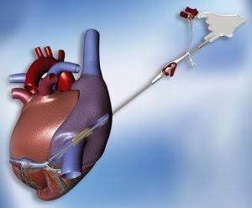

Slide 16
Valve surgery is another problem that this technique has improved. The method formerly used for aortic valve surgery required that the cardioplegia be directed into the coronary is.This was because the aorta was opened.
Advantage
Distribution of CP to region s supplied by occluded vessels
Flushing the air
Improved subendocardial CP delivery
Disadvantage
Shunting of CP into ventricular cavities via thebesian channels.

Slide 17
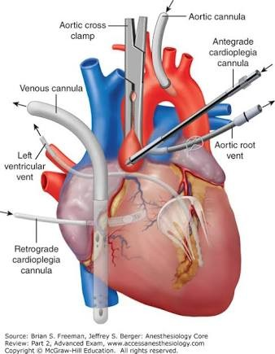

Slide 18
Article in The Annals of Thoracic Surgery
Myocardial protection during
antegrade vs retrograde cardioplegia
Paivi K Kaukoranta MD.......Keijo J peuhkurinen MD, PHD Abstract
Background - It has been suggested that the right ventricular myocardium is protected during retrograde blood cardioplegia
Methods. - Two groups ( n = 18) undergoing an elective coronary bypass procedure were randomized to receive antegrade or retrograde mild hypothermia blood cardioplegia. Trans ventricular differences in O2 extraction, lactate production, pH were monitored during aortic cross clamping and 15 min after aortic declamping andfor analysis of adenine nucleotides and their breakdown products.

Slide 19
Result. - The perioperative characteristics 2 groups were similar O2 extraction and lactate production in the right ventricular myocardium were higher in the retrograde group than antegrade group.
Conclusions. - Retrograde mild hypothermia blood cardioplegia leads metabolic changes compatible with ventricular ischemia.

Slide 20
Cardioplegia delivery system
Many different cardioplegia delivery system are used today. Almost all the systems allow delivery of warm and cold solutions and allow the mixing with blood. The system also allow the monitoring of the infusion line pressure.The system should have the ability to deliver all crystalloid solution or all blood .
The ratios of blood to cardioplegia delivered are determined by the size of the tubing through the roller head.
Blood cardioplegia in a 4:1 ratio has a larger tubing supply the blood while the smaller tubing supplies the crystalloid solution.
Sol
8 - 20 meq/ l potassium Magnesium
Carrier Crystalloid Blood

Slide 21
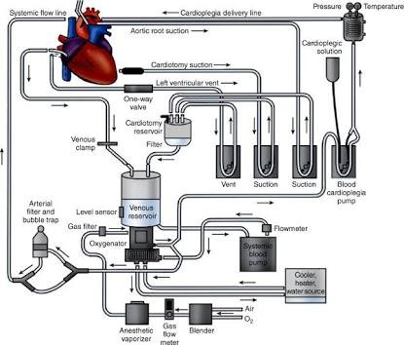

Slide 22
Types
Normothemic- must be transduced continuously Hypothermic- intermittent infusion
Delivery Antegrade Retrograde Antegrade
Antegrade route deliver cardioplegia into the coronary arteries by the way of the right and left coronary ostia.
The heart is arrested in diastole and full ﬂow of cardioplegia into the ostia is possible. Flow. - 250. - 340 ml/ min
Pressure. - 50 - 120 mmhg
Conditions inﬂuence the. ﬂow of cardioplegia delivery - Low ﬂow
Severe widespread coronary artery diseases
Small patient High ﬂow Large patient
Aortic incomppentence Cross clamp malposition

Slide 23


Slide 24
Retrograde
Retrograde cardioplegia deliver into the coronary sinus. The cardioplegia enters the coronary sinus and then ﬂows through the veins. Capillaries, arteries and then out of the coronary ostia into the aorta.
The cannula is placed through the right atrium into the coronary sinus
Flow - 200 ml/ min
Complication related to cardioplegia delivery system
Every Heart if clamped long enough will stop!
If the Heart Does not arrest declamp - a perfused heart is better than a badly plegged heart.

Slide 25
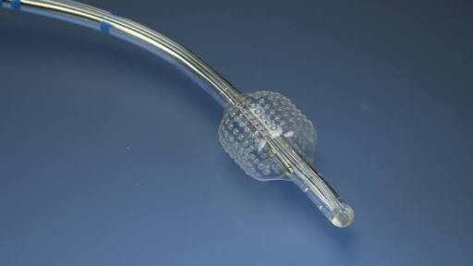

Slide 26
cardioplegia delivery systems can cause problems. These can be classiﬁed into -
Failure to add a sufﬁcient amount of potassium is the most common error when preparing cardioplegia solution These can be avoided by using commercial bags or ampoules, then heart will not arrest till exact time and heating cooling unit may also create a problem in the delivery
The heating cooling unit may fail and cardioplegia not be deliverd at the right temp.
That's why, A simple test is to feel the cardioplegia line during delivery

Slide 27
Cardioplegia deliver management
The Medtronic CSS cardioplegia safety system Model 990 consistsof an electro mechanical assists of the operator in the management if cardioplegia delivery.
The Medtronic CSS cardioplegia safety system used to management of cardioplegia delivery because it contains display.
The display shows running total of solution volumeinfused
And provide both numeric and graph representation. Alarms and alerts are presented and audibly. And the battery offer 60 minute of " on" time and 15 min of pumping time.The15;minutes pumping time is typical time of cardioplegia delivery during bypass surgery.

Slide 28
Spectrum of myocardial injury
Acute Ischemic dysfunction
Ischemia causes predictable dearangement of myocardial function and myocyte metabolism.
Depletion of high energy phosphate accumulation of lactic acid.
Intracellular calcium overload

Slide 29
Necrosis
Irreversible
Hypercontracture:- " Contracture band necrosis", stone heart.
Lysis

Slide 30
Hibernating Myocardium
Moderate and persistent reduction in myocardium blood ﬂow causes diminished regional contraction. Inadequate calcium level in cytosol during each heart beat
Stunned Myocardium
In stunned myocardium severe reduction in blood ﬂow due to function if the myocardium remain pair for a certain period despite reestablishment of ﬂow.
Contractility recover if the myocardium reperfuse before irreversible damage.

Slide 31
Approach to myocardial protection
Pre-op technique
Intra-op technique 3.post-op technique

Slide 32
Pre-op technique
1.increased oxygen supply 2.decreased oxygen demand 3.increased cellular potassium
4.promotion of glycolysis and gluconeogenesis

Slide 33
Intra-op technique
Limiting the duration Of CPB whenever possible. Longer bypass time increase organ damage and dysfunction
Perfusion pressure is easily controlled and should be maintained at adequate levels throughout CPB (50-70mmhg)

Slide 34
Post-operative technique
Cardiac protection extends into the post-operative period.
Optimizing rate, rythm,contractility and supply demand ratio.
Lung protective ventilatory stratigies.

Slide 35
Myocardial injury.....factors
Normothermic Ischemia
20 min.
40.min.
1 hour.
Reversible complete Half cell are necrotic Lethal all cell
Warm cardioplegia is used at the end of the surgery to better recovery of function
Warm cardioplegia concept introduced in 19980 s . warm induction with normothermic blood cardioplegia for for maintenance.

Slide 36
Strategies in myocardial protection
A variety of strategies for myocardial protection, which can be divided into. -
Chemically induced cardiac arrest in diastole, hyperkAlemic localized to the heart.
Hypothermia to decrease myocardial oxygen consumption.
Avoidence or reduction of myocardial edema by liimiting the pressure of cardioplegia and by providing hyperosmolar cardioplegia.
Emerging strategies
Therapies to avoid oxygen radical injury such as superoxide dismutase and xanthine oxidase inhibitiors.
Addition of adenosine to cardioplegia or reperfusion solutions.

Slide 37
Experimental strategies
These included stimulation of nitric oxide production, antineutrophil therapy, compliment pathway inhibition, hyperpolarizing agents, sodium - hydrogen exchange inhibitors, ishemic preconditioning, and strategies aimed at protecting the beating heart during CPB.

Slide 38
Thank you

