Slide 1
B 5.3 Pediatric Audiology
Unit 1: Auditory Development
Dr. Aparna Nandurkar
Professor
Dept. of Audiology and Speech Language Pathology
Sumandeep Vidyapeeth Deemed to be University
Vadodara, Gujarat

Slide 2
B 5.3 Pediatric Audiology
Unit 1: Auditory Development
Review of Embryology of the ear
Development of auditory system from periphery to cortex
Neuroplasticity
Prenatal hearing
Normal auditory development from 0-2 years
Infant speech perception
Incidence and prevalence of auditory disorders in children

Slide 3
a) REVIEW OF EMBRYOLOGICAL DEVELOPMENT OF THE EAR

Slide 4
References
Hearing in children. 6th edition. Northern JL & Downs MP. (2014). Plural Publishing Inc.
Speech and hearing sciences - Anatomy and Physiology. 3rd edition. Zemlin WR.
Comprehensive handbook of pediatric audiology. 2nd ed. Tharpe AM & Seewald R. (2017). Plural Publishing.

Slide 5
The word embryo has come from a Greek word meaning “to swell” and study of embryo is known as Embryology.
A developing baby during its first 8 weeks of gestation is known as embryo.
Major changes in the development of the ear take place in the mother’s womb, first as an embryo and later as a fetus. However development of auditory structures doesn’t stop nor is it totally completed at the time of birth.
Relevance to Audiology
An understanding of embryologic development & its relationship
helps the audiologist for early identification, intervention &
prevention.
The timetable of prenatal development & the association of the
various structures with each other helps the audiologist for raising
suspicion of deafness, its subsequent diagnosis & management.

Slide 6
Knowledge of the origins of auditory structures can be diagnostically significant to the clinician. Eg: An infant presents with a congenital skin disorder, anomalies of the cochlea could be present, as the skin and otocyst both originate from the structure called ectoderm.
The timing of development of the various organ systems guides the clinician about the occurrence of HL. Eg: A noxious influence occurring at 2 months of gestation may result in malformation of pinna that is developing at that time.
However, the pinna malformation doesn’t necessarily imply malformation of the middle ear ossicles, although they are also developing at the same time but the origins of the structures are different.
Prognosis of auditory function can be estimated from the origin & the expected pathology.

Slide 7
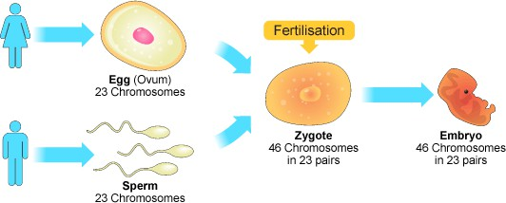
Basic Embryology
All growth is the the result of cell division of the pre-existing cell called zygote.
A zygote is a cell which is an ovum fertilized by sperm.
Ovum + Sperm cell
= zygote

Slide 8
This zygote/pre-existence cell gets divided into 2 main cells through the process called mitosis.
Thus mitosis results in the changes in the nucleus of a cell which produces a specific no. of double structures i.e the cell & nucleus then subdivided into 2 identical daughter cells.
Organization in the embryo stimulates development of associated areas & creates specific differentiation of cells during the developmental process.
One of the earliest organizational developments of embryo is the formation of 3 super-imposed cellular plates known as ‘germ layers’.
Each of these layers is also a key structure for development of the various portions & part of the ear & the auditory system.

Slide 9
Germ layer
Mesoderm
(Skeletal, Circulatory system, kidney, & reproductive system)
Endoderm
(Digestive canals, respiratory organs)
Ectoderm
(Outer skin layers, nervous system,& sense organ)

Slide 10
GERM LAYERS | STRUCTURES
Ectodermal Outer layer | It is associated with the development of outer & inner portion of the ear.
Mesodermal Middle layer | It is associated with the development of Middle ear ossicles &bony labyrinth.
Endodermal Inner layer | It is associated with the development of Middle ear structures other than ossicles such as Tympanic membrane , Eustachian tube, Middle ear muscles.

Slide 11
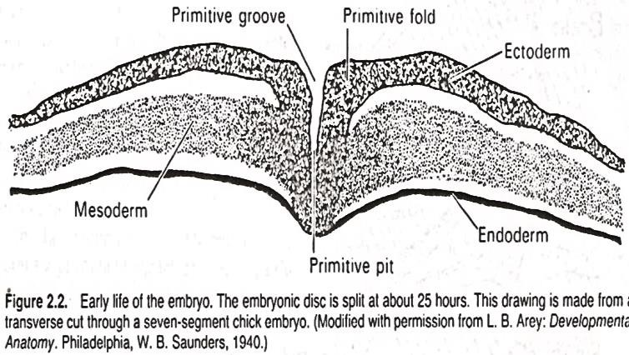
Embryology of the Ear
The ear begins its development during the early life of embryo, i.e at about 25 hours of the embryonic development, when embryonic disc splits & leads to the formation of a structure called primitive groove.
Primitive groove is underlined by ectoderm layer.
This primitive groove then further
develops into a structure called ‘primitive
pit’ which ultimately results to form the ‘neural groove’ & ‘neural fold’.
This neural fold along with the neural grooves come together to form a structure called ‘neural tube’.
This neural tube remarks the beginning of the ear development.
10

Slide 12
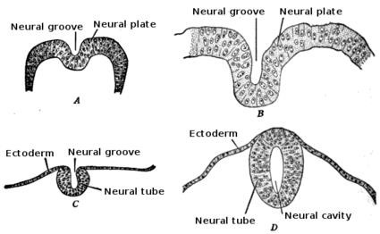

Slide 13
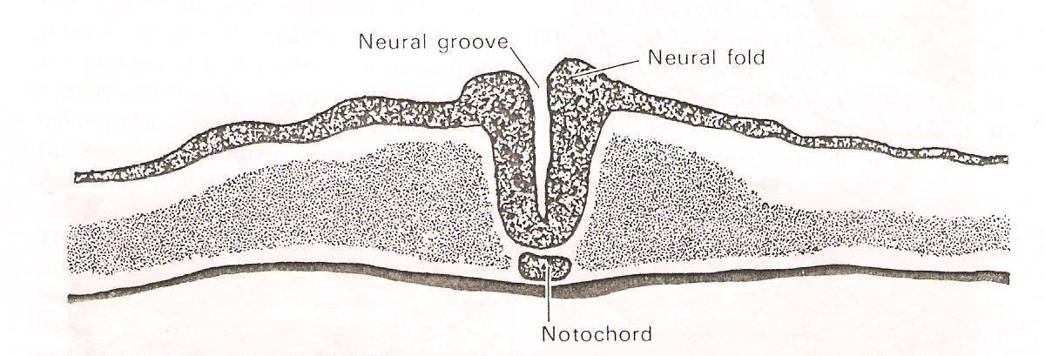

Slide 14
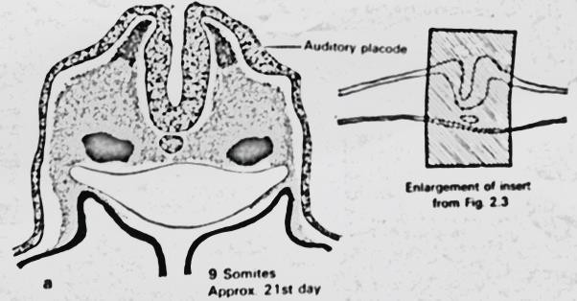
Development of the inner ear
The earliest demarcation of the ear in the human embryo occurs as early as in the 3rd week of gestation.
At this time there is thickening of the superficial ectoderm
on the either side of the ‘open neural plate’.
Each thickening are known as auditory/otic placodes which are the obvious by middle of 3rd week of gestation.

Slide 15
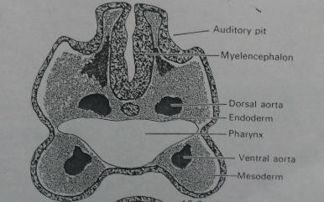
Around 23rd day of gestation, the auditory placodes get mixed with the surface ectoderm & forms auditory/otic pits.

Slide 16
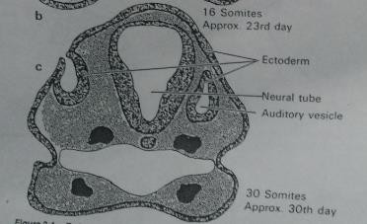
Around 30th day of gestation the mouth of each auditory pit closes off & forms a structure called auditory vesicle and otocyst which remarks the development of the inner ear.

Slide 17
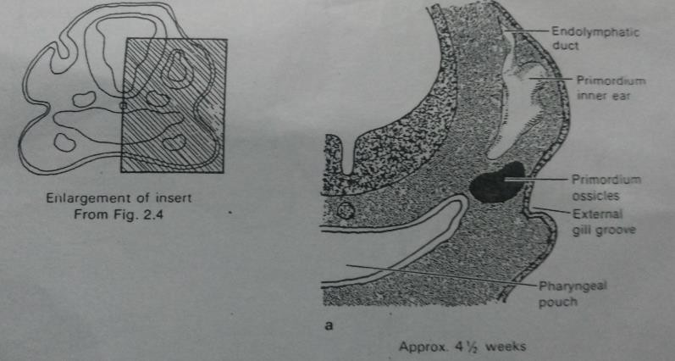
The auditory vesicle takes elongated shape which is divided into 2 parts i.e.
  Utricular-saccule area
  Tubular extension / Endolymphatic duct
By 4½ weeks of gestation, the portion of auditory vesicle get connected to the endolymphatic duct which is the future vestibular apparatus of membranous labyrinth, whereas there is more slender portion of the auditory vesicle begins to form the future cochlea which is originated from the saccular area.

Slide 18
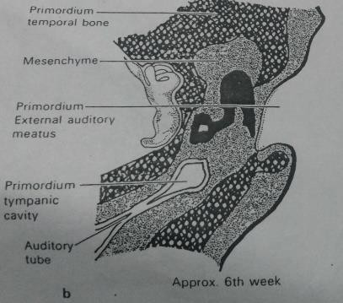
At the end of 6th week of gestation, 3 arch like pockets are visible which are destined to form future of 3 semicircular canal.
At the same time, utricle and saccule are developed as a part of vestibular portion of the auditory system.

Slide 19
By the end of the 7th week of gestation, the elongated portion of the saccule of the auditory vesicle completes one turn / one coil of the future cochlea.
The 2½ turns / 2¾ turns of cochlea get completed from 8-11th week
of gestation.
At this time, the cochlear duct gets attached to vestibular portion by means of narrow tube called ‘ductus reuniens’.
During 8-11 weeks of gestation, the cochlear division of the 8th nerve coils of the cochlear duct i.e. it supplies its fiber to the cochlear duct.
During the 7th week of gestation the bony labyrinth continue to developed into sensory end organs with the appearance of localized thickening of epithelium layers in the utricle & saccule.
Similar localized epithelial thickening in the ampullated ends of the semicircular canals during the 8th week of gestation.

Slide 20
This epithelium thickening shows the differentiation into 2 types of cell .i.e.
  Sensory cells with bristle like hairs (OHC & IHC)
  Supporting cells (Dieter cells)
However complete maturation of these cells in cochlea doesn’t occur until 5th month of gestation when entire cochlear duct results considerable growth & expansion.
The membranous labyrinth of the inner ear reaches its full adult configuration by the early part of the 3rd month of gestation.
At this time the otic capsule / bony labyrinth gets started / begins to ossify.

Slide 21
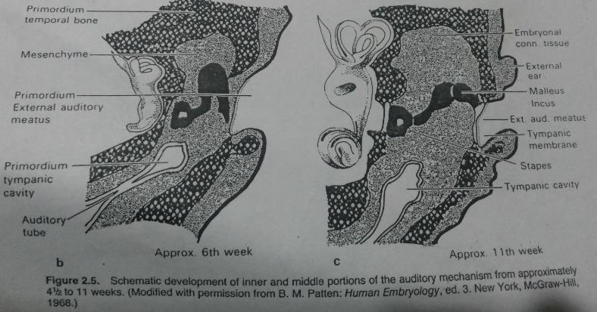
11th week of gestation :

Slide 22
Thus the inner ear is the only sense organ in the entire human body to reach full adult size & differentiation by fetal midterm means 5 months of pregnancy.
However it should be noted that, the cochlear portion of the inner ear is the last inner ear end organ to differentiate and mature.
Thus the cochlea may be subject to more possible developmental deviations, malformations, acquired disease than the vestibular end organs.

Slide 23
FETAL WEEK | INNER EAR
₃rd | Auditory placodes ;auditory pits.
₄th | Auditory vesicle (otocyst); vestibular cochlear division.
₆th | Utricle & saccule present; semicircular canals begin.
₇th | One cochlear coil present; sensory cells in utricle & saccule.
₈th | Ductus reuniens present; sensory cells in semicircular canals.
₁₁th | Two & one-half cochlear coils present; nerve VIII attaches to cochlear duct.
₁₂th | Sensory cells in cochlea; membranous labyrinth complete; otic capsule begins to ossify.
₂₀th | Maturation of inner ear; inner ear becomes adult size.

Slide 24
Development of the middle ear
During the time when the inner ear is developing, at the same time the transmission portion of the auditory mechanism is developed as the middle ear.
Middle ear develops from endodermal structure.
Middle ear cavity begins its development during the 3rd week of gestation, when the auditory pit is sinking into neural plate to become the auditory vesicle.
The tympanic cavity & auditory tube originate from an
elongation of the lateral superior edge of the pharyngeal pouch known as ‘tubo-tympanic recess’.
₁st

Slide 25
By that time, the human embryo is in its 4th week of gestation when a series of 5 branchial grooves known as “gill slits” have appeared.
These grooves are in the lower head & neck region on the outside of the embryo.
At the same time, on the inside of embryo a
corresponding series of 5 pharyngeal pouches develops & these structures collectively identified as ‘arches’.
In fish, these grooves are ultimately meets the
corresponding pouches to form gills as a part of their
respiratory mechanism whereas in humans one of the gill pouches does actually become perforated forming a passage way which becomes the external ear canal & the eustachian tube.

Slide 26
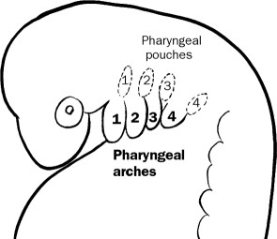
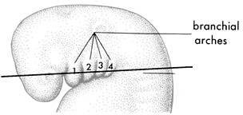
Pharyngeal pouches

Slide 27
The tympanic membrane forms a barrier between these 2 portions of the passage-way.
Occasionally , an
additional
opening will occur
forming a structure called
‘cervical
fistula’ or
‘branchial cyst’ which an opening on
the throat
between pharynx & the surface of the neck.
During the 2nd month, the tubo-tympanic
recess
approaches the embryo, surface between the 1st &
₂nd
branchial arches known as Meckel’s /
Mandibular
and Reichert’s /Hyoid cartilages,
respectively.
By the 8th week of gestation the tympanic cavity is developed in the lower half of the future middle ear, while the upper half is filled with ‘cellular mesenchyme’.

Slide 28
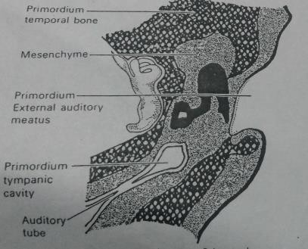

Slide 29
According to the classical theory of ossicles origin, malleus & incus develops from Meckel’s cartilage while stapes developed from Reichert’s cartilage.
According to Pearson et al (1970) suggests the most of the part of malleus & incus are originated from the 1st branchial arch while the lenticular process of the incus, the handle of malleus & the stapes originates from 2nd branchial arch.
Thus the middle ear cavity has a dual origin with the anterior area developing from the 1st arch while the posterior area from the 2nd arch.
The incus & malleus have attained a complete
cartilaginous form like an adult by 8½ weeks, whereas stapes attained the same by 15th week of gestation.

Slide 30
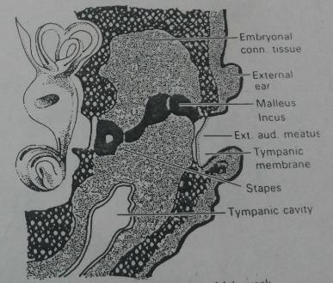

Slide 31
The ossification of malleus & incus begins by end of the 15th week of gestation & reach its completion by 32nd week of gestation.
However, the ossification of stapes begins by 18th week & it continue to develop further during the life.
As the ossicles begin to ossify, the surrounding mesenchymal tissue becomes loose, less cellular, & connects each ossicle to the walls of the middle ear cavity.
While the 30th week of gestation the development of the tympanum proper is almost complete.
The middle ear cavity with antrum is pneumatized during the last 34th to 35th week of gestation.
While the epitympanum is pneumatized during the last fetal
month 36th to 38th week of gestation.

Slide 32
FETAL WEEK | MIDDLE EAR
₃rd | Tubotympanic recess begins to develop.
₄th | 5 branchial grooves known as “gill slits” have appeared.
₈th | Incus & malleus present In cartilage; Lower half of tympanic cavity formed.
₉th | 3 tissue layers at tympanic membrane are present.
₁₅th | Cartilagenous stapes formed.
₁₆th | Ossification of malleus & incus begins.
₁₈th | Stapes begins to ossify.
₂₁st | Meatal plug disintegrates exposing tympanic membrane.
₃₀th | Pneumatization of tympanum
₃₂nd | Malleus & incus completes ossification.
₃₄th | Mastoid air cells develop.
₃₅th | Antrum is pneumatized.
₃₇th | Epitympanum is pneumatized; stapes continues to develop until adulthood; tympanic membrane changes relative position during 1st 2 yrs of life. ³¹

Slide 33
Development of the outer ear
2 main parts of outer ear i.e.
  Auricle / pinna
  External Auditory Meatus (EAM)
_{& 2}nd
Auricle develops from the 1st branchial
arches during the 3rd or 4th week of gestation.
The auricle is actually derived primarily from 2nd
branchial arch while only tragus seems to
originate from the 1st branchial arch.
This is occurring at the same time, when auditory vesicle is formed in the development of inner ear.

Slide 34
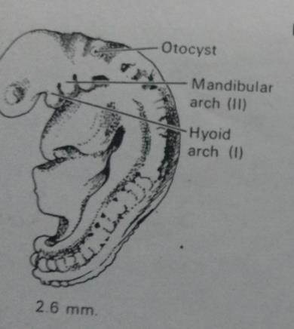

Slide 35
During the 6th week of gestation 6 hillocks or tissue thickenings form on both sides of the 1st branchial groove.
They are arranged as 3 hillocks on each facing border.
The ultimate shape & configuration of the adult auricle depends on the development of these 6th growth centers / hillocks.

Slide 36
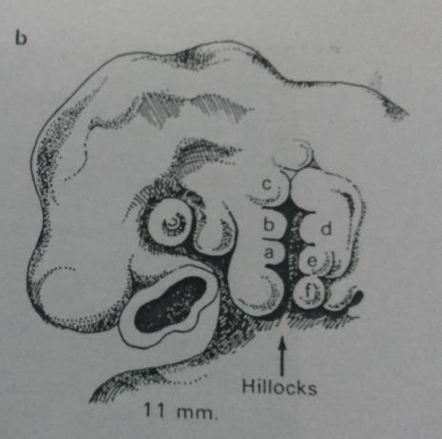

Slide 37
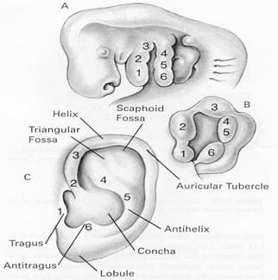

Slide 38
During the 6th week of gestation, the ‘mesenchymal folds’ of the auricle are beginning to become cartilage.
From the 7th to 20th week of gestation, the auricle moves from its original ventro-medial position to be slowly displaced laterally, so as get match to growth of mandible & face.
At the 20th week of gestation, the auricle attains an adult shape but continues to growth until the individual becomes 9 years of age.

Slide 39
The EAM is derived from the 1st branchial groove during 4th to
₅th
week of gestation.
At this time the ectodermal lining of the 1st branchial groove is
in brief contact with the endodermal lining of the
pharyngeal pouch.
₁st
Mesodermal tissue grows between this 2 layers & separate the pharyngeal pouch from that of branchial groove.
In the 8th week of gestation, the primary auditory meatus sinks towards the middle ear cavity & forms outer 1/3rd of auditory canal which is surrounded ultimately by cartilage.
The ectodermal groove continues to deepen toward the
tympanic cavity from the external surface until it meets a
thickening of epithelial cells known as the meatal plug which is developed from surface ectoderm.

Slide 40
Mesenchyme grows between the meatal plug and the epithelial cells of the tympanic cavity.
Thus 3 layers of tissues are formed which are combined to form the tympanic membrane.
These 3 layer includes ;
  The inner circular fiber layer
  Fibrous middle layer of tissue
  Outer radial fiber layer
These entire development occurred before 9th week of gestation.
The solid meatal plug keeps the external auditory canal closed until 21st week of gestation.

Slide 41
By this time the inner & middle ear structures are well formed & ossified.
The meatal plug disintegrates & forms a canal, with the inner most layer of epithelium which becomes the squamous epithelial layer of the tympanic membrane.
The EAM, continues to grow until the 9 year of age.
At birth the floor of the external auditory canal has no bony portion which develops after the birth till the age of 9 years.
Hence the EAC is short & straight in infants while in adult it is longer & curved.

Slide 42
FETAL WEEK | EXTERNAL EAR
₃rd | Auricle develops during 3rd to 4th week from 1st branchial arch gives rise to (tragus) and 2nd branchial arch gives rise to (auricle).
₄th | Tissue thickening begins to form.
₅th | Primary auditory meatus begins from 1st branchial groove
₆th | six hillocks evident; cartilage begins to form on both sides of the 1st branchial grooves.
₇th | Auricle move doroslaterally.
₈th | Outer cartilaginous to 1/3 rd external canal formed, ectodermal grooves deepens towards T.M gives rise to “Meatal plug” .
9th, 10th, 11th, 12th, 13th, 14th, ₁₅th_{, 16}th, ₁₈th | From 7th to 20th auricle continues to develop moving from its original Ventromedial position to be slowly displaced laterally by the growth of the mandible and face.
₂₀th | Auricle is adult shape but continues to grow until age 9.
21st and 30th | External auditory canal continues to mature until age 7.

Slide 43
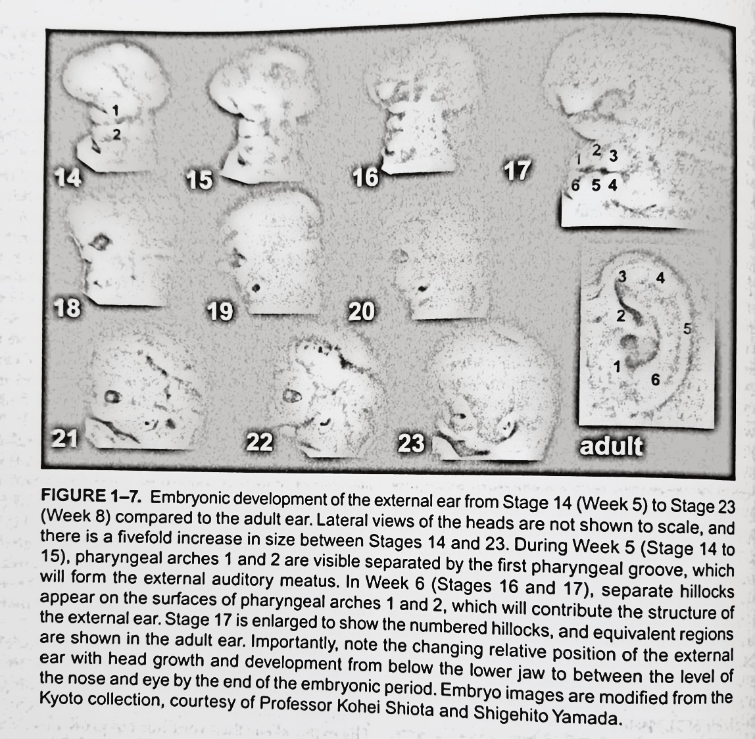
Ref: Comprehensive handbook of pediatric audiology. 2nd ed. Tharpe AM & Seewald R. (2017). Plural Publishing.

Slide 44
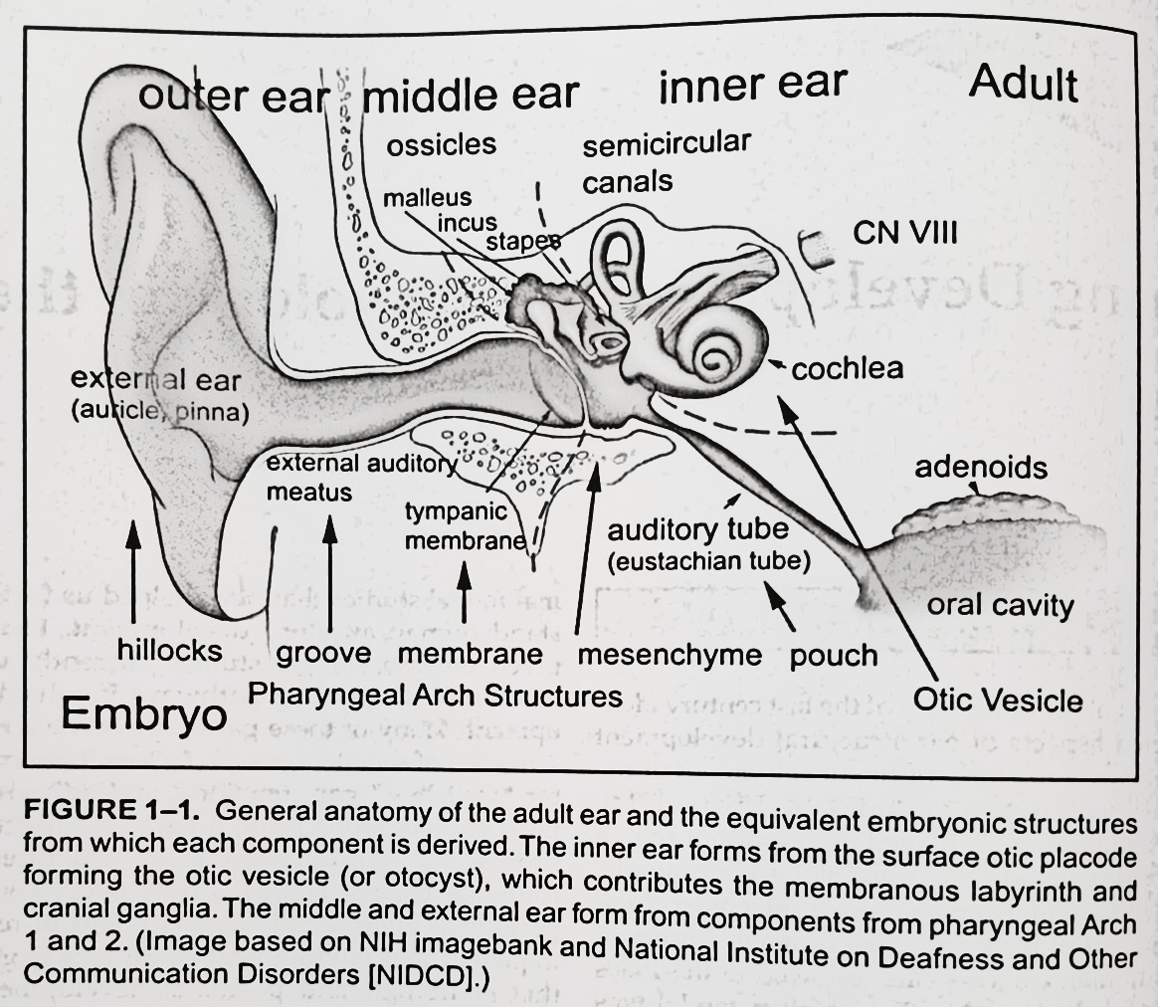
Ref: Comprehensive handbook of pediatric audiology. 2nd ed. Tharpe AM & Seewald R. (2017). Plural Publishing.

Slide 45
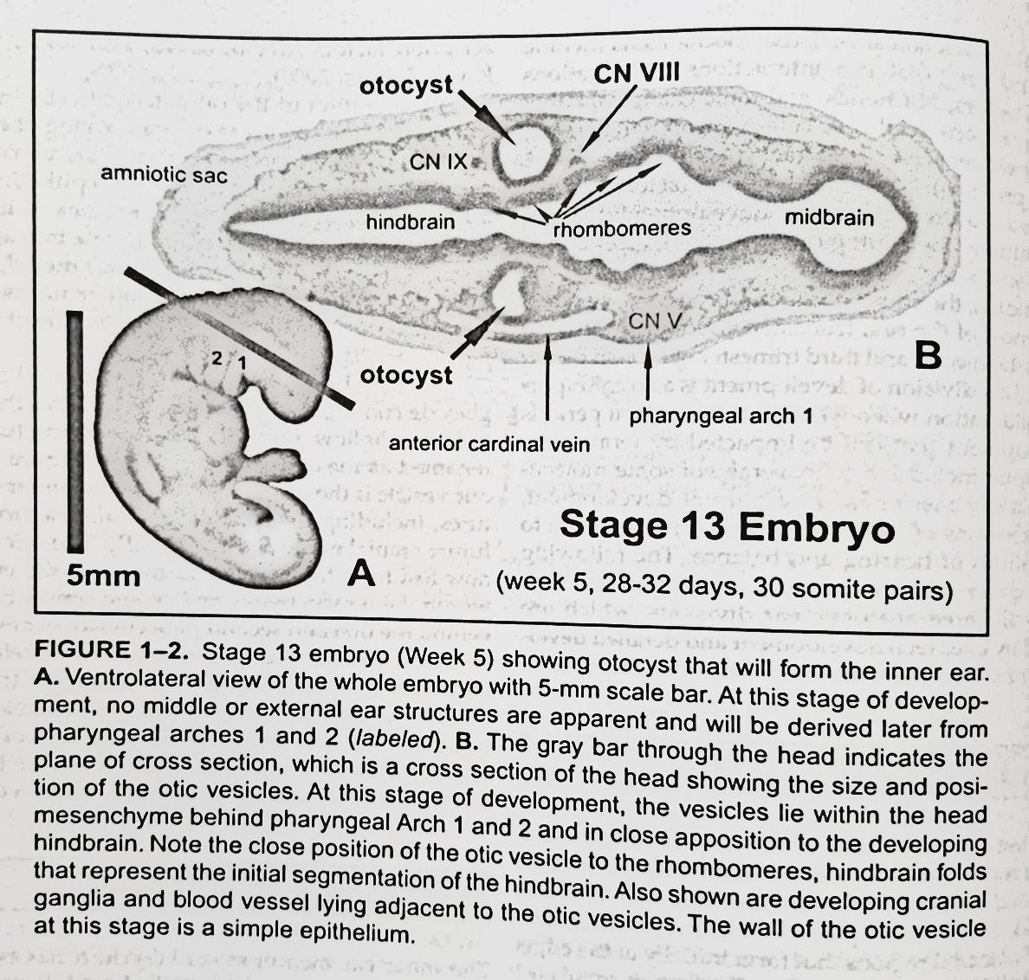
Ref: Comprehensive handbook of pediatric audiology. 2nd ed. Tharpe AM & Seewald R. (2017). Plural Publishing.

Slide 46
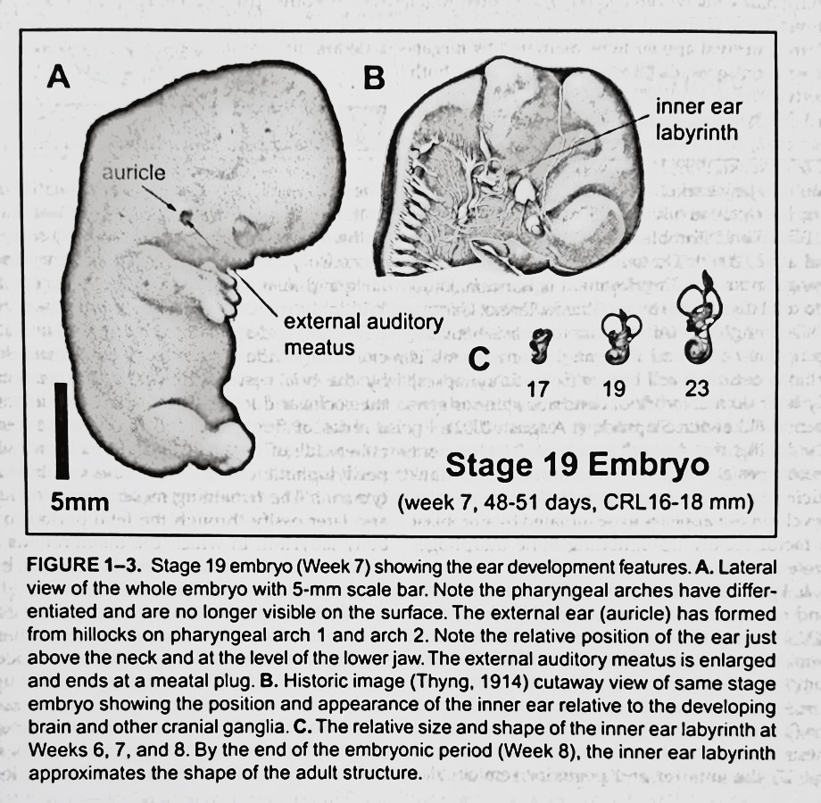
Ref: Comprehensive handbook of pediatric audiology. 2nd ed. Tharpe AM & Seewald R. (2017). Plural Publishing.

Slide 47
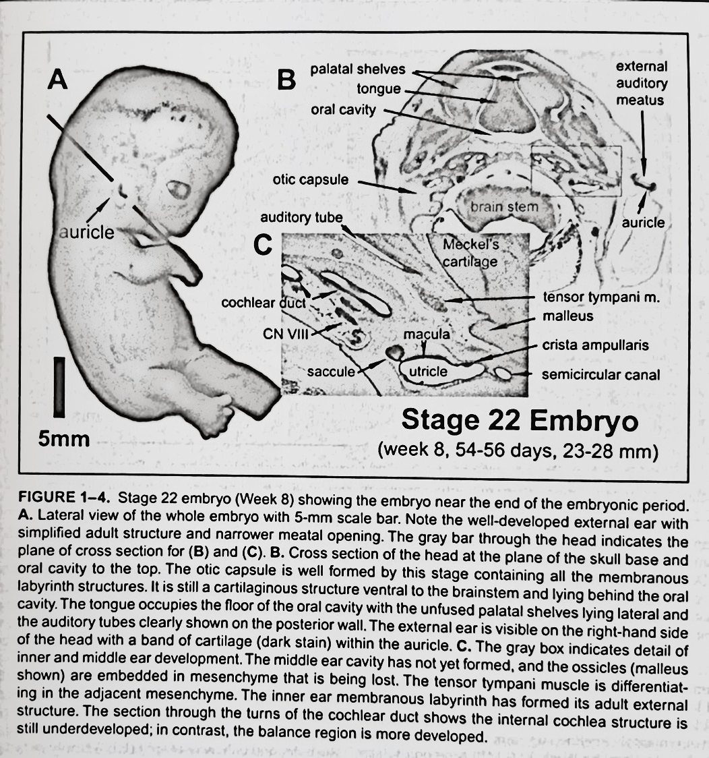
Ref: Comprehensive handbook of pediatric audiology. 2nd ed. Tharpe AM & Seewald R. (2017). Plural Publishing.

Slide 48
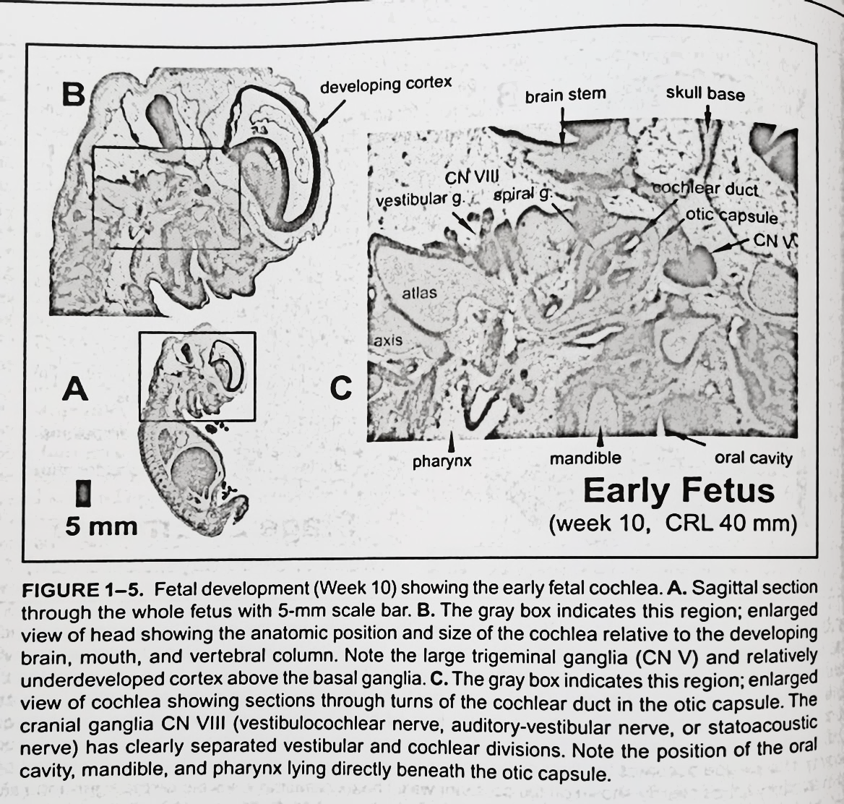
Ref: Comprehensive handbook of pediatric audiology. 2nd ed. Tharpe AM & Seewald R. (2017). Plural Publishing.

Slide 49
b) DEVELOPMENT OF AUDITORY SYSTEM FROM PERIPHERY TO CORTEX

Slide 50
References
Comprehensive handbook of pediatric audiology. 2nd ed. Tharpe AM & Seewald R. (2017). Plural Publishing.

Slide 51
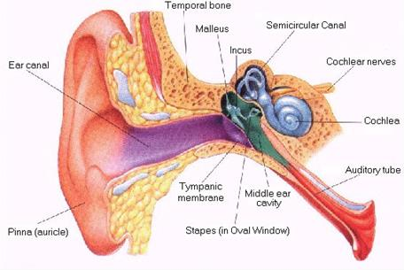
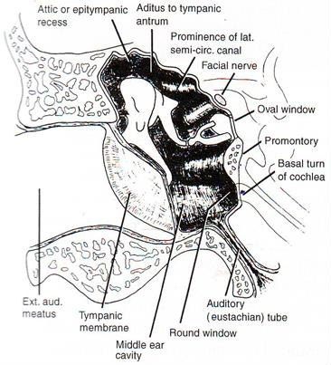
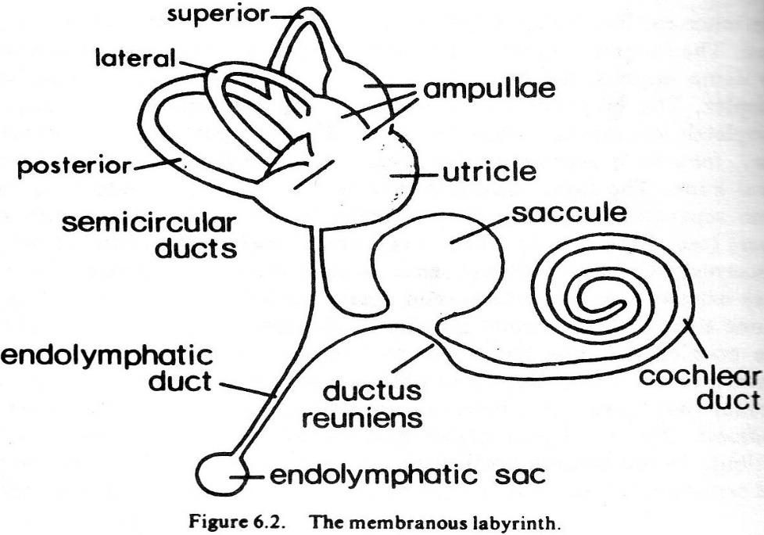
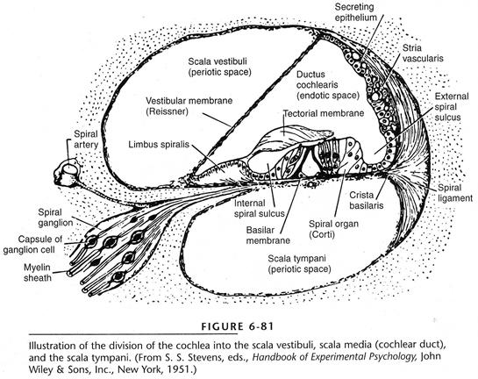

Slide 52
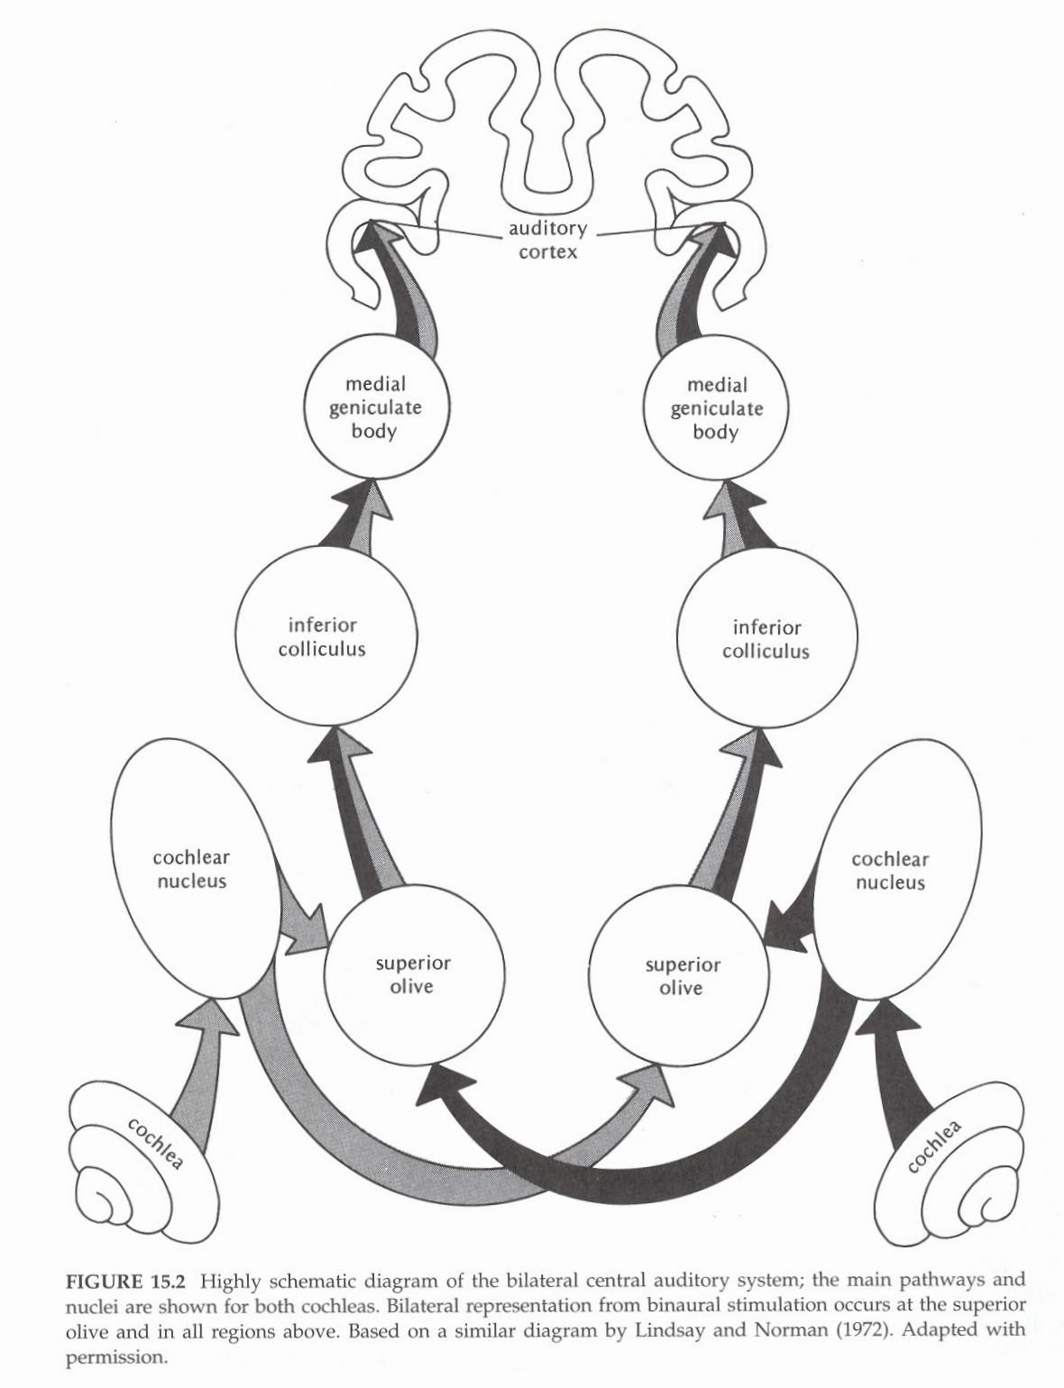

Slide 53
At birth, the human cochlea is fully developed; however, the central auditory pathways are not ready.
The CANS takes over a decade for its maturation and even after that plasticity and learning in some brain areas continues throughout life.
This information is important for a pediatric audiologist to understand the long-term impact of early impairment on the auditory brain and how a particular intervention or treatment will impact these developmental processes. E.g., importance of early detection and intervention, cochlear implantation in young deaf children.
52

Slide 54
No clear cut answer to when the auditory development begins and when it ends. This is determined by the patterns of neural activity in question…..if we consider simple patterns of neural activity in the primary auditory cortex, it might develop fully by 1 to 2 years, while development of more complex processing in the core auditory areas may end by puberty.
As higher levels of cortex are always “plastic”, the development of the auditory system never ends.
Auditory system development can be monitored by various test methods.
52

Slide 55
Early growth of auditory periphery
When cochlear hair cells start to differentiate within the otocyst (about 8 weeks) there is evidence of the formation of pre-synaptic structures.
Within a few weeks the hair cells form synaptic connections with cochlear afferent neurons.
Stereocilia are not fully developed and final maturation of tectorial membrane is incomplete.
Hair cell function in terms of transduction of mechanical stimuli is still not developed.
53

Slide 56
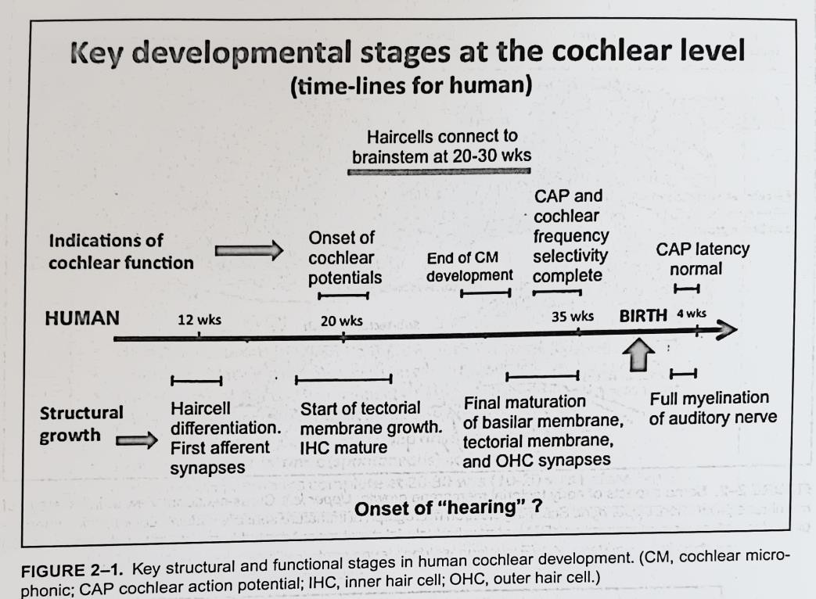
Summary of the developmental timelines for the human cochlea from conception to the neonatal period – structure and corresponding function.
Tectorial membrane maturation is a very important stage in the development of the cochlea.
IHCs and OHCs differentiate around 8 to 10 weeks post conception – well before the tectorial membrane has grown into position.
So, before this happens the HCs may transduce some mechanical signals but role of OHC as biomechanical amplifier and normal mode of stimulation of IHCs is not possible.
Hence, detection of low signals and cochlear frequency selectivity are not present until later stages of gestation.
54

Slide 57
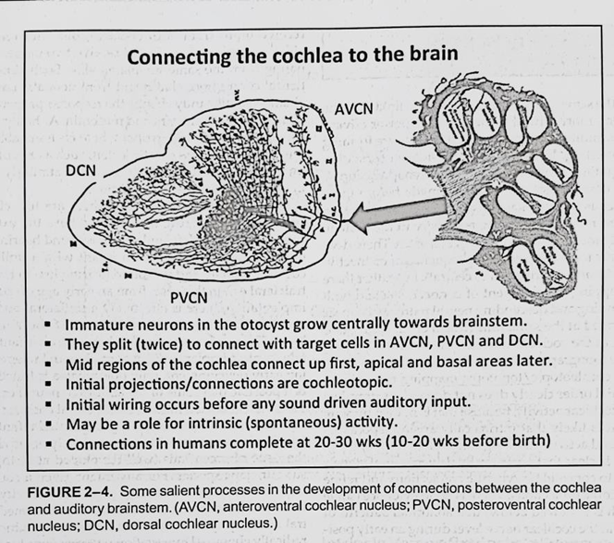
Connecting the cochlea to the brain
Human cochlea functions well before birth and cochlear afferent connections from HCs to the cochlear nucleus are also well established.
The auditory nuclei of the brainstem and mid-brain arise at about the same time as inner ear formation.
Steps summarized in the figure.

Slide 58
In humans, anatomic connections of cochlea to brain are complete at 10 to 20 weeks before birth and toward the end of that period there is evidence of some auditory function. E.g. ABR waveforms can be measured in 15-week premature infants and sound-evoked startle reflex seen at 24 to 25 weeks gestational age in utero.
The sensory epithelium of mid- frequency regions of the cochlea develop first, and connect with the brainstem. The development of more apical and basal areas follows later such that even 6 months after birth, high and low frequency thresholds continue to improve.

Slide 59
Central Auditory Pathway Development
During the same time that the cochlea is linking to the brainstem, more central
nuclei in the SOC, auditory midbrain and thalamus are forming and connecting.
In these locations, neuron formation and migration, axon out-growth and synaptic connections to other target cells are also made before there is any acoustic-driven activity.
Does not appear to be any particular sequence to the connectivity (e.g. peripheral to central), but there is overlapping development of connections, and both the ascending and descending neural pathways appear to be formed at the same time.
As is the case in the cochlear nucleus, more central connections are topographically organized so as to eventually achieve tonotopic organization throughout.
Spontaneous neural activity in the system seems to have an important role in the consolidation of synapses. Later, acoustically driven neural signals will act to consolidate synaptic connections and refine cochleotopic projections.

Slide 60
Development of auditory connections at the level of the cortex
The number of potential synaptic connections and the corresponding complexity of auditory processing increase with ascending level in the auditory system.
Upto the thalamic level, the system is largely activated by auditory signals originating from the periphery.
At the cortical level, many more pathways of connectivity develop including projections to multimodal sensory cortex, speech areas, and nonsensory regions such as motor, memory and arousal systems.
Most of these connection pathways are reciprocal.
System plasticity is greater at the cortical level than in more peripheral auditory areas. (Evidences of cortical plasticity – rewiring of sensory inputs to the cortex during early development, cross-modal plasticity)

Slide 61
Evidences for auditory system development
Evoked potential measures as a function of age
  At birth, ABR and MLR from the thalamo-cortical areas can be detected, but all differ in amplitude and are longer in latency compared to adults.
  During maturation, waveform peak latencies become reduced, such that the earliest ABR waveform component from cochlear nerve has normal values within weeks after birth.
  Later components, such as peak 5 originating from midbrain, continue to reduce in latency few years after birth.

Slide 62
  AEPs originating at the cortical level continue to show developmental changes for many years, including increasing detectability, changes in amplitude and reduction in latency. These cortical potentials mature in adolescence. Clearly indicates that cortical maturational processes continue through adolescence.
  Cortical waveform changes may correspond with neuro-filament maturation in deeper cortical layers.
  Throughout the auditory system, with age, there is a decrease in neural transmission time, perhaps related to increased myelination in neurons or increased efficacy of synaptic transmission.
  Increases in peak amplitudes of waveforms indicate increases in number of neurons contributing or more synchronized responses

Slide 63
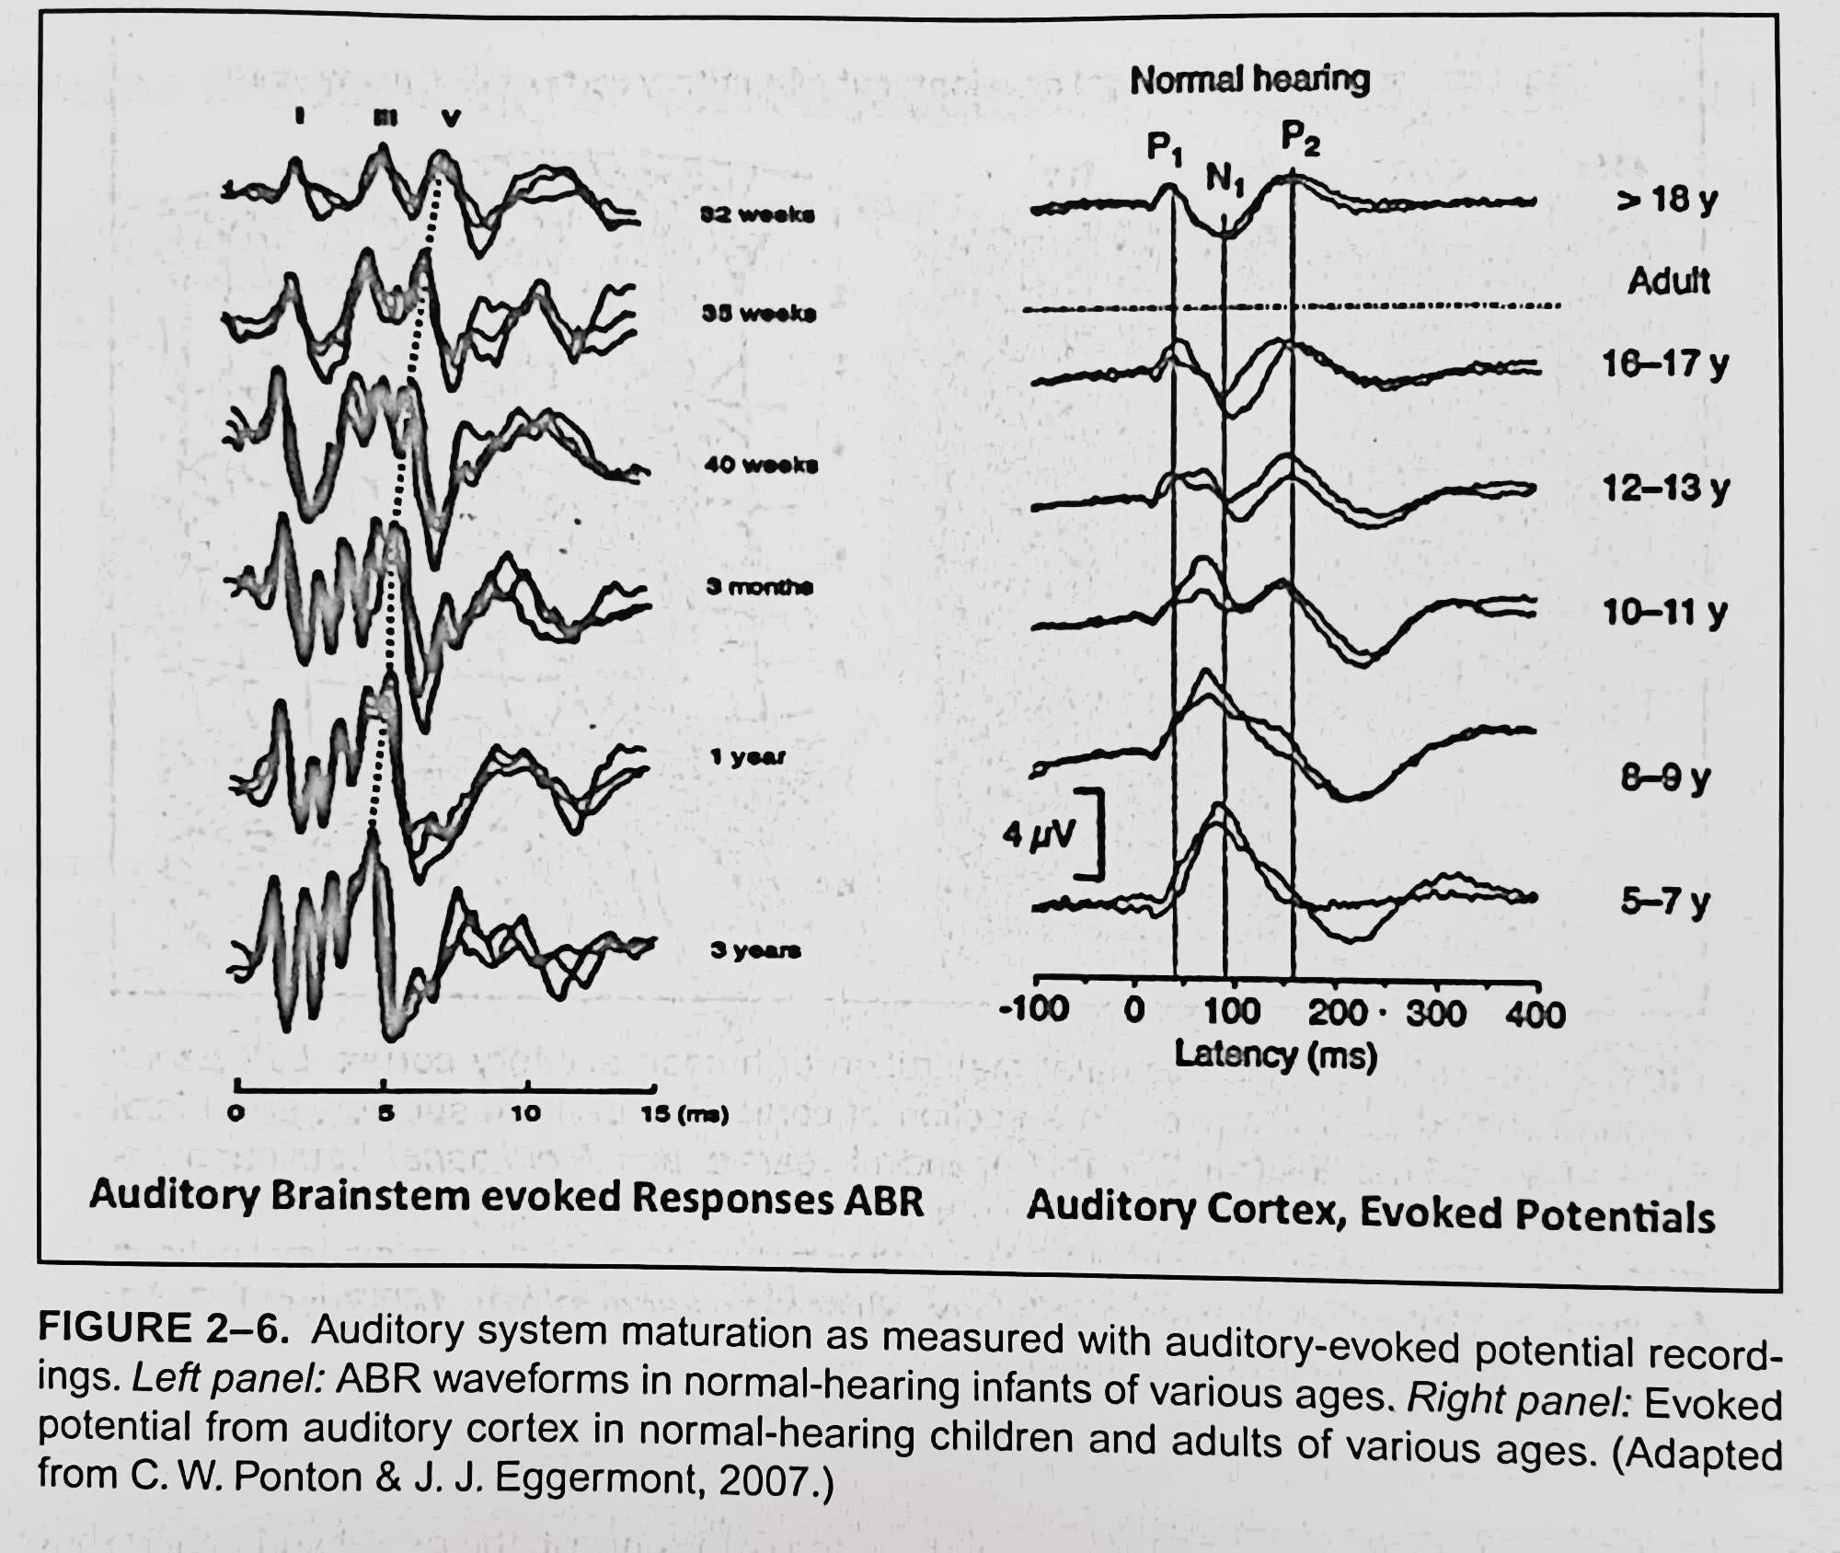

Slide 64
AEPs | Time frame for full maturity
Cochlear action potentials | Within weeks after birth
ABR | Within 3 to 5 years
MLR and cortical potentials | By 14 years of age
Later AEPs (cortical areas beyond primary auditory cortex) | Up to 20 years

Slide 65
Evoked potential studies in children with CI
  Tool to study developmental plasticity that results from electrical activation of cochlea
  Reduction in peak latencies over time
  Trajectories of time-latency functions similar to normal changes from birth, except that they occur after first activation
  Implies that CI has 2 roles in a deaf infant – one is to provide hearing, the other is to promote development.
  Studies in bilateral CI. If there is a long delay between the times of implantation of each ear, auditory signals from both ears will not reach brainstem and midbrain areas at the same time, preventing the timing coincidence from occurring and hence true binaural hearing will not be achieved.

Slide 66
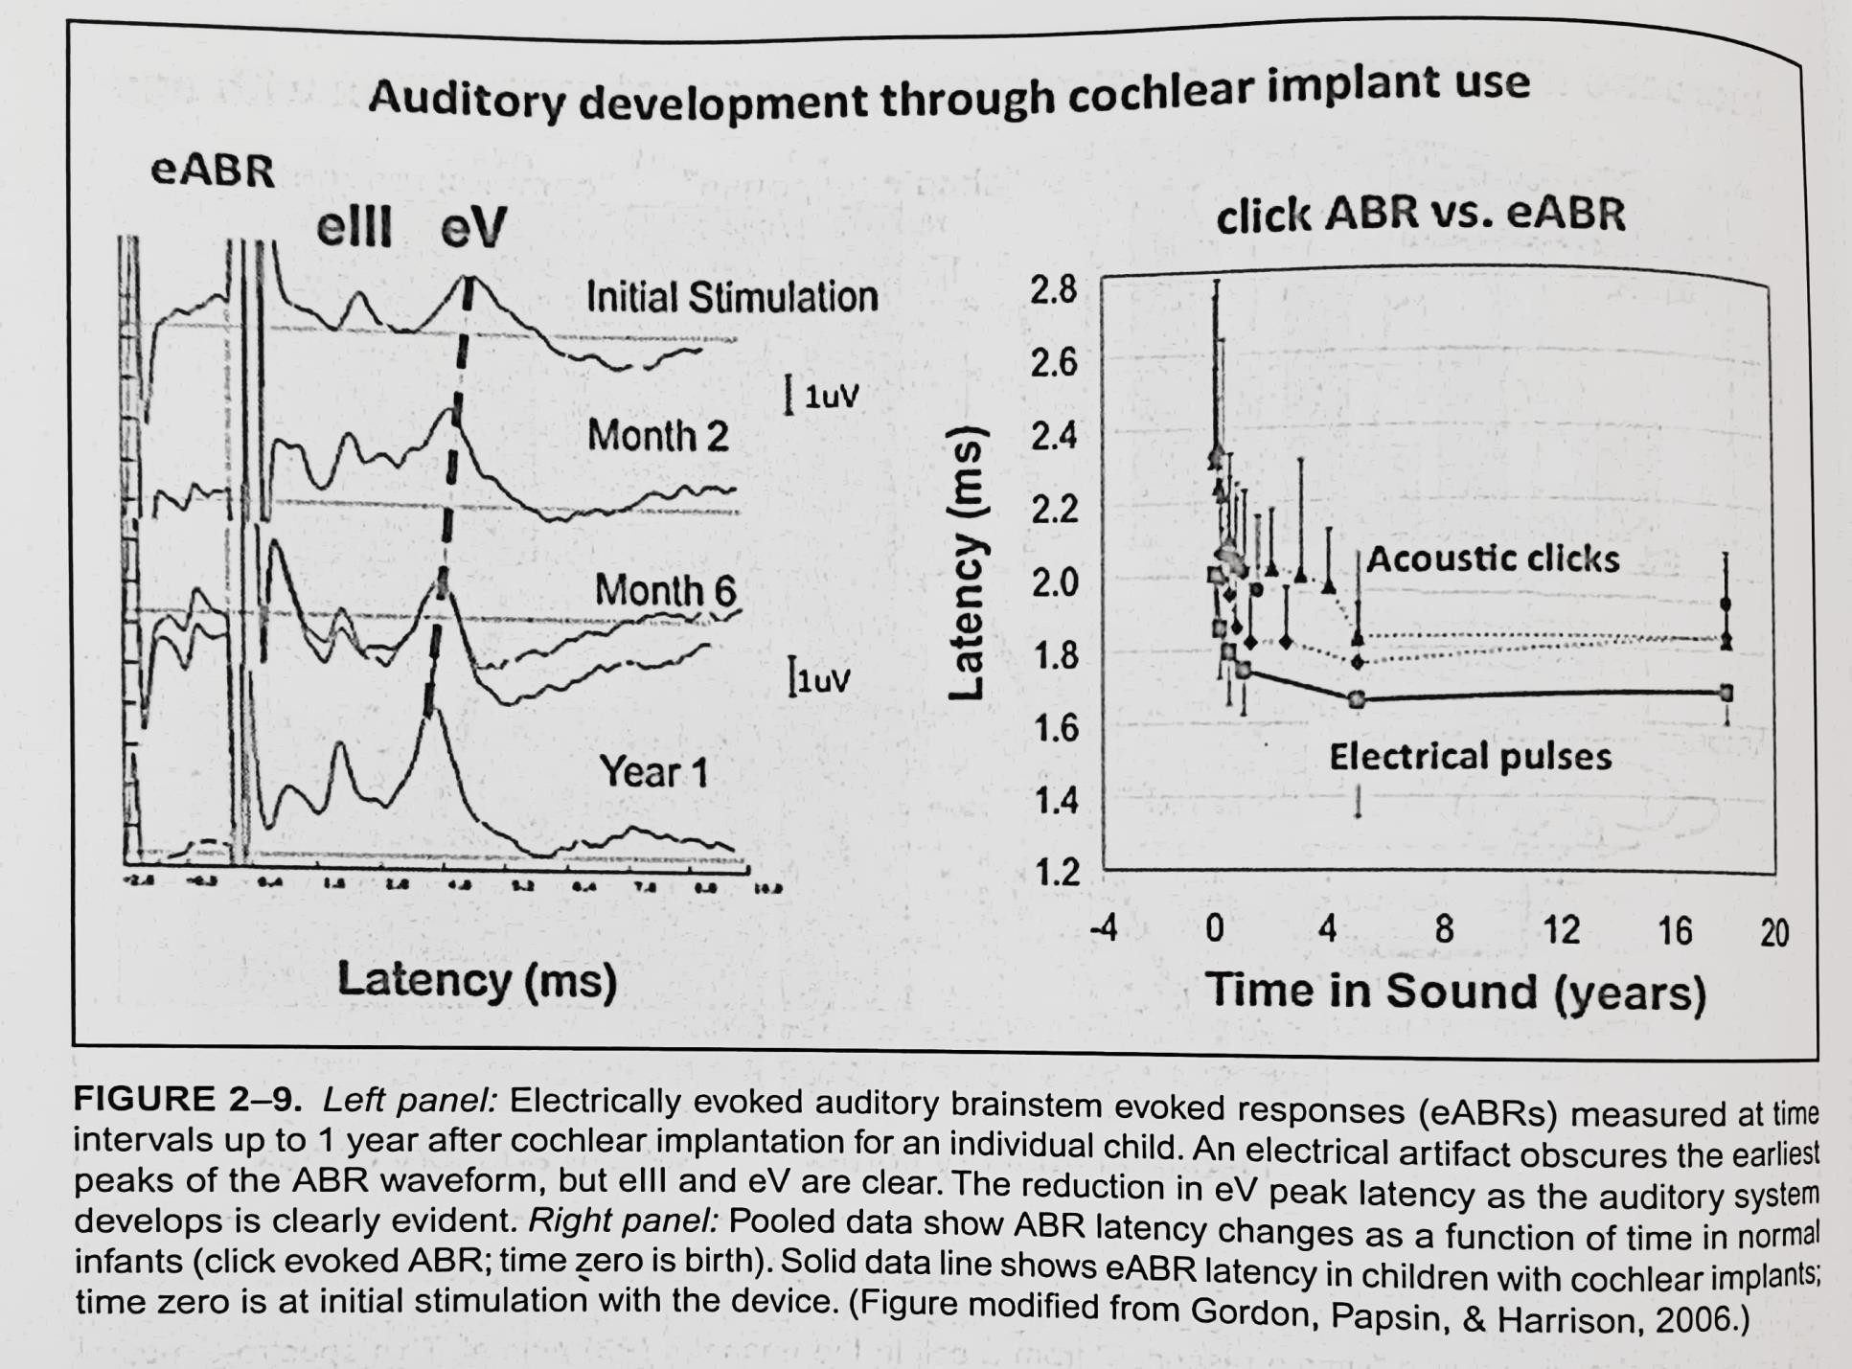

Slide 67
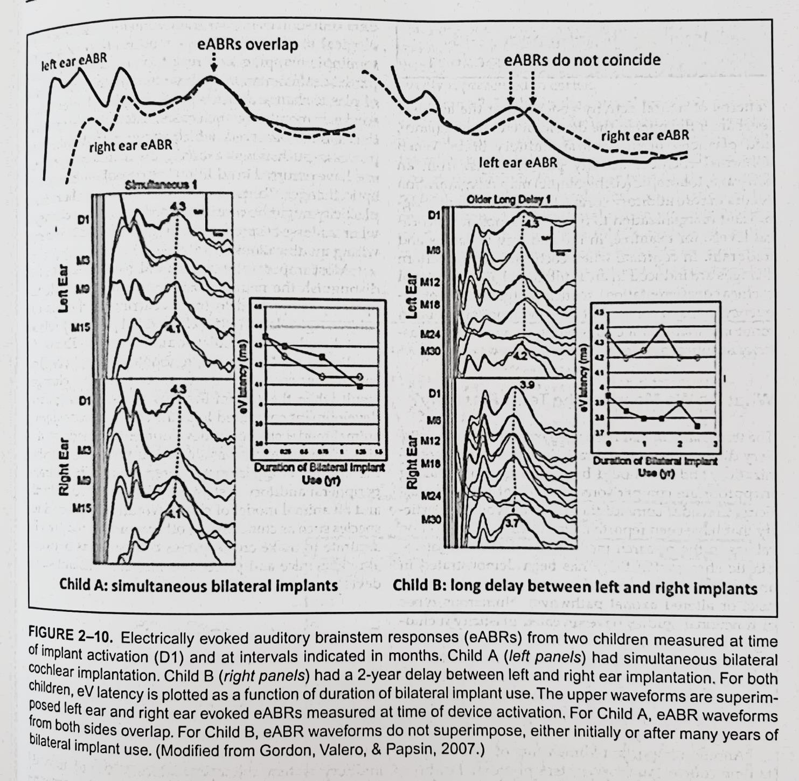

Slide 68
c) NEUROPLASTICITY

Slide 69
References
Hearing in children. 6th edition. Northern JL & Downs MP. (2014). Plural Publishing Inc.
Comprehensive handbook of pediatric audiology. 2nd ed. Tharpe AM & Seewald R. (2017). Plural Publishing.

Slide 70
We hear with our brain, not our ears!!

Slide 71
William James (1890) - one of the first scientists to suggest that the
brain is not a static structure.
Latter part 20th century– belief – active brain development only possible during infancy and childhood.
Studies during last few decades – new insights into early development of brain and nervous system. Use of sophisticated technologies such as brain scans, brain mapping and animal research studies.
One important conclusion from these studies – brain development that takes place during the first 12 months of life more rapid and more extensive than previously realized.
Brain is not a “rigid” structure but a “plastic” organ with the capability of reorganizing itself based on sensory and motor input – a phenomenon known as neuroplasticity.
Brain is a dynamic structure changing throughout life and capable of new learning any time.

Slide 72
Neuroplasticity refers to the brain’s ability to reorganize itself, forming new connections and pathways in response to sensory and motor input, learning new skills, or creating new memories upon which to build additional behaviours.
This process involves orderly increases in the number and density of neurons, dendrites, synapses and the proteins that are essential to the survival of nerve cells.
Brain is constantly laying down new pathways and rearranging existing routes.
Connections between neurons that are inefficient or infrequently used fade away, while those connections that are frequently utilized will be strengthened through a process known as pruning.
Majority of the synapses in the brain may have the capacity to grow, connect, disconnect and reconnect to each other in response to environmental experiences of various types.
Neuroplasticity occurs in each of us every day as we encounter new experiences. When a stimulus is cognitively associated with reinforcement, its cortical representation is strengthened and enhanced. Brain has ability to act and react in ever changing ways to constantly lay down new pathways for neural communication and to rearrange existing ones, thereby aiding our
process of learning.

Slide 73
Brain is an amazing organ in terms of its development, organization,
efficiency and abilities.
From beginning of life, brain cells proliferate rapidly, making connections in a preprogrammed, orderly and sequential manner.
The growing brain of an embryo, by 6 weeks nearly as big as its entire body, is richly irrigated by a vast system of blood vessels.
As each neuron matures, it sends out multiple axons and dendrites to lay out the basic communication routes in the brain.
At the embryo stage, the brain produces many more neurons than it actually needs. At birth each neuron in the cerebral cortex has approximately 7500 synapses. By the time an infant is 2 years old, the number of synapses has doubled and grown to approximately 15000 synapses per neuron, considerably more than we find in the adult brain.
Although plasticity of the brain is maximum during the first 4 years of life, the brain changes throughout life as a function of experiences (it
adapts to its environment).
69

Slide 74
The estimated 15000 synapses per neuron at birth increase with rapidity, growing the total number of synapses at least 20-fold (50 to 1000 trillion synapses by 2 to 4 years of age).
Implication – most sensitive period for functional maturation of the
auditory system is within the first 2 to 4 years of life…..critical to provide auditory input to congenitally deaf children to take advantage of the ongoing neuroplasticity.
Brain mapping studies – biochemical patterns noted in a 1-year-old’s brain qualitatively similar to those found in the brain of normal young adult. Brain cell formation is virtually complete before birth, but brain maturation is not. Next challenge……formation of connections among
the neurons to form the brain’s physical maps that allow learning to take
place.
Synaptic pruning (programmed cell death) eliminates weaker synaptic contacts while stronger connections are retained and
strengthened….process that continues until approximately 16 to 18
years, when it begins to slow down. Experience determines pruning. ₇₀

Slide 75
There are 3 major means by which plasticity of the brain occurs
Synaptic – brain’s ability to create new interconnecting neurons
through learning and practice
Neurogenesis – birth and proliferation of new neurons in the brain
Functional compensatory plasticity – region of the brain
demonstrates sensory reassignment
  Different types of plasticity dominate during certain periods of one’s life
and are less prevalent during other periods.
  Genetics play a role in establishing an individual’s brain plasticity, and
the environment exists heavy influence in maintaining it.
  Early brain development is much more vulnerable to environmental influence than previously suspected. The influence of environment on early development may be long lasting – importance of prenatal environment.
  Implication – More attention be focused on early intervention

Slide 76
Without the experience of auditory stimulation, the brain reorganizes itself to receive input from other senses – primarily vision. Cross-modal regeneration – reduces subsequent auditory neural capacity.
Reintroduction of sensory input after auditory deprivation induces further plastic changes and deleterious effects may be reversed only during early stages of development. Also, brain’s growth spurt begins to slow by 10 years of age and by the end of adolescence brain has declined in plasticity. Again, emphasizes early intervention.
Programs, environments and activities that provide enriched experiences to stimulate the auditory pathways and various sensory, motor and language centers will enhance neuroplasticity and bring about changes in the infant’s brain.

Slide 77
Critical and Sensitive Periods
A sensitive period is a developmental period where brain
plasticity results as a function of sensory experience.
The critical period, in general, is considered a time period within a sensitive period when the best neural representation of the environment is selected from among many competing inputs that affect the maturing nervous system.
Plasticity of brain is maximum during critical period and hence during this period some crucial experience will have its peak effect on development or learning. This results in normal behaviour attuned to the environment to which the organism is exposed.

Slide 78
If the organism is not exposed to this experience until after this period, the same experience will have only a reduced effect or perhaps no effect at all.
The theory of critical periods suggests that after the critical period is over, the brain may never again show the same ability to make big changes in neuronal connectivity.
A critical period for any behaviour is defined as a specific phase of the life cycle of the organism in which there is enhanced sensitivity to experience, or to the absence of a particular experience.
Universally accepted concept – critical period for language acquisition in children.

Slide 79
d) PRENATAL HEARING

Slide 80
Fetal auditory system under structural development and initial
neurosensory maturation during the first 20 weeks of gestation.
Becomes functional around 25 weeks of gestation when connection between cochlear hair cells and brainstem and cortex established.
Elliot and Elliot (1964) – confirmed physiologically that the human cochlea shows response to sound after 20th week of gestation.
Johansson and colleagues (1964) – among the first to test hearing function in fetus. Pure tones presented through a mic placed on mother’s abdomen – increase in fetal heart rate recorded.
Tanaka & Arayama (1969) – heart rate responses to acoustic stimuli
after 6 months gestation
APRs consistently occur at approximately 24 to 25 weeks gestational age in normal infants.
Fetal response to sound primarily reflexive (startle, generalized body movement, APR, cessation of activity).

Slide 81
Pre-adaptive processes for perception of acoustic dimensions of
speech exist.
At birth infant is able to discriminate mother’s voice and will work
towards eliciting the mother’s voice in preference to voice of another
female – DeCasper and Fifer (1980) using sucking paradigm.
Querleu et. al. (1981) performed actual IU measures and
demonstrated that the fetus could hear the mother’s voice and other voices, which were perfectly audible but lacking in tone because the HFs were absorbed.
Bench (1968) – least attenuation for low frequencies and most for high frequencies – frequencies below 1kHz contained frequency response of maternal voice that may be heard by fetus from 4th month of gestation.
Mother’s voice over other female’s voice, native language vs foreign
language utterances, simple familiar stories over unfamiliar stories
A great deal of auditory experience is required to produce
preferential response to mother’s voice – auditory competencies of discriminating rhythm, intonation, frequency variation, stress, phonetic aspects of speech!

Slide 82
At the time of birth, an infant has actually been hearing sounds for at least 4 months, though fluid-borne.
Perceptual learning of global aspects of language commences prior to birth.

Slide 83
e) NORMAL AUDITORY DEVELOPMENT 0 TO 2 YEARS

Slide 84
References
Hearing in children. 6th edition. Northern JL & Downs MP. (2014). Plural Publishing Inc.
Comprehensive handbook of pediatric audiology. 2nd ed. Tharpe AM & Seewald R. (2017). Plural Publishing.

Slide 85
Neonatal hearing

Slide 86
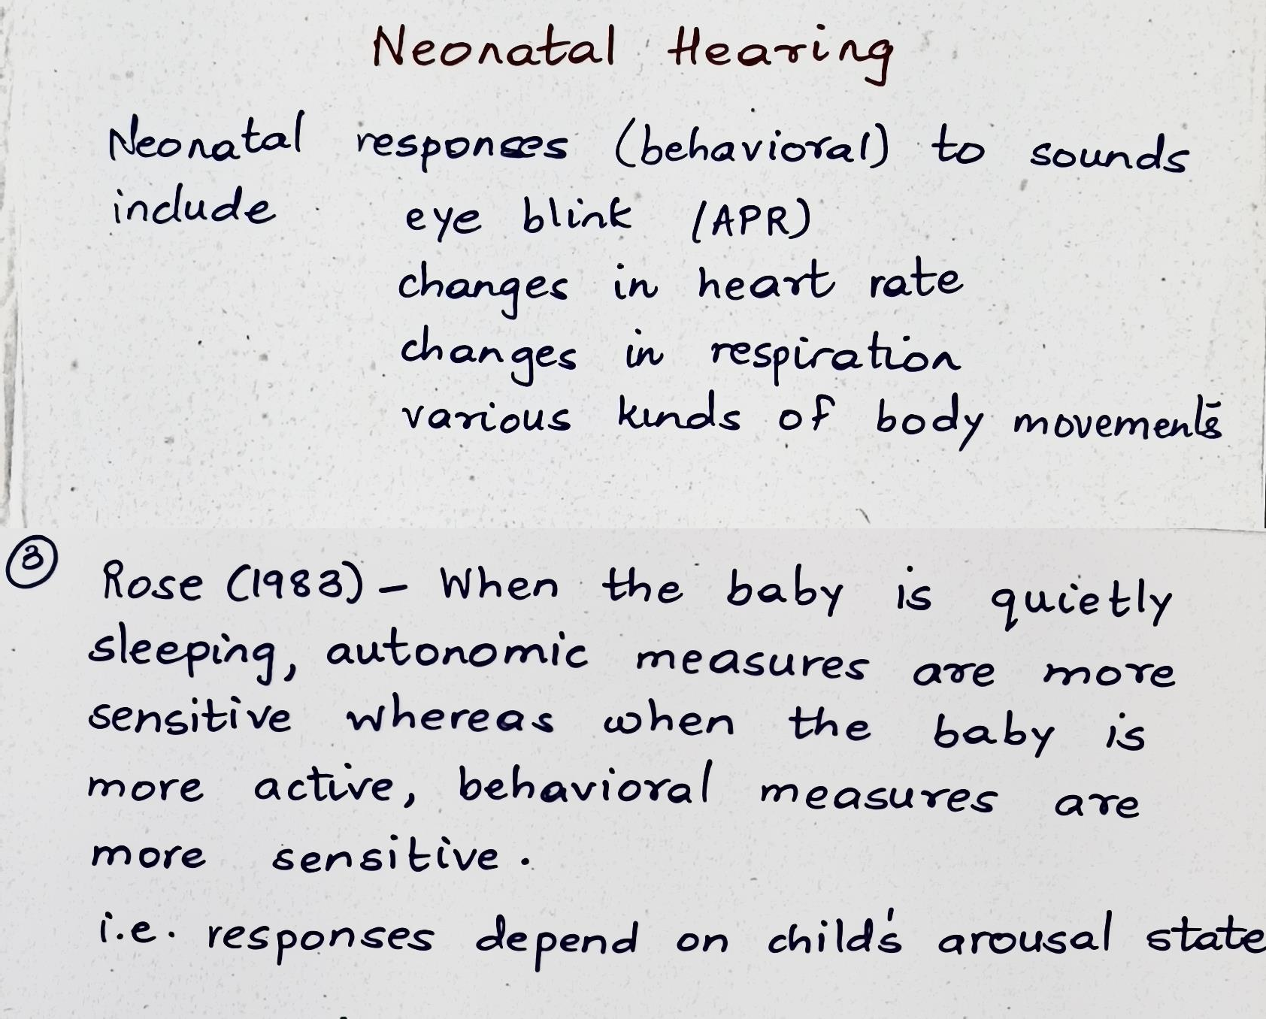

Slide 87
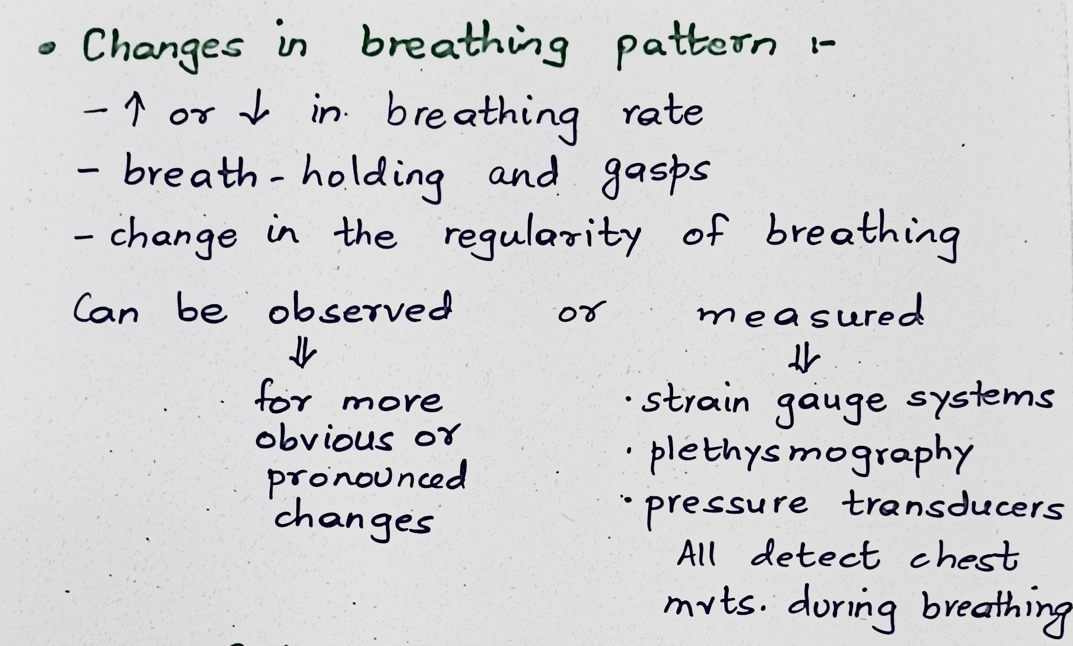

Slide 88
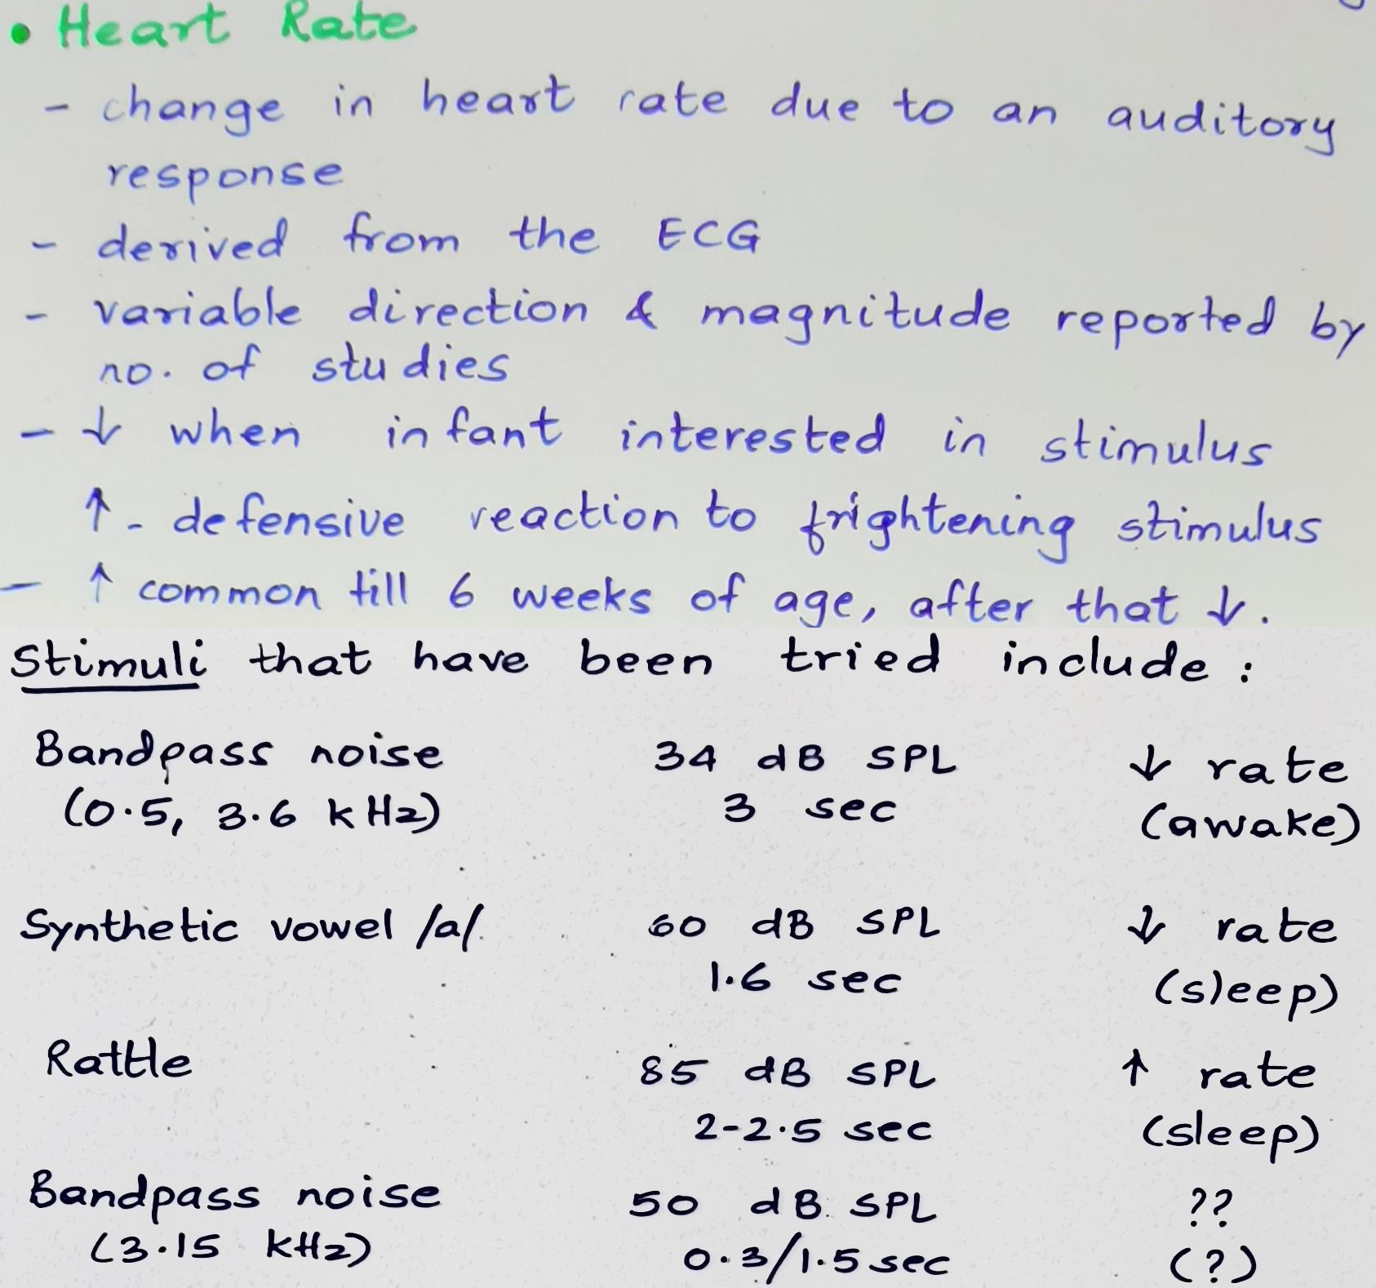

Slide 89
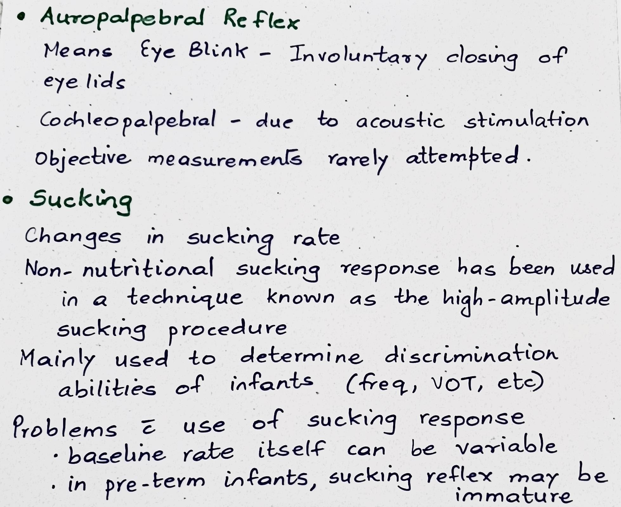

Slide 90
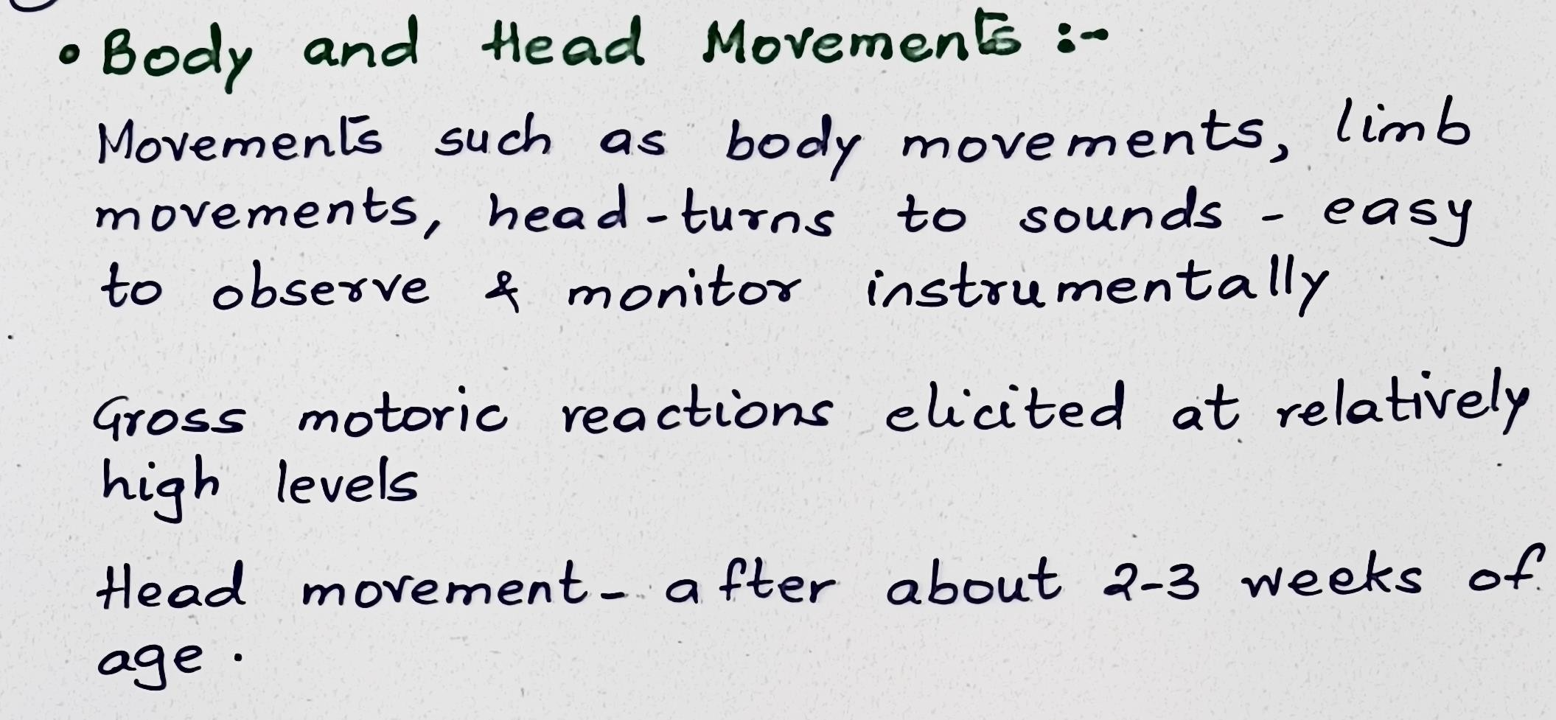

Slide 91
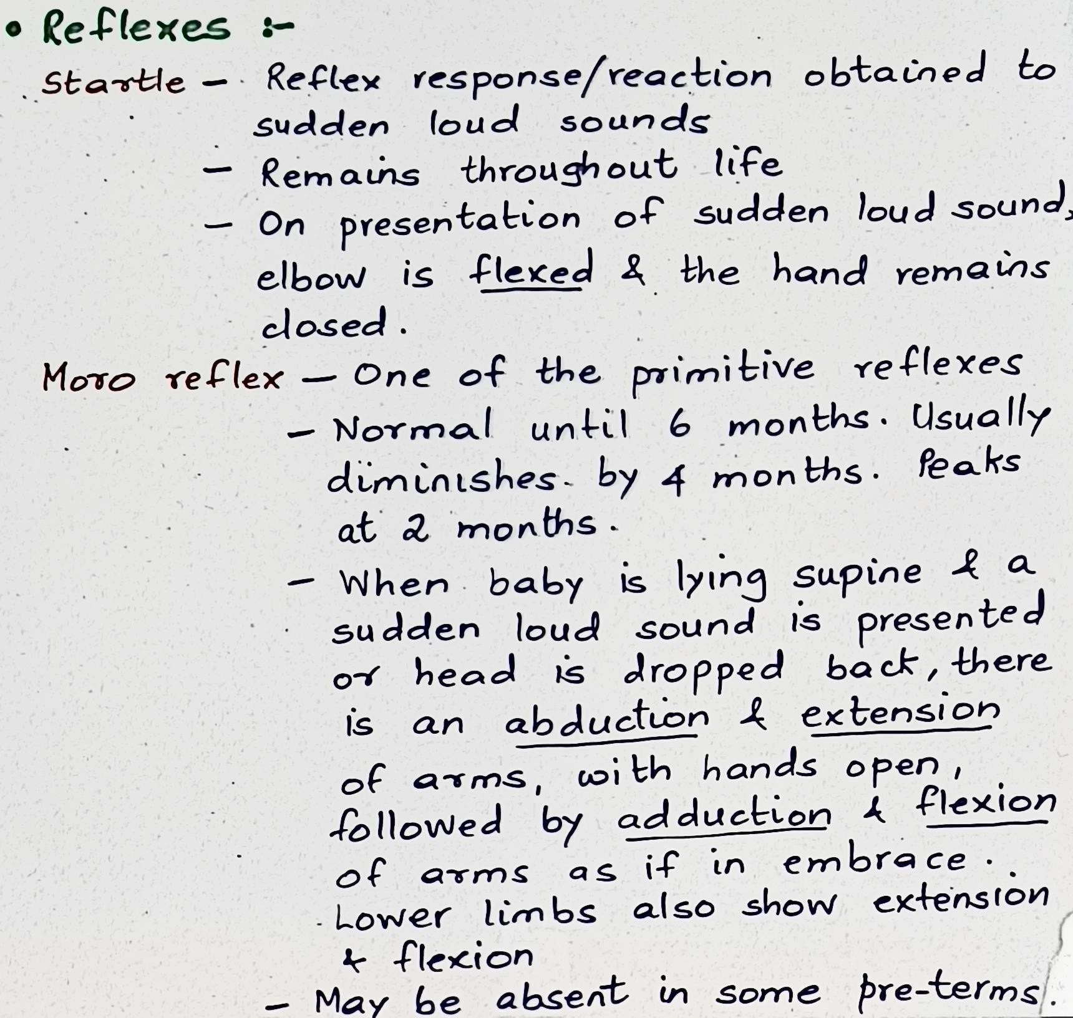

Slide 92
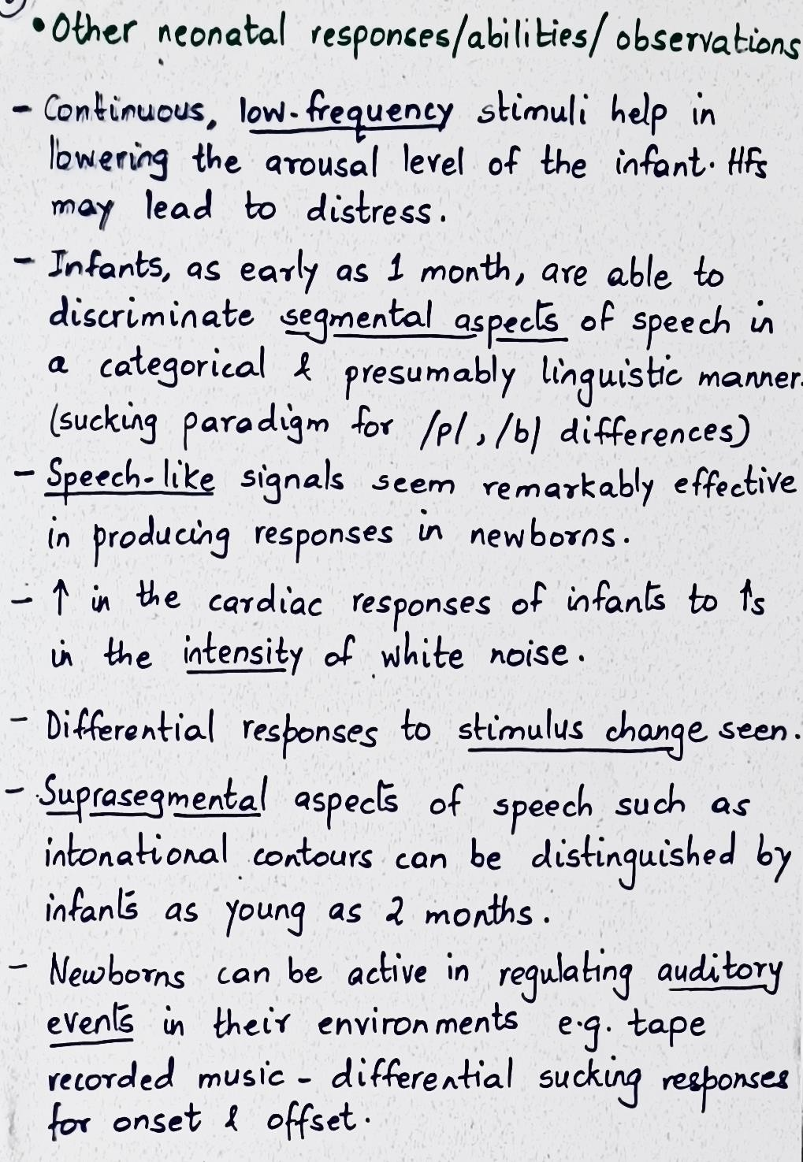
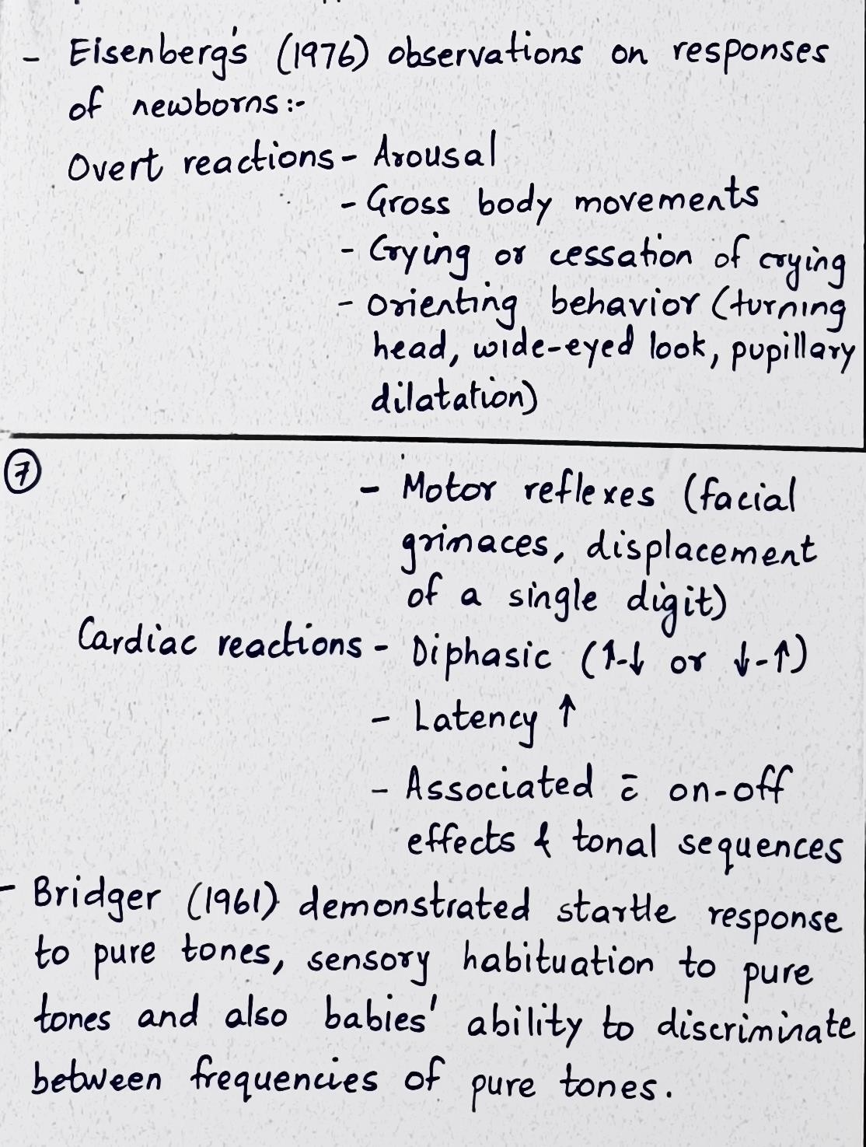

Slide 93
Auditory Development

Slide 94
Various aspects
Development of sound detection – auditory sensitivity
Development of auditory localization
Development of spectral representation of sound
Development of temporal representation of sound
Spatial hearing
Hearing in complex sound environments

Slide 95
Auditory Behaviour Index – sensitivity development

Slide 96
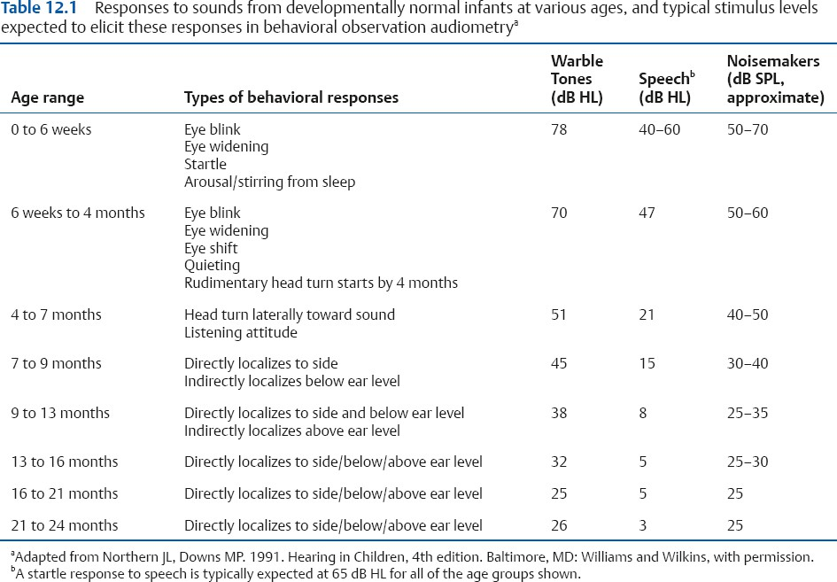

Slide 97
Development of Auditory Localization

Slide 98
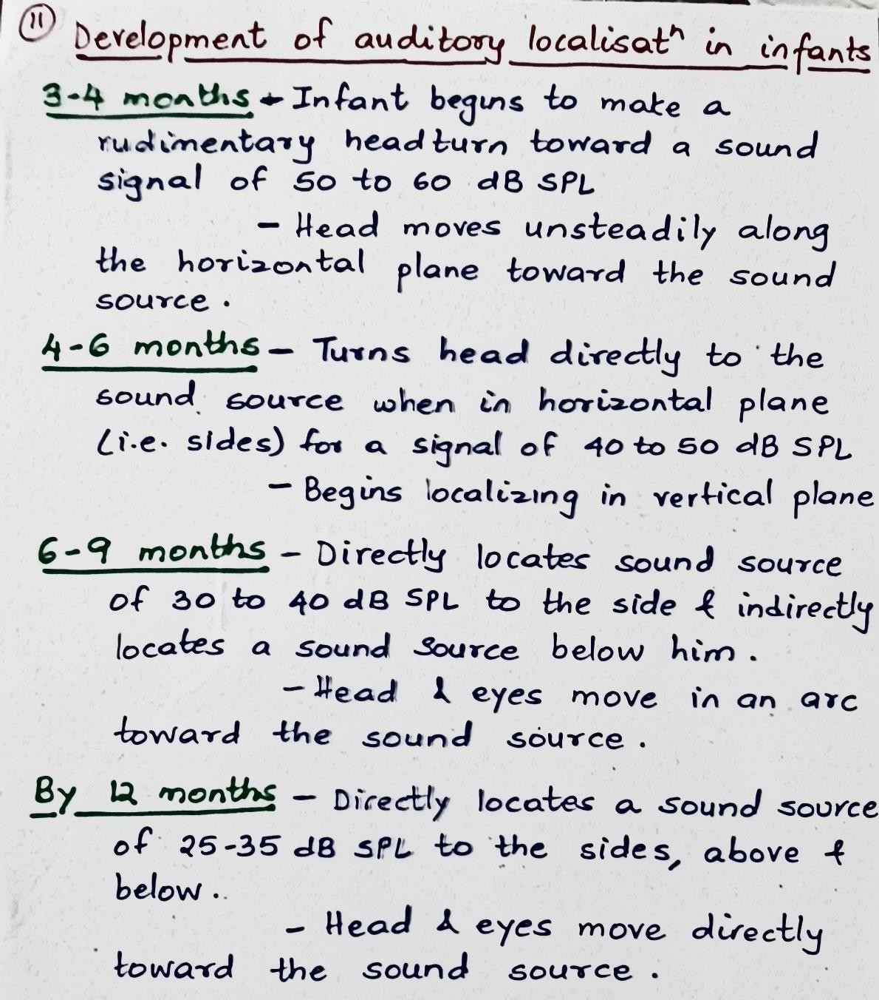
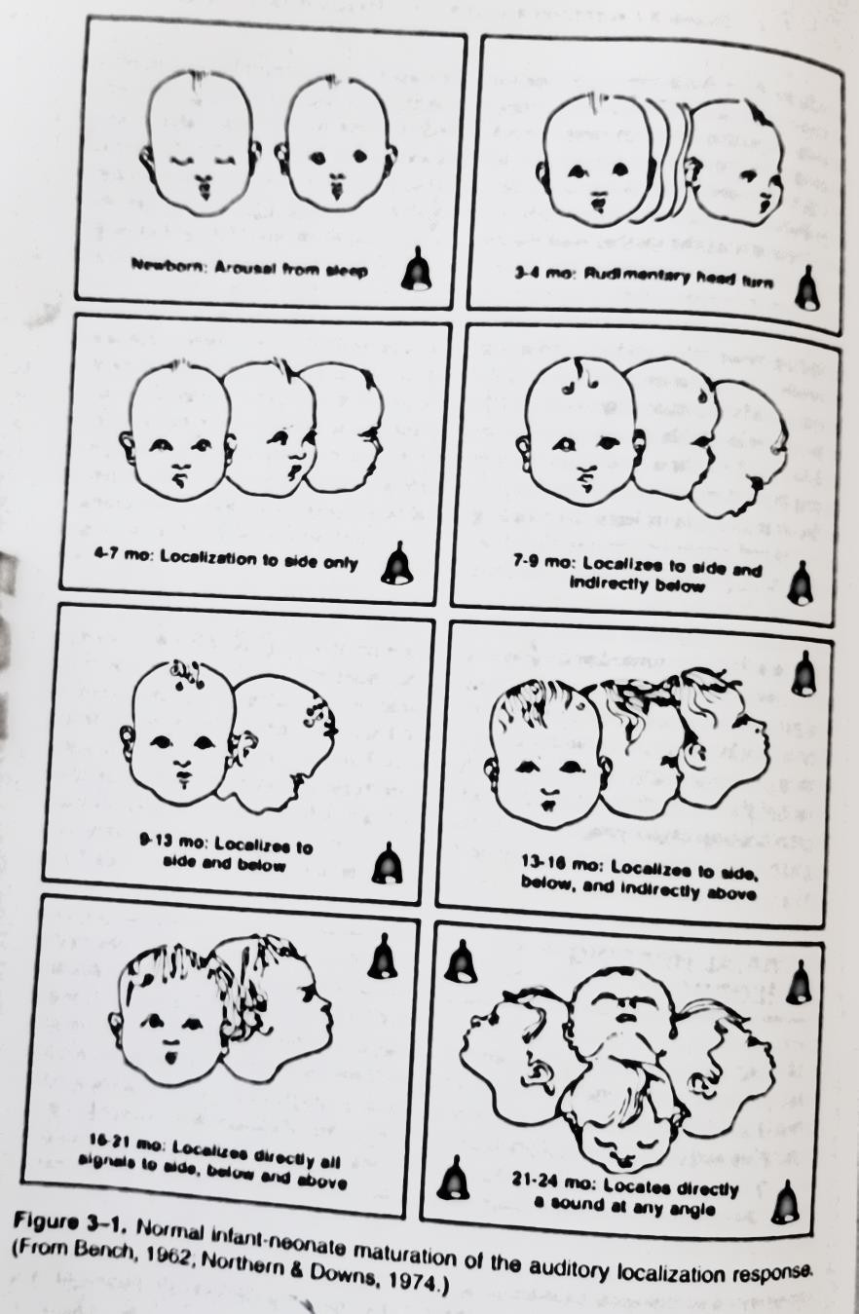

Slide 99
Listening v/s Hearing

Slide 100
Not the same
Hearing – is a sense, a simple act of perceiving sound by the ear, it can be explained on a scientific and biological basis.
Listening is a skill that includes cortical activity. It is a psychological process requiring internal contextual contemplation of the perceived sound waves.
Listening requires concentration so that the brain processes meaning from words and sentences. Active listening is a process that constructs meaning from both verbal and nonverbal messages.
Listening is important because it is the doorway to learning.

Slide 101
Children, as compared to adults require
More complete and detailed auditory information Quieter environment
Louder primary signal i.e., better SNR (at least 10-15 dB)
Listening is when we apply meaning to sound, a cognitive skill built on learned behaviours and rewards.
Listening requires the brain to organize, establish vocabulary, develop receptive and expressive language, internalize concepts.
Listening experiences in infancy are the foundation for language, literacy, cognitive development and psychological development.
Young normal hearing children learn 90% of the information they
acquire through incidental listening and learning.

Slide 102
Listening, speech and language milestones

Slide 103
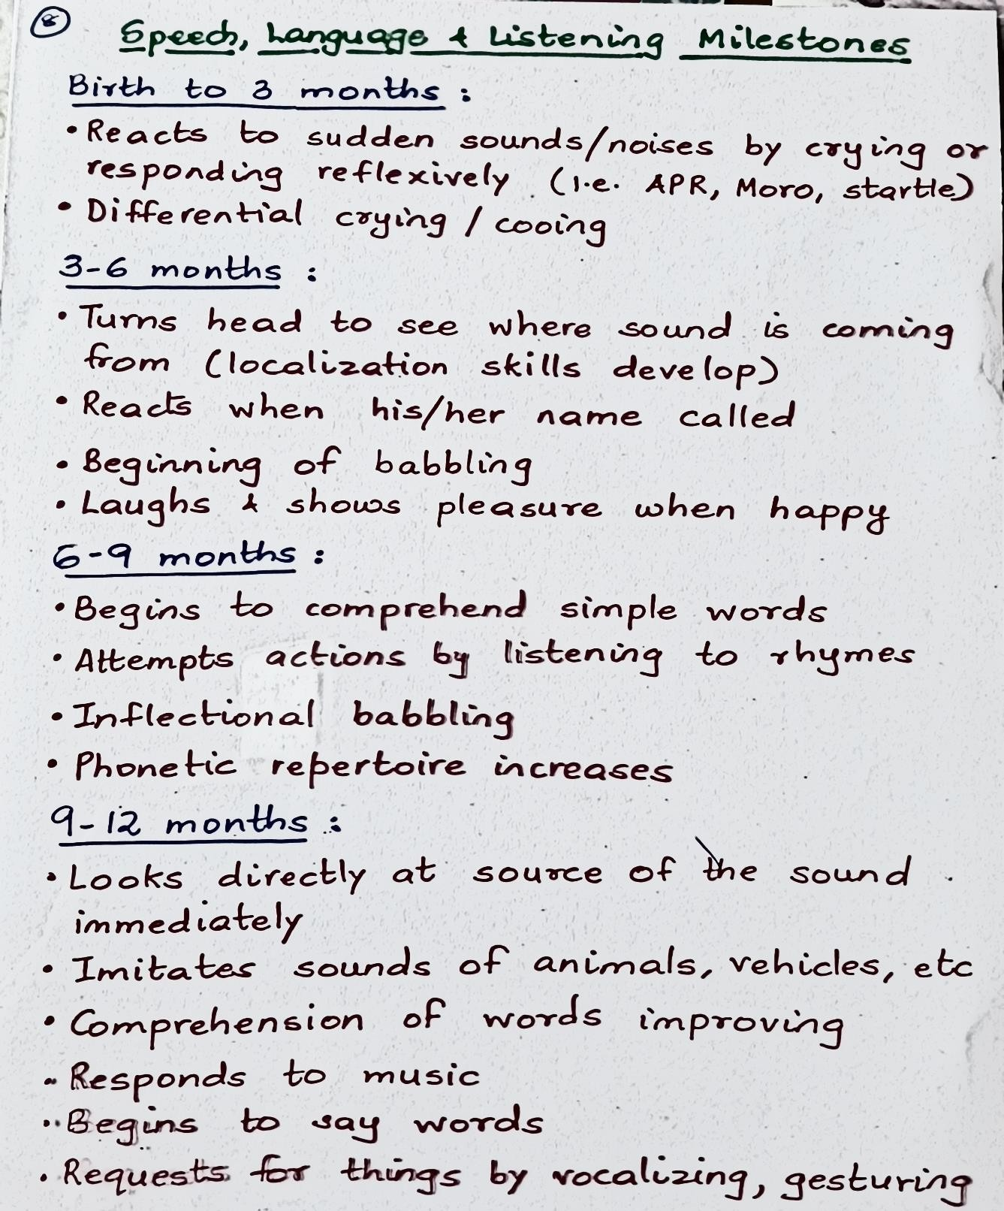

Slide 104
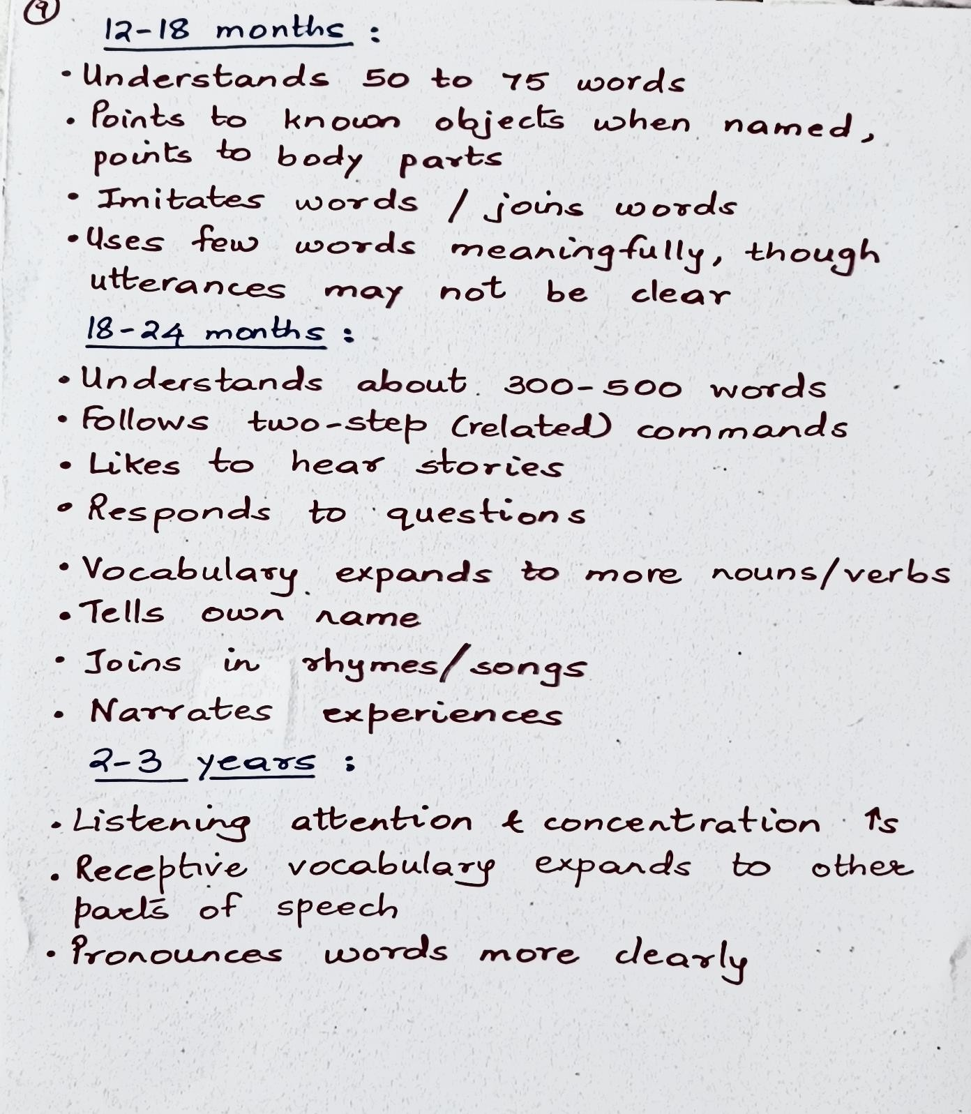

Slide 105
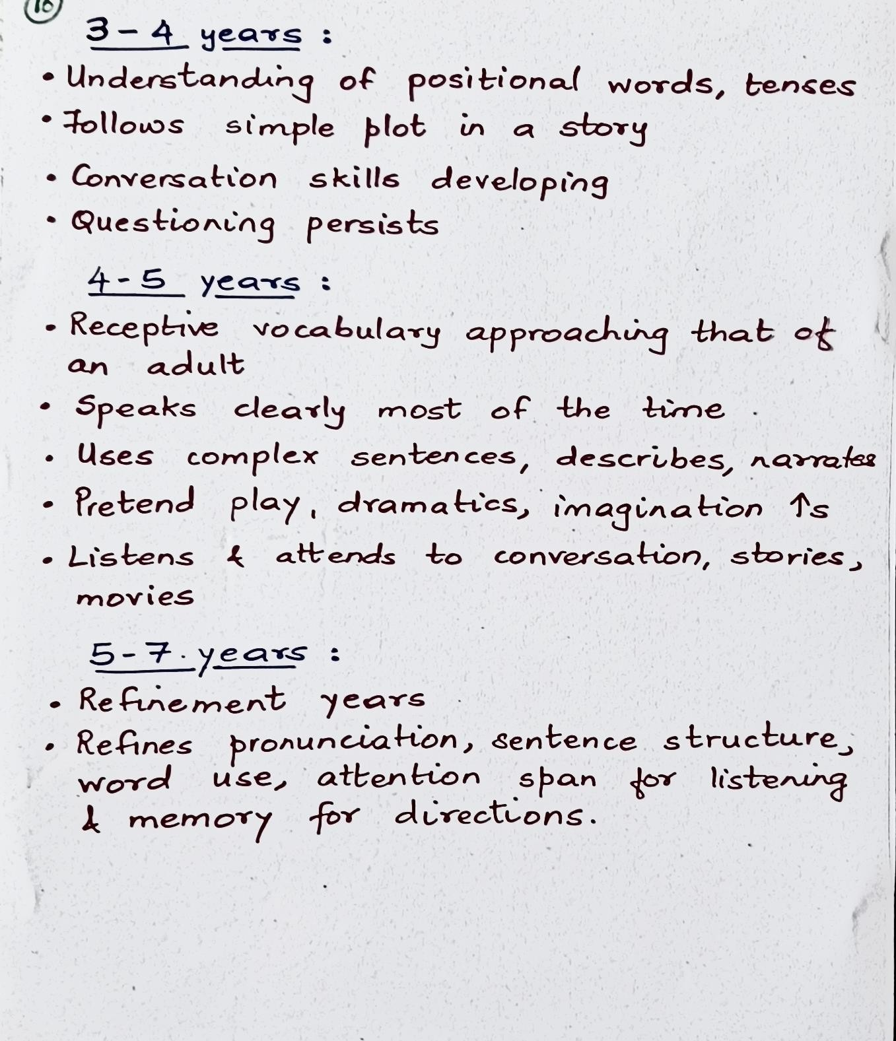

Slide 106
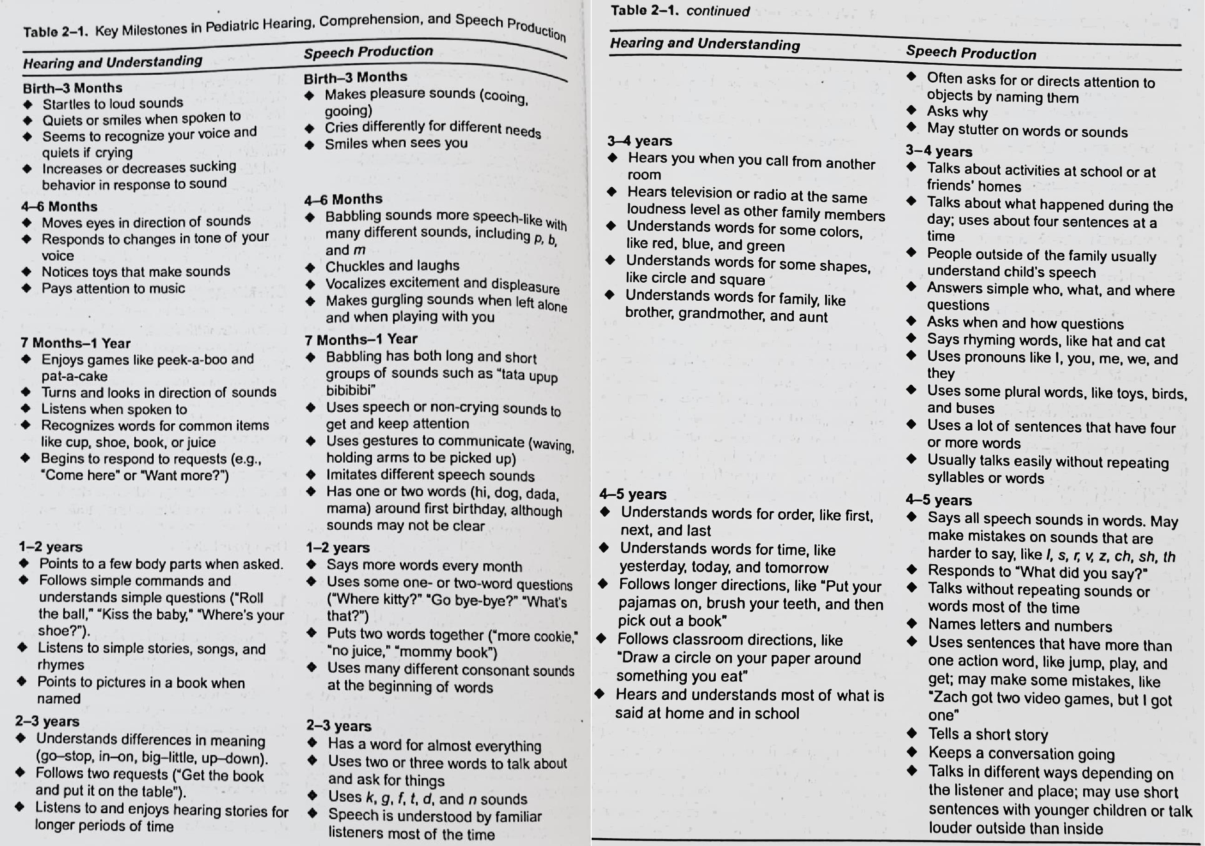
Pediatric SN HL. Clinical Diagnosis and Management. S. Anne, J. Lieu, M. Kenna (2018). Plural Publishing.
102

Slide 107
f) INFANT SPEECH PERCEPTION

Slide 108
References
Comprehensive handbook of pediatric audiology. 2nd ed. Tharpe AM & Seewald R. (2017). Plural Publishing.
Handbook of Speech Language Pathology and Audiology. Lass.

Slide 109
Speech Perception
Speech perception is the process by which the sounds
of language are heard, interpreted and understood.
Perception of speech discusses how we hear sound, how we assign meaning to the acoustic sound wave stimulating our auditory system.
Speech perception is a very interesting phenomenon, because what we consciously perceive are not the acoustic features that make up the phonemes, such as voicing, place of articulation, manner of articulation, but linguistic events such as phonemes, syllables, phrases and sentences.
According to Ingram (1989), infant speech perception is the infant’s ability to perceive linguistic stimuli and it is defined as the ability to perceive speech before the recognition that such speech conveys meaning.

Slide 110
Humans are able to extract linguistic information from speech because of the specialized way in which the human auditory system is tuned.
Study of infant speech perception is concerned with the tuning of the auditory system during early development.
The field of infant speech perception is not yet able to describe with certainty exactly what information infants
perceive at any stage of
development development
and how this and language
undergoes changes with
experience.
Early work – language learning does not happen only with experience/exposure, but requires a special genetic predisposition that humans are endowed with.

Slide 111
Methods to study infant speech perception
Different methods to study speech perception in infants can be broadly classified as
Behavioral methods
Electrophysiological methods
Imaging studies

Slide 112
These are five general procedures that have been developed to assess the speech perception ability of infants between birth and 18 months of age.
High-Amplitude Sucking (HAS) Paradigm
Heart rate (HR) paradigm
Visually Reinforced Infant Speech Discrimination (VRISD) Paradigm or Conditioned Head Turn (CHT) Paradigm
Visual Habituation(VH) Paradigm
MMN

Slide 113
1. High amplitude sucking method (HAS)
Used for children ranging from 3 days to 4 months.
Based on a simple observation: Infants,
perceive
like older in their
people, react to changes they
environment and become habituated to repetitions of the same event.
Involves four phases: baseline, acquisition, habituation,
and recovery.
In this technique, the infant controls the presentation of a speech stimulus by sucking on a pacifier attached to a pressure transducer which records the sucking responses.
Initially the baseline activity is established, following which a repeating speech stimulus such as bababa is presented.

Slide 114
The frequency of presentation of the stimulus is controlled by the infant’s sucking rate, the rate increases as the child learns the contingency between his or her activity and the stimulus.
Increased sucking is thus taken to reflect the child’s attention or interest in the speech-like sound, which serves as a “reinforcing stimulus.”
After several minutes, the infants’ sucking rate typically levels
off and then decreases.
When sucking declines and evidence of habituation can be inferred, a second novel auditory stimulus is presented, and an increase in sucking is observed, thus revealing that the infants can discriminate the speech stimuli.
Discrimination is inferred if an infant shows recovery of the sucking response contingent upon presentation of the second novel auditory stimulus.

Slide 115
The high- amplitude sucking procedure has several drawbacks:
The four phases of the procedure require approximately 15 to 20 minutes to complete. Infants often have difficulty attending for this amt of time.
Specific levels of increased and decreased sucking must be achieved in order to demonstrate reliable shifts b/w each of the four phases of the procedure.
There is only one opportunity to establish discrimination. An infant either recovers the sucking response rate or does not during presentation of the second novel stimulus.

Slide 116
habituation/
2. Heart rate paradigm (HR)
dishabituation
Used with infants 1 to 8 months of age
Derived from the finding that when a sound is presented to an infant at a comfortable listening level, the infant’s heart rate slows down (decelerates) in response to the sound over the course of the next 0 to 20 secs. This heart deceleration has been shown to be the cardiac counterpart of the general orientation behaviour of the individual.
Thus, the cardiac orienting response reflects the infants’
attention to a novel event (Graham and Clifton, 1966).

Slide 117
Begins with a baseline measure of an infant’s heart rate.
An auditory stimulus is then presented, and a change in heart rate is observed. Presentations of the auditory stimulus are repeated over a series of trials during which the magnitude of rate habituates.
A second novel auditory stimulus is then introduced.
If a change in heart rate is noted, the experimenter infers that the infant presumably has detected a difference b/w the two stimuli, orienting to the novel condition.

Slide 118
Limitations:
If two groups of infants discriminate two sound contrasts differently as determined by different magnitudes of heart rate responding, the degree of discriminability among sound contrasts cannot be established from the heart rate procedure.
The heart rate paradigm places considerable memory demand on infants given the recovery time required b/w stimulus presentations and the habituation time across stimulus presentations

Slide 119
3. Conditioned
head
turn (CHT)/ visual
discrimination
reinforced (VRISD)
infant
speech
Originally developed for assessing auditory thresholds (Moore et al, 1975) and was adapted by Eilers, Wilson, & Moore in 1977 to investigate developmental aspects of infant perception.
Capitalizes on the child’s natural orientating response to a sound source. The procedure is widely used for infants in the age range of 6-36months, but the most reliable information is obtained for infants in the age range of 6- 10months.

Slide 120
Testing arrangement typically consists of a child seated on the caregiver’s lap in a sound treated room.
The stimulus is presented through the speakers continuously eg. bababa.
The child is then conditioned to make a head turn when
there is a change in the stimulus eg. da.
The child is reinforced for correct head turn responses by
the illumination of a toy in a darkened plexiglass box.
If the child turns when there is no sound change, the toy does not illuminate.

Slide 121
The response involves requiring the infants to turn their head to one side in response to one particular sound, and to the other side in response to a second particular sound. These attempts have met with mixed success, however, and there is disagreement as to their validity with infants.
The procedure thus contains 3 phases
Training stage (to familiarize the infant with reinforcements)
Conditioning stage (every trial is a change trial)
Testing phase
Evidence of discrimination is obtained when infants turn appropriately during change intervals but don’t turn during equivalent control intervals in which the repeating background stimulus is not changed.

Slide 122
4. Visual habituation (VH)
Infant’s ability to categorize stimuli can be assessed using this method and performance habituation tasks can be used as a predictor of information processing capacity.
The child is asked to look at the television that displays a checkerboard.
Half of the time the stimulus is presented (eg. hop, hop, hop). And the other half of the time the sound is absent.
This presentation continues until the infant reaches a predetermined
“habituation phase” as determined by decreased looking time.
This procedure is based on the premise that infant’s looking time increases when a novel sound is presented. Thus, when the stimulus is changed the looking time increases.

Slide 123
Advantages
Easy to perform. Infants can be trained quickly.
Less time consuming.
The habituation procedure can also be used discrimination of long patterns.
to study
Disadvantages
Not very reliable since the looking time might vary with the interest of the child in the picture soon.
Cannot be done on children with less attention span.
Cannot be done on young infants.

Slide 124
5. Mis-match Negativity (MMN)
MMN is elicited by infrequent changes (deviant stimuli) in an ongoing stream of sound events (standard stimuli). It is most clearly seen in the difference wave obtained by subtracting the average response to standard stimuli from the average response to deviant stimuli.
MMN appears as a negativity that peaks between 130 and 250 msec after stimulus onset depending on the difficulty of the discrimination and whether the deviants represent a change in pitch, duration, loudness, category, pattern, or other abstract sound feature.
Of particular interest in developmental studies because
It does not require a behavioural response.
Although affected by attention, attention is not required for its
elicitation.

Slide 125
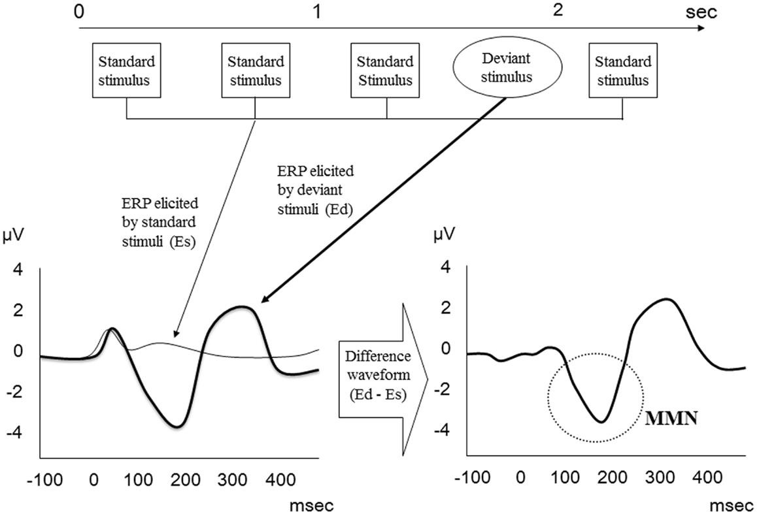
121

Slide 126
Advantages
It reflects discrimination, memory in addition to sensation.
No participation of the child.
Co-relates with the behavioural results.
Less time consuming.
Can be administered on children of any age.
Advantageous in terms of reliability, sensitivity & specificity.
Disadvantages
Inaccuracy with disordered population.
Normative data is not available.
Artifacts can influence the result.

Slide 127
Early speech perception – 0-6 months
In utero experience can shape the skills during early postnatal period.
Suprasegmental information transmits very well to fetuses – how
this affects the infants’ early speech perception?
Evidences show that fetuses encode speech information into memory, especially suprasegmental information.
Both newborns and fetuses demonstrate the ability to discriminate their native language from a foreign language, and their mother’s voice from another woman’s voice – presumably relying in large part on suprasegmental information.

Slide 128
How long do these suprasegmental properties persist in memory?
  DeCasper and colleagues (1986) – differential response to familiar vs novel rhyme – 4 weeks of exposure for few mins a day sufficient for fetuses to encode some properties of a nursery rhyme.
  Krueger and Garvan (2014) – 38-week fetuses demonstrated memory of a nursery rhyme to which they had been exposed regularly from 28 to 34 weeks gestation.
Infants’ sensitivity to rhythmic properties of speech appears to play an important role in their later speech segmentation skills i.e., their ability to locate word boundaries in fluent speech.
Not clear if infants rely on rhythm or intonation to discriminate languages.
Suprasegmental properties play a role in infants’ attention to speech and what they extract.
Infants demonstrate greater attention to Infant Directed Speech (IDS) than Adult Directed Speech (ADS), at least during the first 6 months of life. ??Not due to fetal experience but due to the acoustic properties of IDS.

Slide 129
Segmental information is not readily available to fetuses as much of the
HF acoustic information that distinguishes phonemes is filtered.
Yet, newborns and young infants demonstrate sensitivities to fine
changes in segmental information.
Categorical perception – many studies – infants categorically discriminate voicing, place of articulation and manner of articulation.
Not much information about infants’ ability to encode phonemes into
memory.
Many studies point to universalist view of infant speech perception – i.e.,
infants are born with ability to discriminate any phonemic contrast
potentially relevant to any of the world’s languages, and with experience lose the ability to discriminate contrasts not relevant to their native language.
Discrimination of some contrasts improves with language experience from infancy through adulthood.

Slide 130
Speech perception – 6 months to 1 year
Transition of infants from universal perceivers to having perceptual systems tuned to their native languages …..
  What specific learning abilities of infants might interact with their innate auditory and perceptual abilities to enable this? Several learning mechanisms such as
recognition memory – familiar vs novel
associative learning – simple associations such as relationship between vocal affect and facial expressions
statistical learning – probability of occurrence of units

Slide 131
Role of infants’ motivations and intentions in language development is important.
  What infants attend to in speech depends on their needs, which change with development.
  Beginning – might seek only social-emotional information from speech and attend only to prosodic information. Later, attend to other aspects of speech that are more relevant to language acquisition.
Infants’ speech perception changes through the interaction of cognitive, social and linguistic factors.
Attention to speech and increasingly sophisticated learning mechanisms results in infants forming mental representations that shape how speech is perceived. Form language-specific representations that result in language-specific perception of speech.

Slide 132
g) INCIDENCE AND PREVALENCE OF AUDITORY DISORDERS IN CHILDREN

Slide 133
References
Census of India. (2001).
http://www.censusindia.gov.in/2011common/CensusDataSummary.html.
Census of India. (2001).
http://www.censusindia.gov.in/Tables_Published/C.../c_series_tables_2001.aspx.
Census of India. (2011). http://www.censusindia.gov.in/2011-prov results/indiaatglance.html
National Sample Survey Organization. Disabled persons in India, NSS 58th round (July– December 2002) Report no. 485 (58/ 26/1). New Delhi: National Sample Survey Organization, Ministry of Statistics and Programme Implementation, Government of India, 2003.
National Sample Survey Organization. (1991). Disabled Persons in India. Available from:
round.mospi.nic.in/mospi_new/upload/nsso/concepts_golden.pdf
World Health Organization. (2007). State of hearing and ear care in the South East Asia Region. In: World Health Organization Regional Office for South East Asia. http://www.searo.who.int/LinkFiles/Publications_SEA-DEAF-9.pdf
World Health Organization. (2003) Ear and hearing disorders survey protocol and
Software package. http://www.who.int/pbd/deafness/en/protflyer.pdf.
World Health Organization. (2011). World Report on Disability. Retrieved from www.who.int on May 10th 2012.

Slide 134
Incidence and Prevalence - Concepts

Slide 135


Slide 136
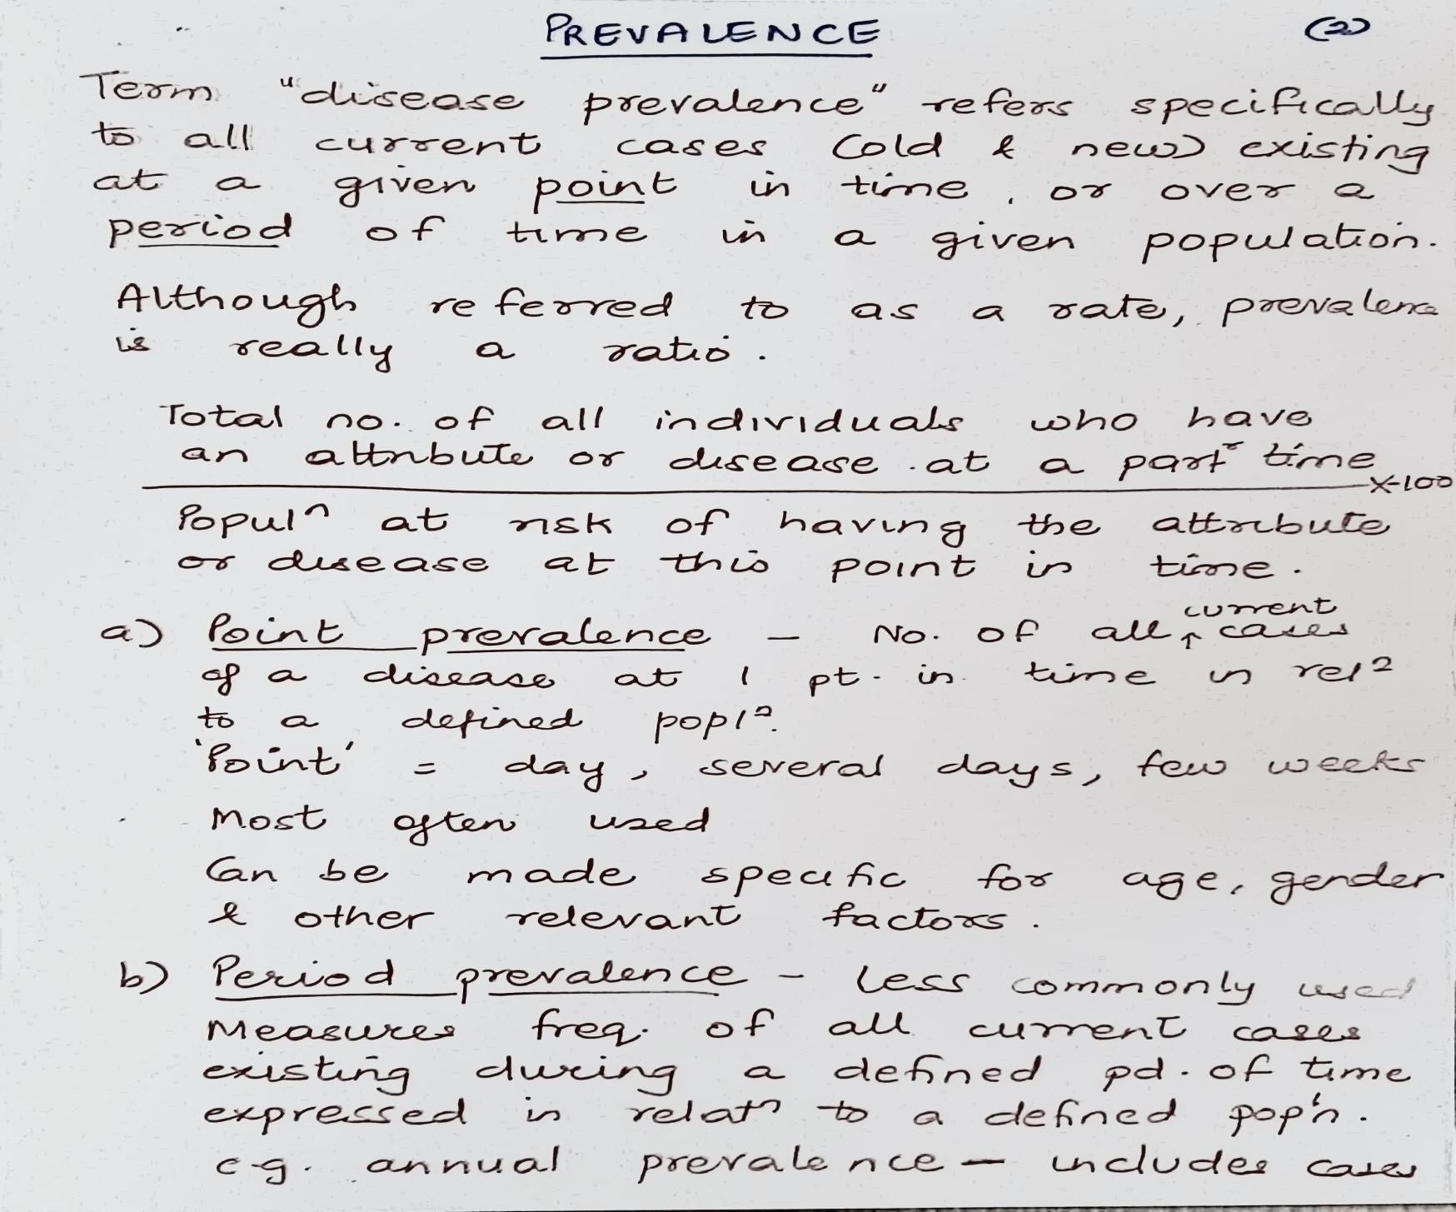

Slide 137


Slide 138


Slide 139



Slide 140
Disability data in India – Historical Perspective

Slide 141
Collection of data on disability dates back to 1872 with the first Indian Census.
Until 1931, it was referred to as infirmity. The rate of this infirmity per 1 lakh population varied between 228 to 369 during 1881 and 1931 i.e. approximately 0.23 per cent to 0.37 per cent of the population. The infirmities included insanity, deaf-muteness, blindness and leprosy.
The data collected during 1881 to 1931 were considered to be not reliable and hence the question on disability was discontinued during the censuses between 1941 and 1971.
Year 1981 designated as the International Year for the Disabled - a renewed effort was made to collect data on disability through a simple single question for three categories of disabilities: Totally Blind, Totally Dumb, and Totally Crippled.
However, as this data was found to be unsatisfactory, the question on
disability was again dropped in the 1991 census.

Slide 142
Census of India - 2001
It was only in 2001 that
Independent India began a
comprehensive Census enumeration of people with
disability.
In this enumeration, a person who could not hear at all (deaf) or could hear only loud sounds was considered as having hearing disability.
A person who was able to hear using hearing-aid was not considered as disabled under this category.
If a person could not hear through one ear but the other ear was functioning normally, he/she was considered having hearing disability.

Slide 143
Census 2001 revealed over 21 million people in India to be suffering from one or the other kind of disability. This was equivalent to 2.1% of the total population.
Seventy five per cent of persons with disabilities were in rural areas, 49 per cent of disabled population was literate and only 34 per cent were employed.
Among the five types of disabilities on which data was collected, visual disability (in seeing) emerged as the top category at 48.5%. Others in sequence were: Disability in movement (27.9%), mental (10.3%), in speech (7.5%), and in
hearing (5.8%).
The disabled by sex followed a similar pattern except that the proportion of disabled females was higher in the category of visual and hearing disability.

Slide 144
 | Population | Percentage (%)
Total population | 1,028,610,328 | 100.0
Total disabled population | 21,906,769 | 2.1
Disability rate (per lakh population) | 2,130 | --
Type of Disability
(a) In seeing | 10,634,881 | 1.0
(b) In speech | 1,640,868 | 0.2
(c) In hearing | 1,261,722 | 0.1
(d) In movement | 6,105,477 | 0.6
(e) Mental | 2,263,821 | 0.2
Disabled population as per sex and
age groups (Census 2001)
Age group (in years) | Persons | Males | Females
0-4 | 23723 | 12832 | 10891
5-19 | 266729 | 155179 | 111550
20-90+ | 968075 | 503754 | 464321
Age not stated | 3195 | 2032 | 1163
Disabled Population according to type of
disability as per Census (2001)

Slide 145
Census of India - 2011
Census 2011 – went a step further and collected information on eight types of disabilities as against five included in the Census 2001.
Information on disabilities namely, disability 'In Seeing', 'In Hearing', 'In Speech', 'In Movement', 'Mental retardation', 'Mental Illness', 'Any Other' and 'Multiple Disability’.
The question on disability vastly enlarged in Census 2011. The questions and the instructions were finalised after extensive deliberation with civil society organisations and the Ministry of Social Justice and Empowerment.
As per Census 2011 a person was considered as having disability 'In Hearing' if he/she: a) Cannot hear at all; b) Has difficulty in hearing day-to-day conversational speech (hard of hearing); or c) If she/he is using a hearing aid. Persons having problem in only one ear were not considered as having hearing disability. The condition of both the ears was taken into consideration for treating a person as disabled 'In Hearing'.

Slide 146
Approaches adopted in Census 2011
Information on disability was collected during the Population Enumeration phase of Census 2011 through ‘Household Schedule’.
Questions on disability were asked about all persons in the Household.
Enumerators were instructed to contact the disabled person in the household besides
the respondent to collect information.
All types of households, i.e. ‘Normal’, ‘Institutional’ and ‘Houseless’ households covered.
Questions & Instructions on disability were finalized after: Field Trial of selected Questions including disability in selected area, Extensive deliberation with civil society organizations & nodal Ministry, Pre-test of all census questions covering rural/urban samples in all States.
Aspects considered in finalizing questions: Simple nomenclature of the types/categories of disability for easy comprehension by both Enumerator & Respondent, Relevance of data for the planners & policy makers, Feasibility of canvassing the question, To cover all types of disabilities as listed in the Persons with Disabilities Act, 1995 and National Trust Act, 1999.
A filter question to ascertain disability status was included.
The placement of the question on disability in the Census Schedule was changed and the question was brought forward.
Special efforts were made to improve the coverage which included extensive training to
the enumerators and publicity measures.

Slide 147

As per Census 2011, in India, out of the 121 Cr population, about 2.68 Cr persons are ‘disabled’ which is 2.21% of the total population.

Slide 148


Slide 149
NSSO data
National Sample Survey Office (NSSO), made its first attempt to collect information on the number of physically handicapped in its 15th round (July 1959- June 1960) which was confined to rural areas only.
In NSSO 16th round (July 1960 – June 1961) the coverage was extended to urban areas.
The subject was again taken up for nationwide survey in its 24th round
(July 1969- June 1970) and 28th round (October 1973- June 1974).
The physical handicaps covered in the above-mentioned surveys were not always same, and information was collected through survey schedules meant for other subjects.
First comprehensive survey in NSS 36th round (July- Dec 1981) followed by a survey in 47th round (July- December 1991) to cover all persons with one or more of the three physical disabilities – visual, communication (ie. Hearing and or speech) and locomotor.

Slide 150
The last survey was carried out by NSS in its 58th round (July- December 2002), which extended the coverage by mental disability in addition to the three physical disabilities (visual, communication and locomotor). Along with the particulars of physical and mental disabilities, the socio- economic characteristics of the disabled such as their age, literacy, employment, vocational training etc. were collected.
For this survey, hearing disability referred to persons’ inability to hear properly. Hearing disability was judged taking into consideration the disability of the better ear. In other words, if one ear of a person was normal and the other ear had total hearing loss, then the person was judged as normal in hearing for the purpose of the survey.
Hearing disability was judged without taking into consideration the use of hearing aids (i.e., the position for the person when hearing aid was not used).

Slide 151
A person was treated as having ‘profound’ hearing disability if he/she could not hear at all or could only hear loud sounds, such as, thunder or understands only gestures.
A person was treated as having ‘severe’ hearing disability if he/she could hear only shouted words or could hear only if the speaker was sitting in the front.
A person was treated as having ‘moderate’ hearing disability if his/her disability was neither profound nor severe. Such a person would usually ask to repeat the words spoken by the speaker or would like to see the face of the speaker while he/she spoke or would feel difficulty in conducting conversations.
The reports of the NSSO surveys are available at
www.mospi.gov.in.

Slide 152
The data from the NSSO (2002) survey indicates the following: Movement 51%, Seeing 14%, Hearing 15%, Speech 10%, and Mental 10%. Following table shows the comparison between NSSO, 2002 and Census, 2001.
Disability | NSSO (in lakh/%age) | Census (in lakh/%age)
Locomotor | 106.34 (51.19%) | 61.05 (27.86%)
Visual | 28.26 (13.60%) | 106.3 (48.54%)
Hearing | 30.62 (14.74%) | 12.62 (5.76%)
Speech | 21.55 (10.37%) | 16.41 (7.49%)
Mental | 20.96 (10.09%) | 22.64 (10.33%)
Total | 207.73 (1.8) | 219.02 (2.1%)

Slide 153
According to NSSO round 47th (1991) and 58th (2002), the prevalence rate of hearing impairment according to age and sex (per 100,000) are shown in the following tables. NSSO (2002) provides detailed data across various age groups ranging from 0 to 60 years and above for the rural and urban population separately. The greater prevalence in the urban population can be explained owing to the greater facilities available in the urban areas and possibly greater awareness among the urban public.
Age wise distribution of hearing disability (per 100,000) in India as per NSSO
1991 and 2002
Age in years | 2002 |  | 1991
 | Urban | Rural | Urban | Rural
0-4 years | 55 | 55 | - | -
5-9 years | 172 | 142 | 235 | 184
Gender wise distribution of hearing disability (per 100,000) in India as per NSSO 1991 and 2002
 | Rural |  | Urban
 | 2001 | 1991 | 2002 | 1991
Males | 498 | 319 | 325 | 234
Females | 435 | 301 | 355 | 238

Slide 154
NSSO (2002) revealed that about 7% of people were born with a hearing disability.
About 56% and 62% reported the onset of hearing disability at
>60 years of age in the rural and urban areas, respectively.
This survey also provides state-wise data across each of the five disabilities included.
Population-based surveys in 2003 in India using the WHO protocol (>41 dB) estimated the prevalence of hearing impairment to 6.3 % or approximately 63 million people suffering from significant auditory loss. The estimated prevalence of adult onset deafness in India was found to be
7.6 % and childhood onset deafness to be 2%.
NSSO (2002) estimates that for 370 out of per 1000 hearing
disabled population, the onset is at birth.

Slide 155
While estimates may vary, there is growing evidence that individuals with disabilities comprise of 5 to 8 per cent of Indian population (WHO, 2011) of which an estimated 6 to 15% encounter hearing loss of some nature.
The problem of deafness is disproportionately high in the Southeast Asia region with a prevalence ranging from 4.6% to 8.8% according to WHO (2007) which further estimates that every year about 38,000 deaf children are born in South-East Asia. This would mean that every day over 100 deaf infants are born in this region. Thus the magnitude of hearing disability in the country is large and needs vital attention.

Slide 156


