Slide 1
B 6.3 Aural Rehabilitation in Adults
Unit 2: Listening Training and Speech reading for adults
Dr. Aparna Nandurkar
Professor
Dept. of Audiology and Speech Language Pathology
Sumandeep Vidyapeeth Deemed to be University
Vadodara, Gujarat

Slide 2
B 6.3 Aural Rehabilitation in Adults
Unit 2: Listening Training and Speech reading for adults
Listening to speech with a hearing loss
Candidacy for auditory training
Listening training to improve speech perception
Listening training to improve music perception
Benefits of auditory training
Speech reading for communication
Characteristics of good vs poor speech readers
Factors affecting speech reading
Assessing vision-only auditory-only processing
Traditional methods of speech reading training

Slide 3
Listening to speech with a hearing loss
- Reduced audibility
- Impaired frequency selectivity and temporal resolution
- Difficult environments
- Increased perceptual effort

Slide 4
Effects of SNHL – Reduced audibility
Understanding of speech acoustics is essential for fully understanding the effects of SNHL on speech listening.
Decreased sensitivity of the speech signal, especially for the frequencies that have characteristically low amplitude.
Hearing loss acts as a filter and attenuates or eliminates those sounds that are not of relatively high amplitude. As a result, some sounds are no longer present and some sounds are acoustically more like one another.
Many persons with SNHL have a sloping loss, so the attenuation and elimination of mid- and high-frequency speech information becomes exacerbated.

Slide 5
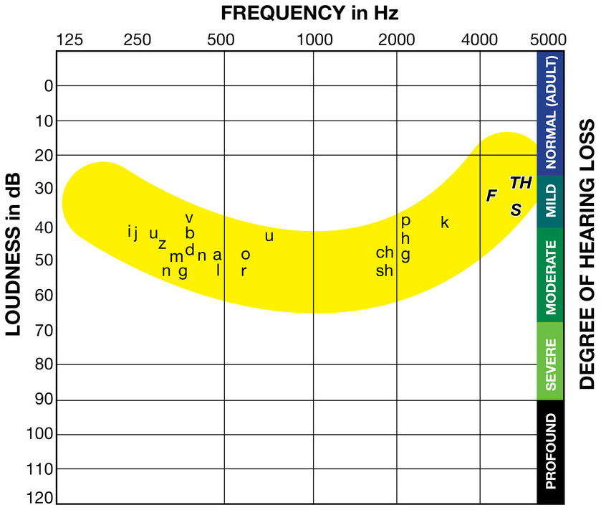
Speech spectrum

Slide 6
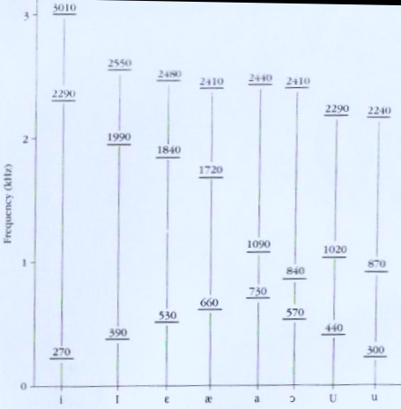
Acoustics of vowels

Slide 7
Frequencies of Consonants
Th (thin) The (the) 250-300 |  |  | About 6000 4500 - 6000
s |  |  | 5000 - 6000
z | 200-300 |  | 4000 - 5000
f |  |  | 4500-5000
v | 300-400 |  | 3500-4500
t |  |  | 2500 - 3500
d | 300-400 |  | 2500-3000
k |  |  | 2000-2500
g | 200-300 |  | 1500-2500
l | 200-200 |  | 2000-3000
p |  |  | 1500-2000
b | 300-400 |  | 2000-3000
h |  |  | 1500-2000
sh |  |  | 1500-2000 4500-550
ch |  |  | 1500-2000 4000-5000
j | 200-300 |  | 2000-3000
m | 250-350 |  | 1000-1500 2500-3500
n | 250-350 |  | 1000-1500 2000-3000
ng | 250 - 400 |  | 1000-1500 2000-3000
r |  | 600-800 | 1000-1500 2000-2100

Slide 8
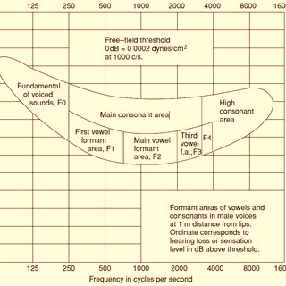

Slide 9
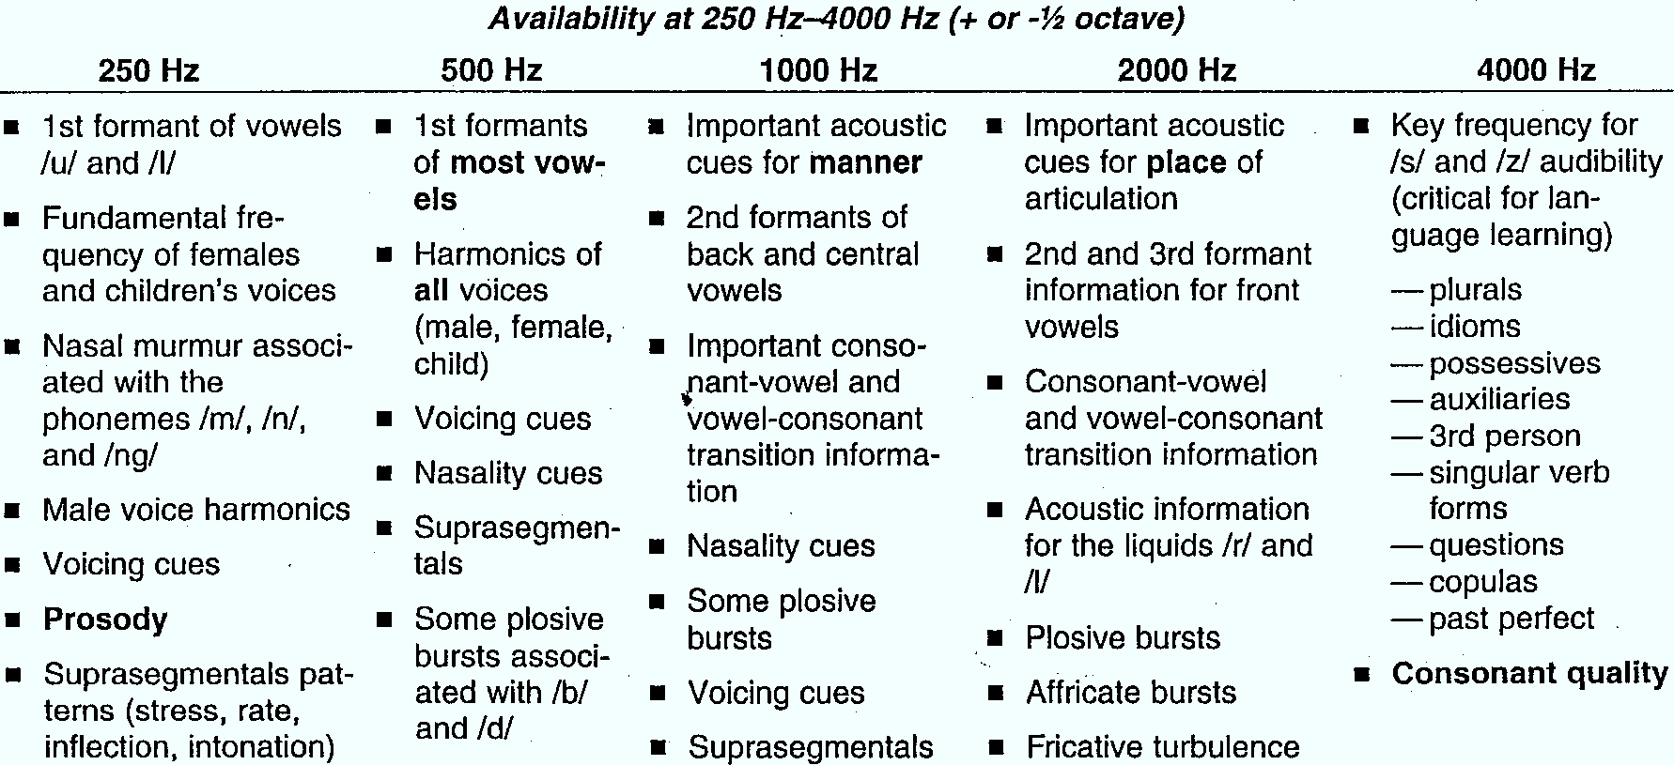
Speech Information

Slide 15
Effects – Frequency selectivity and temporal resolution
Frequency selectivity is the auditory system’s ability to respond differentially to different frequencies and bands of frequencies.
Many persons with SNHL have impaired frequency selectivity – e.g. if they are presented with two different tone pulses, one after another, they require a greater difference in frequency between the two pulses in order to perceive that they are “different pitches” than do persons with normal hearing.
Temporal resolution is the auditory system’s ability to perceive or discriminate sound segments occurring closely in time as separate events.
Many persons with HL have impaired temporal resolution - If they are asked whether a pulse has an interval of silence embedded in its center (i.e., tone pip-silent interval-tone pip), they require a longer temporal “gap” of silence before they say “yes”.

Slide 16
Impaired frequency selectivity and impaired temporal resolution negatively affect speech recognition, even when the signal is loud enough to hear as speech signal comprises a wide range of frequencies and changes rapidly over time.
E.g. spectrally similar words me and knee may be clearly audible to a person with HL, but because they have impaired frequency selectivity and is unable to make fine frequency discriminations, the two words may sound alike.

Slide 17
Effects – Environment
Background noise - The energy in the noise masks the speech signal. It blends with the speech signal & makes it difficult to perceive the sounds.
Reverberation - In a reverberant environment the reflecting signals reaching the ear are temporarily delayed and overlap with the direct signal, resulting in masking of speech.
Distance - If the distance between the speaker and the listener is more, the listener will miss out some of the information due to inadequate audition of certain speech sounds.
SNR - As the noise level increases, the ability to discriminate falls as noise masks the signal.

Slide 18
Effects – More perceptual effort
Perceptual effort is the effort that a person expends to recognize speech, sometimes at the cost of using processing resources that might otherwise be allocated toward encoding speech into memory.
A person with HL often expends more perceptual effort in attending to the speech signal. Due to this increased effort in identifying spoken words, fewer cognitive resources may be available to process information as it comes into working memory and to place the information into long term memory.
E.g. poorer recall for spoken strings of numbers, difficulty remembering content from the first sentence when asked to repeat string of sentences.
They may experience fatigue and/or decide to quit the task at hand to avoid becoming fatigued.

Slide 19
b) Candidacy for auditory training

Slide 20
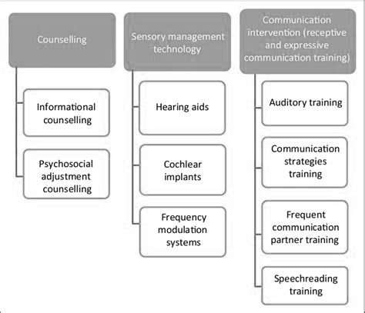
Components of Aural rehabilitation for adults
It involves listening, talking, problem solving, facilitating adjustment to a frustrating disability, and the development of trust between patient and audiologist
To target and enhance auditory function; to increase the probability of positive outcome from sensory management.
To target activity, by supplementing the learning opportunities provided by everyday communication

Slide 21
Who are candidates for AT?
New or changed HA
New users realize greater benefits from training compared with experienced HA users, although experienced users too have shown benefits from training
Dissatisfaction with aided listening performance
May benefit from receiving auditory training in specific conditions such as listening in noisy settings
New CI recipients
Training to accelerate the learning process that often occurs during the first months following implantation
Sudden acquired hearing loss
To adjust to their radically altered listening state
Even before HA fitting
For accepting limitations of HL and being open to trying HAs

Slide 22
Does AT work in adults? Rationale for AT in adults
Brain plasticity: Its relevance to aural rehab
Acquired hearing loss may cause functional changes in the central auditory system, changes that can affect speech perception.
Receipt of a hearing aid or cochlear implant may lead to secondary brain plasticity, and lead to secondary changes in speech perception (even after extended periods).
Neuronal changes may occur in the central auditory system as a result of auditory training.

Slide 23
Evidence for the efficacy of rehabilitation targeting auditory processing and neurocognitive function continues to grow.
Research suggests that to maximise auditory performance of listeners:
  Active auditory training
  Structured and targeted listening activities
Complementary to device fitting, active training of auditory and cognitive skills in combination - an alternative to further enhance communication skills for adults with HL.
Additionally, other considerations such as motivation, device competence and psychosocial function may be complimentary targets for intervention.

Slide 24
Evidences show….
Human speech perception is highly plastic.
Contextual cues play an influential role for adaptation to atypical speech input.
Listeners use lexical information to guide speech perception.
Extended passive listening through a device may not maximize speech understanding.
Comprehensive auditory training for newly fitted adults is feasible.
Structured training may speed up the process of perceptual learning.
Auditory training can lead to benefit beyond naturally occurring learning effects.
Training has an impact on long term device users not limited to post device fitting.
Improvements in daily life situations, such as QoL or self-confidence, may occur in absence of significant improvement in a speech perception task.
Stropahl, M., Besser, J., & Launer, S. (2020, Jul-Aug). Ear and Hearing, 41(4), 697-704. https://doi.org/10.1097/aud.0000000000000806.
Link to full article: https://journals.lww.com/ear-hearing/fulltext/2020/07000/auditory_training_supports_auditory.2.aspx

Slide 25
Theoretical bases of AT
Three theoretical underpinnings for auditory training have emerged in recent years, guided by the influence of principles of second language learning (Krashen, 1985, 1994).
Transfer-Appropriate Processing
Meaning-based orientation
Affective filter hypothesis

Slide 26
Transfer-Appropriate Processing
TAP theory - human learning depends upon the degree of compatibility between training tasks and measures of desired outcome.
Many studies indicate that benefits are tied to what is transfer appropriate: auditory training is most effective when using the same talker during both training and assessment and when using the same tasks during both training and assessment.
Additionally, when different tasks or talkers are used in training compared with assessment, the greater the overlap between the talkers (e.g., one of six talkers overlapping as opposed to zero of six talkers) and task type, the greater the benefit.
Effective training tasks focus on what the patient wants to learn. If the patient wants to understand his or her spouse better, use speech stimuli produced by the spouse as training stimuli. If the patient wants to understand everyday conversation spoken by various communication partners, use the words that have a high frequency of usage as training stimuli so the patient can quickly and easily recognize those words most likely to be spoken on a regular basis.

Slide 27
Meaning-based orientation
When a training task is meaning oriented, the patient must semantically process the speech signal, which entails activating regions of the brain that process semantic content.
By contrast, when a training task is form oriented, no semantic processing occurs, so activation of the semantic regions of the brain may be unnecessary.

Slide 28
Affective-filter hypothesis
This hypothesis recognizes that emotional factors can block input into a second language learner’s language acquisition process.
If a person feels like a hopeless, hapless outsider, the person may raise an affective filter that effectively blocks input that would allow him or her to progress in acquiring a new language.
Similarly, if a person with HL experiences high anxiety during everyday listening, continuous failure in recognizing speech, and low self-esteem, listening skills are unlikely to improve.
AT can be tailored to reduce a patient’s anxiety and to enhance a sense of community with other people who have hearing loss.
E.g. some computer-based training programs adaptively vary background noise during training so that patients always experience an 80% success rate, some use internet to connect patients through shared training goals and message boards.

Slide 29
Approaches/ Methods of Auditory Training in Adults
Walden, Erdman, Montgomery, Schwartz, and Prosek, (1981)
Analytic
Synthetic
Pragmatic
Eclectic
Brockett and Schow (2001) and Schow (2001)
Short-term audiologic rehabilitat-ion
Consonant Recognition Training
Erber (1982)
Detection
Discrimination
Identification
Comprehension
Blamey and Alcantara (1994)
Computerized Approaches to AT
Auditory training to improve speech recognition
Nancy Tye- Murray (2018, 2020)
Auditory training to improve music perception
Arthur Boothroyd (2007)
Sensory management
Perceptual training
Counselling
Instruction
Communication Training and Therapy
Anticipatory Strategies
Repair Strategies
Cognitive brain training
Based on Introduction to audiologic Rehabilitation 7th Edition -Ronald L. Schow, Michael A. Nerbonne

Slide 30
Objectives of AT in adults
When considering auditory training for adults, two general objectives are usually relevant:
1. learning to maximize the use of auditory and other related cues available for the perception of speech and
2. adjustment and orientation to facilitate the optimum use of the hearing device
Re-education or re/habilitation

Slide 31
Considerable amount of analytic drill work on the perception of phonemes that are difficult for the adult.
Speechreading combined with AT – if necessary
Because we often communicate under less-than-ideal listening circumstances, Carhart advocated that AT sessions for adults be conducted in 3 commonly encountered situations:
  (1) relatively intense background noise,
  (2) the presence of a competing speech signal, and
  (3) listening on the telephone.
Focus should also be on assertiveness training, communication strategies training.

Slide 32
c) Listening training to improve speech perception

Slide 33
Important aspects
Preliminary audiologic evaluation – speech perception important
Selecting and adjusting the amplification system
Consistent use of appropriate amplification
Monitoring amplification
Creating a listening environment
Following developmental stages in training – QUIET & NOISY
Evaluating outcomes
Modifying training accordingly

Slide 34
Training Programs
Auditory only, no visual cues
Scheduling – flexible
Monitoring performance is important
Live voice
Computerized programs – digitized speech stimuli, game format

Slide 35
Analytic speech perception training
Analytic auditory training involves structured syllable drill, aimed at improving the recognition of individual consonants and vowels (Walden et al, 1981).
The aim is to help patients learn to use speech cues that should be audible to them, but which for some reason they are not using.
Analytic training concentrates on developing the patient’s ability to differentiate between syllable patterns and between phonemes in syllables or words.
It attempts to break speech into smaller components (phoneme, syllable) and incorporate these separately into auditory training.
It is also called perceptual speech training.

Slide 36
Synthetic communication training
The emphasis is on the patient understanding the message, even if the patient does not correctly perceive every sound.
Training synthetically involves the use of meaningful stimuli (words, phrases, sentences).
Major part of the training involves teaching HI listeners to use any or all of the hearing strategies.
In addition, patients are given practice at understanding speech in a context where they are given feedback about what they perceive and misperceive.
Synthetic communication training is also called active listening training.

Slide 37
Active listening training
The goals are to develop good listening habits to increase the listener’s confidence and help them concentrate more on the meaning of the spoken message.
In this case, the listener frequently lets the talker know that the listener has understood the message (also called reflective listening), but implies the use of other hearing strategies as well.
Emphasis on coping strategies to enable the elderly adult with HL to comprehend the meaning of what was being said, when only part of it is actually heard.

Slide 38
Phoneme based training
Phoneme-based training may present nonsense syllables in VCV context, and/or in CV and VC context, or may present real words in a static context, such as vowels in an h–d context.
One rationale for this - learning to discriminate phonemes in nonsense syllables is akin to acquiring the “building blocks” of language, and this learning will generalize to recognizing larger speech units such as words and sentences.
Phoneme-based training hones bottom-up processing, which is the ability to recognize the constituents of syllables: their onsets, nuclei, and coda (offsets).
A patient may hear two syllables (e.g., ba-da) and be asked to determine whether the two are the same or different.
The use of nonsense syllables violates meaning-based orientation considered earlier.
For this reason, phoneme-based training may be modified in a way that requires a patient to both attend to meaning as well as engage in phoneme discrimination. E.g. four-choice discrimination task for net and nest.

Slide 39
Word based training
Word-based training emphasizes meaningful speech units, as opposed to the “building block” or sub-lexical approach of phoneme-based training.
In a typical training protocol, a student might identify which of a member of possible word choices occurred.
A student might hear a word during training and then indicate which word was spoken from a closed set of choices.

Slide 40
Sentence based training
Sentence-based training presents sentences as training stimuli.
The student listens to a sentence and then self-scores the sentence by clicking on the words heard correctly once the orthographic version of the sentence appears on the computer screen.
In the event of errors, the sentence replays before the program moves on to the next sentence.
Sentence-based training requires students to use both bottom-up processing and top-down processing skills, which is what they must do during everyday speech recognition.
Top-down processing, as it pertains to speech recognition, entails the listener using social and linguistic knowledge as well as expectations based on contextual evidence to identify sentences, in balance with the sensory evidence and bottom-up processing.

Slide 41
Cognitive skill-based training
Cognition includes those mental processes involved in obtaining knowledge, in comprehending, and in thinking, including such mental acts as remembering, judging, problem solving, perceiving, and thinking.
Interactions exist between the effects of peripheral hearing loss and cognitive functions such as working memory and selective attention, and hence these need to be worked upon during therapy.
Working on areas such as auditory attention, auditory processing speed, auditory memory is important especially in older adults or adults with long durations of deafness.

Slide 42
Speech tracking
Speech tracking involves reading a story to listener, one line at a time. Listener repeats back what he/she heard verbatim.
The goal is to help adults with hearing loss attain a tracking rate of at least 50 words per minute, which in turn will improve their communication ability in daily life.
It consists of give-and-take elements of naturally occurring conversations. It is a structured “conversation-like” task that combines sentence identification and auditory comprehension.

Slide 43
Computer-based auditory training
Computer-based training makes it relatively easy to provide repetition and reinforcement, give immediate feedback,adapt difficulty to keep the task challenging but achievable, engage the patient in active participation, and document and display progress to sustain motivation.
There are several computer-based auditory training programs now available. Those for adults include:
  Listening and Communication Enhancement (LACE)
  Read My Quips

Slide 44
Listening and communication enhancement (LACE)
LACE is designed to offer adults with HL exercises meant to enhance listening skills and improve communication.
Provides activities to address listening in adverse conditions and some of the cognitive changes that impact aging adults.
It comprises tasks involving speech perception in babble and against competing talkers, time-compressed speech, and closure skills.
LACE is divided into three main sections:
  Degraded speech
  Cognitive training
  Communication strategies

Slide 45
Speech perception assessment & training system
The Speech Perception Assessment and Training System (SPATS) developed by the authors at Communication Disorders Technology, Inc.
SPATS has two main modules:
  The Sentence Module: provides practice in top-down and combined top-down and bottom up speech perception skills.
  The Syllable-Constituent Module: designed to test and train the identification of all of the significant components of syllables; onsets, nuclei, and codes.
Top-down skills are the abilities to use knowledge of linguistic context to identify words in spoken sentences. Bottom-up skills are the abilities to identify the constituents of syllables: onsets, nuclei, and codas in quiet and noise as produced by eight talkers.

Slide 46
Applications of SPATS
Assess and train speech perception by adult HI/CI users.
It can be used to assess and to successfully train the perception of American English by adult ESL-learners.
It has potential for hearing-aid and cochlear-implant research.
It has potential for hearing-aid fitting and cochlear-implant fitting.
SPATS, with response screens translated to IPA, has potential for use in teaching phonetics.
It may have potential in retraining people with CNS damage.

Slide 47
clEAR
Customized learning: Exercises for Aural Rehabilitation (Tye-Murray, 2016)
Presents listeners with a weekly lesson plan, telling them which training games to play that week and, importantly, why they are playing the particular games.
The program has lesson plans that are uniquely tailored to the patient’s particular listening needs, consonant with Transfer-Appropriate-Processing theory (human learning depends upon the degree of compatibility between the training tasks and measures of desired outcome).
For example, clEAR has a lesson plan for the listener with a new HA, for the listener who wants to understand speech better in the presence of background, and for someone who wants to train with the speech of a spouse or other important communication partner.
The clinician has access to the patient’s feedback charts, so can not only send a lesson plan each week, but provide specific feedback based upon the patient’s charts.

Slide 48
Sound and Beyond
Sound and Beyond (Cochlear Americas) includes auditory training materials for adults with severe to profound losses.
It includes exercises on pitch discrimination; environmental sound discrimination and identification; discriminating male and female voices; discrimination and identification for vowels and consonants; word discrimination; sentence recognition; and identifying musical instruments and tunes.

Slide 49
Resources for listening Training for adults
Adult Cochlear Implant Home-Based Auditory Training Manual Post-lingual Hearing Loss by Henry, Pedley and Fu (2015). Published by Cochlear Ltd. https://mss-p-007-delivery.sitecorecontenthub.cloud/api/public/content/36eb806e052c4bc69acdecddbbab8a8c?v=be24a341
Adult Auditory Rehabilitation Guide by Pedley, Lind and Hunt (2005). Published by Cochlear Ltd.
Aural Rehabilitation Resource Guide. (Lists resources for purchase, online free resources and Apps) https://www.med.unc.edu/ent/adultcochlearimplant/wp-content/uploads/sites/518/2017/11/aural-rehabilitation.pdf
http://angelsound.tigerspeech.com/
http://www.thelisteningroom.com/
http://www.manythings.org/ac/
http://www.esl-lab.com/
http://www.cochlear.com/wps/wcm/connect/us/communication-corner/program-selection/adults.htm
Adult Rehabilitation Kits. Set of 13 kits. https://blog.medel.pro
Rehabilitation Digital (ReDi) App by Med-El.
Rehab at home for adults. Video series by Med-El. https://blog.medel.com/tips-and-tricks/
Smart Tips for CI users by Med-El. file:///C:/Users/intel/Downloads/21557CE_r3_0-SmartTipsForCIUsers-WEB.20240314072352909.pdf
Hearing Success. App by Advanced Bionics for Adults and teens.
able CLIX (Advanced Bionics Listening Exercises – able). ios App.
Starkey Hear Coach

Slide 50
Advantages of games
Playing video games is pleasurable.
Pleasant activities (playing video games) cause the brain to increase production of dopamine, a neurotransmitter that acts as a “messenger” between brain cells.
Increased dopamine levels enhance neural plasticity.
Enhanced neural plasticity allows for greater perceptual learning.
Hence, individuals with HL have better potential for learning to use their residual hearing when playing auditory training games than when engaging in rote auditory training tasks.

Slide 51
Advantages of computerized instruction
Many different talkers can speak training items, which may lead to training benefits generalizing to the real world, where many different talkers are encountered.
Many training items can be presented in a relatively short period of time; concentrated training may lead to faster learning and maintains a student’s interest.
Training is interactive, which means that a student’s response to one training item determines what will happen next; response contingency may lead to enhanced learning.
A record can be maintained of correct and incorrect responses, which affords a means for the clinician to monitor progress.
Training difficulty can vary adaptively, based on a student’s performance.
Instruction is self-paced; students can proceed through an exercise as slowly or as quickly as they choose.
Training can occur in the student’s home and at the student’s convenience.
Training can be self-guided, meaning that a student can choose which activities and exercises to complete.
Costs may be less than labor-intensive clinician-based training.

Slide 52
Independent listening practice - important
Reading out loud to experience own voice
Listening to audiobooks/ podcasts
Watching movies and videos
Phone calls/ video calls
Listening to familiar music
Singing

Slide 53
d) Listening training to improve music perception

Slide 54
Why music?
Similarities in music and speech/language
  Shared terminology – pitch, timbre, timing, intensity
  Melodic contour in both
  Similar strategies used while listening to both
  Early exposure is critical for both
  Time ordered sequence of milestones in acquisition
Differences between music and speech/language
  Music encompasses a greater spectral range
  Music can exist without language
  Language can be altered in music without changing the music itself
  Spoken language exposure is much more than music exposure around us
More music training with CI users

Slide 55
Terminology in music
Rhythm refers to a pattern of sounds and silences that is repeated.
Pitch is a perceptual phenomenon that allows the ordering of sounds along a frequency scale, and is a psychological impression of frequency.
A melody is a sequence of musical tones that are perceived as a single entity.
Timbre is the quality of a musical note that distinguishes different sound sources, such as wind instruments (e.g., a flute) and string instruments (e.g., violin).

Slide 56
Musical Feature Approach
Trains to perceive the structural features of music, such as rhythm, pitch, melody, and timbre – bottom-up approach.
As music is a complex combination of features, a starting point in learning to perceive and organize these features is to learn to perceive and appraise them one by one.
These skills may then generalize to more realistic music listening, and the experience may become more pleasurable.
A typical exercise - to train the recognition of musical instruments, a skill that requires timbre perception. E.g. listeners might be presented the same simple melody over and over, each time produced with one of 12 different instruments and the task is to identify which instrument played a given sample. Alternative tasks - identify simple melodic contours and indicate the pitch contour e.g. rising, falling.

Slide 57
Whole Song Approach
Provides positive and ultimately pleasurable music listening experiences, and is epitomized by some of the activities developed for Med-El and for cochlear implant users seen at the Hearing Rehabilitation Foundation (Plant, 2009).
In this training program, listeners cycle through the following activities:
listening to familiar melodies
listening to songs with simple musical styles; these are songs that have “easy to-access” lyrics and minimal instrumental accompaniment
playing music videos so they can watch the performer’s mouth form the words to the lyrics and see the performer’s body sway to the rhythm
experiencing a live performance, as when a clinician plays the guitar and encourages the patient to sing along
listening to music composed for cochlear implant users, music that is characterized by low frequency timbres, many instrumental solos, and avoidance of complex harmonies.

Slide 58
e) Benefits of Auditory Training

Slide 59
Factors affecting auditory training
Residual hearing
Duration of deafness
Hearing aid use – appropriately fitted
Duration of HA use – number of hours per day
Significant others support
Listening needs
Approaches used
Difficulty of activities
Stimuli used – relevance, interest
Opportunity to carryover skills learnt in training
Motivation
Consistency in practice
Associated impairments
Cognitive and executive skills – attention, memory

Slide 60
Barriers to good listening
Distractions
Feelings of failure
Emotional problems
Lack of motivation
Inappropriate material – too simple or too difficult
Lack of practice
Poor habits – faking, laziness, wandering mind, scanning
Inadequate understanding of principles involved
Inadequate knowledge of progress
Intelligence, cognitive issues

Slide 61
Reported benefits
More listeners who receive auditory training use their hearing aids as opposed to those who do not
Gains in speech discrimination and recognition – enhanced speech perception
Enhanced communication, also in adverse listening conditions
Confidence in speaking with both familiar and unfamiliar talkers
Significantly less perceptual effort and fatigue
Increased music enjoyment
Cognitive benefits – attention, working memory

Slide 62
Assessment in listening training
Why assess?
What to assess?
  Hearing aid itself
  Duration of hearing aid use
  Aided audiogram
  Specific listening skills
Specific techniques
  Ling’s test
  Speech audiometry tests
  Speech perception tests – WRS in quiet and noise, HINT, SPIN

Slide 63
Ling’s six sound test
/a/, /ee/, /oo/, /s/, /sh/, /m/
/a/ – 700 Hz, 50 dB HL
/ee/ - 1000 Hz, 45 dB HL
/oo/ - 400 Hz, 50 dB HL
/s/ - 6000 Hz, 35 dB HL
/sh/ - 2000 Hz, 55 dB HL
/m/ - 1500 Hz, 45 db HL
Performance indicative of aided ability

Slide 64
Simple and quick test given first by Ling (1970).
Can estimate child’s ability to detect and identify speech sounds across the speech frequencies.
Can be administered at awareness level or identification level.
Parent can perform the test each day to check the child’s auditory abilities as well as the functioning of his device.
Teacher should perform before each auditory training session.

Slide 65
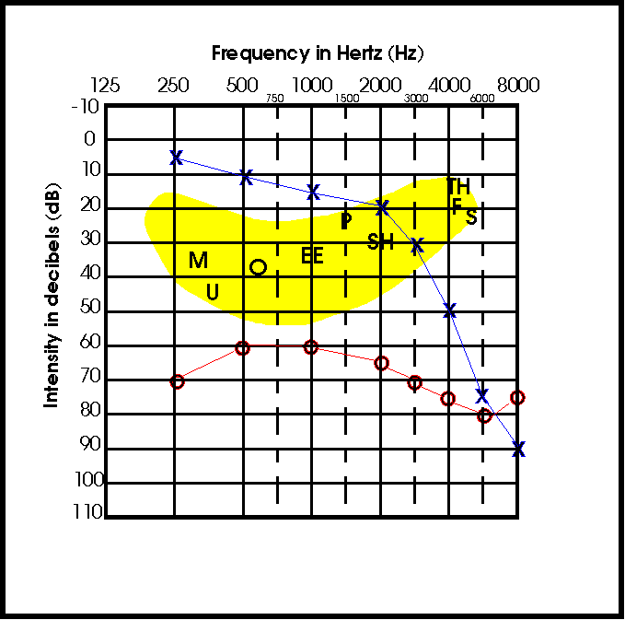

Slide 66
Interpretation of Ling’s Six sound Test
Responses till 1000 Hz – should hear vowels spoken softly at 5 yards distance
Responses till 2000 Hz should be able to hear /sh/.
Responses up to 4000 Hz should be able to hear /s/.
Ability to hear /sh/ predicts ability to hear /i/ and also to discriminate it from /u/ as second formants for /i/ and /sh/ fall in same frequency range.
Ability to hear /u/ but not /i/ indicates poor high frequency hearing.
Ability to hear /a/ but not /u/ indicates insufficient gain below 1000 Hz.
Inability to hear /sh/ indicates poor residual hearing or poor gain in 2000-2500 Hz range and inability to hear /s/ indicates poor gain at 4000 Hz.

Slide 67
Listening environment……
Three main measures to develop listening environment
Acoustic treatment
Assistive Technology
Listening culture and attitude

Slide 68
f) Speech reading for communication

Slide 69
Speech reading
Lipreading is the process of recognizing speech using only the visual speech signal and other visual cues, such as facial expression.
Speechreading is speech recognition using both auditory and visual cues. It is defined as a method of oral communication in which one uses communication strategies to aid in dialogue when some of the auditory information is missing due to hearing loss or a noisy environment.
Makes use of the visual clues of the speaker's lip and facial movements, gestures, posture and body language, along with residual hearing to make use of the speaker’s verbal communication, intonation and context to infer meaning.
People with normal hearing routinely rely on speechreading. A person with hearing loss will depend still more on the visual signal. The greater the hearing loss, the more a person will rely on visual information for communication.

Slide 70
Components of speech reading
Gestures and body language – movements of hands, arms, legs, body position
Facial expressions
Situational cues – place of conversation, roles of people talking
Language and linguistic redundancy

Slide 71
Need for speech reading
Factors affecting clear access to auditory signal – distance, noise, SNR, reverberation
Listening through a hearing device – limitations of the devices – frequency range, noise, poor response at high frequencies
To enhance communication - The aim of speech reading is improved viewing habits and skills so that visual information can be integrated with the auditory information & used to compliment it .

Slide 72
Who needs speech reading instruction?
Any adult with a good hearing aid who still finds that he is not understanding the conversation of those around him needs instruction.
Adults with greater degree of HL, HF sloping losses, retro-cochlear pathologies
For communication in challenging environments
Individuals with tactile devices and cochlear implants

Slide 73
g) Characteristics of good vs poor speech readers

Slide 74
Important factors that predict good speechreading ability
1. Cognitive skills predicting good speechreading ability include
Verbal working memory - temporary storage mechanism that allows incoming information to be actively manipulated
Spatial working memory - responsible for temporarily storing visual information and permits active utilization and updating of visual information from the environment and about one’s spatial position.
Processing speed - rate at which information is conducted and manipulated throughout the nervous system.
2. Age – Young adults do better. Aging adversely affects SR ability.
3. Congenital HL better than those with acquired HL.

Slide 75
Other factors that may predict good speechreading ability
Ability to use contextual cues, willingness to guess, mental agility, linguistic and world knowledge – may have some contribution
Some factors that are not contributing to speechreading ability – intelligence, educational attainments, gender, gaze behavior

Slide 76
h) Factors affecting speech reading

Slide 77
Speaker
Speaker related factors
Lip movements
Nonstandard speech production movements
Rate of speech
Familiarity
Speaker visibility
Viewing angle
Speech habits of the speaker
Gender of the talker

Slide 78
Speech reader
Speech reader related factors
Synthetic ability
Amount of training
Flexibility/Adaptation
Language comprehension
Degree of hearing loss
Duration of hearing loss
Personal factors – emotional, motivation, self confidence
Visual skills – acuity, attention, discrimination, memory
Residual hearing

Slide 79
Environment
Communication environment
Distance from speaker
Lighting
Viewing angle
Sensory distractions
More number of speakers
Noise

Slide 80
Signal or stimulus factors
Visibility of sounds
Rapidity of speech
Coarticulation and stress effects
Visemes and homophenes
Interspeaker variability in production

Slide 81
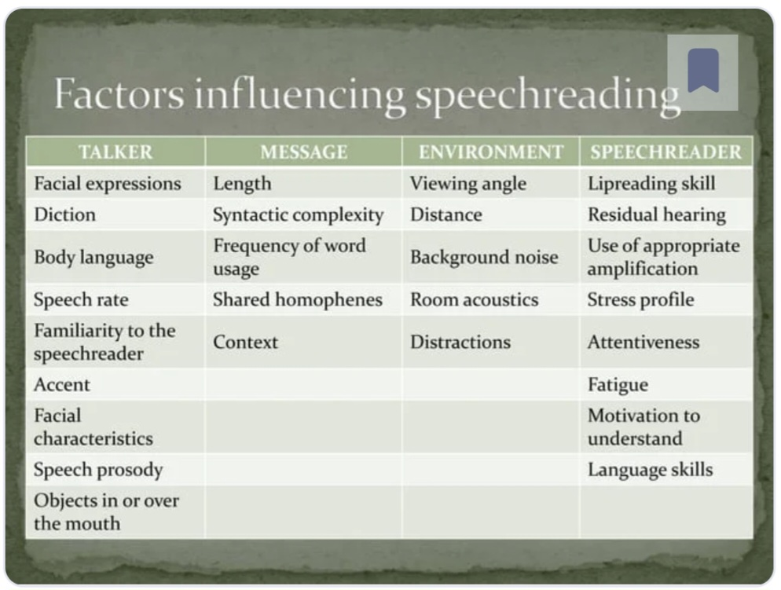

Slide 82
Audiovisual integration
When people speech read, they integrate what they hear with what they see.
Audiovisual integration occurs when information from the auditory and the visual signal combine to form a unified percept.
What we hear influences what we see, and what we see influences what we hear.
McGurk effect - when we recognize speech, we integrate auditory and visual speech information so we perceive a unified percept, and that this integration is obligatory.
Cross-modal enhancement occurs when the response to a stimulus presented through one modality (e.g., hearing) is augmented or modulated by another stimulus presented through a different modality (e.g., sight).
Different theories as to when this integration takes place.

Slide 83
i) Assessing visual-only and audiovisual speech recognition

Slide 84
Assessment
Pre- and post-training assessment
To determine how well they can recognize speech in an audition-plus-vision condition, which is how we communicate typically in face-to-face conversations.
To determine their speechreading enhancement, which indicates how effectively they are using residual hearing to augment the visual speech signal.
Vision-only – Recorded, talker facing, head and shoulders visible, good lighting, plain background.
Variety of speech stimuli and contrasts used.

Slide 85
Scoring
Two different ways of calculating speechreading enhancement score.
A simple difference score by subtracting the percentage correct score obtained in a vision-only condition (V) from the percentage correct score obtained in an audition-plus-vision condition (AV): AV% correct – V% correct. The greater the difference between the two scores, the greater the amount of enhancement provided by the auditory signal.
A normalized ratio score may be computed by first figuring out how much room for improvement there is in a vision-only condition, then referencing the amount of improvement gained with the addition of the auditory signal to that amount available. The formula for computation is: AV% correct—V% correct/100% – V% correct.

Slide 86
j) Traditional methods of speech reading training

Slide 87
Traditional Methods
1. Analytic v/s Synthetic
2. Early v/s Recent
3. Adult v/s Children
Most accepted – Analytic vs Synthetic

Slide 88
Various methods
Analytic
Jena
Mueller Walle
Bruhn’s
Early
Jena
Mueller-Walle
Nitchie
Kinzie
Adult
Bruhn
Kinzie
Brauckman
Synthetic
Nitchie and Kinzie
Morkowin Moore
Jeffers
Raymond Hull
Recent
Moore
Jeffers
Others
Children
Bruhn
Kinzie
Jena

Slide 89
The Jena method
Brauckman Method in Europe and Jena method in the United States.
According to this method, the speech reader learns all of the sound movements by imitating everything the speaker says.
The theory is that after enough training in imitation, the speech reader should be able to remember the feel of the sound as he or she watches a speaker. This is called kinesthetic awareness and is supposed to substitute for hearing.
The speech reader who has developed kinesthetic awareness should be able to more easily understand others.
The basis of the system is syllable drill. The pupil is expected to speak in unison with the instructor and to imitate his lip and jaw movements, at the same time concentrating on the kinesthetic sensations experienced.

Slide 90
Sound movement is introduced at the beginning of each lesson
Drill on repetition of syllable containing the sound
Drill on words made from syllables
Drill on sentences containing these words
Sentences lead to a story
Questions probing understanding its meaning

Slide 91
According to Brauckman, speech has five forms:
The movement form - the total of all movements made by the speech organs, or the complete physiological process.
The audible form - the sound effect which corresponds in every detail to the complete movement form.
The visible form - the movements of speech organs which are visible to the watcher.
The mimetic form - facial expression, glance of the eye, smile, frown, nod or shake of the head, posture attitudes, any bodily movement timed with the words in order to give a clue or to clarify meaning, a visible phenomenon.
Gestures - primarily arm and hand movements used for emphasis, a visible accompaniment of speech closely bound with meaning and rhythm.
It is pointed out that the “movement form” is the only form of speech, other than the audible form, which is complete. Hypothesized that if a person with HL could in some way become aware of all the movements of speech, he could understand as well as though he heard. This can be done by imitation.

Slide 92
The rhythms of speech are considered most important. Therefore, imitation of syllable drills is done using different rhythmic patterns.
Vowel sounds are combined with the various consonant sounds, presented and imitated in one of the four basic rhythms of speech. The 4 rhythms are:
First syllable accented , second unaccented.
First syllable unaccented , second accented.
First three syllables unaccented , fourth syllable accented.
First two syllables unaccented , third syllable accented.
The description and classification of consonant sounds is based not on their visible appearance, but on their formation. They are classified with respect to whether the primary movement is of the lips, tongue, tongue-soft palate.

Slide 93
The Mueller-Walle Method
In 1902, Martha Bruhn introduced the Mueller–Walle method to North America, a primarily analytic method originated in Germany.
The hallmark feature of this program was an emphasis on rapid syllable drill, and rapid phrase recognition.
Students also practiced recognizing homophenous words, using sentence context cues to distinguish between possible meanings, such as ROB won the game versus The children like to ROMP in the garden.
This system lays much stress on the change in appearance of various sounds because of transition. Speech sounds are categorized with respect to their visible characteristics, and lessons are based upon a sound movement or a group of sound movements.

Slide 94
It has more synthetic components than the Jena method.
Exercises include:
“add-a-word” or “add-a-phrase”: Words and sentences are developed from syllable drill. Then the first part of the sentence is repeated , but new words or phrases are added to make new sentences. For eg: “Where are you going?” “Where” do you live?” “Where” do you work?”
Work on homophenes: The students identify a group of homophenous words and select the correct word from the information provided by a sentence.
Exercise story: The teacher introduces a story to the group by using full voice to teach important vocabulary. In addition she presents a group of sentences about the story (clue sentences). The story is then presented with reduced voice and then questions are asked.

Slide 95
Consonants are divided into 2 classes and within each category the sounds are described with respect to their appearance and production.
Class I: Those consonants with the cavity of mouth closed constitute all of the visible consonant movements. All of these are introduced in the 1st session. They are: /f/ /v/ ; /s/ /z/ ; /p/ /b/ /m/ ; /w/ /wh/ ; /sh/ ; /th/.
Class II: Those consonants with the cavity of mouth open.
Vowels are considered to have 4 principal movements:
The lower jaw downwards
The lower jaw moves upward
The lips move forward
The lips move backward.
Five vowels are introduced in the 1st session (IPA: a, ou, u, ei, i). Vowels are considered to be more visible than consonants and hence most important part of the word.
As additional sounds or groups of sounds are introduced in succeeding lessons, they are combined with sounds previously introduced. Eye training is effected through the use of syllable drill.

Slide 96
Each consonant is first practiced in combination with each vowels sound, e.g., fä, fō, fōō, fā, fē, and sä, sō, sōō, sā, sē.
Finally syllables are put together providing consonant as well as vowel contrast and given in groups of two or three, e.g., fä-mä; sē-mē-sō; mā-sē-mē; etc.
An example of a syllable drill used for eye training and leading to a meaningful sentence is :
mā mō Sho me
mā mō Show me the way
mā sē Show me the way to the shop.
Some additional sentences from lesson I are:
  Show me the way to the sea.
  Show me the path to the beach.
Note that the stem of the sentence is repeated, and a new phrase or ending is added on in each instance.
The order of teaching is analytical and from the part to the whole. Training in association is not separated from eye training.

Slide 97
Disadvantages:
By trying to base the lessons around a limited number of sound movements, this method ends up with lesson material that is usually highly visible, but despite this, often difficult to speech read.
The difficulty stems form the fact that sentences that are artificially constructed to meet the criteria are often not functional.
Training in association is not separated from eye training. Sentences evolve out of the syllables designed for eye training. Because of this limitation, and because of further restriction that sounds not yet introduced in the course of study may not be used to form new words, the sentences of the part of the first few lessons are stilted, unnatural, and for the most part, nonfunctional.

Slide 98
Bruhn Method
The basis of the Bruhn method was rapid rhythmic syllable drills.
Aim was like Nitchie. She felt that the pupil should learn to
Feel the sound sensations of speech.
Observe carefully.
Be alert and quick to perceive the rapid movements of speech.
Like Nitchie Bruhn conceived of speech reading as the training of the eye and mind. Grasping the whole rather than parts was stressed.
She felt that the study of speechreading involved visual, auditory and motor memory.

Slide 99
Stressed the necessity of never using one syllable alone except when explaining the movements associated with it.
In the construction of syllable drills, there should be contrast in the direction of movements of syllables.
The rhythmic aspects of the syllables must also be considered.
One syllable of a group should be carried over to the following group.
Exaggeration and syllable separation should be avoided. They should glide into each other and the student should take them as fast as possible.
Drills must be repeated until the speech reader can recognize them subconsciously.
The very obscure movements can be drilled in sentences.

Slide 100
Bruhn’s plans for lessons are divided into four parts.
The first is definition of the movement or movements of the new sound to be studied. These movements are contrasted with the ones previously studied, and are presented by the teacher from various angles.
The second part of the lesson consists of written work.
The third, a brief story or talk.
The fourth is devoted to group practice or a question period.
The lesson is to be given with voice at all times.

Slide 101
Primarily synthetic methods
Synthetic Methods were developed as sensory limitations became all to clear.
Synthetic approaches focus on word, phrase and sentence resolution.
The speech reader is encouraged to focus on coarticulatory cues and linguistic context more so than individual phonemic element.
A word by word, phoneme by phoneme approach to message resolution is discouraged.

Slide 102
The speech reader should be able to “synthesize” the communicative intent of a message from having observed some of it and complete the thought by filling missed words using personal knowledge of the speaker, situation and context.
It was recognized that the language is redundant and that not all information must be received visually or auditorily for the meaning to surface.
Emphasis is placed on comprehension (not repeating word for word of sentences and longer passages).
Nitchie Method and Kinzie Method are based on this approach.

Slide 103
Nitchie method
Uses both “eye training” as well as “mind training”.
Nitchie said that lip reading as an art comprises fundamentally two different kinds of skills:
The ability to recognize quickly the sound and word formations as shown by the visible organs of speech
The ability to grasp the thought of the speaker.
Set forth the following principles that he felt were essential to the technique to the teaching of speech reader:
Be natural
Be thorough
Make the work interesting
Lose no opportunities
Guard against methods that may interfere with the development of any desirable habit
Seek to meet the peculiar needs of each pupil.

Slide 104
For the eye training he suggested that accuracy could be developed through practice with lists of words and sentences in which only one word or movement is changed from sentence to sentence. Mirror practice was also recommended.
For eg in the lesson for [L], some of his movement words included; [she, thee, lee], [teach, teeth, deal], [shed, then, let] , [edge, eth, ell].
Students were asked to compare and contrast the movement of [L] and thus subconscious knowledge of the movements involved in speech reading was done.

Slide 105
For mind training:
Emphasis on synthesization and not word for word accuracy.
Belief that understanding the words from the thought was more important than the thought from the words.
Whether the unit being a short sentence, groups of sentences, or stories, stress should always be placed upon the whole rather than parts.
Development of intuitive power was also emphasized:
His technique was to tell the pupil a familiar story and then retell it, adding many details. The pupil was then given questions to answer concerning the story.
Still another way to develop intuitiveness was to present the student with a practice word that he understood, and then immediately follow with a sentence containing the word.
Another method was to present the student several sentences, one after another, each associated in thought. Homophenous words, colloquial forms, conversion practice, and informal lectures were suggested as useful ways to exercise intuitive powers.

Slide 106
The Nitchie Method makes use of stories, i.e., humorous anecdotes, as well as sentences, to effect “mind training”, but sentences are the primary tool. Pupils are not permitted to interrupt the instructor when they fail to catch a word or a phrase and are encouraged not to give up but to continue watching.
The student would be trained from the first to grasp the thought as a whole by using sentence and story together. The student should not be permitted to interrupt until a sentence, or a complete thought is finished thus training the mind to continue working instead of stopping as soon as something is not understood.
In conversation there is no time to stop and think back or ask what has been said and so the mind must be trained to continue to follow the speaker.
Stressed the importance of using voice in giving instructions and warned the speaker against mouthing, breaking rhythm, and repeating single words in talking to the hard-of-hearing.

Slide 107
Kinzie method
Given by Cora & Rose Kinzie.
Represents a blend of principles and practices set forth by both Nitchie (psychological approach to speech reading and practice words and sentence building) and Bruhn (introductory classification of sounds).
The Kinzies then constructed a series of graded lesson materials for children and adults.
The graded materials for both adults and children are built upon the same word list and the movements are presented in the same order.

Slide 108
In the construction of sentences the Kinzies laid down specific guiding principles.
Sentence should be definite such as “The baby’s shoe is on the sofa” and not indefinite as “It was the least possible”.
They reasoned that indefinite sentences have no distinguishing characteristics and therefore do not give the pupil a fair chance to employ his intuitive and synthetic processes.
Natural sentences resemble those used in conversations.
Inverted sentences with phrases or clauses appearing at the beginning would be classes as unnatural.
They asserted that sentences must be interesting, pleasing, rhythmic and dignified.
Word selection should also be natural.

Slide 109
In story selection the Kinzies considered the short, humorous story to have the greatest value for beginners and intermediates.
They also suggested good stories concerning famous people as excellent materials for these two levels.
For the advanced levels they advised utilisation of choice literary selections.
Thus Kinzies stressed on synthetic approach to speech reading as well as mirror practice and use of voice.

Slide 110
Similarities between Nitchie and Kinzie methods
Nitchie (1950) and Kinzie (1931,1936) believed that both the eye and the mind must be trained but mind training was more important.
Although there are both analytic and synthetic components in their methods, the emphasis is on the synthetic approach.
Words are used for eye training.
During a typical lesson a sound movement is explained.
The students then speech read practice words containing that sound movement, followed by sentences using practice words.

Slide 111
MORKOVIN-MOORE - Life Situation Speech Reading
It was first developed in 1938 by Morkovin and Moore. The units of instruction are filmed conversations such as might emerge from life situations.
They believe that a PWHI, if he is to learn to follow conversation, must make use of a number of senses and must make simultaneous progress in a number of directions.
He needs to develop situational insight, language proficiency, ability to piece together fragments of words, to substitute visual for auditory cues, and the ability to gain information from kinesthetic and rhythmic cues.
The speech reader speech reads conversation hence, conversations deriving from common every day situations would appear to be most appropriate. This idea can be expressed by the letters AVKR, which stands for auditory, visual, kinesthetic, rhythmic sensory integration.

Slide 112
Proceeds from the whole to the part, but does not neglect the “part”.
Titles of some of the life situation films are “The Family Dinner”, “At the Service Station”.
The movies are usually shown at least three times. The student is asked to focus his attention on the whole situation the first time, on the “detailed parts of incidents” the second time, and “on the lip movements” the third time. Following the showing of the movies, questions are asked about motivation, situation, setting, etc. but not about the script.
Each script is intended to emphasize certain speech sounds. Following the script for the movie and questions related to it are additional exercises designed for auditory training, visual or eye training, and kinesthetic-rhythmic training, and vocabulary expansion.

Slide 113
Criticism of Morkovin-Moore system
The major adverse criticism of this system has to do not with the philosophy, but with the materials. The materials do not provide a graded approach from easy to more difficult associations.
The movies themselves are old, technically poor, and the scenes often contrived rather than natural. The newer films suffer from many of the defects of the original ones.
While they are technically excellent and available in color, the articulatory movements are often so minimal or so rapid as to make speechreading almost impossible.

Slide 114
Jeffers Method
Described by Jeffers and Barley.
Concept-training in three areas:
The ability to recognize visible sounds quickly and accurately.
The ability to use all contextual, situational, and nonverbal clues available to correctly fill in the speech that the eye cannot see.
The ability to be flexible, to quickly change one’s mind about what was seen if the original idea doesn’t make sense as the conversation continues.
Modification of Nitchie’s method: quick recognition exercise.

Slide 115
Many different types of exercises are used, including the following:
Quick identification exercise on homophenes. The teacher says a word and asks the student to identify it as well as other words which look the same. After several homophenes have been identified, the teacher speaks sentences containing the homophenes. The student must recognize the correct homophene by using the context of the sentence.
Familiar sentences of a single theme. The student is told the topic, and the teacher speaks sentences or questions about that topic. The student responds by repeating enough of the sentence to indicate understanding of the meaning.
Drill on familiar words and phrases (e.g., days of the week, numbers)

Slide 116
Raymond Hull
Speech reading is a purely synthetic skill and that skill development should be based entirely on mind training.
Right and Wrong Information: The teacher first writes a sentence on the board an then speaks a sentence that may be the same or different. The student must decide whether the two sentences are the same or different and, if different, in what way. For ex: the sentence on the board might be, Where are you going? The spoken sentence might be, When are you going?
Filling in the Gaps: The teacher writes a sentence on the board but leaves out key words or phrases. She or he then speaks the sentence and the student must identify the missing words. For ex: Written sentence:- What _____ is ____ today? Spoken sentence:-What time is dinner today?

Slide 117
3. Structure of the Language: The teacher writes a sentence on the board with all words missing except one. Then the sentence is spoken. If the student cannot identify it, another word is added, and the sentence is spoken again. Words are continually added until the sentence is understood.
E.g. meat
meat expensive.
The meat expensive.
The meat is expensive.
The meat is too expensive.
4. How Would You Say It? How Would the Listener Say it? The teacher identifies a situation such as going to the doctor. The students are asked to suggest sentences that people might say in that situation. The class practices speechreading the sentences.

Slide 118
Training program
Content for a speechreading training program that is interwoven with communication strategies training:
Assessment of speechreading skills
Overview of speechreading, with a consideration of the process
Opportunity to reflect on habits and skills
Tips and rules to follow (e.g., Keep a positive attitude)
Identification of difficult communication situations and formulation of solutions
Formal speechreading lessons may (or may not) commence
Practice recognizing speech using both auditory and visual signals.
As with auditory training, many programs are computer-based, and training may occur in the presence of recorded background noise, either to make the training task more difficult or to mimic real-world communication settings.

Slide 119
Read my Quips
Read my quips (levitt et al., 2011) is designed as an entertaining adaptive speech in noise program. The authors believed that for training to be effective it should be fun.
It focuses on speech-reading training in noise using humorous sayings to maintain motivation.
Trainees are engaged in modified crossword puzzles, in which each box of the puzzle is to be filled with a word (not a letter) and each row or column with a witty quip.
The program employs a hierarchy of signal-to-noise ratios (SNR), making the listeners’ tasks more challenging as performance improves.
Consequently, listeners must progressively suppress distracting noise and rely on visual cues to maintain their performance levels.

Slide 120
Conversation Made Easy
Conversation Made Easy (Tye-Murray, 2002) is a computer-based speech reading program that can be used in the vision-only or combined auditory-visual mode.
It includes speechreading exercises involving
(1) analytic exercises with sounds, words, and phrases;
(2) unrelated sentence recognition with repair strategies; and
(3) contextually related material with both repair and facilitative strategies.

Slide 121
Assertiveness Training
Some individuals with hearing loss are comfortable using communication strategies in a secure clinical/extra-clinical setting with familiar communication partners. Many of them often have difficulty using them in other environments. These persons might benefit from assertiveness training.
The goal of assertiveness training is to increase the cooperativeness between the person with hearing loss and his or her communication partners, while still maintaining equality among the participants who engage in a conversation.
Patients develop neutral, nonaggressive behaviors that allow them to maintain their self-esteem without encroaching on the rights of others, and that allow them to engage in satisfying conversational interactions.

Slide 122
Assertiveness training program involves learning of:
➔ Ways to indicate a hearing loss
➔ Means to request a change in the communication environment
➔ Ways to suggest how the communication partner can facilitate patient's understanding of spoken messages.
➔ Means to provide positive feedback to communication partners to reinforce desirable behaviors.
Might also teach patients ways to manage their level of emotional arousal. They can cultivate such positive behavioral traits as being calm, friendly, reasonable, good-humored, and understanding.
Issues that might be addressed with assertiveness training:
How to tell others what to do so that I can better understand their speech
How do I improve my communication partner's speaking habits?
How do I keep someone from speaking too loudly just because I have a HL?
How do I get help from my communication partner in structuring the listening environment so I can effectively communicate?

Slide 123
References
Boothroyd A. Adult aural rehabilitation: what is it and does it work? Trends Amplif. 2007 Jun;11(2):63-71.
Schow R. L., Nerbonne M. A. (2017). Introduction to audiologic rehabilitation (7th ed.). y Pearson Education, Inc.
Tye-Murray, N., (2014). Foundations of Aural Rehabilitation: Children , adults and their family members 4th edition Plural Publishing San Diego

