Slide 1

Speech & Language Assessment Protocol for Aphasia
Mukesh Sharma
Principal & Associate Professor
Department of Audiology & Speech-Language Pathology
Sumandeep Vidyapeeth Deemed to be University, Vadodara

Slide 2
Contents
Background of assessment
Purpose of assessment
Contemporary tests
Construction requirement of Aphasia test
Factors influencing assessment outcome
ASHA Guidelines
Indigenous tests of aphasia

Slide 3
Aphasia: Definition
Aphasia is a disorder that results from damage to portions of the brain that are responsible for language.
For most people, these areas are on the left side of the brain. Aphasia usually occurs suddenly, often following a stroke or head injury, but it may also develop slowly, as the result of a brain tumor or a progressive neurological disease.
The disorder impairs the expression and understanding of language as well as reading and writing.
Aphasia may co-occur with speech disorders, such as dysarthria or apraxia of speech, which also result from brain damage. (NIDCD, 2017).

Slide 4
Incidence: Aphasia
National Aphasia Association (2019)
Prevalence: 2 million in US
Incidence: 180,000/year
Aphasia and Stroke Association of India (2019)
Aphasia affects an estimated 800,000 to 1,000,000 people annually in India.
Since there is no single reporting agency for aphasia and stroke, this number is highly underestimated than the number of actual patients in the country.

Slide 5
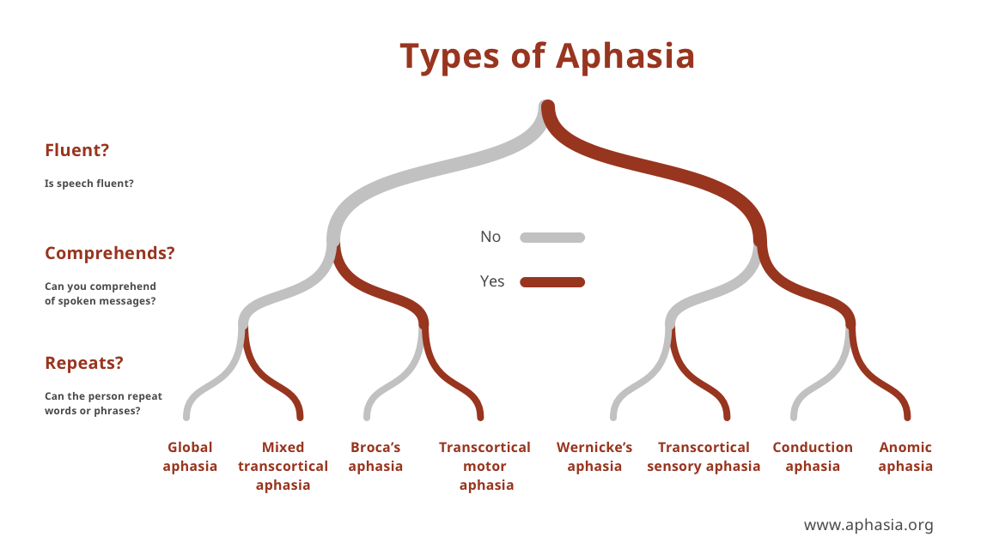
Classification: Aphasia (NAA, 2019)

Slide 6
Historical Perspective of Assessment
Clinical Examination/observation vs. Aphasia Test Battery
Wernicke (1874): Case report on Aphasia examination!
Head (1926): Hand-Eye-Ear Test, 1st Clinical Protocol or Head’s Protocol (Object and color naming, clock test, repetition, reading, etc)
Weisenburg & McBride (1935): Psychological and educational achievement test under controlled condition using autonomic word sequence, naming word repetition, reading writing, sentence completion etc. First comprehensive battery of Aphasia.
Wepman (1951-65): Comprehensive Psycholinguistic Test of language (grammatical correctness, intelligibility, word-finding problems etc)
Geschwind (1971): Repetition of “no ifs, and, or buts”, conversational speech analysis, lexical diversity.
Brookshire (1993): Correct Information Unit (CIU) analysis of connected language
Examination of clinical-anatomical correlation

Slide 7
1. PURPOSE OF ASSESSMENT (Spreen, 2003)
Based on (a) Examiner’s goal
(b) Flexible and knowledgeable approach
1. Screening procedures
2. Diagnostic assessment
3. Descriptive testing in rehabilitation and counseling
4. Progress evaluation
5. Assessment of functional or pragmatic communication
6. Assessment of related disorders

Slide 8
1. Screening Procedures
Purpose: To detect the presence Time Required: 5-20mins
Types:
(a) Bedside clinical examination
(b) Screening tests
(c) Measurement of specific component of language (sensitive to aphasia) e.g. Naming/Repetition

Slide 9
2. Diagnostics assessment
Thorough examination of language which can lead to diagnostic impression
Description about cognitive strength and weakness
In confining type and severity of aphasia
Speculative conclusion about nature of aphasia and underlying brain disorders
Exploring co-morbidity and pre-morbid attributes
Valuable for treatment planning

Slide 10
3. Descriptive testing in rehabilitation and counseling
To know residual functional strength
To offer rationalized advice about therapeutic goals and outcome
Prediction regarding recovery
Fine-tuning treatment tasks and strategy
Predicting specific area which may get more boost to therapy

Slide 11
4. Progress evaluation
Allows examination of spontaneous recovery
Individualized, criterion, tailor-made assessments
To examine expectations about eventual outcome based on prognosis
Can be employed to test the utility of interventions

Slide 12
5. Assessment of functional or pragmatic communication
Ranges from bedside observation to formal testing
Examines the effectiveness of communication
  of patients in social settings
  of family members/caregivers engaged in communicative interaction

Slide 13
6. Assessment of related disorders
Dysarthria
Apraxia of speech
Aprosody
Gestural Communication (asemesia)

Slide 14
2. CONTEMPORARY TESTS OF APHASIA
1. Bedside
2. Screening
3. Tests for specific aspects of language
4. Functional communication
5. Comprehensive tests

Slide 15
1. Bedside Examination of Aphasia
Objective: To check the impact of stroke on language
Components
Spontaneous, conversational speech
Repetition
Comprehension of spoken language
Word finding
Reading
Writing
Mental Status (cognitive funcitons)
Strub & Black (1993), Brookshire (1997)

Slide 16

2. Screening Tests
To detect: Aphasia ±
Aphasia Screening Test (Reitan & Wolfson, 1985)
  To determine performance on simple tasks such as spelling a word or naming an object.
Bedside Evaluation Screening Test, 2nd edition (BEST-2), (West et al., 1998)
conversational expression
object naming
object description
sentence repetition
pointing
reading

Slide 17
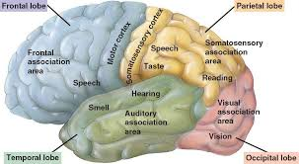
3. Tests for specific aspects of language
Impact of stroke may be different across various aspects of language
Naming: Boston Naming Test (BNT), (Goodglass & Kaplan, 2000)
Aud. Comprehension: Auditory Comprehension Test for Sentences (ACTS), (Shewan, 1980)
Vocabulary: Peabody Picture Vocabulary Test- III, (Dunn & Dunn, 1997)
Fluency: Verbal Fluency Measures
Discourse: Discourse Comprehension Test (DCT), (Brookshire, 1997)

Slide 18
4. Functional communication
Need: Mismatch between diagnostic outcome and everyday communication.
FC as separate variable
FC is not confined to rules of linguistic boundary
Communication as functional goal of language
  Communication Activities of Daily Living, 2nd edition (CADL-2), (Holland et al., 1998)
  ASHA Functional Assessment of Communication Skills for Adults (ASHA-FACS), (Frattali et al., 1995)

Slide 19
5. Comprehensive tests
Language examination as basic goal
Different level of task difficulty along all language dimensions such as naming, spontaneous speech, oral expression, auditory comprehension, repetition, reading and writing.
Western Aphasia Battery- Revised (WAB-R), (Kertesz, 2007)
Boston Diagnostic Aphasia Measure, 3rd edition (BDAE), (Goodglass & Kaplan, 2000)

Slide 20
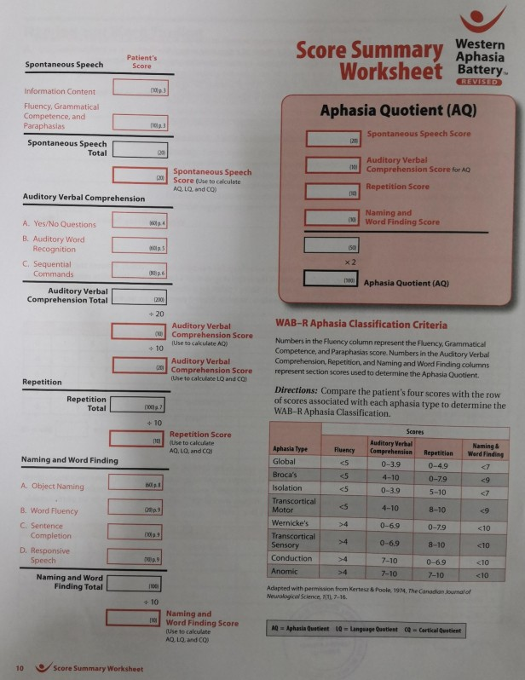
WAB-Revised (Kertesz, 2007)
WAB-R assess 4 main domains:
Spontaneous Speech
Auditory Verbal Comprehension
Repetition
Naming and Word Finding
AQ: Aphasia Quotient

Slide 21
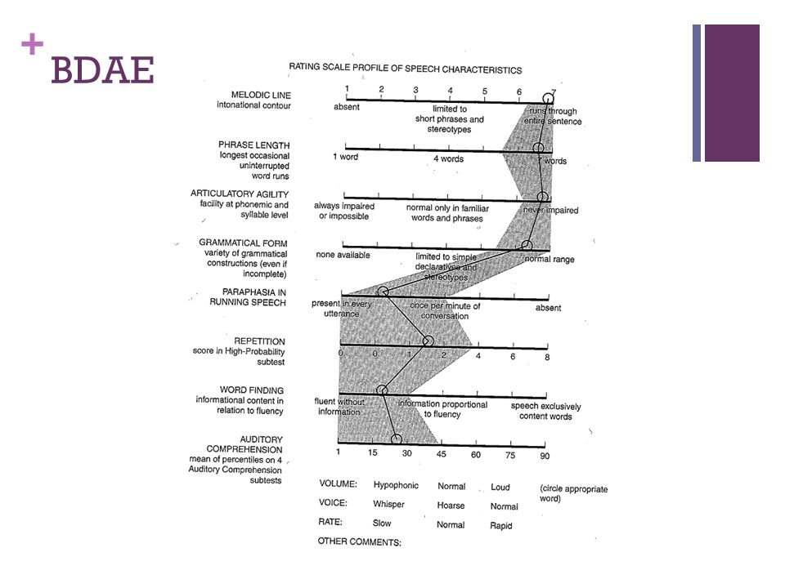
BDAE-3
Conversational and Expository speech
Auditory comprehension
Oral expression (oral agility, sequencing, recitation, rhythm, melody)
Reading (symbol recognition, word recognition, oral reading)
Writing (letter shape, correct letter, motor facility)
Praxis (natural and conventional gesture)

Slide 22
3.CONSTRUCTION REQUIREMENT OF APHASIA TESTS
Stringent Psychometric Requirement (APA, 1985),(Gregory, 2000)
1. Standardization (Uniform structure and administration)
2. Reliability
3. Validity
4. Sensitivity
5. Specificity
6. Range

Slide 23
1. Standardization
Uniform
Presentation of test stimuli
Test environment
Decision making/judgment required for scoring
Accepted variability in test administration based on practicality
Normative vs. individual data
Indian Context-Adaptation and translation

Slide 24
2. Reliability
Reliability refers to consistency, stability and accuracy
Key components
Internal Consistency
Test-retest reliability
Inter-rater reliability
Correlation coefficient r=0.8 to 0.9

Slide 25
3. Validity
Whether a test measures what it claims to measure and its appropriateness in inference based on the performance.
Criterion
Content
Construct

Slide 26
4. Sensitivity
The sensitivity of a test in the ability of the test to identify correctly affected individuals
  Proportion of persons testing positive among affected individuals
Sensitivity = True positives / Affected persons
Estimate the 95% confidence interval

Slide 27
5. Specificity
The specificity of a test in the ability of the test to identify correctly non-affected individuals
  Proportion of person testing negative among non affected individuals
Specificity = True negatives / Non-affected persons
Estimate the 95% confidence interval

Slide 28
6. Range of Items
Very easy to very difficult
Floor effect
Ceiling effect
Accuracy vs. Lengthy

Slide 29
4. FACTORS THAT MAY IMPACT ON SCREENING AND COMPREHENSIVE ASSESSMENT (ASHA, 2001)
Concurrent motor speech impairment (dysarthria, apraxia)
Hearing loss and auditory agnosia (inability to process sound meaning)
Language(s) spoken
Concurrent cognitive impairment (e.g., executive function, memory)
Visual acuity deficits, visual agnosia, and visual field cuts
Upper extremity hemiparesis (may affect ability to write)
Presence of chronic pain from either preexisting or new conditions
Poststroke depression
Endurance and fatigue (testing may need to be broken into shorter sessions)

Slide 30
Screening may result in (ASHA-2001)
recommendation for rescreening
recommendation for comprehensive speech, language, swallowing, or cognitive-communication assessments; and/or
referral for other examinations or services.

Slide 31
Comprehensive Assessment
Consistent with the World Health Organization’s (WHO) International Classification of Functioning, Disability and Health (ICF) framework (ASHA, 2016b; WHO, 2001), is conducted to identify and describe.
impairments in body structure and function, including underlying weaknesses in spoken and written language that might affect communication performance.
co-morbid deficits such as other health conditions and medications that can affect communication performance.
the individual’s limitations in activity and participation, including changes in, and impact on, functional status in communication and interpersonal interactions
contextual (environmental and personal) factors that serve as barriers to, or facilitators of, successful communication and life participation
the impact of communication impairments on quality of life, functional limitations relative to the individual's premorbid social roles, and the impact on his or her community.

Slide 32
Typical Components of Aphasia Assessment (ASHA-2006)
Case History
Medical status and medical history
Education
Occupation
Cultural and linguistic backgrounds
Self-Report
Functional communication struggles and successes
Communication difficulties and impact on individual and family/caregivers
Contexts of concern (e.g., social interactions, work activities)
Language(s) used in contexts of concern
Goals and preferences of the individual
Oral–Motor Examination
Differentiate between language-based and motor-based deficits by assessing
  Strength, speed, and range of motion of components of the oral–motor system
  Sequential/alternating movement repetitions (diadochokinesis; Thoonen, Maassen, Wit, Gabreëls, & Schreuder, 1996)
  Steadiness, tone, and accuracy of movements for speech and nonspeech tasks (Darley, Aronson, & Brown, 1969)
Language
Assess expressive and receptive skills in spoken and written language across a variety of contexts (e.g., social, educational, vocational)
Identification of Environmental and Personal Factors
Facilitators (e.g., family support, availability of communication partners able to provide communication support to persons with aphasia in daily interactions; personal motivation to return to prior level of function; desire for greater communication independence; ability and willingness to use compensatory techniques and strategies, including AAC)
Barriers (e.g., lack of regular and willing communication partners who are able to provide communication support to the person with aphasia in daily interactions; reduced confidence in one’s ability to communicate with familiar and unfamiliar speakers; cognitive deficits; visual and motor impairments; other comorbid chronic health conditions)

Slide 33

Indigenous tests of Aphasia
WAB-Hindi, Telagu etc
IAB (Nehra, 2017)

Slide 34
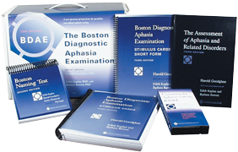
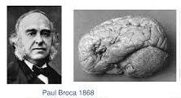
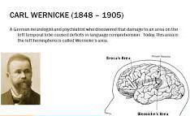

Thank you.

