Slide 1
AUDIOLOGICAL TEST PROTOCOL FOR HEARING SCREENING AND ITS IMPORTANCE IN EARLY IDENTIFICATION AND INTERVENTION
Mukesh Sharma
Principal & Associate Professor
Department of Audiology & Speech-Language Pathology
Sumandeep Vidyapeeth Deemed to be University, Vadodara

Slide 2
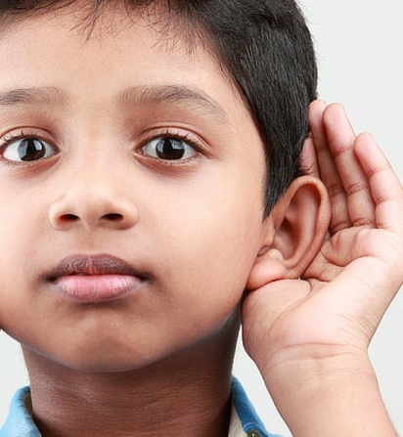
Introduction
HL in children: congenital and acquired conditions.
Congenital hearing loss - most common birth defects affecting approximately 3 infants per 1000 (Cunningham & Cox, 2003; Kemper & Downs, 2000).
SNHL af­fects 1 - 3 out of 1,000 live births in the healthy baby nursery population and 2 to 4 out of 100 infants in the NICU population (Yoon et al., 2003).

Slide 3
About 70% to 80% of CHL - non-syndromic, remaining cases are caused by specific genetic syndromes (Milunsky et al., 2000).
Mutations of the GJB2 gene are thought to account for roughly half of hereditary SNHL (Smith et al., 2005).
Infectious diseases such as meningitis, trauma, ototoxic pharmacologic agents, and noise exposure are frequently cited as causes of acquired HL (Cunningham & Cox, 2003).

Slide 4
Hearing loss interferes with the nor­mal development of the
  auditory system
  development of speech and language
  academic achievement
  social-emotional development (lee et al., 2001; sharma et al., 2005).
Regardless of etiology, early identification of these children is critical

Slide 5
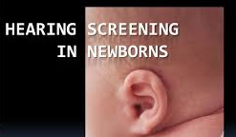
In-order to prevent hearing loss or identify hearing loss the hearing screening program was proposed in the early 1970’s.

Slide 6
HEARING SCREENING
SCREENING:
‘’The process of applying certain rapid and simple tests, examinations, or other procedures, to generally a large number of persons, that will identify those persons with a high probability of a disorder from those persons who probably do not have a disorder.’’

Slide 7
In the screening process there a cut off point involved, below or above which the person is suspected.
This helps survey a large population of undiagnosed and typically asymptomatic persons
  to identify those who are suspected of having the disorder and who require further diagnostic procedures.

Slide 8
An appropriate diagnostic and treatment procedure should be adopted in case of positive or suspicious findings.
The test must be
  Quick
  reliable
  acceptable to the persons who receive it.

Slide 9
DIFFERENT FORMS OF SCREENING
MASS SCREENIG:
SELECTIVE SCREENING:
MULTIPLE (OR MULTIPHASIC) SCREENING:
SCREENING IN INDUSTRY: two sorts:
for special industrial risks,
early detection of diseases that may impair the general efficiency of the worker.
large-scale screening of whole population groups.
screening of selected high-risk groups in the population. It may still be large-scale, and is one form of population screening.
the application of two or more screening tests in combination to large groups of people.

Slide 10
Aspects of hearing screening
Two aspects of screening are important:
Selection of disease or disorder that should be screened
Evaluation of screening procedures

Slide 11
Selection of disorder
Frequently occurring
Consequence serious enough
Amenability to treatment or prevention
Availability of facilities for diagnosis and treatment
Cost of screening

Slide 12
Evaluation of screening procedures
More rigid and critical performance charateristics must be applied to each screening test to evaluate fully its effectiveness in identification.
Decision matrix analysis ( includes four components – true positive, true negative, false positive, false negative)
Validity of the test is determined by sensitivity, specificity, prevalance.
It is desirable to use a test with highest rate of sensitivity.
Sensitivity and specificity represent the true positive and true negative rates.

Slide 13
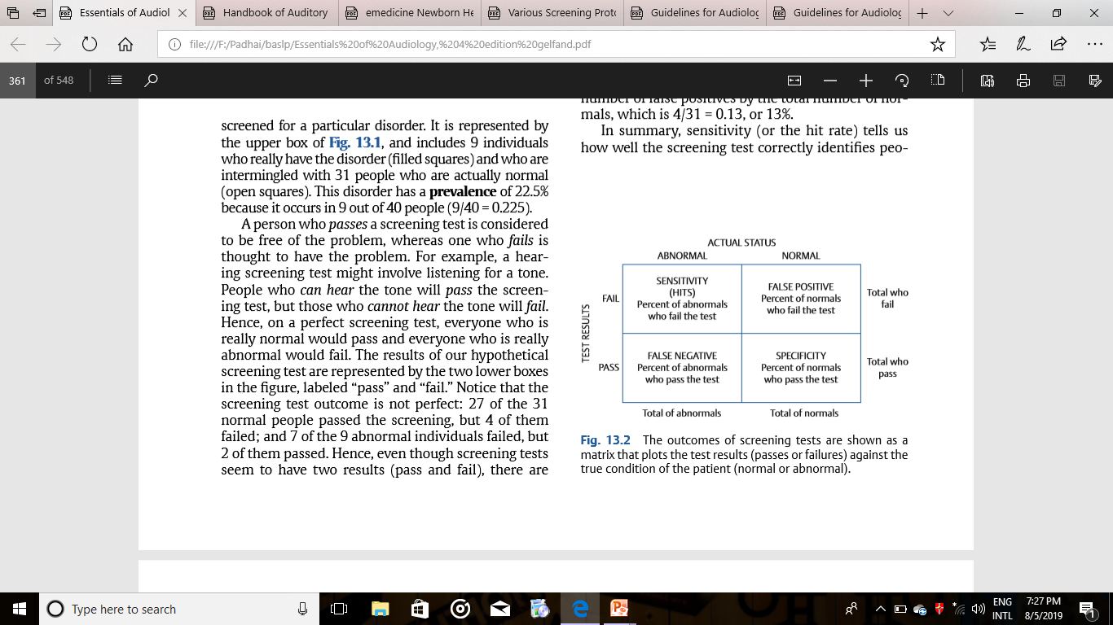
The outcomes of screening tests are shown as a matrix that plots the test results (passes or failures) against the true condition of the patient (normal or abnormal)

Slide 14
UNIVERSAL NEWBORN HEARING SCREENING (UNHS)
In 1994, The National Institute of Health Consensus Development Conference on Early Identification of Hearing Impairment in Infants and Children recommended UNHS.
The Joint Committee on Infant Hearing (JCIH) issued similar guidelines in 1995 and again in 2000.
UNHS is also recommended by the American Academy of Pediatrics, by the Centers for Disease Control and Prevention and in Healthy People, 2010.
UNHS is now performed worldwide compulsorily on all newborns because of the significant harm of unidentified per­manent congenital hearing loss.
Notes:
Surveillance:investigation

Slide 15
The JCIH recommends
  continued surveillance of these children because they may be at risk of progressive hearing loss.
  audiological testing every six months until three years of age.
  In low-risk children, a repeat hearing screening is recommended before entry into kindergarten.
JCIH (2000) included a list of risk indicators for two groups of age.
  Firstly, birth through 28 days which consisted of 5 risk indicators.
  secondly, 29 days through 2 years which includes 10 risk indicators.

Slide 16
Birth through 28 days
Illness or condition requiring admission of 48 hours or more in NICU
. Stigmata or other associated findings associated with hearing loss
. Family history of permanent hearing loss
. Craniofacial anomalies, including pinna and EAC
. In utero infection, such as CMV, herpes, rubella

Slide 17
29 days through 2 years
. Parental or caregiver concern regarding speech and lang. or developmental delay
. Family history of permanent childhood hearing loss
. Stigmata or other associated findings a/w hearing loss
. Postnatal infections associated with SNHL
. In utero infections
. Neonatal indicators: Hyperbilirubinemia requiring exchange transfusion, persistent pulmonary hypertension a/w mechanical ventilation
. Syndromes associated with progressive hearing loss
. Neurodegenerative or sensory motor neuropathies
. Head trauma
0. Recent or persistent otitis media with effusion for 3 months or more

Slide 18
SCREENING TESTS
Evaluation of hearing should include a demonstration of a behaviour in response to a measured stimulus; this cannot be reliably performed on a child younger than 8 to 9 months.
UNHS is now performed for newborns using the JCIH renewed up-to-date guidelines for hearing screening using :
A-ABR
EOAE

Slide 19
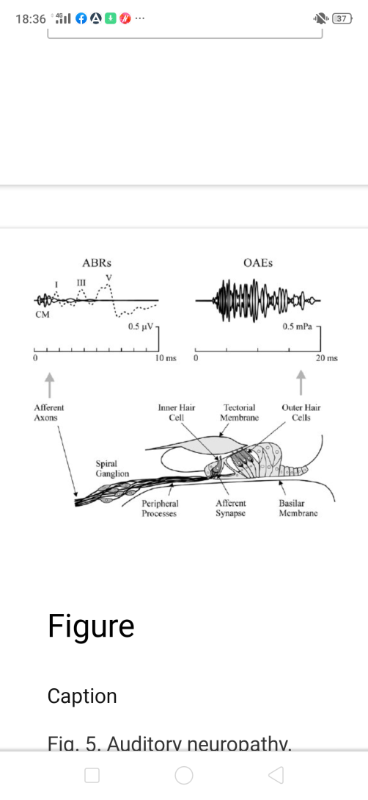

Slide 20
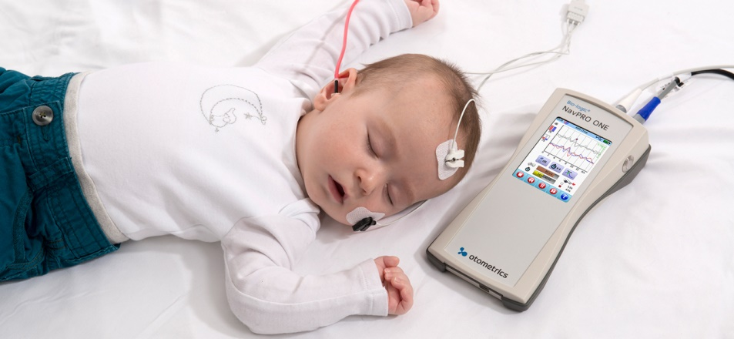
Automated auditory brainstem response (A-ABR)
The ABR is clinically used as an objective, diagnostic measure of the integrity of the ear and auditory nerve pathway up to the brainstem.

Slide 21
The use of ABR for the assessment of newborn hearing has been recommended since 1979.
The ABR measure has been adapted as a neonatal screening test by automating the procedure
  reducing the test time
  and establishing an estimate of auditory thresholds.

Slide 22
A-ABR test
Sound at an intensity of 30-35dBHL in the form of clicks or tones are played to the baby through a probe inserted into the ear
Electrodes placed on the baby’s head detect the change in electrical potentials.
Computer algorithms such as ALGO1 and ALGO2 compare the waveform recorded with normal expected waves.
The presence or absence of the waves is detected.

Slide 23
Auditory evoked response infant protocol
The pass criterion = response at intensity levels of 40dBnHL or less.
“Pass” on ABR screening does not rule out development of hearing impairment in childhood.

Slide 24
Infants whose responses meet the criterion and who are at risk for progressive hearing impairment should receive audiologic monitoring on a periodic basis.
Infants who do not demonstrate responses at intensity levels of 40 dBnhl or less in both ears should enter the audiologic evaluation, follow up, and management system.

Slide 25
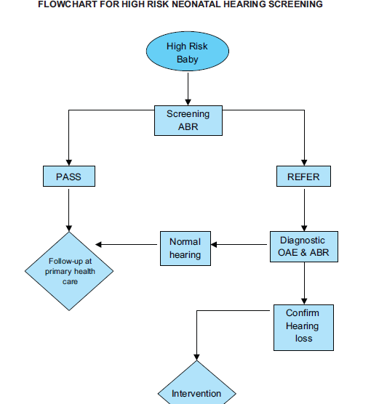

Slide 26
A-ABR vs Conventional ABR
A-ABR can be reliably operated by non professional personal (Jacobson et al., 2003).
Conventional ABR- more complex, time consuming and impractical for screening procedure.
Most of the A-ABR screening units are capable of detecting mild hearing loss (Johnson et al., 2005; Norton et al., 2000b).
Results of A-ABR are comparable with results of conventional ABR (Jacobson et al., 1990).

Slide 27
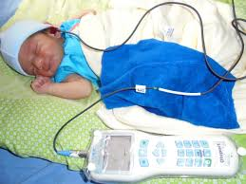
Oto Acoustic Emission (OAE)
TEOAEs - click at 70-80dBSPL
DPOAE - paired tones
Both TEOAE and DPOAE are used in newborn hearing screening.
There are diff types of OAE based on type of sound stimulus used.

Slide 28
Normal external and middle ear function is important for correct OAE measurements and interpretation.
The OAE responses are absent when hearing loss exceeds mild hearing loss levels
The results fall under the dichotomy category (pass or fail).
Additionally easy to administer, quick efficient testing are some other positives.

Slide 29
TEOAEs to 70-80dBSPL click are present in almost all normally hearing adults.
Thus absence of OAEs is a strong indicator of a mild or greater hearing loss.
In Hearing loss >30dBHL, there is a high probability that TEOAE will be absent.
DPOAE are present in the normals but are absent or of very low amplitude in people with hg loss > 30-40dBHL.

Slide 30
The OAE is highly sensitive to a loss of function of the outer sensory hair cells.
Therefore it will not reveal potential hg loss due to abnormalities of the auditory nerve (such as auditory neuropathy) and auditory centres in the brain, unless these include peripheral damage.
The test relies upon sound transmission through the middle ear.
It is also affected by middle ear pathologies or amniotic fluid present in the middle ear after birth therefore give higher false positive rates.

Slide 31
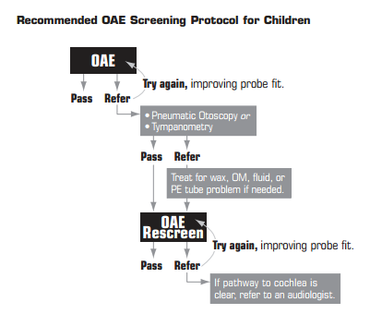

Slide 32
A-ABR Vs OAE -
Test time:
The average test time for screening A-ABR ~ 12 min (Gabbard et al., 1999).
TEOAE & DPOAE ~ 5min (Gorga et al., Norton et al., 2000).
False positive rate:
OAE has greater rate of false positive results when compared to A-ABR.

Slide 33
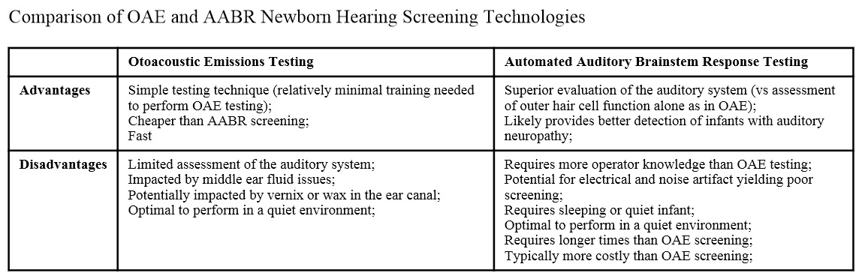

Slide 34
The reasons for higher no. of false positive in OAEs:
Presence of conditions like middle ear fluid or cerumen blocking ear canal which reduce the amplitude of the OAE and hamper pass result (Chang et al., 1993)
Poor technique of selection and placement of probe tip with airtight seal.
Ambient noise level

Slide 35
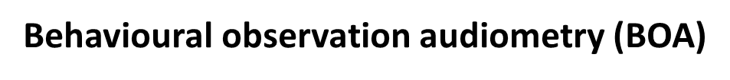
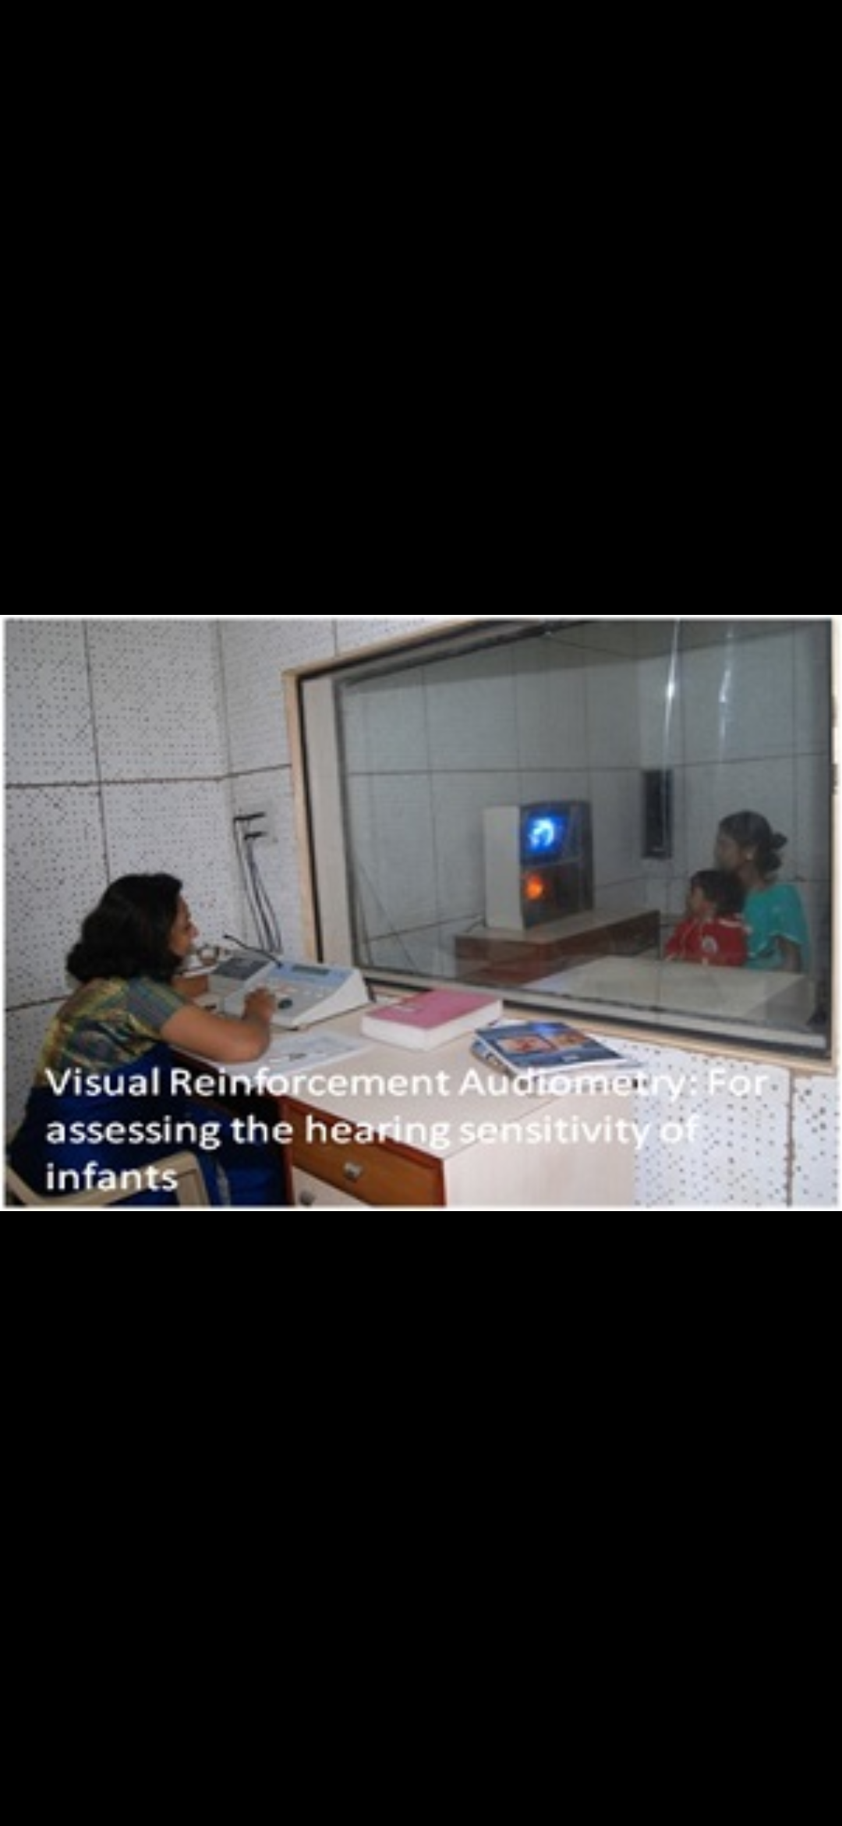
Techniques of infant screening
Behavioural assessment of hg sensitivity in children is complicated by developmental and maturational factors.
As such, BOA is not recommended for estimating infant hearing thresholds.

Slide 36
6-24 months (till yrs of age)
TROCA and VROCA are recommended
25 to 30 months
CPA (Conditioned Play Audiometry) is sometimes possible
30 months
CPA is the method of choice
Because overlap exists among VRA, TROCA/VROCA, and CPA as suitable evaluation techniques.
Successful testing of a child ultimately depends on the observational skills, interpersonal skills, and experience of the audiologist.

Slide 37
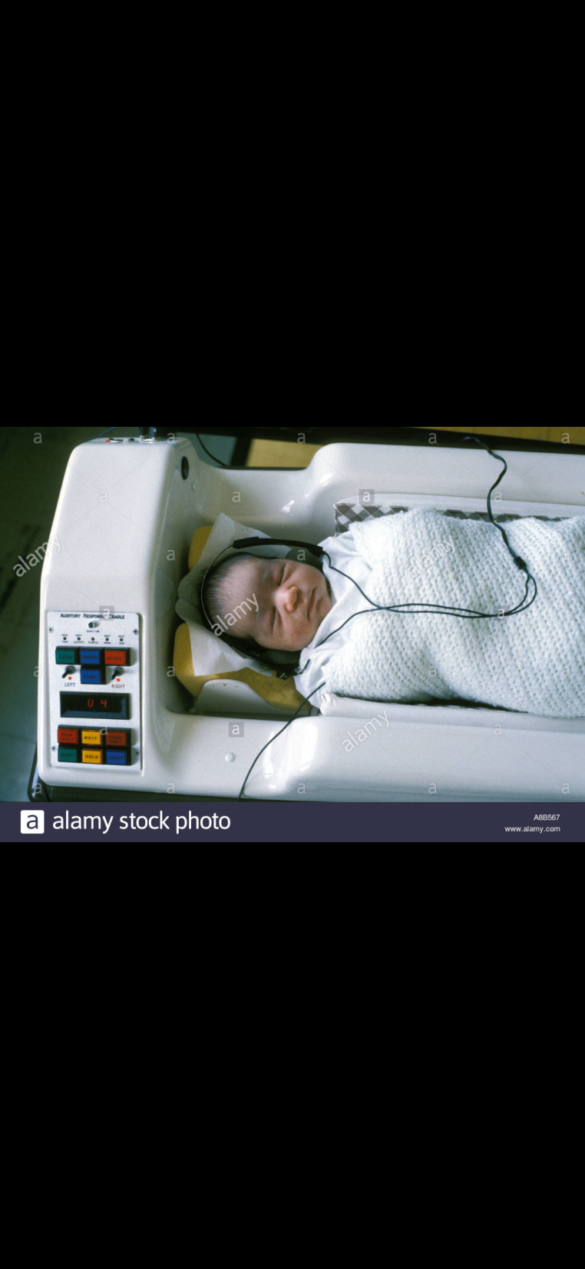
Auditory response cradle
Developed to classify neonatal responses to sound accurately.
It is automatic, microprocessor controlled auditory response cradle.
Consists of a trolley mounted unit comprising a pressure sensitive mattress and head rest.

Slide 38
High pass noise is used because of the prevalence of high frequency impairment among the congenitally deaf.
The sound stimulus is presented to the infant and the resulting motor and respiratory responses are detected and stored in the memory of the microprocessor
Equal numbers of spread, no sound control trials, carried out in an identical fashion, enable calculation of the probability that the responses to sound are specific reactions and not spontaneous events.
Incorporates non-contacting sensors for head turn, startle or head jerk, body activity, and respiration.
A 2600 Hz high pass noise of 85 dBSPL used as test stimulus and presented via close coupled ear probes fitted with tips.

Slide 39
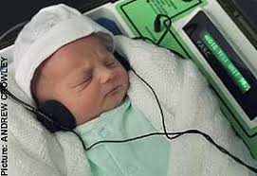
Crib-o-gram
The Crib-O-Gram is an automatic device that measures the movements of a neonate after exposure to a loud sound.
Motion sensitive transducers placed under the mattress in the crib pick up the infant’s activity.
Fixed quantitative criteria are used to establish the presence of a response (Simmons and Russ, 1974; McFarland, Simmons and Jones, 1980).

Slide 40
Immittance screening
Protocols use both tympanometry and acoustic reflex screening.
The scheduling and follow up protocols for immittance screening is a controversy.
May be necessary to use repeated tests to identify all children with chronic middle ear disorders.

Slide 41
Advantages | disadvantages
No behavioral responses required Sensitive measure of middle ear status Some information on hearing sensitivity Provides ear specific information Assesses retrocochlear/ brainstem auditory function | Not a test of hearing Information limited by middle ear dysfunction Does not assess higher auditroy functions Does not assess communication performance.

Slide 42
226 Hz Vs 678 Hz
Study conductance(G) and susceptance(B), components of tympanograms.
Normal tymp: single peaked at 226 Hz and multi peaked at 678 Hz.
Reverse for the neonates, as they are mass dominant.

Slide 43
Benefits of Hearing screening:
It enables early identification of the problem and refers the identified individual for diagnosis and guidance.
It enables referral to early intervention programme.
It gives enough time for the child to cope with the hearing aid.
It gives enough time for parents to cope with the problem.
It provides an opportunity for integration.

Slide 44
It helps the specialist to plan the rehabilitation such as Hearing Aid vs Cochlear Implantation.
It reduces the consequences of deafness and the cost involved in rehabilitation of late diagnosed children.
The language development and scholastic backwardness can be intervened in school going children.
The threat on the life or job or social well being in adults may also be intervened.

Slide 45
Newborn hearing screening in India

Slide 46
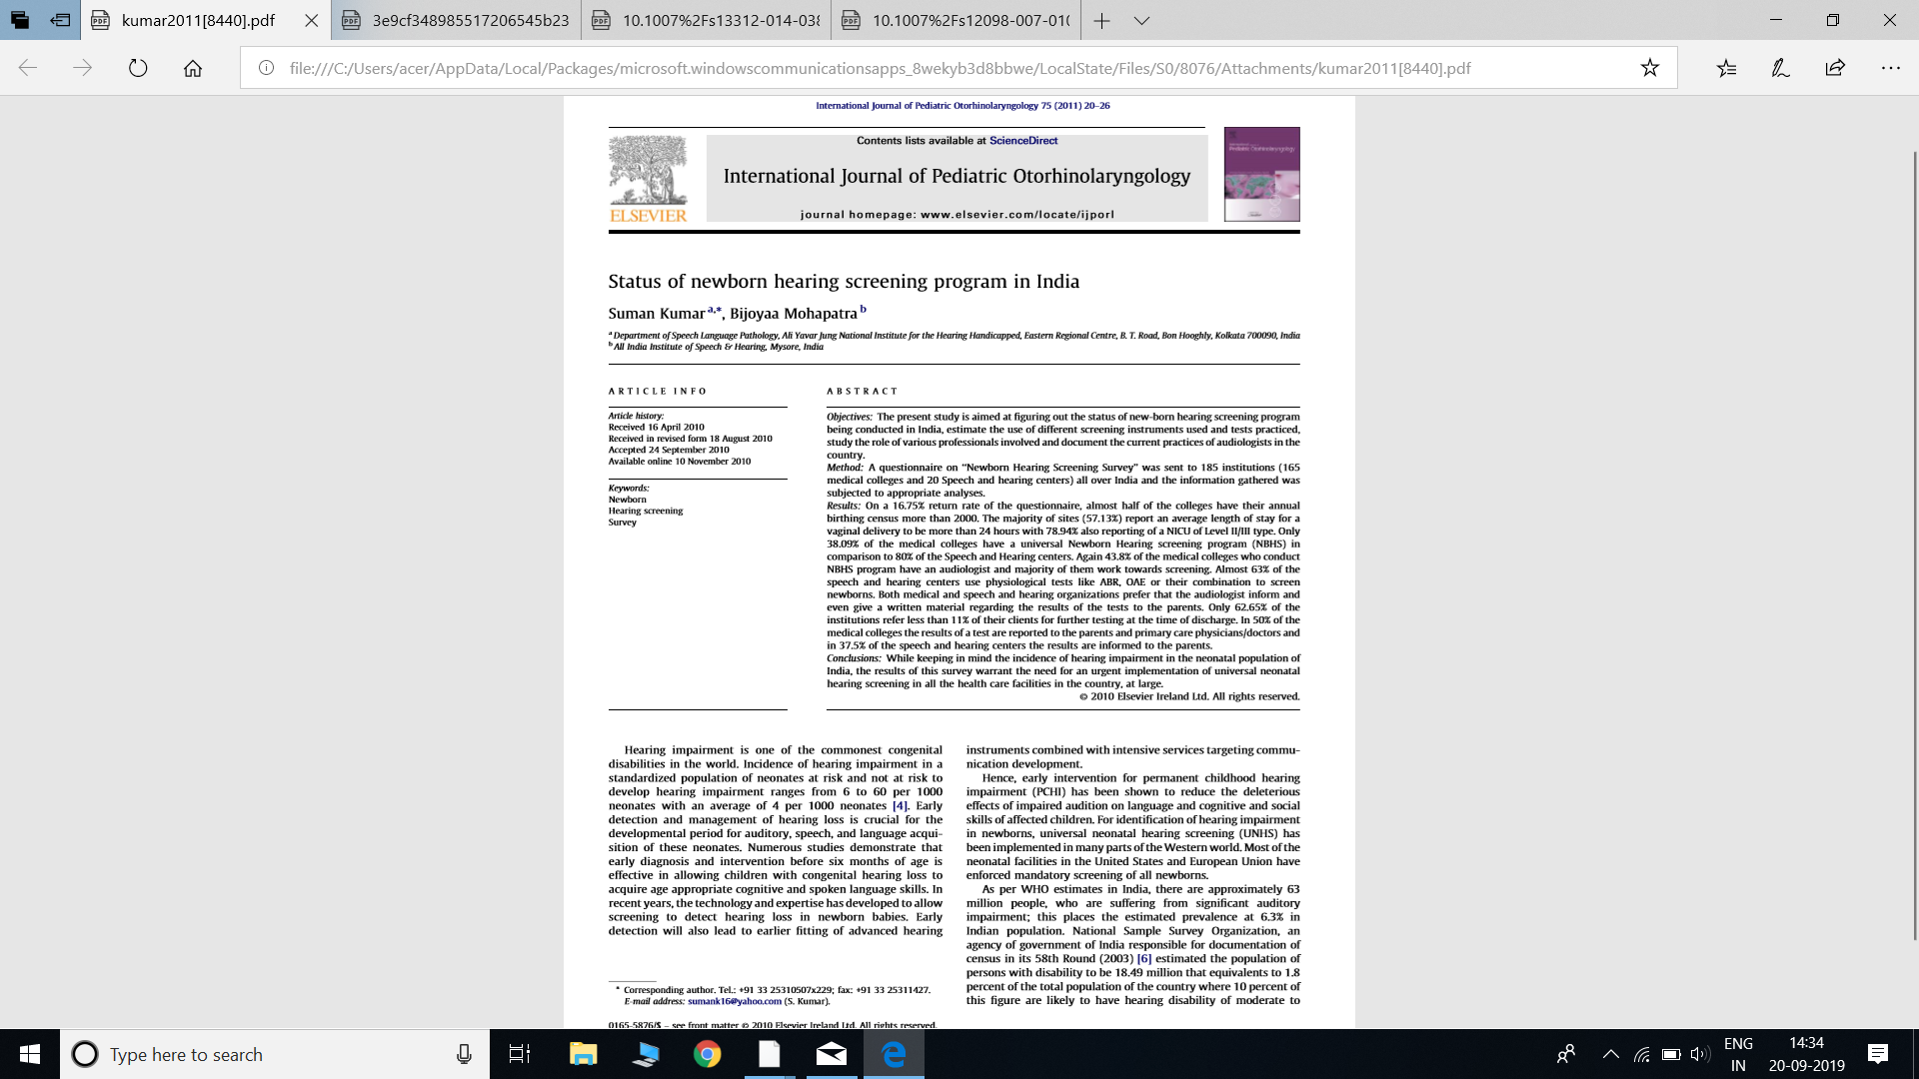
India has recognized the need for screening newborns as urgent (Kumar & Mohapatra, 2011) and their research has stated that the late identification of HL in children is a “significant public health concern.”

Slide 47
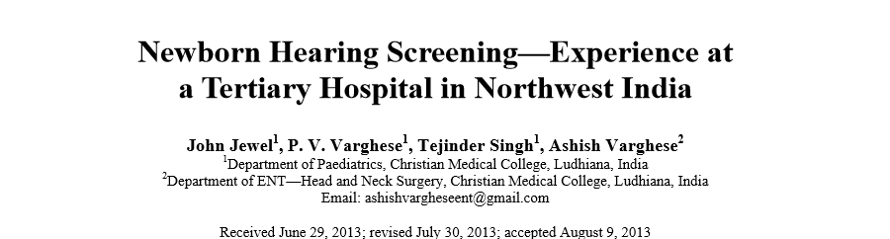
Literature reveals that 50% of hearing impaired children are likely to be missed in HRR and NICU approaches . Moreover, their application requires a team of specialised professionals and adequate time to record risk indicators, making the process expensive.

Slide 48
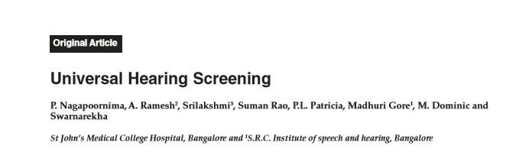
The high incidence calls for all pediatricians to consider incorporating a basic hearing screening for all the neonates using cost effective and appropriate technology. Initial screening may be performed using behavioral observation techniques and confirmation by otoacoustic emissions. (P. Nagapoornima A. et al , 2007 )

Slide 49
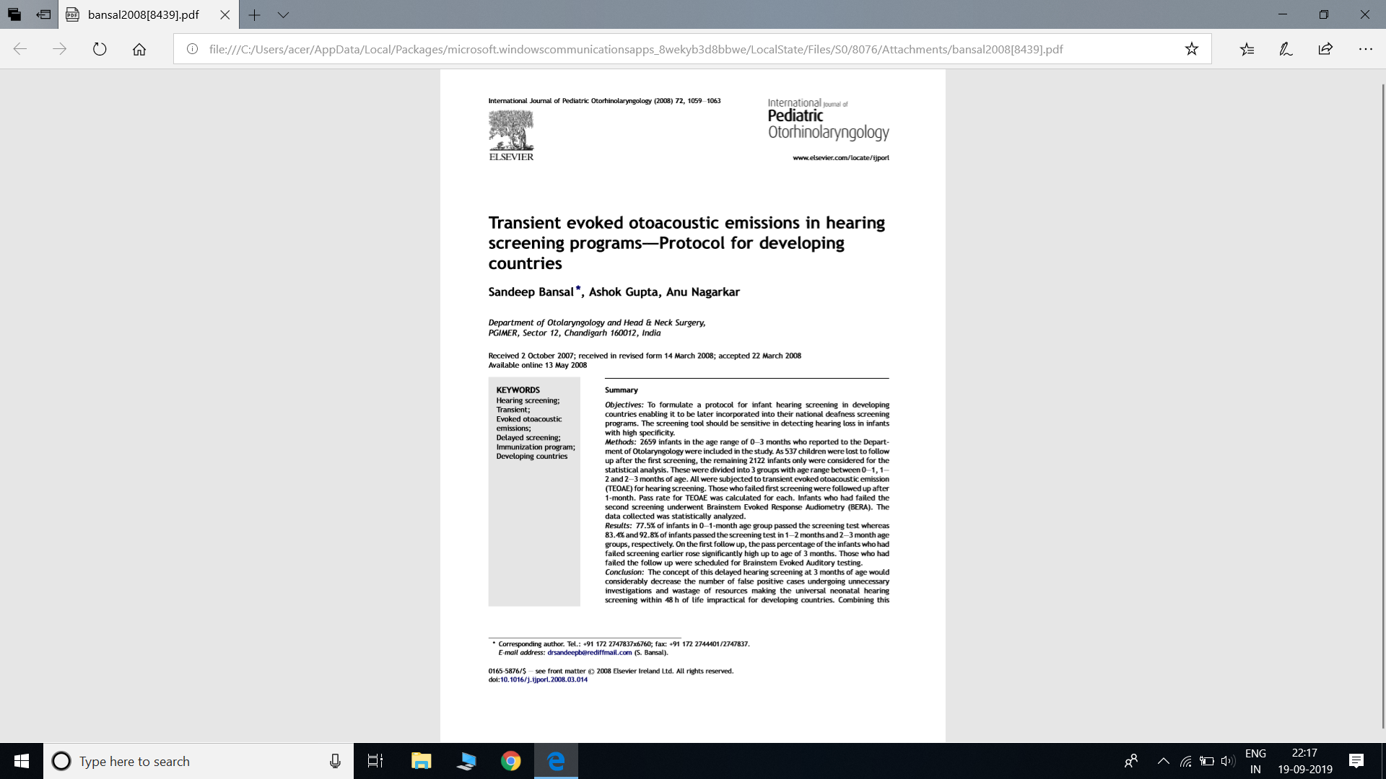
Methods:
N= 2659 infants
Age range = 0-3 months.
TEOAE for hearing screening. who failed ﬁrst screening were followed up after 1-month. And ABR was done
Aim
To formulate a protocol for infant hearing screening in developing countries enabling it to be later incorporated into their national deafness screening programs.

Slide 50
Results and Conclusion
On the ﬁrst follow up, the pass percentage of the infants who had failed screening earlier rose signiﬁcantly high up to age of 3 months.
The concept of this delayed hearing screening at 3 months of age would considerably decrease the number of false positive cases.( Sandeep Bansal et al, 2008 )
Delayed hearing screening with the 3rd dose of universal immunization program would constitute a viable, feasible and universal hearing screening program, which can be drafted into national deafness programs of the developing countries.
.

Slide 51
THANK YOU

