Slide 1
Auditory Evoked Potential
Mr. Vikash Kumar
Assistant Professor
Dept. of Audiology and Speech Language Pathology
Sumandeep Vidyapeeth Deemed to be University
Vadodara, Gujarat

Slide 2
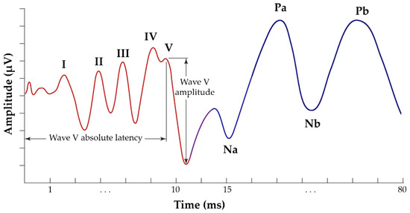
Auditory Evoked Potential

Slide 3
Definition of AEP
Auditory Evoked Potentials represent activity within the auditory system that is stimulated or evoked by sounds.

Slide 4
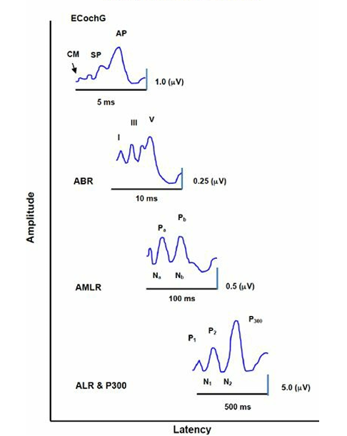
Classification

Slide 5
Intensity as a factor for Amplitude and Latency

Slide 6
Consideration for Amplitude of AEPs
Amplitude
Number of Neurons
30K
10 Millions
Types of Stimuli

Slide 7
Neurophysiology and Neuroanatomy of AEPs
Cochlea
Auditory Brainstem
Auditory Cortex
Brain (Cortical and Subcortical regions)

Slide 8
EcochG
Ernest Glen Wever in 1930

Slide 9
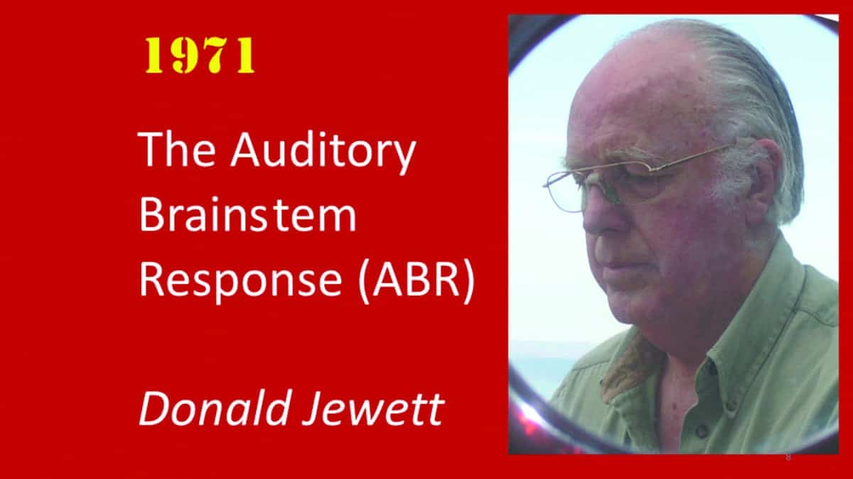
Auditory Brainstem Response

Slide 12
Auditory Middle Latency Response (AMLR)
major contributions from superior temporal gyrus within
the auditory cortex
Reticular activating system
contribution from the inferior colliculus within the midbrain region

Slide 13
Auditory Late Responses
Dr. Hallowell Davis (1896-1992) whose first publications in neurophysiology appeared in 1925 was in 1939 already a respected auditory scientist conducting research in essentially all areas of auditory physiology and on his way to earning the title “Father of Auditory Evoked Responses”.
Dr. Hallowell Davis (1896-1992),
Father of Auditory Evoked Responses

Slide 14
Toward the beginning of an excellent tribute to Hallowell Davis his colleague and friend Robert Galambos includes the following statement:
“The first brainwaves seen on the American continent came out of his own head in 1933, recorded by his graduate students using equipment he had designed. At about the same time he was among the first anywhere to record animal cochlear potentials, human evoked brain potentials, and the activity of single nerve cells at work inside an animal brain. And because he believed scientists should develop useful products out of their discoveries, his name appears prominently in the history of the hearing aid, the audiometer, and the test procedures used in hearing clinics throughout the world. He was admired for his ability to organize apparently unrelated facts in novel and logical ways, and then to speak and write clearly about them. This friendly, witty man–teacher, writer, organizer, and toiler at the bench–said he aimed in life to serve science, his country, and mankind, and that is exactly what he did.”

Slide 16
ALR (60-250)
Brain
Thalamo-cortical
Association cortex of Frontal lobe
Sylvian fissure
Superior Temporal plane in Temporal Lobe

