Slide 1
Auditory Evoked Potential – Stimulus Parameters
Mr. Vikash Kumar
Assistant Professor
Dept. of Audiology and Speech Language Pathology
Sumandeep Vidyapeeth Deemed to be University
Vadodara, Gujarat

Slide 2
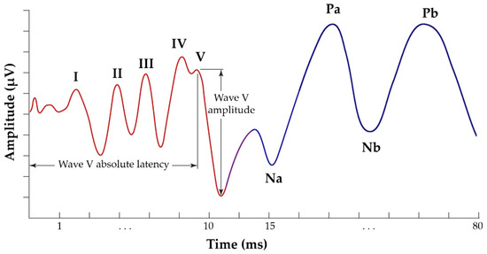
Auditory Evoked Potential – Stimulus Parameters

Slide 3
Stimulus Parameters / Characteristics
Transducer types
Types of Stimuli
Polarity of the stimulus
Stimulus Intensity
Rate of Stimulus
Mode of Stimulus Presentation such as Monoaural vs Binaural

Slide 4
Types of Stimuli
Clicks
Tone Bursts
Speech Stimuli

Slide 5
Click
Click stimuli have a very abrupt almost instantaneous onset and a brief duration of 0.1-ms. Keep in mind that 0.1-ms is the same as 100 microseconds, abbreviated μsec. Clicks are often referred to as transient stimuli. Click stimuli are commonly used in the measurement of ECochG or ABRs.
Relation of Time Dispersion with Clicks or Brief Tone.

Slide 6
Duration of Stimulus

Slide 7
Tone Bursts
Tone bursts consist of 4 or 5 cycles of pure tone signals.
Duration of a single cycle for a 1000 Hz tone is 1-ms. For a 1000 Hz tone there are 1000 cycles per second (cps). Following the 2 cycle-1 cycle-2 cycle rule, a 1000 Hz tone burst has rise/fall times of 2-ms and a plateau of 1-ms. Still adhering to the 2 cycle-1 cycle-2 cycle approach for defining tone burst Duration.
500 Hz stimulus with cycles each lasting 2-ms (i.e., 1000-ms/500) has rise-plateau-fall values of 4-ms-2-ms-4-ms. Durations are shorter for higher frequency tone burst stimuli. For example, with the 2 cycle-1 cycle-2 cycle paradigm for selection of stimulus duration, a 2000 Hz tone burst has rise-plateau-fall values of 1-ms-1-ms-1-ms. Duration values are only 0.5-ms for a 4000 Hz tone burst.

Slide 8
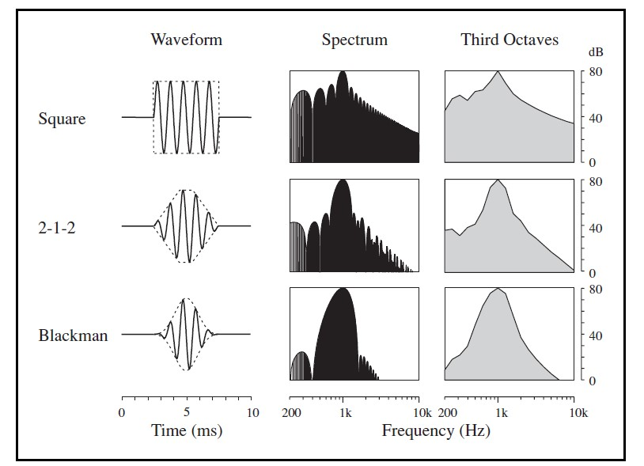

Slide 9
Clicks vs Tone Bursts

