Slide 1
Vocal Folds
Biology of Vocal Folds and Biomechanics
Mr. Vikash Kumar
Assistant Professor
Dept. of Audiology and Speech Language Pathology
Sumandeep Vidyapeeth Deemed to be University
Vadodara, Gujarat

Slide 2
Layers of Vocal Folds
The Epithelium (Skin)
Superficial layer of Lamina propria
Deep Layer of Lamina Propria
The Muscle Layer
Intermediate layer of Lamina Propria

Slide 3
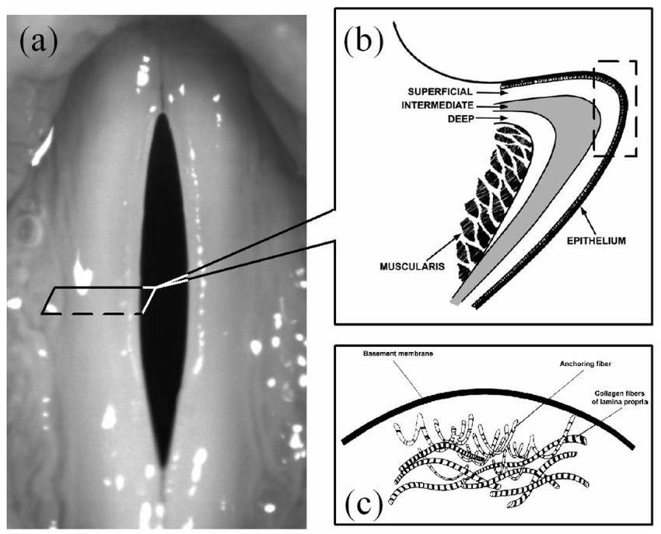
The Epithelium (Skin)
Outermost layer.
Encapsulates the other layers.
Thickness is 0.05 – 0.10 mm.
Composed of Stratified squamous cells.
Underneath the epithelial cells lies a very thin Basement Membrane Zone (BMZ).

Slide 4
The Superficial Layer of Lamina propria
Lies between Epithelium and Muscle.
Made up of few cells but largely non-cellular material (extracellular matrix).
Thickness is 0.5 – 1.0 mm in the middle of the fold and thinner at the ends.
Generally soft and pliable, made up of loosely organised protein strands surrounded by interstitials fluids that lubricates and absorb mechanical stress.
When Injury occurs to the folds from voice use, most of the evidences seen in this superficial layer of Lamina propria.

Slide 5
Cont…
With aging, the Superficial layer may either thicken with edema or for some individuals, the depth of the layer diminishes in size.
In Infants, the entire vocal folds under the epithelium is made up of Superficial Layer of LP material. The Laminar structure is not present at birth, but develops gradually in childhood through puberty.

Slide 6
Intermediate and Deep Layer of VF
1-2 mm thickness together.
Both together known as Vocal Ligament.
Here the fibers are largely aligned in the anterior posterior direction.
The Intermediate layer has a high concentration of protein fibers called elastin. They are nearly Linear elastic because they can be stretched like a spring. This linear elasticity constitutes part of distinction between the Superficial and Intermediate layer of the Lamina propria.

Slide 7
Intermediate and Deep Layer of VF
The Deep layer has more collagen fibers, a different type of Protein. Collagen fibers are not linearly elastic, but they do resist elongation after being “straightened out” from a normally zig-zag molecular organisation.
By running parallel to the free margin of the vocal folds, they serve to withstand high tensile stresses during phonation, like stretched-out cotton threads.
With age, the density of elastic fibers tends to decrease, resulting in a thinning of the intermediate layer and a voice changes due to degeneration takes place.

Slide 8
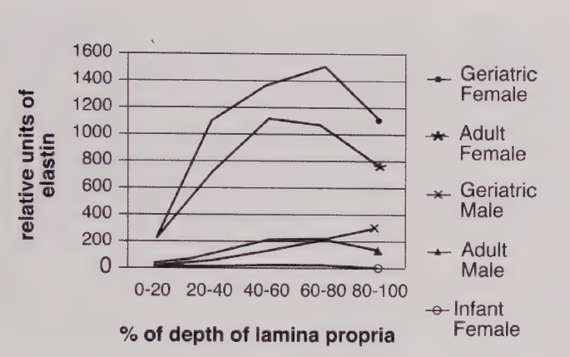
Elastin Fibers of VFs

Slide 9
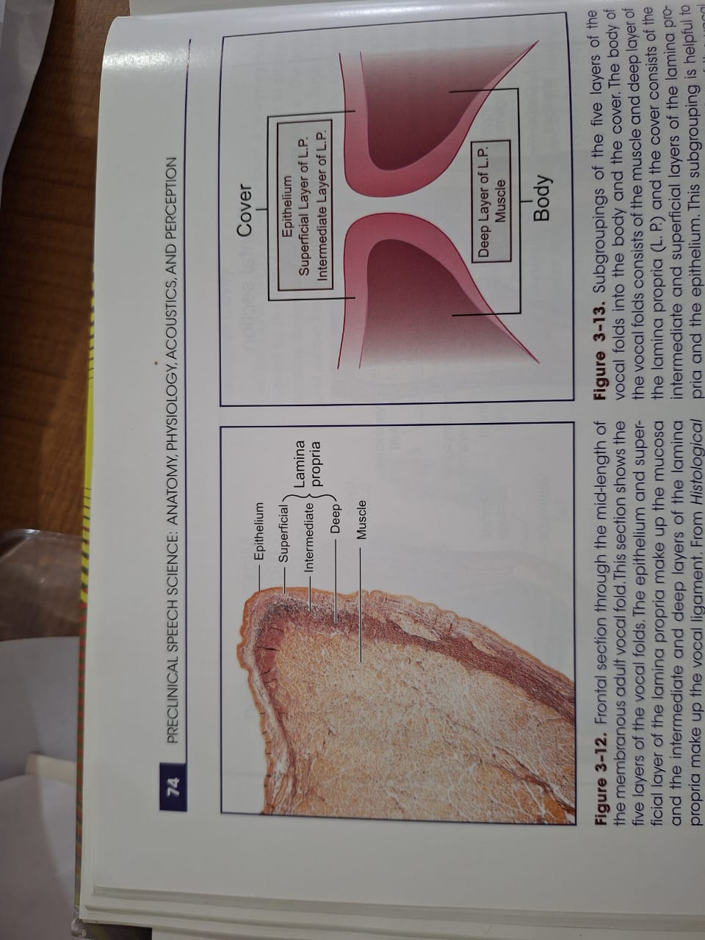
Layers of Vocal Fold

Slide 10
Layers classification in different way

Slide 11
Biomechanics of Vocal Folds
Movable and Flexible
Vocal fold Abduction
Vocal Fold Adduction
Vocal Fold length change

Slide 12
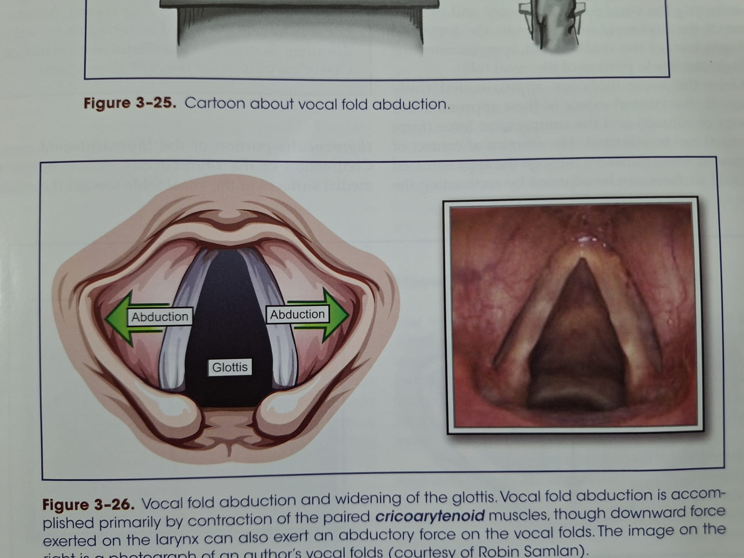
Vocal Fold Abduction

Slide 13
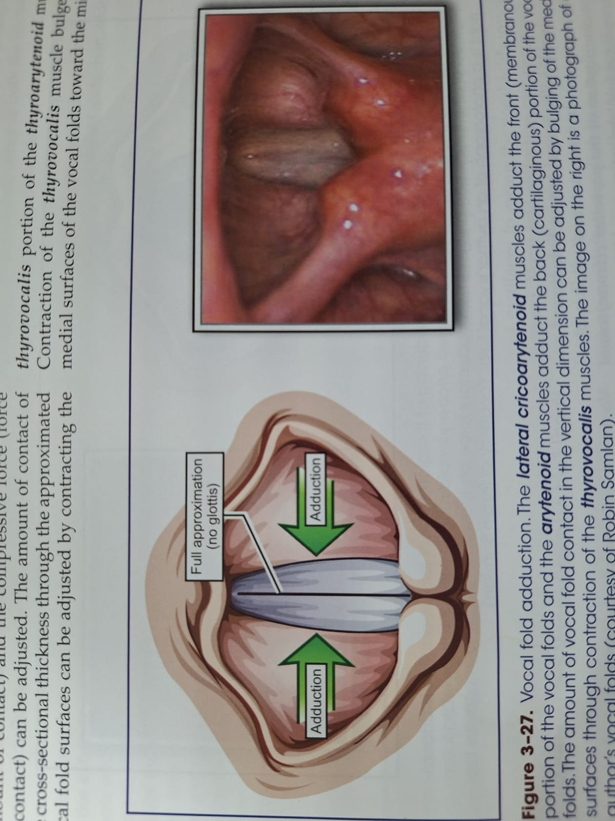
Vocal Fold Adduction

Slide 14
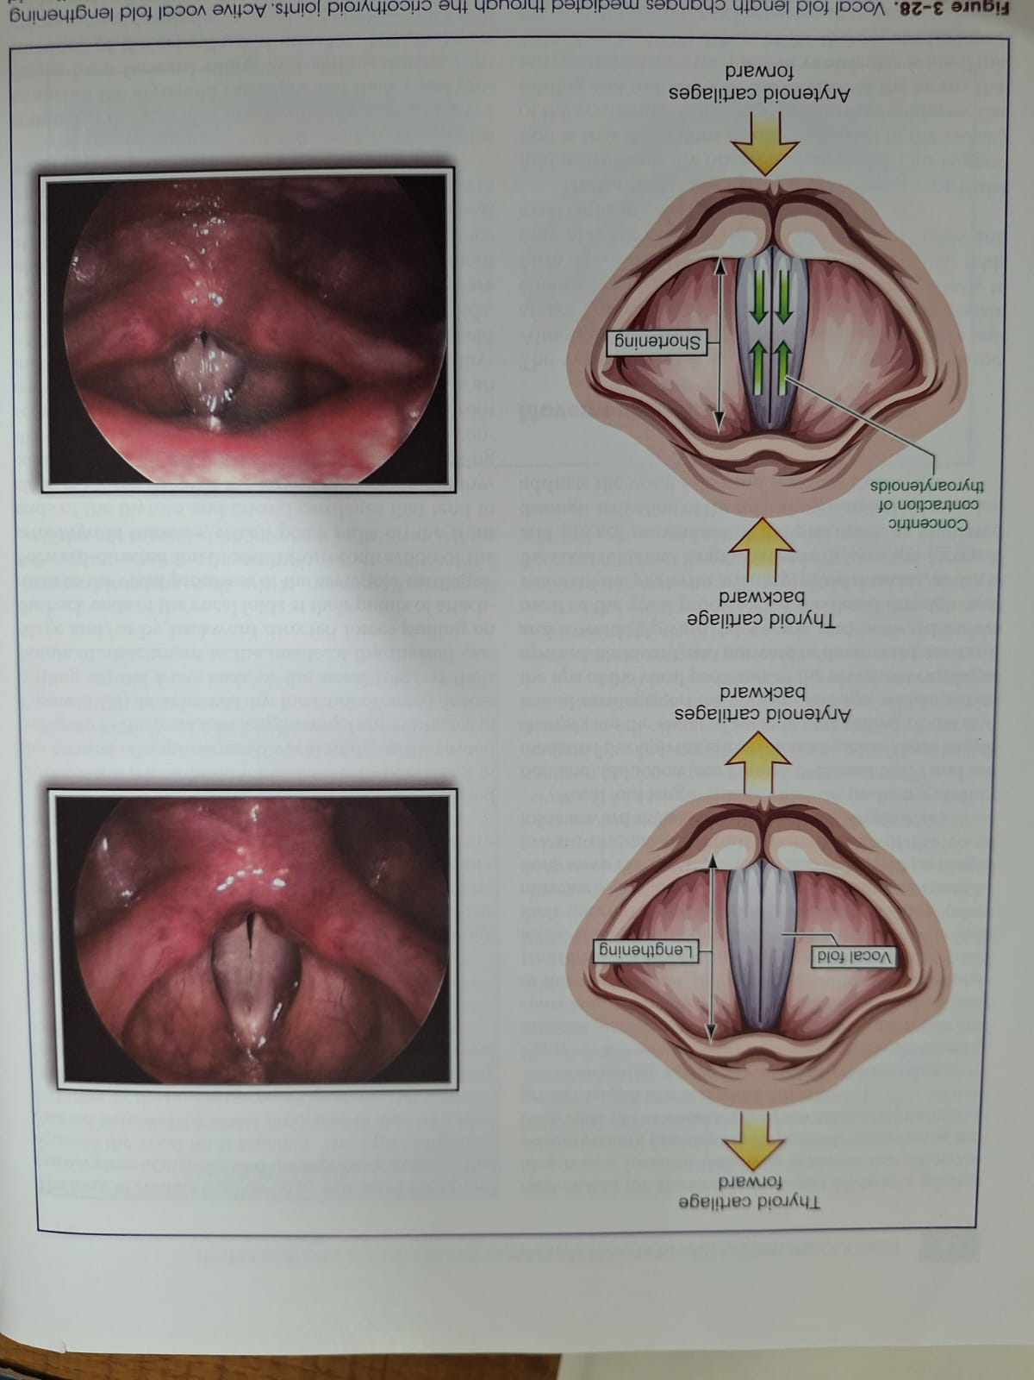
Vocal Fold length change

Slide 15
Voice Control / Modulation
Laryngeal Opposing Pressure
Laryngeal Airway Resistance
Glottal size and configuration
Stiffness of the Vocal Folds
Effective Mass of the Vocal Folds

Slide 16
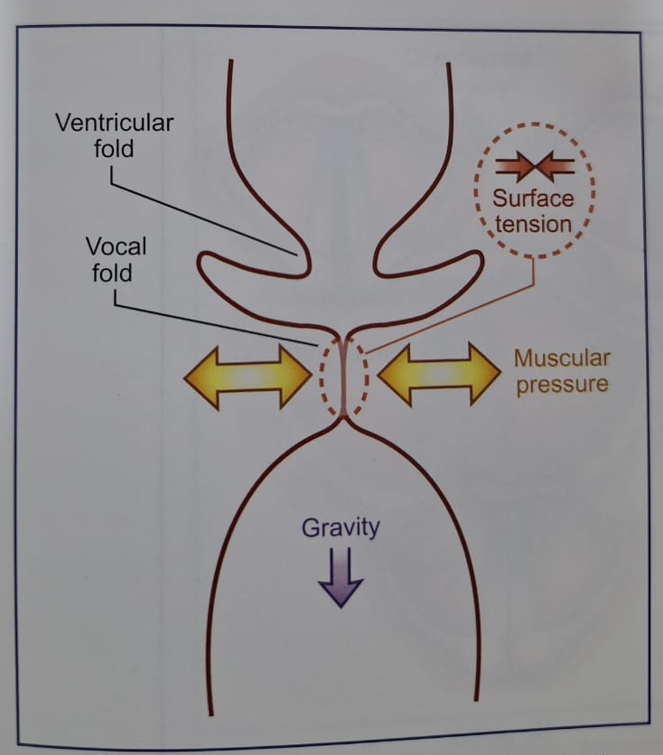
Laryngeal Opposing Pressure
Compressive Muscular Pressure (“squeezes”)
Surface Tension of the Vocal Fold
Gravity

Slide 17
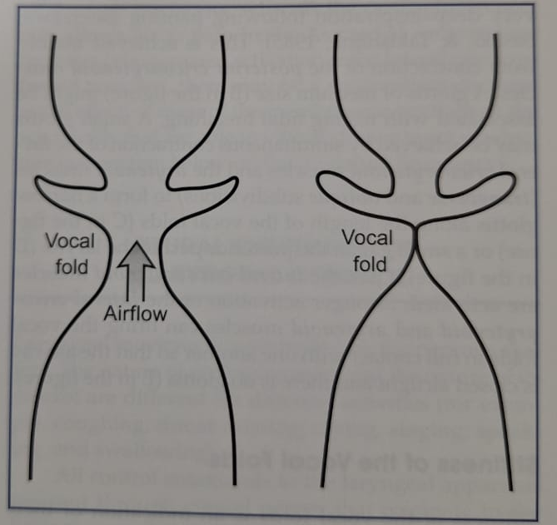
Laryngeal Airway Resistance

Slide 18
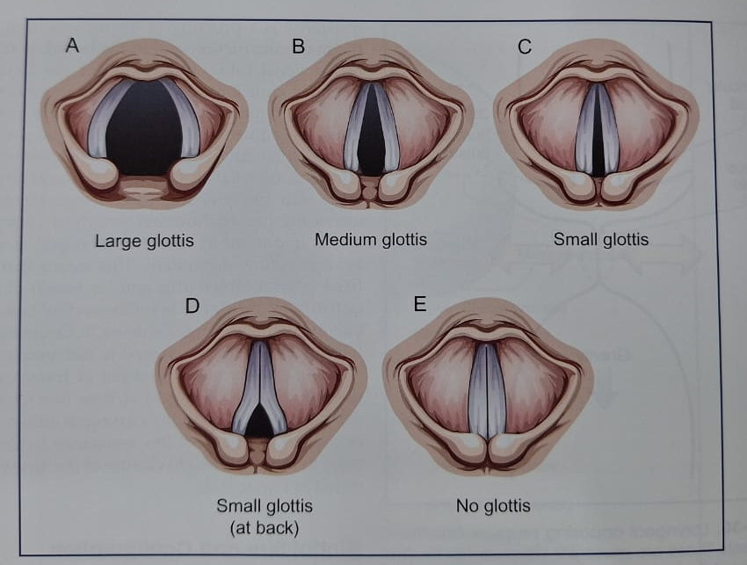
Glottal size and configuration

Slide 19
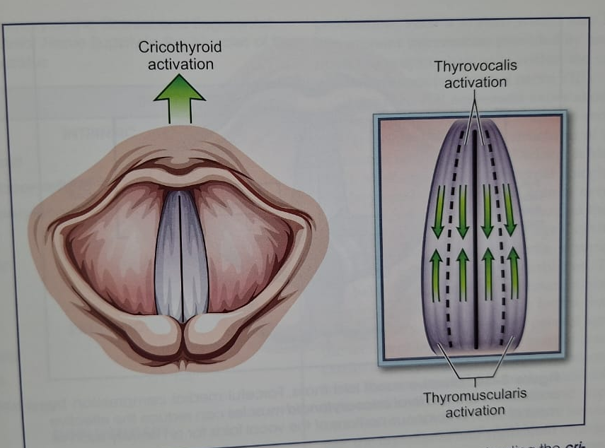
Stiffness of the Vocal Folds

Slide 20
Effective Mass of the Vocal Folds

Slide 21
Recovery and / or
Wound Healing
Vocal Injury
Vocal Fatigue

