Slide 1
Electrocochleography (EcochG)
Mr. Sanket Bhalerao
Assistant Professor
Dept. of Audiology and Speech Language Pathology
Sumandeep Vidyapeeth Deemed to be University
Vadodara, Gujarat

Slide 2
Electrocochleography (EocochG)
Electrocochleography is the method to acquire the electrical responses from the cochlea and the eighth nerve. It is considered as the fast and early potential (short potential) occurs within 2-3ms after an abrupt stimulus.
Picton et al,1974

Slide 3
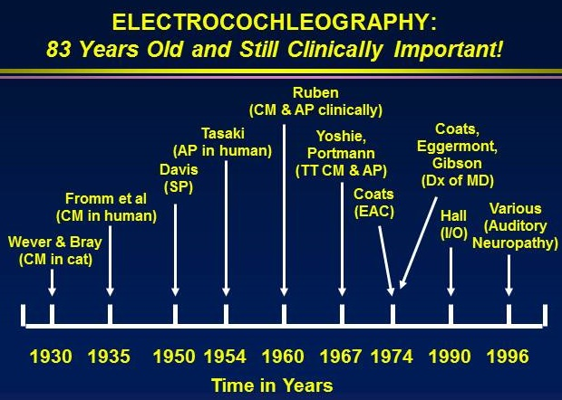
History of EcochG

Slide 4
The cochlear potentials are the earliest described AEP by Waver and Bray in 1930
They reported that the electrode in the cat’s auditory nerve near the medulla with grounded electrode elsewhere on the body noted that the an auditory stimulus presented can be transmitted through an electrode to a telephone receiver with great fidelity.
They named the discovery as the “Wever-Bray effect.”
Davis et al reported that it is generated in teh cochlea ( 1950)
Fromm et al recorded the first CM in human in 1935
SP and AP components were described by Davis (1950) and Tasaki (1954)

Slide 5
The clinical utility of the EcochG was explained by Reuban ( 1960) by using it in the intraoperative monitoring
The transtympanic membrane acquisition of high quality EchochG CM components were explained by Yoshie ohashi & susuki (1967)
The advanced extra tympanic acquisition of EchochG was developed in 1967 and introduced improved ear canal design by Coats Dekey (1970).

Slide 6
Characteristics of the EcochG
It is very early potential
It is an Exogeneous potential
It can acquired by Near field or far field ways
It is a fast response arising from the cochlea and auditory nerve within the first 2-3 ms after the stimulus.
It has major three components
Cochlear microphonics
Summating Potential
Action potentail

Slide 7
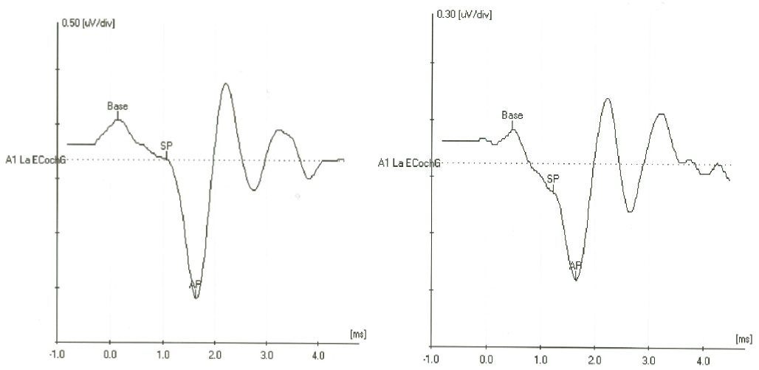

Slide 8
Cochlear microphonic(CM)
CM is an AC potential, It directly reflects the oscillation of the basilar membrane induced by the stimulus.
It is generated at the haircell level in the cochlea
With single polarity stimulus ( rarefaction or condensation) the CM appears as the waveform with series of repeated upward and ten downward peaks
CM componets can obscure the later components of EcochG wave form,,because it is continous as long as the stimulus presented.

Slide 9
Summating Potential
The summating potentials are also derived from cochlear hair cells, both types of hair cells plays important role in the production of SP
The SP is a Direct current (DC) voltage; it is reflect the extracellular activity of the hair cells during acoustic stimulation (Davis 1958)
The SP is a complex response made up of several components.
SP appears as the unidirectional voltage deflection (usually negative), from baseline( Ferraro and Durrent2006). This may be due to the distortion product caused by the BM not moving equally in all the direction( Moller 2006)

Slide 10
The click genrally produce SP prior to the AP, whereas the long duration tone burst ECochG produces the Sp following the AP.
CM & SP are pre neural responses generated at the level of the cochlear hair cells

Slide 11
COMPOUND ACTION POTENTIAL (CAP)
This potential is derived because of the the synchronous firing of the thousand auditory nerves in response to the auditory stimulus such as the click or tone burst (Goldstein and Kiang 1958).
AP is most often generated by click stimuli clinically It is possible to obtain highly frequency specific information using abrupt onset tone bursts of different frequencies and to record response with a promontory electrode. Amplitude is more when we use the click stimuli.

Slide 12
Recording Electrocochleography

Slide 13
Electrode type and location
Lempert et al in 1947-50 recognized the optimal site for ECochG as the round window membrane and predicted the clinical value of the ECochG
Based on the electrode type used and location the EcochG recording can be distinguish in two methods
The placement of the electrode is very important because of the magnitude and quality of the responses depend directly on the distance from the response generator
The different methods are
Transtypanic electrode method
Extratympanic electrode method
Based on the methods used the electrodes are classified in to different types

Slide 14
Transtypanic electrode method
The method of obtaining highest quality responses with a needle electrode placed through the tympanic membrane(posterior-inferior quadrant of TM);directly on the promontory of the cochlea (Aran and Le Bert, 1968, Yoshie, ohashi and Suzuki1967)
This is a kind of invasive technique is potentially pain full and need the assistance of medical professional.
The amplitude of the ECochG components recorded with the TT electrode technique is in the order of 15 to 25micro volt and 10 times to 40 times larger than ear canal electrode placements (Schwaber& Hall 1990).

Slide 15
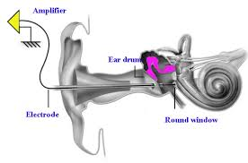
They also reported that it is possible to pass a needle electrode through the tympanic membrane and to make contact with the bony promontory. After the needle is removed the TM heals perfectly in a short time .
TT electrode approach also confirms enhanced reliability, confidence in waveform analysis and, for the diagnosis of Meniere’s disease, optimal test performance(sensitivity and specificity)

Slide 16
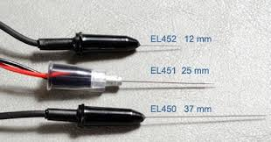
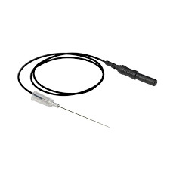

Slide 17
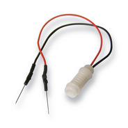
Sub dermal Needle electrodes
These electrodes are used in intraoperative neurophysiologic monitoring, subdermal needle electrodes are in all the locations noninverting, inverting and ground.
It has the advantage of secure attachment to the patient during surgical procedure and lower impedance.
penetrated the ear canal skin close to the tympanic membrane
The major disadvantage of this electrode is spreading of the disease by an unsterilized needle and needle breakage.

Slide 18
Extratympanic electrode method
The method by which the electrode will be placed close to the tympanic membrane as possible either in the ear canal wall or on the resting TM is called the Extratympanic apporach( Ferraro and Ferguson 1997 2003).
The commonly used electrode for extratympanic methods are TIPtrode, Tymptrode.

Slide 19
Tympanic membrane electrodes
It is non-invasive technique
It maximize response amplitudes while minimizing clinical preparation cleansing and insertion requirements,
it consist of a soft foam sponge at the tip, which will be filled with conductive gel
The tube is fed down the ear canal until the electrode at the tip actually makes contact with the TM The electrode is inserted until the patient reports a pressure sensation and/or slight resistance is met

Slide 20
Ear canal should inspect before insertion of TM electrode. Any discomfort to the patients should be monitored.
The presence of the cerumen and other debris be removed if present. Electrode insertion with the microscope is appropriate
These kind of electrode helps in the appropriate recording of EcochG in meneires disease( large amplitude of the waves are obtained),even though it causes some kind of discomfort to the patient.

Slide 21
Tiptrode
It is an ear canal electrode,it is combination of the earphone and the electrode consisting of a foam( polyurethane) insert ear cushion covered with gold foil.
The tiptrode is coupled to special acoustic tubing that connects the insert ear cushion to the transducer
The acoustic tubing consisting of an aligatoclip design at the end that couples to the Tiptrode. The tiptrode acquires the evoked biopotentials via the walls of the ear canal.

Slide 22
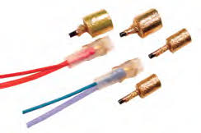
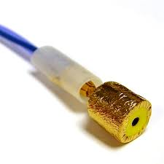

Slide 23
A small amount of the abrasive liquid on to a clean cotton swab should be placed and cleaned the surface in order to reduce the impedece, before the placement of the tiptrode
The ear canal should be inspected before the placement of the electrode.
It enhances the the wave I in ABR, and also helps to detect the CM. Eventhogh it enhances the EcochG AP amplitude, it produce small amplitude of AP component in hearing impaired individuals. The SP components cannot be even detectable.

Slide 24
Surface electrodes
These are attached outside the external canal.
These electrodes are clipped to the earlobe or are placed on the mastoid. The amplitude obtained in this placement is 0.5microV
Recordings from the more external regions of the canal are about half the amplitude of those recorded from the eardrum, with the relative size depending on the distance from eardrum.

Slide 25
Near Field Recording | Far field Recording
Greater amplitude of response | Lesser amplitude of response
Better morphology | Poorer morphology
Short latency | Greater latency
Less contaminated by artifacts | Easily contaminated by artifacts
Invasive procedure, requires anaesthesia | Non invasive procedure, anaesthesia not required

Slide 26
PROTOCOL

Slide 27
Stimulus Parameters
Tranducers
Insert ear phones : are generally used, the advantage of using insert ear phones are
Waveform analysis can be enhanced by separation of the transducer box from the electrode cite,(through the insert tube) so the artifacts can be easily removed.
Helps in the quality recording of the EcochG.
It is advantageous intra operative monitoring during surgical procedure over headphones

Slide 28
Bone vibrators
Usually doesn’t use, because of major problem in increased artifact. the artifacts may extend well into the time period of the response and may obscure the individual components of the response
The disadvantages of bone vibrators are presence of large distortion for high frequency stimulus and excessive electromagnetic stimulus artifacts ( Hall

Slide 29
Stimulus used for recording
High intensity click stilmuli are commonly used stimuli in the recording of the EcochG
Broad band click: Most popular stimulus for short latency AEP (excites synchronous discharges from large population of neurons to produce well defined peaks )
Click produces a 0.1ms electrical pulses.
It enhances the wave 1 component
Mostly used in the intraoperative monitoring
Tone burst:
Tone bust stimulus enhances the detection of the SP component,
( it persist throughout the stimulus) and also helps to distinguish between SP and AP components ( high frequency prolonged tone burst)
The diagnostic value of the Tone burst stimulus is higher for tone burst stimuli with high frequency( more than 1000Hz) for monitoring cochlear status in progressive disorders (MD/ ELH)

Slide 30
Duration of the stimulus
Abrupt onset stimulus is required for generation of the EcochG component, it is an onset response
shorter duration stimuli are most effective in producing the EcochG.
The response is not detected if stimulus rise time is 10msec or more.
In contrast, the SP is dependent on stimulus duration.
CM and SP can be recorded with long rise time and longer duration toneburst.
Measurement of EcochG with longer duration TB is useful in diagnosin MD. By extending the duration of TB the SP persists for the duration of stimulus. AP appears only after stimulus onset

Slide 31
Intensity:
Since CM and SP are not the receptor potentials it is said that their latency is not affected by the intensity level, because neither of them involves a having the synapse.
ie: each potentials are generated in the cochlea as soon as the cochlea is activated by the acoustic stimulus
Usually an intensity level range of 70-90 dBnHL is using
Since CM follows the vibratory pattern of the BM,the amplitude is affected by the stimulus amplitude. As the intensity increases the amplitude of the CM increases
Summating potential is typically recorded only at high intensity levels (Davis 1958) since IHC are playing an important role in the production of the SP

Slide 32
The amplitude of both CM and SP increases with increases of the intensity
Amplitude of AP increases and latency decreases as stimulus intensity is increased.
Since synaptic delay is less high intensity stimulus.Also, high intensities activate basal end of cochlea. Hence leading to decreased latency for high intensity stimulus.

Slide 33
Repetition rate
AP latency increases and amplitude decreases as stimulus rate increases (Wilson and Bowker 2002) adaptation phenomenon at the synapse (Eggermont1974)
As signal rate increases the SP/AP ratio increases, where as CM and SP component of the EcochG are remain relatively stable for a wide range of stimulus rate.
The use of very fast stimulus RR ,has not proven to be very successful in the clinic, in part because the AP contribution in not completely eliminated and the SP may also be reduced under extreme conditions.(>90/sec).
A very fast stimulus rate ( 91.1)is usefull in distinguish the SP from AP, at high rate the amplitude of the SP remain unchanged, detection will be easier.

Slide 34
Polarity
The polarity has varying influence on different components of the EcochG. The CM component is recorded for single polarity signals (rarefaction and condensation)
When the alternating polarity used the CM gets cancelled out, so that SP and AP waves can be easily detected
EcochG components are elicited single polarity singals are true electrophysiological responses, whereas the waveform produced by alternating polarity signals is really derived from the two individual responses.
AP latency shorter for rarefaction polarity signals.

Slide 35
Ease of analysis of the AP latency for signals with rarefractionVs condensation polarity Vs identification of the SP and calculation of SP/AP ratio can make an important contribution to the diagnosis of MD/ELH
There is abnormal latency difference in MD /ELH when recording separate responses for rarefaction and condensation clicks which may provide useful clinical information.
The latency difference for the two signal polarities is considerably and statistically large (e.g. 0.6/0.7 ms) in Meneier’s disease

Slide 36
ACQUISTION PARAMETERS
Analysis time
An analysis time of 5-10 ms is typically used
5 ms is preferable because potentially larger amplitude and later latency brainstem components are eliminated
When ABR recording also doing a time window 10-15 ms is appropriate
Filter settings
The CM components reflects stimulus polarity and frequency, it contains the energy in the region of the stimulus. Filter setting should be wide to encompass these frequencies and avoid the distortion of the CM phase.
SP is DC potential, it is best recorded with little or no high pass filtering ( 10 TO 30Hz)

Slide 37
3 or 10 to 1500 or 3000 Hz band pass filter setting is typically used
In case of click evoked EcochG low pass cut off of 5-100 Hz is used (Durrant and Ferraro 1991) with no detectable change in the SP/AP ratio.
In case tone burst EcochG low pass cut off should be 10 Hz or lesser, to avoid distortion
Amplification factor
An amplification of 50000-100000 is used
SP/AP for ET measurements the amplification factor ranges: 20,000-1,00,000. For TT recordings are 5-10 times smaller than ET.

Slide 38
Inter electrode impendence
Electrode impedance should be measured before and during recording whenever there is a reason to suspect a change in electrode impedance. Inter electrode impedance should be within + 2kohms.
Electrode Montage
Inverting (-ve): Contralateral Mastoid
Non-Inverting( +ve): Test Ear Canal
Ground electrode : Forehead
When recording from both ears, a contralateral tiptrode in the ear canal may be used as the non-inverting electrode.

Slide 40
Factors affecting EcochG

Slide 41
Age:
The effects of age on ECochG have not been studied extensively.
In comparison to adult values, latency is prolonged and amplitude reduced (Stockard, Stockard, &Coen, 1983) In infants
In newborns, particularly premature infants, there is a slight delay in the AP that progressively decreases with maturity. This decrease may reflect maturation of the peripheral system and/or resolution of conductive hearing loss that may be associated with the presence of fluid in the neonatal ear
The CAP amplitude gets smaller with increasing age, mainly in relation to increasing thresholds for 4kHz and 8kHz tones (Chatrain et al., 1985).

Slide 42
Similar ear and gender effects were found by Coats (1986), although his overall amplitudes were larger.
SP amplitude decreased as a function of age.
There was a strong negative correlation between AP amplitude and age and, as a result, a positive correlation between the SP/AP ratio and age.
With advancing age, amplitude of the AP component decreases relatively more than amplitude of the SP component. Therefore, the SP/AP ratio increases with age

Slide 43
Gender:
The amplitude of the CAP is significantly larger for female (mean 1.6µV) than for males subjects (mean 1.1 µV) in ear-canal recordings (Chatrain et al., 1985).
SP amplitude was significantly larger for females than males, but curiously only for left ear.
SP/AP ratio was equivalent between genders (Chatrian et al., 1985)

Slide 44
Ear effect
The CAP is slightly larger for clicks presented to the right ear (mean 1.5 µV) compared to left ear (mean 1.2 µV) (Chatrain et al., 1985).
A significantly larger average SP was produced with right than left ear stimulation (Chatrain et al., 1985
Temperature
Temperature exceeding + 1 degree from normal value (i.e., 36 degrees centigrade or above 38 degrees) must be considered as a possible factor in AER outcome.
In vitro, depolarization in membrane potentials (a decrease) is recorded in supporting cells (Hensen’s) of the organ of Corti (Dantos-Sacchi, 1986).

Slide 45
CM amplitude is reversibly reduced, while CM latency shows little or no change
Variable changes during hypothermia are found for the SP.
Hypothermia also produces a reversible reduction in VIIIth nerve CAP (ECochG N1 component and ABR wave I) amplitude and a reversible increase of N1 (wave I) latency (Kahana, Rosenblith, &Galambos, 1950).
An initial effect of hypothermia may be the selective loss of auditory sensitivity for HF signals, as estimated electrophysiologically (Manley &Johnstone, 1974).
Also, synaptic transmission is delayed and axonal conduction velocity is decreased.

Slide 46
Muscle movement and artifacts
In comparison to later latency AERs, the ECochG components occurring within 2 or 3 ms period after a stimulus are minimally affected by muscle activity.
A quiet patient state contributes to less background noise and facilitates detection of even a small amplitude response.
Random movement related artifact confounds ECochG interpretation, especially identification of the SP component.
The SP often appears as a hump on the upward slope of the AP. False identification of the SP is more likely when excessive movement artifact is present in the waveform, particularly without strict criteria for reliability.

Slide 47
Drugs
A substantial number of drugs can affect CNS activity and, consequently, may influence AERs.
The controll drugs such as the CNS depressents can reduces the neural activity ( pentobaribital, secobarbital, demrol, etc.
The schedulded drugs such as morphines ( potential analgesics) can depress the CNS.
Anaesthetic agents produce differential effects on AERs. ECochG components, which are dependent on the end organ (cochlea) and eighth nerve, are not seriously influenced by anaesthesia

Slide 48
Attention and aurosal
most available clinical evidence shows that there is no difference in EcochG recorded in awake and deep sleep stages. But there is always better response eliciated during the deep sleep along with stable EEG.

Slide 49
WAVEFORM ANALYSIS AND INTERPRETATION

Slide 50
Strategies used in the EcochG analysis
Calculation of the amplitude of major components and diagnosis of MD, a comparison of relative amplitude for the SP and AP components and the SP/AP ratio
Latency analysis for the AP component and for diagnosis of MD, a comparison of the latency difference for the AP component evoked with signals of rarefractionVs condensation polarity
Calculation of the duration of the SP and AP complex and calculation of area under SP and AP components

Slide 51
Latency analysis
Calculation of the absolute latency of components of any auditory evoked response is a fundamental analysis strategy
Latency is measured from stimulus onset to the peak. AP-N latency ranges from 1.3 to 1.7 msec.
In normal ears, latency is slightly shorter for AP components evoked with rarefraction VS condensation signals.
This Normal latency difference associated with signal polarity is more pronounced for persons with MD.

Slide 52
Amplitude analysis
Component magnitudes can be measured from a single point or a baseline reference (clicks)
Typically the peak in SP and AP amplitude in microvolts is calculated from a baseline. This values used to calculate SP/AP magnitude ratio for click stimuli, which is helpful to diagnose and monitor MD/ELH.
The ampltude of the SP and AP can be derived using measure the 'absolute' or peak-to-peak amplitudes of the SP and AP or using a baseline reference (Margolis, Levine, et al., 1992; Ruth, 1994).
The resultant SP/AP value can be represented in both decimal and percentage

Slide 53
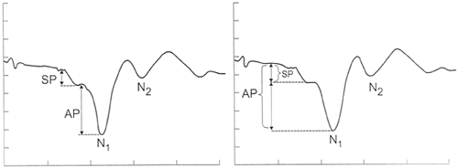

Slide 54
The mean SP/AP amplitude ratio to click stimuli for normal subjects is approximately 0.25 + 0.10 standard deviations (SD).
Although the normal range for this value extends from 0.10 – 0.50( an avarage range of 0.16 to 0.31 irrespective of the placement of the electrode ( Ferraro, 2000).
A SP/AP amplitude ratio greater than 45 % is considered as prolonged ( when the electrode is on the TM), >30% is taken as the prolonged when the electrode is placed on the promontory and more than 50% when the electrode is in earcanal.
With tone burst stimuli of extended duration the SP amplitude can be measured from a point on a the SP plateau (SP amplitude is measured at midpoint of response Ferraro, 2000)

Slide 55
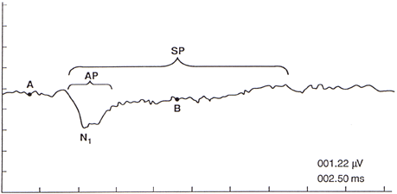
Normal electrocochleogram from the tympanic membrane to a 2,000 Hz toneburst presented in alternating polarity at 80 dB HL

Slide 56
Duration analysis:
Duration or width of the SP and AP components in combination is a measurement parameter for the diagnosis of MD (Ge& Shea 2002).
The width of the SP/AP portion of the wave form, in ms, is defined from the onset to the point where the wave form returns to the baseline.
The suspected mechanism underlying the prolongation in the SP/AP width at least in MD is slowed velocity of the traveling wave within the cochlear secondary to restricted basilar membrane movement with increased loading in ELH (Ferraro and Tibbils 1999).

Slide 57
Area under the curve
A third analysis strategy involves calculation of the area encompassed by the SP/AP waveform complex or “Area under the curve”.
Ferraro and Tibbils (1999) explored this notion by combining both magnitude and duration features of the response to measures ‘areas’ of the SP and AP.
Patients with enlarged SP/AP magnitude ratio also have enlarged SP/AP area ratio. This enlarged area ratio is seen in patients suspected of having MD/ELH but whose SP/AP magnitude ratios were within normal limits
This suggests that SP/AP area ratio may improve sensitivity EcochG.

Slide 58
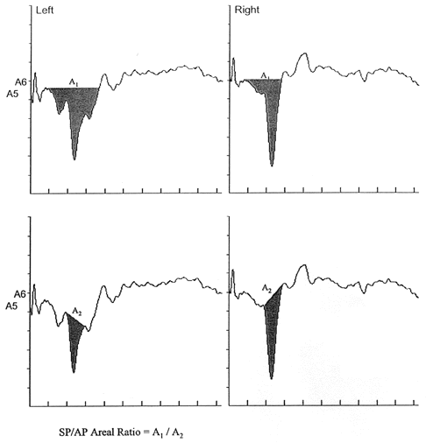
Fig.: Method of measuring the areas of SP and AP to click stimuli to calculate SP/AP area ratio. Shaded portion is the area of the component. Left :-patients suspected of MD(enlarged S) .Right ;-normal EcochG.

Slide 59
Clinical Application of the EcochG

Slide 60
Assessing the hearing threshold
Monitoring the status of the auditory nerve during the otologic surgery
Identifying wave 1 of ABR
Aiding in the assessment, diagnosing and monitoring of the Meniere disease.
In the diagnosis of ANSD

Slide 61
Threshold estimation:
Prior to ABR in 1960s EcochG was the technique of choice for auditory threshold estimation
EcochG was used by Ruben and colleges in John Hopkins Medical College for threshold estimation in children who could not be assessed with behavioral audiometry
By 1970s EcochG was used to estimate threshold, around the world. With advent of ABR EcochG was abandoned as a procedure in pediatric audiology.

Slide 62
Monitoring the status of the auditory nerve during the otologic surgery
This helps surgeon avoid potential trauma to the ear or nerve in an effort to preserve hearing. Mainly used for :
Vestibular nerve section (for debilitating vertigo)
Endolymphatic sac decompression with or without insertion of a drainage shunt
Maintenance of the AP during surgery predicts post-operative preservation of hearing whereas disappearance of the AP indicators that some if not all hearing may be lost
Reductions in SP/AP ratio when endolympatic sac is open or shunted are interpreted as predicting successful outcome. However long term predictive value of intraoperative ECochG remains questionable.

Slide 63
Identifying wave 1 of ABR
An ABR recording with a mastoid or, preferably, earlobe inverting electrode site often fails to yield a clear and reliable wave I component, due to the degree of hearing loss and the difficulty presenting a stimulus that is sufficiently above hearing threshold to generated a detectable wave I
Used in conditions like less than optimal' recording conditions (e.g., noisy electrical and/or acoustical environment, restless subject) wave 1 can be easily identified.
A clear ECochG can certainly be detected with a TT needle electrode located on the promontory, even in the absence of an ABR as recorded with surface electrodes

Slide 64
Aiding in the assessment, diagnosing and monitoring of the Meniere disease.
In pateient with Menieres disease the abnormally enlarged SP amplitude can be observed ( it is because of the distortion of the basilar membrane movement caused by the increased lymphatic pressure.)
The SP/AP ratio is enlarged in patient with menieres disease.( Coats 1981,Dornhoffer 1985)
The latency of the components can be prolonged

Slide 65
Diagnosis of the Auditory neuropathy sprectrum disorder
The classical clinical representation of the ANSD is usually associated with normal OAE recording and abnormal or absent ABR.
In EcochG CM is clearly recorded with single polarity stimuli. Starr et al(2001) reported larger than normal CM amplitude in AN.
SP may be detected or absent in AN depending on site of auditory dysfunction. Starr et al. (2001) commented on the value of SP as an indicator of IHC function in AN
The classic ECochG finding in “Auditory Neuropathy” is a clear often very robust CM for single polarity Stimuli, with no subsequent AP and no ABR waves

Slide 66
If the ABR is recorded with alternating polarity stimulation ,the CM for rarefraction and condensation polarity stimuli are consistently cancelled ,and the result will be no ABR.( hair cells are normal but the lesion is there in the auditory nerve.

Slide 67
Reference
1 Colletti, V., Fiorino, F. G., Mocella, S., & Policante, Z. (1998). ECochG, CNAP and ABR monitoring during vestibular Schwannoma surgery. Audiology, 37(1), 27-3
2 Parving, A., Elberling, C., & Salomon, G. (1981). ECochG and psychoacoustic tests compared in identification of hearing loss in young children. Audiology, 20(5), 365-381.
3) - Samuel R Atcherson, Tina M Stoody Auditory electrophysiology ; a clinical guide
4 Hall. New Handbook of Auditory evoked potentials.
5 Picton.Human auditory evoked potential.
6 Roeser/Valente(2nd edition)-Audiology:Diagnosis.
7 Burkard, Eggermont; Auditory evoked potentials: basic principles and clinical application

Slide 68
THANK YOU

