Slide 1
Unit 1
Differential Sensitivity
Ms. Rajeshvariba Jadeja
Assistant Professor
Dept. of Audiology and Speech Language Pathology
Sumandeep Vidyapeeth Deemed to be University
Vadodara, Gujarat

Slide 2
Differential Sensitivity
The smallest perceivable difference between two sounds is called either the difference limen (DL) or the just noticeable difference (jnd).
The DL is the smallest perceivable difference in dB between two intensities (∆ I) or the smallest perceivable change in hertz between two frequencies (∆ f).

Slide 3
Because delta (∆) is the symbol for “change,” the intensity DL is often called ∆I. If ∆I is the intensity difference needed to tell two sounds apart, then one of those sounds has an intensity of I and the other one has an intensity of I + ∆I.
The values of ∆I and Df are absolute difference limens because they specify the actual physical difference needed to tell two sounds apart.

Slide 4
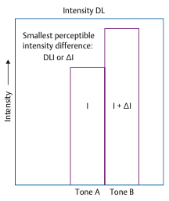

Slide 5
Jnd maybe thought in two ways.
One is as the absolute difference between two sounds, and the other is as the relative difference between them.
The relative difference is obtained by dividing the absolute DL by the value of the starting level.
Thus, if the starting level I is 1000 units and the DL or ∆ I is 50 units, then the relative DL ∆ I/I is 50/1000 = 0.05. This ratio, ∆ I/I, is called the Weber fraction.

Slide 6
Weber’s law states that the value of ∆ I/I (the Weber fraction) is a constant (k) regardless of stimulus level,
∆ I/I = K
Weber fraction decreases with increasing intensity from about 1.7 dB at a sensation level (SL) of 5 dB to about 0.5 dB at 80 dB SL. This slight deviation from Weber’s law has come to be known as the near miss to Weber’s law.

Slide 7
Methods for obtaining intensity difference limen (DLI)
1. Amplitude modulation
• Amplitude modulation is the modulation of a wave by varying its amplitude.
In one interval, the stimulus is unmodulated and in the other it is amplitude modulated.
• Subject is to indicate which interval contained the modulation.

Slide 8
2. Gated pedestal
• Two separate pulses are presented successively, one is more intense than the other.
• Subject indicates which sound was more intense.

Slide 9
3. Continuous pedestal
• Continuous background stimulus is presented and increment in level is imposed on the background stimulus.
• Subject indicates when the increment is perceived.

Slide 10
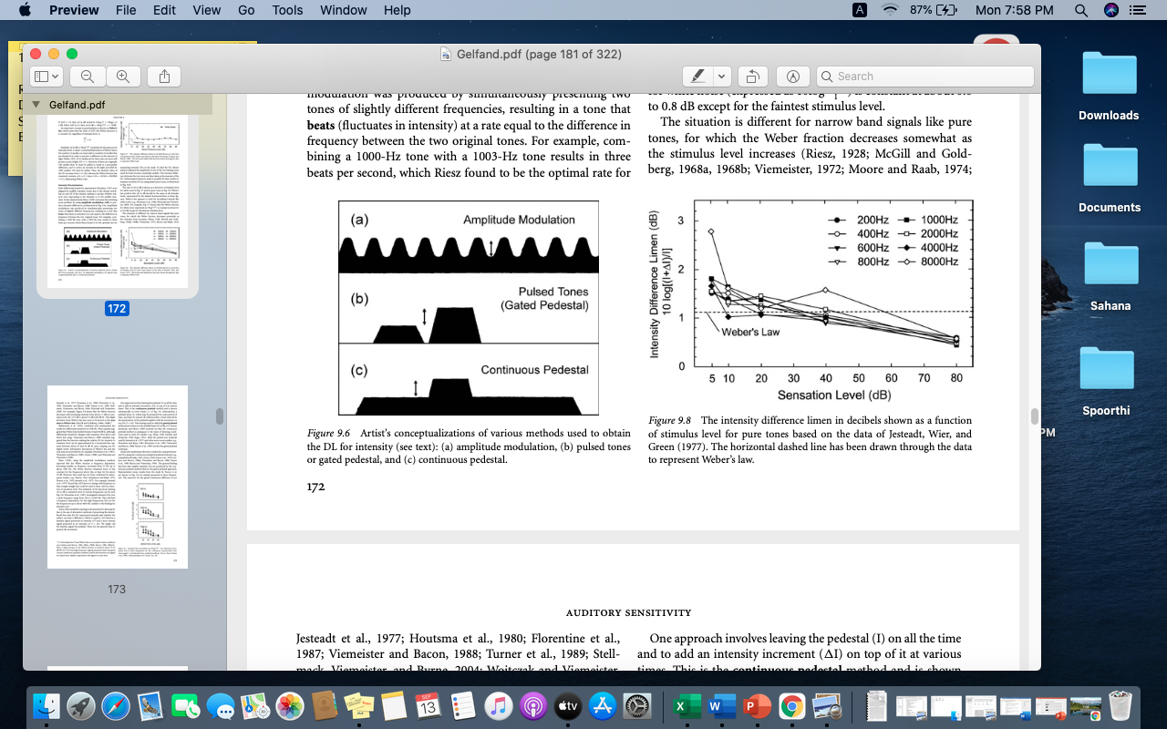

Slide 11
Denes-Nauton test (1950)
In this test the patient is presented with a pair of tones one after the other and has to decide whether they were equal or if one is louder than the other.
Many pairs of tones are presented to the patient to find the DLI. The first tone is always kept at same level, but the second tone would be changed in level.
This procedure is continued until clinician found the smallest level difference that the patient could detect.

Slide 12
Frequency discrimination
The difference limen for frequency, Df, is the smallest discernible difference between the frequencies of two sounds, f and f + Df. The difference limen for frequency becomes larger (wider) as frequency increases and also as sensation level decreases (Wier, Jesteadt, & Green 1977).

Slide 13
At the readily audible and comfortable level of 40 dB SL, the size of Df is ~ 1 Hz at 200 Hz and 400 Hz and 2 Hz at 1 KHz and 3 Hz at 2 KHz ,16 Hz at 4000 Hz, and 68 Hz at 8000 Hz.
In terms of the Weber fraction, Df/f is smallest (~ 0.002) between 600 Hz and 2000 Hz, and gets larger for the frequencies below and above this range.
All of these values become larger (poorer) as the intensity decreases toward threshold. The DL increases substantially above about 1000 Hz so that Δf at 40 dB SL is roughly 16 Hz at 4000 Hz and 68 Hz by 8000 Hz.

Slide 14
Duration discrimination and temporal resolution
Here the subject must determine which one of two signals lasted for a longer period of time. The difference limen for duration (Dt) becomes larger (longer) as the overall duration of the signal (t) increases and the Weber fraction, Dt/t, is not constant.
Temporal resolution refers to the shortest period of time over which the ear can discriminate two signals.
The shortest perceptible time interval or temporal resolution is typically on the order of 2 to 3 milliseconds in young, normal individuals, and can be measured by gap detection as well as other approaches.

Slide 15
1. Gap detection test
The shortest discernible gap is the gap detection threshold.
The stimulus used for gap detection testing is usually a pair of noises that are presented in rapid succession, separated by a very short break or gap.
The duration of this gap is varied according to an appropriate method of measurement, and the subject’s task is to determine whether a gap can or cannot be heard. These principles are illustrated in

Slide 16
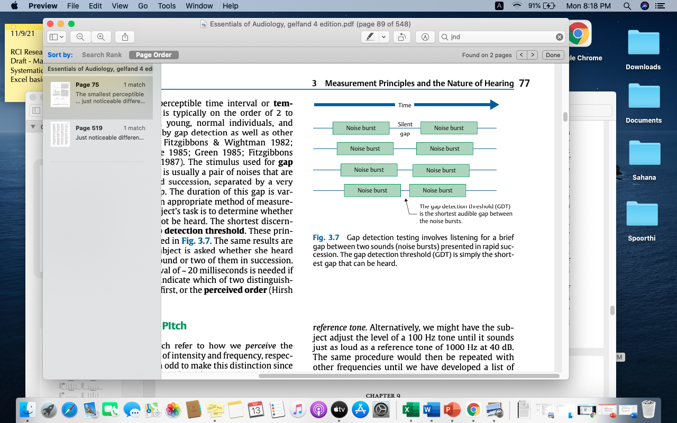

Slide 17
Application of jnd
DLI can be used as a test to differentiate between cochlear and retrocochlear pathology as the DLIs are very small in individuals with CP (that is, even a slightest change in intensity can be detected by individuals with recruitment).
DLF helps in understanding widening of frequency bandwidth which happens in hearing loss (increased critical bandwidth).

Slide 18
GDT, a measure of jnd in the temporal domain has multiple application:
  It is usually affected in RCP as auditory nerve is the major contributor for temporal precision.
  Used as a measure for temporal processing in diagnosing individuals with central auditory processing disorder.

Slide 19
LOUDNESS
Loudness
The perception of intensity is called loudness; generally speaking, low intensities are perceived as “soft” and high intensities as “loud.” In other words, intensity is the physical parameter of the stimulus and loudness is the percept associated with that parameter.

Slide 20
Magnitude estimation and production
There are two major variations of the magnitude estimation method.
In one approach the subject is presented with a “standard” tone called a modulus and is told that it has a magnitude of, say, “10.” She then hears other tones at other intensities and is asked to describe (estimate) their magnitudes with numbers that are proportional to the modulus. A tone that is twice as loud as the modulus is rated 20; 40 means four times louder.

Slide 21
The alternative approach is to omit the modulus. In this case the subject is asked to provide a rating for each sound using numbers that represent how they are perceived.
The opposite of magnitude estimation is magnitude production. Here the subject is presented with numbers and must adjust the intensity (or frequency) to produce a tone with the corresponding loudness (or pitch).

Slide 22
Equal loudness contours
The ear is not equally sensitive to all the frequencies, particularly in the low and high frequency ranges.
The response to frequencies over the entire audio range has been charted, originally by Fletcher and Munson in 1933, with later revisions by other authors, as a set of curves showing the SPLs of pure tones that are perceived as being equally loud.

Slide 23
In their experiment, Fletcher and Munson fixed the level of a 1000-Hz reference tone and, using loudness balancing, asked listeners to adjust the level of a test tone until it was perceived as being equally loud to the reference tone.
They repeated this measurement for multiple frequencies and reference levels. For a given reference level, then, they achieved a single equal-loudness contour.

Slide 24
The curves are plotted for each 10 dB rise in level with reference tone being 1kHz. Also called loudness level contours and the Fletcher-Munson curves.
The curves are lowest in the range from 1 to 5 kHz, with a dip at 4 kHz, indicating that the ear is most sensitive to frequencies in this range.

Slide 25
Consider the following tones, they sound equally loud even though their SPLs are different:
78 dB at 50 Hz
54 dB at 200 Hz
43 dB at 500 Hz
40 dB at 1000 Hz (the reference)
39 dB at 2000 Hz
40 dB at 5000 Hz

Slide 26
Because all of these sounds are equally loud we say they have the same loudness level. The loudness level curve is called a loudness level contour, equal loudness contour, or Fletcher-Munson curve.

Slide 27
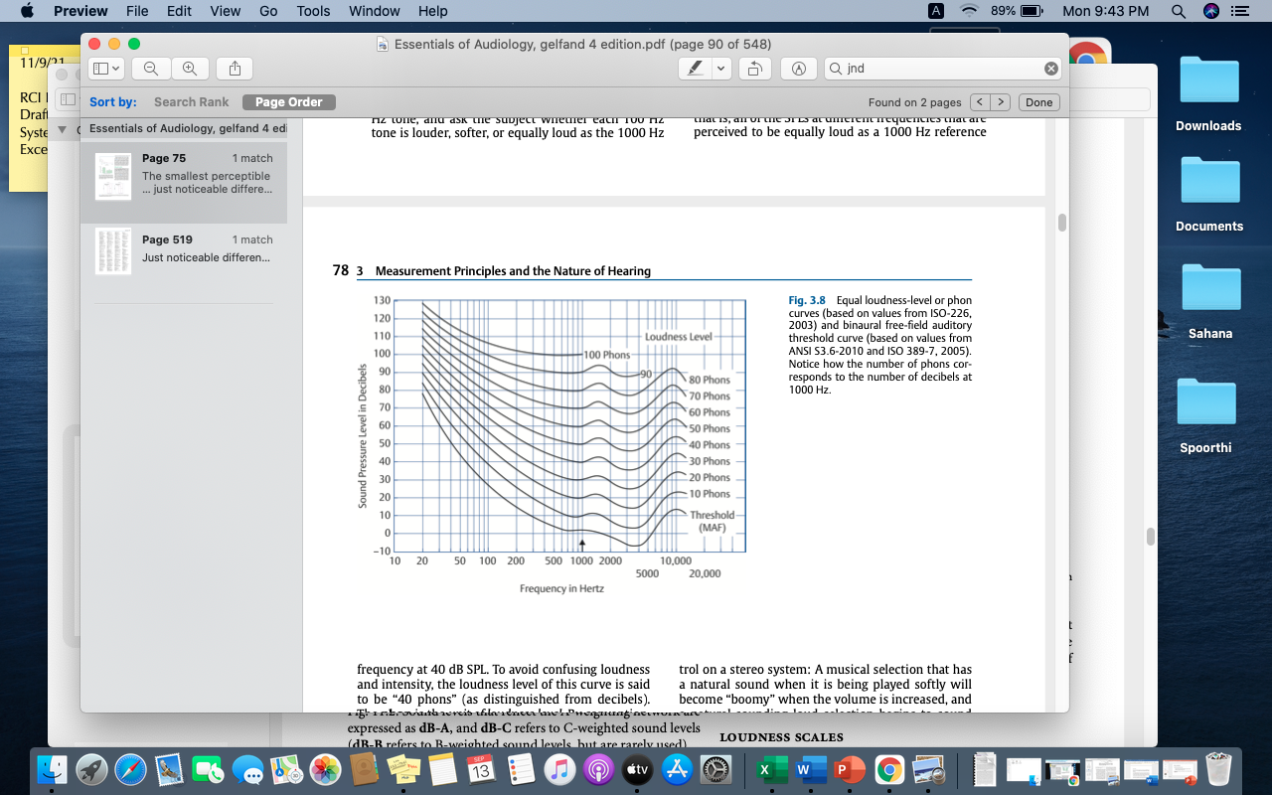

Slide 28
The contour labeled “40 phons” shows the sound pressure levels needed at each frequency for a tone to sound equal in loudness to a 1000-Hz reference tone presented at 40 dB SPL. Thus, any sound that is equal in loudness to a 1000-Hz tone at 40 dB has a loudness level of 40 phons.
A tone that is as loud as a 1000-Hz tone at 50 dB has a loudness level of 50 phons, one that is as loud as a 1000-Hz tone at 80 dB has a loudness level of 80 phons, etc.

Slide 29
At low loudness levels, the phon curves are quite similar in shape to the minimum audible field (MAF) curve. Thus, considerably more intensity is needed to achieve equal loudness for lower frequencies than for higher ones.
However, notice that the phon curves tend to become flatter for higher loudness levels, indicating that the lower frequencies grow in loudness at a faster rate than the higher frequencies.

Slide 30
Loudness scale
Loudness scales show how the loudness percept is related to the level of the sound stimulus.
The unit of loudness is called the sone (Stevens, 1936), such that one sone is the loudness of a 1000-Hz tone presented at 40 dB SPL.
Since sound pressure level in decibels and loudness level in phons are equivalent at 1000 Hz, we may also define one sone as the loudness corresponding to a loudness level of 40 phons.

Slide 31
The phon is the unit of loudness level. Loudness level in phons refers to sounds that are equally loud. By convention, the number of phons corresponds to the number of decibels at 1000 Hz. As a result, an equal-loudness contour is also called a phon curve.

Slide 32
The sone scale is illustrated in Fig. 3.9 and is easily understood. Having assigned a value of one sone to the reference sound, we assign a loudness of two sones to the intensity that sounds twice as loud as the reference, 0.5 sones to the level that sounds half as loud, etc.
For the most part, loudness in sones is a straight line when plotted as a function of sound level on log–log coordinates, revealing a power function relationship.

Slide 33
In other words, the perception of loudness (L) may be expressed as a power (e) of the physical stimulus level (I), according to the formula
L = kIe
where k is a constant. (The value of the constant k depends upon the units used to express the magnitudes.)

Slide 34
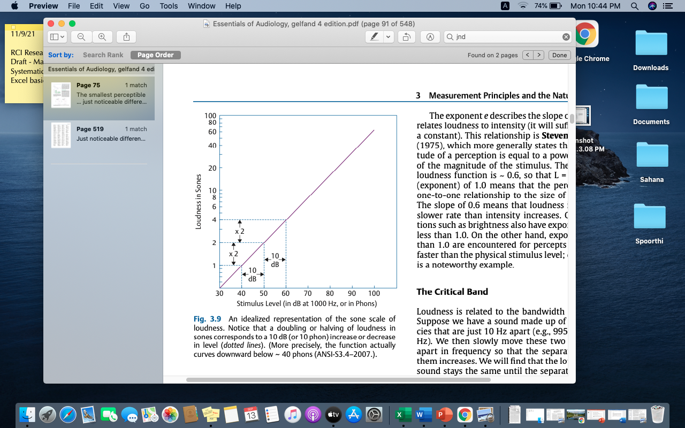

Slide 35
The manner in which loudness is related to the intensity of a sound is usually considered to be a case of Stevens’ power law (1957b), which states that the magnitude of a perception is equal to a power (exponent) of the magnitude of the stimulus.
This means that sensation grows as a function of stimulus level. Stevens’s original work says that the exponent e is about 0.6, which works out to loudness doubling every 10 dB.

Slide 36
Pitch
Pitch is generally described as the psychological correlate of frequency, such that high-frequency tones are heard as being “high” in pitch and low frequencies are associated with “low” pitches (ANSI, 2004).

Slide 37
Mel scale
Just as the sone scale relates intensity and loudness, the relationship between pitch and frequency is depicted by the mel scale, in which the unit of pitch is the mel (Stevens 1975). The reference point for the mel scale is a 1000 Hz tone at 40 phons, which has a pitch of 1000 mels. Following what we know about the nature of ratio scales, 2000 mels is twice as high as (twice the pitch of) 1000 mels, 500 mels is half as high, etc.

Slide 38
Notice that the relation between frequency and pitch is somewhat S-shaped rather than linear, and that the frequency range of 16,000 Hz is “compressed” into a pitch range of only ~ 3300 mels. A doubling of pitch from 1000 mels to 2000 mels corresponds to a tripling of frequency from 1000 Hz to roughly 3000 Hz.
One feature of these data is that clearly doubling frequency causes less than a doubling of pitch.

Slide 39
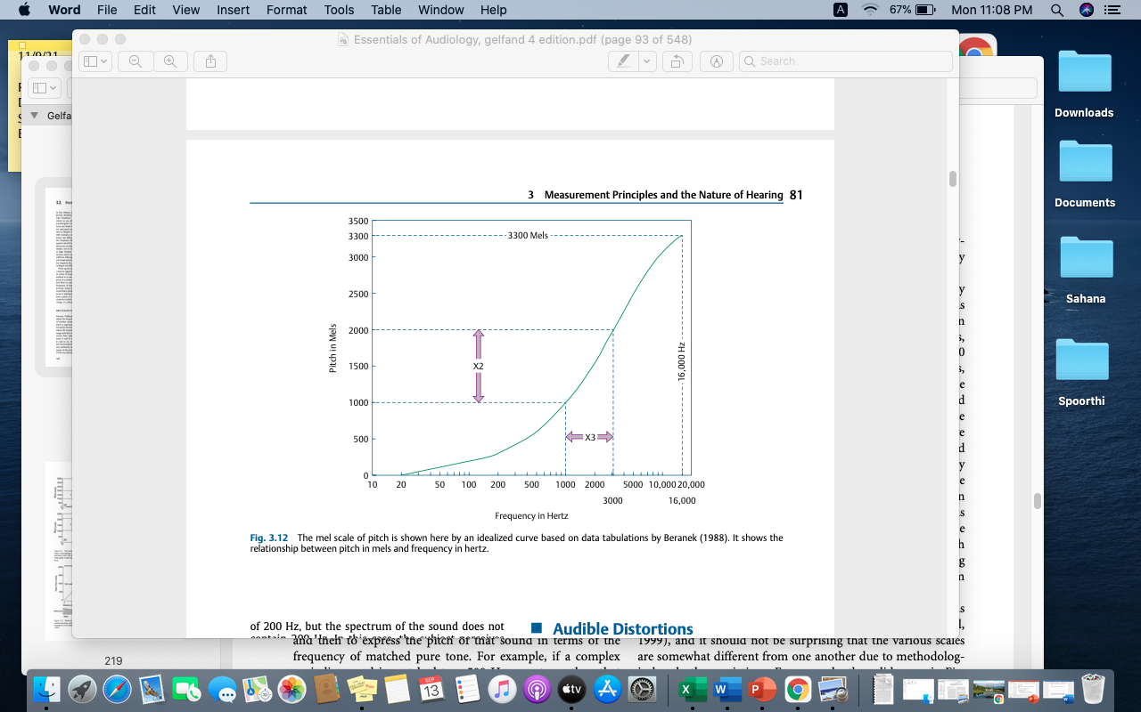

Slide 40
Bark scale
Another method for describing the perception of pitch uses the bark scale.
One bark is equal to the frequencies that make up a critical band. Frequencies within a critical band are close enough in frequency to mask each other.
That is, the presence of one tone can keep you from detecting another tone of similar frequency. For example, frequencies from about 900 to 1060 Hz can easily mask 980 Hz; fre- quencies more distant, such as 850 Hz or 1100 Hz, would have to be more intense to mask the 980-Hz tone.
If 1060 Hz is the edge of one critical band, and the next critical band ranges from 1060 to 1250 Hz, that range is also equal to 1 bark.

