Slide 1
Primitive reflexes and Neurologic disorders, Diagnosis and Management
Mr. Naveen Soni
Assistant Professor
DASLP, SVDU

Slide 2
Primitive reflexes (PRs)
Complex automatic movement patterns present in full-term infants which originate in the central nervous system and are brainstem mediated.
These reflexes become more difficult to elicit later in the 1st year of life, when voluntary motor activity emerges.
Evaluation of the PRs is one of the simplest and frequently used assessment tools among health-care professionals. The responses of PRs have been categorized as normal/abnormal or present/absent.
In general, a PR in infants is regarded as abnormal when it is absent, exaggerated, or diminished during the elicitation period or when it lasts beyond the normal age limit for its disappearance.

Slide 3
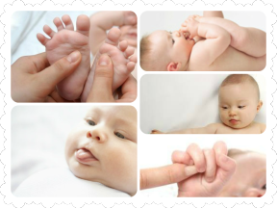
REFLEX PROFILE

Slide 4
Control of reflexes
Primitive reflex control
BS
Postural reflex control
MB
Adult Scema
Cortical control

Slide 5
Primitive Reflexes
Moro reflex
Startle reflex
Palmar
Planter
ATNR
STNR

Slide 6
Postural reflex
TLR
Optical Reflexes
Positive support reflex
Segmental rolling/neck righting reflex
Head righting
Body righting
Traction reflex
Paradrute
Landau reflex
Galant’s reflex
Crawling
Stepping
Swimming

Slide 7
Oral and pharyngeal reflex
Sucking
Suckling
Routing
Gag
Biting

Slide 8
PRIMITIVE / SURVIVAL REFLEXES
Also called as newborn/infantile/ infant reflex
1st few weeks of fetal development
They are automatic, stereotypic movements directed by primitive part of the brain (Brain stem )
No involvement of higher cortical structures
Short lived later it is replaced by sophisticated postural reflexes maintained by cortical surfaces
If still remained then indicative of immatured UMN/ damaged CNS
In Children with CP, these reflexes are either retained or absent
Notes:
In adults thses reflexes may apper due to cerebral damage. If they are not suppressed properly they are called frontal release signs

Slide 9
Importance of infant reflex
4 months prenatally and 4 months post natally
Does not go beyond 1 year
Life span reflex: Knee jerk reflex, Flexor withdrawal reflex.
Reflexes which do not disappear are
not Suppressed by UMN
Integrated into movement disorder

Slide 10
Role of reflexes
Nutrition( sucking , suckling, swallowing, rooting)
Balance and equilibrium (labyrinthine reflex )
Protection (exhibited by the LMN and suppressed by UMN which gets modified as sophisticated movements which are used for future voluntary movements

Slide 11

Infant reflex | Future voluntary reflex
Crawling | Crawling
Labyrinthine | Upright posture
Palmar Grasp | Grasping
Planter grasp | Standing and walking
Diagnostic tool: helps determining neurological maturation

Slide 12
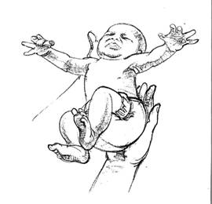
Moro reflex
Sudden lowering of head
Lateral and symmetrical abduction
Upward movements of hands and arms open and gradual flexion
Lower limit exhibit extend and flex
https://www.youtube.com/watch?v=PTz-iVI2mf4

Slide 13
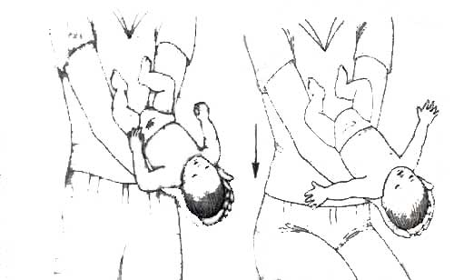

Slide 14
Moro reflex- till 2 months must disappear by 4-6 months above indicates of pathology (CP/ID)
Moro reflex precedes startle reflex doesn’t appear before 2 months of age extension or flexion of upper and lower extremities
Duration: 2-3 months after moro; disappears by 1 year
Less severe startle reflexes elicited through lifespan

Slide 15
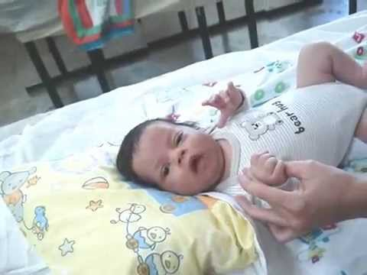
Palmar mandibular reflex/Babkin
Applying pressure on palm of the child
( Birth – 3- 4 months )
Response :
opening of the mouth
Eyes closes,
neck flexes by moving the head forward
https://www.youtube.com/watch?v=_mJX5RkYq1A

Slide 16
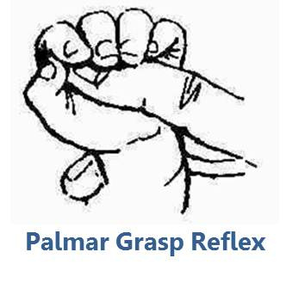
Palmar reflex
When object is placed on the Childs hand the child closes the finger around
( Birth – 3- 4 months )
-ve grasp🡪 neurological problem - Spasticity
https://www.youtube.com/watch?v=TidY4XPnFUM

Slide 17
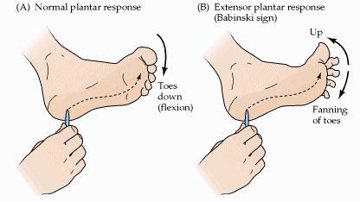
Plantar reflex

Slide 18
Stimulus: touching the foot with a ball
Response : toes appear to be grasping
Duration: birth – 1year
This facilitates kicking movement, muscle tone, provides vestibular stimulation, provides balance
Retained🡪 impede crawling, Affects Visual perception and hand writing difficulties
Important for hand –eye coordination, Integration of vestibular information with other sense

Slide 19
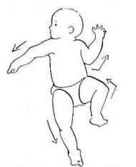
Asymmetrical Tonic Neck Reflex
Make the child lye on supine position and turn the head 180 degree to each side and hold it in that position for 5 seconds and repeat this activity 5 times to confirm the results
Extension of upper and lower limb on the chin side and flexion on the other side
This position is called as Fencer position

Slide 20
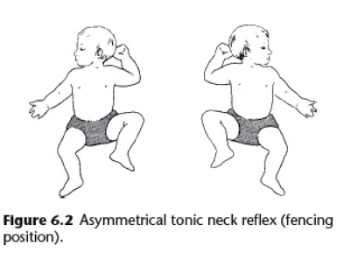
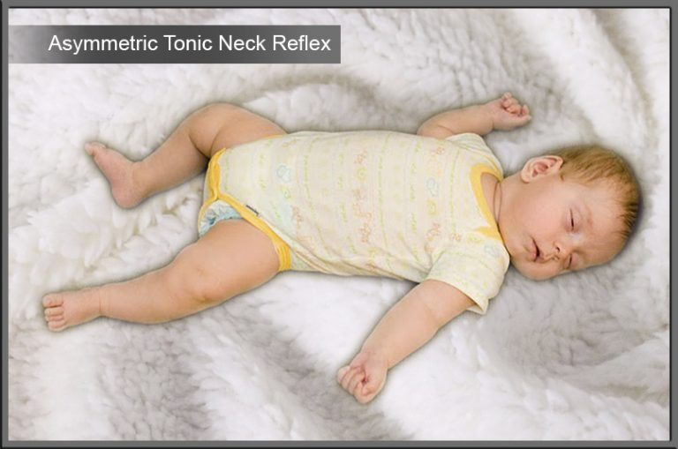
Present in various types of CP. But not used in differentiating between dyskinetic and spastic CP.
More than 8 months present indicates Spastic CP

Slide 21
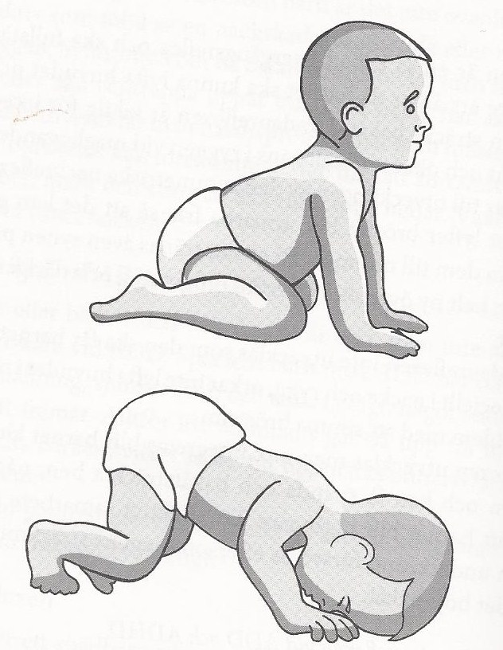
STNR
Head is manipulated in midline (up/down) there is difference in response from upper and lower limbs
Head is bent forward(flex)
Response : Upper limb flex and lower limb extend
Vice versa
Disappears by 5-6 months extends🡪 abnormalities

Slide 22
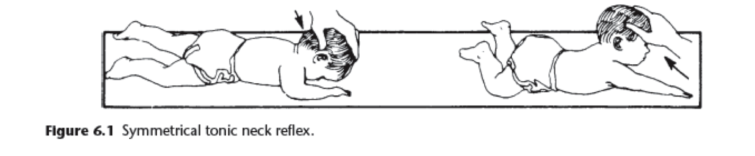
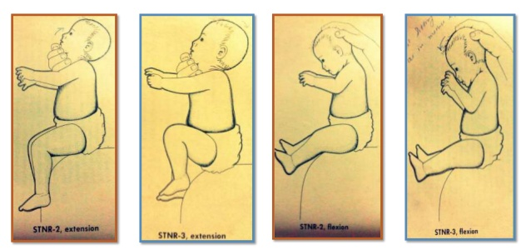

Slide 23
Postural reflex
They are higher order automated involvement
Foundation for later voluntary movements
Controlled by midbrain. Indicating cortical involvement that allows some voluntary inhibition of otherwise “automatic responses” to stimulus
They pave the way for the dependent infant to become an independent adult

Slide 24
TLR
W.r.t the orientation of labyrinth in the inner ear, tested in supine and prone position.
In prone position: head is pulled back by 45 degree and also flexed(head forward) : changes seen in extremities.
Head is flexed(head forward): protection of shoulders, flexion of upper and lower limbs and vice versa when there is extension of neck

Slide 25
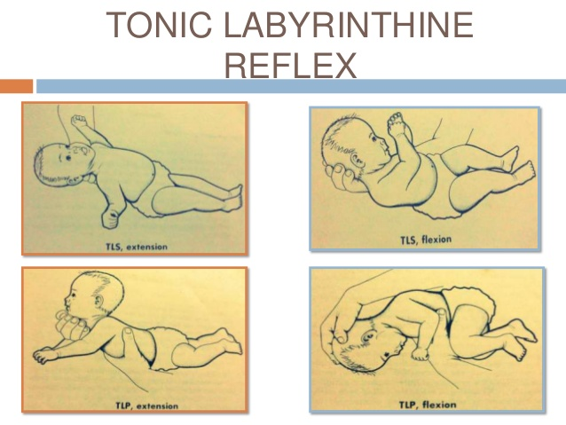

Slide 26
Abnormal: extensor hypertonia 🡪 prevents infant from rolling over only
Pathological response: leg rigid or tongue thrust may occur in children with CP

Slide 27
Positive support reflex
Important for erect posture
The knee or the leg are stimulated. And the contraction of the muscle group to fix the joints of the lower extremities so that they bare the weight. The child is suspended around the trunk and bounced on the balls of the feet 5 times and degree to which the infant can support the weight is assessed
Beyond 4 months

Slide 28
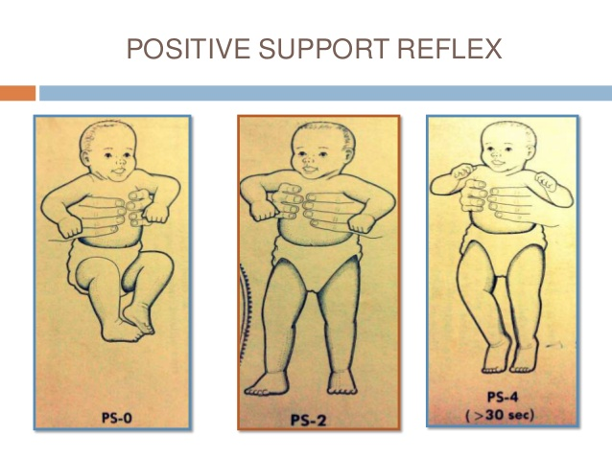

Slide 29
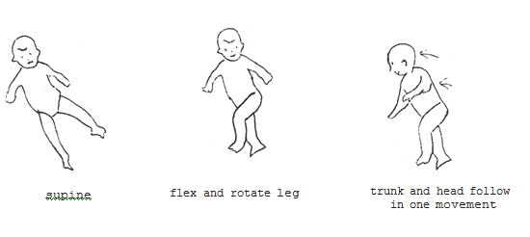
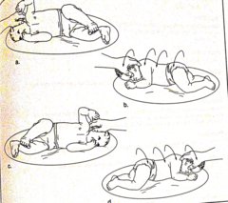
Segmental rolling reflex

Slide 30
Rotation of head produces a reaction in which the infant attempts to undo the applied rotation by twisting the body at the waist allowing only one segment to roll over
(minimal effort required only one segment rolled over time )
Abnormalities: no segmental control

Slide 31
Rotating child from head: rotate by flexion of the head by 45 degree which produces rotation of the shoulder and other segments finally rotation is observed
Rotating child from leg: legs are flexed at the level of knee and rotated then pelvis moves to midline and rotation is observed

Slide 32
Galants reflux
Arching of the infants body towards the stimulus when the skin of the back is stored at the level of the vertebral column. If the body moves inwards it is invading U/L response 🡪 athetosis,
Duration: birth – 2 months of age
The reflex is associated with delay of trunk stabilization and head control in athetoid CP. Persistence beyond 6 months will affect sitting behavior

Slide 33
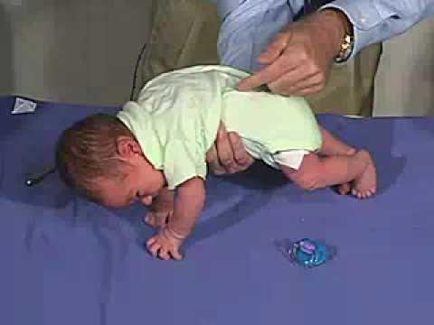

Slide 34
Oral and pharyngeal reflexes
Persistant abnormal oral reflexes
To select AAC systems with non speaking motor handicapped child

Slide 35
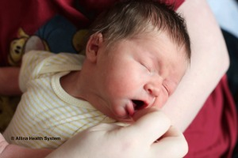
Rooting reflex
Gentle tap/ touch /brushed on the corner of the mouth / surrounding mouth- : head moves towards and then away from stimulus. Duration: till 1month and later replaced by direct head turn response.

Slide 36
Direct head turn response: response to stimulus when applied in corners of mouth, the lower lip and tongue moves towards the direction of stim ulus.
Duration: birth till 6 months (CN impulses in this reflex are V, VII, XI,XII and is mediated by pons , medulla and cervical spinal cord.

Slide 37
Suckling
One of the 1st reflex to be observed in infant. Observed at 4-5 months of age and disappears by 6 months to 1 year.
More of involuentary act
CN involved are 🡪 V, VII, IX, XII, it is mediated at pons and medulla oblongata

Slide 38

Sucking
Rhythmic pumping and squirting action of tongue, mandible and soft palate. It is similar to sukling but not a continuous process
In sucking liquid is accumulated in oral cavity and action is interrupted by breathing and swallowing pattern. It occurs with development of negative pressure.

Slide 39
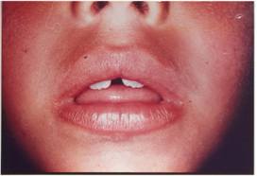
Tongue reflex
It is considered as a part of suck swallow reaction. Tongue trust between lips. It is persistant beyond 18 months. Or if there is excessive thrust . It is abnormal, it is mediated at the level of medulla

Slide 40
Bite reflex
Duration: Birth to 12 months of age.
Moderate pressure on gums elicits jaw closure and a bite response. This is replaced by more matured chewing patterns
Weak bite reflex: brainstem lesion. If its exaggerated it is corticobulbar lesion. CN involved in V mediated through lower mid brain and pons

Slide 41


Slide 42
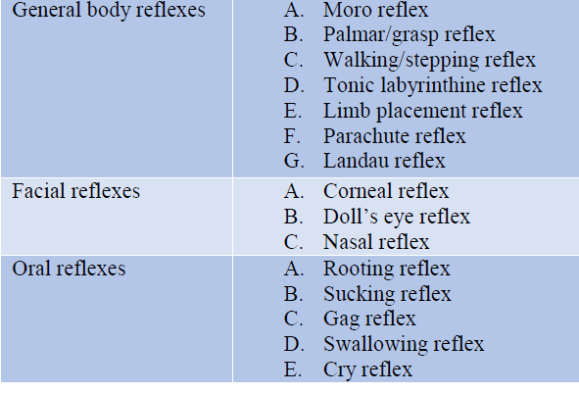

Slide 43
What happens if Primitive Reflexes don’t go away?
If the Primitive Reflexes are retained past the first year of life (at the very latest) they can interfere with social, academic, and motor learning.
Basically, the perception of our inner and outer environment and our response to it may be disturbed; that is, conscious life may be disturbed
Children with learning disorders, ADHD, Autism Spectrum, and various other neurodevelopmental disorders are known to have retained primitive reflexes contributing to their symptoms and level of dysfunctions, conscious life may be disturbed.

Slide 44
Sensory Processing Disorder
Each reflex is associated with one or more of the Sensory Processing Systems: Auditory, Taste, Tactile, Smell, Visual, Vestibular, Proprioceptive and/or Interoceptive.
Therefore, if retained, a child/person may experience dysfunction within one or several of the sensory processing systems.
This can lead to what is known as Sensory Processing Disorder.

Slide 45
Quick Screening Questionnaire
This “quiz” should not be used as an official diagnosis; however, if your child presents with a “cluster” of “yes” answers to the following, they should be screened by a trained health professional knowledgeable in the retainment of Primitive Reflexes, their meaning, and recommended treatment.
Part I: Pregnancy & Birth History
1. Did the mother have a viral infection in the first trimester of pregnancy?
2. Were there any medical problems during pregnancy such as threatened miscarriage, high blood pressure, or excessive morning sickness?
3. Was the mother under severe emotional stress between the 23rd and 28th week of pregnancy?
4. Were there any complications during pregnancy or delivery; prolonged labor, fetal distress

Slide 46
5. At any time during the pregnancy/delivery was the child said to be in a breech position?
6. Was there use of forceps or suction delivery?
7. Was a caesarian section performed?
8. Was the child more than 2 weeks pre-mature or 2 weeks late?
9. Were excessive ultra sounds performed during pregnancy?
Part II: Family & Health History
1. Is there any history of learning difficulties in the family or either parents' family?
2. Has the child been diagnosed with a learning disability?
3. Has the child been diagnosed with ADD/ADHD or Autism Spectrum Disorder?

Slide 47
4. Did/does the child suffer from chronic ear infections?
5. Did/does the child have a history of allergies, asthma, or frequent illnesses?
6. Does the child have chronic digestive disorders?
7. Is/was the child a bed wetter past the age of 5 years?
8. Does the child suffer from motion sickness?
9. Did the child suffer from a head injury?
Part III: Learning & Developmental History
1. Was there lack of, or little, creeping or crawling on all fours with this child?
2. Were there any troubles with feeding or latching on in the first 3 months?
3. Did/does this child have difficulty distinguishing right from left?
4. Is, or did, the child have difficulty deciding which hand they would use as their dominant hand?

Slide 48
5. Does the child have difficulties sitting still and/or paying attention?
6. Does the child have difficulty tying shoelaces or doing up buttons?
7. Does the child have reading difficulties?
8. Does the child occasionally reverse letters when writing?
9. Does the child have difficulty writing or is their writing very messy?
10. Does this child have difficulty catching a ball or have poor hand-eye coordination?
11. Does this child seem awkward in P.E., dance, gymnastics, etc?
12. Does/did the child have difficulty learning to ride a bicycle, swim, or swing?
13. Does the child have any speech/articulation difficulties?

Slide 49
Clinical Significance
Infants
Primitive reflexes are important in the newborn neurological examination.
An absent or abnormal sucking reflex is an indirect indicator of neurological maturity in newborn infants.
When an abnormal sucking reflex is associated with other signs of CNS involvement, it suggests basal ganglia or brainstem dysfunction.
In a 2011 study, morbidity-related factors statistically correlated with the sucking and Babinski reflexes.

Slide 50
Moro reflex is weak in preterm infants compared to full-term infants due to their poor muscle tone and resistance to passive movements
This response correlates with a delay in motor development in very low birth weight infants. The absence of the Moro reflex suggests CNS dysfunction
Persistence of primitive reflexes past 4 to 6 months or absence before this time when they should have been present is predictive of cerebral palsy
The presence of 5 or more abnormal reflexes correlated with the development of cerebral palsy or mental delays

Slide 51
Moro reflex evaluation- low birth weight (VLBW) premature infants
. The authors found that VLBW infants exhibited retention of PRs, and this interfered with early motor development.
A higher incidence of motor delay was seen in preterm VLBW infants than normal term infants
The study by Allen and Capute described the pattern of appearance of eight PRs including Moro reflex, in 47 viable extremely premature infants. They found that the Moro reflex was present in some premature infants as early as 25 week PCA, and in the majority (80%) by 30 weeks PCA, which further strengthens with increasing PCA.
They concluded that the pattern of PRs in the premature infant at term (40 weeks PCA) was similar to that of full-term newborns

Slide 52
Moro reflex and CP
Burns et al. found that the assessment of Moro reflex at 1 and 4 months failed to identify infants with CP, however a subsequent assessment at 8th month helped in identifying them.
Further, they recommended that the identification should be based on a combination of assessments including motor, neurological, and PRs.
Similar finding was observed in Harris's study, where in they found that in high-risk populations a present Moro response at 4 months was not associated with CP

Slide 53
Moro reflex, that high-risk infants exhibited abnormal or absent reflex which is an indicator of a motor delay.
These studies also signify the importance of inclusion of Moro reflex in the newborn assessment and indicate that the assessment should be made periodically and should be done along with other relevant assessments.

Slide 54
Adults
Primitive reflexes, also known as frontal release signs, can be normal in the adult population.
Multiple frontal release signs observed on neurological examination correlate with frontal lobe brain pathology, including Alzheimer disease, multiple sclerosis, and schizophrenia
Patients with schizophrenia were found to have more frontal release signs than their unaffected siblings and the control group

Slide 55
In a 2005 study, researchers detected grasp and Babinski reflex responses in patients with dementia.
A present Babinski reflex is important in the evaluation of a suspected pyramidal tract lesion and is an upper motor neuron damage sign.
The reappearance of the grasp reflex has been associated with frontal lobe lesions and can be an early sign in corticobasal syndrome, Lewy body dementia, and progressive supranuclear palsy.

Slide 56
The glabellar tap and palmomental reflexes can be seen as an early sign of Parkinsonian disorders as well.
The presence of primitive oral reflexes must be distinguished from tardive dyskinesia in patients exposed to neuroleptics.
The sucking and rooting reflexes may indicate diffuse cerebral atrophy, while snout reflex suggests a frontal lobe lesion

Slide 57
If retained, the child/adult may be hypersensitive to other senses and may over-react to stimulation and be in constant ‘fight or flight’.
This will lead to over activity of the sympathetic nervous system and the Adrenal Glands.
Due to the constant demands on the adrenal glands, they may become fatigued and a child/person may suffer with allergies, asthma, depressed immune system, and chronic illnesses
Other observable social/learning problems associated with a retained Moro reflex are: unable to focus on one thing at a time, poor impulse control, emotional immaturity, withdrawn or timid, easily distracted, difficulty playing ball games, aggressive, anxious, and/or highly excitable.

Slide 58
The Rooting Reflex
Observable social/learning problems associated with a retained Rooting reflex include: poor articulation, tactile sensitivity around the face, messy eaters, and poor manual dexterity.

Slide 59
Assessment of Sucking Reflex- Findings
Sohn et al. investigated the sucking reflex in high-risk infants. Their study consisted of two high-risk groups (physiological risk group which consisted of 22 preterm newborns, without any pathologic conditions and pathologic risk group which consisted of 41 newborns, with respiratory distress syndrome, transient tachypnea or intrauterine growth retardation in addition to prematurity).
They found that 36% among 63 high-risk newborns presented with an abnormal or absent sucking reflex, which was attributed with respiratory difficulties and decreased mental status.
The results of this study implied that an abnormal or absent sucking reflex may indicate a neurologic impairment in the high-risk newborns

Slide 60
Babinski reflex
Sohn et al. also found that one-third of 67 high-risk infants presented an abnormal Babinski reflex (33.3%).
Babinski reflex was absent in 7.9% of the infants. Factors such as length of hospitalization, Apgar scores, and total scores on the Infant Coma Scale (mental status) were statistically associated with the Babinski reflex.
The findings of the selected studies on plantar reflex clearly show that a negative or diminished response of this reflex during early infancy is highly suggestive of neurologic abnormalities, especially spasticity.

Slide 61
The Palmar Reflex
Observable social/learning problems associated with a retained Palmar reflex include: poor manual dexterity, poor pencil grip, difficulty with writing, intertwined speech and hand movements which can lead to difficulty with speech.
Clinical significance: Spastic form of cerebral palsy and Kernicterus show exceptionally strong grasp reflex whereas it is asymmetrical in cerebral damage and hemiplegia.

Slide 62
Palmar reflex in high-risk infants.
Allen and Capute found that grasp reflex was present in all premature infants, from 25 week PCA and beyond.
They reported that the pattern of PRs in the premature infant at term (40 week PCA) was similar to that of full-term newborns and thereby recommended sequential or periodic assessment of the PRs in extremely premature infants prior to term

Slide 63
The study by Zafeiriou et al.
Found that the palmar grasp reflex was preserved until age 5 months in majority of normal infants, after which it began to disappear. However, most spastic children exhibited full activity of the reflex until 11 months of age.
They concluded that the presence of positive palmar grasp reflex after 7 months can be used as an early diagnostic clue to confirm whether a high-risk infants will become normal or abnormal at 2 years of age.
Thus, the manifestation of palmar grasp reflex in infants >4 months of age is predictive of damage in the central nervous system, caused by anoxia, neural degenerations, trauma, among other etiological factors

Slide 64
Stepping Reflex
Clinical significance: The mature infants walk in heel–toe pattern whereas those who are premature have toe-heel pattern of walking.

Slide 65
ATNR
Observable social/learning signs of a retained ATNR include: possible scoliosis, poor handwriting, difficulty expressing ideas in written form, difficulty with eye tracking, difficulty with hand-eye coordination, difficulty with tasks that require crossing the mid-line (reading/writing), difficulty with tasks that require both sides of the body. Every time the head turns, the arm may follow it and the fingers open.
Therefore, it takes a lot of effort and concentration to try and hold the hand still while writing when the head has to move to look at another paper or the white board.
The older child or adult may complain of chronic or recurrent shoulder or neck injury/pain; often times always on the same side.

Slide 66
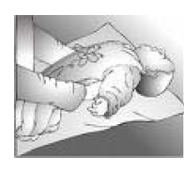
Tonic Labyrinthine Reflex (TLR)
With this reflex, tilting the head back while lying on the back causes the back to stiffen and even arch backwards, causes the legs to straighten, stiffen, and push together, causes the toes to point, causes the arms to bend at the elbows and wrists, and causes the hands to become fisted or the fingers to curl.
This reflex prepares the baby for movements of rolling over, crawling on all fours, standing and walking. The presence of this reflex beyond the newborn stage is also referred to as abnormal extension pattern or extensor tone.
Inhibition of the tonic labyrinthine reflex is a gradual process involving the maturation of other systems. This reflex should be gone by three and a half years of age.

Slide 67
TLR
Observable social/learning problems associated with this reflex include: difficulty keeping the head in a flexed position, trouble paying attention when sitting at a desk and/or reading, poor posture,
poor balance, motion sickness, dyspraxia, toe walkers, hypo or hyper-tonus (muscle tone), dislike of physical education (PE), poor sense of rhythm/timing, oculo-motor difficulties (reading/writing), orientation and spatial difficulties

Slide 68
Clinical significance:
Retained reflex leads to spatial problems, motion sickness, poor posture, muscle tone, and visual perception difficulties.
In prone position, the child is in excessive flexion and may not be able to lift or turn the head to clear the air passage.
In supine position, the severely involved child is in stiff extension and cannot lift head, bring hands to midline or turn over

Slide 69
Symmetrical Tonic Neck Reflex (STNR)
Observable social/learning problems associated with a retained STNR: poor posture, tendency to slump when sitting, sits in a “W” position with their knees, Simian (ape-like) walk, poor eye-hand coordination, messy eater, clumsy child, difficulties with readjustment of binocular vision (child cannot change focus easily from blackboard to desk), slowness at copying tasks, poor swimming skills.
Associated sensory systems: vestibular, proprioceptive, and visual

Slide 70
Parachute reflex
It is a protective reflex that appears at about 6-9 months of age & persists thereafter.
The reflex is elicited by holding the child in ventral suspension and suddenly lowering him to couch. The arms are reflexively extended forward towards couch as defensive reaction.
Clinical significance: In children with cerebral palsy, the reflex may be absent or abnormal. It would be asymmetrical in spastic hemiplegia.

Slide 71
Assessment of PRs
the assessment of PRs in the newborn screening protocol. However, the studies included in the review suggest that it is not necessary that all high risk infants should exhibit absent PRs, which highlights the fact that PR assessment should be done in conjunction with other relevant assessments.
Infants exhibiting a marked variation in the reflex patterns and persistence of these reflexes beyond the specified age of disappearance of each reflex should carefully be observed for the development of any neurological abnormalities.
The subtle variations in all these reflexes and its persistence can affect the infant's motor, speech as well language development in the later life

Slide 72
Hence, speech-language pathologists should recognize their significance, learn to elicit these reflexes and analyze the responses associated with these reflexes, as it will aid in the early identification of developmental disabilities.
more number of studies are required that is aimed at investigating the efficacy of these PRs in identifying children with developmental disabilities and to check which of these or a combination of these are more sensitive indicators of neurological damage and at what timeline in an infant's life, which will yield a better understanding of the significance of PRs in high-risk infants.

Slide 73
Treatment
Through various specific movement and exercise protocols offered at our office, primitive reflexes can be inhibited- allowing for proper neurological development to take place.
The long term results of such treatment is better social behavior, improvement in academic and motor learning, and overall improvement in physical health, emotional health, and overall well being.
Inhibition of Primitive Reflexes will also help develop a stronger and healthier functioning Sensory Processing system.

Slide 74
Primitive Reflex Treatment
When primitive reflexes haven’t integrated within the appropriate time frame, it is important to revisit the missing developmental stages.
Specific movement activities will help rebuild the foundation and create new neural pathways. A primitive reflex integration program involving specific movement patterns makes it possible to retrain the brain.
Such programs are directed by developmental optometrists, occupational therapists, or other developmental specialists trained in reflex integration

Slide 75
Signs of Retained Reflexes
Poor impulse control
Fidgeting
Poor dexterity
Interrupted eye tracking
Toe walking
Motion sickness
Difficulty changing gaze from far to near
Poor posture

Slide 76
Reflex inhibition programs
When primitive reflexes are not integrated it is important to address those missing developmental stages. The movement activities associated with integrating these reflexes will help rebuild those early childhood foundations and create/repair neural pathways.
Reflex inhibition programs consist of specific, stereotyped movements practiced everyday for 5-7 minutes per day. Generally these are practiced over a period of 9-12 months.

Slide 77
Specific integration exercises associated with each reflex and functional activities that promote regulation or increase integration when this reflex is retained
Primitive Reflex | Integration Exercises | Functional Activities to Promote Integration and/or Regulation
Moro | Starfish pose lying supine, then pulling and holding the position of deep flexion | Sensory diet, weighted blanket, deep breathing, routines, deep flexion activities, emotional regulation strategies
Spinal Galant | Snow angels | Crawling, loose fitted clothes, posture support, backless chairs for comfort
Palmar | Ball squeezing, digital separation of fingers | Finger puppets, playing an instrument, tactile bins/ putty, ripping or crumpling paper, fine motor development tasks
ATNR | Robot exercise, Zombie marches | Midline crossing activities, pushing a shopping cart while turning the head, crawling through tunnels while searching for items, zombie walks while turning head, walking with monster feet, handwriting development

Slide 78
Primitive Reflex | Integration Exercises | Functional Activities to Promote Integration and/or Regulation
STNR | The stretching cat exercise, STNR rocking tasks | Crawling (particularly with items under the chin to promote neck flexion with arm extension), hand-eye coordination development, sustained attention strategies
TLR | The Meatball, foot massage activity while lying flat and supine on the floor, Superman | Body awareness in space tasks, proprioception development, activities completed while prone, vestibular development, spatial orientation tasks
Rooting | Cat whiskers exercise (facial massage from ear to mouth) | Chewing gum, chewy necklaces, sucking on a straw from a water bottle

Slide 79
Other activities
Floor-Time
Grasp Activity
Consider incorporating multiple sessions of play time on the floor between you and your child.
Incorporate a mix of spontaneous play with other activities like reading, crawling through tunnels, passing a ball, and building with blocks.
Play on the floor for 20 minutes each session and take cues from your child's play pattern.
The sessions that follow this initial playtime should include challenges to help your child improve communication, thinking, and relational skills
If child exhibits signs of grasp reflex, such as messy handwriting or sticking his tongue out as he writes, help him subside these reflexes by stroking your child's palm to stop the reflex.
Repeating this activity a couple of times a day may help integrate it.

Slide 80

Face Stroking for Root and Suck Reflex
Stroke the child’s face until the reflex stops, which usually takes five to six times in a row.
at least twice a day until -no longer elicit the reflex
Chewing gum can also be helpful to inhibit this reflex

Slide 81

Starfish for Moro Reflex
child sit in a chair in a fetal position, with the right wrist crossed over the left and the right ankle crossed over the left ankle. Fists should be closed.
Ask the child to inhale and make like a starfish by swinging his arms up and out and thrusting his legs out while extending the head back and opening hands.
Have him hold this position for 5 to 7 seconds while holding his breath. Then tell him to exhale and return to the same position, crossing the left wrist and ankle over the right wrist and ankle.
Repeat this again until they are back to the original position. Do this 6 times in a row a few times a day until the reflex is inhibited fully.

Slide 82

Snow Angels for Galant Reflex
Have your child lie face-up on a mat or flat surface with his legs extended and arms at the sides. have him breathe in an simultaneously spread his legs outward and raise his arms out along the flour and overhead, with the hands touching.
The hands should touch at the same time the legs are fully extended. Exhale and return to the original position.
The key is to get the child to move all four limbs slowly at the same time.
Do this 5 times several times a day until you can no longer elicit the reflex.

Slide 83
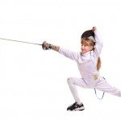
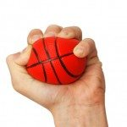
Ball Squeezes for Palmer Grasp Reflex
Fencer Exercise for Asymmetric Tonic Neck Reflex
Have child squeeze a small ball, such as a tennis ball, several times in a row.
Or you can just stroke the palm of the hand with a light brush until the reflex is suppressed.
Have your child sit in a chair and turn his head to both sides or to the one side that still elicits the reflex.
As your child is turning his head, have him extend the foot and arm of the same side outward from the body and look at his hand.
The opposite hand should also open, the arm should flex, and the other leg should bend.
Have the child return to starting position and repeat until the reflex fatigues. Repeat three times in a row.

Slide 84
Key Things to Remember
Exercises should be repeated in succession 5 to 10 times until the reflex fatigues.
Frequency is more important than intensity.
Movement must be slow and purposeful.
Proper mind-set is crucial: stay motivated and positive!
Give it time

Slide 85


