Slide 1
ASEPTIC PROCESS TECHNOLOGY

Slide 2
FLOW CHARTS OF MANUFACTURING PROCESS

Slide 3
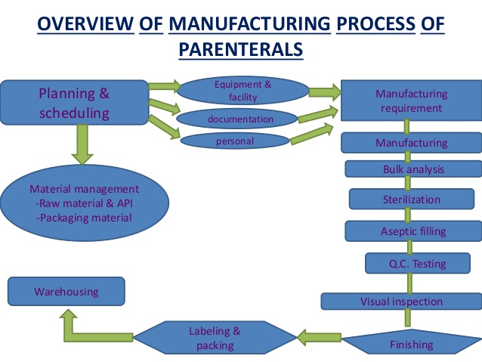

Slide 4
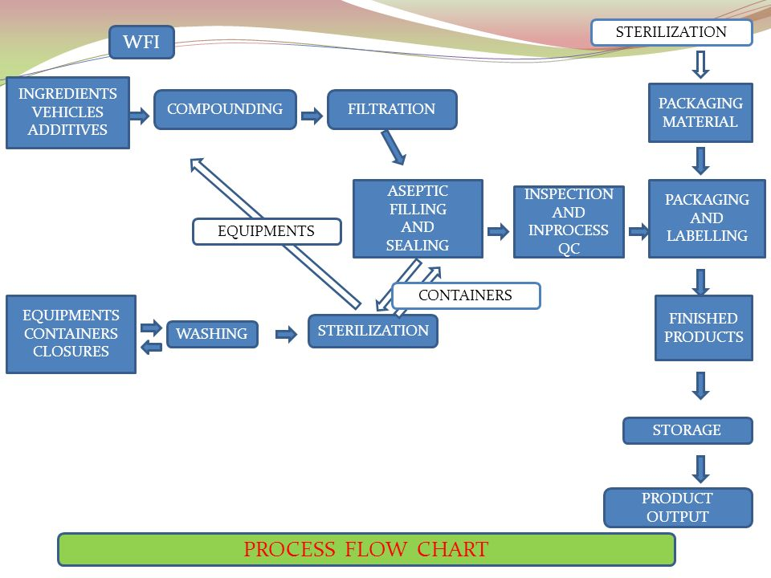

Slide 5
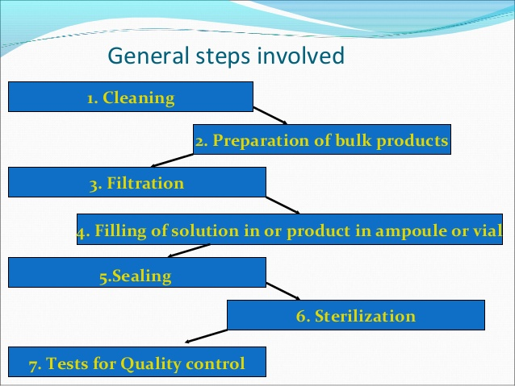

Slide 6
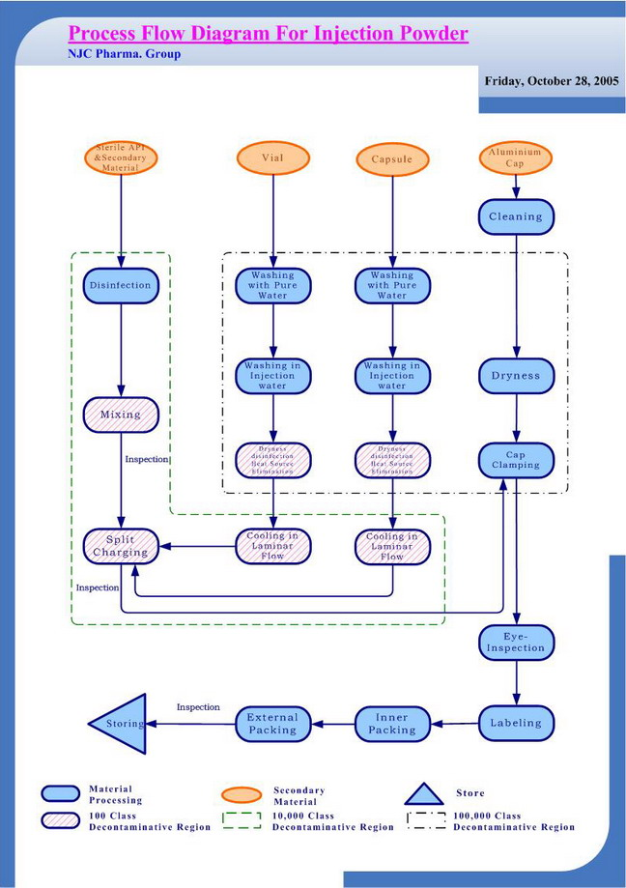

Slide 7
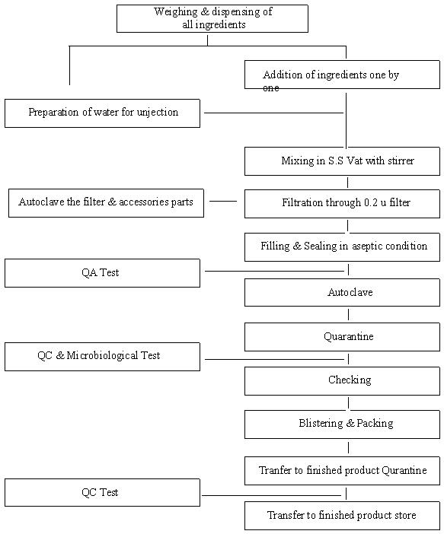

Slide 8
ADVANCED STERILE PRODUCT MANUFACTURING

Slide 9
Advanced Aseptic Processing, or Advanced Aseptic Technology, protects product manufacturing using separation technologies (isolators, RABS, and closed system processing) and automation (robots, automated lyo loading, etc.
An advanced aseptic process is one in which direct intervention with open product containers or exposed product contact surfaces by operators wearing conventional cleanroom garments is not required and never permitted.

Slide 10
Advanced aseptic processing strategies offer manufacturers the best solution for protecting the quality and safety of their products and for ensuring the highest contamination control standards possible for products that cannot be terminally sterilized.
Unlike terminal sterilization, aseptic processing lines don’t involve a high-heat kill step for final products.
But because they can’t rely on that all-powerful, microbial-destroying heat treatment, manufacturers have to put in place strict controls, in-process control testing and validation steps throughout the manufacturing process to ensure that no contaminants ever find their way into materials, components and final product.

Slide 11
Terminal sterilization involves filling and sealing product containers under high-quality environmental conditions to minimize the microbial and particulate content of the final product, and then subjecting the final product to a sterilization step.
In most cases, the product and the container closure exhibit low bioburden going into the process, but they are not sterile until the final container is subjected to the sterilization process, such as heat or irradiation.

Slide 12
While terminal sterilization is an ideal choice for heat-resistant products because there are fewer opportunities for error, it’s not usually a viable solution for heat-sensitive products such as vaccines and other biologic products.
The high heat used in the autoclave to eliminate microorganisms can weaken or destroy heat-sensitive pharmaceutical ingredients, particularly in the case of biotech products, which feature bioactive proteins that would be denatured under the intense heat of an autoclave.

Slide 13
These delicate products can be affected not only by temperature but also light, pH balance, sheer, and the velocity at which the product runs through a nozzle and hits the surface of a storage container.
“If you have one percent degradation in a product, the rest of it will die within days. Once it starts, you can’t stop it.”
As a result, many pharmaceutical as well as food and beverage products are manufactured using advanced aseptic processing strategies, and as the biotech industry matures, the ratio of aseptically produced products to those that are terminally sterilized continues to expand.

Slide 14
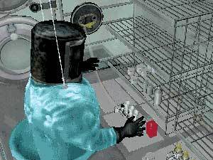
Separating people from product
An advanced aseptic process is one in which direct intervention with open product containers or exposed product contact surfaces by operators wearing conventional clean room garments is not permitted.

Slide 15
Through aseptic processing conditions, manufacturers of pharmaceuticals, vaccines and similar products produce sterile end products by compounding and assembling sterile bulk drugs or raw materials with sterile packaging components.
The key is to maintain the sterility of all the ingredients and packaging by using containers, closures and processes that are already sterile and are kept inside a high-quality environment, typically within an ISO 5 (Class 100) cleanroom.

Slide 16
The FDA guidance notes that because aseptic processing involves more variables than terminal sterilization, it requires more validation and controls.
For example, before assembly, the individual parts of the final product must be subjected to appropriate sterilization processes, such as heat for glass containers and filtration for chemicals and liquids.

Slide 17
If the environment, ingredients, equipment and personnel do not meet the strict guidelines that govern the aseptic processing environment, any step in the process could introduce an error that could ultimately lead to contamination in the final product.

Slide 18
Human interaction with the product is one of the biggest contamination control risks. As the involvement of operators in cleanroom activities increases, so does the risk to finished product sterility.
Operators must be trained to use aseptic techniques at all times.

Slide 19
Problems can occur because of human error, but also as a result of natural causes, such as people shedding particulate through the performance of their daily activities.”
For example, operators working within a cleanroom environment can shed millions of 0.3 μm particles in the form of skin flakes and clothing fibers.
In fact, a motionless person, sitting or standing, can generate approximately 100,000 particles per minute, and with motion, as much as 500,000 to 1,000,000 particles per minute-for a grand total of up to 1 billion skin flakes per day.

Slide 20
In operations in which toxic and potent chemicals are used, such as the manufacture of immune-suppressing cancer drugs, the operators also need to be protected from the product.
Teaching workers in a simulated environment allows them to practice and perfect their skills before they go into a real cleanroom.
This can be done without using expensive live space, real equipment or materials just for training purposes.

Slide 21
Isolators & RABS
Humans can do everything right and still contribute to contamination, which is why the industry is pushing to create systems that eliminate human contact with equipment and the product.
To achieve that goal, isolators and restricted access barrier systems (RABS) continue to claim their place in aseptic processing manufacturing as companies realize the benefits of adding controlled spaces and enclosed equipment in which product can be shielded from environmental and human interaction.

Slide 22
The goal of isolators and RABS is to segregate people from product.
Isolators can be used in a wide variety of applications, including both large- and small-volume parenterals, lyophilized products, powder fills, combination products, and medical devices, as well as more typical liquid fills into a single container.

Slide 23
There are two types of isolator systems: closed and open.
In closed systems, all components are gathered in batches into portable transfer isolators and moved into the sealed isolator through double-door systems and rapid transfer ports (RTPs).
Open-system isolators feature mouse holes through which vials pass. Because the mouse holes are open during operation, continuous overpressure of the barrier isolator ensures separation of the environment inside the isolator from the surrounding room air.

Slide 24
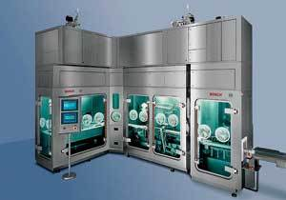
The isolator shown here features (from left to right) a vial accumulation area, a filling system, and a stoppering station, with an outfeed to a tray.
Bosch Packaging Technology.

Slide 25
Some facilities use isolator technology just for critical steps, such as filling vials.
Others have implemented series of isolators to produce an entire line, with filling, overcapping and washing all taking place inside the isolator environment.
Conveyors or robot exchange systems are used to transfer the vials between production areas.

Slide 26
BENEFITS TO ISOLATOR
There are several benefits to isolator technology in the cleanroom.
The sterilization level inside an isolator can be brought to a sterility assurance level (SAL) of 10⁻⁶, or one contaminated vial in a million, which in most cases is significantly higher than the sterilization rate of a conventional cleanroom space.

Slide 27
It also allows for extended campaigning, in which several product lots can be filled over the course of several days and for up to four weeks without shutting down the production line. “Existing technology can maintain aseptic conditions for 28 days. As long as you can validate that you can maintain sterility during that time, you can do it,” he says.
significant cost savings by eliminating extended downtime for cleaning steps.

Slide 28
Using isolator technology for aseptic processing can also save facility owners a significant amount of money in the design and construction of new facilities.
Because the isolator maintains ISO 5 conditions internally, the equipment can be placed into an ISO 8 (Class 100,000) cleanroom.
The cost per square foot is much less in that scenario.

Slide 29
The operating space can also be much smaller, further reducing facility costs.
You do have to put more money into equipment, but the reduced cost for the facility far outweighs it.

Slide 30
RABS[RESTRICTED ACCESS BARRIER SYSTEMS]
Like isolators, RABS can be used in cleanrooms to isolate product from people, although this type of system is less secure.
RABS and isolators provide similar functions, but RABS offer product protection and contamination control by providing a “physical and aerodynamic barrier” over the critical process zone.
Although there are some isolators that use this combination (in the form of the isolation barrier and a sterilizing tunnel), the aerodynamic barrier is restricted to transfer entry or exit zones into and out of the critical zone.

Slide 31
RABS use a combination of a barrier and a dynamic HEPA-filtered airflow to create isolated space and prevent human interventions.
Compared to isolators, RABS can allow for faster start-up time and ease of changeover.
However, because it is not a closed system, steps need to be taken to ensure the sterility of the process.
Using restricted access barrier equipment on its own is not enough to protect the process. It must be supported by critical, validated operating procedures to ensure quality standards are met.

Slide 32
RABS system must possess certain criteria, including:
Properly designed equipment;
management oversight;
a quality system in place;
proper surrounding room design to maintain ISO 5 in the critical zone;
proper gowning practice;
proper training;
initial high-level disinfection with a sporicidal agent; and
proper SOPs for rare interventions, disinfection, appropriate line clearance, and documentation of an event.

Slide 33
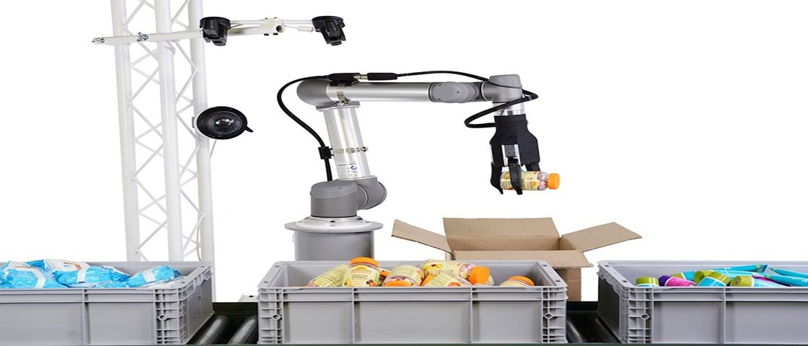
Robotics in Pharma

Slide 34
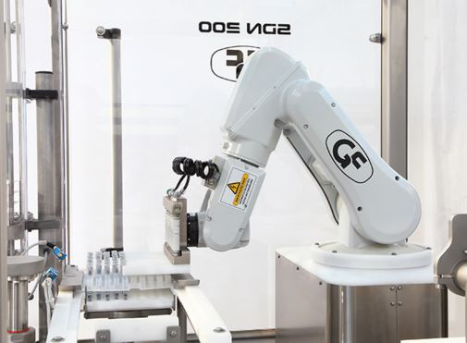

Slide 35
advanced sterile product manufacturing technology
Area Planning: Different Classes are planned according to GMP requirement, according to task to be performed.
Controlled Area : Preparation or manufacturing area where nonsterile product, in-process materials and product-contact equipment surfaces, containers and closures are exposed to the environment .
Control nonviable and viable contaminants to reduce product /process bioburden
Class 100,000 or Class 10,000
Capping areas are now considered controlled manufacturing areas
– Should be supplied with HEPA filtered air
– Should meet class 100,000 conditions during static conditions

Slide 36
Critical Area: Aseptic processing area where sterile products, components or in-process products are exposed to the environment and no further processing will occur.
Air quality must be Class 100 during processing.
Local Class 100 areas are often utilized during open processing steps during drug substance manufacture.

Slide 37
Environmental Control:
GMP-Acceptance crieteria -According to area
Environmental Monitoring Components
Airborne nonviable particulate monitoring
Airborne viable contaminant monitoring
Viable contaminant monitoring of surfaces
Viable contaminant monitoring of personnel
Temperature and humidity monitoring
Pressure differential monitoring

Slide 38
Water monitoring:
– Total organic carbon
– Conductivity
– Microbial Contaminants
– Endotoxin etc
Air monitoring:
– Microbial Contaminants

Slide 39
Wall and Floor treatment:
The basic cleanlability requirement includes smooth, cleanable walls, floors, ceilings, fixtures.
eliminate all edges or surfaces with in the room where dirt may accumulate.
All inside walls must be finished; common methods of finish are block, plaster, or gypsum board. Concrete block walls are sturdy and easily constructed. The porosity of concrete block walls can be reduced by coating with block filler prior to painting. But even filled concrete block walls have a surface texture that is not conductive to cleaning. Painted concrete block walls are particularly susceptible to peeling if they are subjected to moisture as from leakage or rain on the backside.

Slide 40
Use of ceramic-faced block can overcome the surface finish problems of concrete block.

Slide 41
Fixtures and machineries
Change Rooms:
Personnel Flow:
Utilities & utilities equipment location:
Engineering & maintenance

