Slide 1
Drugs Containing Resins
PH -305 Pharmacognosy-II
Chapter 7

Slide 2
Introduction
Resins are amorphous mixture of essential oils,
oxygenated products of terpenes and carboxylic acids,
obtained as exudates from plants and
considered as end product of metabolism.

Slide 3
The exact mechanism of formation in unknown, but it seems to be the product of oxidation of volatile oils followed by polymerization.
It is produced and stored in schizogenous or schizolysigenous gland
Chemicallly resin contain resin acids, resin phenols, resin esters, resin alcohol and inert substance.

Slide 4
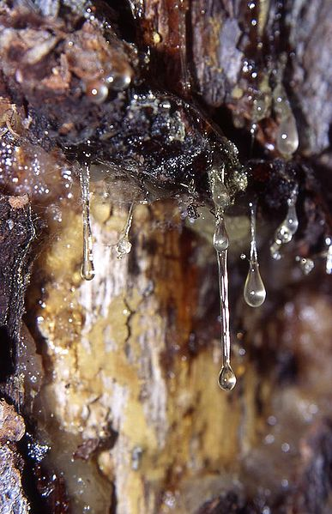
occurrence
Various parts of plant, which contain resin are:
Root and rhizome: Ginger, Turmeric, Podophyllum, Asafoetida, Jalap
Trunks: Tolu balsam, Peru balsam, Colophony, Copoiba
Flowering and fruiting tops: Cannabis
Fruits: Black piper, Long piper, Colocynth, Capsicum
Seed: Kaladana

Slide 5
Resin Cells : Ginger– Zingiber officinale Roscoe (Family: Zingiberaceae);
Schizogenous Ducts or Schizolysogenous Ducts or Cavities: Pine Wood–Pinus polustris Miller. (Family: Pinaceae).
Glandular Hairs : Cannabis–Cannabis sativa Linne’. (Family: Moraceae)

Slide 6
Properties
Physical
Translucent solids, semisolids or liquid
Insoluble in water and petroleum ether
Soluble in alcohol, solvent ether, benzene or chloroform.
Burns with smoky flame
On heating they soften and finally melted
Specific gravity more than one and havier than water

Slide 7
On being heated in a closed container i.e., in the absence of oxygen, they undergo decomposition and very often give rise to empyreumatic products i.e., products chiefly comprising of hydrocarbons.
Resins are bad conductors of electricity, but when rubbed usually become negatively charged.

Slide 8
Chemical
Resins, in general, are enriched with carbon, deprived of nitrogen and contain a few oxygen in their respective molecules.
Majority of them undergo slow atmospheric oxidation whereby their colour get darkened with impaired solubility.

Slide 9
Resins are found to be a mixture of numerous compounds rather than a single pure chemical entity.
They may also be regarded as the end-products of destructive metabolism.
The acidic resins when treated with alkaline solutions they yield soaps (or resin-soaps).

Slide 10
Solubility
Majority of resins are water-insoluble and hence they have practically little taste.
They are usually insoluble in petroleum ether (a non-polar solvent) but with a few exceptions, such as: colophory (freshly powdered) and mastic.
Resins mostly got completely dissolved in a number of polar organic solvents, for instance: ethanol, ether and chloroform, thereby forming their respective solutions which on evaporation, leaves behind a thin-varnish-like film deposit.

Slide 11
They are also freely soluble in many other organic solvents, namely: acetone, carbon disulphide, as well as in fixed oils and volatile oils.
Resins dissolve in chloral hydrate solution, normally employed for clarification of certain sections of plant organs.

Slide 13
Preparation of Resins
Physiological
Pathological

Slide 14
Physiological resins
These are formed as a normal product of metabolism without making injury to the plants and mainly present in specialized cells like:
  Schizogenous glands: e.g. Copaiba
  Secretion cells: e.g. Ginger
  Oil glands: e.g. Clove
  Oil ducts: e.g. Umbelliferous fruits

Slide 15
Pathological Resins
These are formed as a result of wound, injury or abnormal circumstances the plant gets shock and produces number of resin ducts. e.g. Benzoin, Colophony, Balsams, Aloe resin etc.

Slide 16
Classification
Resin
On the basis of chemical nature
Taxonomical Classification
On the basis of association with other group of compound like essential oil and gum
Resin acid
Resin Ester
Resin Alcohol
Glycoresin
Resenes
Coniferous resin
Berberidaceae resin
Zygophyllaceae resin
Oleoresin
Gum resin
Oleogum resin
Balsam

Slide 17
Resin Acid
Contain large portion of carboxylic acid which may or may not have phenolic compound.
With alkali and their metallic salts are termed as resinates
with aqueous sol. of alkali they form soap-like solution or colloidal suspension.
Abietic acid (Colophony), commiphoric acid (myrrh)

Slide 18
Resin Esters
Esters of resin acid or other aromatic acids like benzoic, salicylic acids etc.
Converted to free acid by treatment with caustic alkali
Cinnamyl cinnamate (Storax), Benzyl benzoate (Benzoin)

Slide 19
Resin Alcohol (Resinol)
H.M.W. and occur in free form and combined form
Tetracyclic or pentacyclic alcohols and are normally α-amyrin and β-amyrin derivative

Slide 20
Resinotannols: The resin alcohols which give a specific tannin reaction with iron salts are termed as resinotannols.
Siaresinotannol – From Sumatra Benzoin (Benzoin, Styrax)
Toluresinotallol – From Balsam of Tolu

Slide 21
H.M.W. and occur in free form and combined form
Phenolic group of tannin is combined with resin acids
Give positive test with iron salts.
Due to phenolic group they form phenoxoids and become soluble in aqueous alkali solution.
peruresinotannol (Balsam of peru), siaresinotannol (Benzoin)

Slide 22
Resinols: The resin alcohols that fail to give a positive reaction with tannin and iron salts are known as resinols.
Benzoresinol – From Benzoin which

Slide 23
Glyco Resin
Combined with sugar
Hydrolysed by acidic hydrolysis to sugar and complex acid
Jalap resin (Jalap)

Slide 24
Resenes
Inert resin product as they do not contain characteristic functional group
Found in free state and do not show any chemical properties
Do not form salt or esters and are not hydrolysed by alkalies
Asafoetida contain 50% of asaresene

Slide 25
Class | Drugs | Examples
Resin acid | Colophony, Myrrh, Copoiba | Abietic acid commiphoric acid
Resin ester | Storax, Benzoin | Cinnamyl cinnamate, Benzyl benzoate
Resin phenol | Balsam of peru, Benzoin | peruresinotannol , siaresinotannol
Resin alcohol | Benzoin, Storax | Benzoresinol, Storesinol
Glycoresin | Jalap | Jalap resin
Resenes | Asafoetida | asaresene

Slide 26
Oleo Resin
Mixture of resin with volatile oil
Trace amount of gum sometime found in oleoresin
Oleoresins may be either liquid, or semisolid, or solid.
Ginger, Copaiba, Turpentine

Slide 27
Oleo gum Resin
Mixture of resin, gum and volatile oil
Asafoetida, Turmeric, Myrrh

Slide 28
Gum Resin
Contain benzoic zcid or cinnamic acid or both
Balsam containing free acid are partially soluble in hot water
Benzoin, Storax, Balsam of Peru, Balsam of Tolu

Slide 29
Balsams
Naturally occurring resinous mixture contain high proportion of aromatic balsamic acid such as benzoic acid, cinnamic acid and their esters.
Balsam contain free acids are partially soluble in hot water.
Ginger, Copaiba, Turpentine

Slide 30
Class | Drugs | Examples
Oleoresin | Ginger, Copaiba | Gingerol, Zingerone, Shogaol, metacopavic acid
Oleogum resin | Asafoetida | Asaresinol ferulate
Gum resin | Gambage | Gambagic acid
Balsam | Tolu balsam, Benzoin | Benzoressinol, Somaressinol, Benzoic and cinnamic acid

Slide 31
Extraction and isolation
Resin can be extracted from plants and animals by
By extraction with alcohol and then precipitating with water e.g. jalap, ipomea
As plant exudates by injury or incisions e.g. asafoetida, myrrh
By heating the plant parts e.g. guaiacum
By distillation method e.g. colophony
by various treatment of the excretion obtained from animal e.g. shellac

Slide 32
Identification test
Physical Test
Chemical Test

Slide 33
Solubility test:
Resins are insoluble in water,
Rarely soluble in light petroleum (except Colophony and Dammar)
Soluble in alcohol, ether, acetone, chloroform, fixed oils and volatile oils etc.

Slide 34
Turbidity test:
Resinous drug was extracted with alcohol and water is added in excess to form turbidity, because these are insoluble in aqueous solutions.

Slide 35
HCl test:
One gram of drug was extracted with few ml of acetone and 3ml of dilute HCl was added.
Formation of pink colour after heating the solution on water bath for 30 minutes indicates presence of resins.

Slide 36
FeCl³ test:
Few drops of FeCl³ solution was added to the alcoholic extract of drug.
Formation of greenish blue color indicates presence of resins.

Slide 37
Pharmaceutical application
local irritant and hence act as local cathartics (e.g. Jalap and Ipomea)
As anti cancer (Podophyllum)
In bronchial asthma (e.g. Cannabis) also
Used externally as mild antiseptic in the form of tinctures (Benzoin) ointment and plasters (Turpentine and Colophony).
Resins are also used in the preparation of emulsion and sustained released formulations.

Slide 38
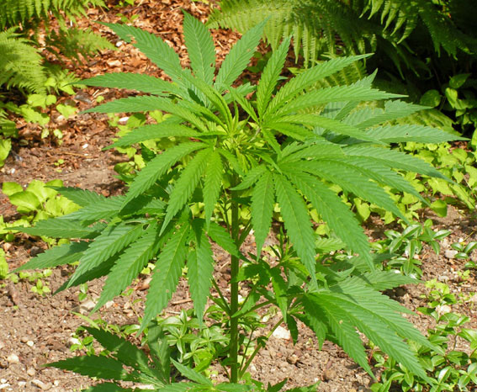
CANNABIS

Slide 39
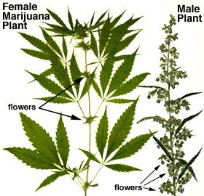
Cannabis
Synonyms
Indian hemp, Ganja, Bhang, Charas
Biological Source
It consists of dried flowering tops of the pistillate plant of Cannabis sativa
Family
Cannabinaceae

Slide 40
Diagnostic Characters
Indian hemp usually occurs as green to brown flattened masses which are hard and resinous.
If reduced to a powder the product is brown to greenish-brown with a heavy, characteristic odour and a slight taste.
Resin secreted by numerous glandular hairs (eight celled head with uni to multicellular stalk)
Corrigan and Lynch, a reagent consisting of vanillin in ethanolic sulphuric acid, stain the cannabis gland a deep reddish-purple.

Slide 41
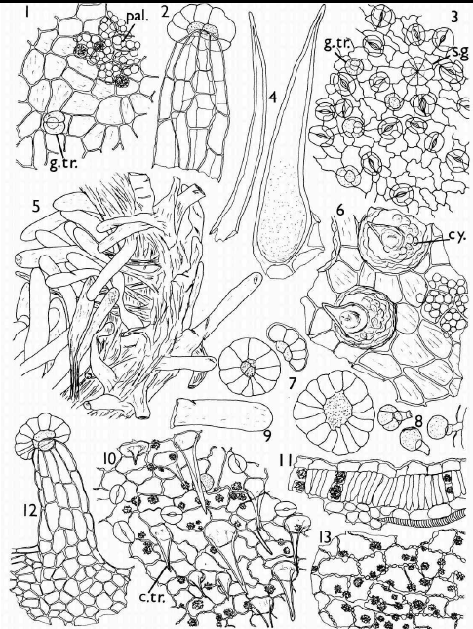
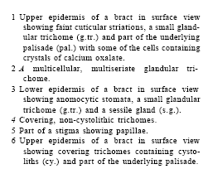
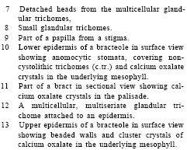

Slide 42
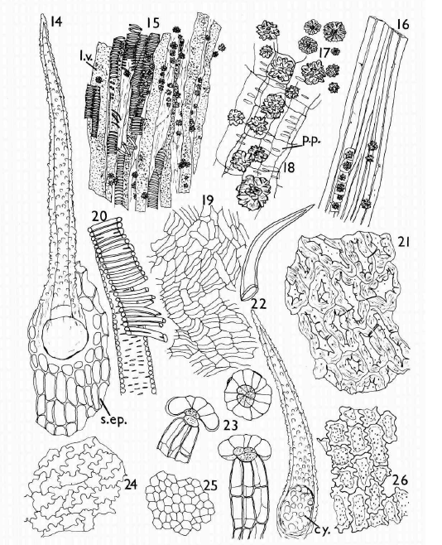
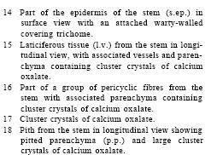
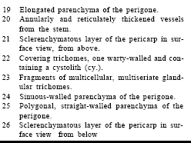

Slide 43
Abundant conical, curved, unicellular hairs also found, many having cystolith of calcium carbonate in their enlarged bases.
Cluster crystal of calcium oxalate are abundant, particularly in the bracteoles

Slide 44
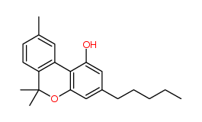
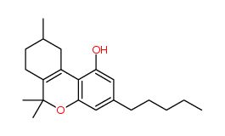
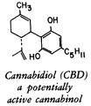
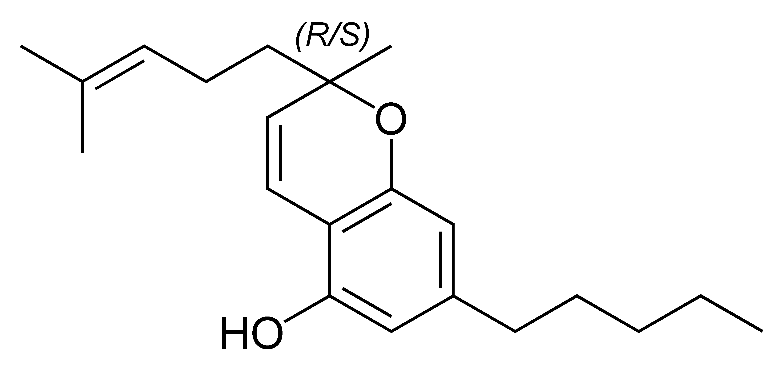
Chemical Constituents
15-20% resin
Cannabidiol, cannabidolic acid, cannabinol, cannabichromene and trans-tetrahydrocannabinol
Cannabidiol
cannabinol
cannabichromene

Slide 45
Uses
Tonic, Sedative, Analgesic, Stomachic, Antispasmodioc, Antianxiety, Anticonvulsant, Antitussive and narcotic
It cause dependence and act upon the nervous system

Slide 46
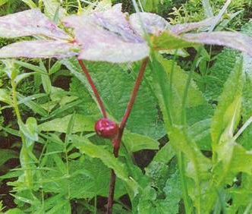
podophyllum

Slide 47
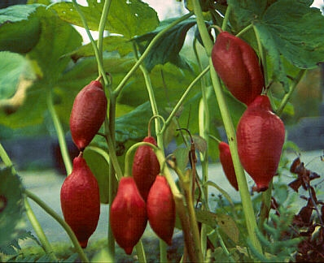
Podophyllum
Synonyms
Podophyllum, American Mendrake, May-apple root
Biological Source
It consists of dried root and rhizome of Podophylum peltatum
Family
Berberidaceae

Slide 48
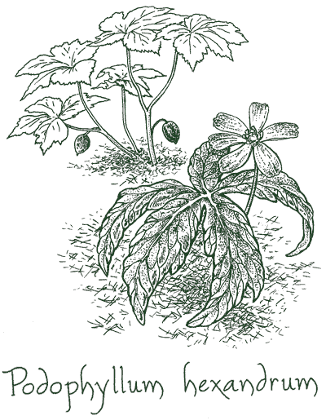
Diagnostic Characters
Color- dark reddish brown
Odour- characteristic
Taste- bitter and acrid
Fracture- short and starchy (rhizome)
Shape- subcylindrical and having distict nodes and internodes
Show scars of aerial stem and adventitous roots
Outer surface is smooth or wrinkle and

Slide 49
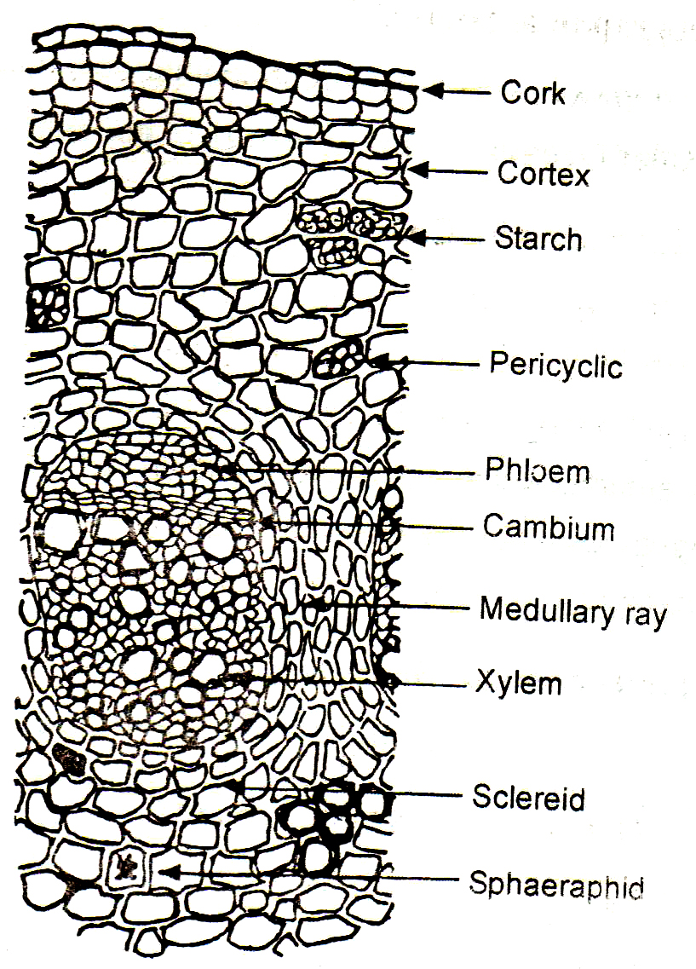
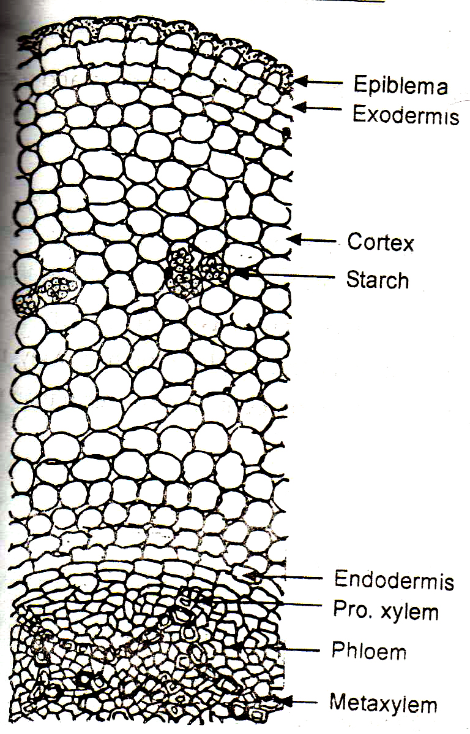
Rhizome TS
Root TS

Slide 50
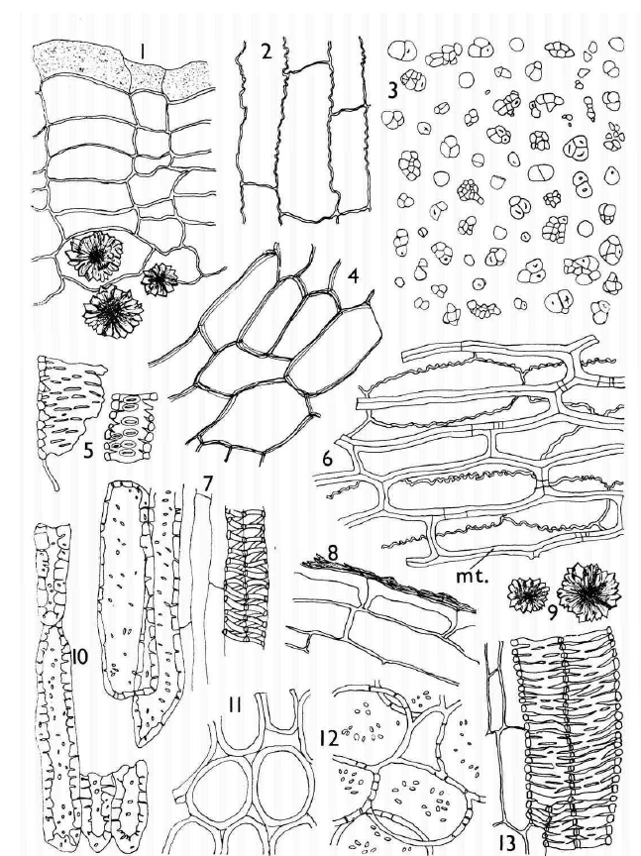
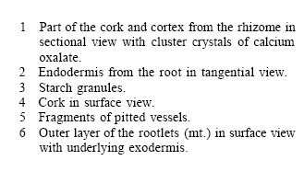
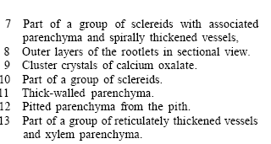

Slide 51
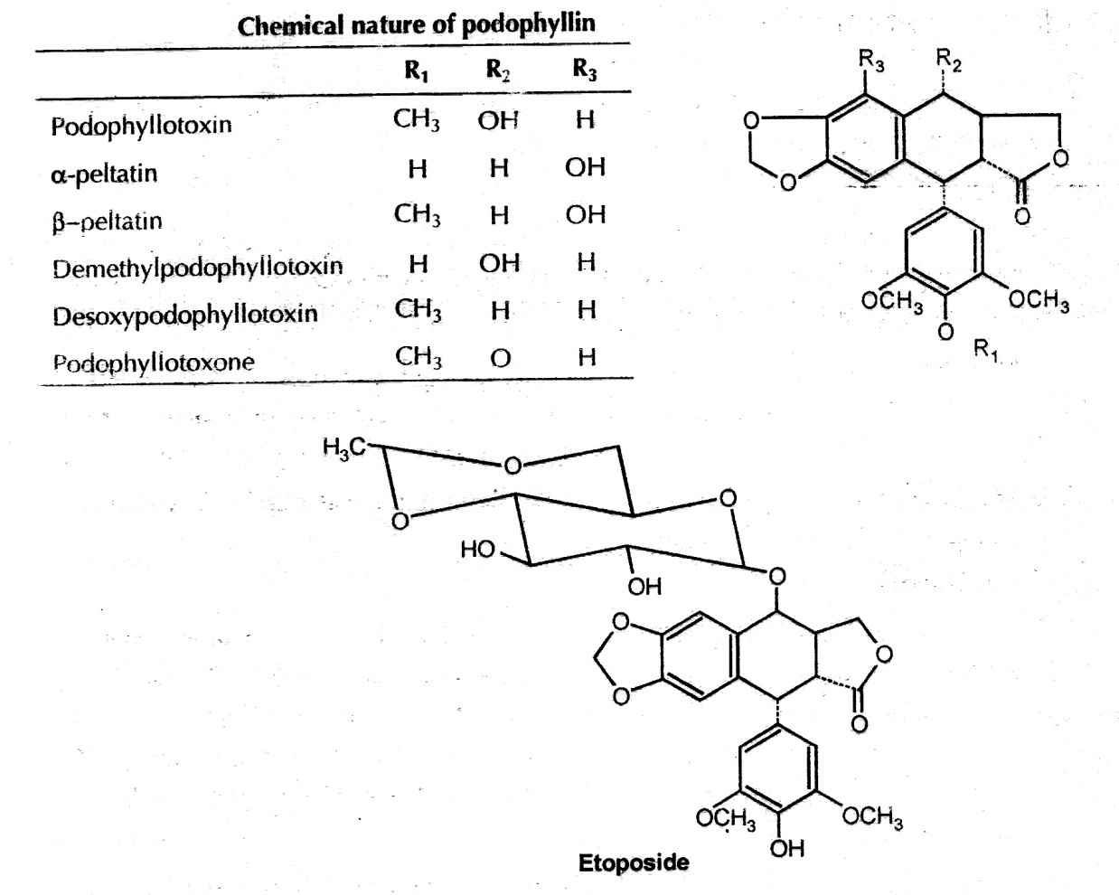
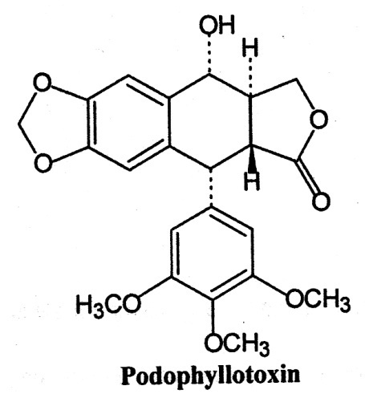
Chemical Constituents
2-8 % resinous material known as podophyllin
Major: lignan derivative such as podophyllotoxin, α- and β- peltatin
Lignan found in form of glycosides and also as their aglycon

Slide 52
Uses
Used for the treatment of venereal and other warts.
Podophyllotoxin is semisynthetically converted to a potent anticancer agent etoposide which is mainly used for the treatment of lung and testicular cancer.
Used as a purgative

Slide 53
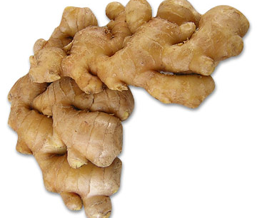
ginger

Slide 54
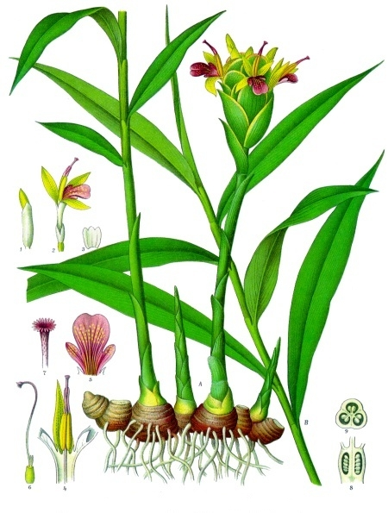
Ginger
Synonyms
Ginger, Zingiber
Biological Source
It consists of dried rhizome of the Zingiber officinale
Family
Zingiberaceae

Slide 55
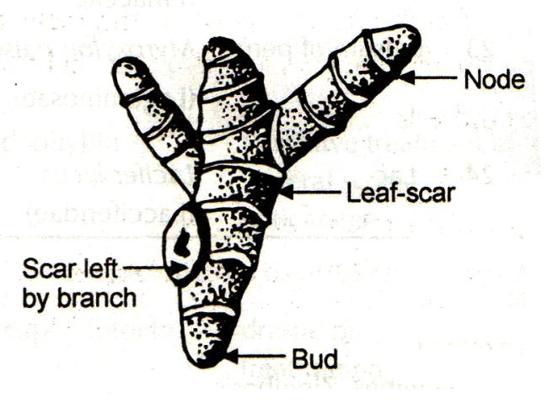
Diagnostic Characters
Organoleptic Characters :
Color- The outer surface is buff-coloured and longitudinally Striated or fibrous; it shows no sign of cork.
Odour- agreeable aromatic odour.
Taste- Pungent
Size: Rhizome of ginger is about 5-15cm x 1.5-6cm.
Shape: The rhizome is laterally compressed bearing short flat, Ovate and oblique branches on the upper side, with bud at the apex.

Slide 56
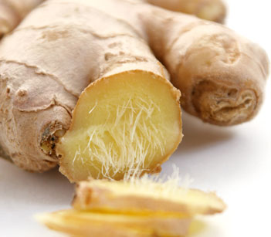
Fracture: Its fracture is short and fibrous
Extra Feature: Longitudinal striations and the occasional project fibre are present on the surface of ginger. Transversely cut surface and stele.

Slide 57
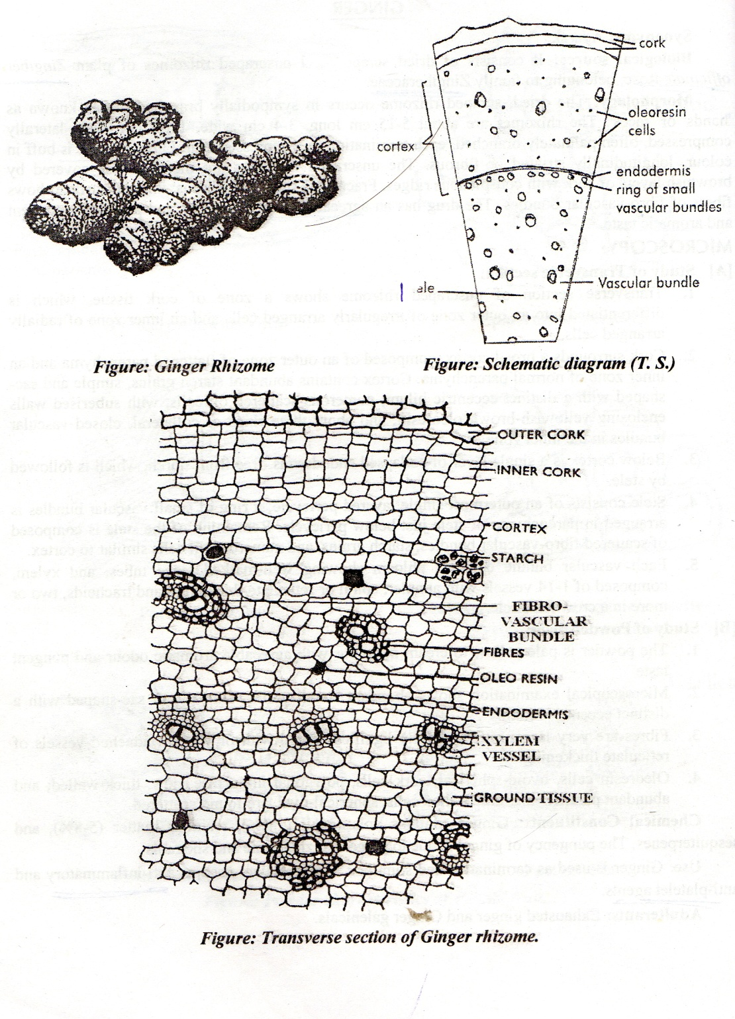
Cork consists of irregularly arranged cells, followed cortex.
Cortex is made up of thin walled parenchymatous tissue.
Well marked endodermis distinguishes the stale and the cortex.
Cortical tissue encloses several closed collateral fibrovascular bundles. Vascular bundles just inside the endodermis are free of fiber.
Oleo resinous cells and starch grains are fond throughout the ground tissue. Endodermis is free of starch.

Slide 58
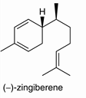
Chemical Constituents
Ginger contains about 1-2% of volatile oil and 5-8% of resinous matter, starch and mucilage.
Oil of ginger, to which the drug mainly owes its aroma, contains a mixture of over 50 constituents, consisting of monoterpenes and the sesquiterpene alcohol zingiberol.

Slide 59
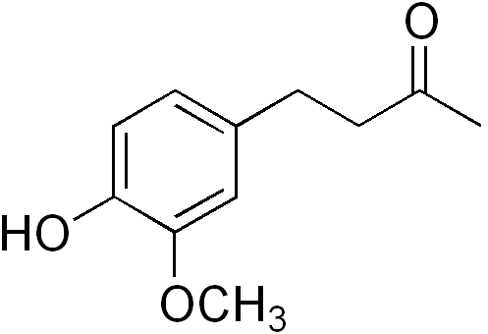
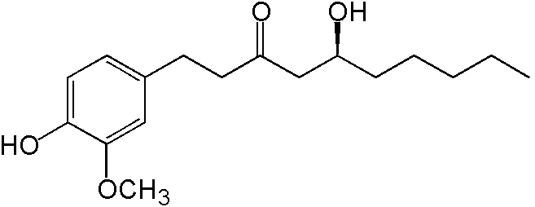
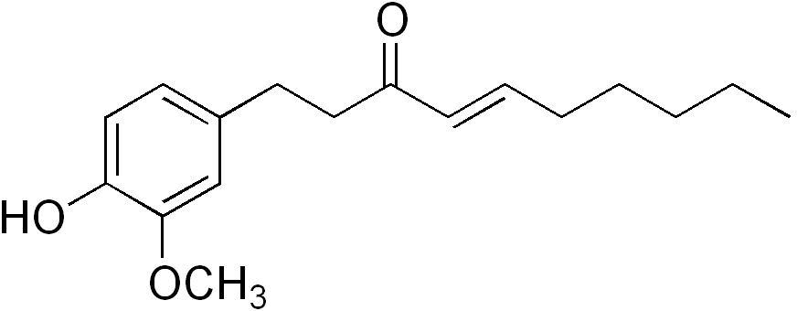
The pungency of ginger is due to gingerol, Zingerone and shogaol
gingerol
Zingerone
shogaol

Slide 60
Uses
Ginger is used as carminative and stimulant.
Gingerol are used as anti-inflammatory and anti-platelet agents.
Used as an antiemetic, positive inotropic, spasmolytic,

Slide 61
Adulteration
Exhausted ginger

Slide 62
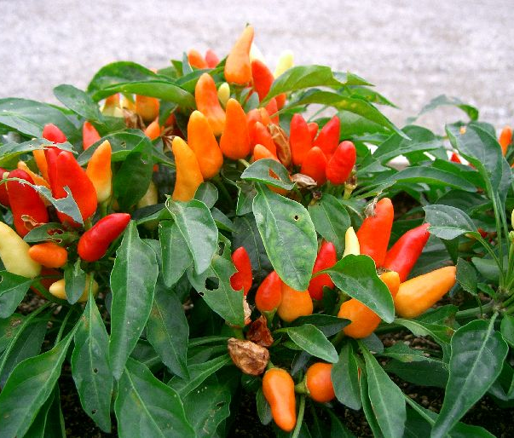
capsicum

Slide 63
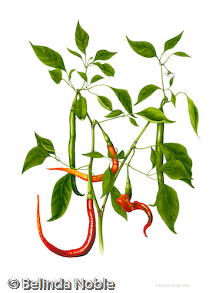
capsicum
Synonyms
Chillies, Red pepper, Mirch, Capsicum fruit, Fructus Capsici
Biological Source
Dried ripe fruits of Capsicum minimum and Capsicum annum
Family
Solanaceae

Slide 64
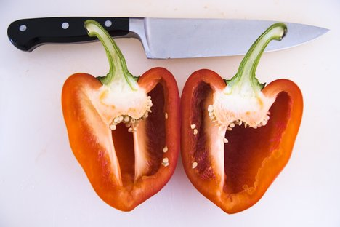
Diagnostic Character
Shape: 5-12 cm long, 2-4 cm wide, globular, ovoid or oblong in
Color: orange or red
Odour: Characteristic
Taste: Pungent
Extra Feature: Fruits are divided into two halves by memberanous dissepiment to which seed are attached
Seeds are reniform, flattened , 3-4 cm long with coiled embryo and oily endosperm

Slide 65
Chemical Constituents
Fixed oil, oleoresin, carotenoids, capsacutin, capsico (Volatile alkaloid), Volatile oil, ascorbic acid.
Resin: Pungent principle, capsaicin (0.5%)
Carotenoids: Capsanthin , zeaxanthin
Pungency of capsicum is destroyed by oxidation with pottasium dichromate or permanganate

Slide 66
Uses
As a spice
Used as stimulant, counter iritant, stomachic, rubefacient, carminative, dyspepsia and flatulence
Capsaicin is used for the treatment of migraine

Slide 67
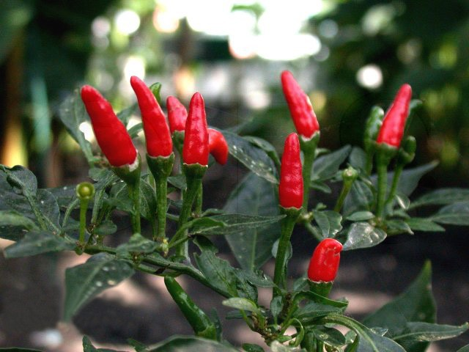
Allied Drugs
Japanese Chillies (C. frutescens): free from pedicels and calices and have bright red color

Slide 68
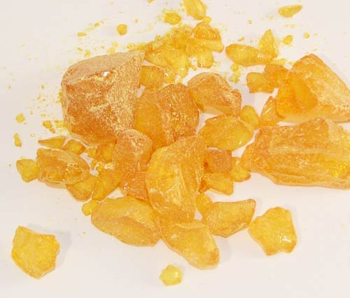
colophony

Slide 69
Synonyms:
Colophonium, Resina, Amber resin
Biological Source:
Residue left after the distillation of the oil of turpentine from the crude oleoresin of various species of Pinus like Pinus roxburghii
Family:
Pinaceae

Slide 70
Diagnostic Character
Color : Pale yellow or brownish yellow
Odour : Slight turpentine
Taste : Bitter
Shape : irregularly shaped pieces of different size
Solubility : Insoluble in water and freely soluble in alcohol, ether, benzene, glacial acetic acid

Slide 71
Standards
Melting point : 75- to 85º C
Acid Value : Not less than 150
Saponification value: 188 to 192
Ash value : Not more than 0.125%

Slide 72
Chemical Constituents:
90% of abietic acid , 5-6% of resene, 0.5% of volatile oil and traces of bitter substance.
Abietic acid is found in its three isomeric modification α, β, γ abietic acid

Slide 73
Chemical Test:
0.1 gm of colophony + 10 ml of acetic anhydride (gentle heating)
Cool
Add Sulphuric acid
Produce bright red color which change to violet

Slide 74
Colophony + Light petroleum
Filter
Add dil cupric acetate (two times)
Petroleum layer shows emerald green color

Slide 75
Uses
Stimulant and diuretic properties
Used as a ingredient of plasters and ointments
Used in manufacturing of varnishes, paint drier, printing ink, soaps, wood polishes, cement, plastics and fireworks

Slide 76
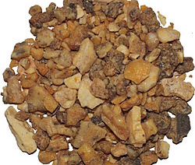
benzoin

Slide 77
Two commercial variety of benzoin
SUMATRA BENZOIN
SIAM BENZOIN

Slide 78
SUMATRA BENZOIN
Synonyms:
Loban, Benzonium
Biological Source:
Sumatra benzoin is a balsamic resin obtained from incised stem of Styrax benzoin and S. paralleloneurus
Family:
Styraceae

Slide 79
Characters:
Shape: masses of opaque, creamy white tears, embedded in a dull, greyish brown, resinous matrix
Texture: Hard and brittle
Fracture: Dull and uneven
Odour: Agreeable and Balsamic
Taste: Slightly acrid
When heated, it melts and gives irritating fumes of benzoic and cinnamic acid

Slide 80
Chemical Constituents:
Total Balsamic acid(26%)
Free cinnamic acid 10.3%
Free benzoic acid 6.5%
Combined cinnamic acid 7.3%
Combined benzoic acid 2.5%
Sumaresinolic acid and their esters with balsamic acid at hydroxyl group
Styrol, vanillin and phenyl propyl cinnamate

Slide 81
Uses:
Used as antiseptic, expectorant, stimulant, carminative, diuretic, protective and healing agent
Used in preparation of compound benzoin tincture which is used as topical protectant, antiseptic and expectorant
Used in respiratory tract infection

Slide 82
Siam benzoin
Synonyms:
Biological Source:
It is a balsamic resin obtained from Styrax tonkinensis
Family: Styraceae

Slide 83
Characetrs:
Color – Yellowish brown to rusty brown
Odour- Balsamic vanilla like
Taste- First sweet then slightly acrid
Shape- Occurs as separate tears or in forms of masses

Slide 84
Chemical Constituents
75% of coniferyl benzoate, siaresinol benzoate, d-siaresinolic acid
Small quantity of vanilla and esters of benzoic zcid

Slide 85
Chemical test:
Drug + Solvent ether
Take 1 ml decanted ether extract
Add sulphuric acid
Deep purpulish red color

Slide 86
Uses:
Used as mild disinfectant
Used in perfumeries and cosmetics as fixative
Used as expectorant and carminative

Slide 87
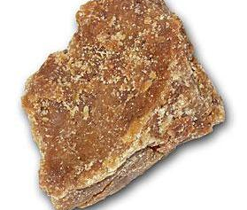
asafoetida

Slide 88
Synonyms:
Devil’ dung, Food of the gods, Hing
Biological Source:
It is an oleogum resin obtained as an exudation by incision of the decapitated rhizome and roots of Ferula asafoetida
Family:
Apiaceae

Slide 89
Characters:
Occurs in 3 forma. Paste, tears and Mass.
TEARS
Shape – Rounded or flattened
Size – 0.5 – 4 cm in diameter
Color- Dull yellow and becomes reddish brown on keeping . It is yellowish , translucent or opaque.
Odour- Intense, penetrating and alliceous
Taste- Bitter, acrid and alliceous
Fresh drug is tough at ordinary temperature, becoming harder when cooled and soften when warmed

Slide 90
MASS
More or less agglutinated tears and varying quantities of stones, earthy matters, Calcium carbonate and Calcium sulphate.

Slide 91
Chemical Constituents
Resin (40-64%):
Asaresene A(50%), Ferulic acid (1.3%), Esters of ferulic acid with asaresinol (16%)
Sesquiterpene coumarins like Farnesiferol A, B, and C
Volatile oil:
Pinene and organic disulphides like 2-butyl 1-propenyl disulphide, 1-(1-methyl thiopropyl) 1- Propenyl disulphide
Trisulphide and tetrasulphide are also present

Slide 92
Chemical Test:
Combined Umbelliferone Test
0.5 gm drug triturate with sand
Boiled with Water + HCl
Filter
Filterate + Eq. vol. of Alcohol + Excess strong ammonia
Blue Fluorescense

Slide 93
When triturate with water, it forms yellowish orange emulsion
Fresh Drug treated with 50% nitric acid gives green color
Fresh tears treated with conc. Sulphuric acid gives bright red or brownish red color. It changes to violet when washed with water

Slide 94
Uses:
Used in nervous disorder and in hysteria
Used in gastric disorder such as flatulence and carminative
Used as flavoring agent

