Slide 1
Lipid containing drugs
PH 104-Pharmacognosy-I

Slide 2
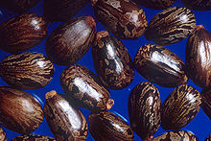
1. Castor oil
Synonym: Ricinus oil
B. S. : it is fixed oil obtained by cold expression of the seeds of Ricinus communis
Family: Euphorbiaceae
G. S.: Brazil, Thialand, U.S.A., India. Andhra pradesh, Gujarat, Karnataka, Maharashtra.

Slide 3
Preparation of medicinal castor oil:
Castor oil is prepared by
i) by crushing of whole seeds in hydraulic press and
ii) in ghani consists of screw press.
Seeds are graded, impurities are removed.
Hulls are removed and decorticated, which help in controlling acid value and improve the color of the oil.
Decorticated seeds are pressed under hydraulic press with a pressure of 2 tonnes per square inch, it helps in extracting out 30% of the oil present in the seed at room temperature. The oil is known as cold drown oil.

Slide 4
Rest if the oil is removed by increasing the pressure, hot pressing, or solvent extraction procedure. This oil is not suitable for medicinal purpose.
The cold drown oil is steamed at 80°C, to destroy the enzyme lipase and ricin (toxic protein), then bleached, deacidified with sodium carbonate to remove free fatty acid.
If necessary oil is washed with hot water before steaming to remove the mucilaginous matter present.
Finally it is treated with activated earth or animal charcoal to remove the impurities by adsorption and filled into containers.

Slide 5
Description:
  Color : pale yellow or colourless
  Odor : slight
  Taste : acrid tasting
  soluble in ethanol (unlike most oils) due to so much hydroxy- acid
Standards:
  Acid value : not more than 2
  Iodine value : 80 - 90
  Saponification value: 176 – 187

Slide 6
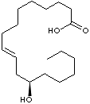
Chemical constituents:
  It cotains 46-53% fixed oil, which consist of glycoside of ricinoleic acid, isoricinoleic acid, stearic and dihydrostearic acids.
  ricinoleic acid 91%,
  glycerides like isoricinoleic,
  linoleic ,
  stearic and isostearic acid.
  Purgative action of oil is due to free ricinoleic acid and its stereoisomer which is produced by hydrolysis in duodenum.

Slide 7
Identification:
It mixes with half its volume of light petroleum.
Add to the oil an equal volume of ethanol, clear liquid is obtained.
Uses:
Castor Oil is regarded as one of the most valuable laxatives in medicine.
It is used as lubricant,
In paints, enamel, varnish, grease, polish, and printing ink.
Constituent of flexible collodion.
Hydrogenated castor oil USP/NF(1995) is used as stiffening agent.
Nonionic surfactants (polyethoxylated castor oils) of variable composition are produced by the reaction of castor oil with ethylene oxide and are use in certain intravenous preparations which contain drugs with low aqueous solubility

Slide 8
Allied drugs:
Croton seeds obtained from Croton tiglium family: Euphorbiaceae.
Seeds of Atropa curcas family: Euphorbiaceae.
Physic nut or purging nuts are seed of Jartropha curcas
Brus seeds (prayer seeds) seeds of Abrus precatorius Family: Leguminosae contain toxic resin abrin and toxic peptide having haemagglutinating properties.

Slide 9

2. Shark liver oil
B. S.: it is the fixed oil obtained from the fresh and carefully preserved livers of various species of the shark, mainly Hypoprion brevirostris and Galeorhinus zyopterus.
In India Scoliodon, Carcharias and Sphyrna are main species.
According to I.P 1gm of oil should contain not less than 6000 IU of vitamin A.
G. S.: India – Tamil nadu, maharastra and kerala.

Slide 10
Method of preparation:
The livers are cleaned and minced.
The minced mass is taken to a boiling pot, where temp. of 80°C is maintained.
The oil extracted is treated with dehydrating agent to remove water .
The oil is then taken to the vacuum still for dehydration and chilled to separate stearin.
Centrifuges are used to separate suspended materials in oil.
The clear oil is manipulated to adjust the desired strength of vit. A.
The oil is being sensitive to light and air – care is taken to minimize the exposure.

Slide 11
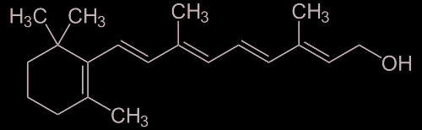
Description:
  Colour: pale yellow to brown-yellow
  Odour: characteristic fishy
  Taste: Bland or fishy
Solubility:
  oil is soluble in solvent ether, chloroform.
  Insoluble in water and slightly soluble in ethanol.
Standards:
  Acid value: NMT 2
  Iodine value: NLT 90
Chemical constituents:
  Vit. A, glycerides of saturated and unsaturated fatty acids, squalene and omega-3-fatty acids.

Slide 12
Identification:
Dissolve 1gm shark liver oil in 1 ml chloroform and treat with 0.5 ml sulphuric acid – It acquires light violet colour changing to purple and finally to brown (due to vitamin A).
Dissolve 1gm shark liver oil in 10 ml chloroform and treat with saturated solution of antimony trichloride in chloroform. Shake well – blue colour is developed (due to vitamin A).
Uses: deficiency of vit. A, as a nutritive, shark liver oil emulsion, burn and sunburn ointment.
Storage: preserved in well-filled and well-closed containers protected from light.

Slide 13
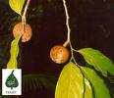
3. Hydnocarpus oil
Synonyms: Chaulmoogra oil
B. S.: fixed oil obtained by cold expression method from ripe seeds of the plant Taraktogenos Kurzii. King, and Hydnocarpus anthelmintic, H. heterophylla, and other species of Hydnocarpus.
Family: Flacourtriaceae
G. S.: it is a native of Myanmar, Thailand
And East India. It is also found in Sri Lanka
and Bangladesh. In India – Assam and Tripura.
Method of preparation:
Seeds are decorticated by machine after grading. The kernels are pressed with the hydraulic press and the oil obtained is filtered.

Slide 14
Description:
Colour: yellow to brownish-yellow liquid
Odour: characteristic
Taste: somewhat acrid
Solubility: slightly soluble in alcohol, soluble in chloroform, ether, benzene.
It is soft white solid below 25°C.
Standards:
Acid value – NMT 10
Sap. value – 195 – 213
Iodine value – 93 – 104
Specific rotation – NLT +48° and NMT +60°
Refractive index – 1.472 – 1.476

Slide 15
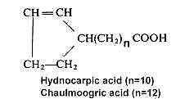
Chemical constituents:
The oil contains chaulmoogric acid (27%)and palmitic acid, hydnocarpic acid (48%) and the fatty oil has been found to yield glycerol, a very small quantity of phytosterol and a mixture of fatty acids.

Slide 16
Medicinal Action and Uses
Employed internally and externally in the treatment of skin diseases, scrofula, rheumatism, eczema, also in leprosy, as a counterirritant for bruises, sprains, etc., and sometimes applied to open wounds and sores. Also used in veterinary practice.

Slide 17
Substitution:
H. wightiana – found in west Bengal, kerala, weatern ghat.
H. alpine – kernataka, kerala, tamil nadu

Slide 18
6. Wool Fat
Synonym: Lanolin, Anhydrous lanolin, Hydrous wool fat
B. S.: it is the purified fat, obtained from the wool of the sheep Ovis aries L.
Family: Bovidae. It contains 25 to 30% water. It is the secretion of sebaceous glands of sheep deposited on to the wool fibres.
G. S.: Australia, USA and very less in India

Slide 19
Method of preparation:
Raw wool contains 31% wool fibres, 32% earthy matter, 25% wool grease or crude lanolin.
Crude lanolin is separated by washing with sulphuric acid or soap solution.
It is further purified and bleached.
The product is known as anhydrous lanolin or wool fat.
The hydrous wool fat is produced by mixing wool fat with 30% water.

Slide 20

Description:
  Colour – whitish yellow
  odour - faint & characteristic
  Taste – Bland
  It is found in the form of ointment like mass and on heating in water bath, it separates into two layers.
  Solubility – partially insoluble in water and soluble in chloroform and solvent ether with separation of water.

Slide 21

Chemical constituents:Chemically, lanolin is a wax, that is a mixture of esters of fatty acids with high molecular weight alcohols like oleic, myristic, cholesterol and 50% water.
cholesterol

Slide 22
Identification test:
Dissolve 0.5 gm of hydrous wool fat in chloroform, add 1 ml of acetic anhydride and 2 drops of sulphuric acid – deep green color is produced indicating presence of cholesterol.
Uses: water absorbable ointment base, common ingredient and base for water soluble creams and cosmetic preparation.
Adulterants: soft paraffin wax, animal or veg. oils and fats.

Slide 23
7. Yellow Bees wax
Synonyms: Bees wax, Yellow wax, Cera-flava
B. S. : It is a purified wax and obtained from the honey comb of the bees Apis mellifeca and species of Apis
Family: Apidae

Slide 24
Processing And Preparation
Combs and cappings of honeycomb are broken and boiled in soft water.
These are then enclosed in a porous bag weighed to keep under water.
The boiling causes oozing of the wax, which gets collected outside the bag and forms a cake after cooling.
It is removed by scraping.
Bees wax is purified by heating in boiling water and settling.
This process is repeated several times and finally wax is skimmed off.

Slide 25
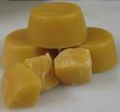
Description:
Colour – yellow to yellowish brown
Odour – Agreeable and honey like
Extra features:
Non-crystalline solid
Soft to touch and crumbles under the pressure of fingures to plastic mass
Under molten condition, it can be given any desired shape
It breaks with a granular fracture
Solubility:
Insoluble in water, soluble in hot alcohol, ether, chloroform, fixed and volatile oil.

Slide 26
Standards:
  Melting point : 62 to 65°C
  Acid value : 05 to 10
  Saponification value : 90 to 103
  Ester value : 80 to 95
Chemical constituents:
  Myricyl palmitate 80%
  Free carotic acid 15%
  Melissic acid
  Aromatic cerolin

Slide 27
Uses:
  Used in ointments,
  plasters,
  polishes,
  candles,
  moulds,
  In dental and electronic industries,
  cosmetics for lip-sticks,
  face cream.
  It is an ingredient of paraffin ointment.

Slide 28
Adulterants:
It is adulterated with
  Colophony,
  hard paraffin,
  Stearic acid,
  Carnauba wax.
Identification:
The genuine wax should not give turbidity when 0.5 gm of wax is boiled with 20 ml of aqueous caustic soda for 10 min. and cooled.

Slide 29

8. Kokum Butter
Synonyms: Goa butter, Kokum oil
B. S.: it is the fat expressed from the seeds of Garcinia indica
Family: Guttiferae
G. S.: Thailand, Cambodia, China, India – konkan, weatern ghat, nilgiri hills. It is cultivated in Maharashtra.
Method of preparation:
The kernel from the seeds are churned and boiled in water.
The melted fat is separated by skimming, washed with hot water twice and decolorized with animal charcoal.

Slide 30
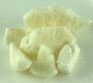
Description:
Colour: light grey or yellowish
Odour: slight and characteristic
Taste: characteristic
Shape: it is marketed in the form of egg shaped lumps
Standards:
Melting pt: 39 to 42°C
Acid value: NMT 3
Sap. Value:185 to190
Iodine value: 35 to 37

Slide 31
Chemical constituents:
  Glycerides of stearic 55%,
  Oleic 40%,
  Hydroxy capric acid 10%,
  Palmitic 2.5%,
  Linoleic acid 1.5%.

Slide 32
Uses:
Nutritive, demulcent, astringent, emmolient
Cake is used as a manure
Kokum butter is used in sizing of cotton yarn, ointments, suppositories
Dysentery, diarrhoea

Slide 33
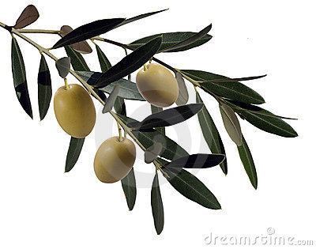
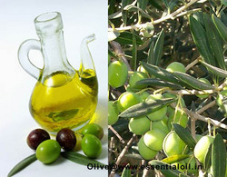
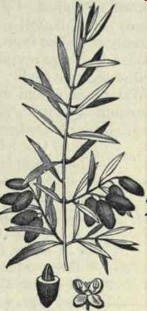
9. Olive oil
salad oil, sweet oil
From ripe fruits of Oleo europoea (Oleaceae)
  Mediterranean, California
  native of Palestine, known in Egypt in 7th century B.C., introduced into Spain early on
Pale yellow with greenish tinge (chlorophyll and carotene) liquid.
Natural fluorescence of oil in UV.
Bland, slight odour, goes “pasty”/cloudy at 10ºC.

Slide 34
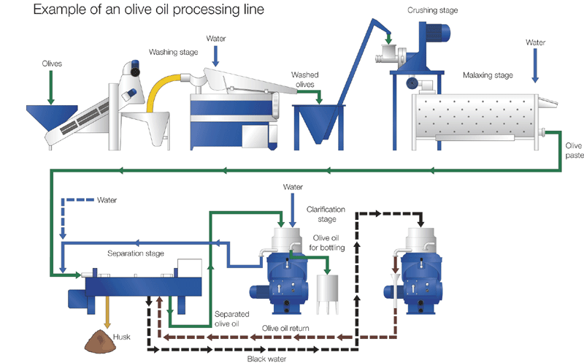
Collection and preparation
Hydraulic pressure
First oil to be expressed from ground fruits is known as virgin oil.
Subsequently the marc may be solvent extracted to be obtain the lower quality oil.

Slide 35
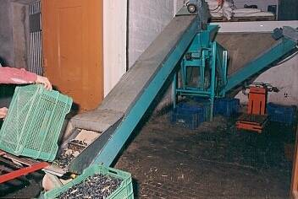
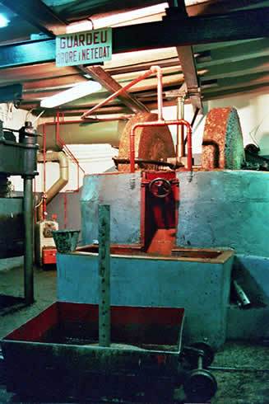
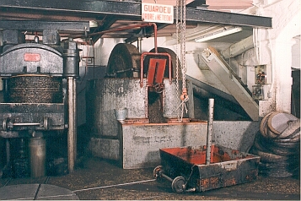
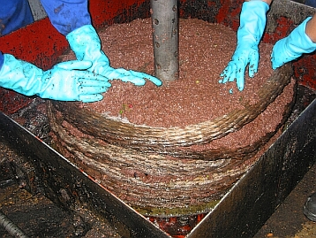
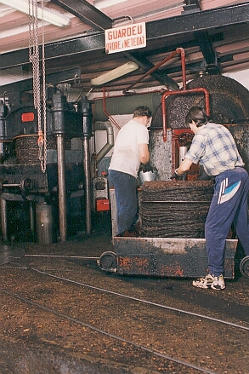
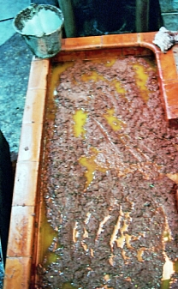
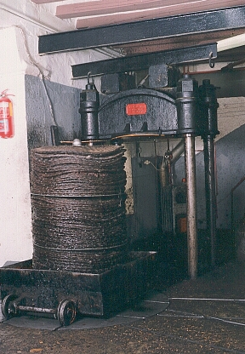
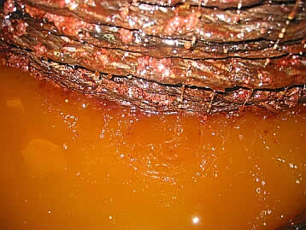
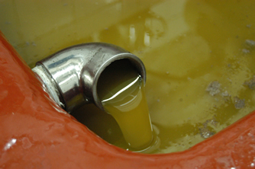
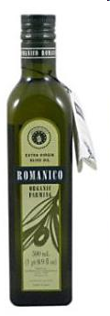

Slide 36
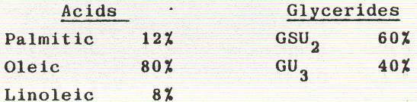
tested for absence of arachis oil, cotton-seed oil, sesame oil, peanut oil and tea-seed oil (Camellia sasanqua)
Composition:
high iodine value, low acid value
The characteristic odor of olive arises from the presence of volatile C6 alcohol (Hexanol, E-2-hexenol,), C6 aldehyde and acetylated esters
Uses
  salad oil, soaps, plasters
  manufacture of parenteral preparations (low acid value, free of water)

Slide 37

10. Cocoa Butter
Synonyms: Theobroma oil
B. S. : From seeds of Theobroma cacao.
Family:Sterculaceaea
G. S. : Central America, in Brazil, W.Africa (Nigeria), Meico and India.

Slide 38
Preparation of Cocoa butter:
The seeds are rotated at 100 - 140°C, seed loose water and acetic acid and it facilitates the removal of seed coats.
Seeds are cooled, fed to nibbing machine to remove the shells, winnowing is done.
Kernels fed to hot roller which yield pasty mass containing cocoa butter.

Slide 39
Description:
Color: Yellowish white. Solid and brittle below 25°C.
Odor: Pleasant chocolate
Taste: Bland chocolate
Solubility: insoluble in water, but soluble in ether, benzene, chloroform, petroleum ether.
Standards:
Melting point: 30-35°C
Saponification value: 188-195
Iodine value: 35-40

Slide 40
  Chemical constituents: high steric and palmitic acid content (35%, 25%), oleic acid 3%
  Uses:
  It is used as a base for suppositories and ointments, creams, toilet soaps and as food.

Slide 41
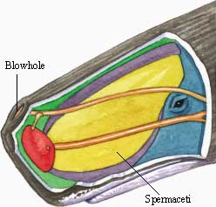
11. Spermaceti
B.S.: Spermaceti (from Greek sperma, seed, and Latin cetus, whale) is a wax present in the head cavities of the sperm whale (Physeter macrocephalus).
Originally mistaken for the whales' sperm (hence the name), spermaceti is created in the spermaceti organ inside the whale's head and connected to its nasal passage. Its biological function is uncertain

Slide 42
Method of preparation of spermaceti
The sperm whale's head was either brought on deck or lashed to the side of the ship where the whale men would cut a hole in the case.
The spermaceti could then be drawn out by bucket or a whale man would enter the hole and manually remove the fluid.

Slide 43
Spermaceti is extracted from sperm oil by crystallization at 6 °C (43 °F), when treated by pressure and a chemical solution of caustic alkali.
Spermaceti forms brilliant white crystals that are hard but oily to the touch, and are devoid of taste or smell, making it very useful as an ingredient in cosmetics, leatherworking, and lubricants.

Slide 44
Physical properties
Spermaceti is insoluble in water,
very slightly soluble in cold alcohol,
but easily dissolved in ether, chloroform, carbon disulfide, and boiling alcohol.

Slide 45
Chemical composition
Spermaceti consists principally of cetyl palmitate (the ester of cetyl alcohol and palmitic acid), C15H31COO-C16H33.
Esters of cetyl alcohol and jojoba oil are used as a substitute for spermaceti.

Slide 46
The substance was also used in making candles of a standard photometric value, in the dressing of fabrics, and as a pharmaceutical excipient, especially in cerates and ointments.

