Slide 1
Oral CDDS

Slide 2
Oral controlled drug delivery system
The controlled release system for the oral use are mostly solids and based on diffusion, dissolution or a combination of both mechanisms in the control of release rate of drug.
Oral route has been the most popular and successfully used route for controlled delivery of drug because of following reasons :
Convenience and ease of administration
Greater flexibility in dosage form design
Ease of production and low cost of such a system

Slide 3
Classification
Controlled drug release system
Continuous release system
Continuous transit system
Matrix ( hydrophobic/ hydrophilic/ hydrid)
Single layer
Multi layer
Resiorvoir
Multiparticulates ( coated particles, granules, pellets, microcapsules)
Minitablets
Tablets ( film or compression coated)
Ion exchange resins

Slide 4
Gastroretentive system
Low density system
High density system
Modified shape system
Mucoadhesive system
Pulsed release system
Time specific system
Osmotic pressure
Rupturable coating
Swellable/soluble/eroidable coating
Diffusive coating
Pulsincap

Slide 5
Site/colon specific system
Time dependent
pH dependent
pH/time dependent
Enzyme dependent
Colonic pressure dependent
Osmotic pressure dependent

Slide 6
Continuous transit system
These system release the drug for the prolonged period of time along the entire length of GIT with normal transit of the dosage form.
Matrix Type Oral CDDS
This type CDDS are possibly the most common of the monolithic devices for controlling the release of drug for following reasons:
Relatively easy to fabricate compared to reservoir devices.
No danger of accidental dose dumping compare to monolithic reservoir devices.

Slide 7
In such device the active agents is present as a dispersion within the polymer matrix, and they are typically formed by the compression of a polymer/drug mixture or by dissolution or melting.
Drug release depend upon:
Initial concentration of the drug
Solubility of drug
Presence of water soluble additives or surfactants
Porosity and tortuosity of matrix
Polymer system foaming the matrix
The drawback of matrix type drug delivery system is their first order drug delivery mechanism cause by changing surface area and drug diffusion path length with time.

Slide 8
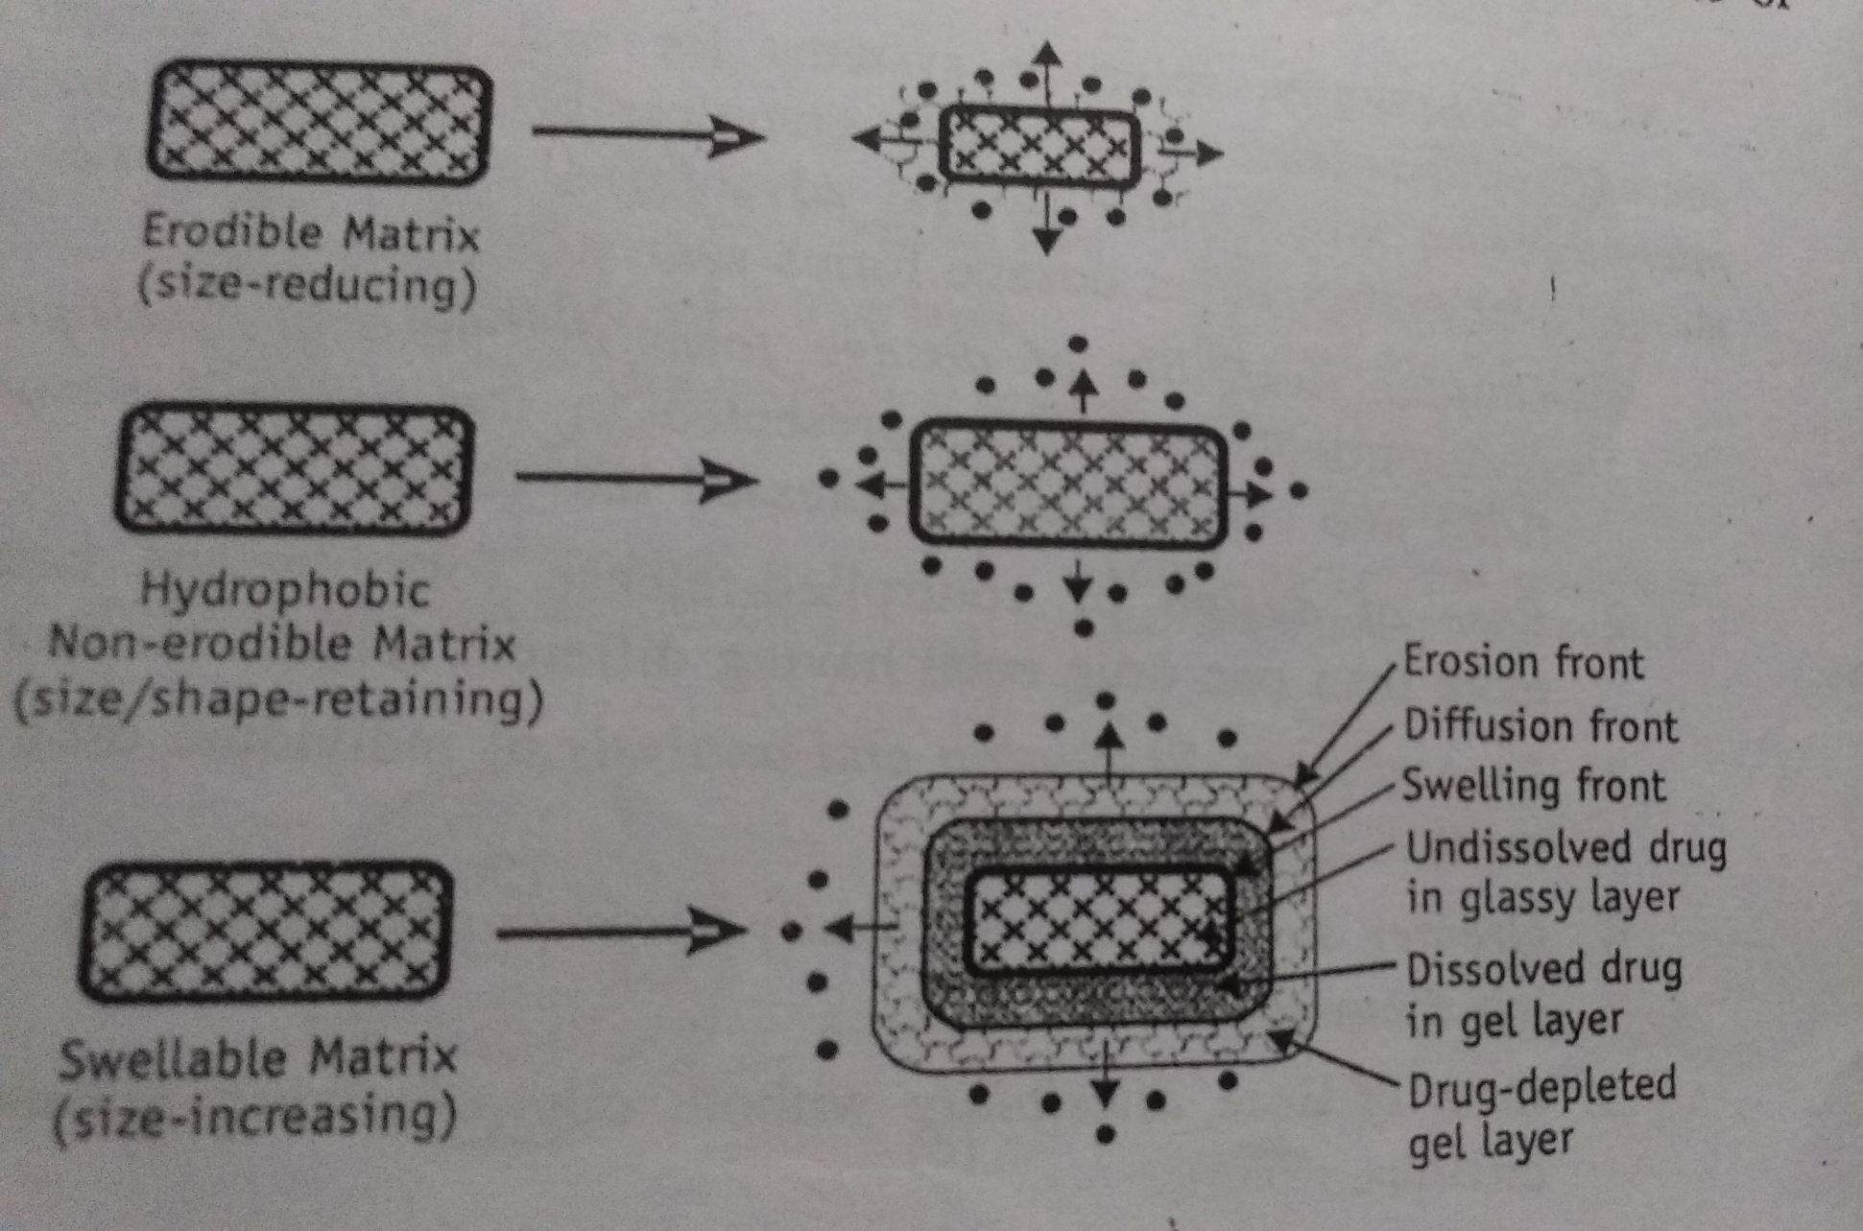

Slide 9
Reservior type oral CDDS
This type CDDS are those where the drug crystal, particles, granules, minitablet or tablet is present as a core encased or encapsulated with a rate controlling wall, film or membrane having a well defined thickness.
Advantages
Zero order delivery is possible.
Release rate can be easily modulated by polymer type, polymer membrane thickness and membrane porosity.
Disadvantages
Possible dose dumping in the event of membrane failure and hence reservoir devices are seldom formulated as tablets.
Higher cost of formulation compared to matrix tablets.

Slide 10
Various methods exist for the coating of multiparticulates :
Air suspension coating ( e.g. Wurster coating)
Compression coating ( generally suited for compressed dosage forms)
Microencapulation techniqes

Slide 11
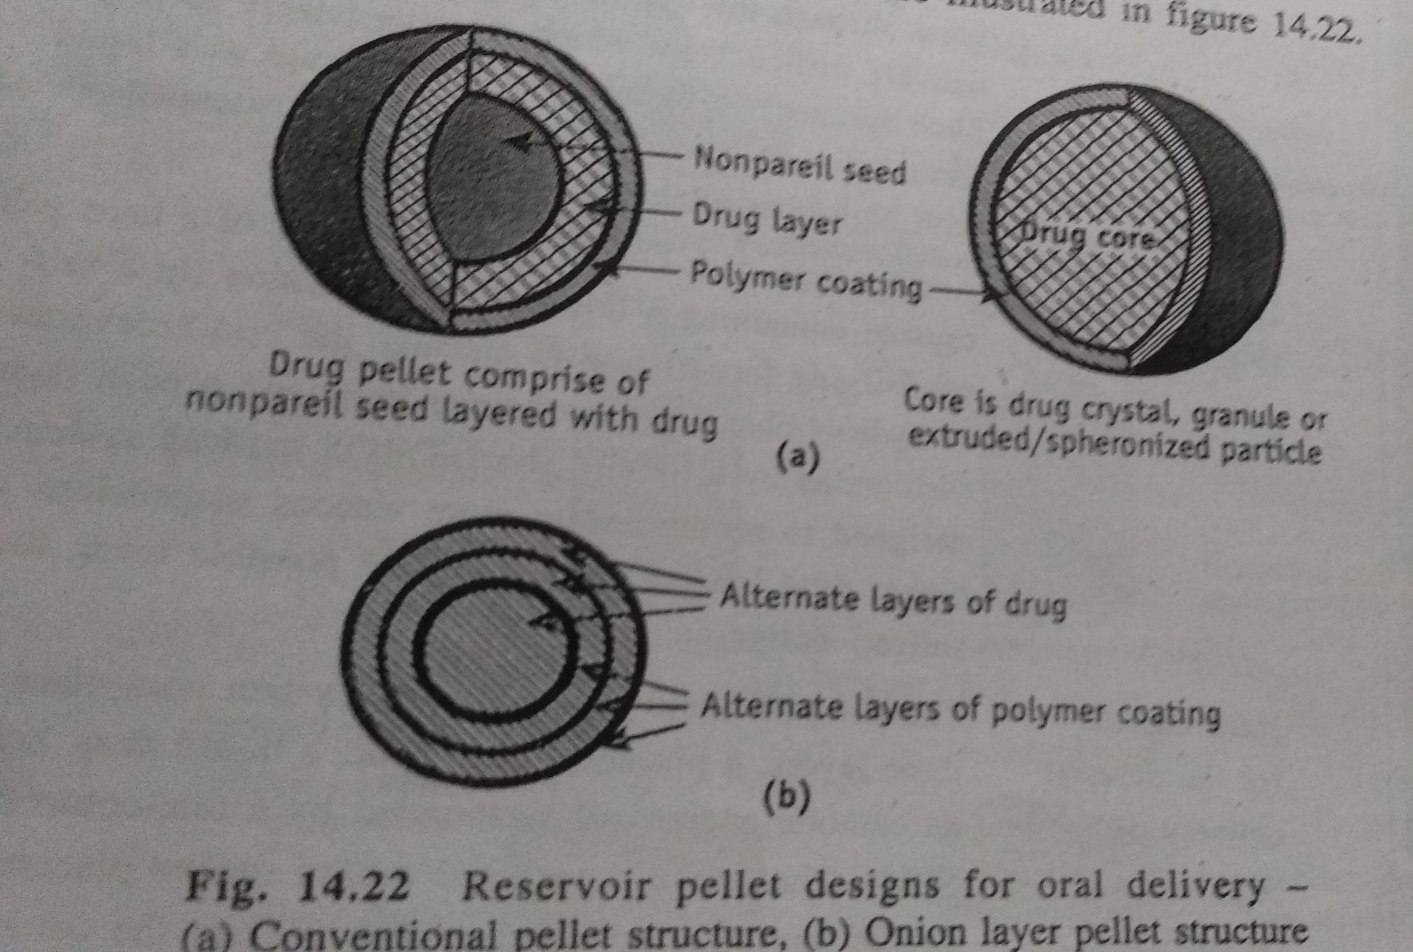

Slide 12
Oral osmotic CDDS
In comparison to DDS based on diffusion and erosion, osmotic system are more complex in design but provide better zero order drug delivery.
They work on the principle of osmotic pressure to release the drug at a constant zero order rate.
Advantages :
True zero order drug release is possible.
Drug release is independent of pH and other physiological parameters such as food, GI motility, etc.
Drug delivery can delayed, pulsed or targeted as desired.
Drug release rate is predictable, programmable and reproducible.
High degree of IVIVC is obtained.

Slide 13
In design, most OROS system comprise of four basic components :
A rigid, shape retaining semipermeable membrane
A drug layer
Osmagent like NaCl, dextrose, mannitol, HPMC, PEO etc.
Delivery orifice
Factors important in drug delivery from OROS are :
Drug solubility
Osmotic pressure
Delivery orifice
Coating membrane
Hydration rate of polymers

Slide 14
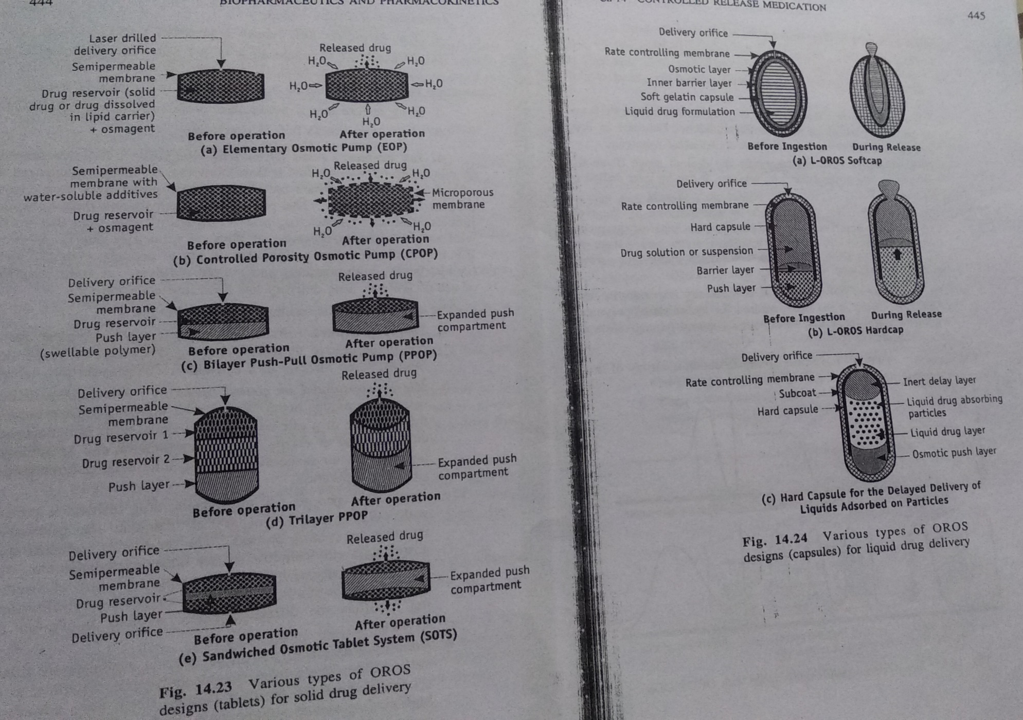

Slide 15
Ion exchange resin drug complexes :
Controlled delivery of ionized acidic and basic drug can be obtained by complexing them with insoluble nontoxic anionic and cationic resins respectively.
The drug is release slowly by diffusion through the resin particle structure.
Moreover, IER impart flexibility in designing a variety of delivery system, such as liquids, beads, microparticles and simple matrices.

Slide 16
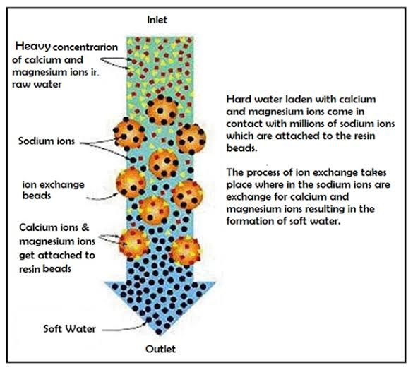
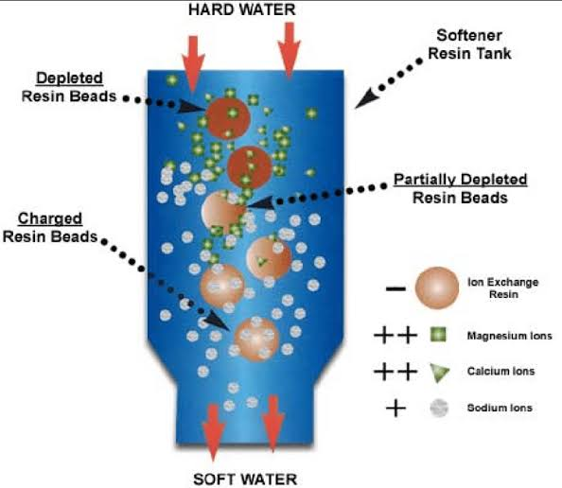

Slide 17
Gastroretentive DDS
Dosage forms with a prolong gastric residence and controlled drug delivery are called as GRDDS.
Classification of GRDDS
Low density system/Floating dosage forms
Effervenscent system/gas generating system
Non-effervensent system
Swelling or expanding system
Inherently low density system
High density system
Modified shape system
Mucoadhesive system

Slide 18
Low density system/Floating dosage forms
This system have a bulk density less than that of gastric fluids and so remain buoyant in tha stomach. Such system are also called as hydrodynamically balanced system.
Effervenscent system/gas generating system
gas generation and entrapment not only increase the size of the DDS but also decrease its density and possibly, provide floating properties.
Swelling or expanding system
These system use a gel forming or swellable hydrocolloid such as polysaccharides likes guar gum, HPMC, PEO, carbomer.
Inherently low density system
They are solution to easier systems that initially settle down before floating and thereby possess a risk of premature gastric emptying.

Slide 19
High density system
High density devices use their weight as a retention mechanism.
When the density of the system is larger than that of the gastric juice, the device settles down to the bottom of the stomach, remaining located below the pylorus.
Density increasing agents: Iron oxide, titanium dioxide, barium sulphate
Modified shape system/Unfolding system
These system unfold to a large size that limits passage through pyloric sphincter.
Drugs have been incorporated in several geometric shapes, such as tetrahedron, ring, cloveleaf, disc, string, spiral, pellet, sphere, which can be packed tightly into a gelatine capsule and unfold after dissolution of the capsule shell.
These system consists of at least one erodible polymer, one non erodible polymer and a drug that is dispersed within the polymer matrix.

Slide 20
Bioadhesive system/mucoadhesive systems
A bioadhesive polymer such as cross linked polyacrylic acid, when incorporated in a tablet, allow it to adhere to the gastric mucosa or eoithelium.
Such system continuously release a fraction of drug into the intensine over prolonged periods of time.

Slide 21
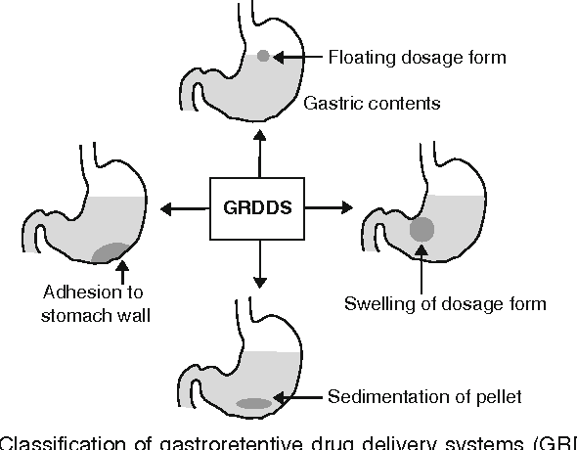

Slide 22
Pulsed release system
Time specific systems:
Such system are independent of an environment and the lag time prior to the drug release is controlled by the delivery system.
These time controlling system may be single unit or multiple unit systems.

Slide 23
Osmotic pressure based systems
The various types of osmotic pulsatile delivery system are:
Capsule or tablet composed of a large number of pellets:
Each pellets has a core that contains the therapeutic drug and a water soluble osmotic agents.
A water permeable but insoluble polymer film encloses each core.
On exposure to water and its subsequent penetration into the pellets, the osmotic agents dissolves which causes the pellets to swell and thereby regulate the rate of diffusion of drug from dosage form.
Programmable oral release technology:
The PORT system is composed of gelatine capsule coated with a SPM like cellulose acetate that contains an immediate release drug tablet, an insoluble plug and an osmotic agent along with second portion of drug for timed release.
Upon contact with the aqueous media, the immediate release drug is delivered, water enters into the capsule through the SPM, which increase the osmotic pressure and result in the ejection of the plug after a lag time, which is mainly controlled by the thickness of the SPM coat, following which the second dose is delivered.

Slide 24
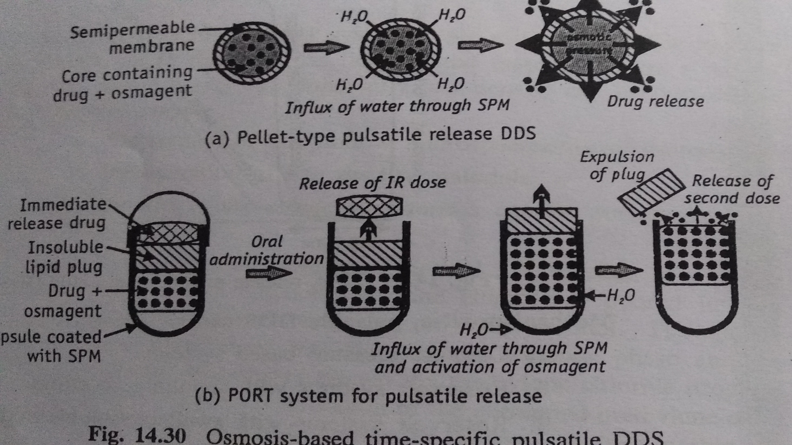

Slide 25
Reservoir pulsatile system
These system consist of a drug containing core, covered by a pressure generating layer and an outer insoluble, but semipermeable polymer coating.
The pressure generating layer comprises of effervescent excipients, swelling agents, osmagents.
Upon contact with GI fluids, water penetrate through the outer polymer coating and generates the pressure due to effervescence, hydration of swelling polymer or osmosis.
This, in turn ruptures the external polymer coating leading to rapid drug release.
Rate controlling factors:
The permeation and mechanical properties of the polymer coating
The degree of pressure generated by the effervescent agents, swelling agents and osmagents.

Slide 26
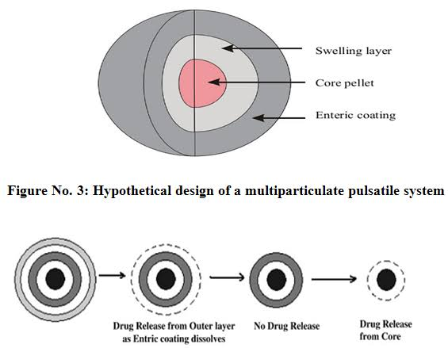

Slide 27
Reservoir pulsatile system with swellable/soluble/erodible coating
In these system the barrier swells, erodes or dissolves after a specific lag period and the drug subsequently release rapidly.
The lag time depends on the thickness of the coating layer.
Reservoir pulsatile system with diffusive polymeric coatings:
A typical example of this system is sigmoidal release system, a multiparticulate DDs comprising of drug/succinic acid mixtures loaded on nonpareil seeds and an outermost Eudragit RS film applied by spray coating.
The lag time is controlled by the rate of water influx through the polymer membrane.

Slide 28
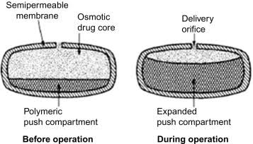

Slide 29
Capsular pulsatile system with polymeric plugs:
A example of this system is Pulsincap which is composed of a capsule with water soluble cap, an insoluble body filled with drug and sealed with a hydrogel plug.
On administration, the soluble cap dissolves thereby allowing the hydrogel plug to swell and expand.
After a predetermined lag time, which is governed by the size of the hydrogel plug, it is swollen to an extent that it is ejected from the capsule body variable gastric emptying.

Slide 30
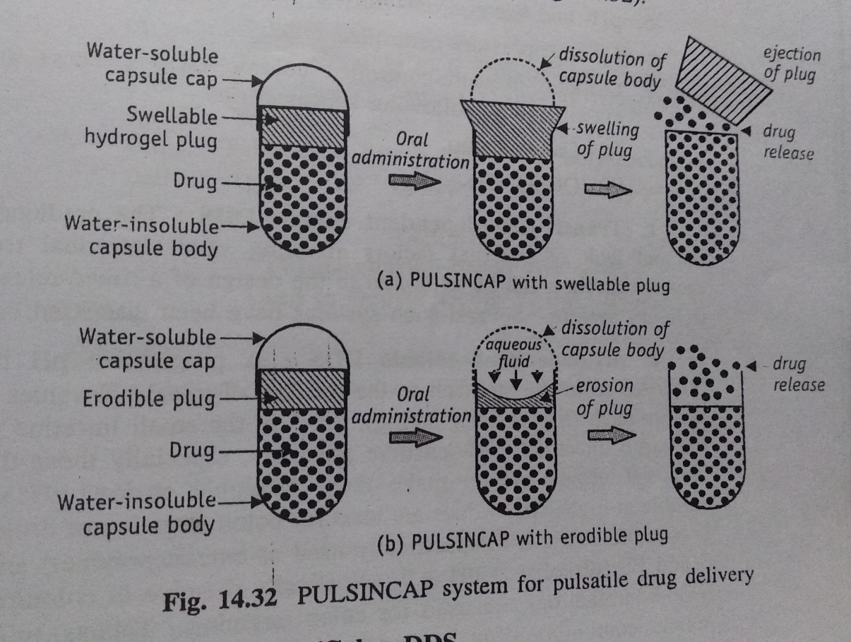

Slide 31
Oral site specific/colon DDS
Transit time dependent colonic DDS:
The predictable nature of and lack of external factors affecting small intestinal transit time means that they can be exploited in the design of a time release colonic delivery system.
pH dependent colonic DDS:
pH sensitive polymer, especially those that contain carboxyl group which make them insoluble at low pH values and soluble at high pH value are use for colon targeting of drug.
E.g. Eudragit L, Eudragit S, Eudragit FS are use for colon targeting.
pH and time dependent colonic system:
By combining an enteric coating approach to prevent drug dissolution in the stomach and a delayed release element that relies on the passage of time, it is possible to target release of a drug in the terminal ileum and colon.

Slide 32
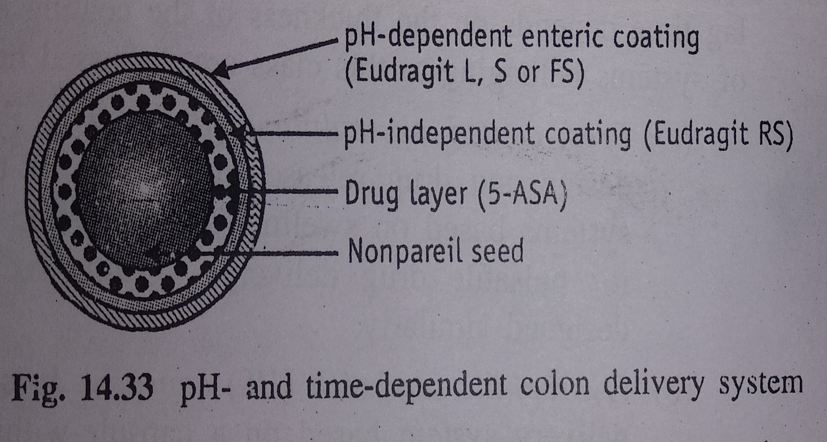

Slide 33
Bacterial enzymes dependent colonic DDS
The colon is permanently colonised by a large number of bacteria especially anaerobic.
Of the multitude of bacterial enzyme that are produced in the colon, two main classes are, on the whole, through to be reproducible enough and present in sufficient quantity to be exploited in drug targeting.
These are
Azoreductases: which reduce azo bonds
Polysaccharidases: the large number of mainly glycosidic enzymes which degrade the polysaccharides present in the colon.
Based on this DDS can classified as
Prodrug based system: these system are based on covalent linking of drug with a moiety that can be cleaved by the enzymes.
Coating and matrices based systems

Slide 34
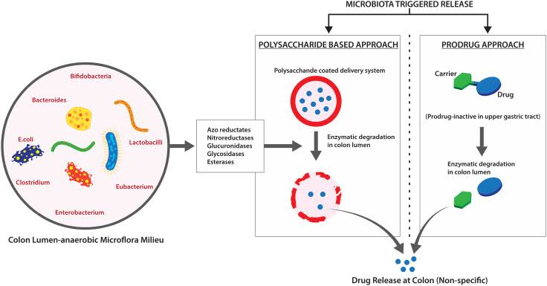

Slide 35
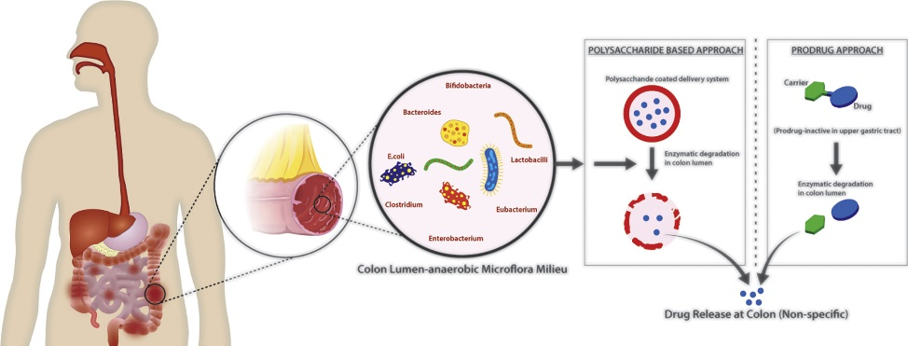

Slide 36
pH and bacterial enzyme dependent colonic DDS
The outer coating is composed of a standard enteric polymer such as Eudragit L which dissolve after the transit of dosage form into the small intestine and exposes the undercoating, which is composed of Eudragit E.
The under coating permits lactulose to be released into the enviorment adjacent to the tablet.
This disaccharide is metabolised in lower pH to the point where the Eudragit E dissolve.

Slide 37
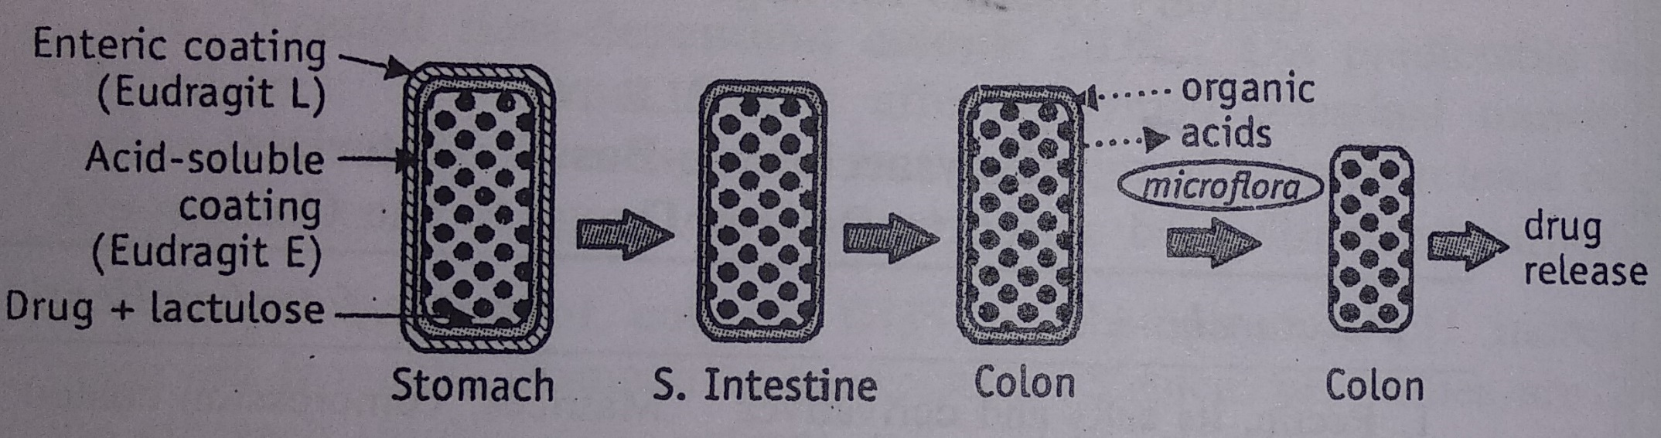

Slide 38
Colonic pressure controlled DDS
This approach relies on the strong peristaltic waves in the colon that leads to a temporarily increase luminal pressure.
In which comprises of drug containing capsule coated with water insoluble polymer ethylcellulose.
In the upper GIT, the capsule is not directly subjected to the luminal pressure.
In response to the raised luminal pressure in the colon, the system ruptures and release the drug load.

Slide 39
Osmotic pressure controlled colonic DDS
The primary aim of this system to provide zero order release kinetics over an extended time period.
However the need for an activation phase, which could be adjusted according to the thickness and diffusion properties of a SPM irrespective of pH and hydrodynamics of the medium.
The two OROS (osmotic controlled release oral delivery) for colon delivery are:
Osmet pump
OROS CT

Slide 40
Osmet pump
It consists of an enteric coated semipermeable, rigid cylindrical shell, which encloses an osmotic layer along with a central impermeable and collapsible reservoir filled with solution or suspensions of drugs or other tracer substances.
The initiator of this compartment is connected with the external environment through a delivery orifice located at one end.
After dissolution of the gastric resistant film, water is allowed to penetrate through the semipermeable barrier, thus raising the pressure inside the device.
As a result, the inner reservoir shrinks and the drug formulation is pumped out at a constant rate via the shell opening.

Slide 41
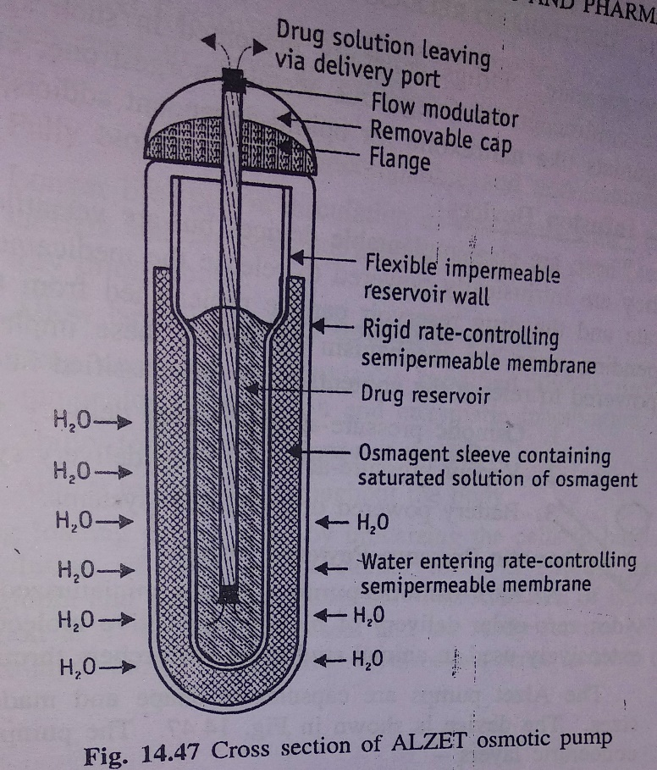

Slide 42
OROS CT:
It consist of a tablet with enteric coating, a SPM, a layer to delay drug release and a core consisting of two compartment – drug and push-pull.
The system either comprise a single osmotic unit or it may contain as many as 5-6 push pull units enclosed within a hard gelatin capsules.
Immediately after ingestion, the hard gelatine capsule shell dissolves.
However, the push pull units is prevented from absorbing water in the acidic environment of the stomach by the enteric coating.
The osmotic pumping action results when the coating dissolves in the higher pH environment (pH>7) of the small intestine, and the drug is delivered out of the orifice at rate controlled by the rate of water transport across the membrane.

Slide 43
